Slide 1

POLY-GENERATION OF POWER AND DESALINATED WATER BY SMALL MODULAR REACTORS
Marco Cioffi
Ansaldo Energia

Slide 2




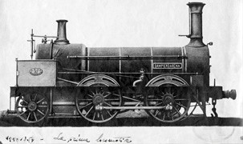
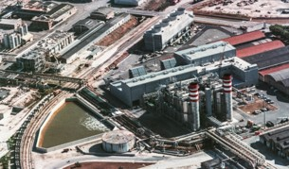





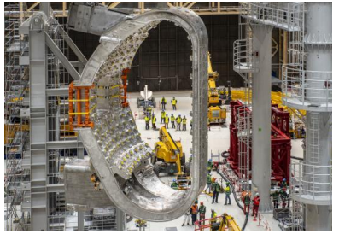

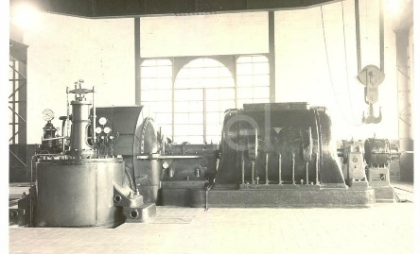
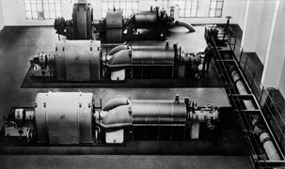

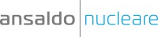

ANSALDO: A HISTORY SPANNING 170 YEARS
Plant design
Long-Term Service
Agreement
1995
Environmental
impact analysis
1853
2014
First Combined Cycle
Power Plant based on
Ansaldo Energia Gas Turbine
Giovanni Ansaldo & co. founded
Acquisition of
NES Nuclear Engineering Services ltd.
Optimized
performance
throughout
the lifecycle
Remote
monitoring &
digital services
Project
manag.
Commissioning
BOP
purchase
ANSALDO ENERGIA
Construction
management
2016
1911
1923
Acquisition of Alstom
Gas Turbine Technology
World's First Geothermal Power Plant
First Thermal Power Plant
A global supplier of turnkey plants, machines, engineering and service solutions
Notes:
I wish to start with a short overview of my company. Ansaldo has been founded in the middle of the XIX century in Genoa: it was operating on the construction of trains and railways, large ships and then steam and hydro power plants. Ansaldo Energia is today focused on the design, construction and maintenance of gas and steam turbines, generators, geothermal and nuclear power plants and it is a global supplier of turnkey plants and energy solutions. In 2016 we expanded our portfolio of engines with the acquisition of the large Gas Turbines Technology from the former Alstom Power (SHIFT).
*********************
https://www.imeche.org/news/news-article/nuclear-engineering-services-agrees-30-million-sale-to-italian-firm-270514-3
https://www.lincolninternational.com/transactions/ldc-sold-nes-engineering-innovation-to-ansaldo-nucleare/
https://www.expressandstar.com/business-picks/2014/06/03/italians-swoop-in-30m-nuclear-deal-for-nes/

Slide 3
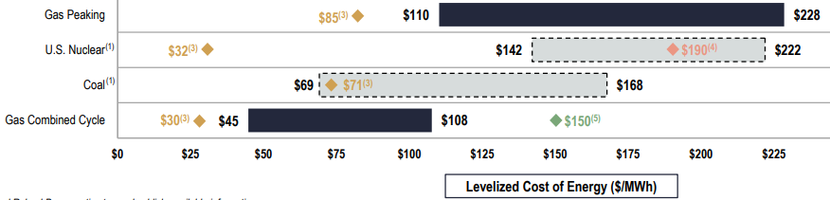

Strategies for SMR Steam Power Island Design
Steam Power Island Design Goals:
fit for purposes: base load & flexible operation, largest availability, major resilience to grid instabilities and (extreme) weather, non-nuclear services, black start capability.
fit in time: NOAK design, modular approach, supply chain optimization.
fit in cost: design to (life cycle) LCOE cost, supply chain optimization.
tailored design strategies.
adopt high TRL (Technology Readiness Level ≥ 8) solutions.
Levelized Cost of Electricity
Target LCOE = 70 ÷100 €/MWh
US focused data
Design Strategies
  Modular Design concept.
  Design for Maintenance: replacement by modular concept, mid life replacement, fit to nuclear timing.
  Design for Reliability and Availability: advanced control strategies, backup of critical systems.
  Design for Resilience: weatherization, black start, island mode operation.
  Design for Safety: no impact on the nuclear island, fire fighting.
  Supply Chain optimization and duplication.
  Controls and diagnostics.
Target SMR Customer:
not the usual NPP one!
In 2023 Google electricity consumption grew up
to 24 TWh, more than Croatia.
Agreement with Kairos Power to buy 500 MWs
from six to seven SMRs by 2030.
⁽³⁾ marginal cost of operating fully depreciated plant
⁽⁴⁾ Vogtle NPP
⁽⁵⁾ CCGT with 20%vol green H2
Notes:
In order to avoid the issues of some of the last nuclear projects, a different design and execution nuclear plants model is gaining a renewed interest. The concept of Small Modular Reactor is not new, and it has been already adopted in the past, mainly for mìlitary applications. It today indicates a model aimed at effective cost and risk management and project control. The SMR model is adopted for all sections of the plant, even, of course, for the conventional Steam Power Island. The main Design Goals of the Steam Power Island in a SMR can be summarized in such a way:
- fit for purposes (pàrposis): which means base load & flexible operation, largest availability, major resilience to grid instabilities and extreme weather, non-nuclear services.
- fit in time: which means design based on “First of a Kind” or “FOAK” and "Nth of a Kind” or NOAK concepts, modular approach, supply chain optimization and localization (localaization).
- fit in cost: design to lifecycle cost (from Design to Execution to Operation to Maintenance) and again optimization (optimaizetion) of the supply chain.
- tailored design and execution strategies by adopting Advanced Project Management procedures and quality.
The adoption of quite matùre technologies (with a high Technòlogy Readiness Level) can facilitate the achievement of these goals by reducing the technological risk of the project: (SHIFT)
Sometimes the parameter LCOE or levelized cost of energy is adopted to compare the cost of generating electricity from renewable energy to conventional technologies by accounting for factors like generation and output, upfront capital costs, fuel costs, operating and maintenance expenses, and asset lifetimes. Here we can see a table from the last release of the LCOE Report by Lazard where the evaluated ranges for different generation are plotted. A typical target values of LCOE for SMR is within the range 70 ÷100 €/MWh. (SHIFT)
When performing the SMR business case, it is very relevant to consider that the target user and customer could be different from the usual one of large nuclear plants: for instance, a final user coming from a quite different sector, such as Google or Meta or Amazon, therefore carrying new requirements and priorities. For instance, in 2023 Google electricity consumption grew up to 24 TWh, more than a country like Croatia. Some days ago, Google signed a corporate agreement with Kairos Power to buy by 2030 500 MW of power from six to seven SMRs. (SHIFT)
********************
Project & Construction Management model
NB : check su island mode operation
Design for Reliability and Availability: advanced control strategies, backup of critical systems (DCS, UPS).
******************************
LCOE:
The LCOE compares the cost of generating electricity from renewable energy technologies (e.g., wind and solar) to conventional technologies (e.g., gas, coal and nuclear), including across various scenarios and sensitivities. The LCOE allows for an apples-to-apples comparison of different technologies by accounting for factors like generation/output, upfront capital costs, fuel costs, operating and maintenance expenses, and asset lifetimes.
LCOE SMR:
https://www.reuters.com/business/energy/frances-edf-drops-plans-develop-its-own-small-nuclear-reactor-technology-2024-07-01/
https://www.lazard.com/research-insights/levelized-cost-of-energyplus/
II LAZARD’S LEVELIZED COST OF ENERGY ANALYSIS—VERSION 17.0
(3) Reflects the average of the high and low LCOE marginal cost of operating fully depreciated gas peaking, gas combined cycle, coal and nuclear facilities, inclusive of decommissioning costs for nuclear facilities
(4) Represents the illustrative midpoint LCOE for Vogtle nuclear plant units3 and 4 based on publicly available estimates. Total operating capacity of ~2.2 GW, total capital cost of ~$31.5 billion, capacity factor of ~97%, operating life of 60 –80 years and other operating parameters estimated by Lazard’s LCOE v14.0
(5) Reflects the LCOE of the observed high case gas combined cycle inputs using a 20% blend of green hydrogen by volume.
No plant modifications are assumed beyond a 2%increase to the plant’s heat rate. The corresponding fuelcostis$6.66/MMBTU, assuming ~$5.25/kg for green hydrogen (unsubsidized PEM).
*************
Google:
https://x.com/curious_founder/status/1811419282221506614
https://www.statista.com/statistics/788540/energy-consumption-of-google/
Microsoft:
https://www.reuters.com/markets/deals/microsoft-may-pay-constellation-premium-three-mile-island-power-agreement-2024-09-23/

Slide 4
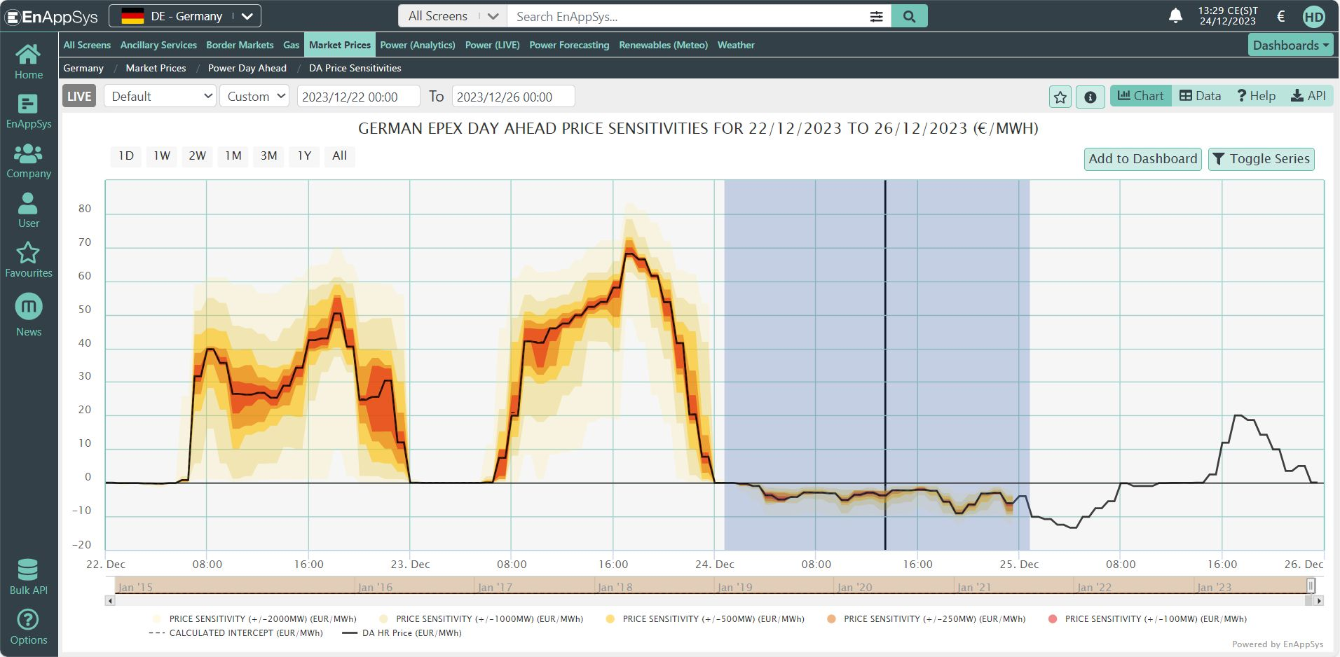
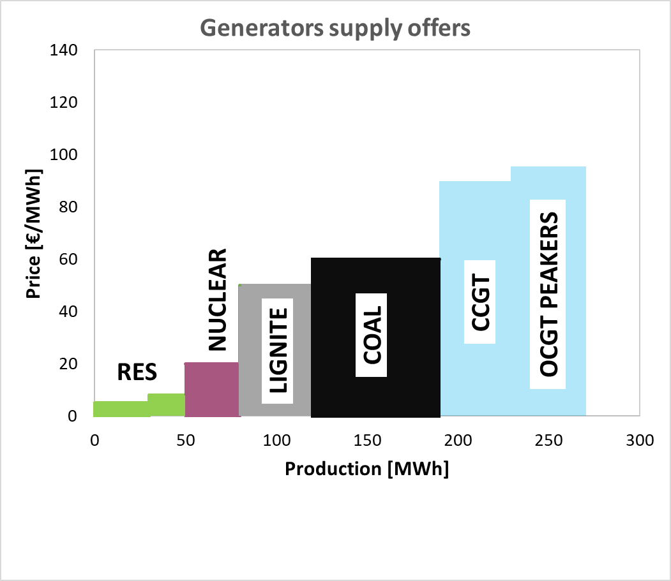
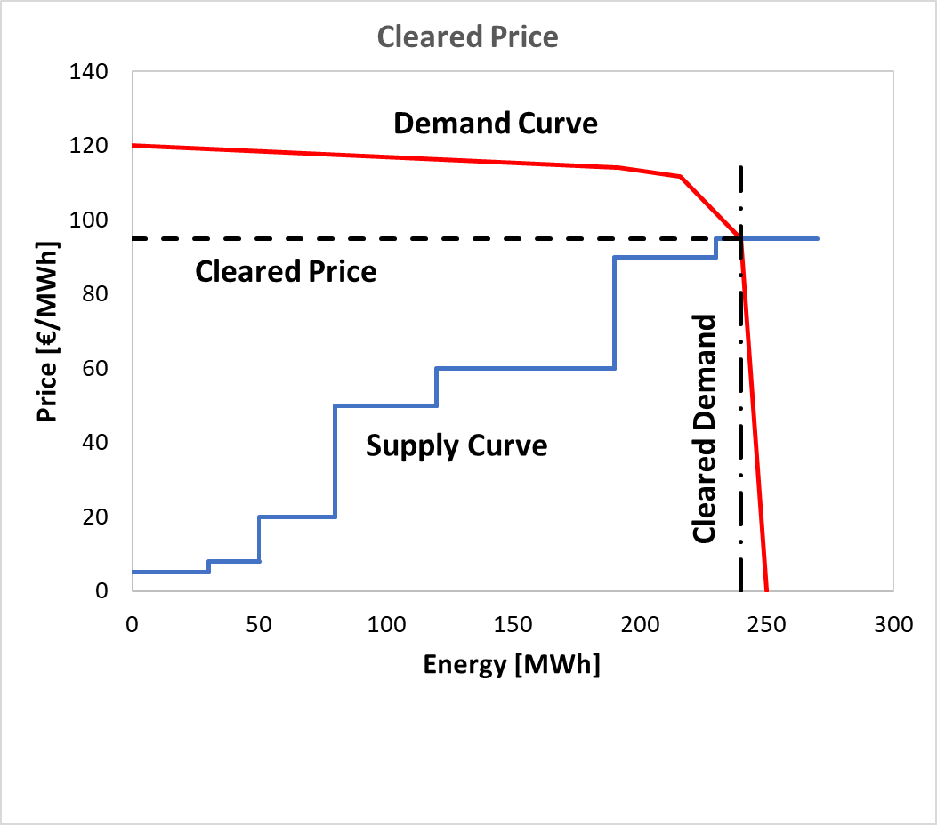
Day Ahead Market: Merit Order and Negative Prices
Alterative Sales models: long-term contracts.
Contract for Difference: governments compensate producers or consumers.
Microsoft :
deal with Constellation to restart Three Mile Island NPP.
might pay about $110-$115 /MWh with a 20-year-long PPA.
Electricity Market Design reform.
Day-Ahead (Spot) Electricity Market
Producers: offer electricity for each hour of the next day with the quantity (MWh) and the minimum selling price (€/MWh).
Consumers: bid hourly demand for electricity with the quantity and the maximum purchase price.
Market Operator:
  Economic Merit Order.
  Supply Curve: Renewables, Nuclear, Lignite, Coal, Natural Gas Base Load, Peakers.
  Demand Curve.
The Market-Clearing Price is set.
The Marginal generator set the price: the most expensive is cleared.
Negative Prices
RES and subsidized generators often offer at negative prices: pay to sell.
The Marginal Cleared Price can get negative: paid to consume.
2023 Christmas week: Germany experienced 38 continuous hours of negative prices.
Notes:
SMRs operation rely, of course, on the sale of electricity to the market. Therefore, the electricity market structure sets the economic balance of the plant and is the base for its operation. So let's have a quick look at the electricity market. The Day Ahead Spot market is an auctions system where:
- the Producers offer electricity for each hour of the next day with the quantity and a minimum selling price.
- the Consumers bid hourly demand for electricity with the quantity and a maximum purchase price.
- the Market Operator sorts the supply offers for the economic Merit Order by increasing unit price and defines the Supply Curve. The different generation technologies are therefore sorted as: Renewables, then Nuclear, then Lignite, hard Coal, Natural Gas Base Load, and Peakers.
- Also the demand bids are sorted by decreasing unit price on the Demand Curve.
- At curves intersection, the Market-Clearing Price is set. (SHIFT)
Renewables often offer at negative prices (so, they actually pay to sell power). Therefore, the Marginal Cleared Price can sometimes get negative: consumers are paid to consume.
For instance, during the last Christmas week, in Germany they had 38 continuous hours of negative prices. (SHIFT)
Other sales models for nuclear plants, for instance based on long-term contracts, can be adopted, able to subsidy (sabsidi) the nuclear producers or regulate and balance the electricity market. In the Contract for Difference scheme, gòvernments compensate electricity producers when the selling price of electricity falls below a set threshold and compensate consumers when prices go above. Another One of these schemes is the fixed price PPA Power Purchase Agreement. Microsoft signed a deal with Constellation to restart one unit of the Three Mile Island nuclear plant in USA: Reuters reported Microsoft might pay Constellation about $110 per megawatt hour as part of the 20-year-long PPA. (SHIFT)
********************
https://www.linkedin.com/posts/harry-d-14b923125_de-negative-power-price-record-smashed-activity-7144668466568994816-IMI2/?utm_source=share&utm_medium=member_android
https://www.euractiv.com/section/electricity/news/nuclear-windfall-profits-in-focus-as-eu-electricity-reform-talks-near-finishing-line/
https://www.renewable-energy-industry.com/news/world/article-6502-new-hinkley-point-c-nuclear-power-plant-electricity-costs-over-15-cents-per-kilowatt-hour-at-launch
https://montelnews.com/news/1536944/no-cfd-plans-for-edfs-nuclear-fleet--ministry
https://www.reuters.com/technology/artificial-intelligence/google-buy-power-small-modular-nuclear-reactor-company-kairos-ai-needs-2024-10-14/
https://www.linkedin.com/posts/sollid_nuclear-domino-effect-2024-another-day-activity-7252345888402993152-kX-u/?utm_source=share&utm_medium=member_android
In the liberalised wholesale electricity markets (for instance in the Italian Day Ahead Spot Market called Mercato del Giorno Prima MGP), energy is sold or acquired among supply/demand firms through a competitive auction system managed by the market operator through established price fixing mechanisms.
The inspiration idea for the creation of short-term electricity markets was the introduction of competition at the wholesale level, in order to finally result in lower electricity prices for end consumers and maximize the so-called Social Welfare.
The Day Ahead Spot market usually includes the large liquidity of the different electricity markets.
In this work I adopt the well market model based on the merit order concept and marginal pricing.
In this model, different independent producers are putting electricity on the market by adopting several generation sources: the model is common to other commodities markets (sale of wheat, for instance), as it assumes electricity “quality” does not depend by the generation process. In a marginal pricing market model, participants offer at their Short-Term Marginal Cost (STMC), which is made up by the operation and maintenance costs (O&M-OPEX), plus the opportunity cost (OC), which include the recovery of life-cycle costs. The STMC is usually below the LCOE, which also encompasses capital expenditures (CAPEX).
Day-ahead trading is mainly based on hourly contracts for the following day. Participants submit supply offers by generators or demand bids by consumers, where they specify the quantity and the minimum/maximum price at which they are willing to sell/purchase.
Demand bids and supply offers are accepted after the closure of the market sitting based on the economic merit-order criterion. From the bids/offers, aggregated supply and demand curves are formed after trading by the market operator, usually the Transmission System Operator (TSO). TSO sorts the sales offers submitted for "economic merit" by non-decreasing unit price, starting from those with zero-unit price (or even negative price). Within each class, usually a further order of priority is identified for offers based on the time of receipt. In a similar way, TSO accepts the bids for power demand of consumers and sorts them by non-increasing unit price, starting from those with a unit price not indicated.
The short-term supply curve of electricity (or merit order) shows, for each generation technology, the generation capacity available on the market in a defined time-period (x-axis, in Fig. 1). On the y‑axis, the production cost for an additional MWh of electricity is plotted for each generator: this is the SRMC. The generation offers (and technologies) are sorted by increasing price, usually starting from renewables, through nuclear, lignite, and coal, to natural gas (first base load, then peaker plants). In the same graph, the demand (or load) curve shows how much the consumers are willing to buy electricity: it plots the price for each purchased MWh.
Where the two curves intersect, the Market-Clearing Price (MCP) is established: MCP sets the equilibrium point and the amount of electricity produced and consumed in a period of time. The clearing price is determined by the production cost of the most expensive generator which is necessary to serve the demand (called the marginal generator). The MCP is usually applied to all executed orders, which are sales offers, that are strictly below the MCP, and purchase bids, that are strictly above the MCP (pay-as-cleared method). Infra-marginal producers are all those that offer below the MCP and hence they will be rewarded at a marginal price above their marginal cost: they are "In-the-Money". Suppliers, whose offers are above MCP, are "Out-the-Money" and they do not produce and do receive anything.
Considering the totality of offers made by a generation company, this can only earn on those that it can set below the equilibrium price: obviously, the more the company excels in the production of low-cost energy, the greater it will be the profit. In addition, penalties are usually foreseen for failure to comply with the energy supply and zero gain for offers that are not accepted.

Slide 5
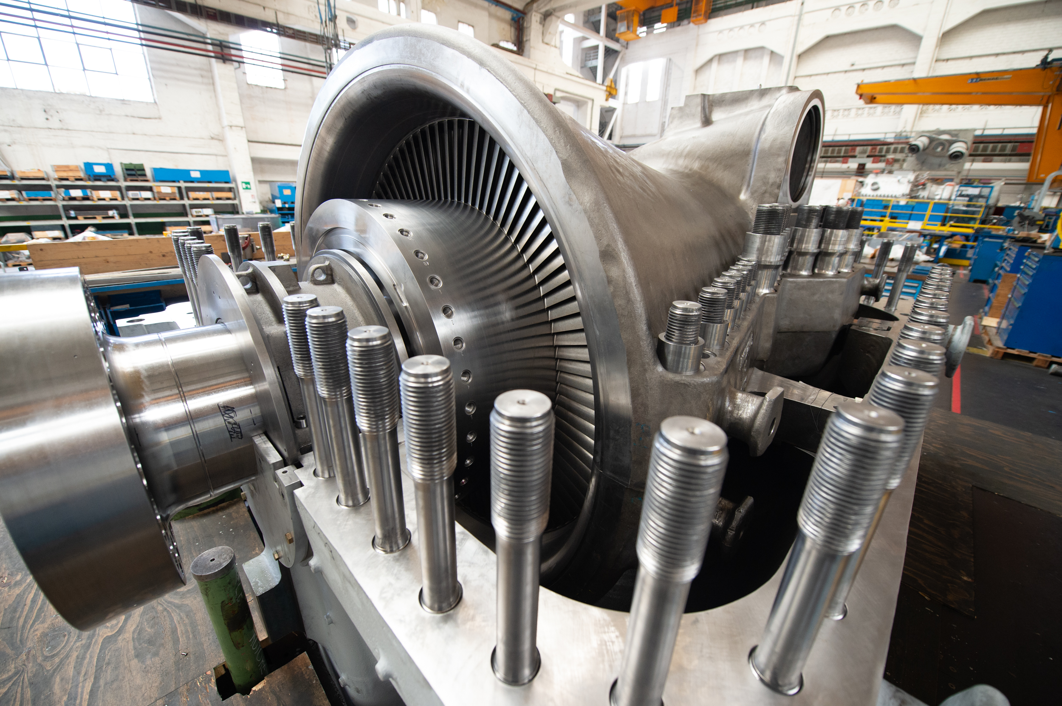
Steam Cycle: PolyGeneration
Hybridization of NPP with other services:
Concurrent generation of Power, Heat, Hydrogen, Water.
Storage: Battery Energy Storage Systems (BESS).
Customer/Grid Benefits
Reduce the requirement of grid load-following and components cycling/fatigue/aging.
Resilience and fitting to market requirements: multiple revenue streams.
Grid balancing and ancillary services.
Resilience to grid instabilities.
Steam spills for:
Hydrogen production: electrolyser, pyrolysis.
CHP Combined Heat & Power: industrial heat, district heating.
Desalination.
Notes:
In order to reduce the requirement of grid load following and to deal with changing market prices, SMRs power island can be designed to provide additional services, such as:
- The concurrent (concarrent) generation of Power and Heat, or Hydrogen, or Water.
- The hybridization (aibridaizescion) with a storage system, for instance with a Battery Energy Storage System.
This polygeneration can provide a number of benefits to the customers and to the power grid:
- Reduce the requirement of grid load-following and cycling, fatigue and aging of the components.
- Resilience and fitting to the market requirements.
- Participate to the grid balancing and ancillary services.
- Resilience to grid instabilities.
- Desalination (disalainèscion): one of the main options in different areas is the production of water from the sea for agriculture, industrial or civil use. (SHIFT)

Slide 6
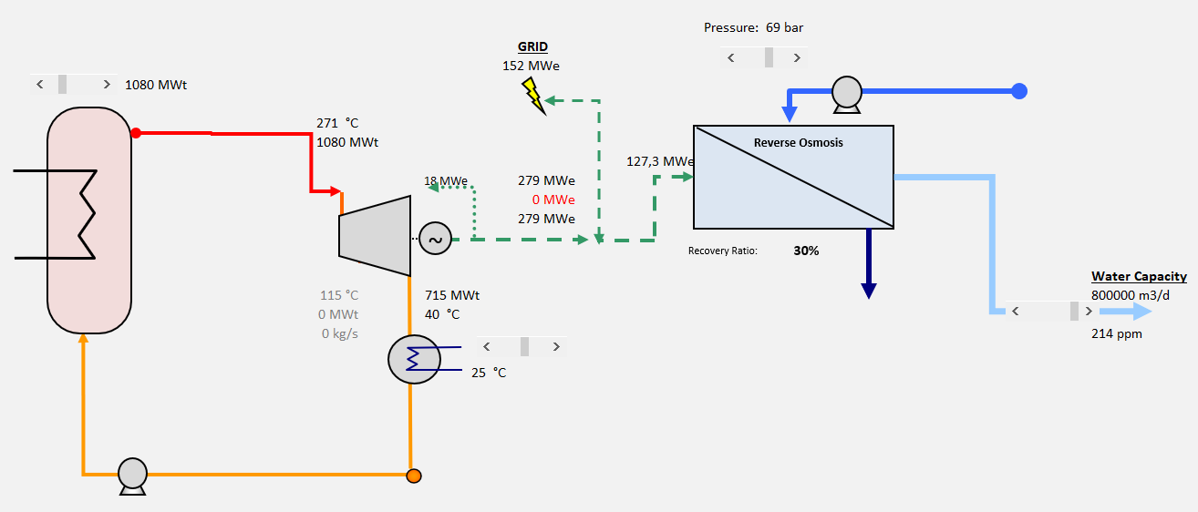

Test Case: Water Production for Abu Dhabi by SMR
Scope: water for Abu Dhabi City (estimated population of 1.5 million).
An SMR supplies steam to a desalination plant to provide 800,000 m3/day of water, almost 1/4 of city's daily request.
Tool DEEP 5.1 by IAEA.
Thermal Power: 1,080 MWth Water salinity: 42,000 ppm
Generated Power: 345.6 MWe Water temperature: 25 °C
Desalination Techn. : Reverse Osmosis (RO)
Plant construction : 48 months
Desalination constr. : 12 months
Plant lifetime: 60 years
SMR Power Plant | Data for DEEP Analysis
Electricity Production | 2,203 MWh/yr
Availability | 90%
Desalination Plant | Case A | Case B | Case Ref.
Type | RO | RO | n.a.
Total Capacity | 800,000 m3/d | 1,600,000 m3/d | 0
Feed Salinity | 42,000 ppm | 42,000 ppm | n.a.
Power used for desalination | 127 MW(e) | 255 MW(e) | 0
SMR Construction Cost: 4 k$/kW
SMR Decomm. Cost: 0.6 k$/kW
Desal. Construct Cost: 1.1 k$/mc*d
Notes:
Here I want to present a short resume of the performed analysis for the production of water by an SMR. The scope is to supply fresh water for the Abu Dhabi City which has an estimated population of 1.5 million inhabitants. In this scheme an SMR supplies power to a desalination plant designed to produce 800,000 m3/day of water, which is almost 1/4 of city's daily request. The analysis has been performed by using the tool DEEP, developed by the International Atomic Energy Agency. Here are reported some of the technical and economic data used for this simulation. The reference SMR is a Pressurised light Water Reactor co-generation plant, with a total power output (in pure electricity mode) = 346 MW(e) and the desalination technology is the Reverse Osmosis. The adopted Power Plant construction time is 48 months, the Desalination Plant construction time is 12 months and the plant’s lifetime is supposed to be 60 years. (SHIFT)
Three test cases have been evaluated: the first reference Case A, with a water production of 800,000 m3/day; the Case B, with double water production; and the case C with no water production and pure power generation. (SHIFT)
*********************************
The adopted discount rate is the Weighted Average Cost of Capital (WACC), which here has been set equal to 5%, which in line with the ranges indicated by the Department of Energy of Abu Dhabi. The currency reference year is 2024.
The specific nuclear plant construction cost (also referred to as overnight construction cost, excluding site related cost, contingencies, escalation and interest during construction) is set to 4000 US $/kW(e). For NPPs, this cost is the main contributor to the electricity generation cost. For the distillation RO plant, the adopted value for the base unit cost is 1177 US $/m3/d.

Slide 7

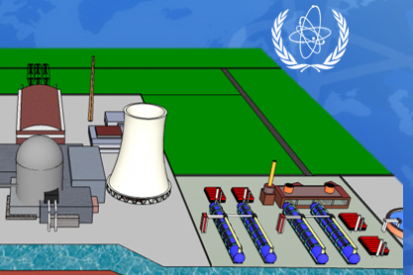
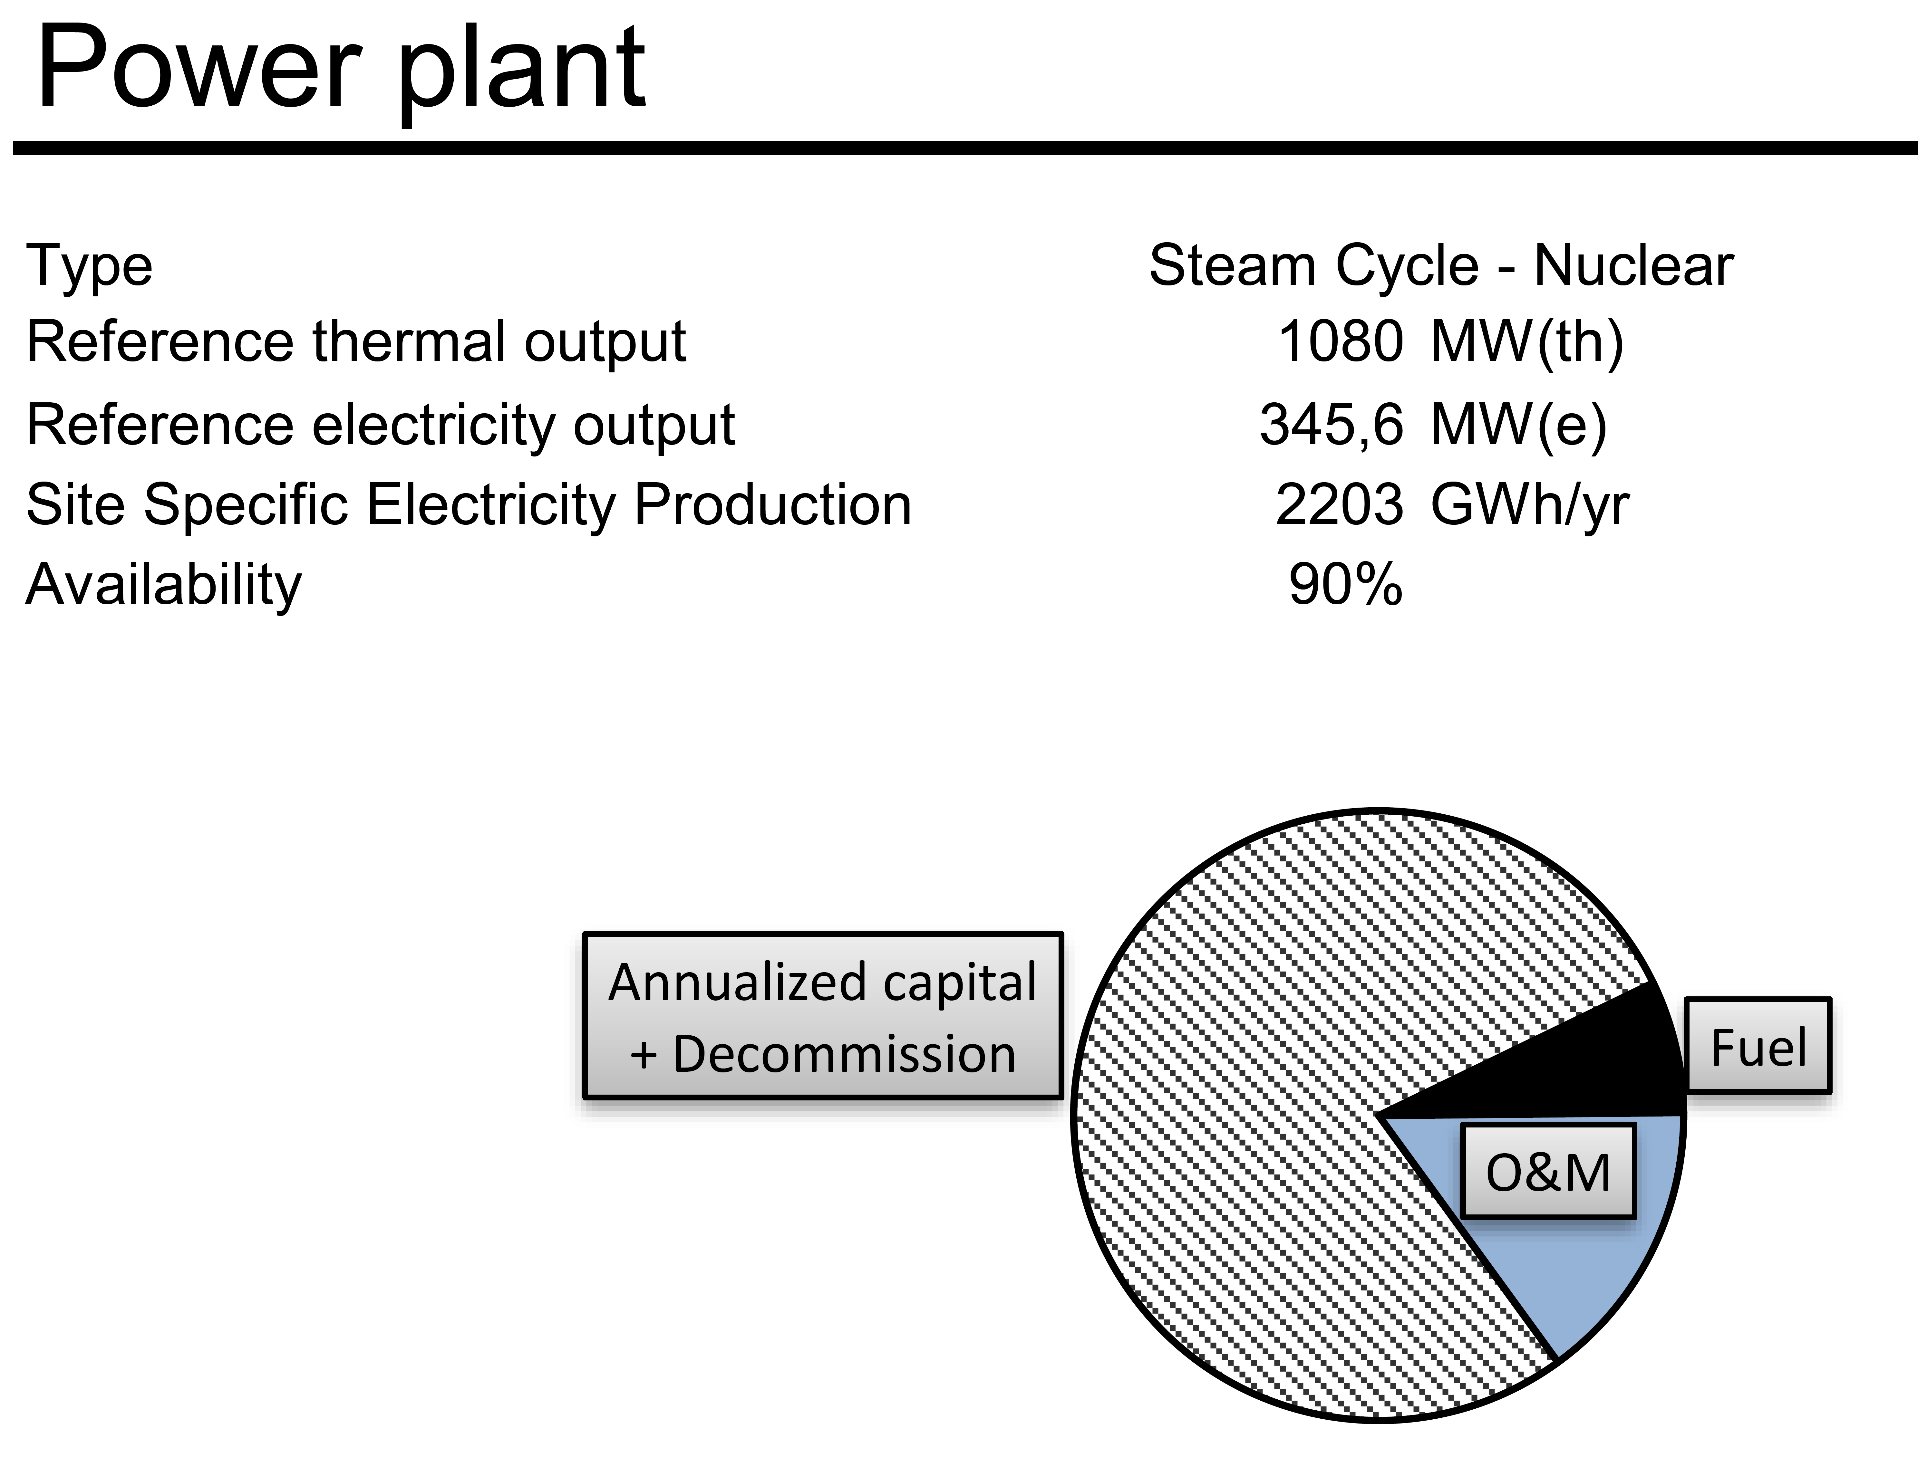
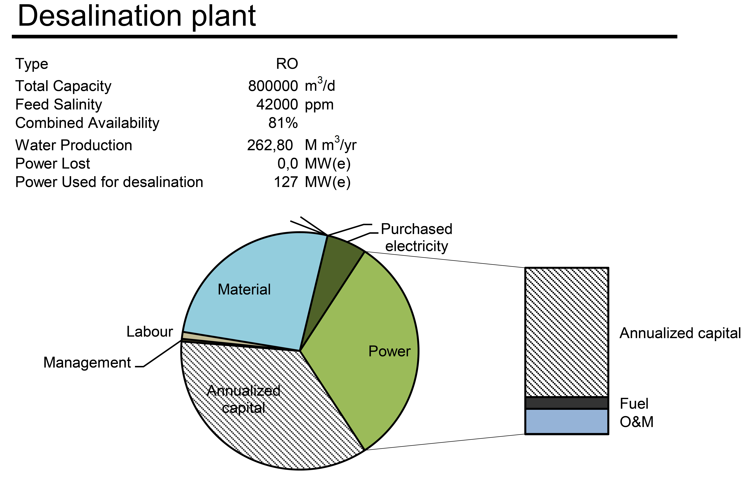
Test Case: Economic Results Case A
 | Case A
Simple Payback Time | 8.2 years
Net Present Value (@6%) | 3,386 M$
Levelized operating cost (water) | 0.43 $/m3
Total water cost | 0.652 $/m3
Notes:
Here we cannot go into the details of the model you can find in the paper, and I present just the main economic results of the performed analysis for the three cases. For the reference Case A, with 800.000 m3/d of water production, the Simple Payback Time is evaluated as 8.2 years, with a Net Present Value (at 6% expected return on equity ROE) almost 3.400 M$ (3,386 M$). The computed water Levelized Operating Cost is 0.652 $/m3. From the analysis of DEEP data of the SMR plant for the Case A, plotted in the left-hand chart, it is possible to observe that globally: the annual capital cost shares 78 % of the annual management expenses, the fuel cost shares 7 %, and the O&M cost shares 15 %. For the Desalination plant for the Case A, data plotted in the right-hand chart show that globally: the annual capital cost (shares 35 %), the energy cost (shares 36 %), and the O&M cost (shares 30%) each one shares about 1/3 of the annual management expenses. (SHIFT)

Slide 8
Test Case: Economic Results
 | Case A | Case B | Case Ref
Simple Payback Time | 8.2 years | 7.9 years | 9,2
Net Present Value (@6%) | 3,386 M$ | 5,419 M$ | 1,363 M$
Levelized operating cost (water) | 0.43 $/m3 | 0.43 $/m3 | n.a.
Total water cost | 0.652 $/m3 | 0.65 $/m3 | n.a.
Water costs are in line with the price race in progress during
the last years in the Middle East.
Notes:
And here a comparison among the three test cases. For the Case B, with 1.600.000 m3/d of water production, the Simple Payback Time is evaluated to be 7.9 years, with a Net Present Value (at 6% expected return on equity ROE) of 5,419 M$. For the Case C, with no water production and pure electricity plant, the Simple Payback Time is 9.2 years, and the Net Present Value (@6%) 1,363 M$. The computed water Levelized Operating Cost is 0.65 $/m3 for the Case B, close to the value of Case A. In the graph, we can see the low sensitivity of the water cost with the capacity of the plant. These presented water costs are in line with the price race in progress during the last years in the Middle East region, where the production costs for water desalination are continuing to fall by the combined effect of improvements in energy efficiency of the plants, economic push by low interest rates, and low-priced Renewables generation. (SHIFT)

Slide 9

Conclusions
The Small Modular Reactors concept, design and building architecture apply to the entire power plant and therefore affect the conventional power island.
Ansaldo Energia is developing the most suitable solutions for the steam turbine and synchronous generator machines, and their auxiliary systems to be tailored for the specific boundary and operative conditions of SMRs.
The target lifetime of 60 years requires a specific focus on the design for maintenance of all systems to optimize the plant availability and reduce OPEX.
The request for drinkable and industrial water is steadily increasing in ME: one of the most promising uses of SMR is for the desalination of seawater for agriculture, industrial or civil use.
The poly-generation of electricity and desalinated water by SMR has been shown to be a valuable path to efficiently increase the Net Present Value and reduce the Payback Period of the investment, while providing low-carbon power and cheap fresh water.
The presented design approaches are combined with the long
experience and knowledge Ansaldo Energia got providing
engines and components for the former Italian nuclear
fleet and worldwide during past decades.
Notes:
I would like to recall here some recaps and some conclusions. The Small Modular Reactors concept, design and building architécture (arkitéctar) apply to the entire (entàir) power plant and therefore affect the conventional power island. Ansaldo Energia is devéloping the most suitable solutions for the steam turbine and synchronous generator machines, to be tailored for the specific boundary and òperative conditions of SMRs.
In the Middle East region: one of the most promising uses of SMR is for the desalination of seawater. With the presented analysis, the poly-generation of electricity and water by an SMR has been shown to be a vàluable way to efficiently increase the Net Present Value and reduce the Payback Period of the investment, while providing low-carbon power and cheap fresh water. (SHIFT)
*************************
In order to keep the complete control of the main objectives, an overall and life cycle project management model is required. The model should cover all project's phases, from Design to Execution to O&M, with the full assessment of the scheduled costs and revenues streams.

Slide 10
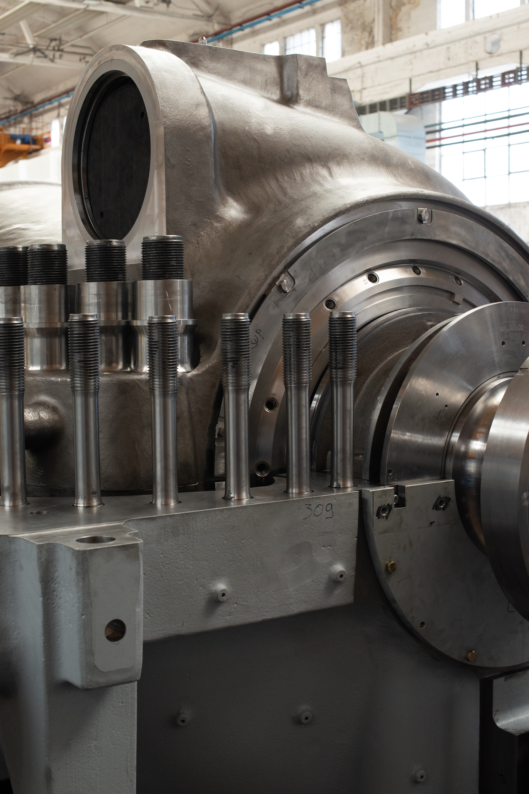
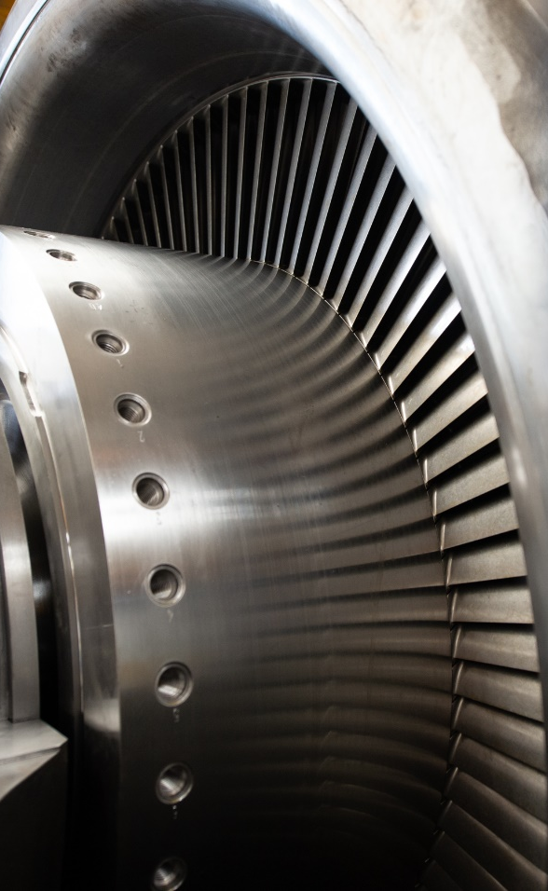





Marco Cioffi, PhD
Steam Turbines and Generators Product Manager
marco.cioffi@ansaldoenergia.com
For additional information on Ansaldo Energia power plant solutions,
please scan the
QR code and
follow the link
or follow us on socials
Notes:
That's all. If you wish to discuss of these or other solutions for power generation, please contact me.

Slide 11
Ansaldo Energia Disclaimer
Disclaimer for public documents:
All information contained in this document is the property of Ansaldo Energia S.p.A. and/or all its controlled companies, whether directly or indirectly (hereafter “Ansaldo Energia Group”).
No part of this document may be reproduced, distributed, or transmitted in any form or by any means, without the prior written permission of Ansaldo Energia Group.
Public

Slide 12
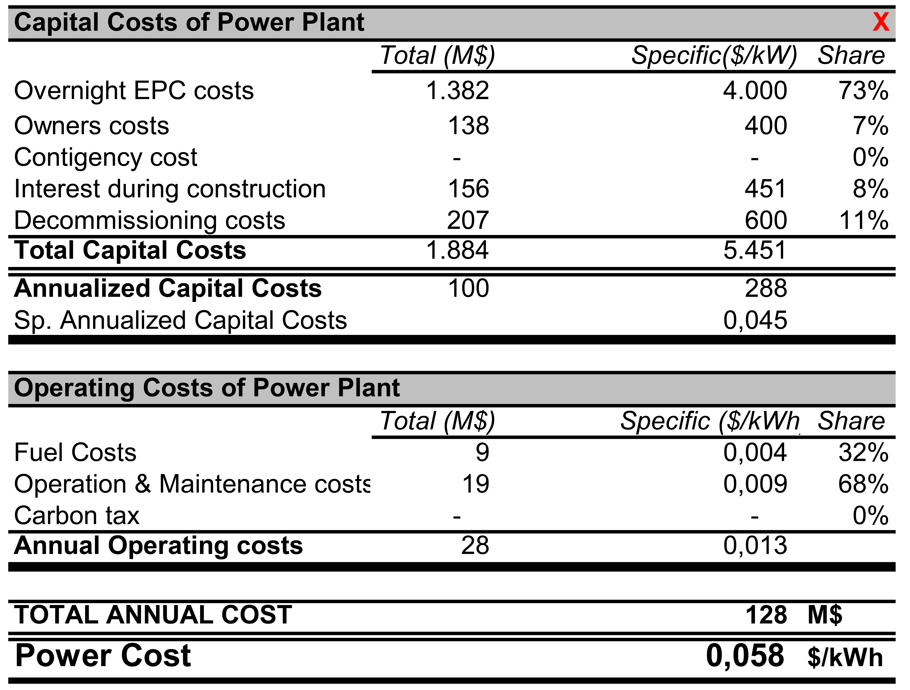
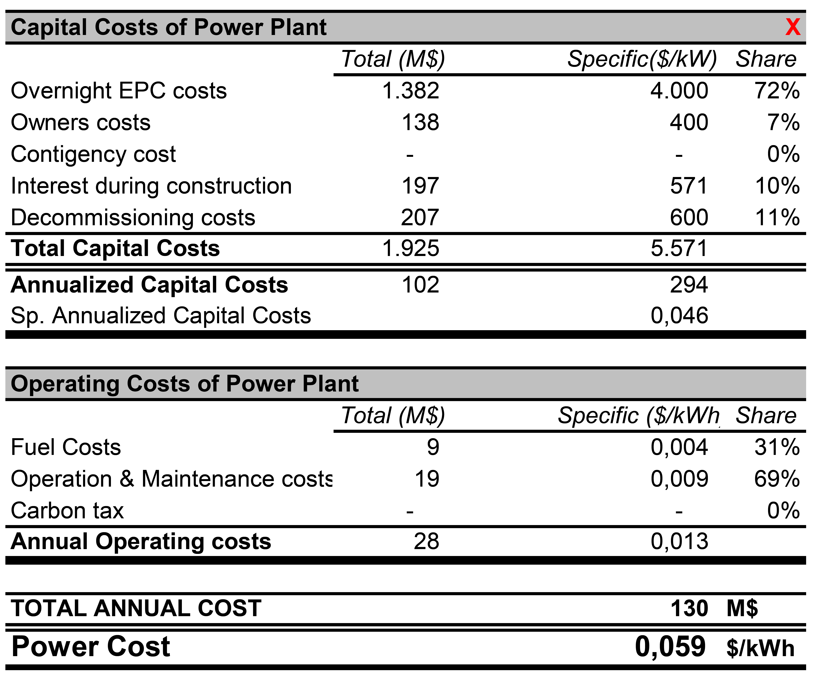
Test Cases: Power Plant
Case A
Case B
Case C

Slide 13
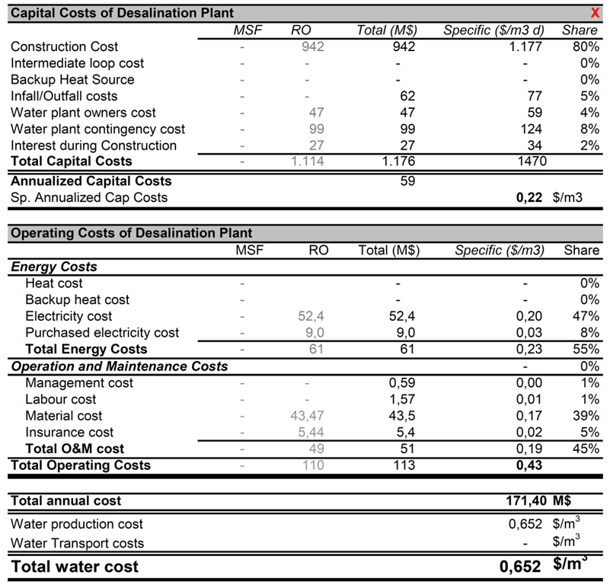
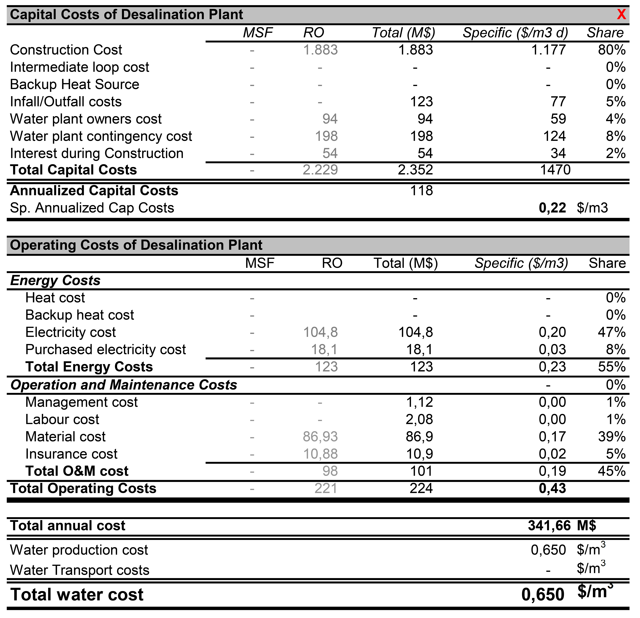
Test Cases: Desalination Plant
Case A
Case B

