Slide 2
release-category-based emergency planning zone calculation applied to a light-water small modular reactor design
Juan Carlos de la Rosa Blul, A. Guglielmelli
European Commission Joint Research Centre

Slide 3
Outline
Background
Introduction
Methodology
Case study
Results
Conclusions

Slide 4
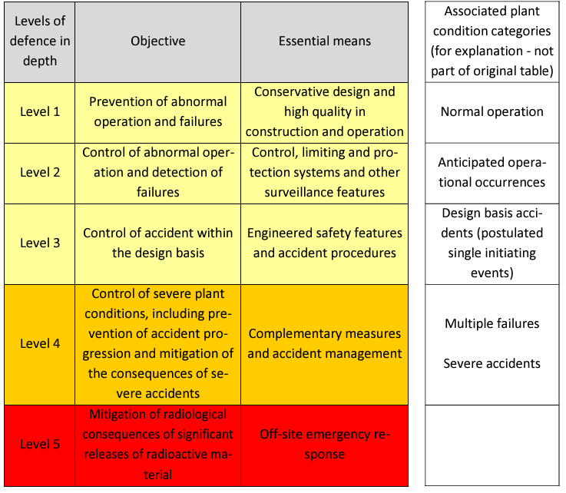
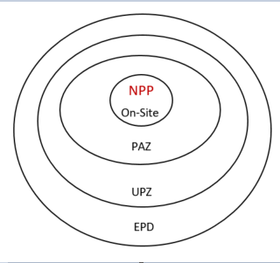
Background
Emerging Planning Zone (EPZ) drives the extension of offsite protective arrangements and provisions in a nuclear emergency;
EPZ evaluation often relies on generic methodologies that does not account for the strong difference of the ongoing SMRs technologies;
The Source Term quantification via the identification of accident scenarios is one of the most relevant, debatable and sensitive step informing any EPZ methodology;
The Defence-in-Depth approach is used to define the plant condition categories that can cause a failure of the multiple independent barriers .
On-site safety scenarios (DBA, DEC) have not fully informed off-site arrangements because the Defense-in-Depth (DID) approach was applied separately to on-site and off-site safety measures;
The separate application of the DID approach to on-site and off-site safety measures has led to incomplete information regarding off-site arrangements based on on-site scenarios (DBA, DEC).
The Fukushima accident revealed weakness in the current implementation of DiD (i.e., the lack of independence, the inadequate design basis and the insufficient safety margins).

Slide 5
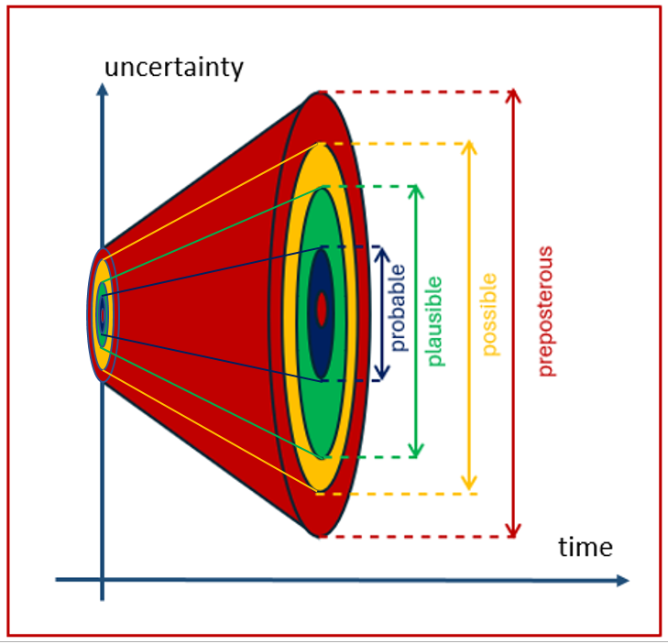
Introduction
This work proposes a balanced, graded approach for EPZ evaluation, allowing to analyze a wide range of severe accident (SA) events
The proposed approach aligns with the concept of 'practically eliminated conditions,' where the screening-out criteria are limited to
  Events that are physical impossibility to occur;
  Events that are extremely unlikely to arise, with a high degree of confidence;
  Events that can be practical eliminated due to the effectiveness of the design features.
This approach also aligns with the perspective of including all plausible accident scenarios in the context of DID Level 5;
This approach would also provide a more comprehensive, logical, and conservative EPZ evaluation, making it suitable for application in SMR design;
This approach was applied to five case studies each corresponding to five release categories, to demonstrate its capability in evaluating parameters useful for quantifying EPZ distances

Slide 6
Methodology – flowsheet
A Release Categories Based Methodology (RCBM) is here proposed for quantifying a wide range of Source Term (ST) spectra;
The RCBM combines deterministic and probabilistic techniques to identify all plausible bounding sequences that define the release categories and their associated STs;
The proposed methodology involves the following steps:
  Define a Plant Damage State (PDS) derived from Level 1 Probabilistic Risk Assessment (PRA) analysis;
  Define the various plausible Release categories via Containment Event Tree (CET) application;
  Quantify the ST for each release category;
  Combine each ST with an Atmospheric Dispersion calculation (ADC) to analyze radiological consequences;
  Compute EPZ distance based on maximum (bounding) radiological consequences values.

Slide 7
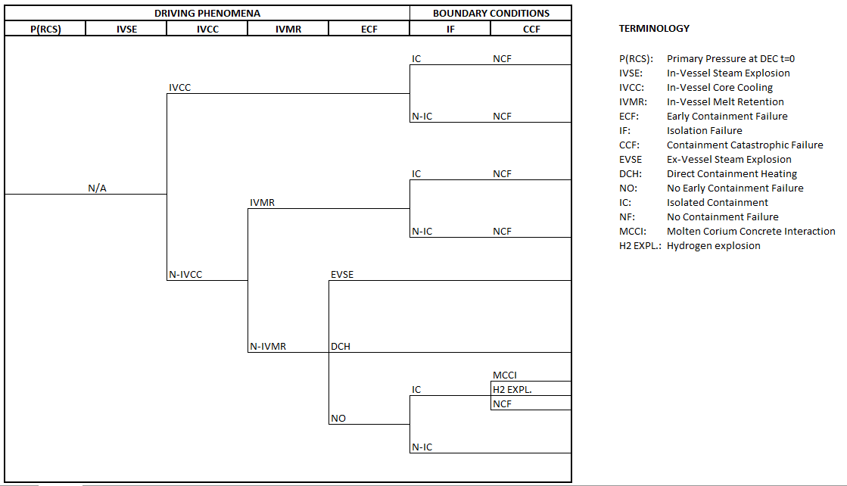
Methodology – Containment Event Tree
The analysis begins by postulating a core damage state and progresses according to a design-specific CET;
The CET accounts for all plausible accident sequences with the potential for off-site release;
The CET is characterized by the key physicochemical phenomena, including the potential for containment failure;
The construction of a CET enables the definition of release-based categories without considering their relative frequency

Slide 8
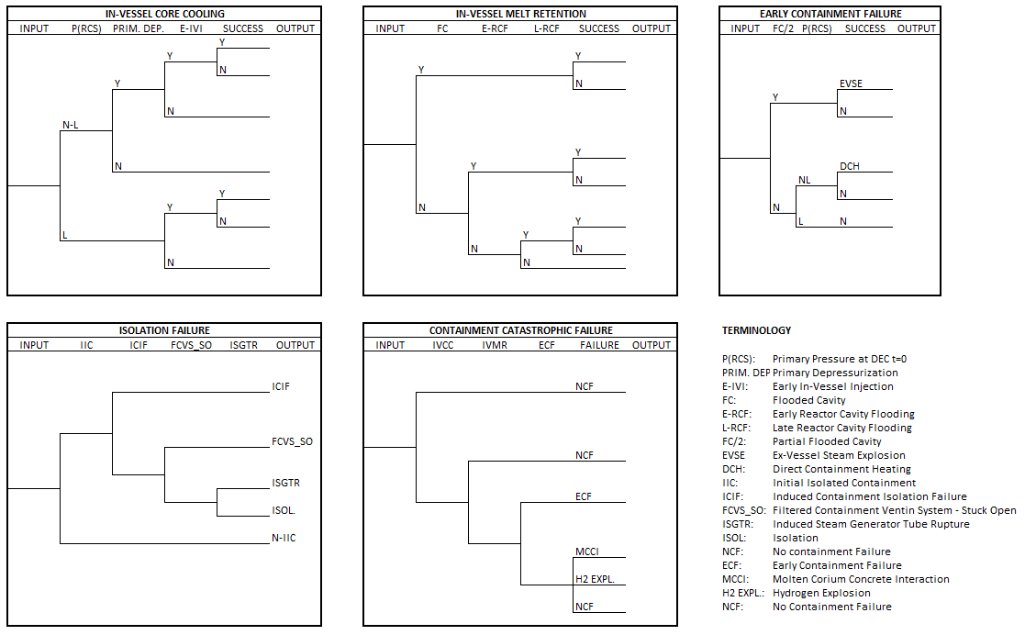
Methodology – Design Event Tree
The Design Event Tree (DET) decomposes each Top Event of the CET;
The DET analyses all the different possible outcomes for a given input state;
Each release category is the combination of a particular set of DET outcomes;

Slide 9
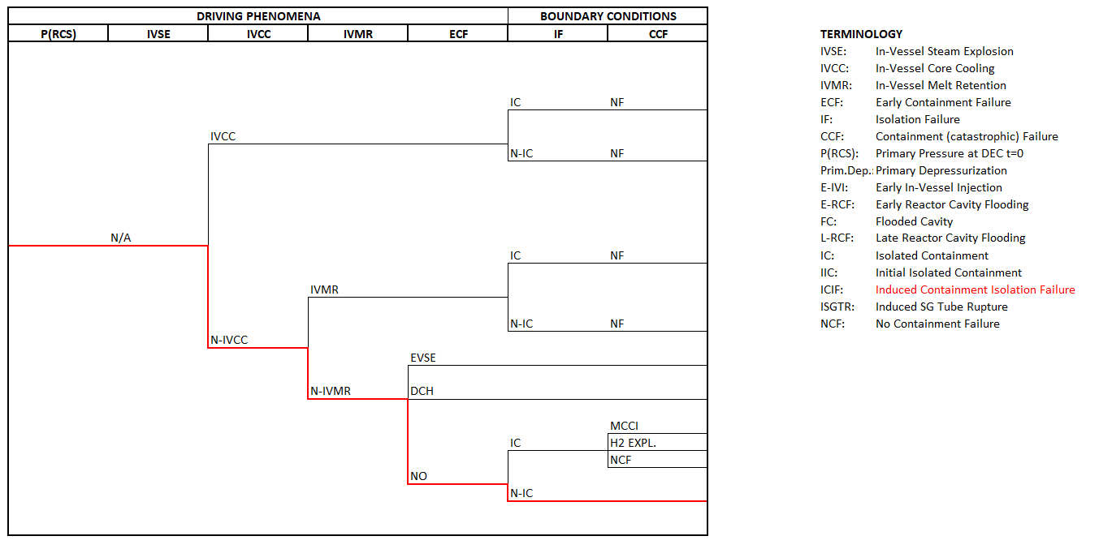
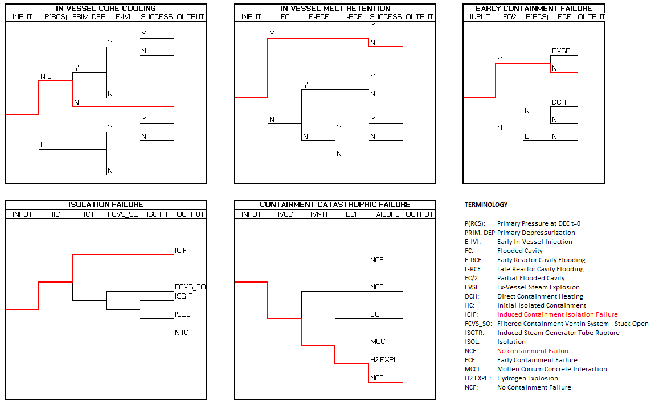
Case study – Five Release Categories
The methodology was applied to five different SA sequences, all connected to the same PDS;
PDS: LOCA in the Direct Vessel Injection (DVI) line, with failure of primary depressurization and unavailability of the Emergency Heat Removal System (EHRS);
  First case: failure to prevent vessel lower head failure (VLHF) both by IVCC and IVMR, with containment failure driven by high temperature;
  Second case: failure to prevent VLHF both by IVCC and IVMR, with FCVS open and containment isolation achieved;
  Third case: success to prevent VLHF by the IVMR and success in achievement containment isolation;
  Fourth case: failure to prevent VLHF both with IVCC and IVMR, with successful containment isolation with a Late Reactor Cavity Flooding;
  Five case: failure to prevent vessel lower head failure both by IVCC and IVMR with successful containment isolation.

Slide 10
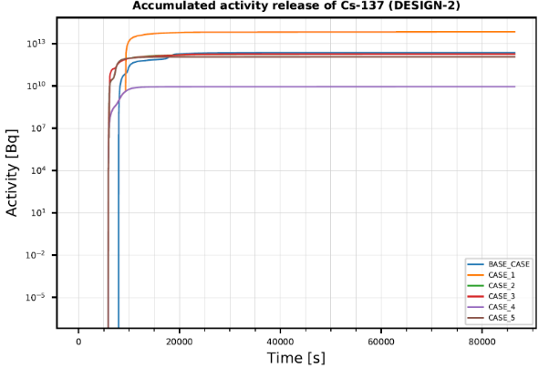
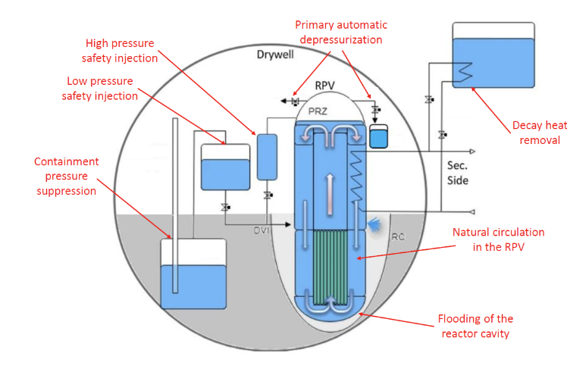
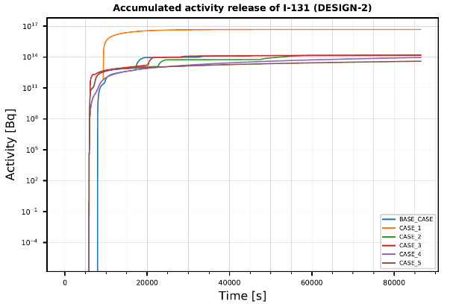
Case study – Source Term
The Source Term was evaluated for each of the five release-category-based scenarios;
  Reactor design: 1000 MWth integral Pressurized Water Reactor (iPWR-SMR); SASPAM-SA Design 2
  Simulation tool: Modular Accident Analysis Program (MAAP, ver. 5.06).

Slide 11
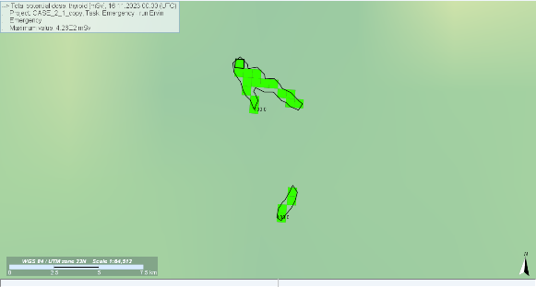
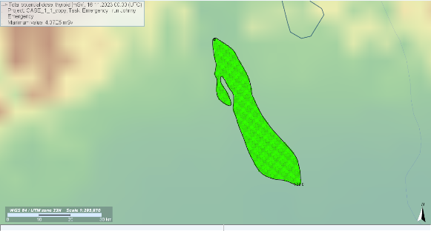
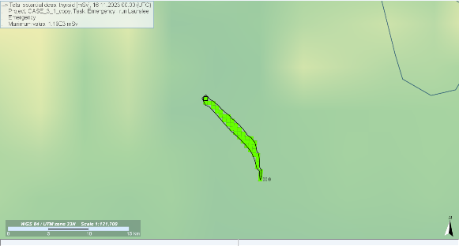
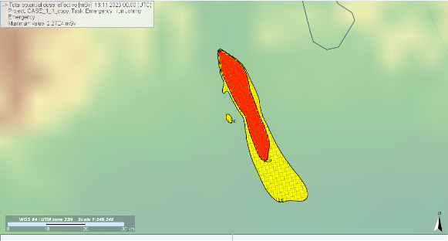
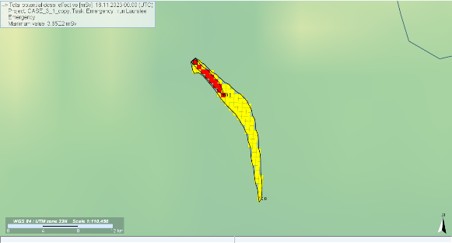
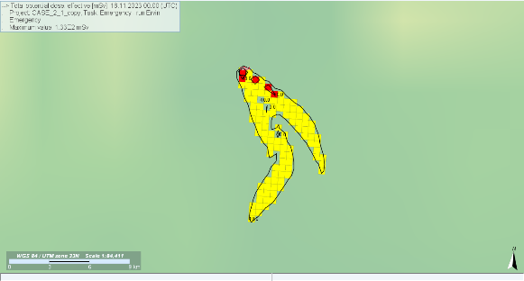
Case study – Atmospheric dispersion
JRODOS was used to evaluate the atmospheric dispersion of radionuclides resulting from the five source terms based on the five release-category-based cases.
  Time of emission: random fixed data (15/11/2023 – 00:00)
  Meteo data: ECMWF (10 x 10 km)
  Domain of emission: 96x96 km
  Unit cell dimension: 500 m
  Height of releases: 20 m above ground
  Duration of simulation: 24 hours

Slide 12
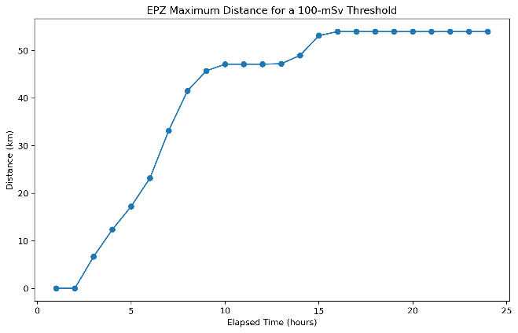
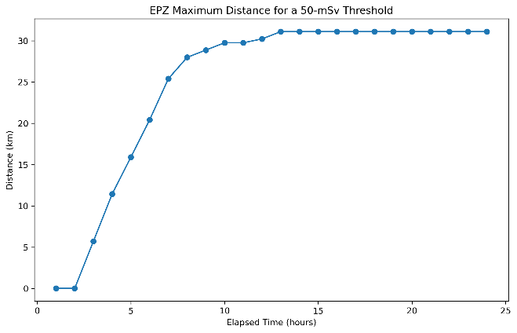
Case study – EPZ sizing
A bounding radiological consequences scenario was applied to evaluate the maximum distance at which a fixed threshold dose value is reached;
The bounding scenario was obtained by convolution of the five AD results, selecting the highest value from each results both in time and space;
The maximum distance was evaluated in accordance with IAEA guidelines on the implementation of protective actions.

Slide 13
Conclusion
A Release-Category-Based Methodology (RCBM) for accident sequence identification aimed at calculating EPZ distance calculation was implemented;
The RCBM is consistent with the concept of practical elimination condition and bridges the gap between the online and offsite domains applied to nuclear safety under the application of the DID approach;
The methodology employs the CET and DET instruments to provide a wide spectrum of release-based category without considering the frequency associated at each sequences;
The methodology was applied to five different SA sequences for a two-inches DVI LOCA in a 1000-MWth integral PWR SMR design (SASPAM-SA Design 2).

