Slide 1
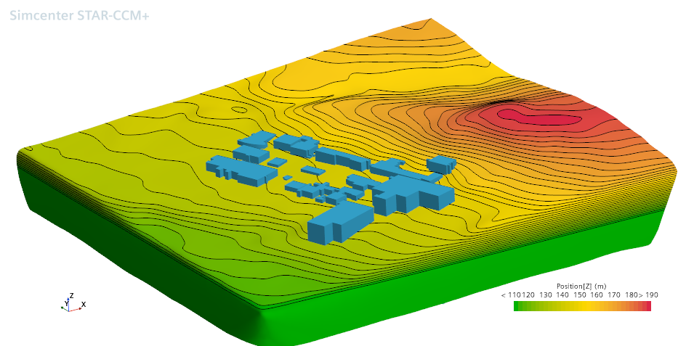
Benchmarking Near-field Radionuclide Dispersion with CFD and Gaussian Model
Sreeyuth Lal, Aneesh John, Luke Lebel
International Conference on Small Modular Reactors and their Applications
October 21-25, 2024

Slide 2

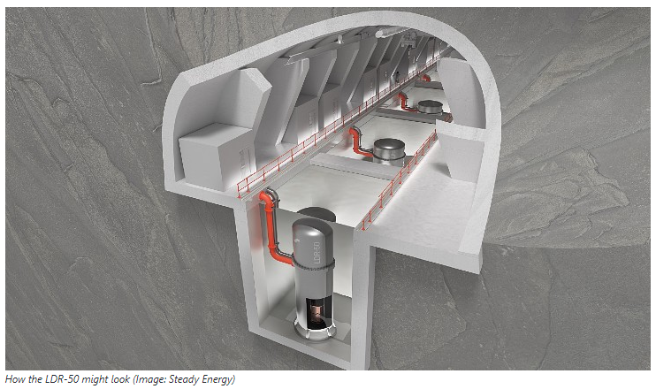
Introduction
EPZ ‘at site boundary’
Small modular reactors (SMRs) expected to have smaller accident source terms
Smaller emergency planning zones (EPZs) may be justifiable considering the reduced risk [1]
Possible deployment of SMRs in populated and heavily built-up areas, in close proximity to potential end users such as industrial or district heating applications
Significant knowledge gap exists in modelling atmospheric dispersion of radionuclides in the near-field (≈ <500 m from source) in case of postulated accidents
Two modeling approaches compared in this study:
  Computational fluid dynamics (CFD) – StarCCM+
  Gaussian plume model - RASCAL
Potential EPZ concept for SMRs with site boundary framework
Tritium dispersion
Notes:
Downwind distances ranging from 500 m to 30 km
Harper et al. (1995) document the expert elicitation that provides a technical basis for defining the plume lateral and vertical dispersion for a range of stability conditions, a range of surface roughness corresponding to several land-use categories, and downwind distances ranging from 500 m to 30 km.
MACCS assume building wakes complex geometry effect using simplification factor
MACCS does not directly model building wake effects. Instead, if there is building wake, it is up to the user to specify the initial plume width (SIGYINIT) and height (SIGZINIT) of the gaussian plume segments that are emitted from building wakes.
Radionuclide concentrations can increase several orders of magnitude due to nearfield obstruction
The maximum concentration of the radioactive material increased by 7 times compared to the concentration when the terrain and building effects were not considered.. [Jeong et al. 2014, "Terrain and building effects on the transport of radioactive material at a nuclear site"]
Simple models for deposition can be updated with CFD informed data for complex geometies
For small scales, CFD can provide spatially varying distribution of the radionuclide;
-complement MACCS efficiency for larger scales
-CFD can be used to develop efficient nearfield correlation for MACCS

Slide 3
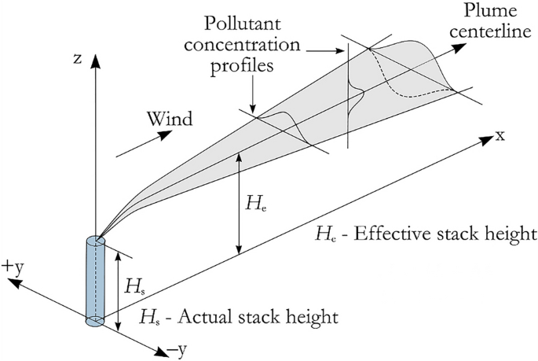
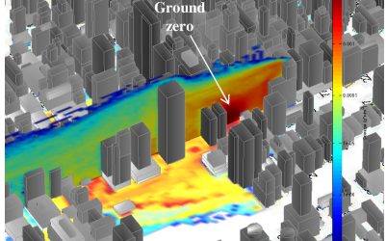
CFD vs Gaussian Models
Dispersion models often intended for local (e.g., ADDAM, MACCS) [2], or regional/global scales (e.g., HYSPLIT, WSPEEDI)
Nearfield concentrations are strongly affected by obstruction [2]
Building wake effects are captured by empirical factors in dispersion codes
CFD complements others in the nearfield
  Develop higher fidelity nearfield dispersion and deposition correlations
  CFD-informed data can be used to complement other systems’ nearfield dose assessments
Gaussian atmospheric dispersion model [3]
Tritium dispersion
Tritium dispersion
CFD simulation of an explosive radiological dispersal device [4]

Slide 4
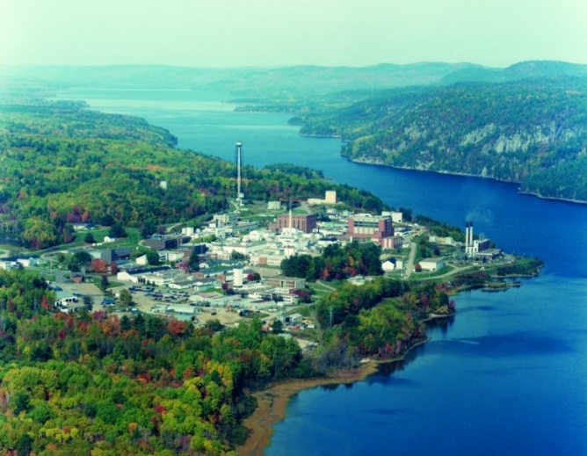
Site Selection
Fictitious point source from a building at CNL
Complex terrain including dense vegetation, hills, the Ottawa river, and multiple low-rise buildings
Availability of high-quality meteorological data
Potential validation experiments in the future
Tritium dispersion
Chalk River site of Canadian Nuclear Laboratories (CNL)
Notes:
Radon exposure is a common issue and one of the leading causes of cancer around the world. The regulatory limits of safe concentration are below 200 Bq/m3
In many residential homes, the key pathway to radon exposure is through ingress of soil-laden radon into house through concrete slabs in buildings
A promising strategy to mitigate this issue is through a sub-slab depressurization where radon below the concrete slab is dispersed to the atmosphere through an above roofline or above ground line discharge
The above roofline is the standard practise which limits of the re-entrainment of radon-laden air back into the residential area. But during winter climates, this method can lead to icing and blockages.
On the other hand, above ground level dischange avoids these issues; but is presents the possibility of re-entrainment and exposure of individuals to discharged radon.

Slide 5
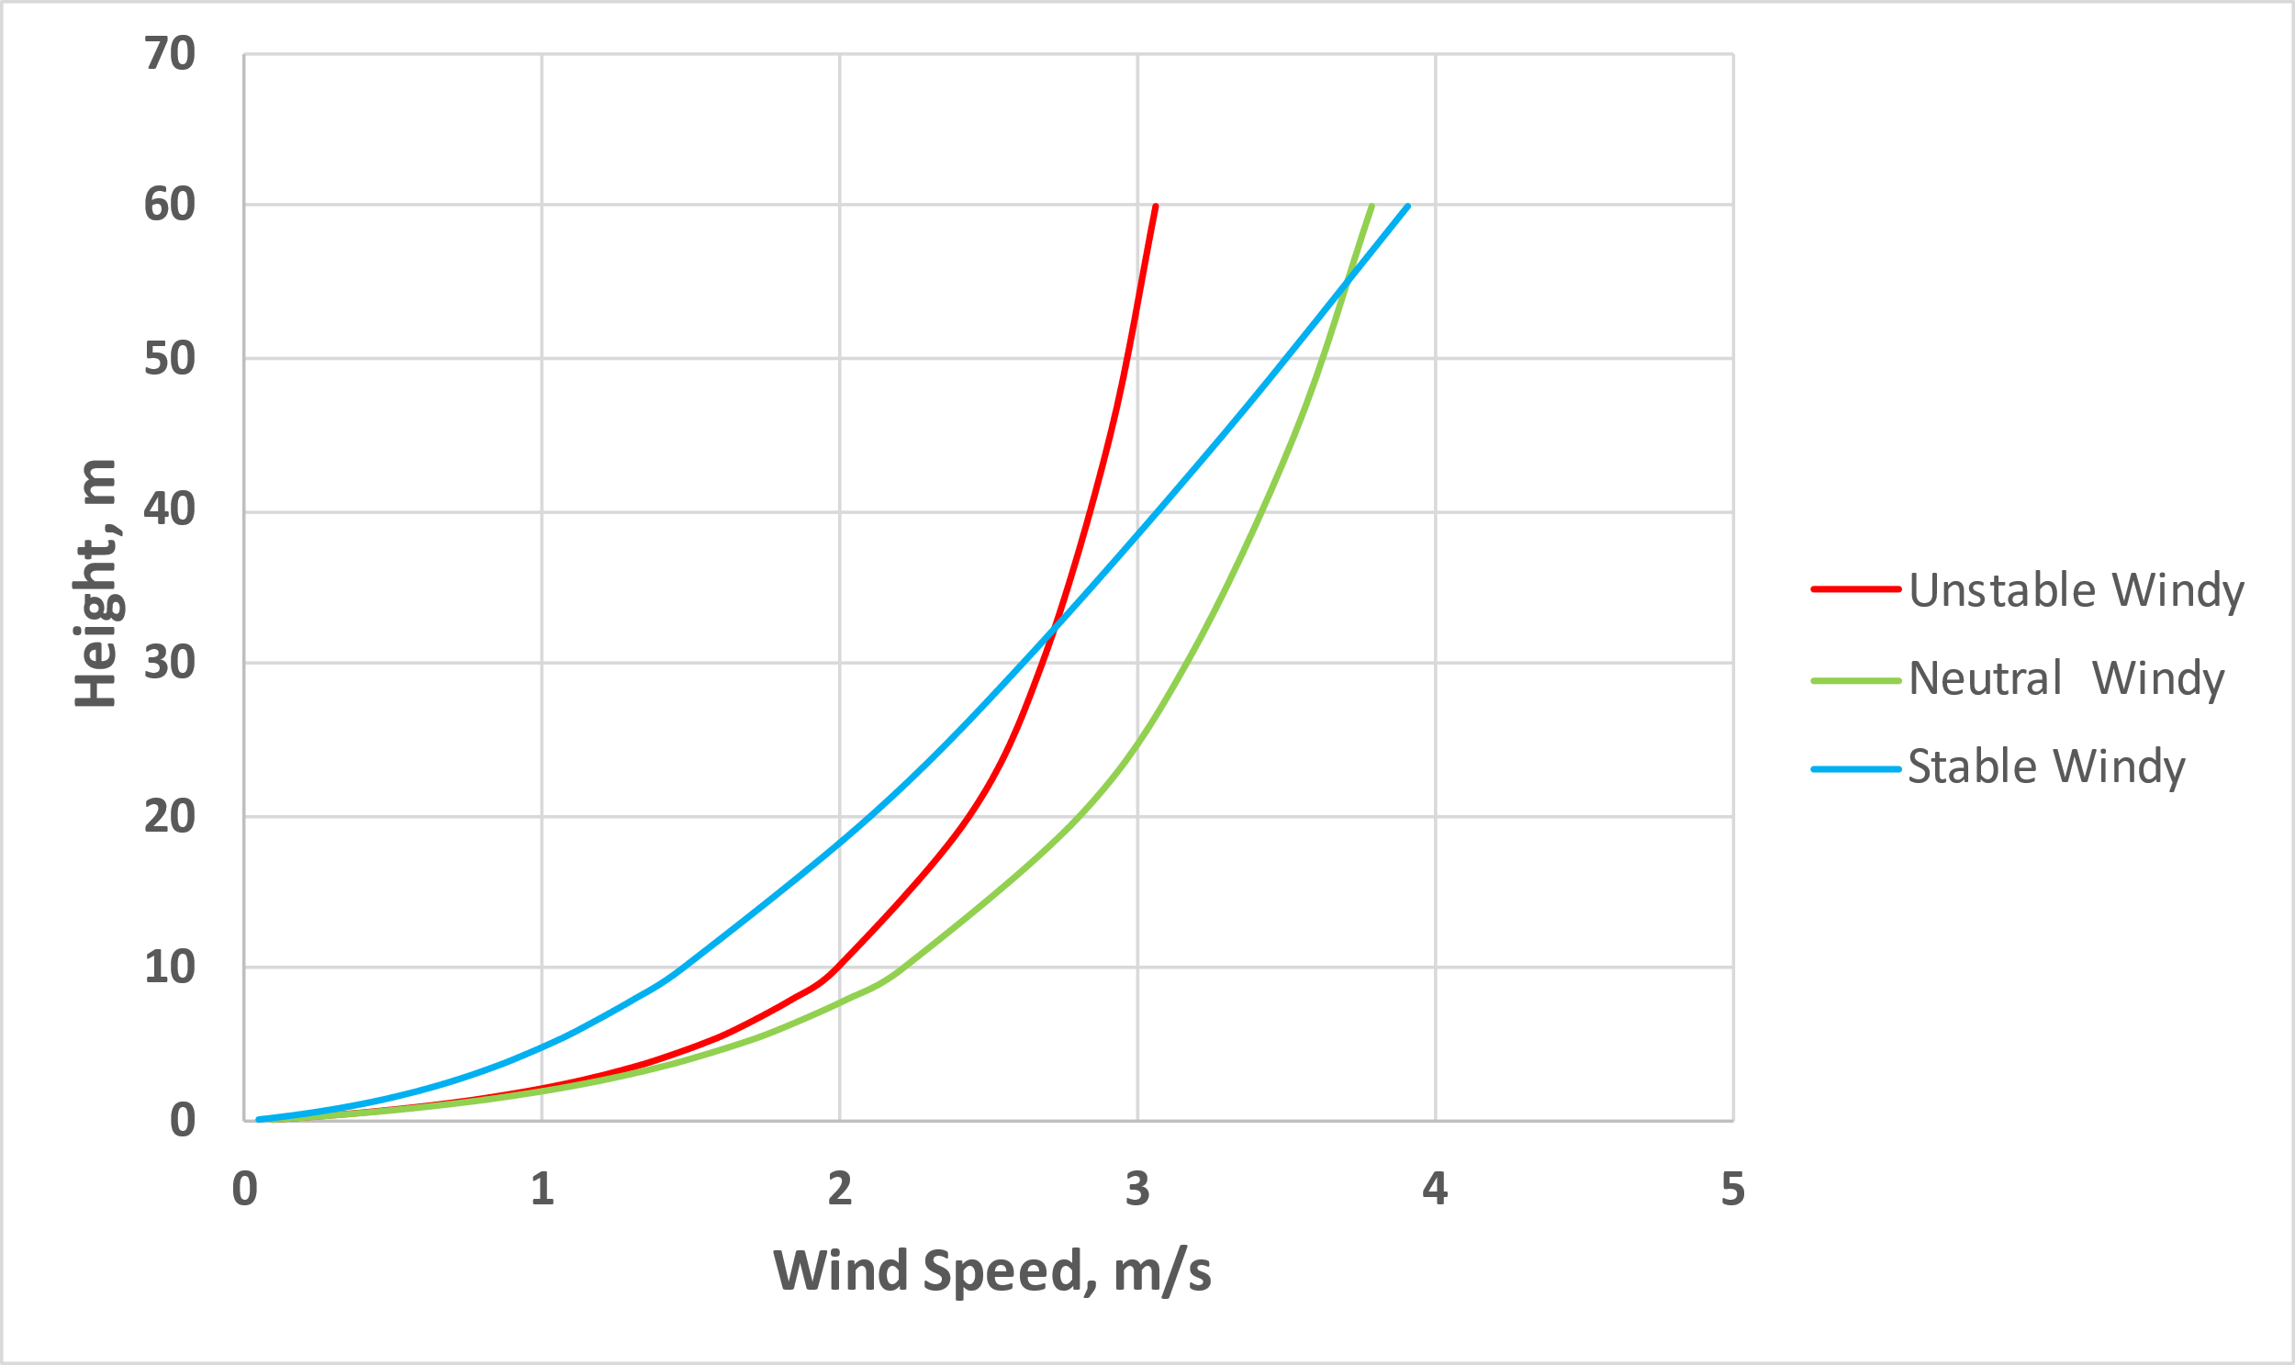
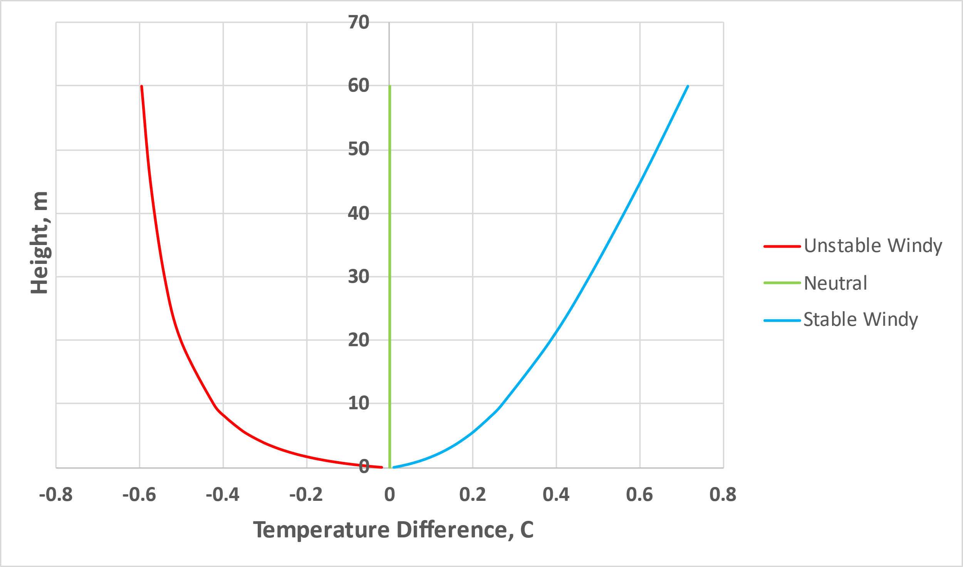
Meteorological Data
Meteorological Conditions for Simulations
RASCAL
CFD
Data from onsite building roof
Hourly data from 2019 processed as per Pasquill Stability classification with simplification
Windiest conditions from each class modeled
Stability class | Median wind speed at 30 m (m/s) | Median temperature gradient (°C/100 m) | Wind speed at 10 m (m/s) | Friction velocity (m/s) | Monin-Obukhov length (m)
B (unstable) | 2.68 | -1.9 | 2 | 0.388 | -110
D (neutral) | 3.16 | -1.5 | 2.2 | 0.387 | ∞
F (stable) | 2.63 | 1.5 | 1.5 | 0.201 | 74
Wind inlet profiles (only for CFD)
Temperature inlet profiles (only for CFD)

Slide 6
Computational Domain (CFD)
CFD model of buildings and terrain
CNL site geometry and terrain from aerial scans
Point source surrounded by occupied buildings and hilly terrain in the near vicinity
Lateral extents of domain according to Blocken [5]
N
Numerical Method
Steady RANS using segregated form
Realizable k-ε two layer turbulence model
Boussinesq assumption for buoyancy
Passive scalar model for radionuclides
H_{max} = 25 m
Fictitious point source
Notes:
- Aerial scans by drones, imported them to StarCCM.
- Strength of CFD that this cannot be captured in more complex models.

Slide 7
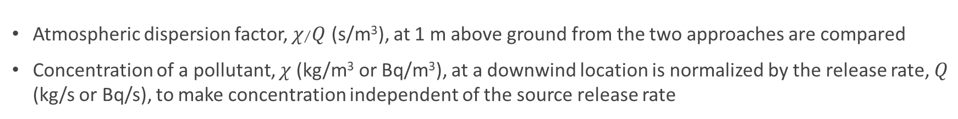
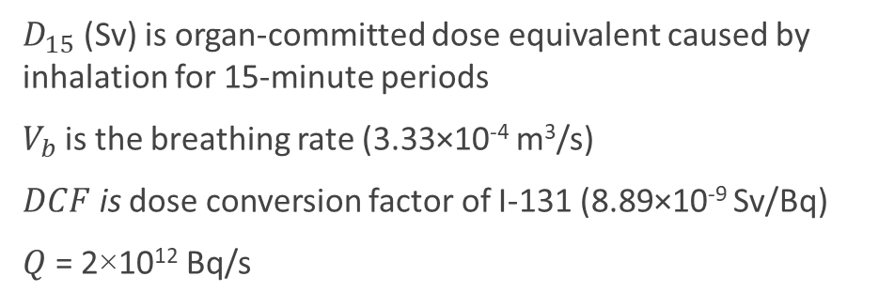

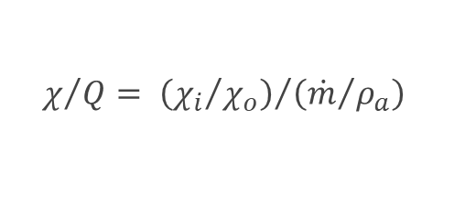
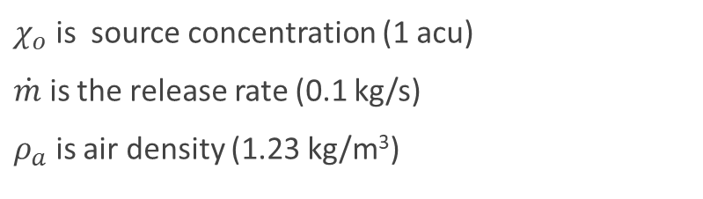
Benchmarking Parameter
Atmospheric dispersion factor, $χ/Q$ (s/m³), at 1 m above ground from the two approaches are compared
Concentration of a pollutant, $χ$(kg/m³ or Bq/m³), at a downwind location is normalized by the release rate, $Q$ (kg/s or Bq/s), to make concentration independent of the source release rate
CFD
RASCAL
$$D_{15}=V_{b}\sum_{n}{\left[{DCF}_{n}\int_{t}^{t+15}{χ_{n}\left(t\right)dt}\right]}$$
$$χ/Q= {\left({χ_{i}}/{χ_{o}}\right)}/{\left({\dot{m}}/{ρ_{a}}\right)}$$
$χ_{o}$ is source concentration (1 acu)
$\dot{m}$ is the release rate (0.1 kg/s)
$ρ_{a}$ is air density (1.23 kg/m³)
$D_{15}$ (Sv) is organ-committed dose equivalent caused by inhalation for 15-minute periods
$V_{b}$is the breathing rate (3.33×10⁻⁴ m³/s)
$DCF$ is dose conversion factor of I-131 (8.89×10⁻⁹ Sv/Bq)
$Q$ = 2×10¹² Bq/s
Notes:
- Aerial scans by drones, imported them to StarCCM.
- Strength of CFD that this cannot be captured in more complex models.

Slide 8
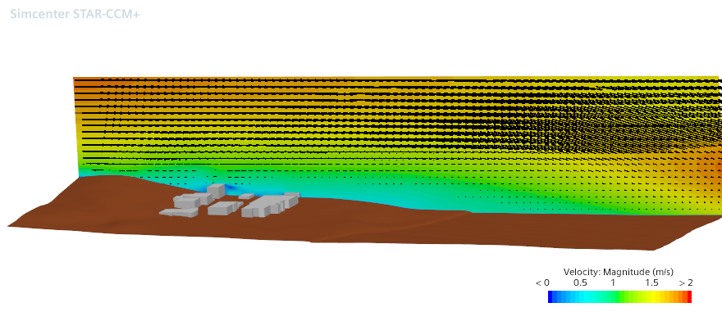
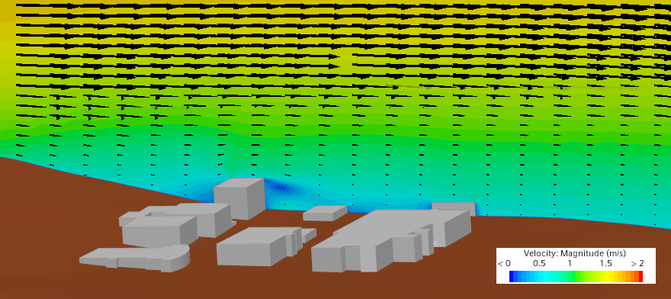
CFD Results - Wind Speed
Wind velocity along streamwise center plane of source building
Wind
Wind
Notes:
Winds from W to E
We can see ABL

Slide 9
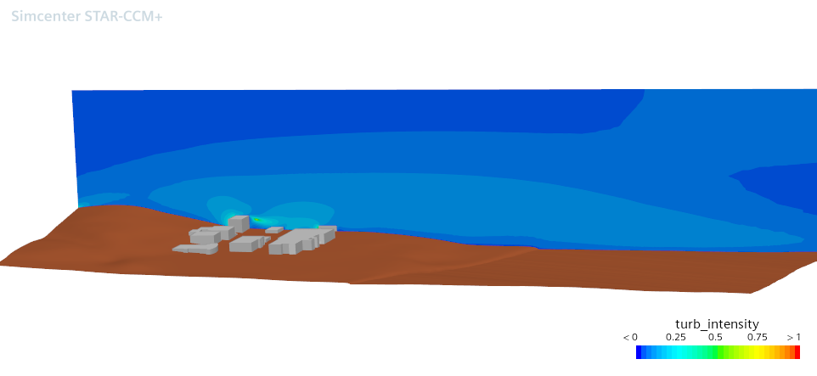
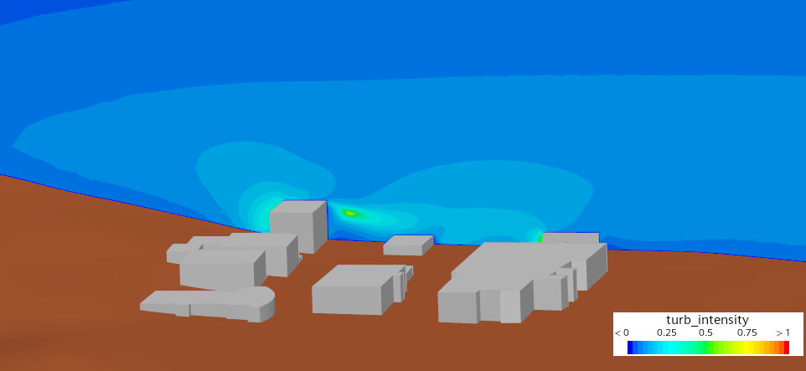
CFD Results - Turbulent Kinetic Energy
Turbulent kinetic energy along streamwise center plane of source building
Wind
Wind
Notes:
TKE also affects the mixing and dispersion of the radionuclides

Slide 10
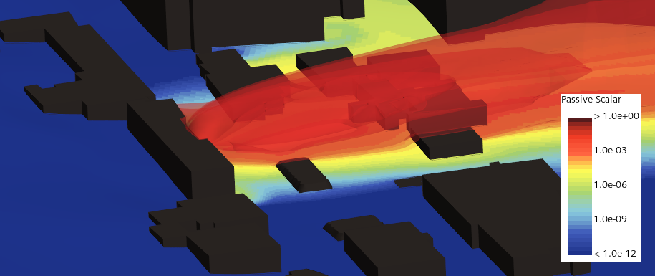
CFD Results - Plume Transport
Unstable case
Wind
Notes:
TKE also affects the mixing and dispersion of the radionuclides

Slide 11
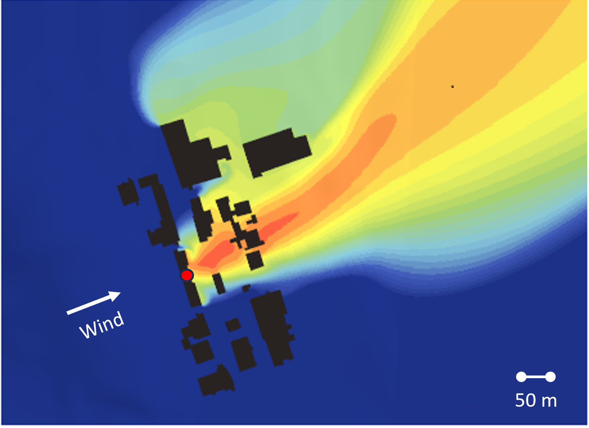
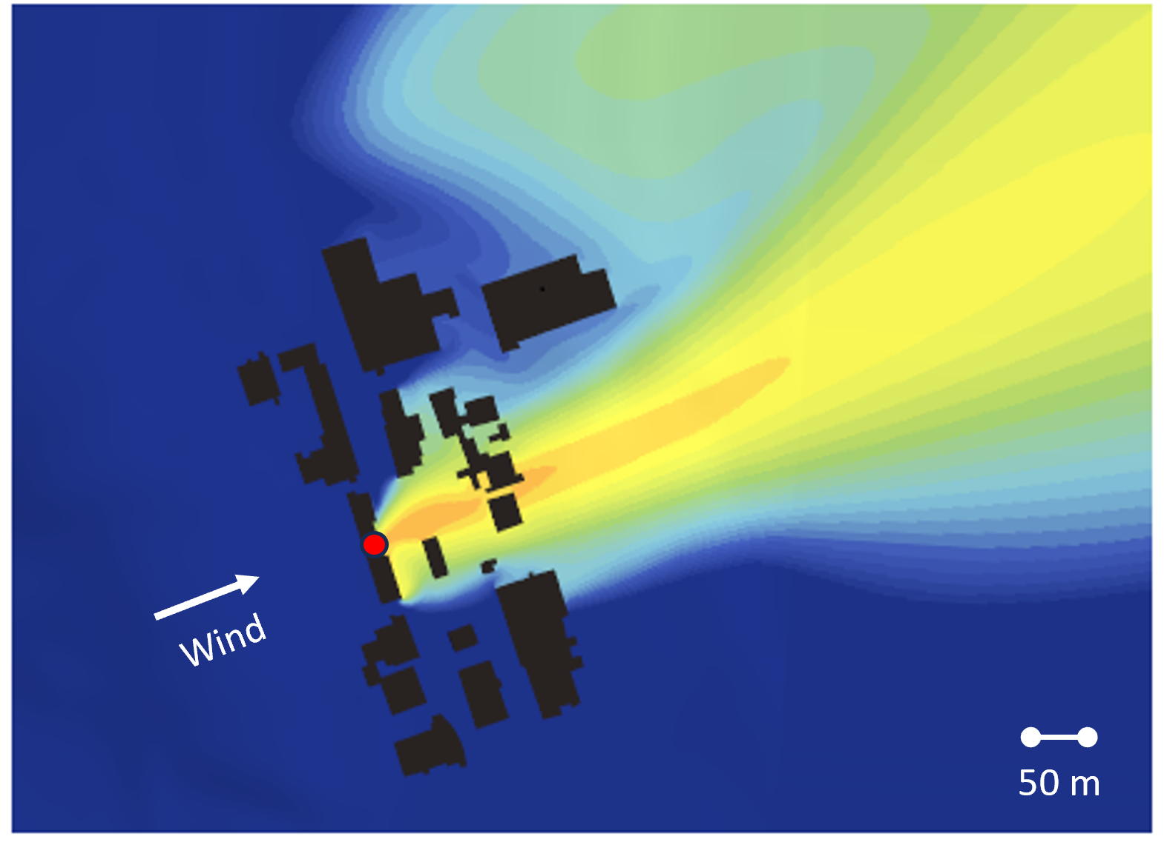
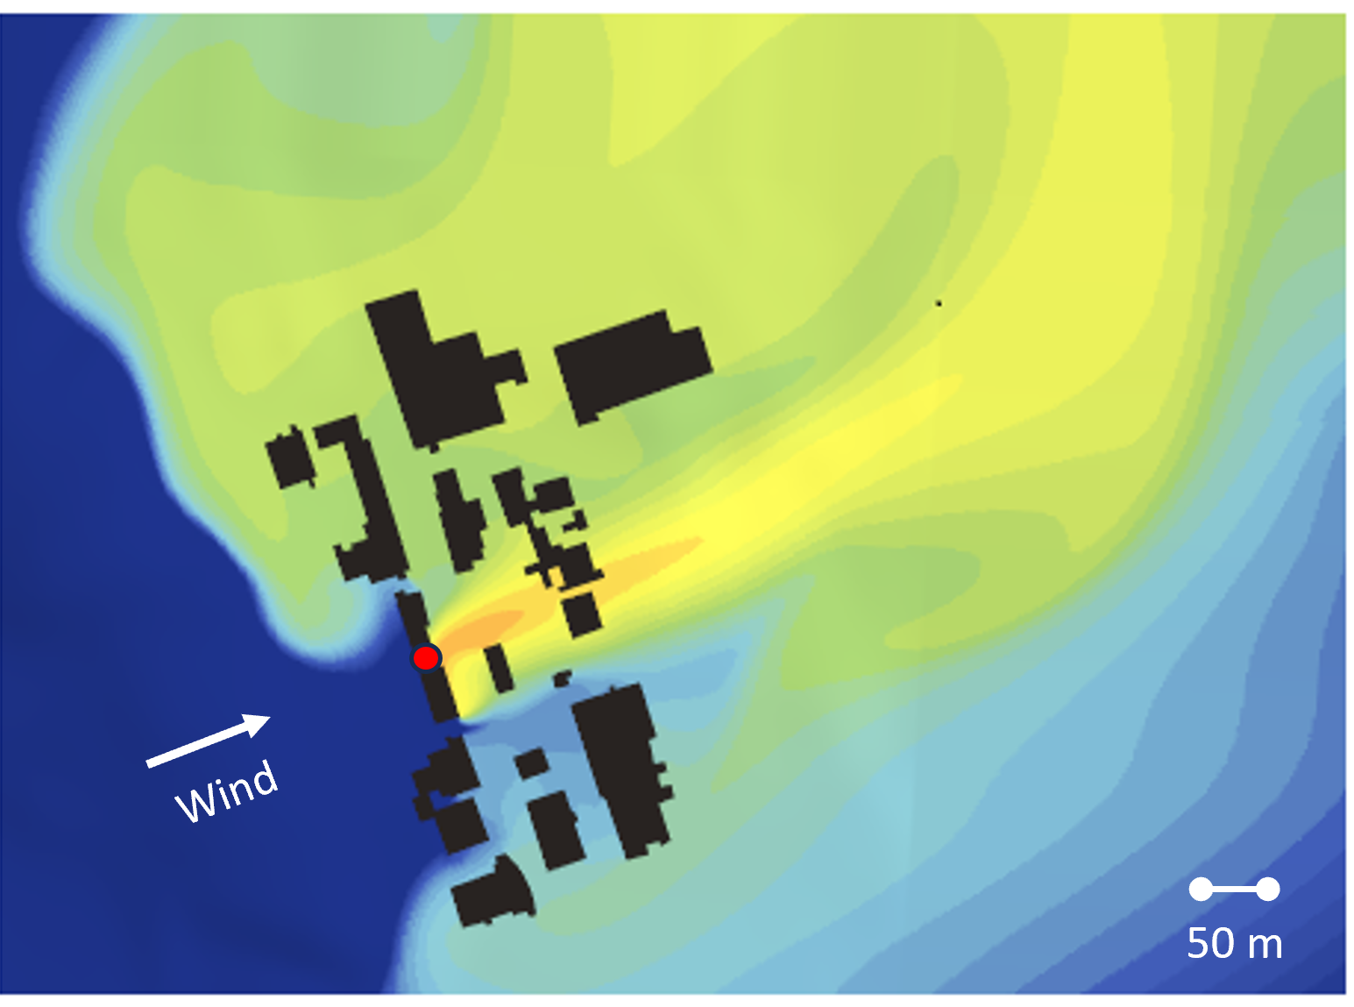
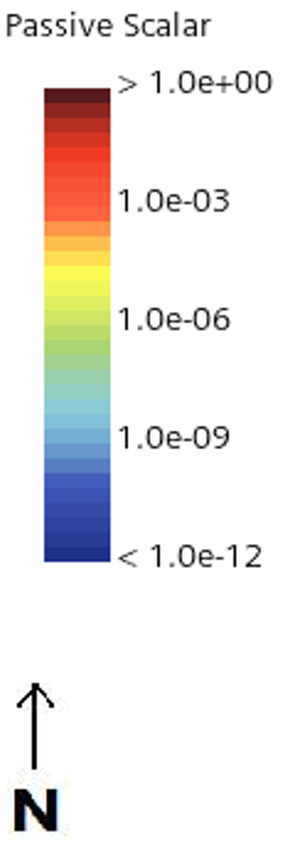
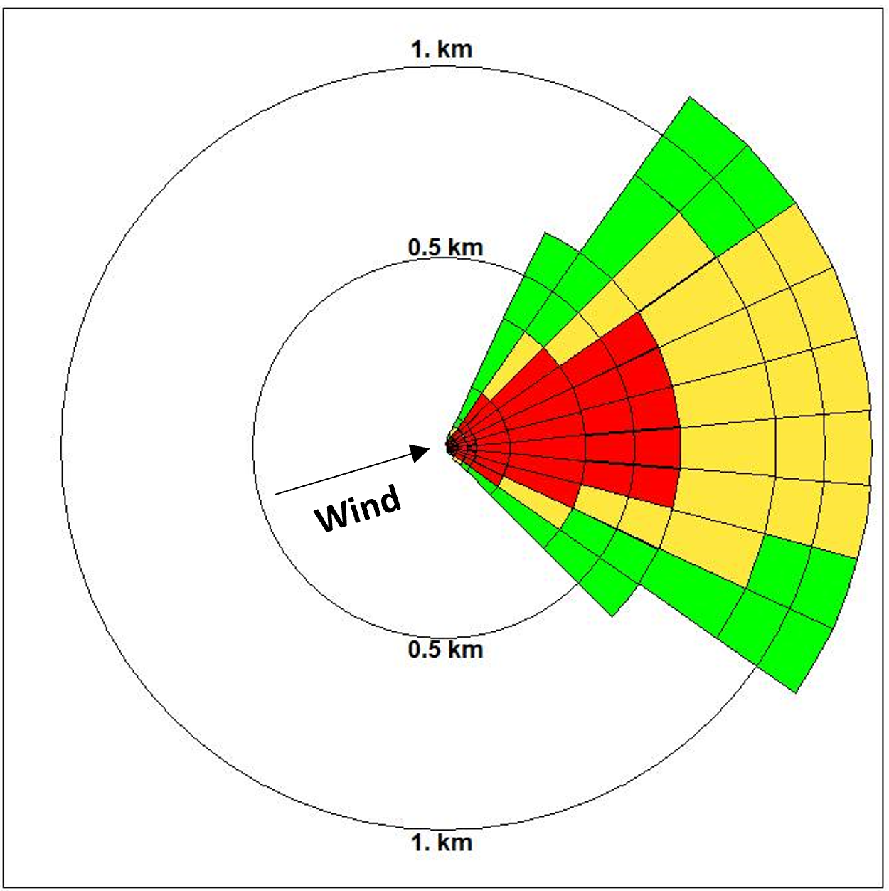
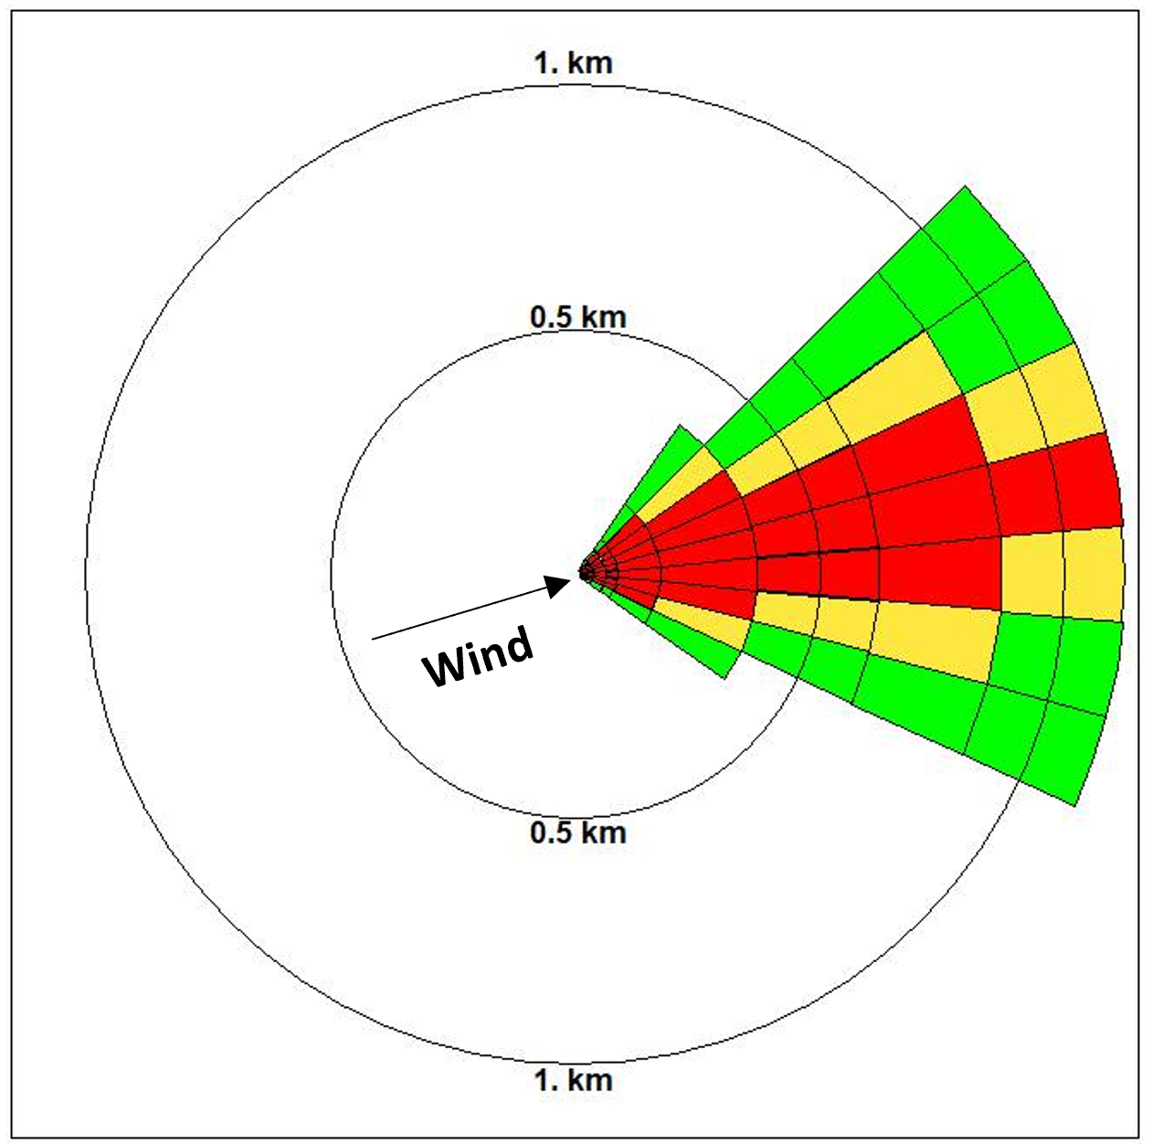
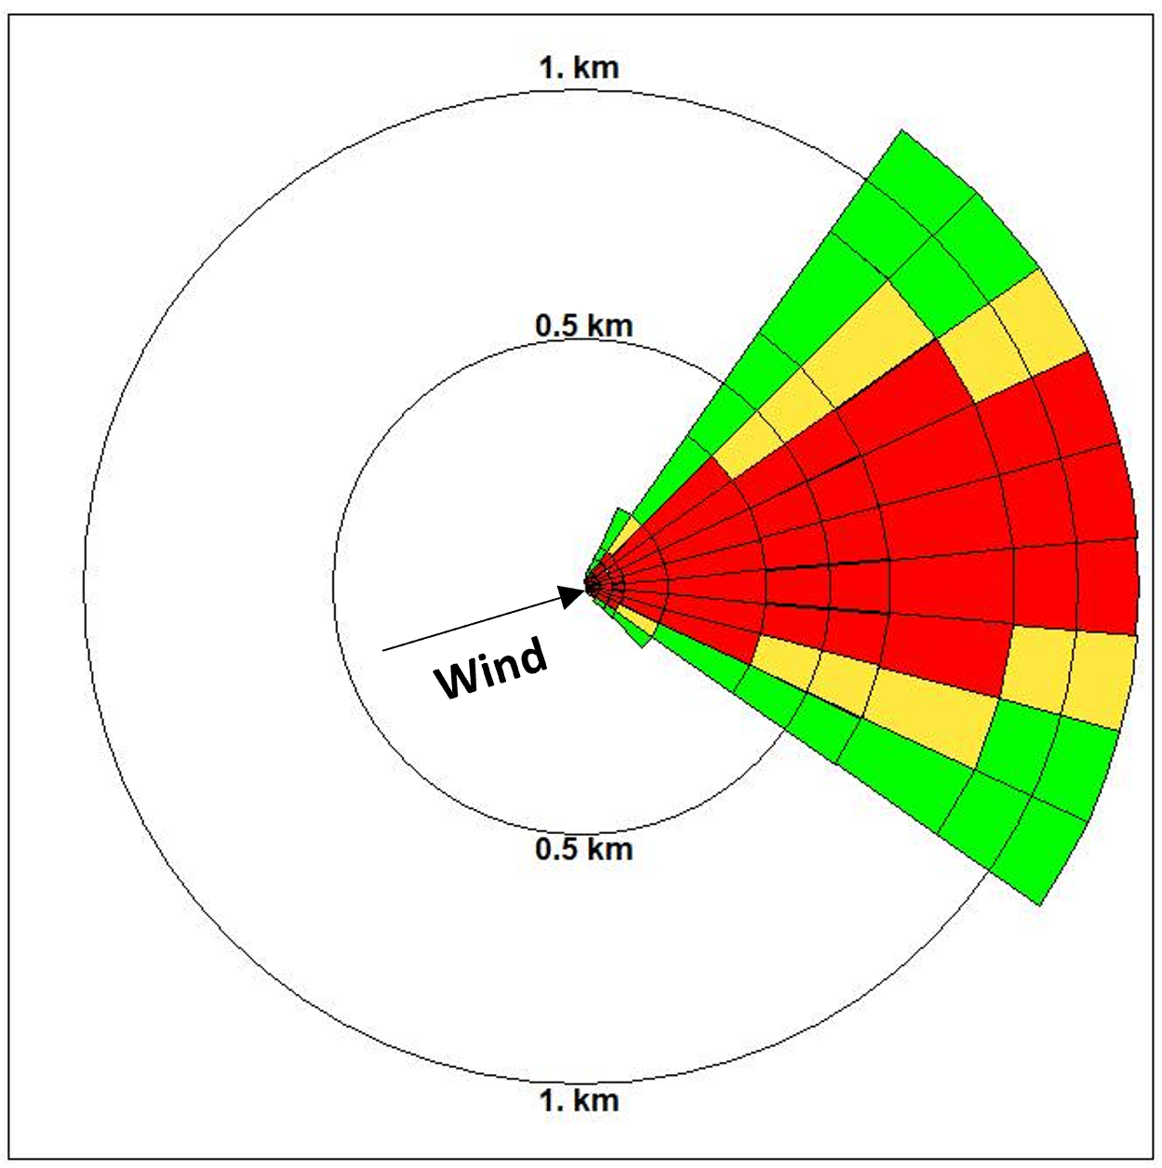
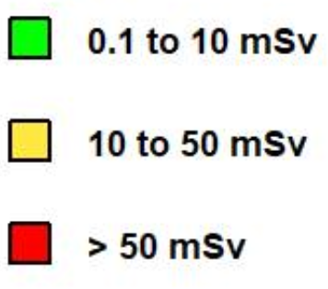
Comparison of dispersion
Unstable
Neutral
Stable
Hill effect
CFD
RASCAL
Notes:
Winds from W to E
We can see ABL

Slide 12
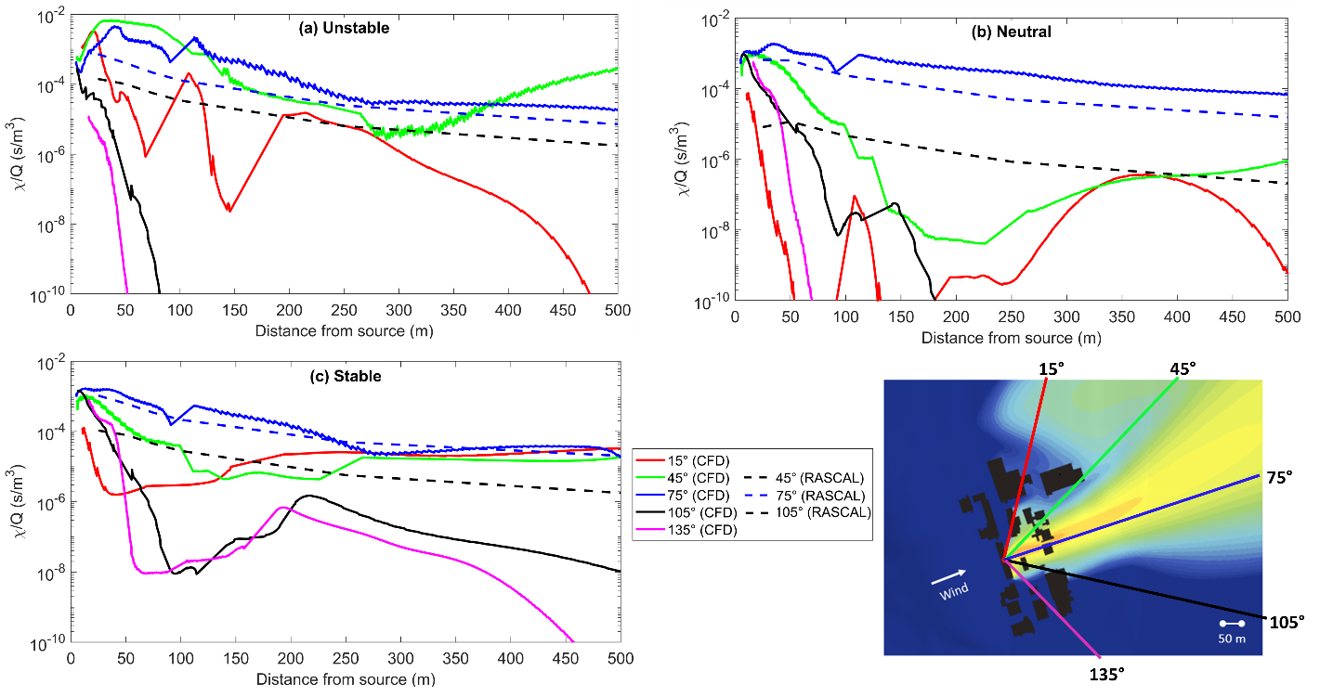
Comparison of $χ/Q$
In the near-field, along plume centerline (75°), CFD shows higher dispersion, especially in unstable case → building wake effect
CFD shows higher dispersion along 45° due to “hill effect”, and consequently lower along 105° due to mass conservation
Gaussian models cannot capture subtleties of flow dynamics caused by buildings and terrain
CFD could be in the toolkit for determination of EPZs when real buildings or complex topology present
Notes:
Winds from W to E
We can see ABL

Slide 13
References
[1] D. W. Hummel, S. Chouhan, L. Lebel, and A. C. Morreale, "Radiation dose consequences of postulated limiting accidents in small modular reactors to inform emergency planning zone size requirements," Annals of Nuclear Energy, vol. 137, 2020, https://doi: 10.1016/j.anucene.2019.107062.
[2] H. Jeong, M. Park, H. Jeong, W. Hwang, E. Kim, and M. Han, “Terrain and building effects on the transport of radioactive material at a nuclear site,” Annals of Nuclear Energy, vol. 68, pp. 157–162, Jun. 2014, doi: https://doi.org/10.1016/j.anucene.2014.01.004.
[3] H. Snoun et al. “A Comprehensive Review of Gaussian Atmospheric Dispersion Models: Current Usage and Future Perspectives.” Euro-Mediterranean Journal for Environmental Integration, 28 Mar. 2023, https://doi.org/10.1007/s41207-023-00354-6.
‌[4] M. D. Kaminski et al. “Wide-Area Decontamination in an Urban Environment after Radiological Dispersion: A Review and Perspectives.” Journal of Hazardous Materials, vol. 305, Mar. 2016, pp. 67–86, https://doi.org/10.1016/j.jhazmat.2015.11.014.
[5] B. Blocken, "Computational Fluid Dynamics for urban physics: Importance, scales, possibilities, limitations and ten tips and tricks towards accurate and reliable simulations," Building and Environment, vol. 91, pp. 219-245, 2015, https://doi: 10.1016/j.buildenv.2015.02.015

Slide 14
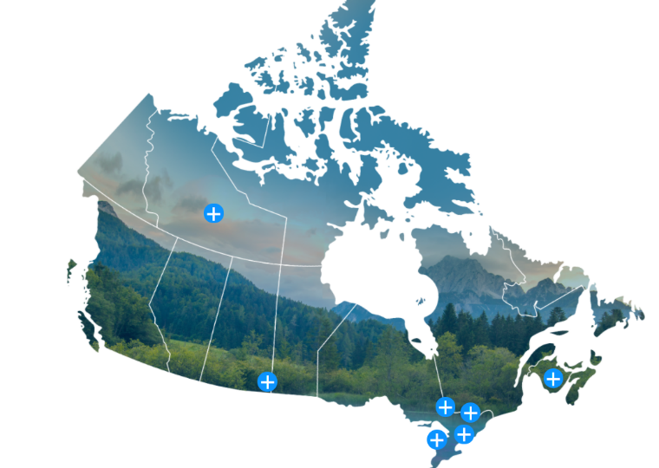
Thank you
Contact information:
Sreeyuth.Lal@cnl.ca

