Slide 2
Determining emergency planning zone size through
JRODOS calculated radiation dose consequences in high-temperature gas-cooled reactors
Piotr KOPKA
Email: Piotr.kopka@ncbj.gov.pl
Maciej SKRZYPEK, Eleonora SKRZYPEK, Aleksiej KASZKO
National Centre for Nuclear Research
Otwock-Świerk, Poland

Slide 3
Purpose of the Publication:
Postulated Severe Accident of the HTGR Reactor (MELCOR)
JRODOS (Real-Time On-Line Decision Support)
Emergency Planning Zone (EPZ)
Results
Summary and Conclusions

Slide 4
Key Points Describing the Analyzed HTGR Accident
Reactor Type: The analyzed High-Temperature Gas-Cooled Reactor (HTGR) features prismatic fuel assemblies with TRISO fuel, similar to Japan's High-Temperature Engineering Test Reactor (HTTR).
Accident Type: The focus is on the Depressurized Loss of Forced Cooling (D-LOFC) accident, a significant Design Basis Accident (DBA) that results in high maximum fuel temperatures.
Depressurization Process:
A large 65 mm break leads to rapid pressure loss, causing the reactor coolant (helium) to escape.
The reactor experiences nearly complete depressurization within 500 seconds.
This limits the cooling of the reactor core structures.
SCRAM and Decay Heat:
  Following SCRAM, decay heat is controlled by decay heat curves.
  Heat is transferred from the core to the Reactor Pressure Vessel (RPV) primarily via conduction, supported by convection and radiation.
  Graphite structures absorb heat, slowing the rise in core temperature due to the high heat capacity of graphite.
Reactor Cooling:
  The Reactor Cavity Cooling System (RCCS) cools the reactor vessel, moderating maximum fuel temperature.

Slide 5
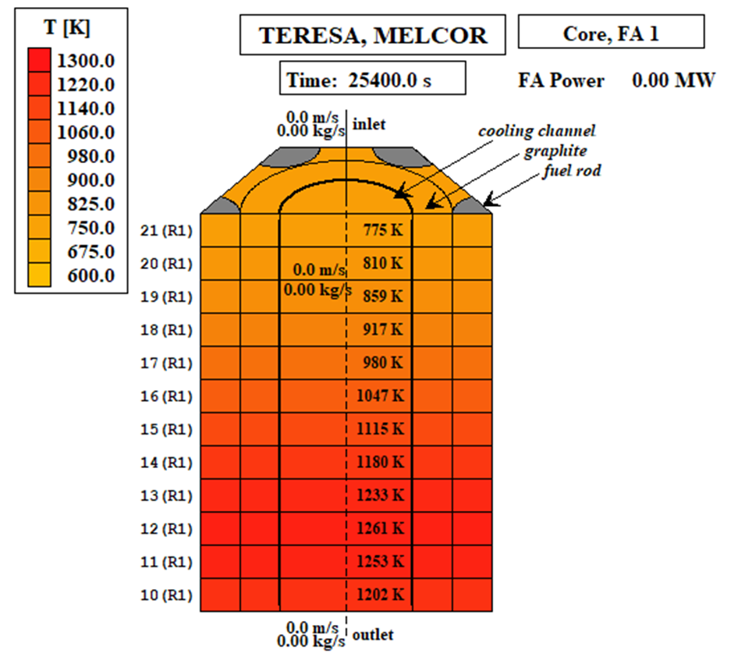
Source-term
TABLE 1. Source term for HTGR TeResa after DLOFC accident. Data is calculated using the MELCOR code.
Isotope | [Ci] | [Bq] | Isotope | [Ci] | [Bq]
Ag110m | 4,42E-03 | 1,64E+08 | Kr85m | 1,43E+00 | 5,29E+10
Ba139 | 2,12E-04 | 7,84E+06 | Kr87 | 2,88E+00 | 1,07E+11
Ba140 | 2,16E-04 | 7,99E+06 | Kr88 | 3,59E+00 | 1,33E+11
Cs134 | 5,25E+00 | 1,94E+11 | Rb86 | 6,24E-02 | 2,31E+09
Cs136 | 1,20E+00 | 4,44E+10 | Rb88 | 6,37E+01 | 2,36E+12
Cs137 | 6,97E+00 | 2,58E+11 | Sr89 | 1,61E-04 | 5,96E+06
I131 | 8,03E-01 | 2,97E+10 | Sr90 | 1,56E-05 | 5,77E+05
I132 | 1,04E+00 | 3,85E+10 | Sr91 | 2,00E-04 | 7,40E+06
I133 | 1,21E+00 | 4,48E+10 | Sr92 | 2,06E-04 | 7,62E+06
I134 | 1,25E+00 | 4,63E+10 | Xe131m | 4,22E-02 | 1,56E+09
I135 | 1,10E+00 | 4,07E+10 | Xe133 | 5,59E+00 | 2,07E+11
Kr83m | 5,89E-01 | 2,18E+10 | Xe133m | 1,80E-01 | 6,66E+09
Kr85 | 6,90E-02 | 2,55E+09 | Xe135 | 1,91E+00 | 7,07E+10
Figure 7. Temperature in the cooling channel of central block of the core: DLOFC conditions, Tmax at t = 25,400 s (BOL case). SKRZYPEK, E., MUSZYŃSKI, D., SKRZYPEK, M., DARNOWSKI, P., MALESA, J., "Pre-conceptual Design of the Research High-Temperature Gas-Cooled Reactor TeResa for Non-Electrical Applications", Energies, 15(6), 2084 (2022).
Radionuclide Release:
MELCOR simulations were used to calculate radionuclide release fractions for different chemical groups, validated by long-term release scenarios.

Slide 6

JRODOS
JRODOS is designed to assist decision-makers in mitigating the consequences of radioactive releases after a nuclear incident, applicable in national or regional emergency control centers.
Diagnostic Mode: Uses real-time local meteorological data for current situation analysis.
Prognostic Mode: Uses atmospheric dispersion models to predict the spread of radioactive substances on both local and continental scales.
Local-Scale Models: RMPP: Meteorological pre-processor, RIMPUFF: Puff diffusion model for short-range dispersion. Dipcot: Lagrangian model for local dispersion.
Long-Range Models: MATCH: Eulerian model for long-range atmospheric dispersion. LASAT: Lagrangian model for long-range scenarios, with some limitations.
Radionuclide Transfer Modeling: DEPOM: Models deposition from the atmosphere to the ground and food products. FDMT: Calculates radionuclide transfer through the food chain, requiring customization based on regional climate, agriculture, and dietary habits.

Slide 7
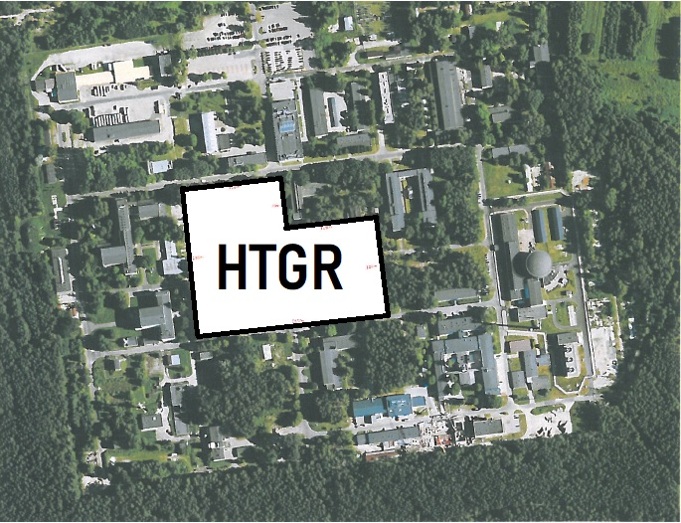
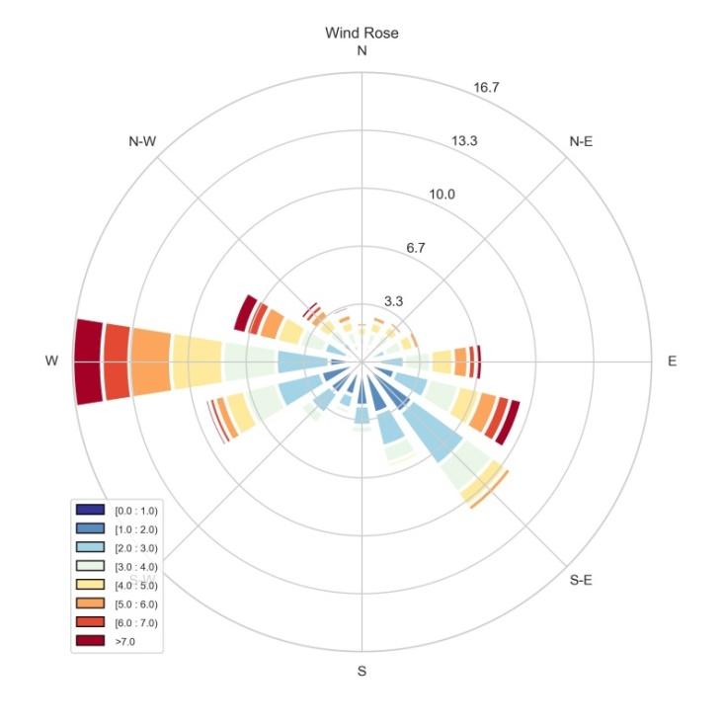
Side - NCBJ
TABLE 2. Postulated worst/conservative weather conditions obtained from measurement data and literature
Weather scenario name | Wind Speed [m/s] | Wind direction | Pasquill Stability Classes | Total rainfall 6h [mm] | Reference
EPA_1 | 1,50 | 275,00 | F | 0,00 | [20]
EPA_2 | 3,00 | 275,00 | D | 0,00 | [20]
Mdata_Comm | 3,90 | 273,00 | C | 0,10 | Fig.1
Mdata_Wwind | 0,10 | 130,00 | A | 0,00 | Fig.1
Mdata_Swind | 15,00 | 270,00 | D | 6,00 | Fig.1
FIG1. Wind rose from the Otwock Swierk location. Observation data from a period of 10 years.
[20] US EPA: “Risk Management Program Guidance for Offsite Consequence Analysis” (2009).

Slide 8
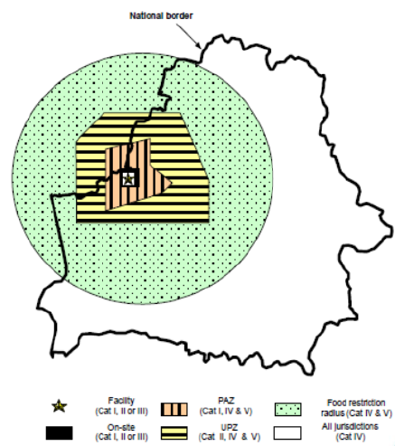
  Emergency Planning Zone
According to PAA guidelines for Category II facilities, which include research reactors, fuel processing plants, isotopic enrichment and nuclear fuel production facilities, and radioactive waste repositories, specific zones with defined limits are assessed:
The Urgent Protective Action Planning Zone (UPZ): An external zone designated for immediate intervention planning. This zone encompasses effective doses from both external and internal exposure, excluding the ingestion of radioactive substances (≥ 100 mSv) and an equivalent dose to the thyroid from the ingestion of radioactive iodine isotopes (≥ 50 mSv).
The Extended Planning Distance (EPD): A zone for expanded planning, which involves an effective dose greater than or equal to 100 mSv from both external and internal exposure, including the ingestion of radioactive substances.
The Ingestion and Commodities Planning Distance (UCPD): A zone for consumption planning and commodity control, which includes a dose of 10 mSv or more from the ingestion of food and drinking water, considering the local dietary habits of the population in the area.

Slide 9
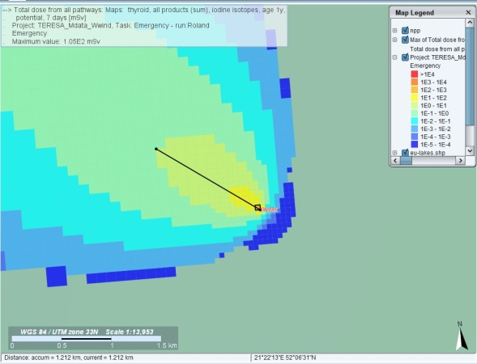
Results
 | EPA_1 |  | EPA_2 |  | Mdata_Comm |  | Mdata_Wwind |  | Mdata_Swind
Dose type | MD [mSv] | DIS [km] | MD [mSv] | DIS [km] | MD [mSv] | DIS [km] | MD [mSv] | DIS [km] | MD [mSv] | DIS [km]
Total effective dose from all exposure except ingestion | 7.46E-2 | - | 1.65E-2 | - | 5.69E-3 | - | 1.25E0 | 0.05 | 2.77E-3 | -
Total dose from all pathways Thyroid iodine | 7.60E0 | 1.1 | 1.56E0 | 0.3 | 6.17E-1 | - | 1.05E2 | 1.212 | 6.19E-2 | -
Total dose from all pathways | 9.29E-1 | - | 1.99E-1 | - | 8.88E-2 | - | 1.45E1 | 0.494 | 1.21E-2 | -
Ingestion dose all nuclides | 8.53E-1 | - | 1.82E-1 | - | 8.20E-2 | - | 1.32E1 | 0.458 | 9.32E-3 | -
TABLE 3. Maximum values (MD) ​​of different doses for different types of scenarios. The dose types correspond to the specific zones described in the Section 4. Additionally, the maximum distance (DIS) obtained to a dose of 1mSv is presented. Red color means the values are above the limits
FIG2. Total dose map from all pathways for thyroid exposure due to all iodine isotopes for a 1-year-old child over a 7-day period, based on the scenario Mdata_Wsind. The results were generated using the JRODOS system.

Slide 10
  SUMMARY AND CONCLUSIONS #1
Importance of Weather Scenarios:
The choice of weather scenarios is critical for calculating zones and areas affected by radioactive releases. Conservative weather assumptions, such as stability class A and low wind speeds (around 0.1 m/s), can greatly influence dose values and distances.
Regulatory Recommendations:
Regulators should define specific weather scenarios for different locations to eliminate ambiguities and disputes between investors and regulators regarding worst-case scenarios.
Dose Thresholds for HTGR TeResa Reactor:
The threshold dose values for zones, such as the Urgent Protective Action Zone (UPZ) and Ingestion Control Protective Action Zone (ICPD), were only reached under very weak wind conditions and stability class A.
This is attributed to the low power of the reactor and the use of advanced technologies like TRISO fuel.
Source Term Determination:
Accurate determination of the source term is essential, as it significantly affects the calculated zones and areas.
The source term derived from MELCOR simulations is much lower than conservative estimates found in existing literature, which often overestimates release fractions.

Slide 11
  SUMMARY AND CONCLUSIONS #2
Comparative Analysis:
The study from Idaho National Laboratory provides insights into a different HTGR accident scenario (D-LOFC with scram without air ingress), demonstrating the need for precise calculations of release fractions relative to iodine-131.
Need for Improved Calculations:
It is crucial to verify that the proposed source term aligns with worst-case accident predictions using updated computational codes.
Conducting simulations with codes comparable to MELCOR can help accurately assess source terms.
Recommendations for HTGR and SMR:
For low-power HTGR reactors, precise calculations of radionuclide transport following severe accidents should be performed using Computational Fluid Dynamics (CFD) codes for better hazard assessment.
Establishment of Guidelines:
It is recommended to create a definitive list of required weather conditions for which EPZs and distances should be calculated to prevent overly favorable assumptions.
Areas of interest should be grouped based on similar weather conditions, akin to EPA recommendations for dispersion modeling, to ensure rigorous analysis of severe accidents in nuclear facilities.

Slide 12
  THANK YOU FOR YOUR ATTENTION
[1] SKRZYPEK, E., MUSZYŃSKI, D., SKRZYPEK, M., DARNOWSKI, P., MALESA, J., "Pre-conceptual Design of the Research High-Temperature Gas-Cooled Reactor TeResa for Non-Electrical Applications", Energies, 15(6), 2084 (2022).
[2] DĄBROWSKI, M., et al., “Concept of the polish high temperature gas-cooled reactor HTGR-POLA”, Nuclear Engineering and Design, Volume 424, 2024,
[4] SKRZYPEK, M., et al., “Study on the DLOFC accident of the GEMINI+ conceptual design of HTGR reactor with MELCOR and [9] SPECTRA” J. Phys.: Conf. Ser. 2048, 2021
BARESCUT, J., LARIVIERE, D., STOCKI, T., RASKOB, W., TRYBUSHNYI, D., IEVDIN, I., ZHELEZNYAK, M., "JRODOS: Platform for Improved Long Term Countermeasures Modelling and Management", Radioprotection, 46(6), S731-S736 (2011).
[20] US EPA: “Risk Management Program Guidance for Offsite Consequence Analysis” (2009).
[21] PREZES PAŃSTWOWEJ AGENCJI ATOMISTYKI, "Wyznaczanie Stref Planowania Awaryjnego Oraz Rozszerzających Je Dystansów Wokół Jednostki Organizacyjnej Wykonującej Działalność Zakwalifikowaną do I Lub II Kategorii Zagrożeń: Zalecenia Organizacyjno-Techniczne", Warszawa (2021).
[22] HUMMEL, D. W., CHOUHAN, S., LEBEL, L., MORREALE, A. C., "Radiation Dose Consequences of Postulated Limiting Accidents in Small Modular Reactors to Inform Emergency Planning Zone Size Requirements", (2020).

