Slide 1
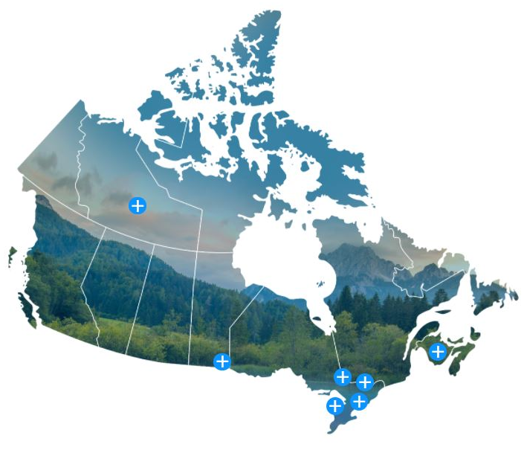
A Method for Sizing Emergency Planning Zones around Small Modular Reactors and New Reactor Technologies
David Hummel, Luke Lebel, John Cui, and Sohan Chouhan
International Conference on Small Modular Reactors and their Applications
21-25 October 2024, Vienna, Austria
153-120200-001-000

Slide 2
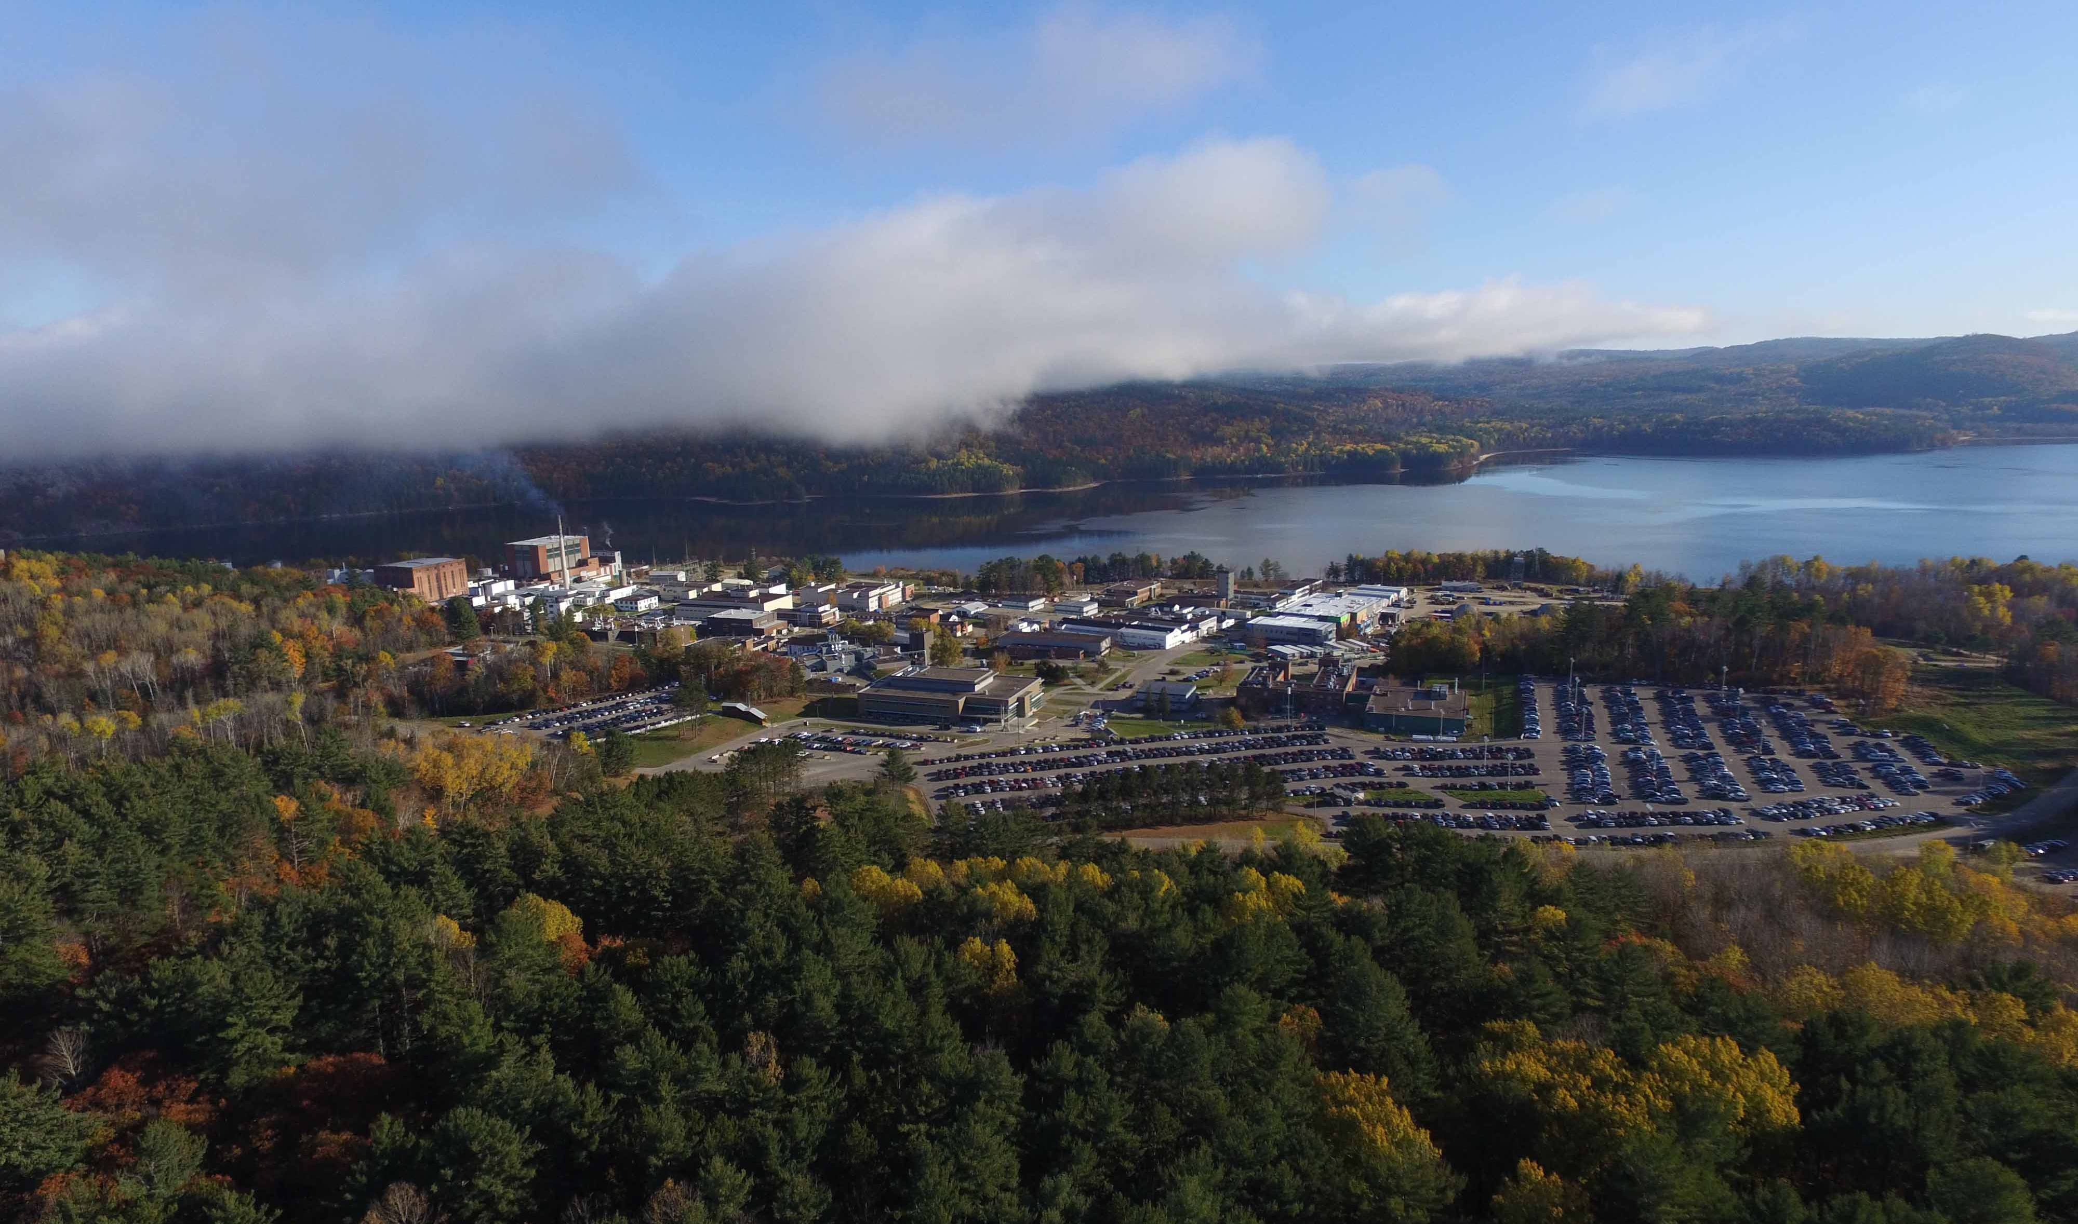
Outline
Introduction to emergency planning zones
Optimisation of protective actions taken in response to an emergency
Proposed EPZ evaluation method
Results of demonstration case study
Next steps
Chalk River Labs (CRL) site in 2015

Slide 3
Emergency Planning Zone (EPZ)
Definition
“…the regions encapsulating the advanced planning areas [for prompt or urgent response areas] and the planning distances [designated during the response as a result of evolving accidents]. Advanced emergency planning should be conducted in order to avoid or minimize severe deterministic effects, reasonably reduce stochastic effects and mitigate consequences of the accident at its source.”
SMR Regulators’ Forum, referencing IAEA General Safety Requirements No. GSR Part 7

Slide 4
Types of EPZ in Canada
CSA N1600:21 General Requirements for Nuclear Emergency Management Programs
Automatic Action Zone (AAZ): Area surrounding the plant where pre-planned actions are taken by default upon declaration of a general emergency. Aim to prevent deterministic health effects.
(IAEA analog is precautionary action zone, PAZ)
Detailed Planning Zone (DPZ): Area where pre-planned actions are taken as needed based on known conditions, modeling, and environmental monitoring. Aim to reduce stochastic health effects.
(IAEA analog is urgent action zone, UPZ)
Limit of “EPZ” per IAEA definition
Contingency Planning Zone (CPZ): Area with contingency planning & arrangements to allow protective actions to be extended past DPZ as needed. Aim to reduce chance of exposure.
(IAEA analog is extended planning distance, EPD)
Ingestion Planning Zone (IPZ): Area where arrangements are made to protect the food chain and restrict the distribution of potentially contaminated products.
(IAEA analog is ingestion and commodities planning distance, ICPD)
Site boundary

Slide 5
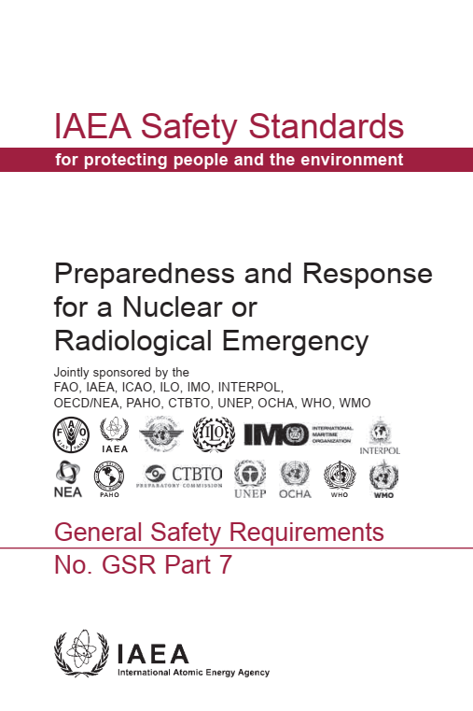
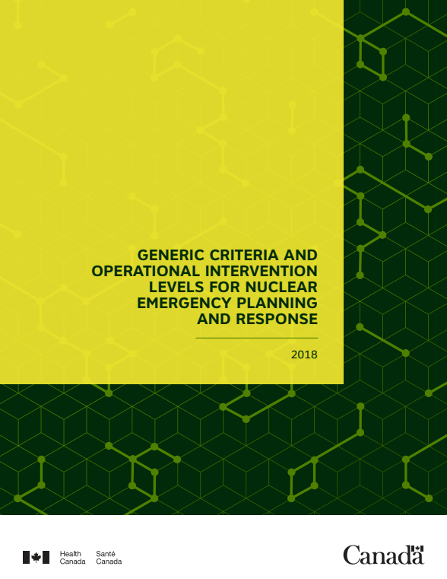
Optimisation of Emergency Response Actions
Justification
Projected radiation doses used to trigger response actions are called “generic criteria.”
Urgent protective actions can include:
  Stable iodine thyroid blocking
  Sheltering in place
  Evacuation
Protective actions are justified when a net benefit is achieved, and this net benefit should be maximized considering prevailing circumstances and non-radiological factors.
Over-prescription of protective actions meant to address just a radiological hazard* could lead to net negative health outcomes.
Generic criteria in Appendix II
Generic criteria in Section 5
https://www-pub.iaea.org/
MTCD/Publications/PDF/P_1708_web.pdf
https://publications.gc.ca/collections/collection_2018/sc-hc/H129-86-2018-eng.pdf
*when projected doses are below the reference level of 100 mSv (acute or annual)

Slide 6
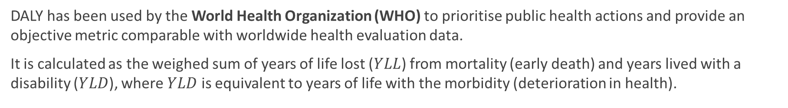

Measurement of Health Outcomes
Disability-Adjusted Life Year (DALY)
DALY has been used by the World Health Organization (WHO) to prioritise public health actions and provide an objective metric comparable with worldwide health evaluation data.
It is calculated as the weighed sum of years of life lost ($YLL$) from mortality (early death) and years lived with a disability ($YLD$), where $YLD$ is equivalent to years of life with the morbidity (deterioration in health).
$$DALY=YLL+YLD$$
1 $DALY$ is one lost year of healthy life without the burden of disease.

Slide 7
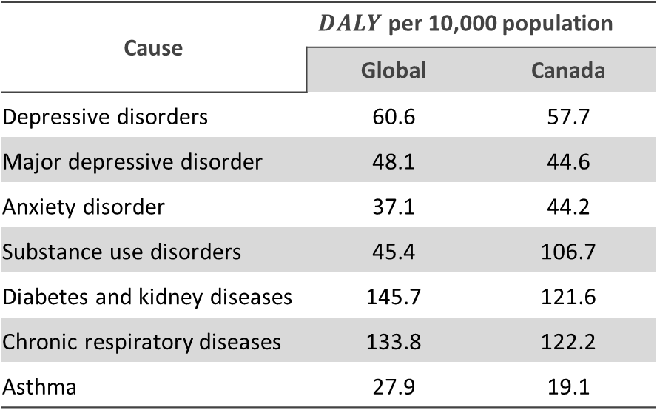
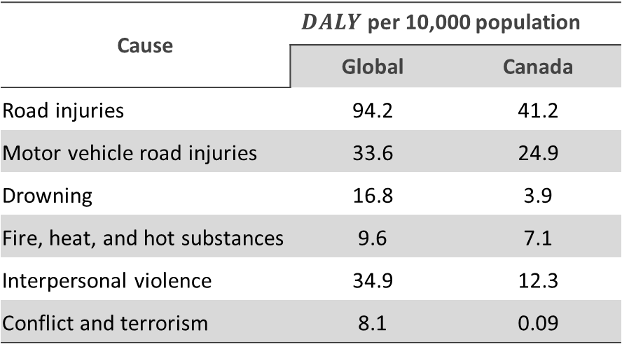
Measurement of Health Outcomes
Disability-Adjusted Life Year (DALY)
Cause | $DALY$ per 10,000 population
 | Global | Canada
Depressive disorders | 60.6 | 57.7
Major depressive disorder | 48.1 | 44.6
Anxiety disorder | 37.1 | 44.2
Substance use disorders | 45.4 | 106.7
Diabetes and kidney diseases | 145.7 | 121.6
Chronic respiratory diseases | 133.8 | 122.2
Asthma | 27.9 | 19.1
Cause | $DALY$ per 10,000 population
 | Global | Canada
Road injuries | 94.2 | 41.2
Motor vehicle road injuries | 33.6 | 24.9
Drowning | 16.8 | 3.9
Fire, heat, and hot substances | 9.6 | 7.1
Interpersonal violence | 34.9 | 12.3
Conflict and terrorism | 8.1 | 0.09
Data from Global Burden of Disease Study 2019 (GBD 2019) Data Resources https://ghdx.healthdata.org/gbd-2019

Slide 8
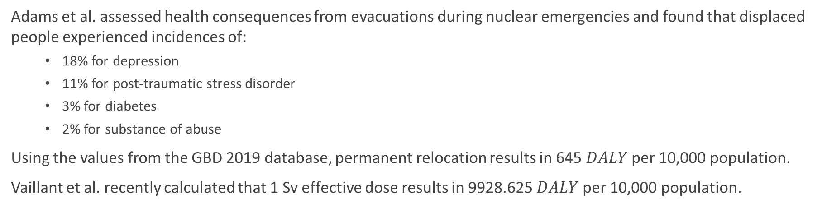
Measurement of Health Outcomes
Disability-Adjusted Life Year (DALY)
Adams et al. assessed health consequences from evacuations during nuclear emergencies and found that displaced people experienced incidences of:
18% for depression
11% for post-traumatic stress disorder
3% for diabetes
2% for substance of abuse
Using the values from the GBD 2019 database, permanent relocation results in 645 $DALY$ per 10,000 population.
Vaillant et al. recently calculated that 1 Sv effective dose results in 9928.625 $DALY$ per 10,000 population.
ADAMS, T., MACMILLAN, L., CASAGRANDE, R., OSBORN, M., HUFF, A., SMITH, T., Nonradiological Health Consequences from Evacuation and Relocation, NUREG/CR-7285, United States Nuclear Regulatory Commission, Washington DC (2021).
VAILLANT, L., MAITRE, M., LAFRANQUE, E., SCHNEIDER, T., WASSELIN, V., Proposal of a quantitative approach integrating radioactive and chemical risks, Radioprotection 58 2 (2023) 147-155.

Slide 9
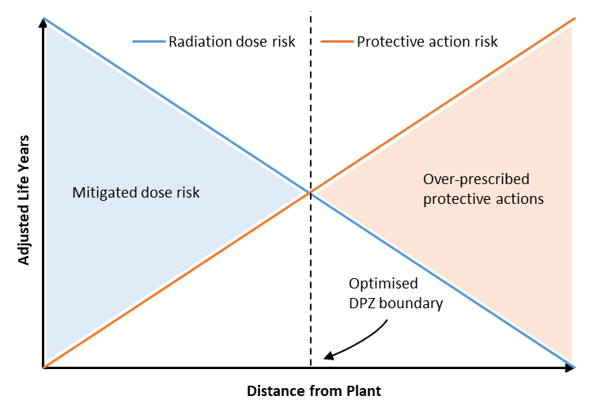
Proposed Method
Thesis: DALY of radiological and non-radiological health consequences is a basis for determining EPZ
Where radiation dose risks from plant accidents are in the same units as the risks from protective actions, there must be a threshold where protective actions are unwarranted based on optimisation of protection.
If that threshold in space (distance) for a particular event is within the site boundary, the event could be reasonably eliminated from the off-site EPR planning basis.
Risk thresholds in space are proposed as the basis for the geographical extent of AAZ (deterministic health effects) and DPZ (stochastic health effects).

Slide 10
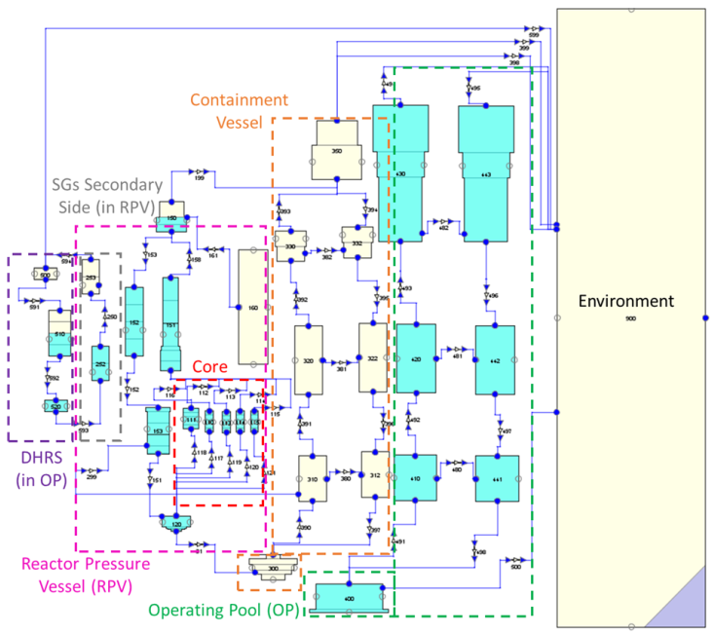
Demonstration Case Study
Source term estimation: MELCOR model of a generic small modular reactor (SMR)
A model of a generic 160 MW_{th} integral pressurized water reactor (iPWR) SMR was created with the code MELCOR.
The model predicts transient behaviour and radionuclide release to the environment (source term) under the assumptions that:
  Station blackout (SBO) has occurred.
  Alternative steam generator feed water may or may not be available after some delay.
  The decay heat removal system is operating at full or reduced capacity.
  The containment vessel is intact or has leak (break).
  The operating pool is intact or has a leak (break).
CUI, J., LEBEL, L., MORREALE, A., HUMMEL, D., MELCOR model of iPWR and application to emergency planning zone study, The 14th International Topical Meeting on Nuclear Reactor Thermal-Hydraulics, Operation, and Safety (NUTHOS-14), Canadian Nuclear Society, Vancouver (2024).
Idealization of the generic iPWR in MELCOR

Slide 11
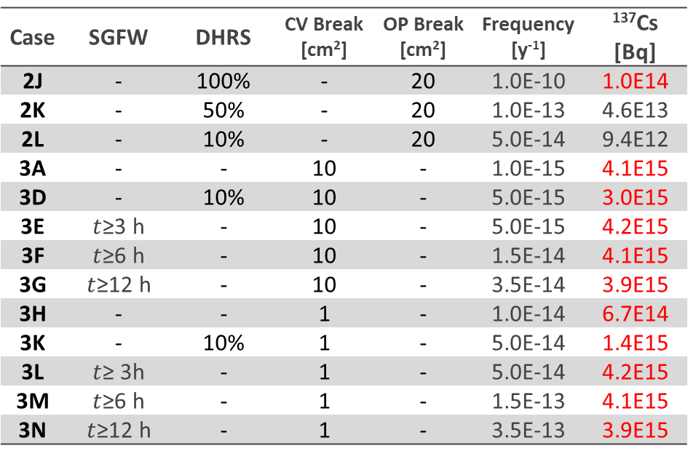
Demonstration Case Study
Source term estimation: generation of event sequences
A risk-based approach to size the EPZ was posited to incorporate many aspects of Level 2 and Level 3 probabilistic safety analysis (PSA).
The generic SMR modelled with MELCOR was not a complete design, so PSA results were not available.
Model Level 2 PSA results were created by assuming specific system failure frequencies and combinations of events.
Case | SGFW | DHRS | CV Break [cm²] | OP Break [cm²] | Frequency [y⁻¹] | ¹³⁷Cs [Bq]
2J | - | 100% | - | 20 | 1.0E-10 | 1.0E14
2K | - | 50% | - | 20 | 1.0E-13 | 4.6E13
2L | - | 10% | - | 20 | 5.0E-14 | 9.4E12
3A | - | - | 10 | - | 1.0E-15 | 4.1E15
3D | - | 10% | 10 | - | 5.0E-15 | 3.0E15
3E | $t$≥3 h | - | 10 | - | 5.0E-15 | 4.2E15
3F | $t$≥6 h | - | 10 | - | 1.5E-14 | 4.1E15
3G | $t$≥12 h | - | 10 | - | 3.5E-14 | 3.9E15
3H | - | - | 1 | - | 1.0E-14 | 6.7E14
3K | - | 10% | 1 | - | 5.0E-14 | 1.4E15
3L | $t$≥ 3h | - | 1 | - | 5.0E-14 | 4.2E15
3M | $t$≥6 h | - | 1 | - | 1.5E-13 | 4.1E15
3N | $t$≥12 h | - | 1 | - | 3.5E-13 | 3.9E15
…
…
…
…
…
…
…
Examples of different SBO permutations modelled with MELCOR.
Red indicates large release (≥10¹⁴ Bq ¹³⁷Cs).

Slide 12
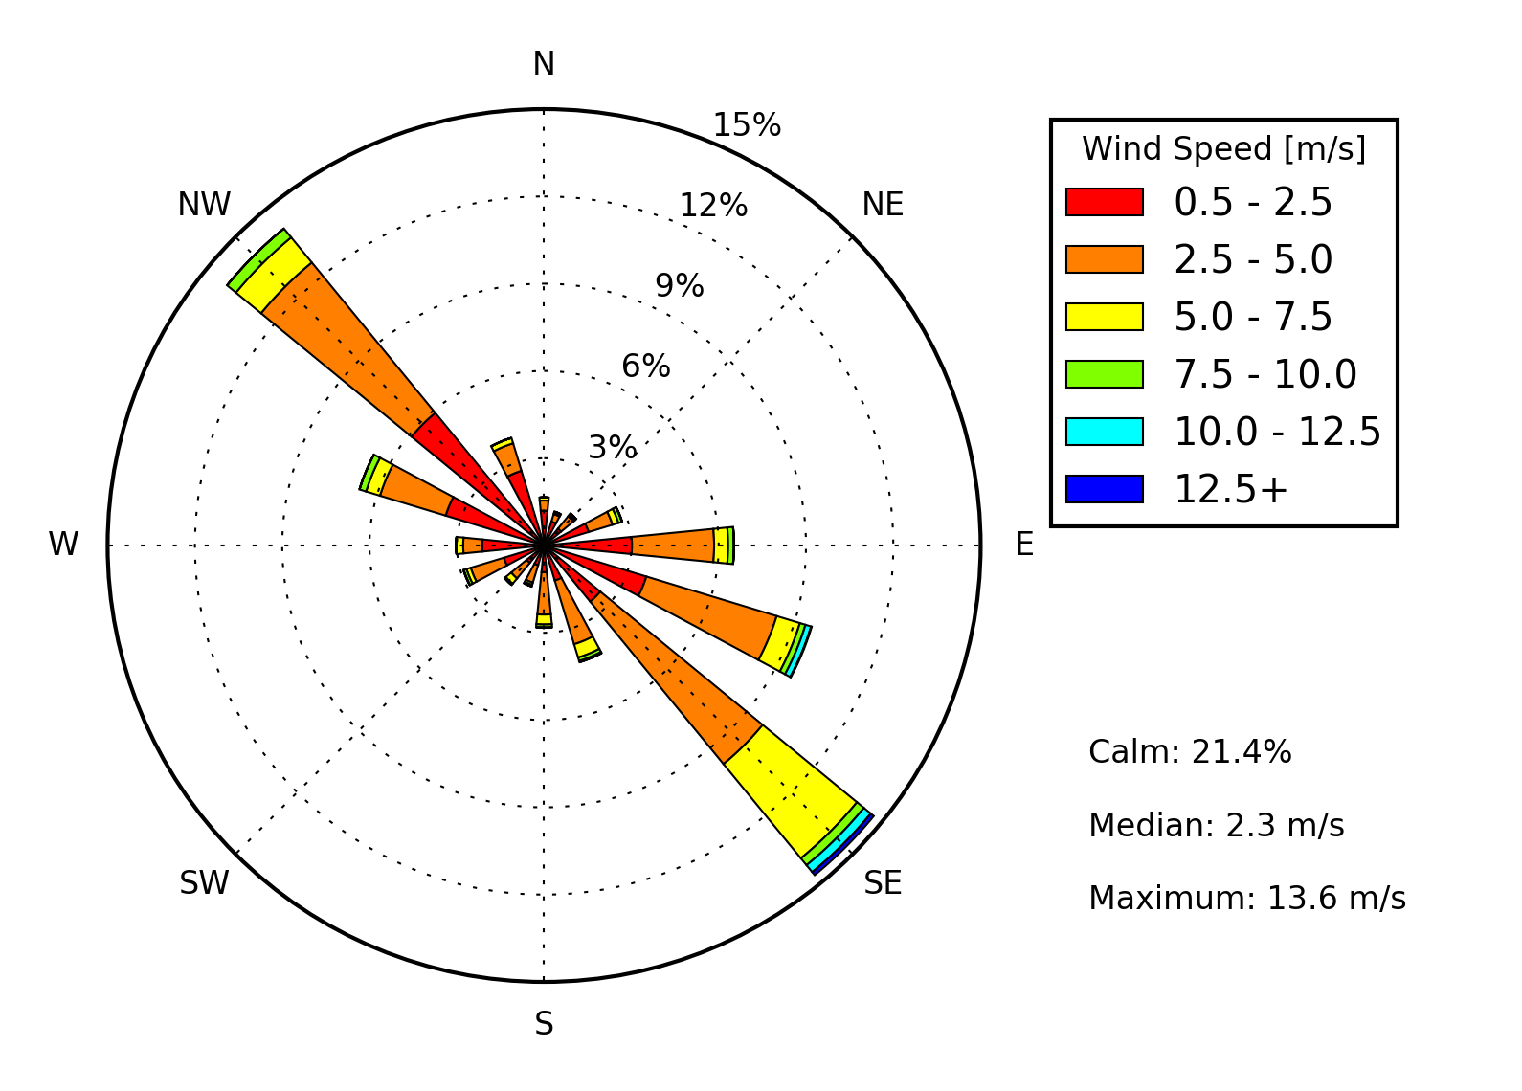
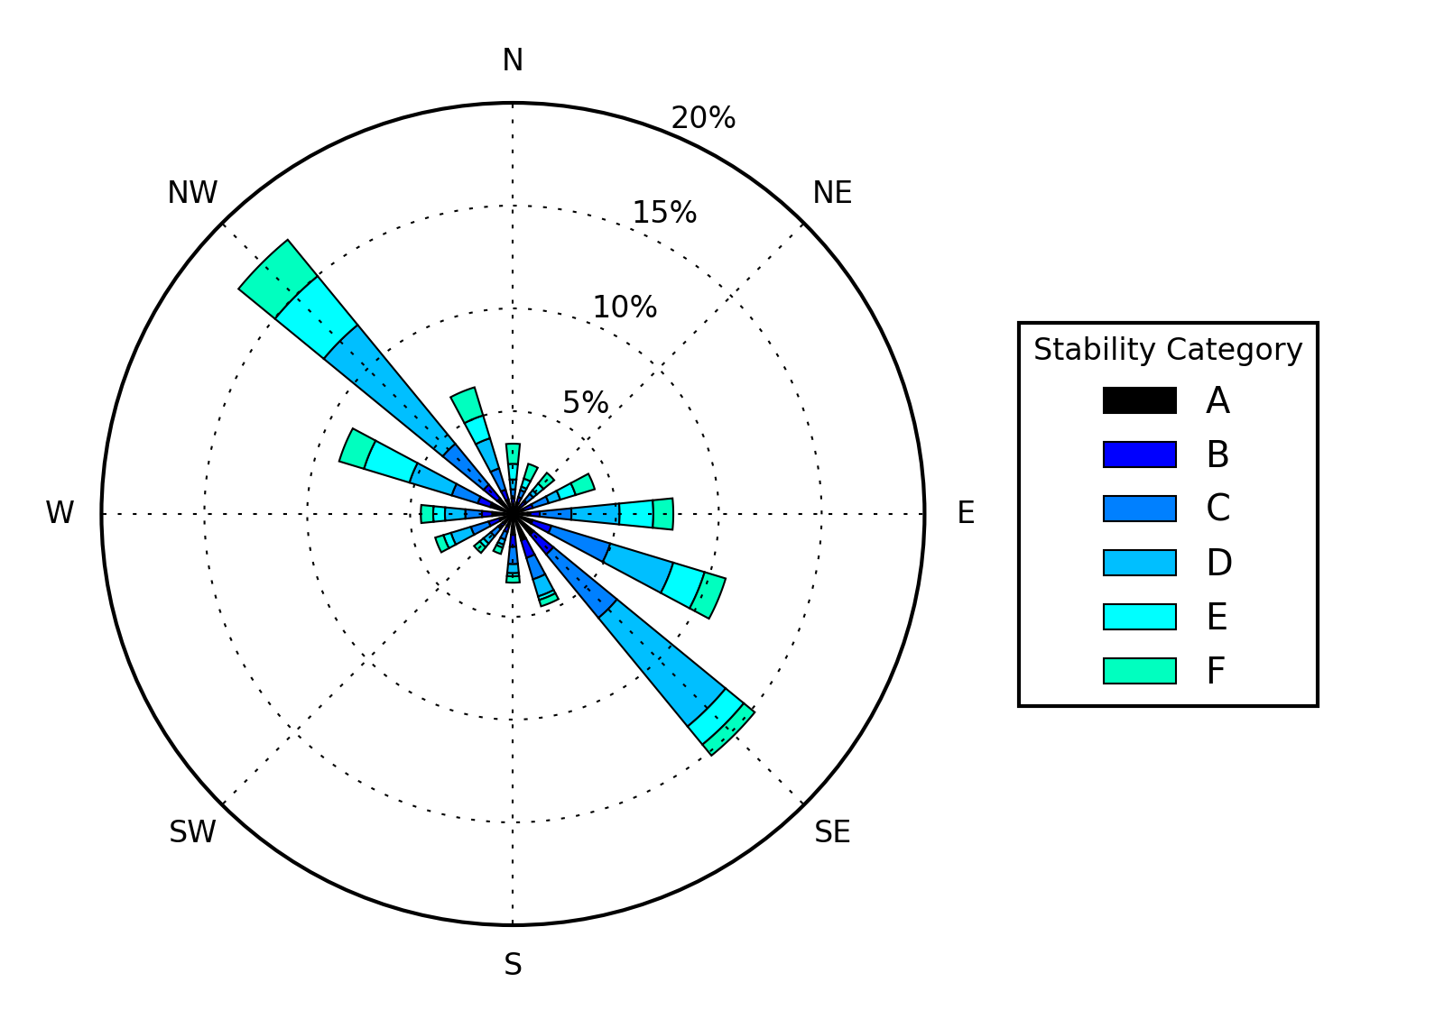
Demonstration Case Study
Dispersion and dose assessment: ADDAM
Source terms calculated by MELCOR were provided to the ADDAM code for atmospheric dispersion and dose assessment.
ADDAM is part of the industry standard toolset for nuclear safety analysis in Canada. It uses a Gaussian plume model and dose conversion factors based on ICRP* recommendations to calculate cumulative whole-body and organ-specific doses.
Meteorological data measured at the CRL site was used, assuming building wake and entrainment effects for a 120 m × 20 m structure with a 10 m height.
Calculation was performed over 16 sectors and 24 radial distances (100 m to 40 km), corresponding to 384 dose receptor mesh points.
Weather data measured at CRL site
*International Commission on Radiological Protection

Slide 13
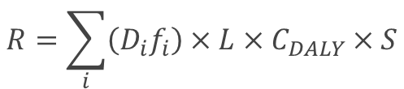
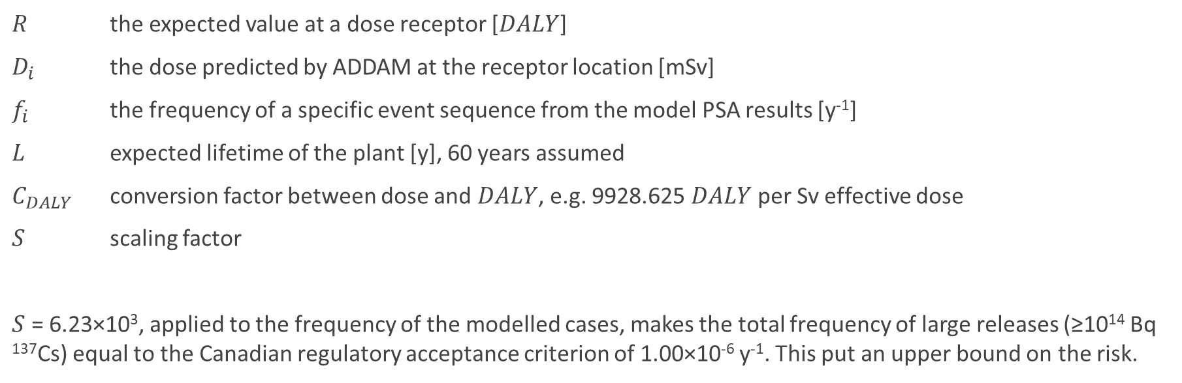
Demonstration Case Study
Determination and scaling of risks
$$R=\sum_{i}{\left(D_{i}f_{i}\right)×L×C_{DALY}×S}$$
$R$ the expected value at a dose receptor [$DALY$]
$D_{i}$ the dose predicted by ADDAM at the receptor location [mSv]
$f_{i}$ the frequency of a specific event sequence from the model PSA results [y⁻¹]
$L$ expected lifetime of the plant [y], 60 years assumed
$C_{DALY}$ conversion factor between dose and $DALY$, e.g. 9928.625 $DALY$ per Sv effective dose
$S$ scaling factor
$S$ = 6.23×10³, applied to the frequency of the modelled cases, makes the total frequency of large releases (≥10¹⁴ Bq ¹³⁷Cs) equal to the Canadian regulatory acceptance criterion of 1.00×10⁻⁶ y⁻¹. This put an upper bound on the risk.

Slide 14
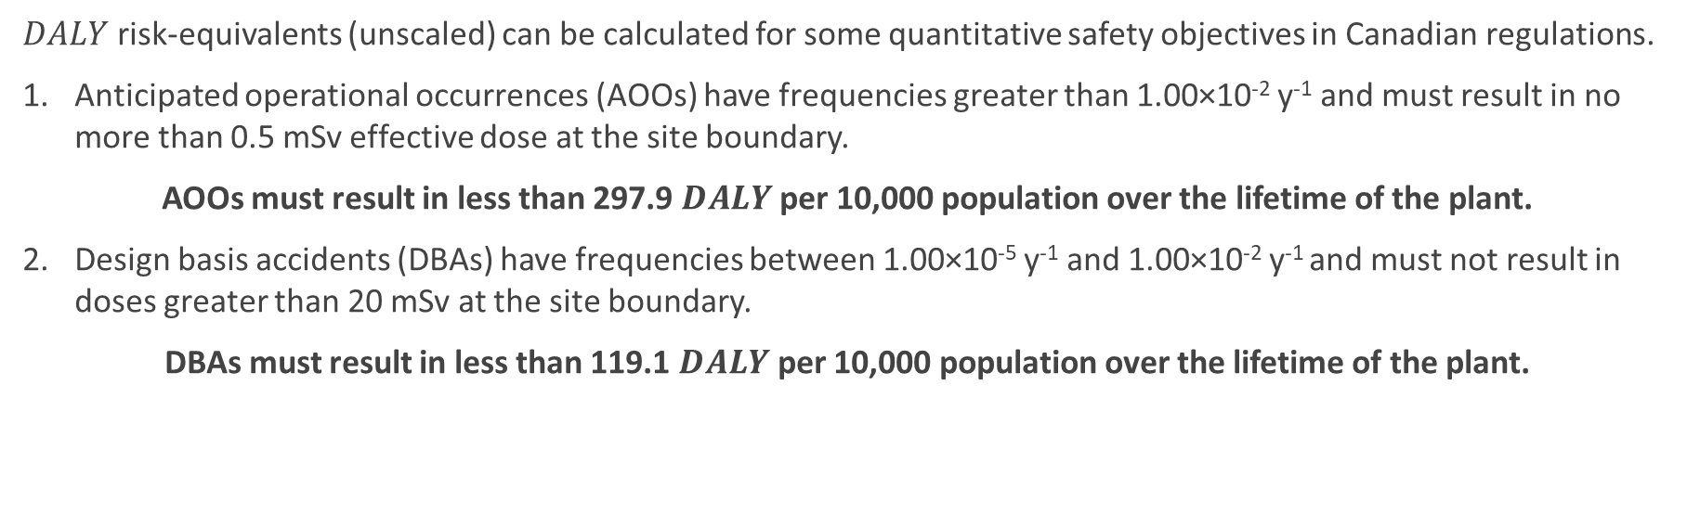
Demonstration Case Study
Context for assessing risks as $DALY$
$DALY$ risk-equivalents (unscaled) can be calculated for some quantitative safety objectives in Canadian regulations.
Anticipated operational occurrences (AOOs) have frequencies greater than 1.00×10⁻² y⁻¹ and must result in no more than 0.5 mSv effective dose at the site boundary.
AOOs must result in less than 297.9 $DALY$ per 10,000 population over the lifetime of the plant.
Design basis accidents (DBAs) have frequencies between 1.00×10⁻⁵ y⁻¹ and 1.00×10⁻² y⁻¹ and must not result in doses greater than 20 mSv at the site boundary.
DBAs must result in less than 119.1 $DALY$ per 10,000 population over the lifetime of the plant.

Slide 15
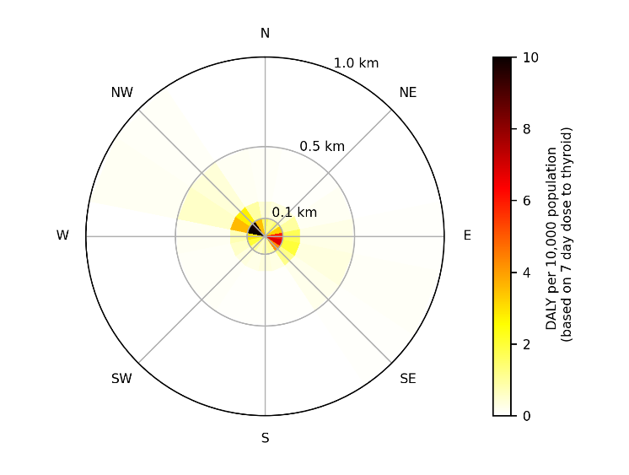
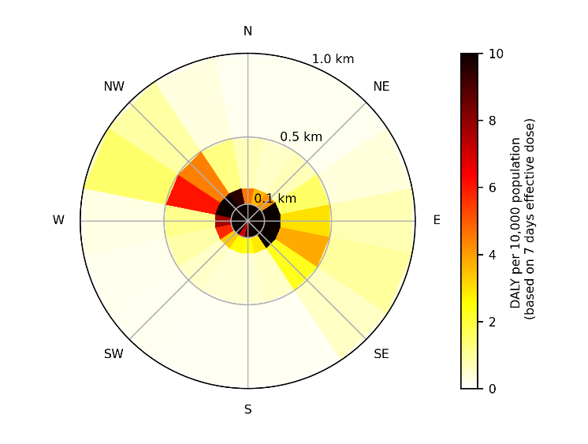
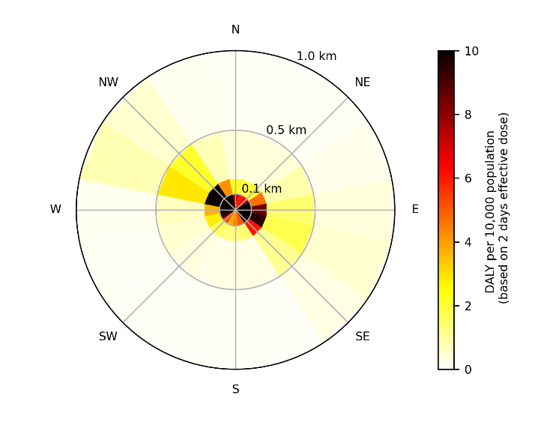
Results of Case Study
Spatial distribution of integrated risk ($DALY$) from the hypothetical SMR severe accidents
Calculated with respect to the generic criterion for dose to the thyroid over 7 days
Calculated with respect to the generic criterion for effective dose over 7 days
Calculated with respect to the generic criterion for effective dose over 2 days

Slide 16
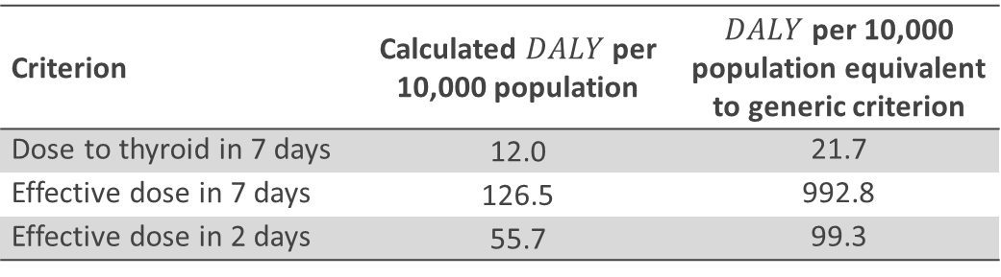
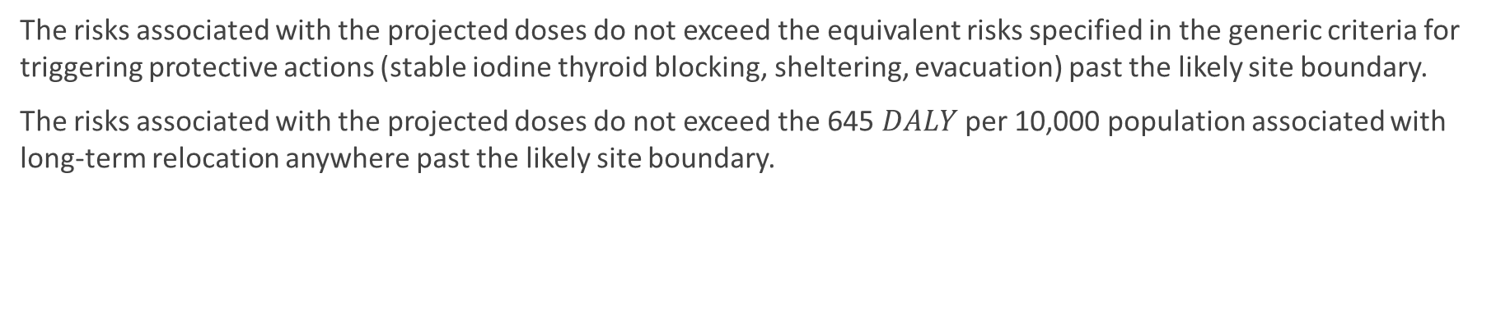
Results of Case Study
Integrated risk from dose at 100 m considering all event sequences
Criterion | Calculated $DALY$ per 10,000 population | $DALY$ per 10,000 population equivalent to generic criterion
Dose to thyroid in 7 days | 12.0 | 21.7
Effective dose in 7 days | 126.5 | 992.8
Effective dose in 2 days | 55.7 | 99.3
The risks associated with the projected doses do not exceed the equivalent risks specified in the generic criteria for triggering protective actions (stable iodine thyroid blocking, sheltering, evacuation) past the likely site boundary.
The risks associated with the projected doses do not exceed the 645 $DALY$ per 10,000 population associated with long-term relocation anywhere past the likely site boundary.

Slide 17
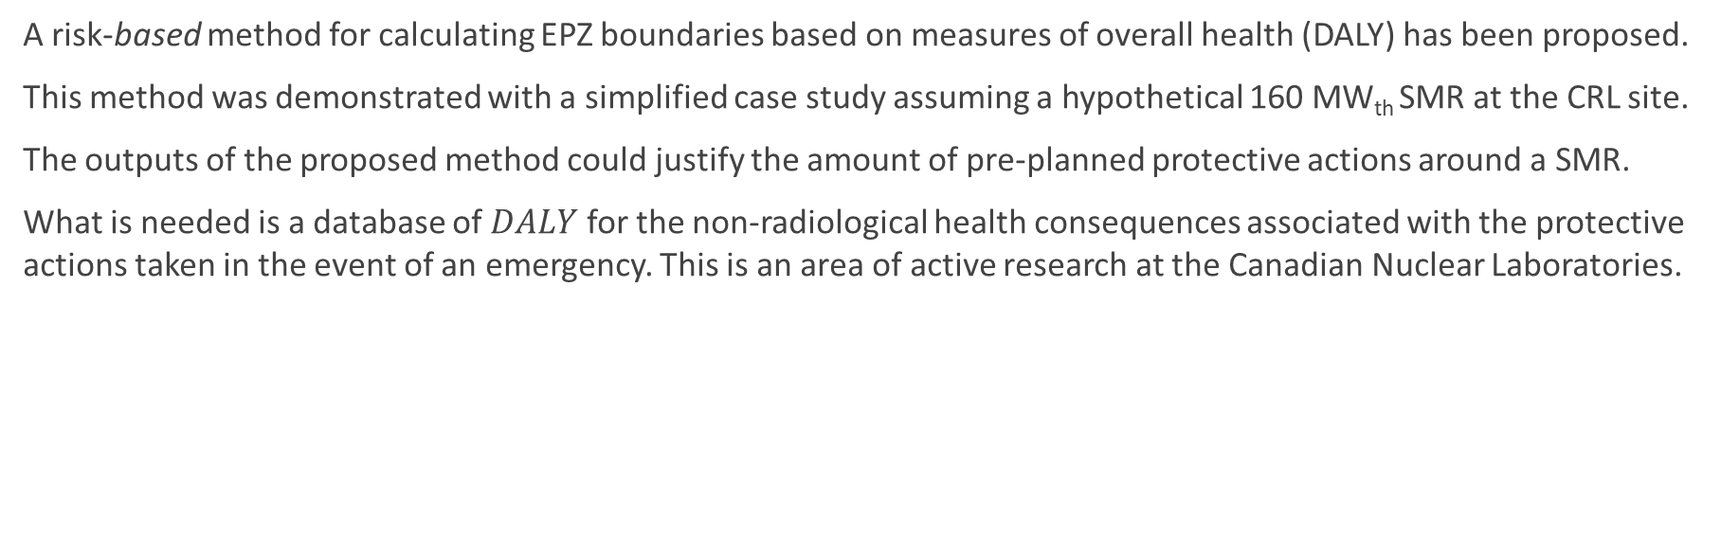
Summary and Next Steps
A risk-based method for calculating EPZ boundaries based on measures of overall health (DALY) has been proposed.
This method was demonstrated with a simplified case study assuming a hypothetical 160 MW_{th} SMR at the CRL site.
The outputs of the proposed method could justify the amount of pre-planned protective actions around a SMR.
What is needed is a database of $DALY$ for the non-radiological health consequences associated with the protective actions taken in the event of an emergency. This is an area of active research at the Canadian Nuclear Laboratories.

Slide 18
This study was funded by Atomic Energy of Canada Limited under the auspices of the Federal Nuclear Science and Technology Program.
The research was conducted at the Canadian Nuclear Laboratories by staff within the Directorates of Advanced Reactors, Safety and Security, and Isotopes, Radiobiology & Environment.

Slide 19
Thank you. Merci.
Dave Hummel (david.hummel@cnl.ca)
Questions?
Luke Lebel (luke.lebel@cnl.ca)
John Cui (john.cui@cnl.ca)
Sohan Chouhan (sohan.chouhan@cnl.ca)

