Slide 2
HYBRID DCMD AND SWRO DESALINATION USING A SMALL PWR OF 75 MW(th) FOR COGENERATION OF WATER AND ELECTRICITY
Paulo Augusto Berquó de Sampaio
Luiz Flávio Rodrigues Alves
Maria de Lourdes Moreira
Nuclear Engineering Institute- IEN/CNEN ~BRAZIL

Slide 3
Nuclear Cogeneration Systems:
  Gaining attention for electricity and water production.
  Supports UN Sustainable Development Goals: Clean Water, Affordable Energy, Climate Action.
Desalination Technologies:
Desalination plants require significant energy.
Current systems primarily use established techniques: MSF (Multistage Flashing), MED (Multi-Effect Distillation), SWRO (Sea Water Reverse Osmosis).
SWRO has the lowest specific electricity consumption (3.5 to 4.5 kW(e)h/m³) and is widely used.
  SWRO produces lower quality water as compared to thermal technologies

Slide 4
Hybrid Nuclear Desalination Strategy:
  This study focuses on the simplest nuclear hybrid desalination solution.
  DCMD and SWRO plants operate in parallel and independently.
  Blending water from both processes improves quality and reduces costs.
Membrane Distillation (MD) (Emerging Technology):
  Adequate for low-grade waste heat or renewable energy.
  Direct Contact Membrane Distillation (DCMD) separates feed and permeate flows via hydrophobic porous membranes.
  No additives needed to prevent fouling (unlike SWRO).
  Low environmental impact from brine discharge;

Slide 5
SWRO Technology:
  Electricity for SWRO comes exclusively from the small PWR.
  High-pressure pumps are powered by the nuclear power plant
  Utilizes a semi-permeable membrane that allows water to pass while blocking dissolved solids.
  Requires high pressure to overcome osmotic pressure.
  Feed (seawater) is pressurized by a high-pressure pump (HPP) before entering the RO system.
  Additives are needed to prevent fouling

Slide 6
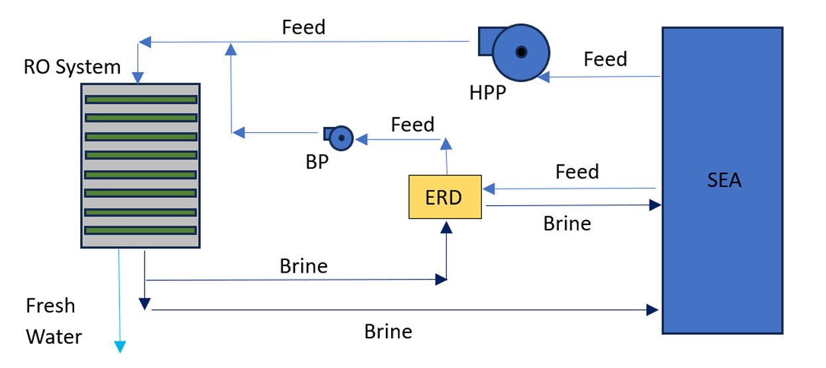
Separation Process:
  The RO system separates permeate (freshwater) from brine.
Energy Recovery:
  Brine exits the RO system at high pressure.
  Energy Recovery Devices (ERD) harness this pressure to save energy by transferring it to the feed.
  Schematic representation of the SWRO desalination plant.
  Highlights the integration of high-pressure pumps and energy recovery devices.

Slide 7
The DCMD Plant with Heat Recovery :
Cogeneration System:
  Coupling of a DCMD plant with a small PWR of 75 MW(th).
Parallel Rankine Cycles:
  Steam from the generator is divided into two parallel cycles.
Cycle A:
  Operates at typical Rankine cycle conditions for electricity generation.
  Condenser A at 0.063 bar, condensing steam at 37°C.
  Feed seawater enters at 26°C, heated to 32°C.
Cycle B:
  Steam expansion in turbine B to just below atmospheric pressure.
  Condenser B operates at 0.911 bar, condensing steam at 97°C.
  Feed temperature elevated to 92°C before entering DCMD.

Slide 8
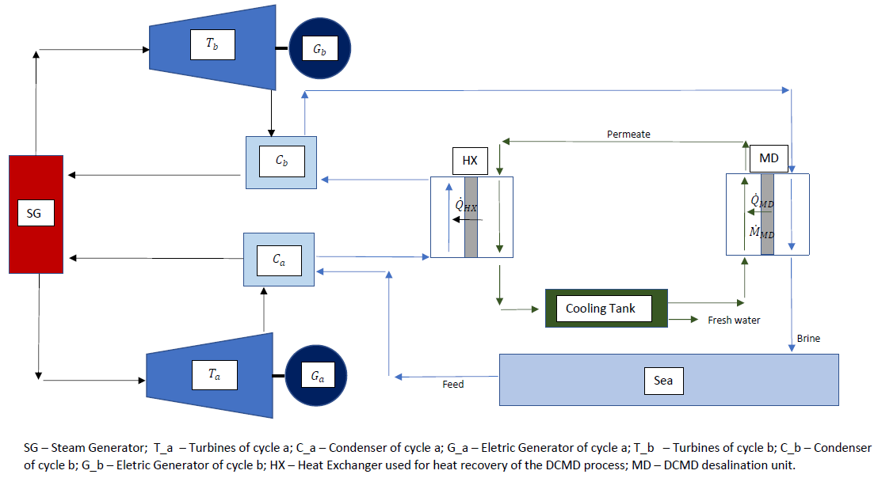
DCMD Plant: Coupling using two parallel Rankine cycles

Slide 9
Heat Transfer:
  Inside the MD unit, mass and heat are transferred from feed to permeate.
  Heat recovery exchanger (HX) reuses heat transferred to the permeate.
Safety Considerations:
  External heating comes from cooling the Rankine cycle condensers.
  No risk of radioactive contamination of seawater.

Slide 10
Simulation:
  Coupling was modeled using DESAL-PLANT (IEN/CNEN ) and DE-TOP(IAEA) programs.
DE-TOP Program:
  DE-TOP simulates Rankine cycles of the small PWR.
  Uses IAPWS-IF97 for thermodynamic properties.
DESAL-PLANT Program:
  Models DCMD desalination with heat recovery.
  Comprises several modules of shell and hollow fiber tube type.
  Good agreement with experimental results.

Slide 11
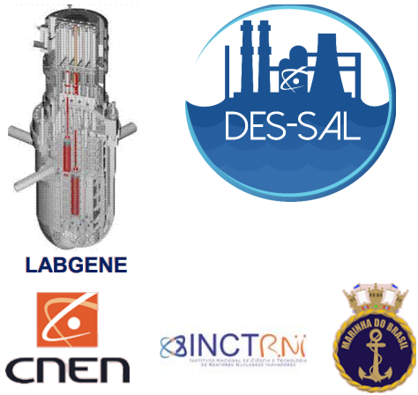
DES-SAL REACTOR:
75 MW(th) Gen III nuclear reactor (SMR) with passive residual heat removal system and core catcher.
National Technology (Brazilian Navy, CNEN, Universities).
Cogeneration of water and electricity.

Slide 12
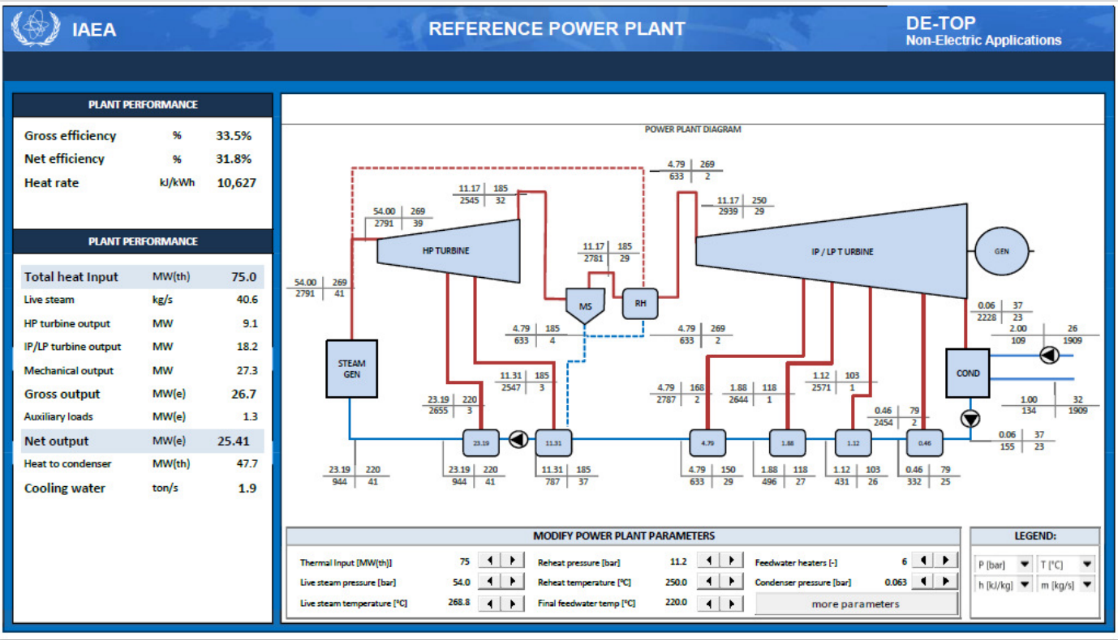
DE-TOP schematic representation of the reference 75 MW(th) PWR (regenerative Rankine cycle with reheat).

Slide 13
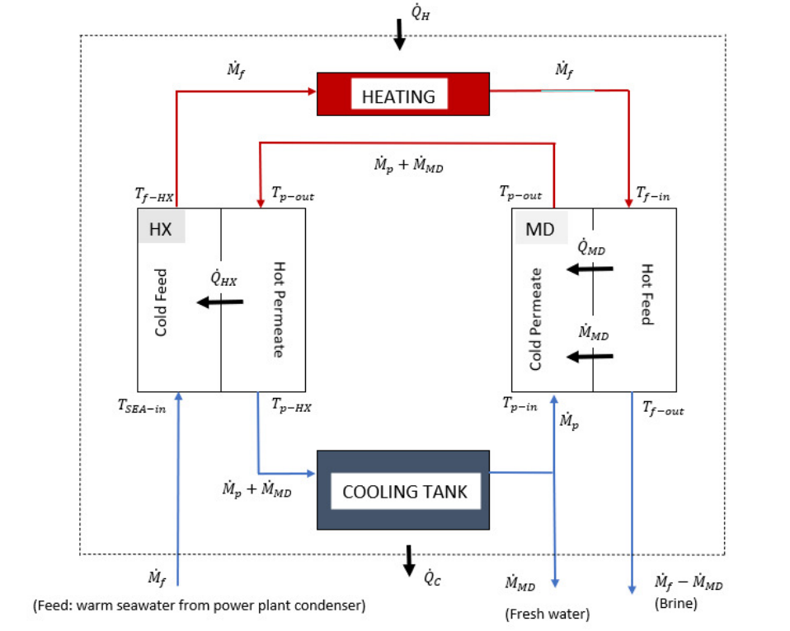
Modelling the DCMD Plant:
DESAL_PLANT (IEN/CNEN):The program is based on a multiscale approach to model DCMD desalination systems with heat recovery.

Slide 14
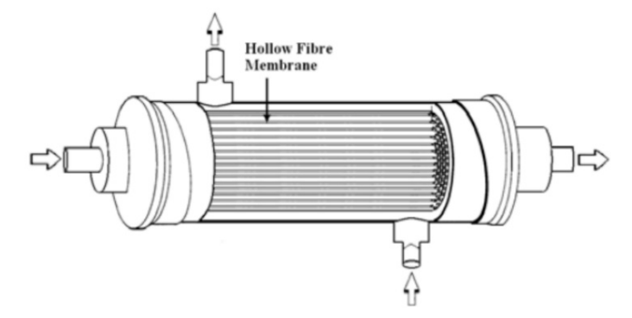
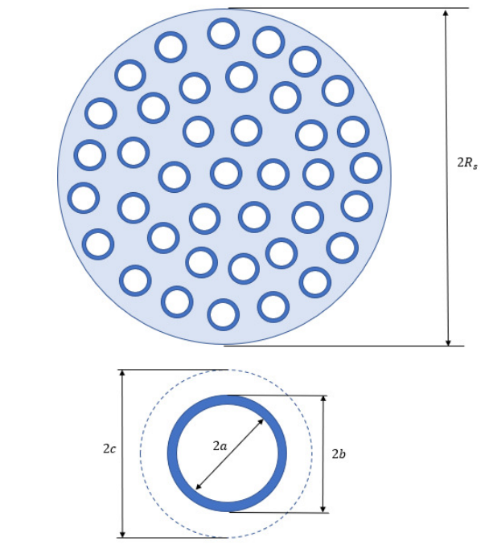
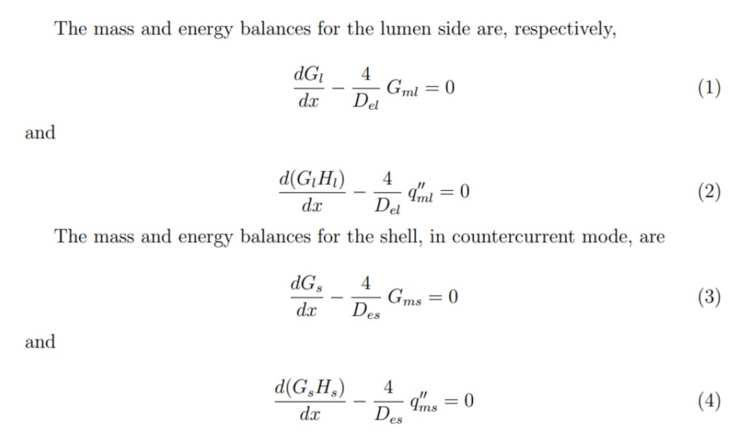
Single Module Scale:

Slide 15
How do we split the SG steam (heat) between cycles "a" and "b"?
How much of the 75 MW(th) goes to each cycle?
Answer: Given the temperature rises DTa and DTb of the seawater (feed) in condensers Ca and Cb, we split the SG steam such that the seawater flowrates required to cool condensers Ca and Cb are the same -> All heat rejected at the condensers is used to rise the feed temperature.

Slide 16
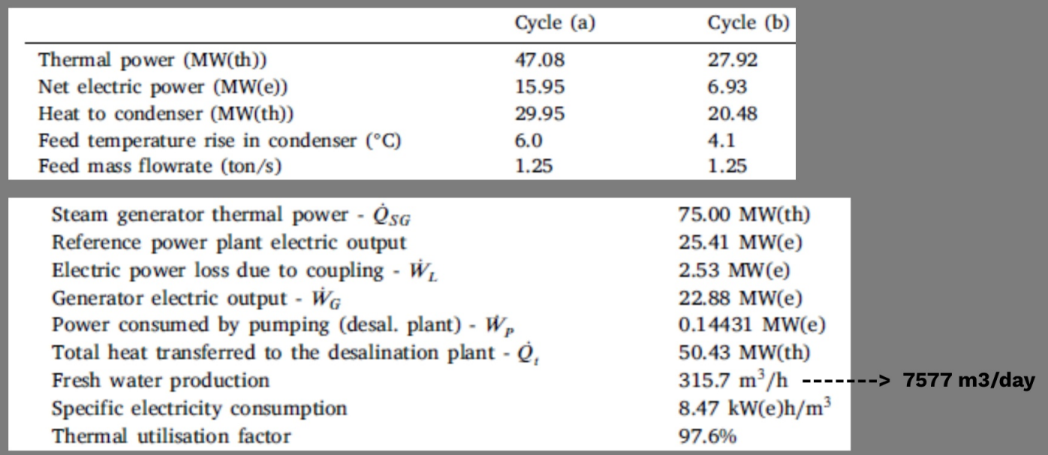
Data for the example simulated with DE-TOP and DESAL_PLANT:

Slide 17
Freshwater production:
We consider a blend of equal parts of the freshwater produced by the SWRO and DCMD desalination plants.
The SWRO plant must produce 7577 m3/day to match the production of the DCMD plant.
Considering the typical specific electricity consumption of 4 kW(e)h/m3 of SWRO
plants, the power plant will need to supply 1.2628 MW(e) directly to the SWRO plant.
Impact on Electric Power Output:
  Total loss of electric power output:
    Compared to reference plant (25.41 MW(e)): loss of 3.93 MW(e).

Slide 18
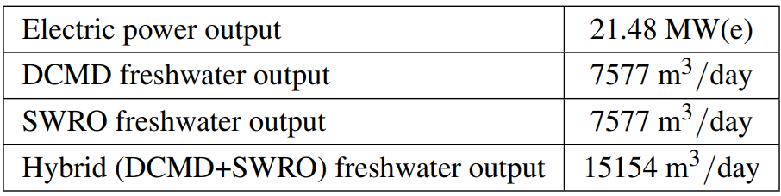
Summary of Cogeneration System Performance:
Electric Power and Freshwater Production
The overall specific electricity consumption of the hybrid DCMD + SWRO arrangement is 6.235 kW(e)h/m3.

Slide 19
Concluding Remarks
Advantages of Hybrid Desalination:
Hybrid Configuration:
  DCMD and SWRO operate in parallel and independently.
  Blending Benefits:
    Improved Water Quality: Enhanced quality from combined production.
    Cost Reduction: More economical than using DCMD alone.

Slide 20
Thank you
Support:
  This work is supported by:
    FINEP: No. 000298/16
    CAPES-PROCAD-DEFESA: No. 88887.387824/2019-00.

