Slide 1


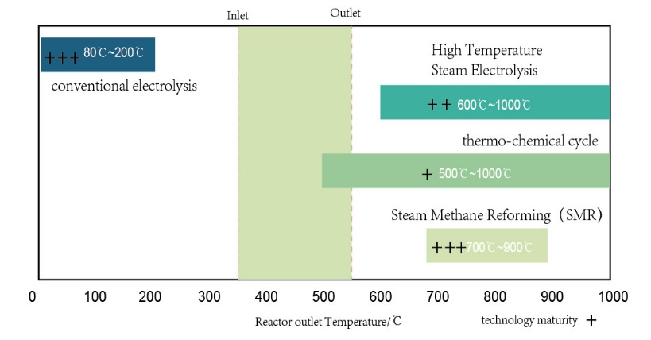
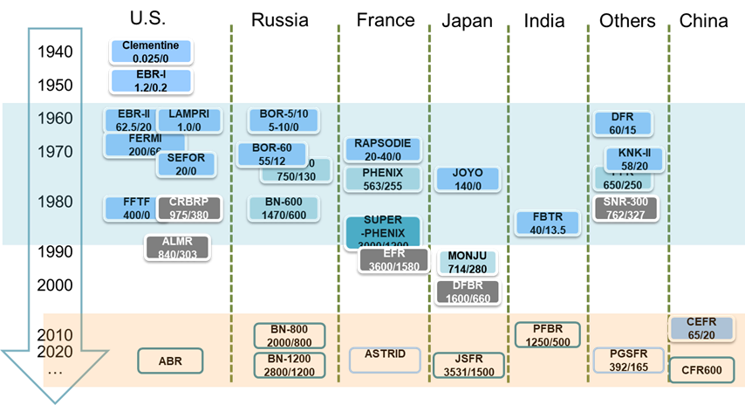
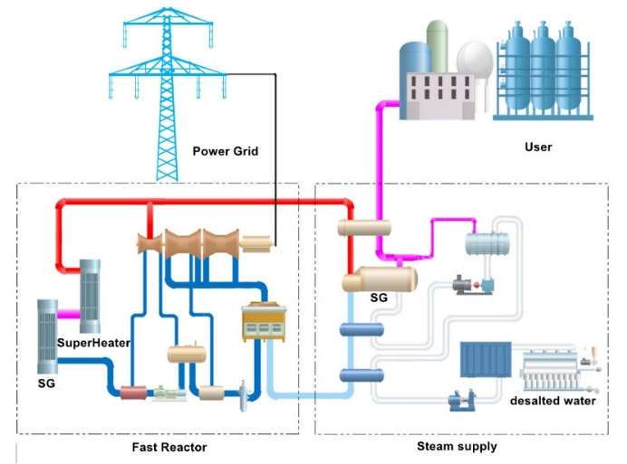
MULTI-PURPOSE APPLICATIONS OF SMALL MODULAR SODIUM-COOLED FAST REACTORS IN TWO-COMPONENT NUCLEAR POWER SYSTEM
Zhiwen Dai, Donghui Zhang, Songping Wang, Xiyong Chen, Shangang Cao, Yuting Yang, Fuhui Zhang.
Xiapu Nuclear Power Corporation, CNNP., CNNC.
IAEA-CN-327-110
Track 1 : Design and Technology development of SMRs
Abstract
Two-Component Nuclear Reactor System
Hydrogen production by SMSFR
The global installed capacity of nuclear energy is expected to continue growing rapidly, with a focus on the crucial issue of natural uranium reserves in the development of nuclear power plants.
Fast Reactors (FR) are critical in providing efficient, safe, and sustainable energy for long-term nuclear power development, developing a two-component nuclear system of pressurized water reactors (PWR) and FR will be critical globally in the future.
Small Modular Sodium-cooled Fast Reactors (SMSFR) are expected to play a role in developing a two-component nuclear power system by acquiring and processing its' reactor fuel.
This study aims to explore the potential application and economic evaluation of SMSFR in hydrogen production, steam production, and isotope production.
After natural Uranium extraction, through the enrichment and manufactured into PWR’s fuel. After entering the PWR and generating the electricity, it becomes the Spent Nuclear Fuel(SNF). The SNF is reprocessing a nuclear reprocessing plant and turning it into a fast reactor’s MOX fuel. After entering the fast reactor power plant, it generates power and proliferates into new fuel, turning the U-238 into the Pu-239. Simultaneously, the breeding fuel can be made into a PWR’s MOX fuel, which could be used by PWR.
A two-component nuclear power system includes PWR and FR.
FR is a centralized closed nuclear fuel cycle that permits generate electricity, reprocessing spent fuel, repeated fuel recycling.
The two-component nuclear power system could break the limitation of PWR’s installed capacity due to the lack of natural uranium.
The two-component nuclear energy system based on fast reactors can maximize the advantages of nuclear energy, break the resource and long-life radioactive waste limitations, and achieve large-scale, sustainable, green, and environmentally friendly development of nuclear energy.
It is indicate that the most suitable hydrogen production methods for SMSFR are the copper-chlorine cycle and conventional electrolysis.
Economic analysis shows hydrogen production via water electrolysis using SMSFR with MOX fuel costs $3.78 per kg.
Steam production
Compared to advanced reactors like PWR and HTGR, the SMSFR offers higher steam outlet temperature and pressure, producing high-quality steam for industrial use.
SMSFR can meet thermal users' high, medium, and low-pressure steam requirements without additional heat sources. with a temperature of 455℃ and pressure of 10MPa, is competitive with that from PWRs and HTGRs.
SMSFR in Two-Component Nuclear Reactor System
The SMSFR or the other kind of SMR can utilize reactor fuel from the two-component nuclear power system, and the SNF can be sent to a two-component nuclear power system for burning and recycling.
XIAPU
Isotope production
Conclusion
SMSFR have been shown to produce isotopes like 63Ni and 60Co. 63Ni is used in nuclear batteries, is widely employed in aerospace and medical equipment. Fast reactors capable of producing high specific activity 63Ni that meets nuclear battery requirements.
60Co is used as an industrial or medical source, with a market demand of billions of dollars. The mass production of 60Co using SMSFR offers lower costs and significant economic benefits.
The production of 252Cf and 238Pu will be economically significant. 252Cf is primarily used as the start-up neutron assemblies. 238Pu is used primarily for nuclear batteries in aerospace.
The SMSFR holds significant potential for various applications, such as high-quality steam production, hydrogen production, isotope production
The main challenge of the development of SMSFR is the economic challenges from other renewable energy, like solar, and wind power.
However, with the lower investment and shorter construction period, the SMSFR could offer a more comparative investment compared with other power plants.

