Slide 2
INPRO’s Activities in
Transportable Nuclear Power Plants
Alexander Bychkov – independent expert (ex-DDG IAEA, 2011-2015)
Gaye Sayin - INPRO, IAEA

Slide 3
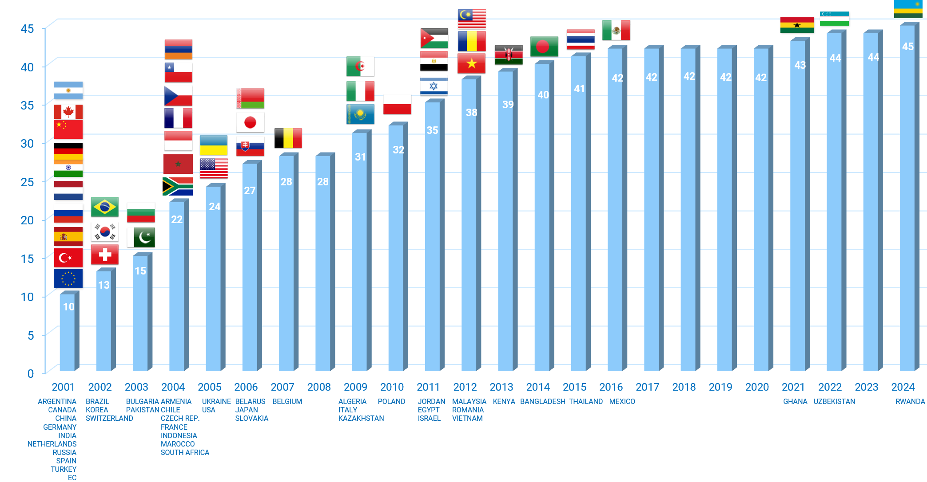
International Project on Innovative Nuclear Reactors and Fuel Cycles (INPRO)
Established in 2000 - IAEA’s integrated, forward looking activity
INPRO Objectives:
Ensure nuclear energy is available to contribute, in a sustainable manner, to the growing energy needs of the current century and beyond.
Bring together all interested Member States in joint international and national innovation tasks in nuclear energy
Environmental Impact
Proliferation Resistance
Safety
Sustainable
Nuclear Energy
Economics
Waste Management
Infrastructure

Slide 4
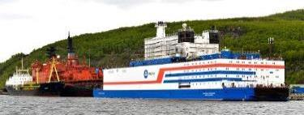
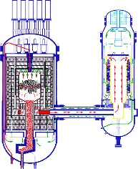

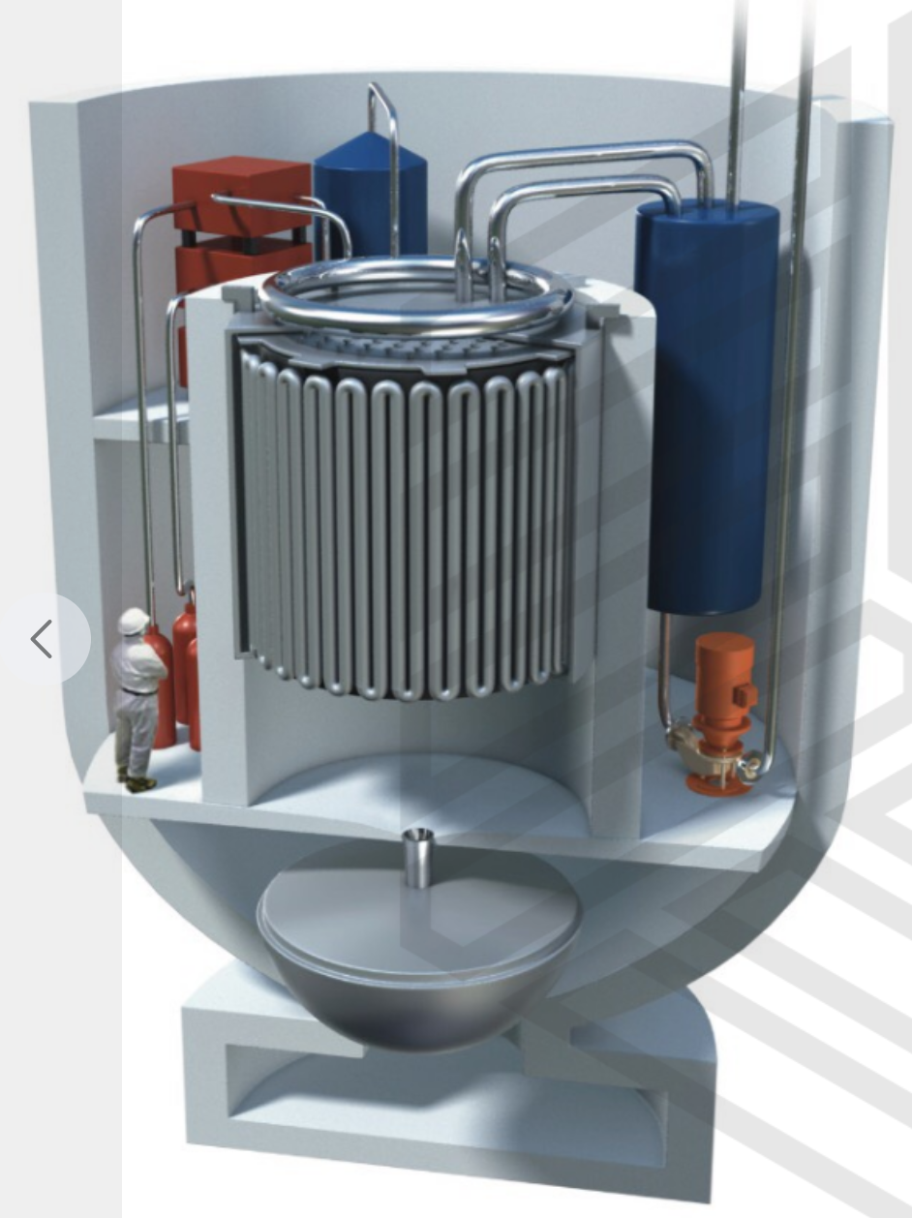

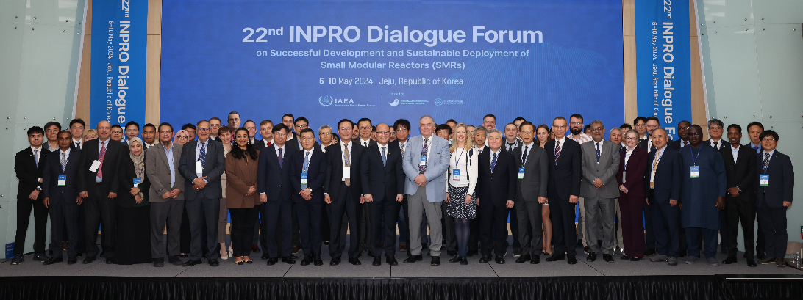
Current INPRO Projects on SMR
ASENES
Scenario modelling and analysis
Economic analysis and evaluation of Nuclear Energy System (NES)
Comparative evaluation of NESs and scenario options
Road mapping towards enhanced NE sustainability
Global Scenarios:
Collaborative project: “Analysis Support for Enhanced Nuclear
Energy Sustainable Deployment Scenarios for SMRs” (ASENES SMR)
Innovations:
Case studies for the Deployment of Factory Fuelled SMRs (Transportable NPPs)
Sustainability Assessments & Strategies:
Nuclear Energy System Sustainability Assessments (NESA) for SMRs
Dialogue Forums (DF) on SMRs:
  3rd (2011), 6th (2013), 13th (2016), 17th (2019),
  21st (2023 Russia) on Deployment of SMR Projects & Technologies to Support the SDGs
  22nd (2024 Rep. of Korea) - Successful Development &
  Sustainable Deployment of SMRs
MESSAGE-NES
NEST
KIND-ET
ROADMAPS-ET
CAREM
SMART
RITM-200M
CMSR

Slide 5
INPRO: Nuclear Innovations vs. Legal and Institutional Drivers and Impediments – TNPP Studies
Role of Nuclear innovations for Sustainable Development
SMRs and Transportable Nuclear power plants (TNPP)
Analysis of Legal and Institutional aspects of innovations deployment
INPRO Study of Legal and Institutional Issues of TNPP
2008 - 2013
INPRO Case Study for the Deployment of a Factory Fuelled SMR (Transportable)
2015 - 2024

Slide 6
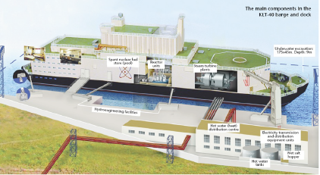
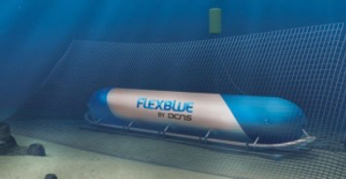
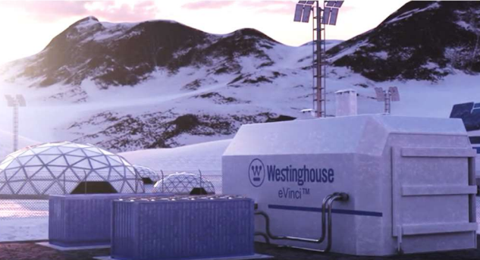
Status and Examples of TNPPs
Floating NPP with the two KLT-40 reactors
Countries that are designing marine-based transportable SMRs
Westinghouse eVinci™ Micro Reactor
“Flexblue” NPP module in its operational position on the sea bottom

Slide 7
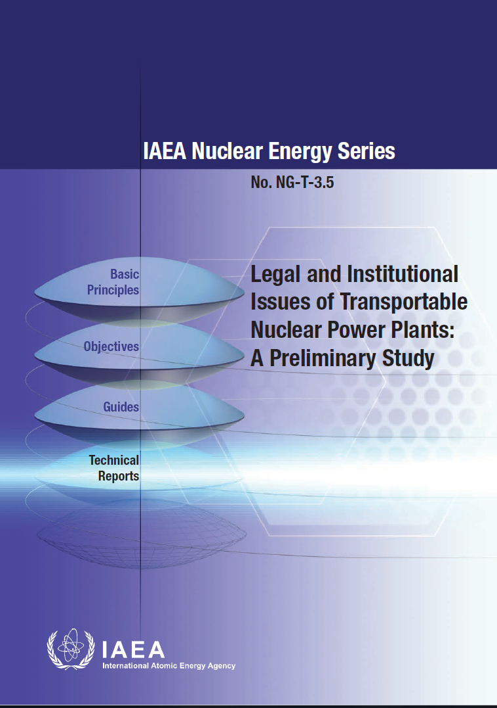
INPRO Collaborative Project: Study on Transportable Nuclear Power Plants (TNPP-I)
Two factory assembled TNPP Options:
Factory fuelled and tested, Supplier maintains, refuels and decommissions
Factory tested (non-nuclear), Host State maintains, fuels and refuels
Two scenarios:
Supplier is operator/Host State is regulator.
Host State entity is operator and regulator.
Issues for consideration: Infrastructure, safeguards, legal, nuclear safety and security, nuclear liability.
Recommendation: Detail consideration of factory fueled TNPP option, as it has obvious gaps and an insufficient coverage in the international nuclear law and in the non-binding international norms.
2008-2013

Slide 8





Major Conclusions from TNPP-1
Legal clarity is essential through treaties or existing laws.
Safeguards are similar to non-transportable installations,
Requires IAEA verification for nuclear weapon states to non-nuclear weapon state exports.
Transporting fuelled TNPP poses some challenges and required legal consideration and safety standards analysis
IAEA safety standards apply but may need adaptation
Nuclear security requires State coordination

Slide 9
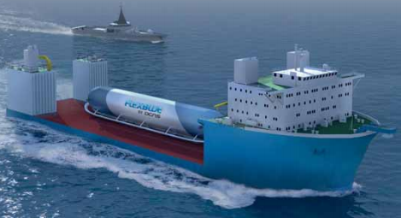
TNPP-2: Factory Fuelled SMRs
57th IAEA General Conference resolution encouraged “the Secretariat to continue providing guidance for regulatory reviews of SMRs of various designs”.
2015: Collaborative Project launched with 8 INPRO MSs and IAEA departments (NE, SG, NS and OLA).
Case Study: examine legal and institutional issues for export deployment
of TNPP that is factory fuelled, tested and sealed reactor
and investigate other aspects for deployment as TNPP on Host State
History of Activities:
  2015-2021: 14 consultancy meetings (CM)
  2022-2024: additional internal reviews and editorial works, 2025: expected publication as IAEA TECDOC

Slide 10
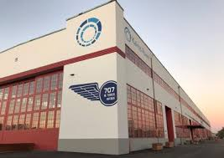
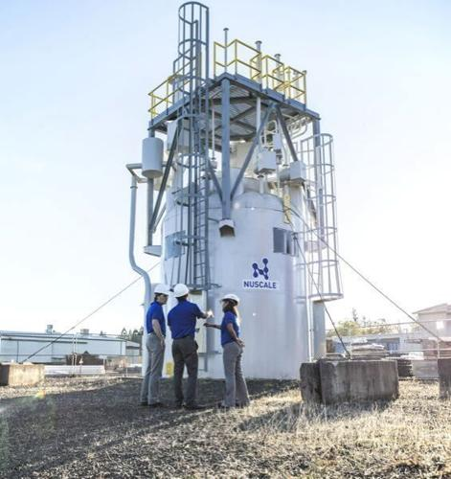
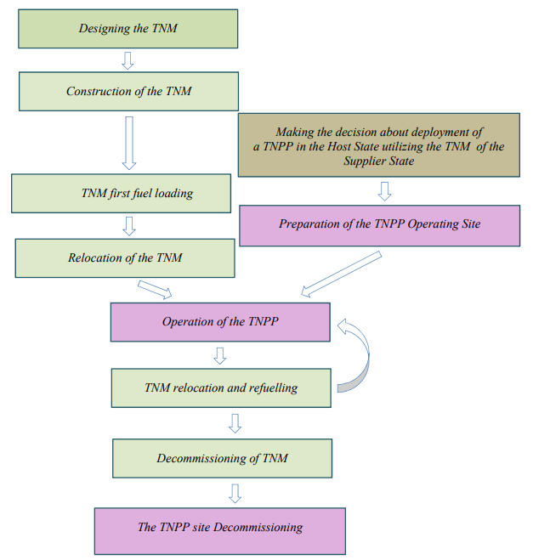
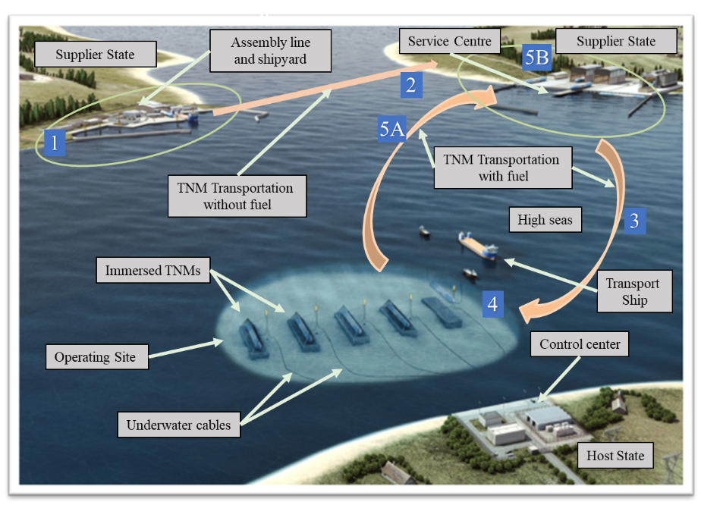
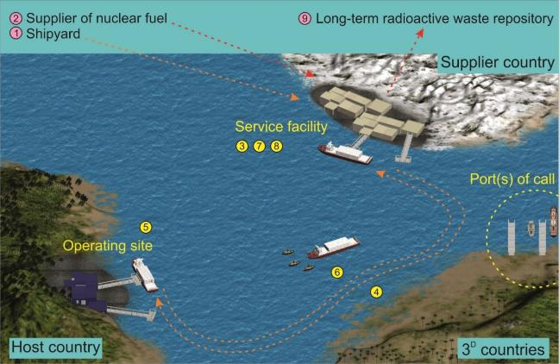
TNM Life-cycle for 3 Cases
Transportable nuclear module (TNM):
Land-based TNM/TNPP
Floating TNM/TNPP
Immersed TNM

Slide 11
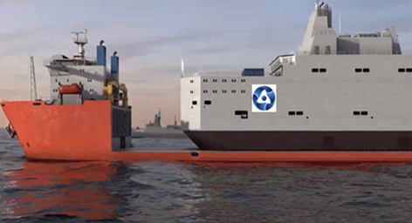
Project TNPP-2 Focus Areas
The Collaborative Project was based on the in-depth study of the factory manufactured TNM life cycle scenario with reactors loaded with nuclear fuel in the Service Centre, tested and sealed in Supplier State for further relocation and operation as a TNPP in a Host State.
Supplier State is nuclear weapon State and scenario of maximum outsourcing was considered.
The TECDOC draft includes the chapters:
  Legislative (including Maritime Law and civil liability for nuclear damage)
  Nuclear Safety
  Licensing Process
  Safeguards
  Nuclear Security
  Staffing and Training

Slide 12
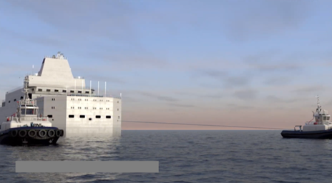
TNPP-2 Case Study Preliminary Conclusions
Existing legal and regulatory framework for NPP is generally applicable to TNM/TNPP life cycle, despite absence of specific international rules. May require modifications for safeguards, nuclear damage civil liability, etc.
Differences in regulatory framework compared to NPPs is primarily related to marine specifics of a TNM (floating and immersed designs,) and maritime laws regarding transport of TNM/TNPP between Supplier State and Host State. May need innovative licensing mechanisms
Identified "gaps" in legal framework of TNM/TNPP for current technology development stage, may be covered by Intergovernmental Agreements for the implementation of particular TNMPP projects.
TNM Pilot Projects (FOAK) will bring new practical information for further deployment of TNM/TNMPP.

Slide 13
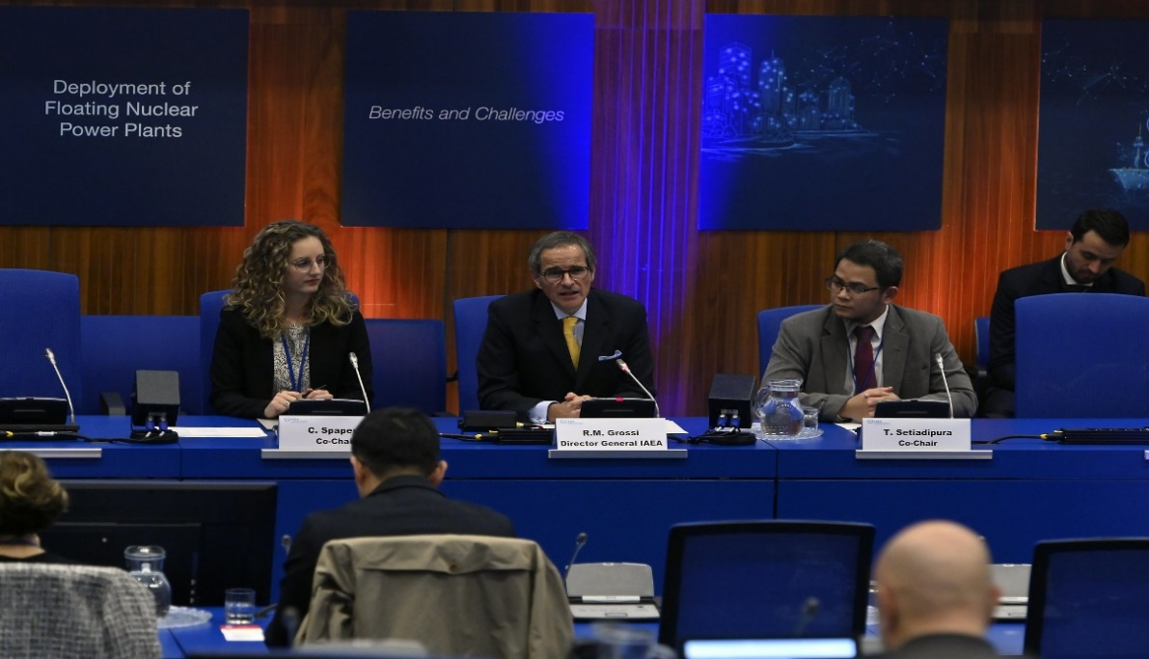
IAEA International Symposium:
Deployment of Floating Nuclear Power Plants –
Benefits and Challenges
IAEA FNPP Symposium
November 14 -15, 2023 in Vienna:
168 participants from
44 Member States and
4 International Organizations.
Wide range of stakeholders essential to the development and deployment of FNPPs
Representatives from the nuclear and maritime industries, regulatory bodies, maritime classification societies, and legal experts.
INPRO along with NS and other Departments played a key role in organizing symposium

Slide 14
Key Findings from FNPP Symposium
Industry cooperation
Collaboration between reactor developers/vendors and shipyard companies
Crucial for serial production of FNPPs in shipyards
Regulatory cooperation
Involves IAEA, Internation Maritime Organization (IMO), national nuclear and maritime regulators, and maritime classification societies
Industry coordination
Safety, Security, Safeguards (3S)
Early coordination between industry and regulators
Crucial to ensure regulatory readiness for FNPP licensing
Early integration of 3S in design phases

Slide 15
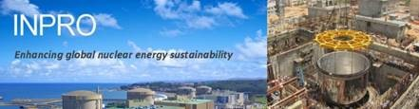
Thank you for attention!
https://www.iaea.org/services/key-programmes/international-project-on-innovative-nuclear-reactors-and-fuel-cycles-inpro
Notes:
Thank you!

