Slide 1

EVALUATION OF THE MOLTEN SALT REACTOR TECHNOLOGY FOR THE APPLICATION OF FLOATING
NUCLEAR POWER PLANTS
Ioannis Kourasis, Jake Miles, Mamdouh El-Shanawany

Slide 2
Contents
01
Introduction to FNPPs
04
Evaluation of MSR applicability based on FNPP Criteria
02
FNPP Reactor Technology Evaluation Criteria
05
Criticality Safety of water moderating fuel salt
03
Molten Salt Reactor (MSR)
06
Conclusions

Slide 3
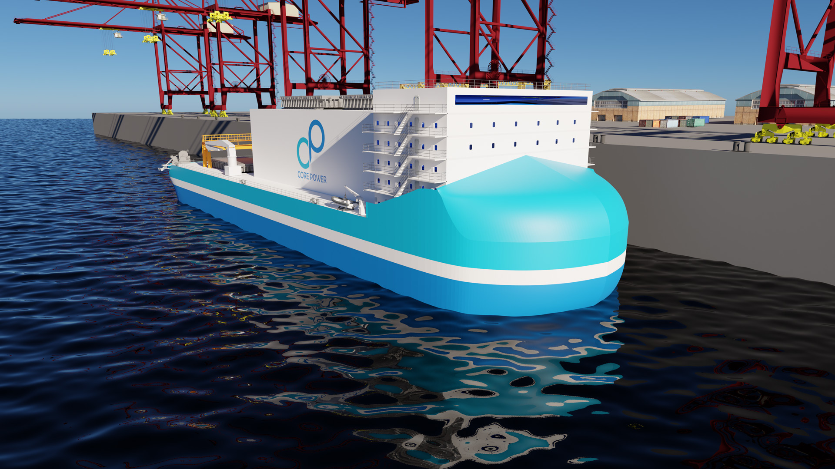
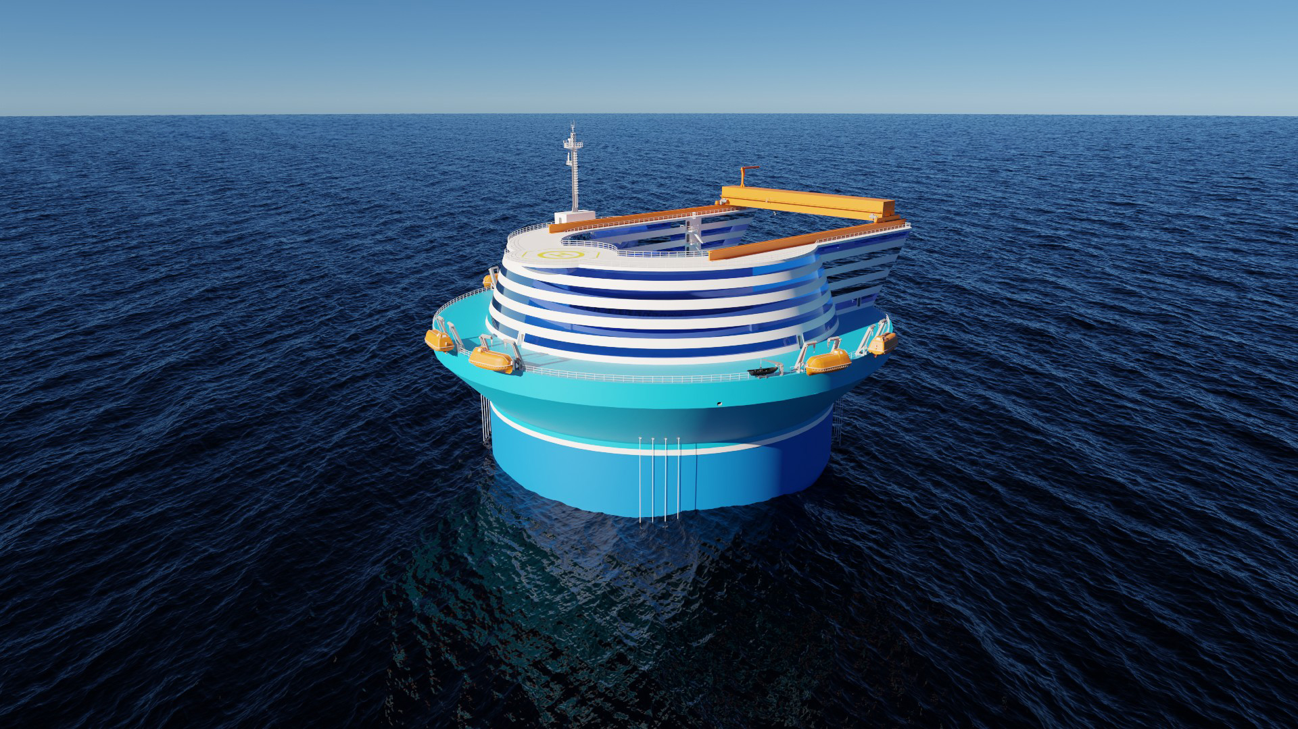
Floating Nuclear Power Plants Introduction
Potential Applications
Potential Advantages
Powering of ports, islands and coastal areas.
Desalination, Hydrogen & E-fuels production.
Decarbonizing remote fossil fuel facilities.
Disaster Relief.
Mobile & Transportable – can be deployed in remote areas.
Increased Passive Safety – access to abundance of water for cooling and decreased seismic risk.
Decreased BoP cost – can be manufactured efficiently in shipyards.
NEARSHORE
OFFSHORE

Slide 4
FNPP Reactor Technology Evaluation Criteria
01
Availability: Fuel Cycle Duration, Refuelling and maintenance frequency
04
Plant Power Output
07
Proliferation Resistance
02
Design Safety for Marine Accident Scenarios
05
Plant Footprint
08
Operation in marine conditions and transients
03
Plant Emergency Planning Zone Size
06
Grade of Output Heat
09
Transport in marine conditions and transients

Slide 5
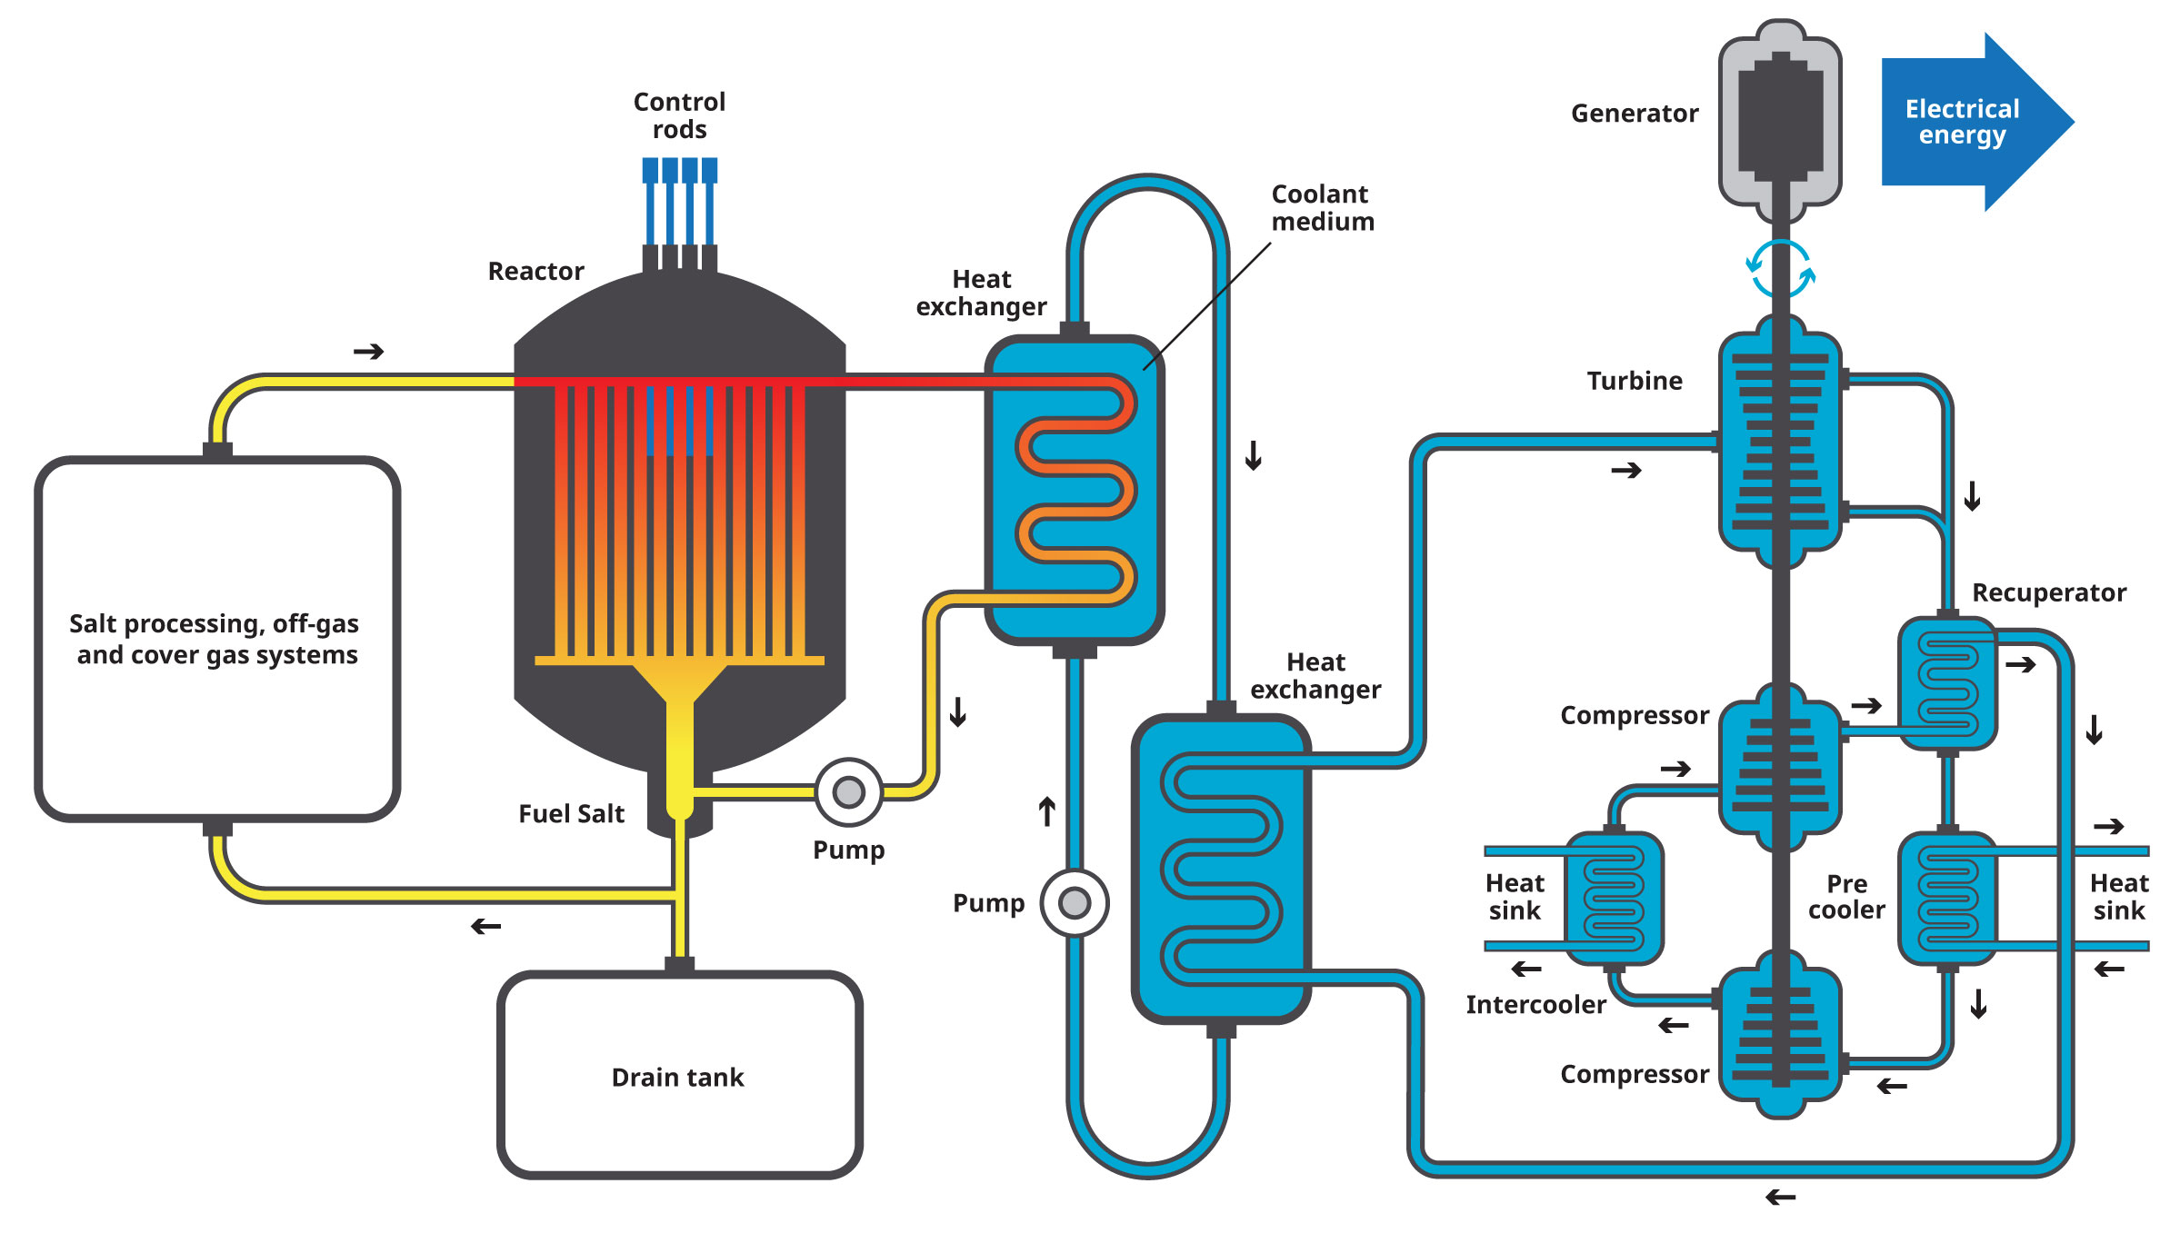
MSR Basics
Liquid Fuel
500 – 700 C
Typically, fluoride or chloride-based salts
Graphite moderator for thermal designs – reflecting material for fast designs

Slide 6
Evaluation of MSR applicability based on FNPP Criteria (1)
EVALUATION CRITERIA | MSR
#1 Availability – Fuel Cycle, Refuelling and maintenance frequency | The liquid nature of the fuel allows for online refuelling, processing and fission product filtering, offering high availability. This could allow for very long intervals (up to decades) between planned reactor outages for refuelling and maintenance. Therefore, the frequency of handling either fresh or spent fuel on board is minimized, in particular when compared to a PWR that requires handling of the solid fuel assemblies every 18 to 24 months on average. This vastly improves the economics of the floating application, enhances proliferation resistance and overall safety. However, storing the fresh fuel required to perform this function as well as the fission products that are being removed, will present added safeguarding and nuclear material accounting and control issues that will need to be addressed according to IAEA standards.
#2 Design Safety for marine hazards | Liquid fuel can be drained, cooled and solidified in a safely subcritical drain tank, which accommodates decay heat removal. In addition, an in-core MSR shutdown is possible by inserting neutron absorbing rods, or permanently poisoning the salt by dispersing neutron absorbing materials in it. These shutdown methods can be implemented under marine accident scenarios, in the case of operating crew needing to evacuate. The effect that the presence of sea water will have in the criticality of those shutdown configurations needs to be further understood and is investigated in section 3 of the paper.
#3 Plant Emergency Planning Zone Size | MSRs operate at low pressure. During standard operation, the fuel salts are only under the pressure required for their circulation. The liquid fuel is also very accident tolerant, with an extremely high boiling point and a very strong negative temperature coefficient. In addition, due to some FPs being soluble in the fuel, and the rest filtered, MSRs can have a lower fuel source term in paper. Utilizing all these intrinsic safety features, MSR plants could achieve an Emergency Planning Zone at the site boundary, based on the new risk-informed performance based regulatory guidelines.
#4 Power | MSRs have only been operated successfully up to the 10MWth range. However, there is no theoretical limit to scaling MSR power output to hundreds of MW.
#5 Size | Compared to other reactors, MSRs have a much smaller vessel size and do not require pressure vessels and can reach high power densities. However, MSRs do require extra space for a cover gas system, fuel tanks and fission product filtering. Overall, judging from the MSRE footprint [7], overall system architecture and industry concept designs, an MSR plant can be designed to fit on a floating platform.

Slide 7
Evaluation of MSR applicability based on FNPP Criteria (2)
EVALUATION CRITERIA | MSR
#6 Output Heat Grade | MSR operating temperatures are in the range of 600 – 700 C, providing high grade heat for potential FNPP applications and increasing overall power conversion efficiency.
#7 Proliferation resistance | In a molten salt core, most of the fission products are soluble in the salt, creating a mixture of actinides and lanthanides. This feature greatly increases inherent proliferation resistance. Security measures such as liquid neutron poison injection, or other injections can be utilized to increase the proliferation resistance of the fuel in case of hijacking or piracy.
#8 Operation in marine conditions | In principle, liquid fuel will be affected by the motions and accelerations experienced in a marine environment. An MSR designed for a marine application should be able to operate at these motions and inclinations, by minimizing free surface and utilizing forced flow systems. MSR designs that are based on natural circulation are not directly applicable for FNPP use.
#9 Transport in marine conditions | Prior to startup, MSR fresh fuel is in a stable solid form, hermetically sealed to prevent oxygen or hydrogen ingress. The paper performs a brief evaluation of the criticality safety of this fissile material in the presence of water. Following reactor shutdown, MSR technology allows for the controlled solidification of the fuel in a subcritical geometry as demonstrated by MSRE [7] with a cooling system required to remove decay heat. In both cases, the fuel will be in a solid state so its geometry will not be significantly affected by marine motions. In addition, fission products that have been separated from the fuel during operation and stored on-site, either solid or gaseous, can be treated and packaged according to nuclear material transport regulations prior to transportation. Overall, MSR technology will allow the plant design to meet international standards for transport safety.

Slide 8
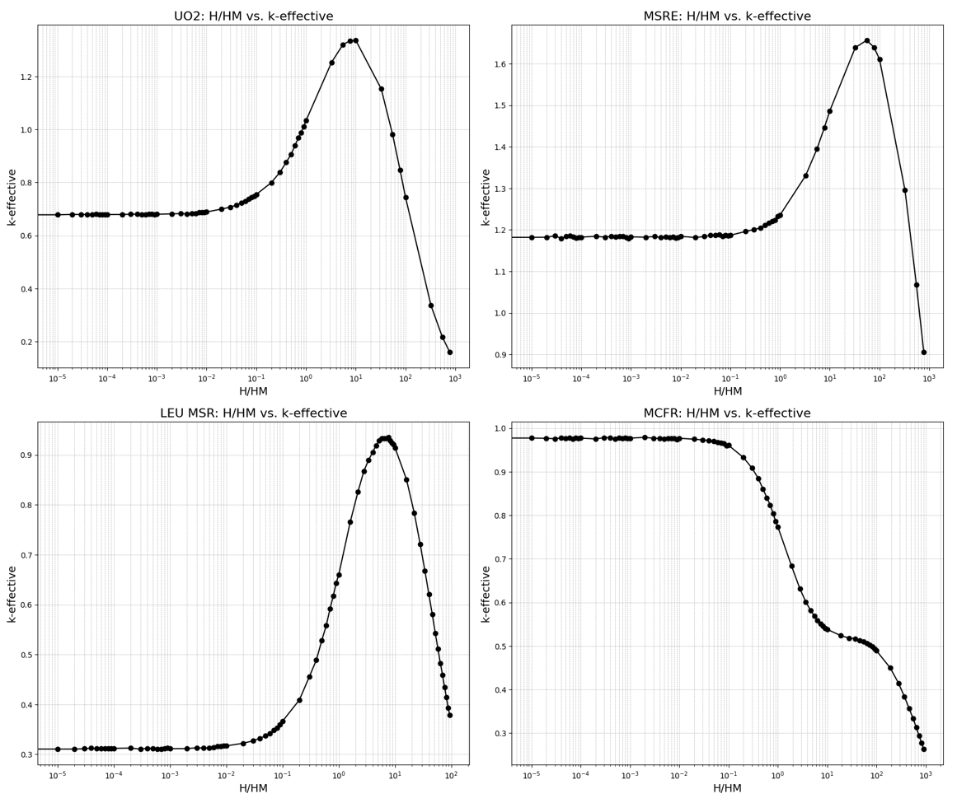
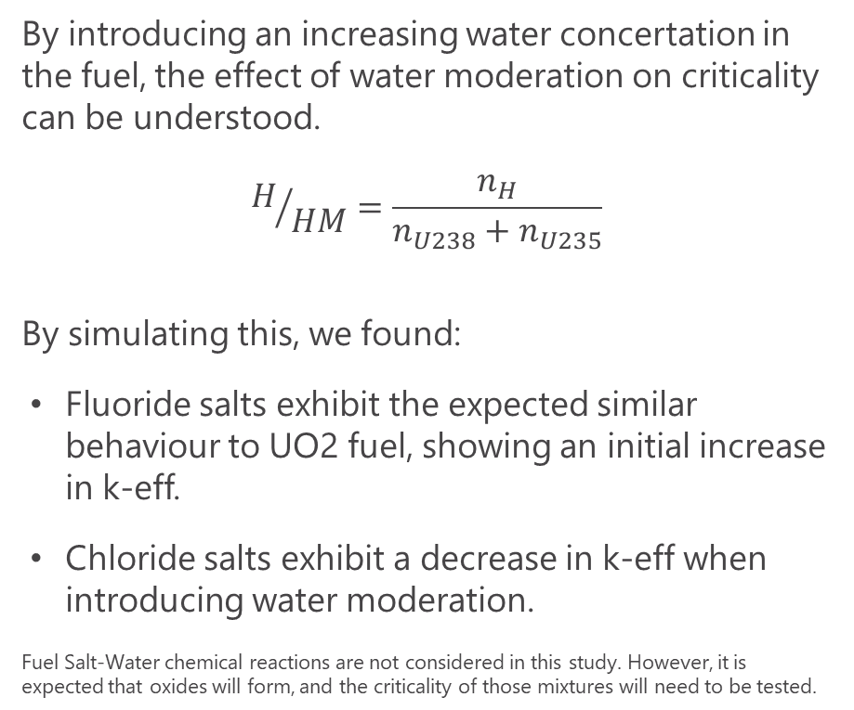
Criticality Safety: Water moderating fuel salt
By introducing an increasing water concertation in the fuel, the effect of water moderation on criticality can be understood.
$$H/{HM}=\frac{n_{H}}{n_{U238}+n_{U235}}$$
By simulating this, we found:
Fluoride salts exhibit the expected similar behaviour to UO2 fuel, showing an initial increase in k-eff.
Chloride salts exhibit a decrease in k-eff when introducing water moderation.
Fuel Salt-Water chemical reactions are not considered in this study. However, it is expected that oxides will form, and the criticality of those mixtures will need to be tested.

Slide 9
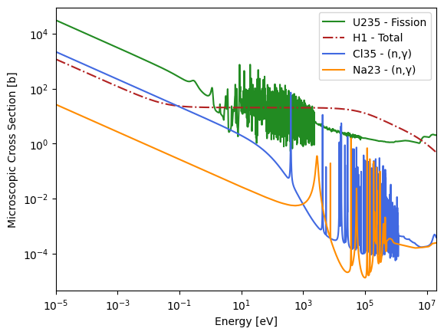
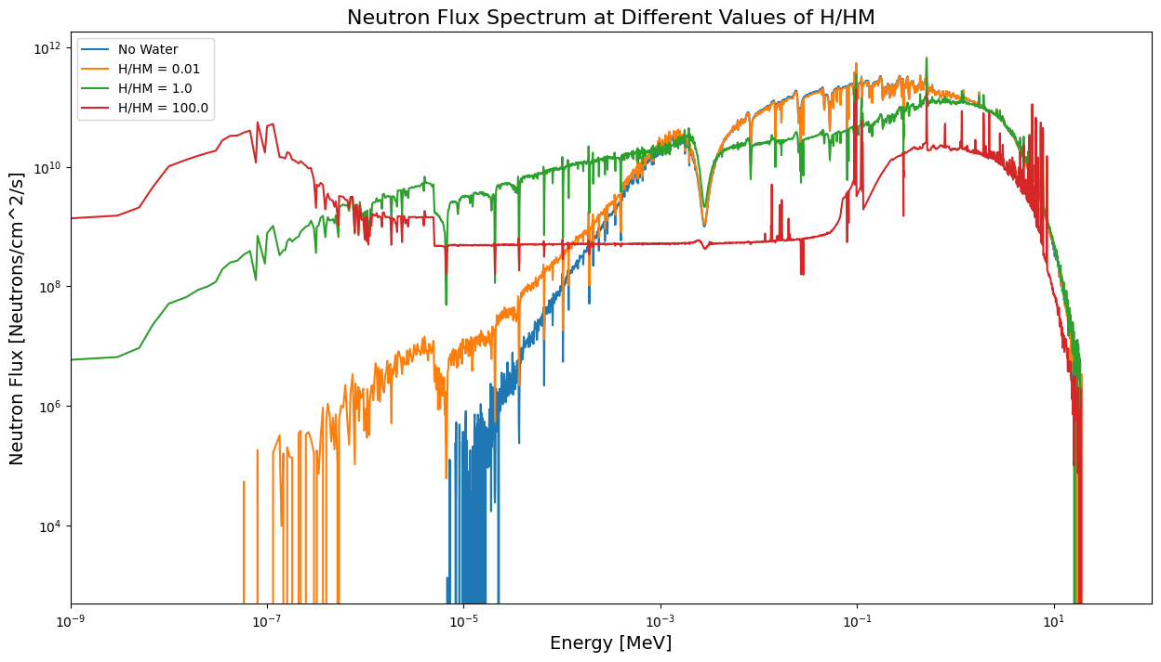
Criticality Safety: Water moderating fuel salt
Microscopic cross sections for relevant nuclides
Neutron Spectrum at different H/HM values
Note: Different scale and range on x-axis

Slide 10
Conclusions
Overall
Technology
Future
The Molten Salt Reactor concept appears as a promising candidate for use in FNPP applications, taking advantage of the liquid fuel and increased passive safety features to achieve competitive economics with online refuelling, increased availability and high-grade heat.
An MSR design that uses forced flow instead of natural circulation, and minimizes free surface is best posed to counteract the effect of marine motions and accelerations.
A chlorine-based fuel salt shows the most promising criticality safety behaviour under water moderation.
MSR technology still requires significant research in areas such as component development, salt-facing materials, salt-chemistry and nuclear data.
The Molten Chloride Fast Reactor Program, a joint collaboration between TerraPower, Southern Company, CORE POWER and Hyundai Heavy Industries is performing this research and planning to run a test reactor (MCRE) at INL, in this decade.

