Slide 2
Floating Nuclear Power Plants: Legal and Regulatory Gap Analysis
Hamid Saeed Raza
Pakistan Nuclear Regulatory Authority
Islamabad, Pakistan

Slide 3

Outline
Introduction
FNPPs and Radioactive Material Deployment Scenarios
Applicability of the Existing Laws (Nuclear & Maritime)
Applicability of the Existing IAEA Safety Standards
Conclusions
Harmonization of Nuclear & Maritime safety
Photo courtesy: https://www.pda.org/home
Notes:
I have a very short presentation and will try to keep it short and crisp to consume. Content is flashed on the screen

Slide 4
Introduction
  Floating Nuclear Power Plants (FNPPs) present novel approach to install Small Modular Reactors (SMRs) on floating barges or platforms.
  Have advantages, but also pose legal and regulatory challenges.
  Safe Deployment of FNPPs as clean energy source.
Notes:
Their mobility offers advantages over traditional land-based plants, but also pose unique transport-related legal and regulatory challenges.
Specific requirements for floating reactors are still missing in the legal instruments governing nuclear safety.

Slide 5
FNPPs and Radioactive Material
Deployment Scenarios
Transport of radioactive material (Fresh Nuclear Fuel) to onshore/offshore facility.
Transport of radioactive material (Spent Fuel or Radioactive Waste) from onshore/offshore facility.
DEPLOYMENT SCENARIOS
FNPP being transported as a Facility with fresh Fuel.
FNPP being transported as a Facility with Irradiated Fuel.
Notes:
Their mobility offers advantages over traditional land-based plants, but also pose unique transport-related legal and regulatory challenges.
Specific requirements for floating reactors are still missing in the legal instruments governing nuclear safety.

Slide 6
Applicability of the Existing Nuclear Laws
Safety
Security
Liability

Slide 7
Applicability of the Existing Nuclear Laws
(CENNA): Does not bar the location or source of nuclear accidents, to minimize transboundary impact of accidents. Thus, CENNA may apply to FNPPs.
Joint Convention on the Safety of Spent Fuel Management and the Safety of Radioactive Waste Management (Joint Convention).
(CACNARE): This may be addressed in relevant Inter-Governmental Agreements (IGA).
Convention on Nuclear Safety (CNS), 1996:
  FNPP do not appear to be explicitly mentioned in the definition of “nuclear installations” as it is not a land-based civil NPP.
Notes:
Convention on Early Notification of a Nuclear Accident (CENNA)
Convention on Assistance in the Case of a Nuclear Accident or Radiological Emergency
Joint Convention on the Safety of Spent Fuel Management and the Safety of Radioactive Waste Management (Joint Convention), 2001: Covers transboundary movement of spent fuel and radioactive waste, and is applicable.

Slide 8
Applicability of the Existing Nuclear Laws
Nuclear Security
  Convention on Physical Protection of Nuclear Material (CPPNM) and 2005 Amendment (A/CPPNM) are the only legally binding instruments for physical protection.
  Application of existing A/CPPNM.
Nuclear Liability
  Although the 1962 Convention on the Liability of Operators of Nuclear Ships (Brussels Nuclear Ship Convention) addresses nuclear ship-related liability issues, the ratification of the convention has become deadlocked and failed to enter into force.
Notes:
The application of the existing A/CPPNM appears to sufficiently cover the deployment of FNPPs.
If defined as land-based facilities or structures, FNPPs-related liability and compensation can be solved by nuclear liability conventions. However, if defined as ships, the application of these liability conventions would face controversies.

Slide 9
Applicability of the Existing Maritime Laws
United Nations Convention on the Law of the Sea, 1982 (UNCLOS): FNPPs deployment-related safe zones.
International Convention for the Safety of Life at Sea, 1974 (SOLAS): Definitional aspects amendment.
International Convention for the Prevention of Pollution from Ships, 1973 (MARPOL): Applicability on FNPPs.
Convention for the Suppression of Unlawful Acts against the Safety of Maritime Navigation (SUA Convention) 2005 Protocol to the SUA Convention.
Notes:
United Nations Convention on the Law of the Sea, 1982 (UNCLOS): FNPPs deployment-related safe zones are not clear; Can work on it by defining safety zones.
International Convention for the Safety of Life at Sea, 1974 (SOLAS): [A nuclear ship is a ship provided with a nuclear power plant. EXCEPTIONS Ships not propelled by mechanical means;] Definitional aspects may be amended to address FNPPs.
International Convention for the Prevention of Pollution from Ships, 1973 (MARPOL): The applicability of MARPOL on FNPPs is clear.
Convention for the Suppression of Unlawful Acts against the Safety of Maritime Navigation (SUA Convention) 2005 Protocol to the SUA Convention: defines ship as a vessel of any type whatsoever not permanently attached to the sea bed, including dynamically supported craft, submarines, or any other floating craft.

Slide 10
Applicability of the Existing Maritime Laws
Possible Solution
  Legal Framework: Obligations/Responsibilities of Supplier State; Host State; Transit State; Coastal State; Third party (IAEA and IMO).
  Bilateral and/or Regional Cooperation Treaty.
  Harmonizing Legal Documents and Standards of IMO and IAEA.
Yet some questions are still left to answer:
  What would be the Point of transition for the safety responsibility?
  Are the Supplier State and the Host State in treaty relations through conventions on Civil liability for nuclear damage?
Notes:
Possible Solution
Legal Framework: Obligations/Responsibilities of Supplier State; Host State; Transit State; Coastal State; Third party (IAEA and IMO).
Bilateral and/or Regional Cooperation Treaty: Cooperation agreement between all entities involved (Host state, supplier state, operator, transit state, territorial waters states) for safety, security, liability, insurance, port access.
Harmonizing Legal Documents and Standards of IMO and IAEA: Harmonize documentation by agreeing upon unified applicable international standards.
Yet some questions are still left to answer:
What would the Point of transition for the safety responsibility?
Are the Supplier State and the Host State in treaty relations through one or more of the existing conventions on Civil liability for nuclear damage?

Slide 11
Applicability of Existing Safety Standards (IAEA)
Applicability of SSR-6 (Rev.1) to Requirements of SSR-2/1
  Control of radiation, Criticality & Thermal hazards.
  Example: Planned releases
  Ability to withstand accident conditions.
  Examples: Vibration &
    Alignment.
Notes:
Applicability of SSR-6 (Rev.1) to Requirements of SSR-2/1
SSR-6 establishes requirements that provide control of radiation, criticality, thermal hazards; to people, property, and the environment during the transport of radioactive material.
SSR-2/1 establishes requirements, particularly for the design of nuclear power plants.
E.g. in SSR-2/1 Planned release is allowed, however, SSR-6 does not support it.
SSR-6 requires Tests to demonstrate the ability to withstand accident conditions of transport. However, for NPPs, additional requirements will arise which may include:
Vibrations in the platform, especially if offshore;
Deviation of the reactor from its normal Vertical alignment.

Slide 12
Applicability of Existing Safety Standards (IAEA)
Applicability of SSR-6 (Rev.1) to Requirements of GSR Part 4
  Concept of Radiological Consequences for geographically remote populations.
  An Independent Verification of the safety assessment.
  Use of the Safety Assessment and the use of the Periodic Review in perspective of GSR Part 4.
Notes:
Applicability of SSR-6 (Rev.1) to Requirements of GSR Part 4
There is no concept of Radiological Consequences for geographically remote populations in SSR-6, Rev. 1.
Independent verification of the safety assessment before it is used by the operating organization or submitted to the regulatory body can be addressed by ensuring the concept of Independent Verification in the perspective of GSR Part 4.
This also includes ensuring the concept of the use of the Safety Assessment and the concept of the use of the Periodic Review and updating of the safety assessment in perspective of GSR Part 4.

Slide 13
Conclusions
01
Time lag between legal & regulatory framework and innovative technologies.
02
Jurisdiction of FNPP is beyond land; Integration of nuclear and maritime safety.
To re-think the scope of nuclear and maritime safety; as much has changed and changing rapidly.
03
Notes:
The time lag between legal & regulatory framework and innovative technologies must be addressed.
Jurisdiction of FNPPs is beyond land, thus requiring integration of nuclear safety with maritime safety.
Perhaps it is the best time to re-think the scope of the international legal framework for nuclear and maritime safety as much has changed and changing rapidly.

Slide 14
List of Reference Documents
Legal and Institutional Issues of Transportable Nuclear Power Plants: A preliminary Study, IAEA Nuclear Energy Series No. NG-T-3.5, IAEA, Vienna (2013).
Nuclear Law the Global Debate, IAEA (2022).
United Nations Convention on the Law of the Sea (UNCLOS) 1982, UN.
International Convention for the Safety of Life at Sea (SOLAS), 1974, IMO.
International Convention for the Prevention of Pollution from Ships (MARPOL), Adoption: 1973 (Convention), (1978 Protocol), 1997 (Protocol - Annex VI); Entry into force: October 1983 (Annexes I and II), IMO.
Convention for the Suppression of Unlawful Acts Against the Safety of Maritime Navigation, Protocol for the Suppression of Unlawful Acts Against the Safety of Fixed Platforms Located on the Continental Shelf, adopted 1988; Entry into force 1992; 2005 Protocols: Adopted 2005; Entry into force 2010, IMO.

Slide 15
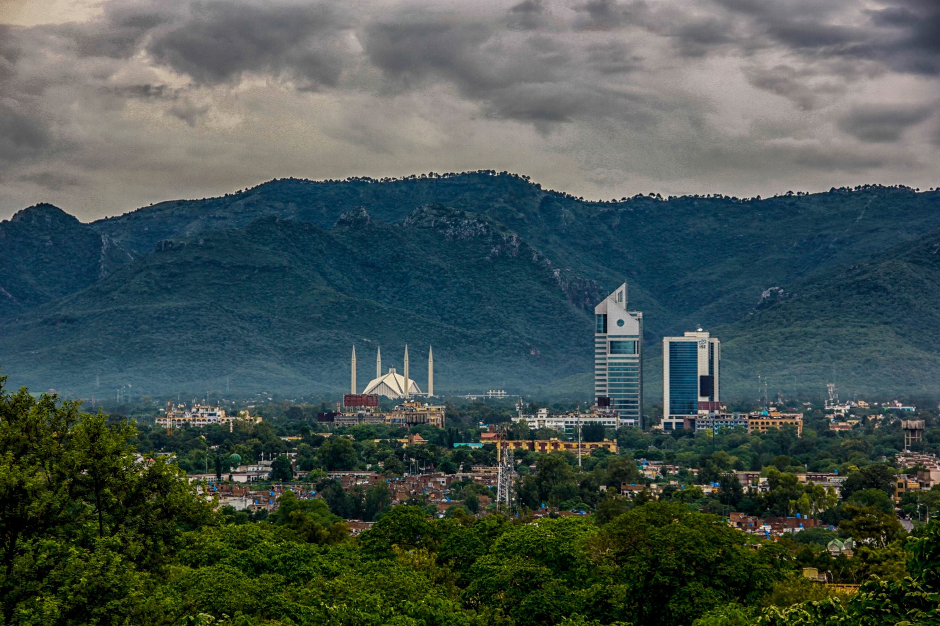
Coordination with COPB
COPB is the PoC for all correspondences with SPD
PNRA refers all cases to COPB for:
  Approval of regulations (as per directives of SPD)
  Policy matters, ROSS approval
  Approval for holding various events such as workshop/training courses, etc in Pakistan involving foreign experts
  Clearance of research papers for publication
  International interactions (arrangements with foreign countries, data sharing, issuance of NOC for visits abroad), etc.
Thank You

