Slide 1
Deployment And Uses Of Floating Nuclear Power Plants Powered By Small Modular Reactors
Scott Edwards
Director of Regulatory Development | CORE POWER

Slide 2
Agenda
1.
The Problem
4.
Regulatory Requirements
2.
The Solution – Floating Nuclear
5.
Conclusions
3.
Deployment Opportunities

Slide 3
The Problem

Slide 4
The current nuclear landscape
Nuclear is seen as one of the lynchpins to develop a fully decarbonised electricity system
Recent large-scale projects however especially in European countries and the US have suffered from massive cost and time overruns.
It is hoped that the advent of SMR technology will reduce this, however these deployments will still require extensive civil works for deployment.
To meet the ambitious goals set out at the COP 28 to triple nuclear capacity by 2050 a technological game changer will be required.

Slide 5
The Solution – Floating Nuclear

Slide 6



Inherent passive safety and operational simplicity
Long fuel cycles
Minimal Emergency Planning Zones
Notes:
Requirements for maritime nuclear

Slide 7
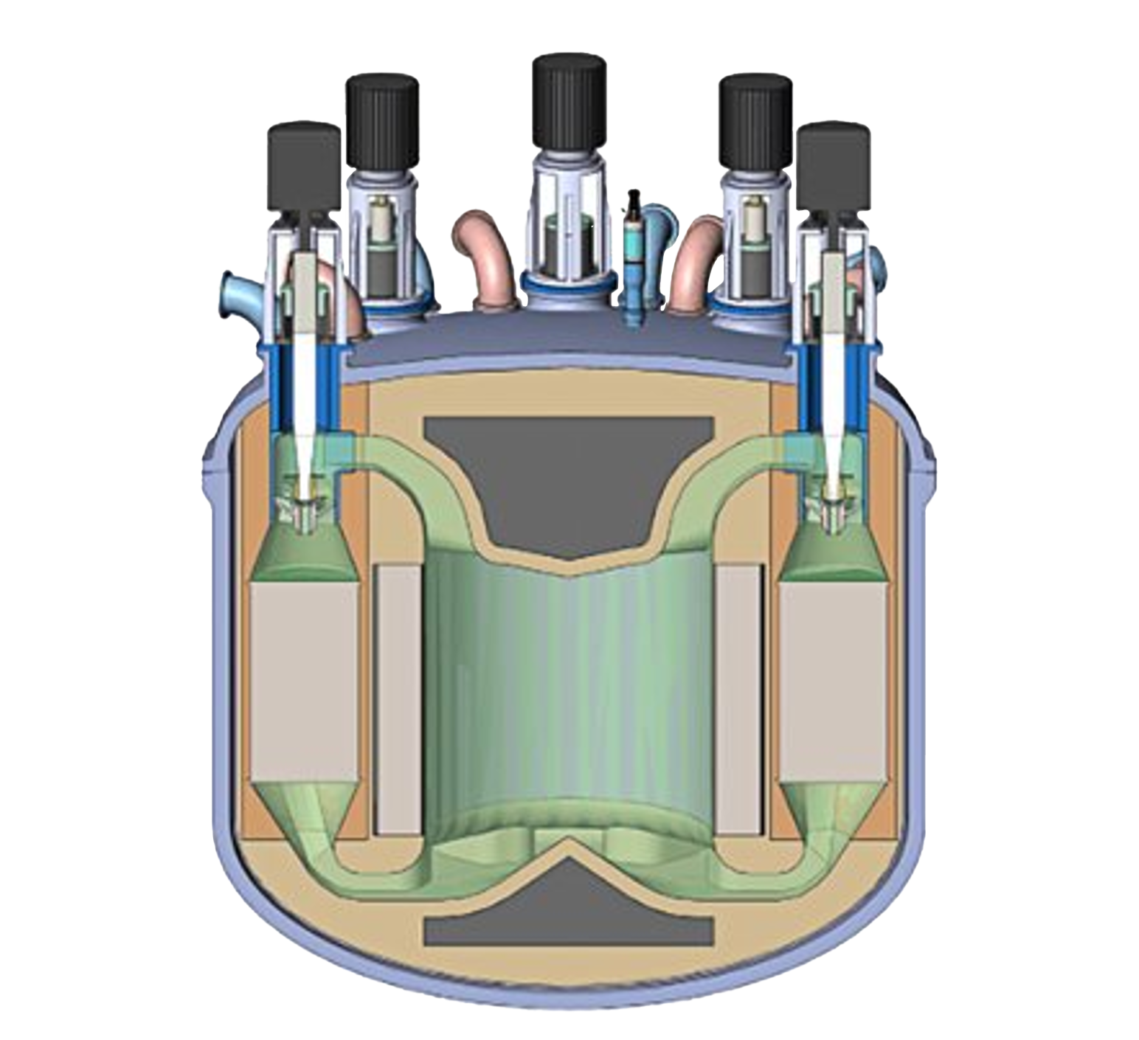
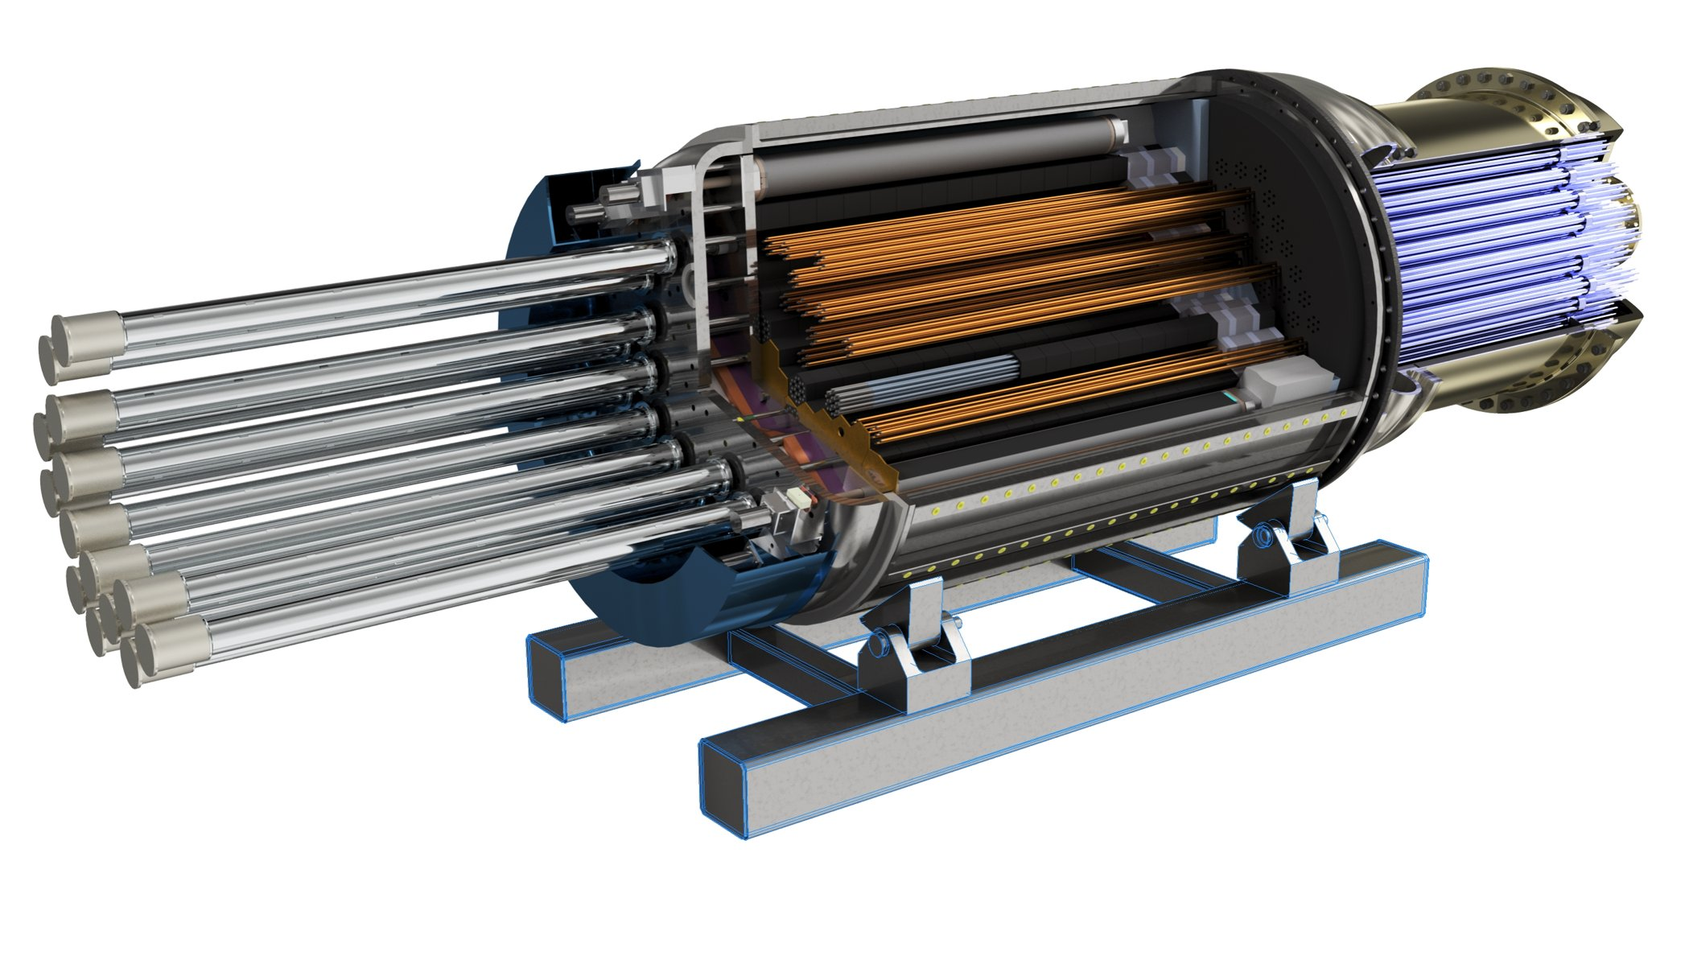
Molten Salt Reactors
Use a liquid molten salt that contains both the fuel and coolant
Passive safety features requiring minimal intervention
Ambient pressure so minimal risk of material expulsion
Heat Pipe Reactors
Solid State Reactor with minimum moving parts
Low pressure reactor with 10–15 year refuelling cycle
Fully factory built and able to be mounted on barges

Slide 8



Siting Flexibility and redeployability
Complete safety from geological events
Immediate and easy access to the world's largest heat sink
Notes:
Benefits of maritime deployment

Slide 9
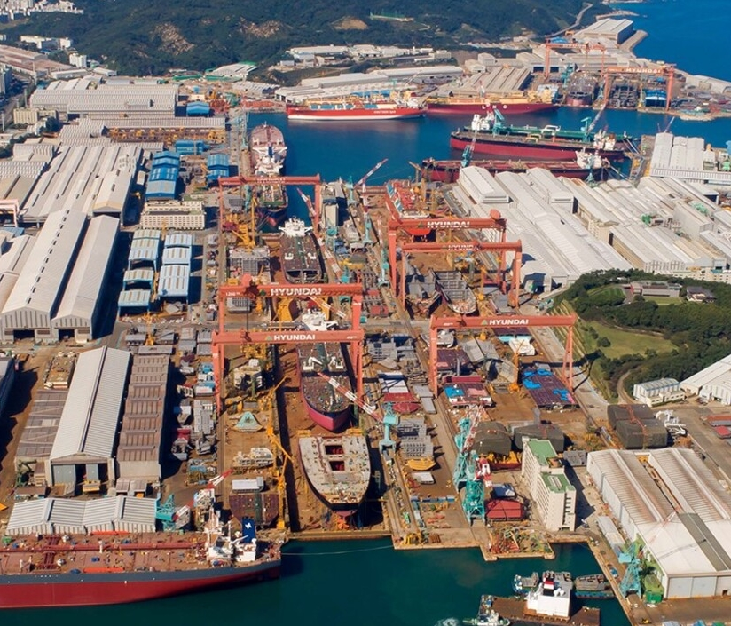
The benefits of shipyard construction
The key benefit of maritime nuclear is the ability to move to full factory construction.
Repeated builds will allow the nuclear industry to achieve full nth of a kind production
Experience of the US Navy has already shown that this is possible through the deployment of SMR powered submarines

Slide 10
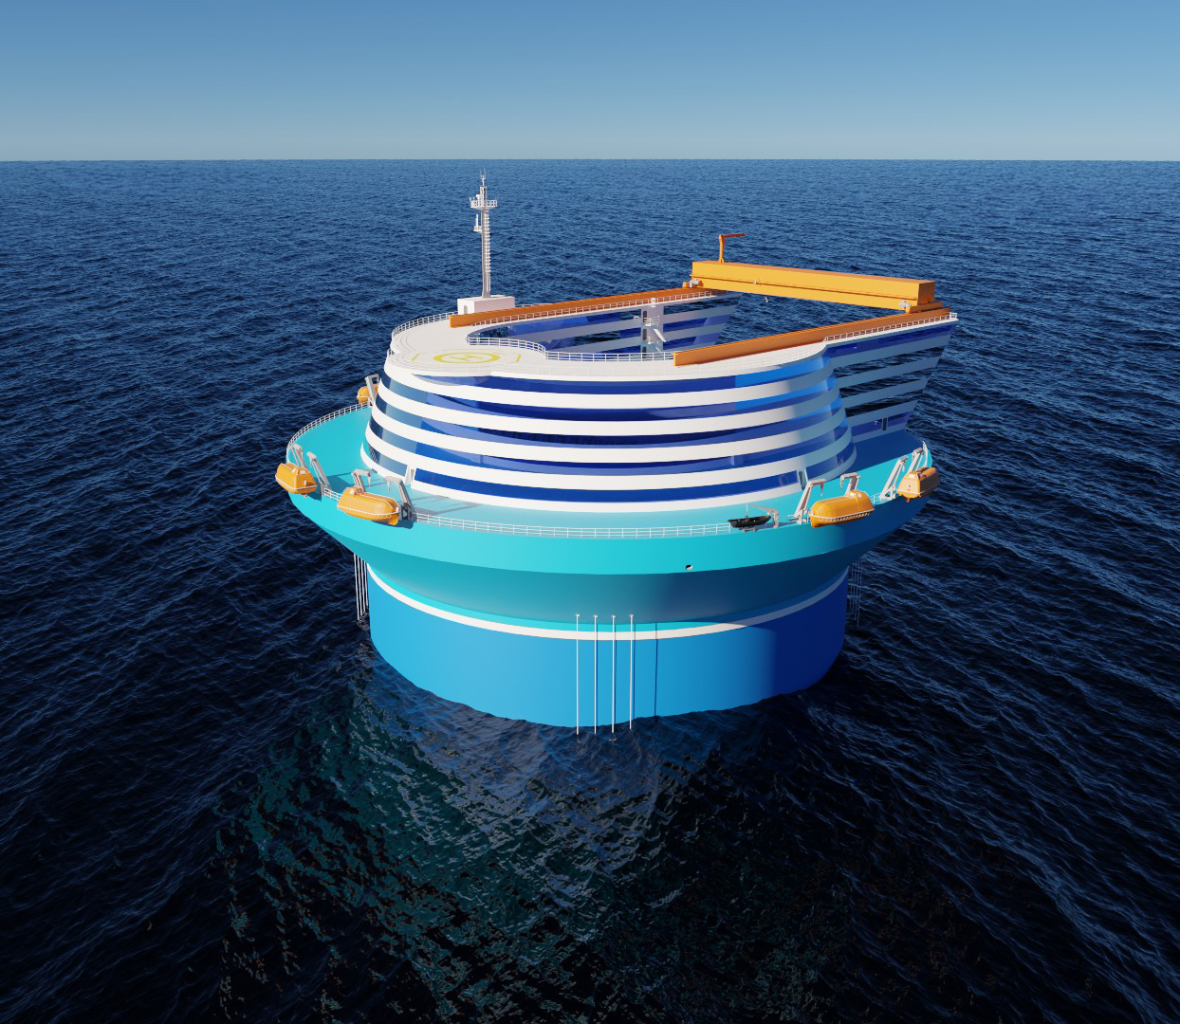
Deployment Opportunities

Slide 11
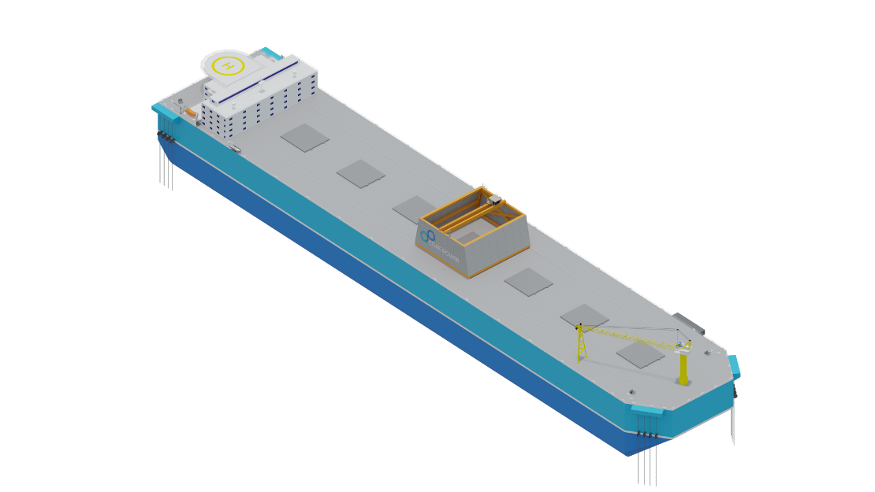
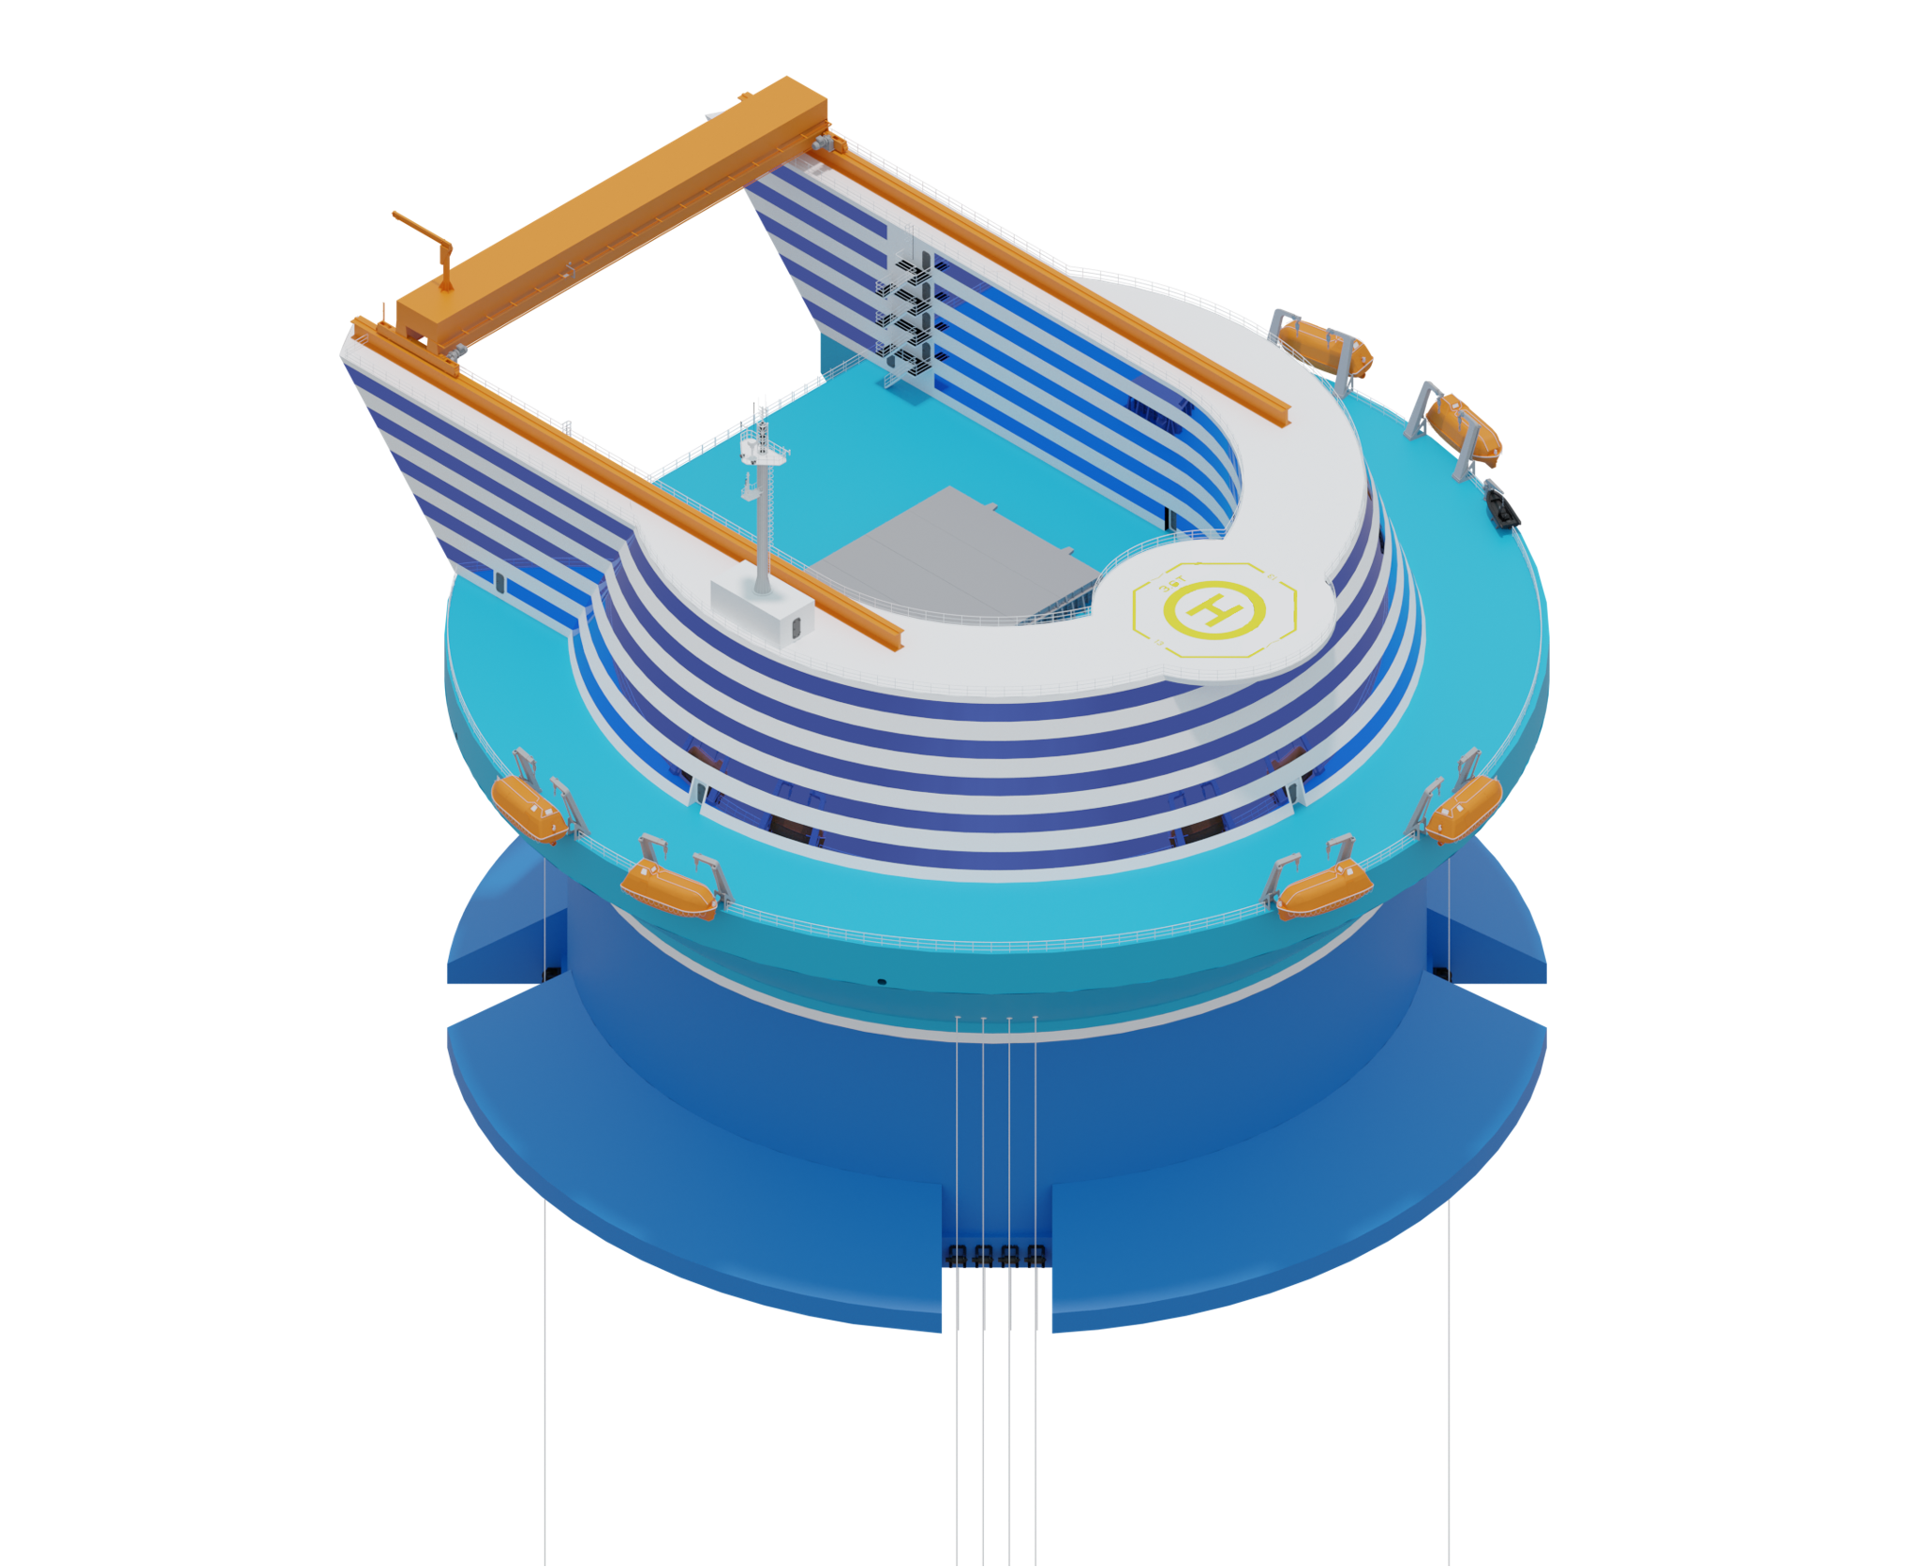
CORE POWER FNPP Designs

Slide 12
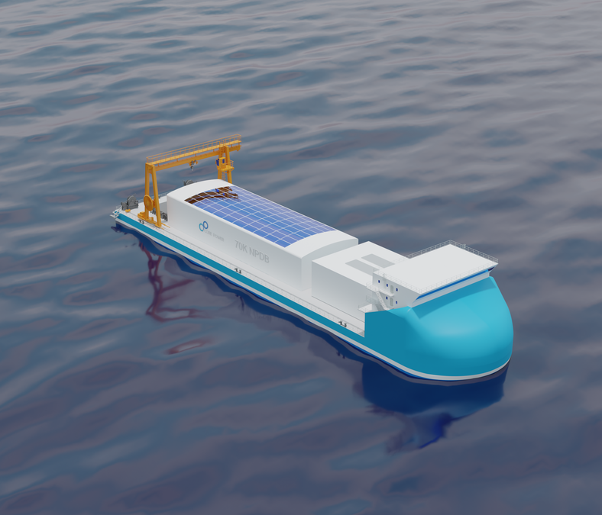
Desalination
Global water demand is expected to grow by ~30% by 2050 aggravating already existing water shortages.
Current desalination plants can suffer from low utilisation rates when water Is abundant making them expensive to run.
Nuclear powered floating desalination plants could alleviate this issue.
Able to provide power and water they offer a more attractive economic proposition for deployment.

Slide 13
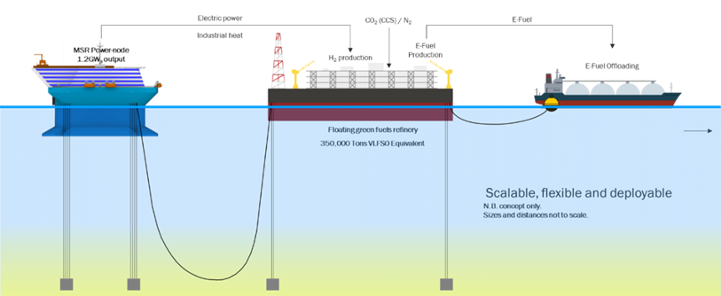
Production of Efuels
Notes:
Efuels Discussion – Mention MIT Project here

Slide 14
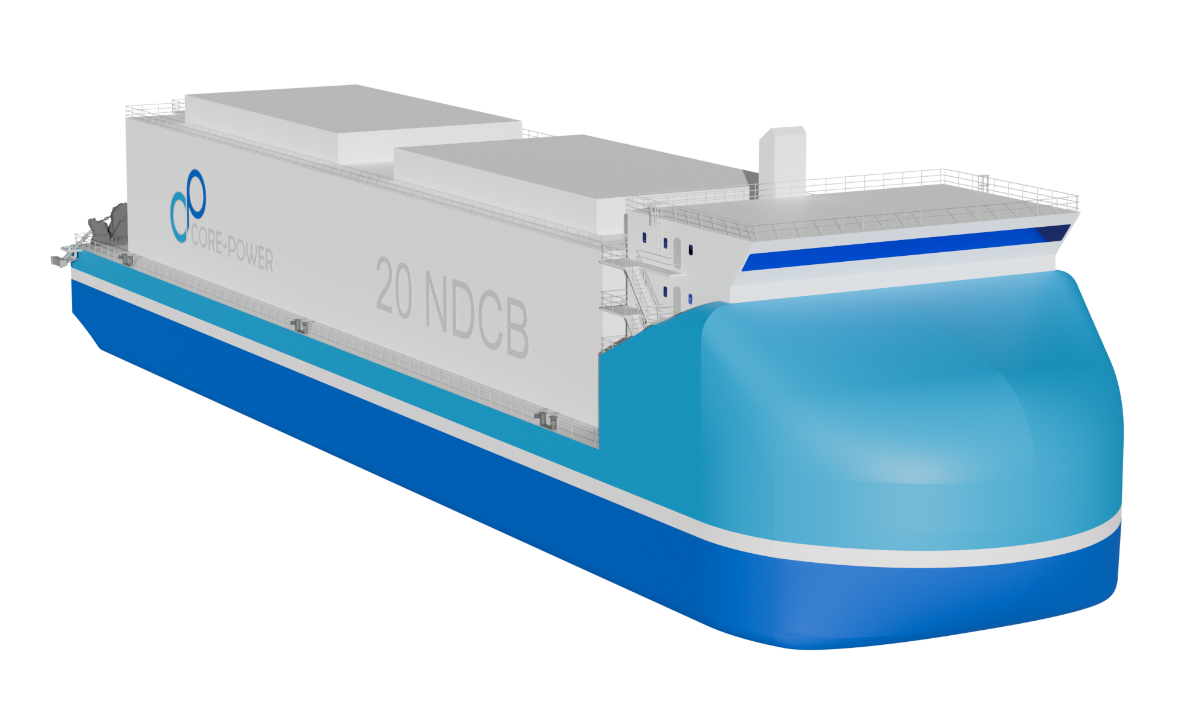
Floating Data Centres
Data centres are one of the fasting growing loads on the electricity grid. Demand is predicted to reach 2600 TWh by 2024.
This is expected to accelerate with the further digitalisation and the increasing prevalence of AI technologies.
Floating Data Centres powered by SMRs could speed up deployment without putting strain on constrained local grids.

Slide 15
Regulatory Requirements

Slide 16
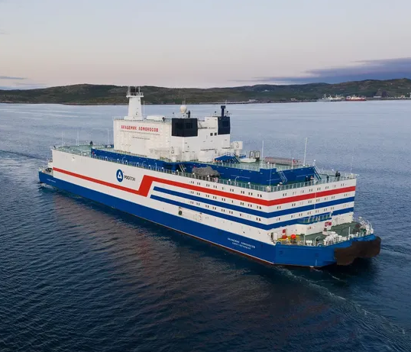
Current Regulations
Currently there are no specific regulations governing the use of FNPP’s at an international level.
The world's only floating nuclear power plant the AKADEMIK LOMONOSOV was built and operate solely under national regulations.
Work has begun at the IAEA on a TECDOC on the Design Safety and Security Considerations for Floating Nuclear Power Plants
The IMO has existing rules for nuclear powered ships, but they have not been updated since the 1980s

Slide 17
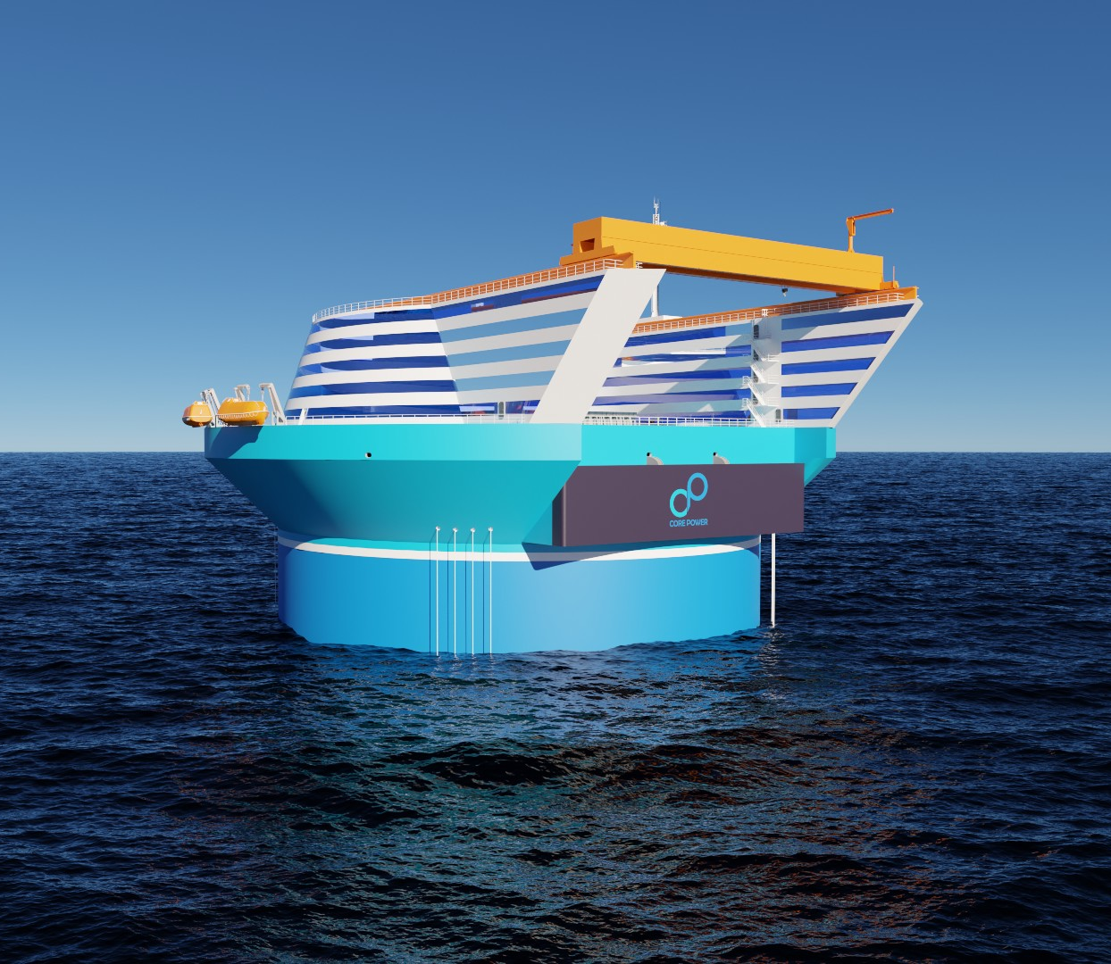
Conclusions

