Slide 2

Classification Requirements for Floating Nuclear Power Plants (FNPPs)
American Bureau of Shipping (ABS)
Meg Dowling
Derek Novak
Jin Wang

Slide 3
Contents
Maritime Demand for Decarbonization
Maritime Regulatory Framework
Regulations for Commercial Nuclear Maritime Applications
ABS Requirements for Nuclear Power Systems
  Stakeholder Roles
  Risk Assessment
  Marine and Nuclear System Interface
3 | Classification Requirements for Floating Nuclear Power Plants (FNPPs) Track A.4 - 185

Slide 4
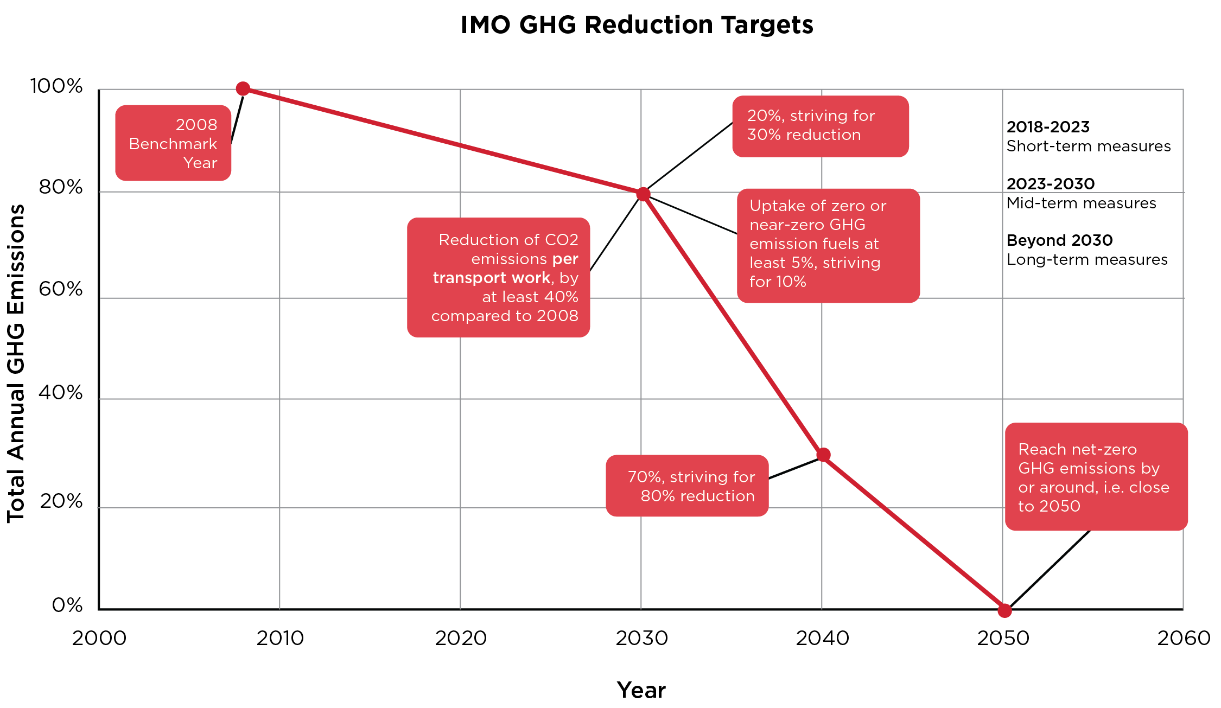
Maritime Demand for Decarbonization
International Maritime Organization (IMO) targets eliminating all greenhouse gases from shipping by 2050
Mid-term measures must be adopted in the 2030s
4 | Classification Requirements for Floating Nuclear Power Plants (FNPPs) Track A.4 - 185

Slide 5
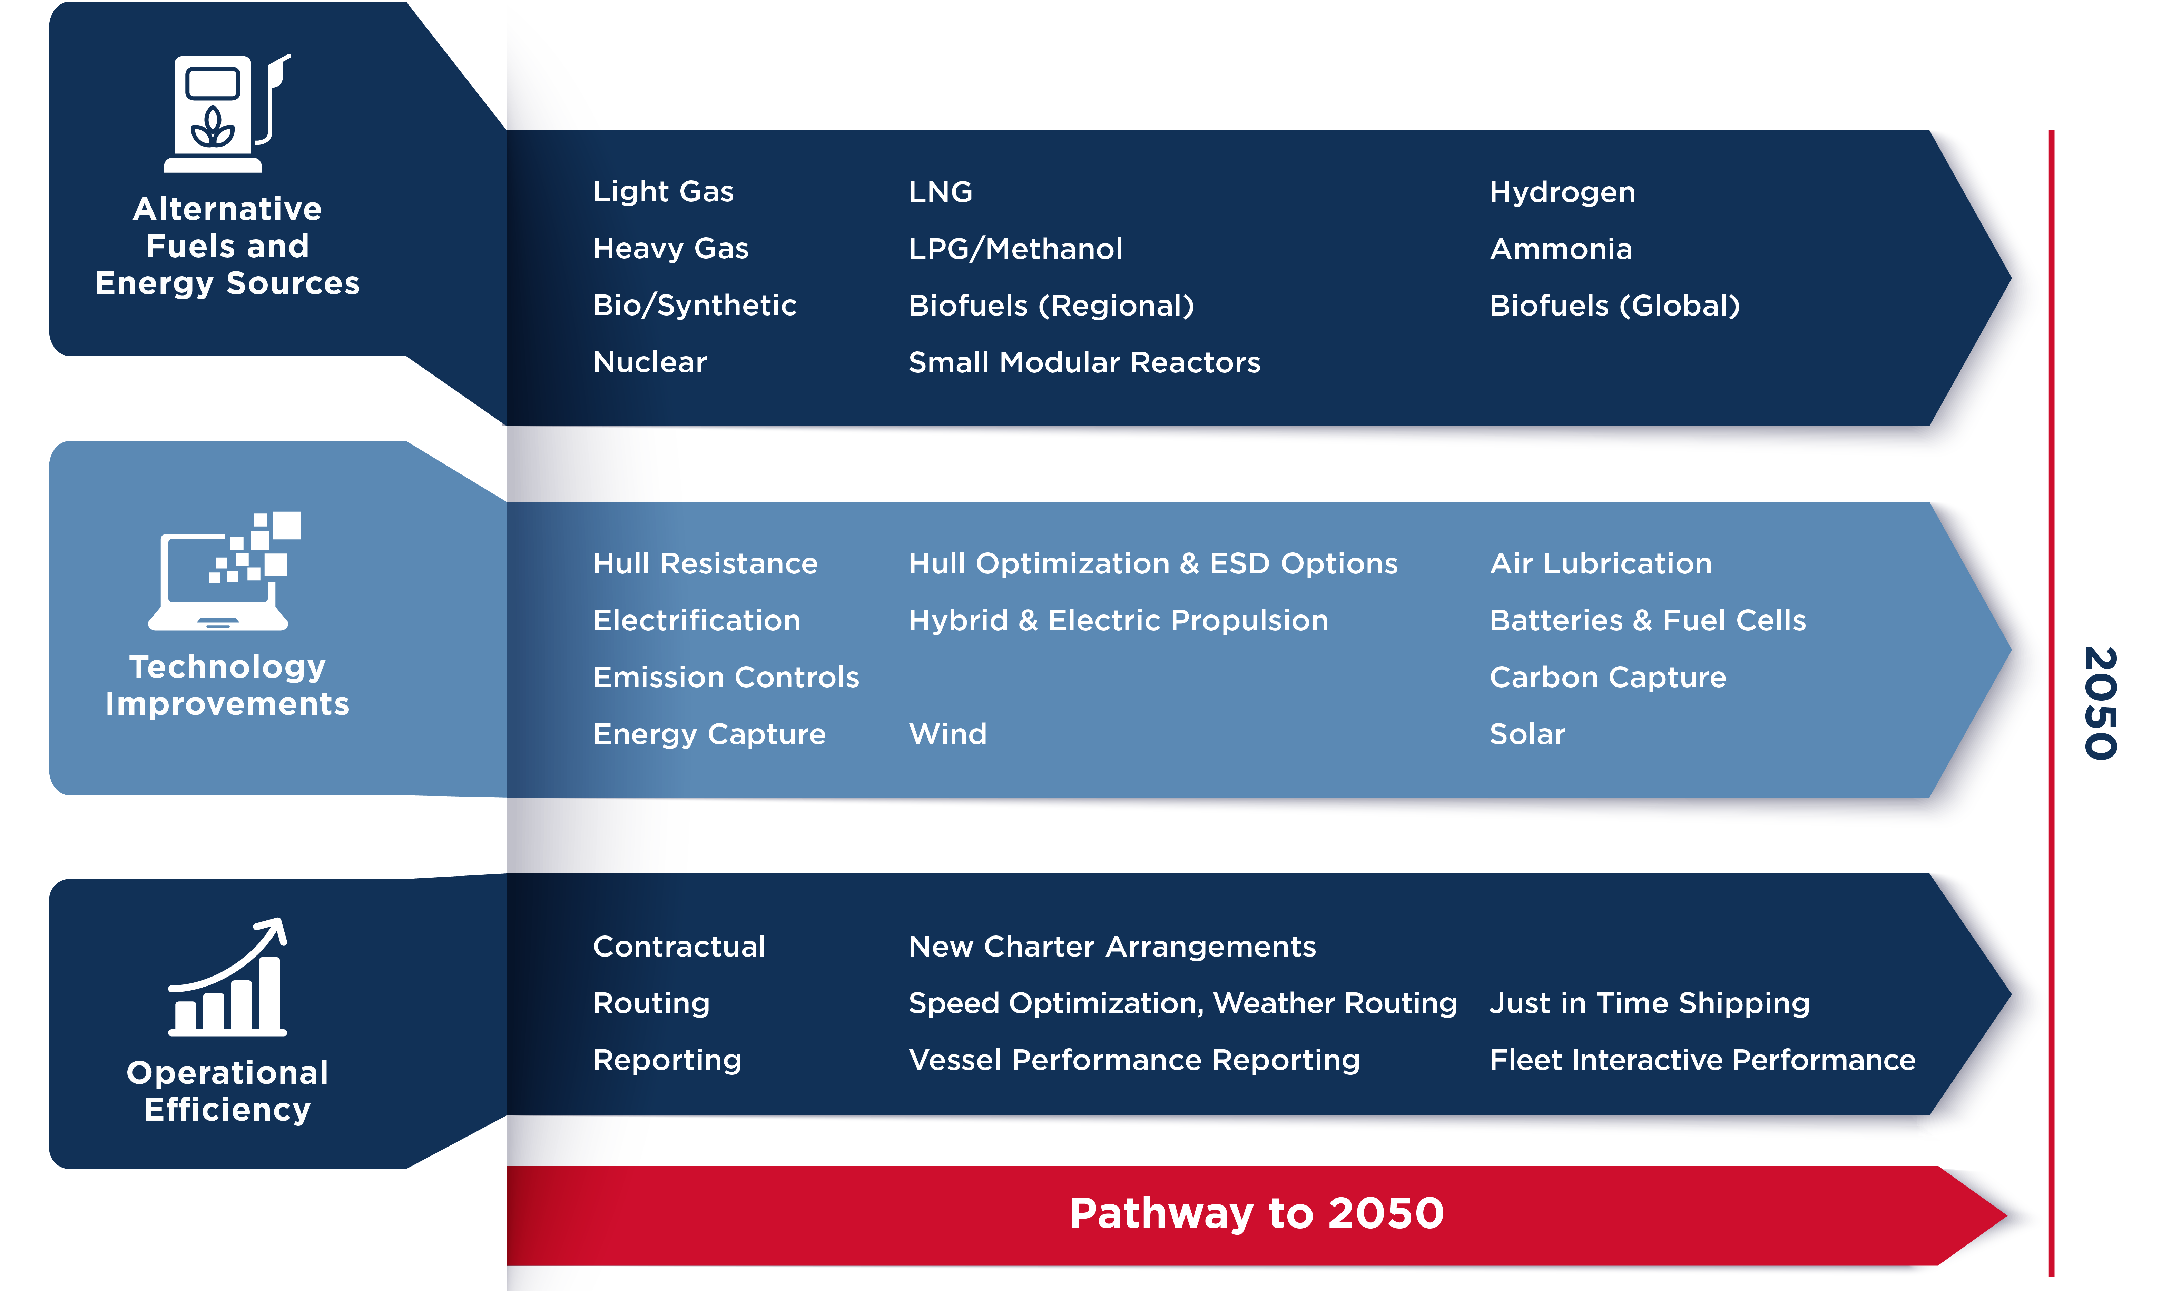
Maritime Demand for Decarbonization
5 | Classification Requirements for Floating Nuclear Power Plants (FNPPs) Track A.4 - 185

Slide 6

Maritime Regulatory Framework
Classification Societies (Class)
International Maritime Organization (IMO)
Codes and standards for commercial vessels endorsed and implemented by member States
International Association of Classification Societies (IACS)
Non-Governmental Organizations (NGOs)
Establish and administer standards for design, construction and survey
Appointed by flag Administrations as Recognized Organization (RO) to perform statutory inspections
6 | Classification Requirements for Floating Nuclear Power Plants (FNPPs) Track A.4 - 185
Notes:
174 Member States and other Non-Governmental Organizations
For Classification Societies,
Class Certificate demonstrating Compliance issued by Classification Society

Slide 7
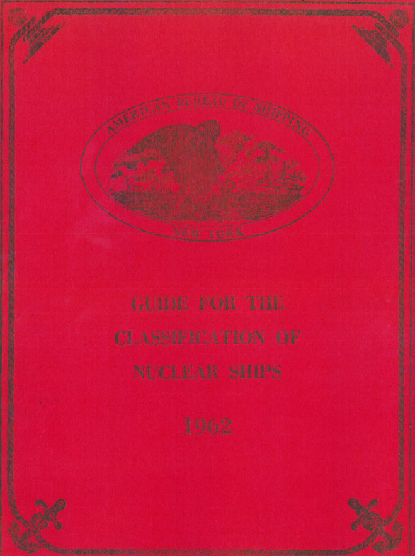
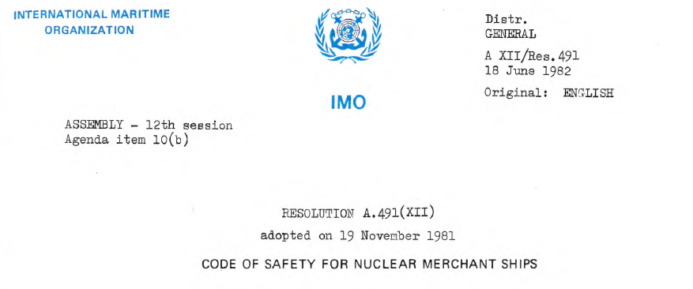
Requirements for Nuclear Propulsion
International Regulations
Classification Rules
International Convention for the Safety of Life at Sea (SOLAS) Chapter VIII: Nuclear Ships
7 | Classification Requirements for Floating Nuclear Power Plants (FNPPs) Track A.4 - 185
Notes:
Outdated
Old, PWR-Based, But not bad thinking…
Established set of requirements, including goals and technical requirements from which functional requirements could be derived by nuclear and maritime experts.

Slide 8
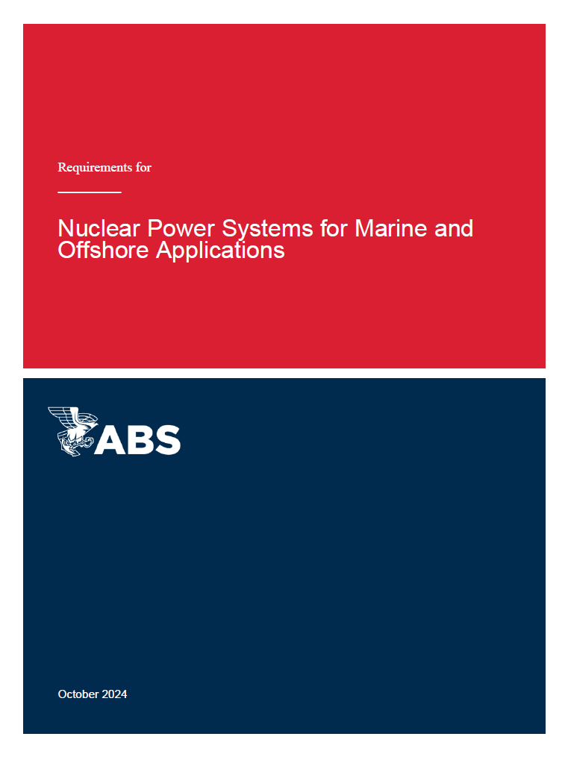
ABS Requirements for Nuclear Power
Non-nuclear propulsion maritime applications (i.e., FNPPs)
Mandatory Power Service (Nuclear) Notation
Suitable for any type of nuclear technology
Designated interface between stakeholders according to marine or nuclear service
8 | Classification Requirements for Floating Nuclear Power Plants (FNPPs) Track A.4 - 185

Slide 9




Stakeholder Roles
© Adam Melnyk/Shutterstock
Flag Administration
Classification Society
© EtiAmmos/Shutterstock
Nuclear Regulator
Port Authorities/Port States, Coastal States and Port State Administration
9 | Classification Requirements for Floating Nuclear Power Plants (FNPPs) Track A.4 - 185
Notes:
Flag Administration
- The national authority with whom the vessel is registered
Classification Society
-Flag-Administration designated recognized organization (RO) for design review and approval, as well as audits, survey and inspection.
Nuclear Regulator
- Independent agency of a national authority that has authority over the approval and licensure of nuclear reactors and related systems.
Port Authorities/Port States, Coastal States and Port State Administrations
- Appropriate authority of the country in which the vessel is operating, stationed, or laid up.
Port State Administration may also be the appropriate authority of the country:
● in which the vessel is constructed (nation of construction);
● where the vessel is serviced or maintained, either in a floating condition or in drydock; or
● where the vessel may be deactivated and decommissioned.

Slide 10
Risk Assessments
Considerations for Maritime Applications
Marine Systems
Nuclear Hazards Imposed on Marine Safety
Radioactivity
Thermal Energy
Corrosive Materials
Unit Safety
Marine Hazards Imposed on Nuclear Safety
Structural Loads
Motions
Onboard Fire
External Hazards
Mooring
Nuclear Systems
10 | Classification Requirements for Floating Nuclear Power Plants (FNPPs) Track A.4 - 185
Notes:
Goals and Objectives
Aid in decision making to introduce risk-reduction measures
Demonstrate that the risks involved with NPPs have been evaluated resolve any adverse effect to the security of life, property, and the natural environment.
Use acceptable and recognized risk analysis techniques to determine that there are no unacceptable risks to the asset, people or the environment.

Slide 11
Interface Document
Establish Technical Agreement Among Stakeholders
11 | Classification Requirements for Floating Nuclear Power Plants (FNPPs) Track A.4 - 185
Notes:
Describe the marine and nuclear systems
Stakeholders whose approvals are necessary
The responsibilities assigned to the Stakeholders
Form the technical agreement between stakeholders to confirm that all parties involved understand and accept the distribution of responsibilities.

Slide 12
Key Takeaways
Classification functions as RO of flag Administration
ABS class requirements allows for any type of nuclear technology for FNPP use
Process involves nuclear regulator to license reactor(s)
Risk assessment informs design decisions
Interface document must be developed and agreed upon to establish the division of responsibility between review and approval authorities
12 | Classification Requirements for Floating Nuclear Power Plants (FNPPs) Track A.4 - 185

Slide 13
Thank You

