Slide 2
RISK-BASED TECHNOLOGY QUALIFICATION MARINIZATION OF SMRS
Paper 107
Jose ESTEVE OTEGUI
Bureau Veritas Marine & Offshore

Slide 3
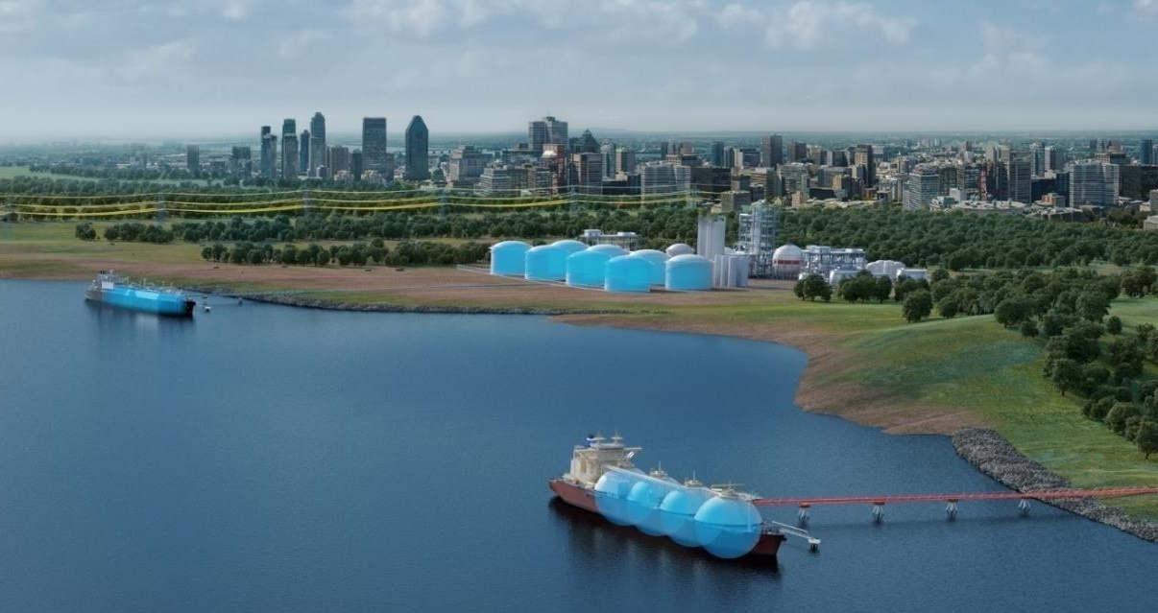
Technology Qualification in the Gas Value Chain
Two decades ago :
  The LNG Carrier loads from a Liquefaction terminal (A)
  The LNG Carrier offloads at an import terminal for regasification and redistribution to grid (B) (in a different country)
Gas fields offshore sent the feedgas to liquefaction terminals through subsea pipelines
(A)
(B)
LNG: Liquefied Natural Gas

Slide 4
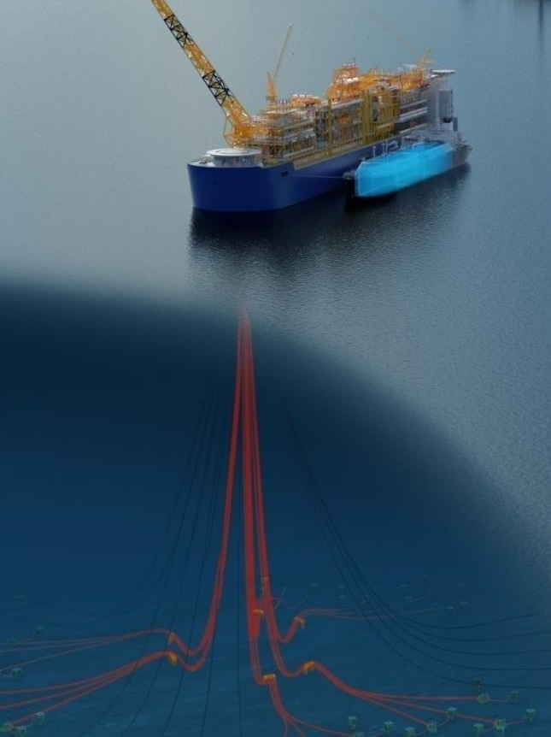
Technology Qualification in the Gas Value Chain
But the industry asked itself, what if we :
  Send the liquefaction terminal right where the gas fields are (D), even if at hundreds or a thousand meters depth ?
  Have the LNG Carrier load directly from the offshore floating terminal? (A)
(C)
(A)
  This was achieved through Technology Qualification, using risk assessments for components never used before or used in a very different environment.
  FLNGs (C) started to appear and operate
(D)
FLNG: Floating Liquefied Natural Gas

Slide 5
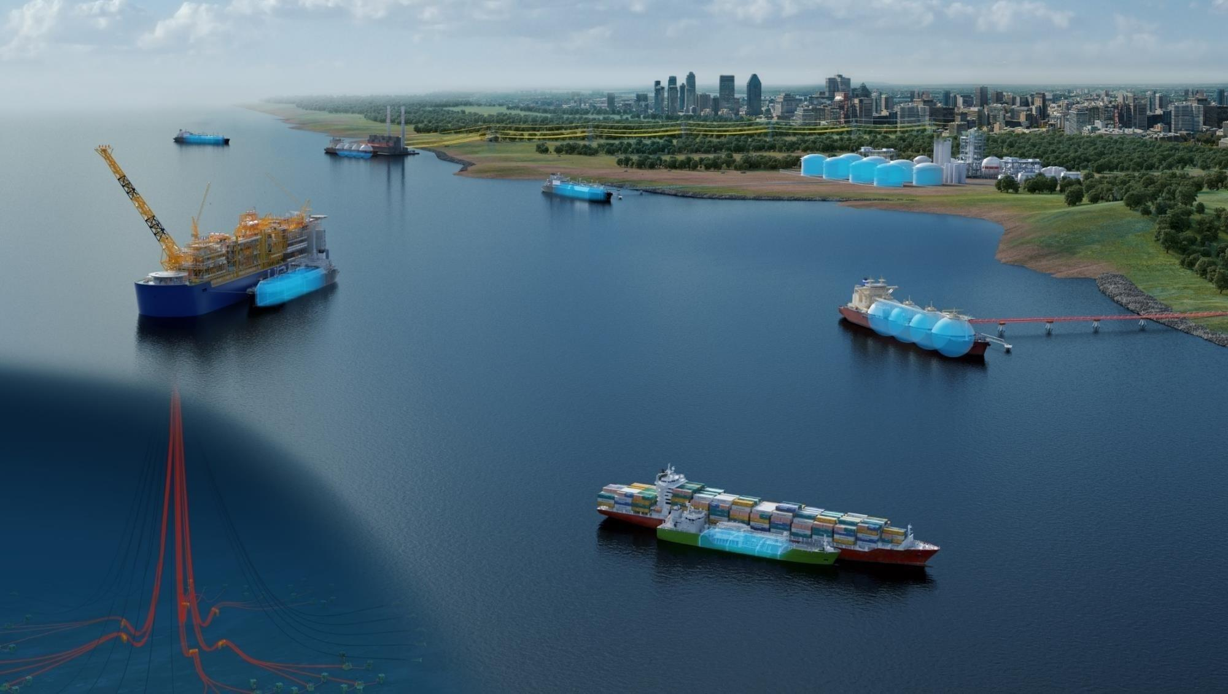
Technology Qualification in the Gas Value Chain
These are arctic-capable LNG Carriers
(F)
(A)
(C)
(A)
Since then :
  There are 8 FLNG projects worldwide
  There are 50+ FSRU units operating
  LNG is transferred as a fuel to other vessel types (bunkering) (E)
  Floating Gas-powered barges are being fed by FSRUs (F)
  .
(B)
(E)
(D)
FSRU: Floating Storage Regasification Unit

Slide 6
Objectives:
  Technology maturity vs deployed application: new environment, new combination of components to deliver a function, new components,…
  Identification of failure modes and associated risks
  Demonstration that mitigation and control means are in place through qualification activities
  Identification of most applicable existing codes & standards or conclusion of their absence
  Confirm feasibility of concept / Confirm presence of shows-stoppers
Risk-Based Technology Qualification
FNPPs and TNPPs
FNPP: Floating Nuclear Power Plant
TNPP: Transportable Nuclear Power Plant

Slide 7
Technology Qualification Battery Limits
Introduction to the Technology
  Purpose of the Facility
  Expected environmental and Operational Conditions
  Minimum Design Life
Technology Description
  Functional Breakdown
  Physical Breakdown
  Acceptance Criteria
  Life-Cycle Phases
Scope and Technology Description
Focusing on the interface between
“clearly, this is nuclear technology”
and
“clearly, this is marine technology”

Slide 8
Principal Functions
  Energy Production
  Electricity Production
  Energy and/or Electricity Distribution
  Others?
Auxiliary or Secondary Functions
  essential for the completion of principal functions
Constraint Functions
  made necessary by the conditions to which it is exposed to
Nuclear-related Constraint Functions
  Radiation Containment Barrier(s)
  Nuclear Safety Barriers
  Security Barriers
Functional Breakdown
Physical Breakdown Linking systems and components to the functions they provide | Acceptance Criteria Either through codes & standards or project specific based on the functions defined

Slide 9
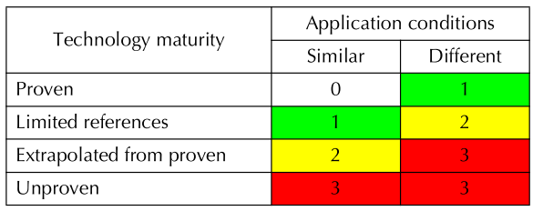
Materials
  not used for the conditions and/or functions
Components
  Not used for the functions being considered
  Not used in a system/configuration proposed.
  Used in different operational/environmental conditions.
  For which the codes or acceptance criteria being considered have not been applied before.
Maturity Assessment
Linked to TRL but not the same
TRL: Technical Readiness Level

Slide 10
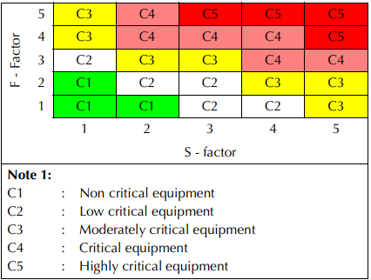
Risk Assessment
Criticality Ranking
(PoF ; Severity)
Focusing on Maturity Ranking > 1
PoF: Probability of Failure
Probability of failure ranging from
Extremely improbable, not expected in design life | to | Extremely probable, several occurrences during design life
Severity of failure ranging from
No personnel injured, Minor environment impact, Minor production impact | to | Multiple fatalities/permanent disabling Major environment impact, Total permanent production loss

Slide 11
Describe
  Qualification activities & give acceptance criteria
  RACI
  Surveillance and inspection requirements
May refer to 3rd party Certification activities
Nature of Qualification Activities
  Engineering analysis
  Destructive Testing
  Manufacturing Tests; FAT
  Visual Inspection & Monitoring
  QA/QC audits
Execution Tracking & Reporting
Qualification Plan
Evidence that risks are addressed
Using Criticality Ranking as basis
RACI: Responsible, Accountable, Consulted, Informed
FAT: Factory Acceptance Test
QA/QC: Quality Assurance & Quality Control

Slide 12
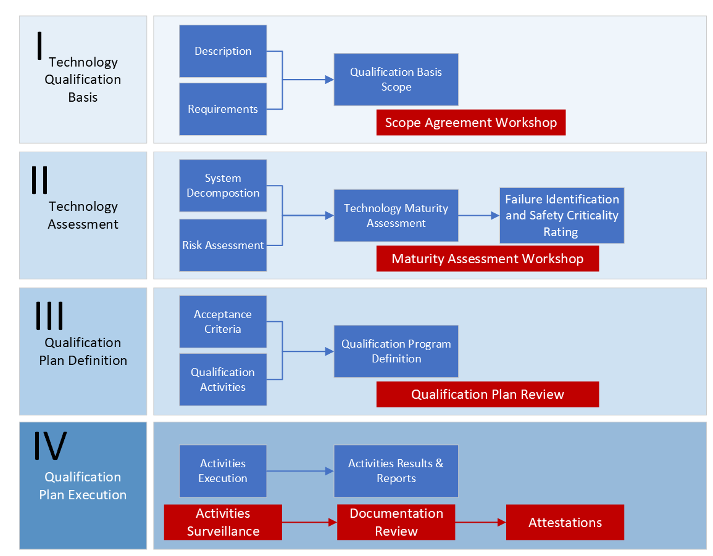
SUMMARY
Support a due diligence process for joint civil nuclear and marine stakeholders to deliver FOAK FNPPs and TNPPs
FOAK: First of a Kind

Slide 13
Thank you for your attention
Paper 107
Jose ESTEVE OTEGUI
Bureau Veritas Marine & Offshore

