Slide 2

AI FOR DESIGN, ENGINEERING, CONSTRUCTION, AND OPERATION OF SMRS
Prof. NAWAL K. PRINJA
Technology Director, Energy & Environment International, Amentum
(previously Jacobs Clean Energy)
Booths Park, Knutsford, WA16 8QZ, UK
email: nawal.prinja@jacobs.com

Slide 3
Contents
Introduction
AI for Material Qualification
AI for Cogeneration and load following
AI for NDT / ISI
AI for QC and SCM
AI for KMKP
Conclusions

Slide 4
Current Position
Experience
Advisor to the Ministry of Defence (MOD) on the Nuclear Propulsion Research & Technology programme for the nuclear submarines and chair of AI Technology Focus Group for nuclear propulsion.
Technical Expert invited by the IAEA (United Nations) to chair expert meetings on safety classification and Technology Readiness Levels and to participate in Nuclear Knowledge Management and Seismic expert missions to UAE, S Africa, China, Spain and Poland.
Member and Ex-Chair of CORDEL at WNA.
Member of the EC funded FENET and EASIT2 projects aimed at developing computer based simulation competencies.
Member of the Board of Directors for the Professional Simulation Engineer (PSE) certification scheme.
Technology Director, Jacobs
Honorary Professor in the School of Engineering at Aberdeen University.
Honorary Professor in the College of Engineering, Brunel University London.
Member of the Nuclear R&D Advisory Board to the UK Government.
Chair of Industry Advisory Committee for the National Structural Integrity Research Centre at Cambridge.
Ex-Member of Technical Assessment Panel of Fusion for Energy (F4E)
Honorary Professor, School of Engineering, Bolton University.
Independent assessor appointed by the Innovate UK of UKRI.
Appointments
43 years of engineering and technology experience in aerospace, automotive, oil & gas and nuclear power.
Over 50 Technical publications including 3 books.
Honorary Professor, School of Computer Science and Electronic Engineering, the International Centre of Nuclear Engineering, Bangor University.
UK representative and Chair of the Senior Industry Advisory Panel of Gen IV International Forum (GIF)
Member of Plant Systems Design code committee of ASME.
Ex-Member of the Fusion Advisory Board, EPSRC of UKRI.
Member of Digital Twin Steering Group in the UK.
Member of the lead team of ‘AI for Nuclear’ group of the Nuclear Institute.
Recipient of the Donald Julius Groen prize from IMechE for an outstanding contribution to the advancement of pressure systems technology on 1 Dec’23.
My Introduction
Prof. Nawal K Prinja

Slide 5
The Way We Do Engineering is Changing
Impact of AI and Data Science
Future
Present
Past
Data Based Understanding
Mechanistic Understanding
Empirical Understanding

Slide 6
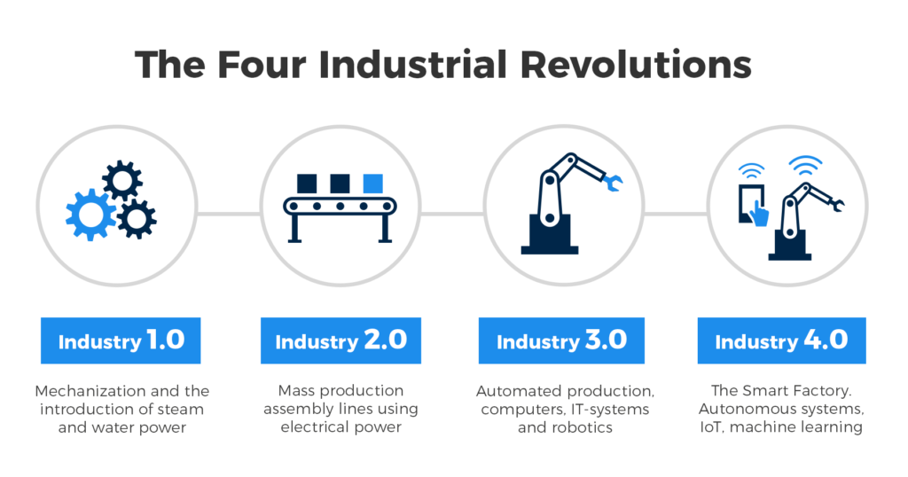
Engineering after 3rd & 4th Industrial Revolution
Predictive Capability
Uncertainty Quantification
Optimisation
Hybrid Modelling
The integration of computer simulation technologies from the 3rd Industrial Revolution with AI from the 4th Industrial Revolution is transforming engineering simulations. This synergy enhances accuracy, speed, and accessibility, enabling engineers to tackle complex problems more effectively and innovate in ways previously unimaginable
Prof. Nawal K Prinja
6

Slide 7
AI in Material Qualification
AI for Materials
New materials and joining techniques require a large number of physical qualification tests for inclusion in codes and standards.
AI can help reduce the number of experimental campaigns.

Slide 8
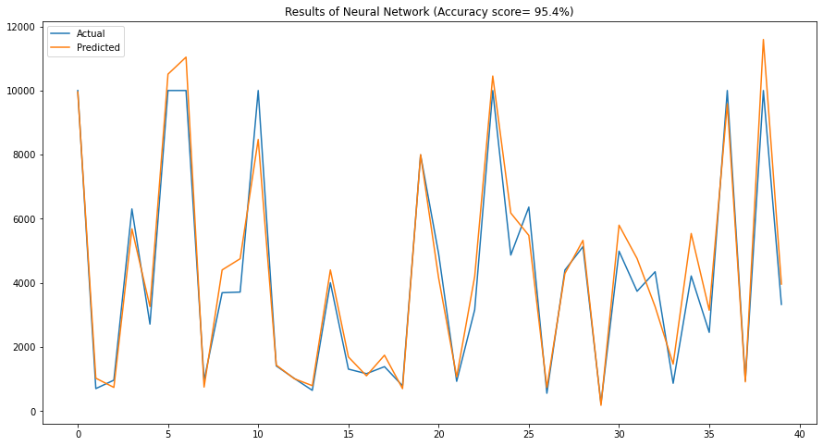
Example : Predicting Environmental Impact on Fatigue/Fracture Behaviour of Steel
246 tests conducted to establish environmental impact on number of cycles it took for a specimen to reach failure.
135 input features were being monitored. Data analysis was done to perform correlation, principal component analysis and feature importance to reduce the number of features to 9.
A sequential Artificial Neural Network (ANN) model with 10 dense layers of neurons was developed.
The data was split 80%-20% to train and test the model.
95.4% accuracy was achieved by the ANN model.
Results of 38 tests were predicted with 95.4% accuracy from previous data.
At £15000/test, over half a million pounds could have been saved.
The INCEFA PLUS data was generated under the INcreasing safety in NPPs by Covering gaps in Environmental Fatigue Assessment (INCEFA) project funded by H2020 which is the EU funding programme for research and innovation. Data courtesy of Alec McLennan

Slide 9
Material properties predictor for power plant steels (M4Ps)
AI models trained to predict material properties from known chemical composition and processing history.
58 steel types in the data base containing a number of steel product forms (tubes, plates, bars etc) used in power plants.
AI models predicted three sets of material properties : tensile properties (Proof Stress, Ultimate Tensile Strength, Elongation% and RA%), creep rupture properties (Fracture time, Elongation% and RA%) and hardness (HRB/HRC).
Accuracy ranged from 85% to 98%
Such AI models can help develop new materials.
A project being considered by CEN on use of AI to help qualify Cu-Cr-Zr for fusion industry for the French RCC-MRx code.

Slide 10


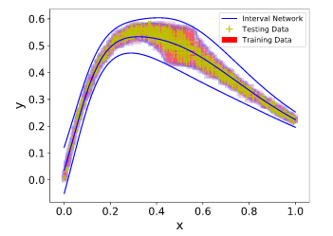
AI with Probabilistic Methods
THE PROBLEM: The existing AI are trained with deterministic data and models require a large number of physical tests to cover the natural variability in the material properties. An extra challenge for the nuclear industry is that there is not sufficient material test data available for such a data centric AI approach.
THE SOLUTION: Combine ANN with Bayesian statistics and Interval Predictor Models to enhance the robustness of the response. This allows for the uncertainties from the sparse data and material variability to be accounted for and it allows to provide the necessary confidence associated with the prediction.
Integrated AI and Probabilistic approaches
  Demonstrated the feasibility of merging AI with probabilistic tools;
  Increased robustness and accuracy of AI tools;
  Provided confidence in the predictions;
Probabilistic AI for Prediction of Material Properties (PROMAP)
Prof. Nawal K Prinja

Slide 11
AI for NDT and ISI
AI for Construction & Operation
In the nuclear industry, several types of welds are subjected to Non-Destructive Testing (NDT) and In-Service Inspection (ISI) to ensure safety and integrity.
Electron beam (EB) welding is highly significant in the manufacture of SMRs due to their speed (EB welding is about 10 times faster than traditional arc welding), cost savings, precision (minimal heat-affected zones) and the reduced heat input (minimizes thermal distortion and residual stresses).
Prof. Nawal K Prinja

Slide 12
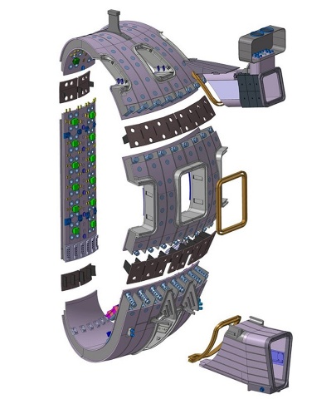
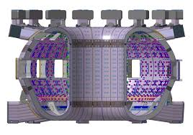
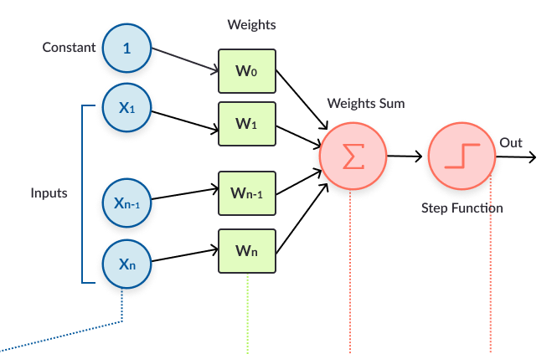
Example : AI model to improve EB Welding
Example: Predicting Outcome of EB Weld Inspections
AI Model
There are 9 sectors. Each sector requires over 10000 different types of welds with full 100% inspection.
Input: EB welding parameters.
Output: Probability of non-conformance
Result | Conformance
NC_EBW_R | Not conform - Defect related to EB Process - Weld to be repaired
NC_OTH_R | Not conform - Defect not related to EB Process - Weld to be repaired
NC_OTH_NR | Not conform - Defect not related to EB Process - No repairing need
NC_DOC_NR | NC related to documentation - No repairing need
C | Compliant- Weld accepted
EB Parameters | EB Conditions
Length | Sector/ Segment
Current | Orientation
Welding Velocity | Supplier
Focussing System Current | Type of weld
 | Position
Machine Learning from previous weld data
Prediction | Actual
One weld with 90% chance of failure | Failed
16 others with 56% to 60% chance of failure. | 7 out of 16 failed
Trained AI using 1802 welds data. Predicted outcome of the 70 new welds to do.

Slide 13

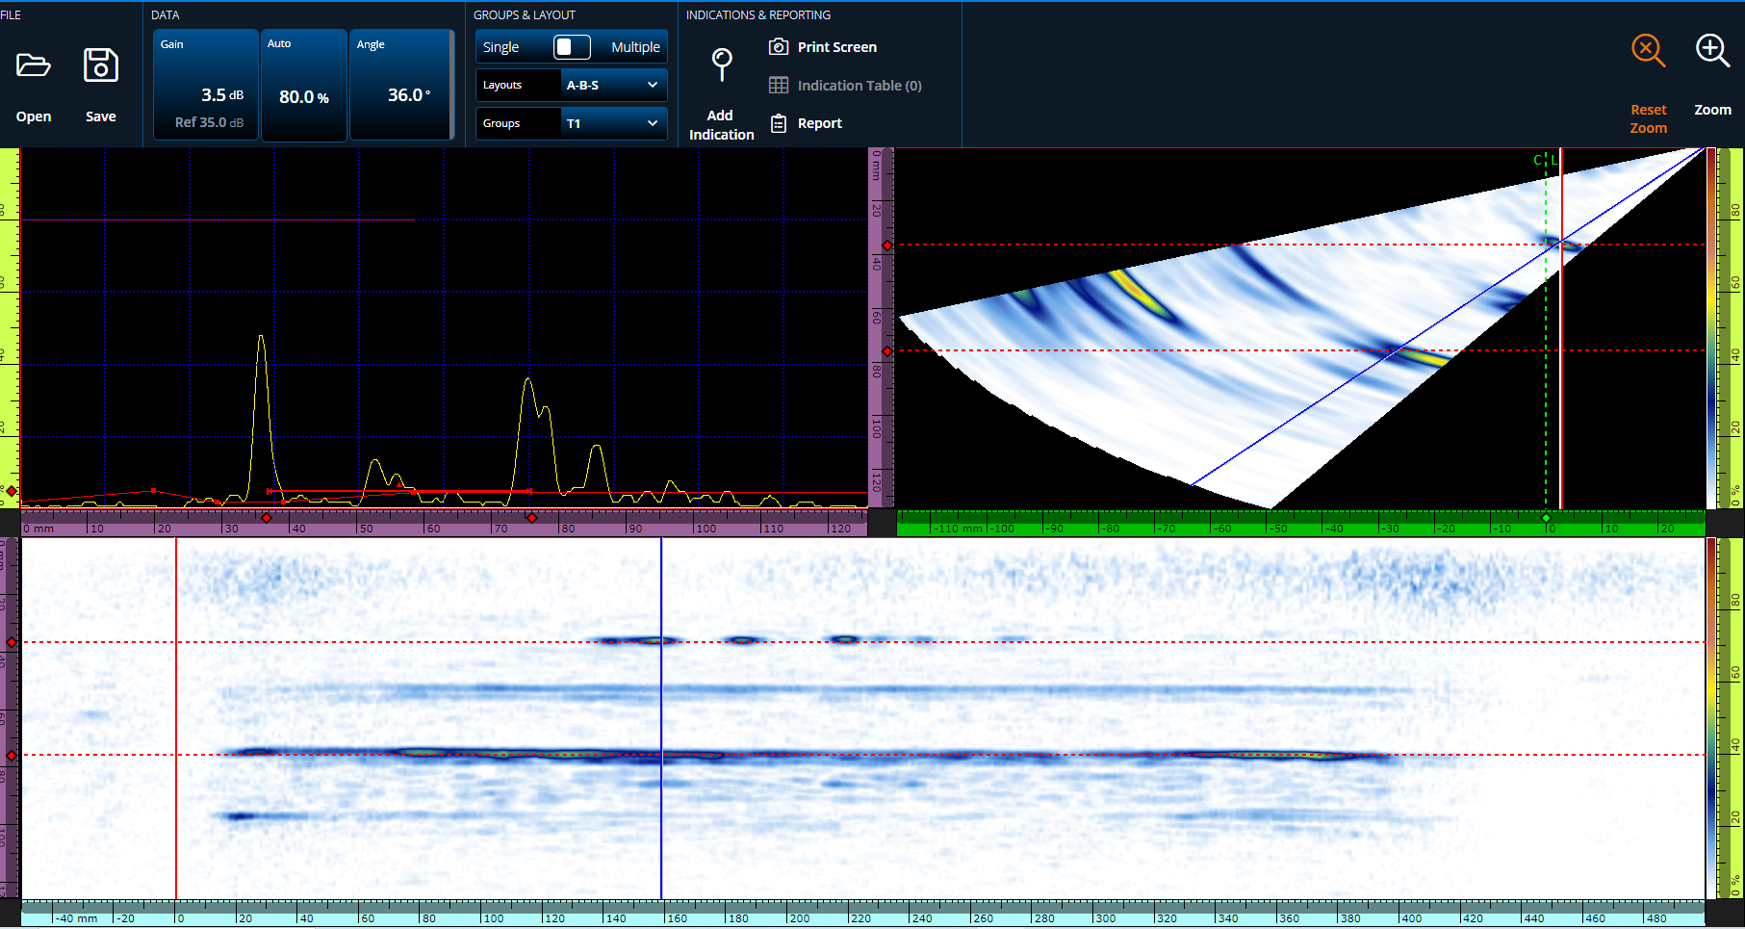
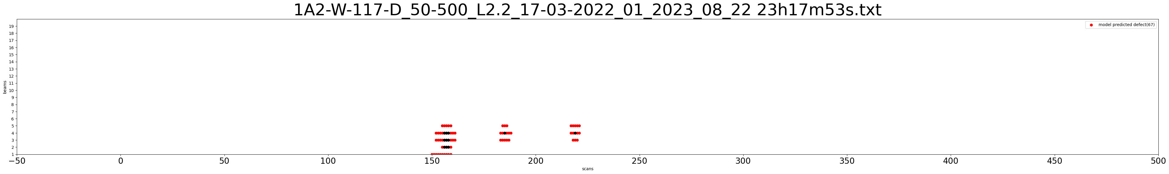
Accelerating UT Inspections
Flaw ID | Scan Position of Flaw Centroid Xo (mm) |  | Focal Law (Beam Number) |  | Depth, Zo (mm)
 | Report | AI | Report | AI | Report | AI
FL02 | 159 | 156 | 36º (4) | 36º (4) | 34.8 | 35.44
FL03 | 184 | 186 | 36º (4) | 36º (4) | 33.1-35.6 | 35.44
FL04 | 218 | 219 | 36º (4) | 36º (4) | 32.3-35.2 | 35.05
Following a UT scanning, manual analysis to identify defects can take several hours.
AI model took less than a minute

Slide 14
AI for QC and SCM
Analyse
Process
Evaluate
Responsibilities
QC
?
QA
✓
Planning
Design
Implement
Programme
Analysis and evaluation of test results, Learning from Experience and implementing a plan to reduce risk can help improve Quality Control (QC) and Supply Chain Management (SCM)
In nuclear sector, overall QA is very good.
Processes and responsibilities are well defined.
AI can de-risk and accelerate projects
Prof. Nawal K Prinja

Slide 15
AI for Knowledge Management and Knowledge Preservation (KMKP)
Prof. Nawal K Prinja

Slide 16
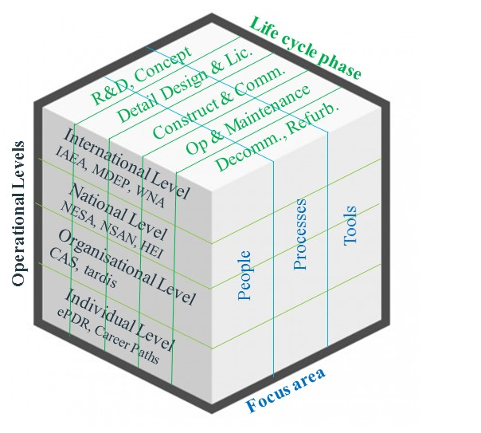
AI for Nuclear Knowledge Management and
Knowledge Preservation
Research & Development
Design & Licensing
Constr-uction
Operation, Life Extension
Decom / Refurb
10-20 yrs.
5-10 yrs.
5-10 yrs.
50 yrs.
10-20 yrs.
There is a need to maintain & leverage this knowledge over the Life-cycle (80 to 110 years)
Enablers
  People
  Processes
  Technology
  Governance
  Culture
Activities
  Acquiring
  Applying
  Retaining
  Handling Outdated Knowledge
Organisations may have to manage knowledge flowing through 5 x 3 x 4 = 60 areas over 100 years
Can this knowledge be leveraged effectively over the entire life-cycle?
AI/NLP can help.
Prof. Nawal K Prinja

Slide 17




The Challenge
Millions of assets
Structured
Semi-structured
Unstructured
Including, but not limited to:
Cognitive Search Intelligence
Intelligence Automated
17
Prof. Nawal K Prinja

Slide 18
Trial for Generation IV International Forum (GIF)
Extracting Knowledge from Molten Salt Reactor Research Reports
Scanned copies of 233 ORNL reports (about 3GB of data)
Goldfire was used to create a knowledge base from these 233 reports.
The software analysed all the reports which involves reading all the contents and creating a knowledge base which was done in 1 hour 12 minutes.
Cognitive Search Intelligence
Intelligence Automated
Following are some examples where answers were given in less than 15 seconds:
Question 1: what is the strength of Inconel at elevated temperatures?
In order of relevance, Goldfire identified 12 reports.
At the top was ORNL-TM-0326 which included “The creep-rupture results for Inconel (Fig. 16)”
ORNL 1515: I checked and found that page 66 of the ORNL-1515 report contains a table that gives ‘Strength of Inconel and Columbium at elevated temperatures.
Question 2: coolant for salt to gas heat exchanger
Goldfire identified ORNL-2605 as the most relevant report and quoted a summary from this report.
Upon checking, I found that ORNL-2605 does discuss Helium, Hydrogen and steam as coolants for a salt to gas heat exchanger and identifies the one with best performance.
Prof. Nawal K Prinja

Slide 19
The Archive Project
Background:
The Energy, Security & Technology (ES&T) business unit within Jacobs currently has approximately 25,000 boxes held in a secured offsite storage location.
These boxes contain information relating to nuclear projects, dating back over 40+ years.
The information contained within these boxes could be vital to support future research and projects.
The Project:
200 boxes were identified and retrieved from the archives.
2943 documents from these 200 boxes were scanned and converted into pdf files.
In total nearly half a million pages of information was converted into a ‘Knowledge Base’ by Goldfire.
Cognitive Search Intelligence
Intelligence Automated

Slide 20
The Archive Project : Testing and Performance
Testing:
Q: Why did graphite core bricks crack?
488 results were obtained broken down into various categories according to author, topics etc. The top (most relevant) answer was technically correct and precise.
Q: Bore hole investigation at Sellafield site.
117 results were found. We were able to locate the report and the page containing details of a specific bore hole.
Q: Sizewell B thick and thin liner joint liner assessment.
This query was related to weld joint connecting thick and thin steel plates used to line the inside of the Siz B containment. 15 results were found and a report on Sizewell B pressure boundary review was quoted.
Performance:
Each search took less than 20 seconds to complete. A manual search would have taken days !!

Slide 21
Non-Electric Applications and Load Following
Cogeneration :
Balance between process heat and electricity generation
AI to help monitor and control
Physics Informed Neural Networks (PINNs) for nuclear reactor performance
Load Following :
To help with power control
Help contribute to grid stability
Start up and shut down systems
Prof. Nawal K Prinja

Slide 22
Conclusions
The successful deployment of SMRs hinges on the efficient integration of advanced digital technologies such as Artificial Intelligence (AI) and Machine Learning (ML).
By harnessing the power of AI/ML, SMR stakeholders can accelerate innovation, improve safety, and reduce costs throughout the lifecycle of SMR projects.
Transformative potential of AI in material qualification, non-destructive testing, supply chain management, and knowledge management and knowledge preservation has been demonstrated.
AI-driven solutions will play an increasingly pivotal role in shaping the future of clean, reliable, and sustainable energy generation.
Prof. Nawal K Prinja

Slide 23
nawal.prinja@jacobs.com
nawal.prinja@hotmail.com

