Slide 1

IAEA Coordinated Research Project on Challenges, Gaps and Opportunities for
Managing Spent Fuel from SMRs
Ms Amparo González-Espartero, PhD
Technical Lead Spent Fuel Management
Nuclear Fuel Cycle and Materials Section
Department of Nuclear Energy, IAEA
a.g.espartero@iaea.org

Slide 2
Content
Recommendations (in 2019) from the Technical Working Group on Nuclear Fuel Cycle Options and Spent Fuel Management on the Nuclear Fuel Cycle Options of SMRs
IAEA Technical Meeting on Backend of the Fuel Cycle Considerations for SMRs, held in 2022
International Workshop on the Chemistry of Fuel Cycles for Molten Salt Reactor Technologies, held on 2-6 Oct. 2023, in cooperation with the OECD-NEA
International Conference on Spent Fuel Management: Meeting the Moment, held in June 2024
Coordinated Research Project on Challenges, Gaps and Opportunities for Managing Spent Fuel from SMRs (CRP SMR-COGS)
Upcoming Related IAEA Meetings

Slide 3
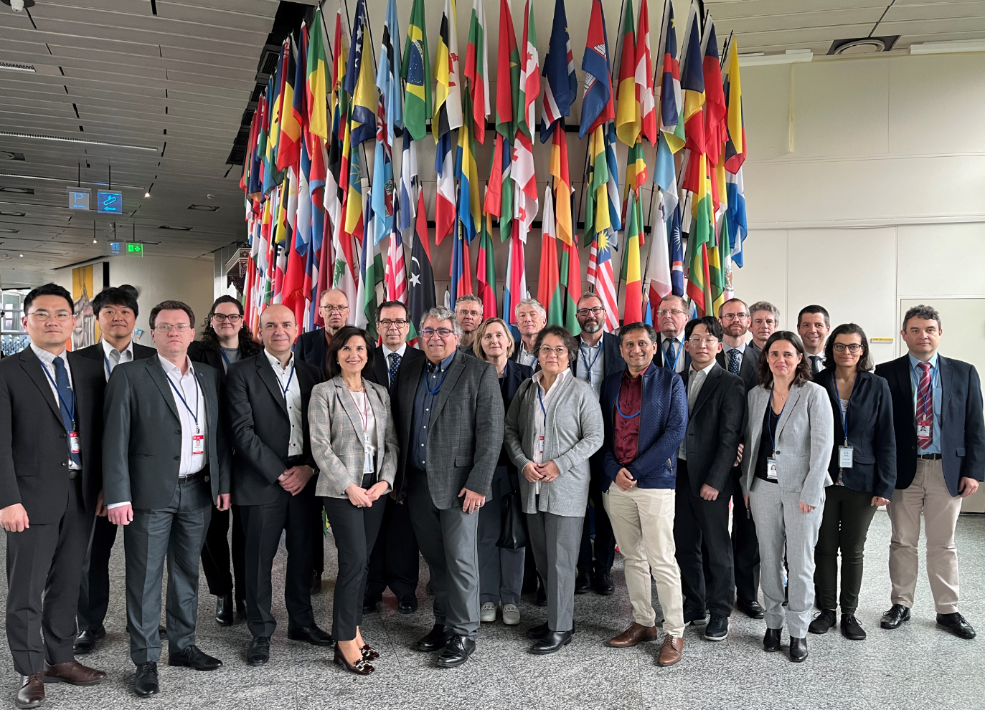
Technical Working Group on Nuclear Fuel Cycle Options and Spent Fuel Management (TWG-NFCO)
  20 Member States (Belgium, Canada, China, Finland, France, Hungary, India, Japan, RoK, Mexico, Netherlands, Romania, Russia, Spain, Sweden, Slovakia, UK, UAE, Ukraine, USA). Three International Organizations (EC, OECD/NEA and WNA)
TWG-NFCO focuses on nuclear fuel cycle options with an emphasis on:
Spent fuel management (storage, recycling and transportation)
Innovative fuel cycles (multirecycling, minor actinides management and P&T of long-lived fission products)
Nuclear materials management
  TWG-NFCO Meeting April 2024
In its Annual Meeting in April 2019, TWG-NFCO recommended the IAEA that:
“… the IAEA has several Sections looking into several different aspects of SMR deployment…, however, fuel cycle and in particular spent fuel management from SMRs does not appear to be a topic of investigation.
The next update of the Advances in Small Modular Reactor Technology Developments Report should consider technologies for managing SNF from SMRs including the back-end infrastructure that would be needed to support SMRs (e.g. transportation, storage, recycling, and disposal).
Nuclear fuel cycle aspects, in particular the backend, should be integrated into all IAEA working groups that are looking at SMRs…”

Slide 4
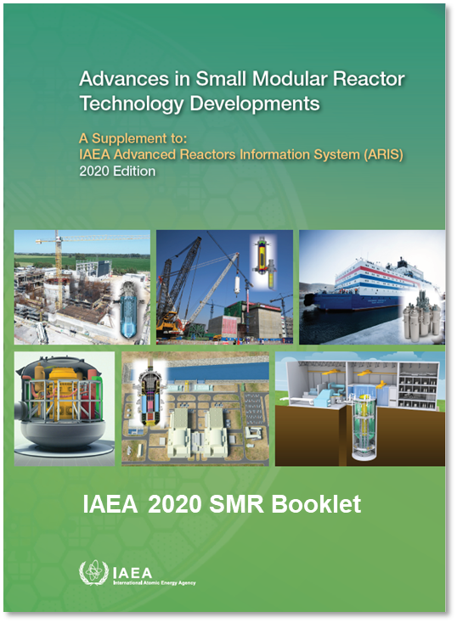
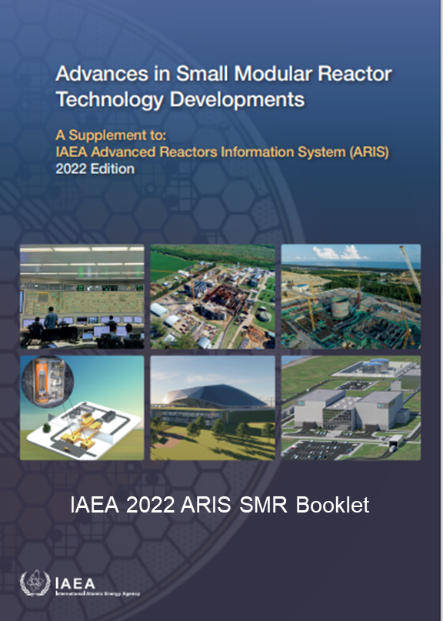
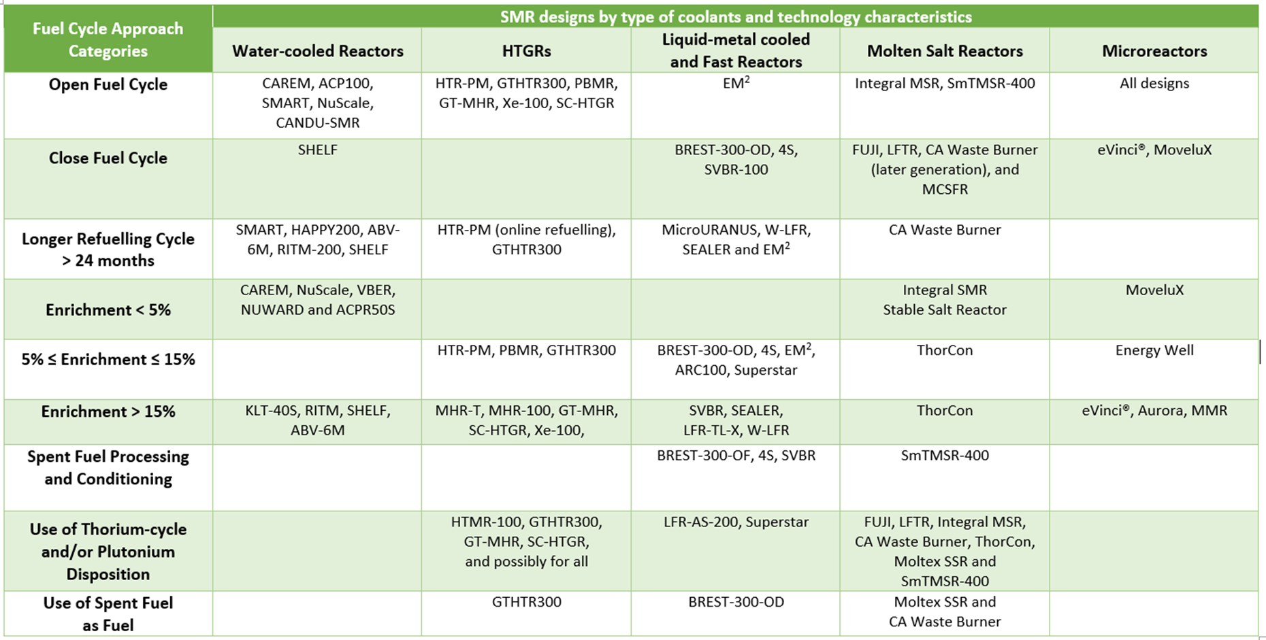
IAEA-ARIS SMR Booklet
2020/2022 Editions
2020 Edition: For the first time a special coverage on fuel cycle approaches and waste management by technology was included
Insightful annexes with various charts and tables
Very limited experience worldwide on the management of SNF from SMR technologies

Slide 5
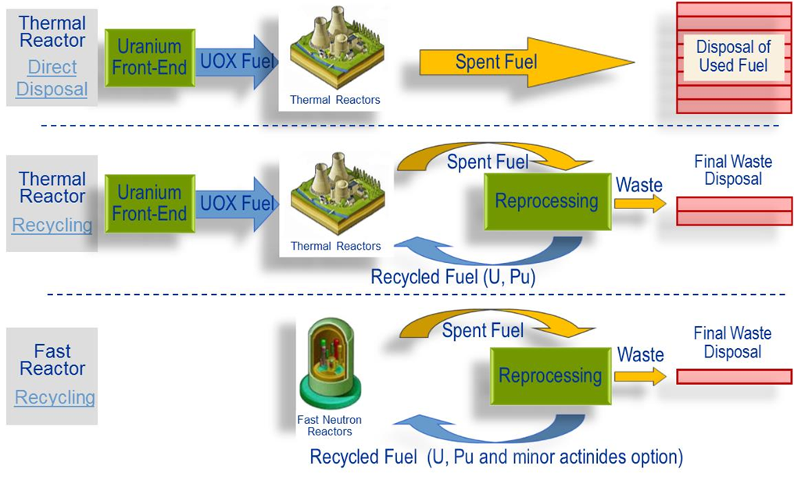
Nuclear Fuel Cycle Options
For Nuclear power to be sustainable, the nuclear fuel cycle must remain economically viable and competitive through the optimization of the use of fissile materials in reactor cores or the recycling of valuable materials
This results in different fuel cycle options, some already implemented and others may be deployed in the future
Potential future synergies between LWR-SMRs and AMRs will bring new spectrum of Nuclear Fuel Cycle Options
Each Type of Reactor has an Associated Nuclear Fuel Cycle

Slide 6
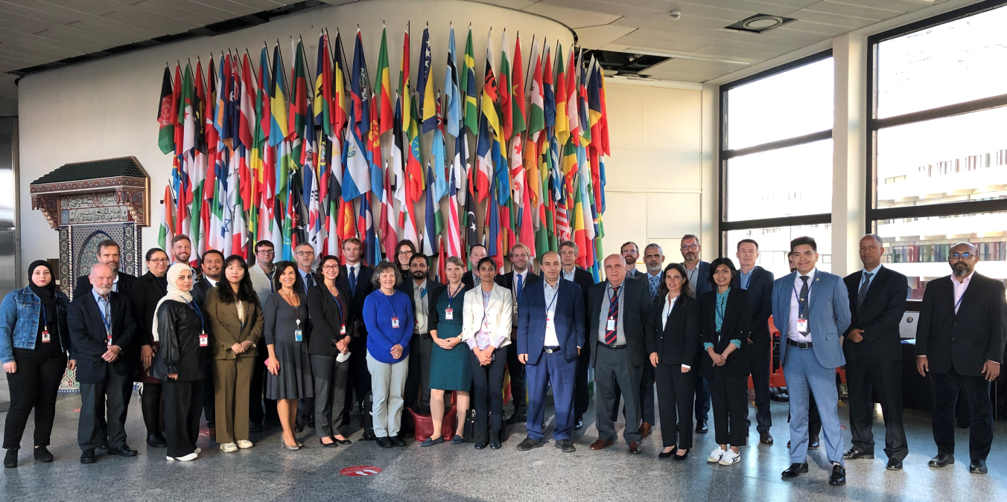
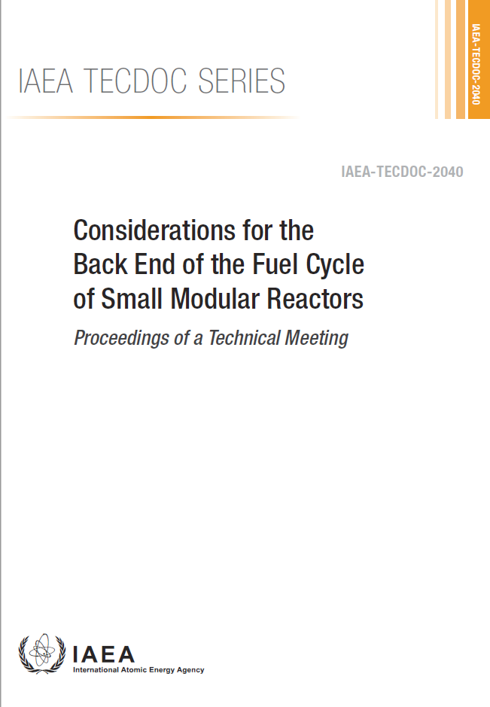
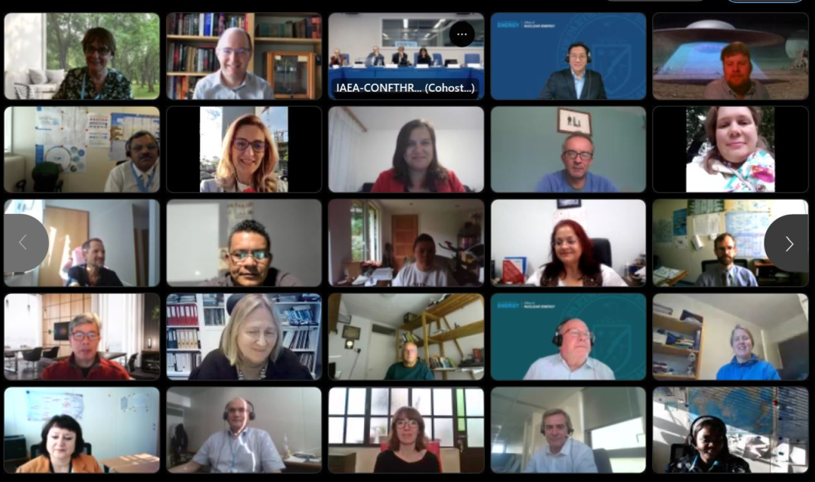
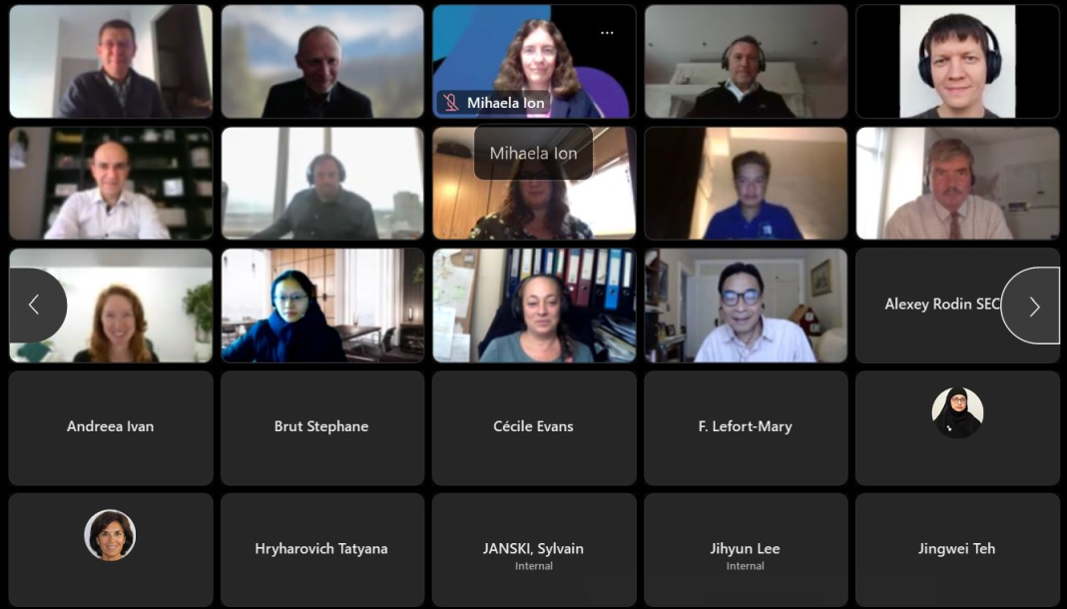
Technical Meeting on
Backend of the Fuel Cycle Considerations for SMRs, 20-23 September 2022
107 Participating Experts
from 32 Member States &
3 International Organizations
~ 40 Presentations and Extended Abstracts
Published in Dec. 2023
https://conferences.iaea.org/event/321/

Slide 7
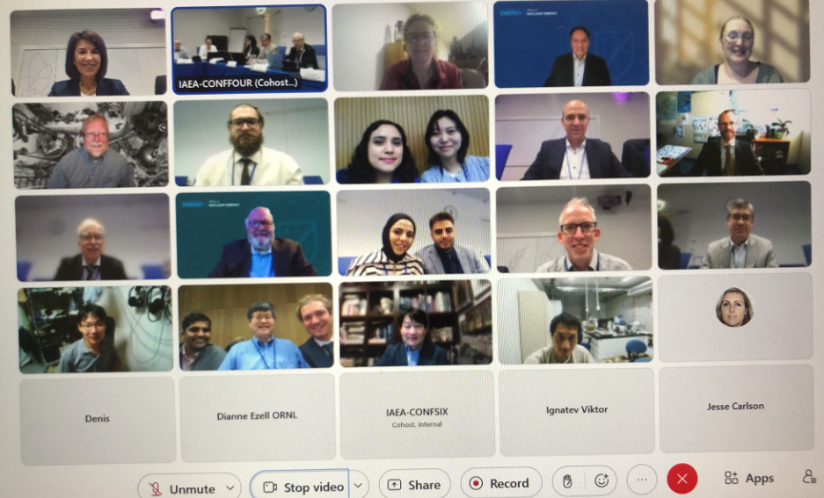
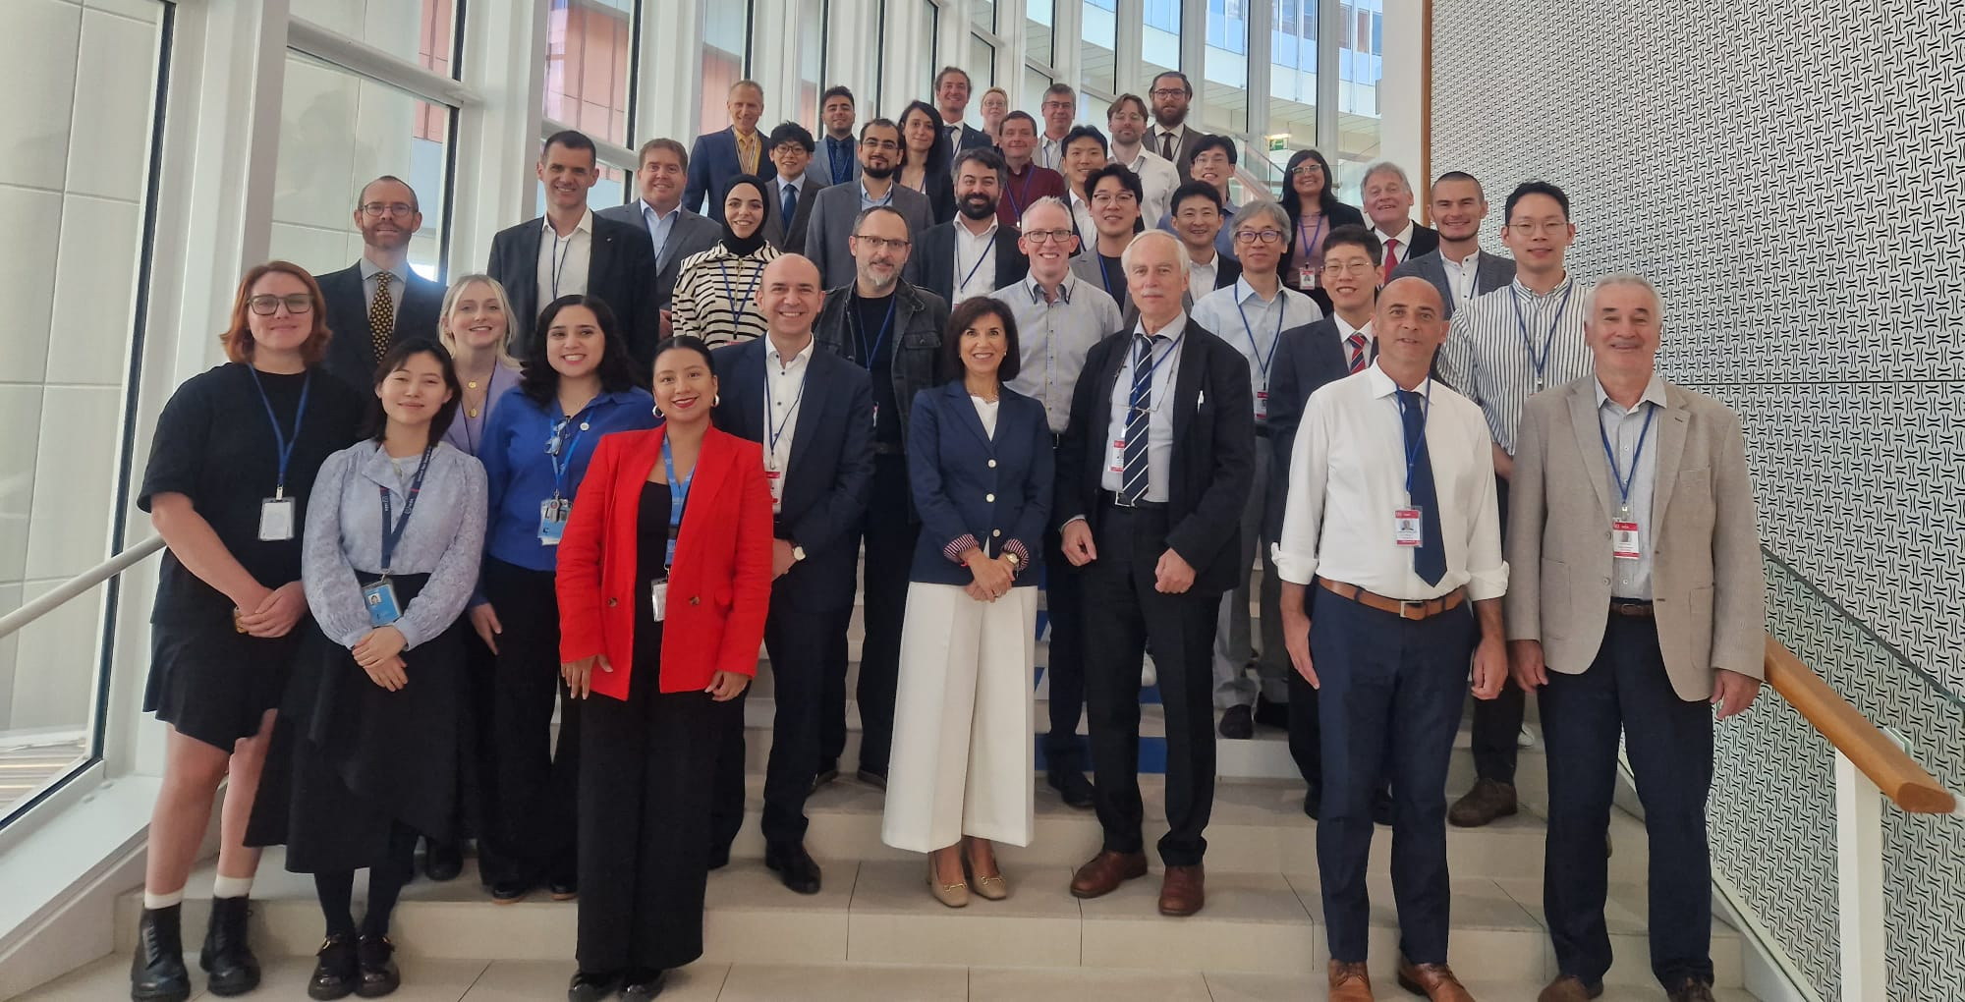
International Workshop on the Chemistry of Fuel Cycles for Molten Salt Reactor Technologies, 2-6 Oct. 2023, in cooperation with the OECD/NEA
  Global attendance from national laboratories and SMR developers
    44 participants including 4 SMR developers
  Follow-up activities: to develop
    a Taxonomy of nuclear fuel cycle options for MSRs
    a Terminology associated to nuclear fuel cycle options for MSRs, to help when communicating on concepts

Slide 8
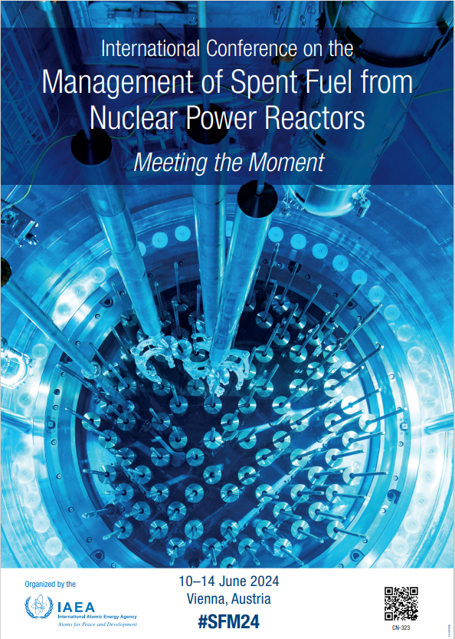
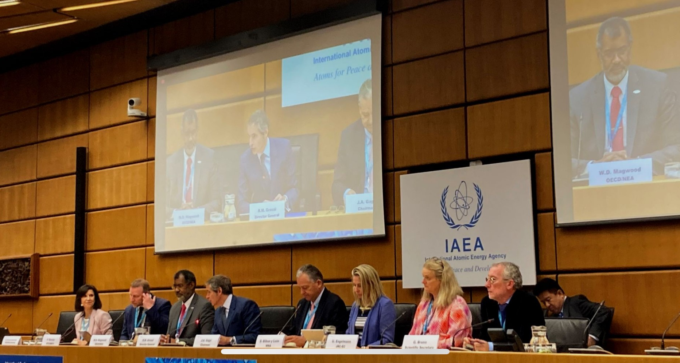
International Conference on Spent Fuel Management: Meeting the Moment
10-14 June 2024
  In cooperation with OECD/NEA, WNA, EC, WNTI
  300 in person participants from 50+ countries and 4 Int Org
    86 women and 214 men present
    About 220 participants online
  77 oral presentations, 4 panels, 2 side events, 13 E-posters, 21 posters
  Proceedings in progress (publication: early 2025)

Slide 9
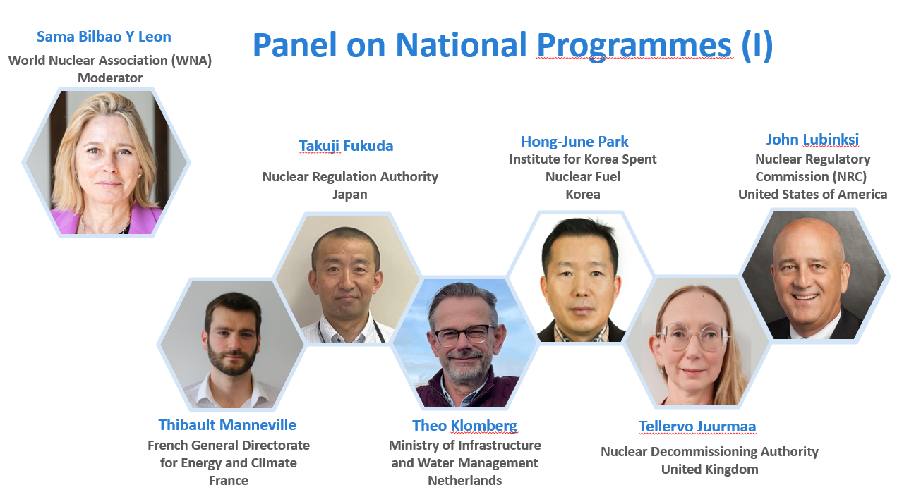
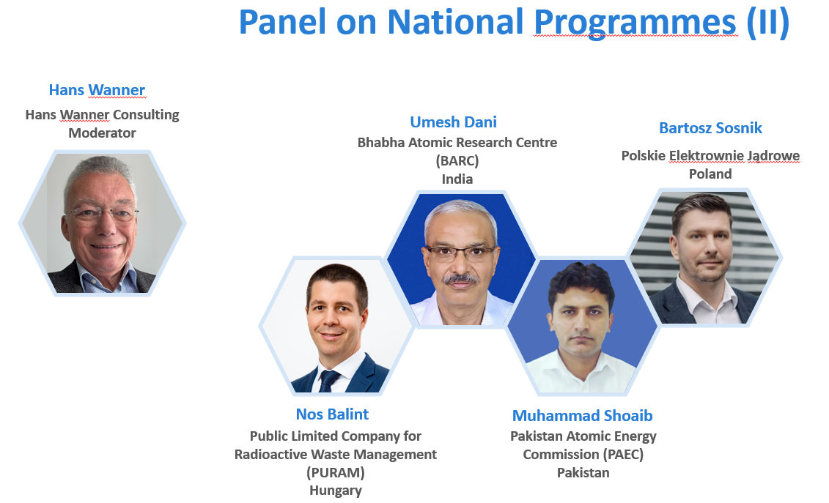
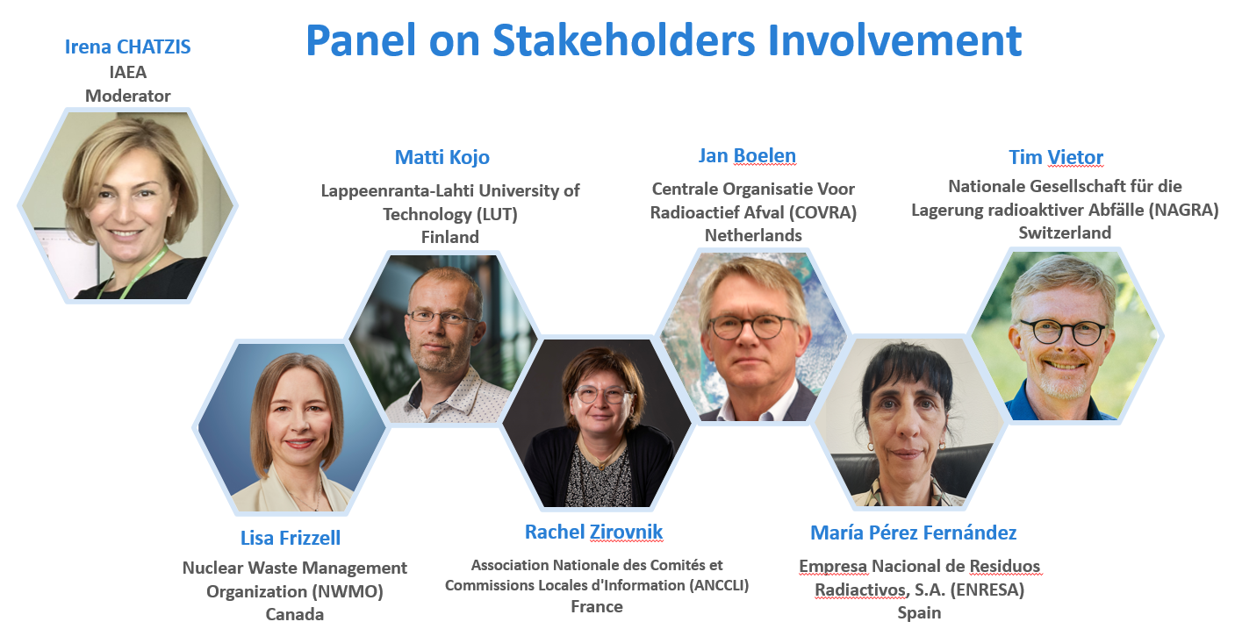
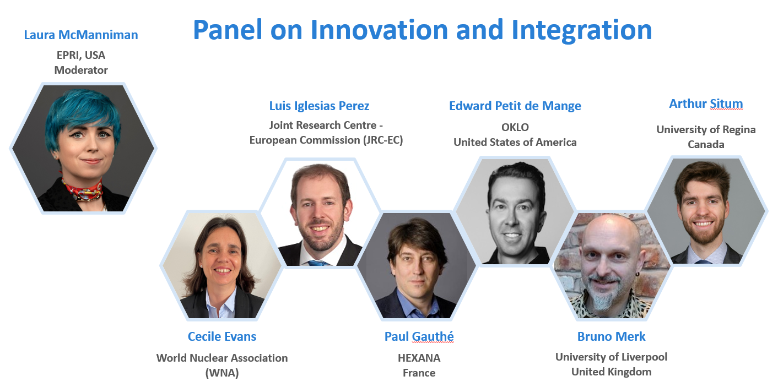
#SFM24 Panel Discussions

Slide 10
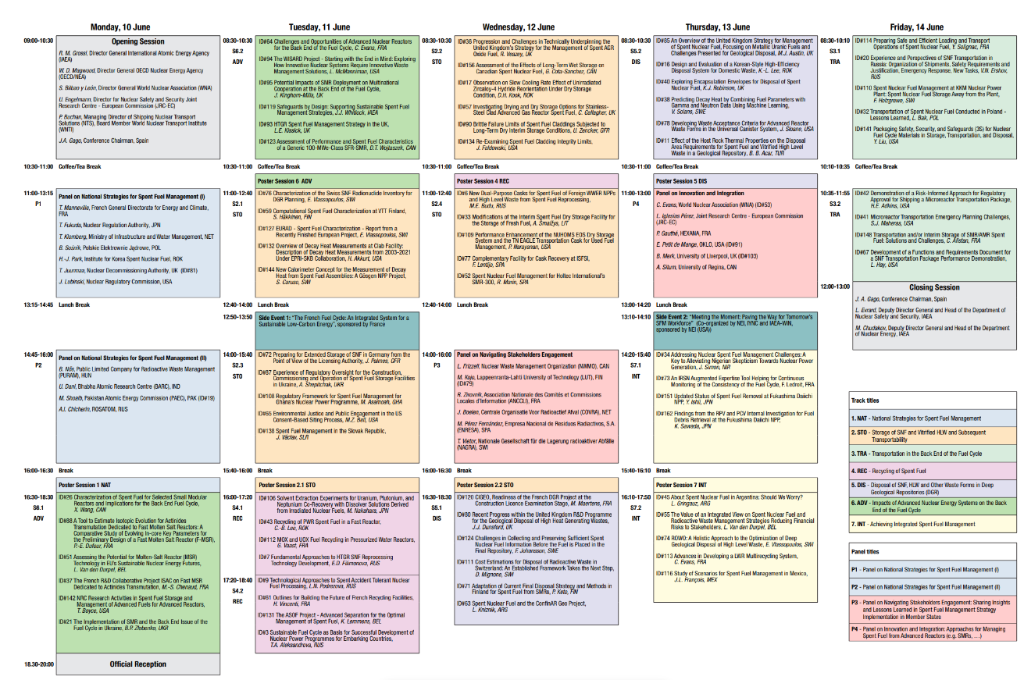
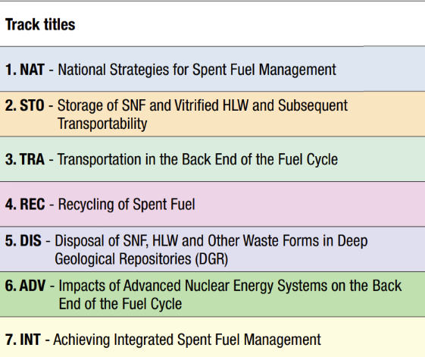
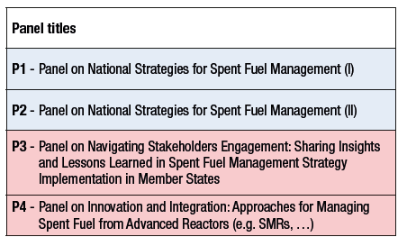
Scientific Conference Programme from 8:30h to 18:30h
14 Sessions in 7 Tracks
77 contributed oral presentations 13 E-posters, 21 posters from 29 Member States and 2 international organizations

Slide 11
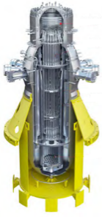
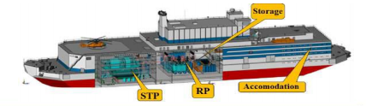
Identified Challenges for the Management of SMRs’ Spent Fuels
LWR-type SMRs: Enrichment levels (below 5%) are similar to conventional PWRs
  CHALLENGES
  Transport and storage solutions for smaller fuel assemblies → recertification or new developments are needed
LWR-type SMRs: Enrichment levels up to 20% (HALEU)
CHALLENGES
Necessary code validation, e.g. decay heat, …, calculations. International collaboration is key!
More attractiveness for recycling Pu and RepU → expand current reprocessing and recycling capacities

Slide 12
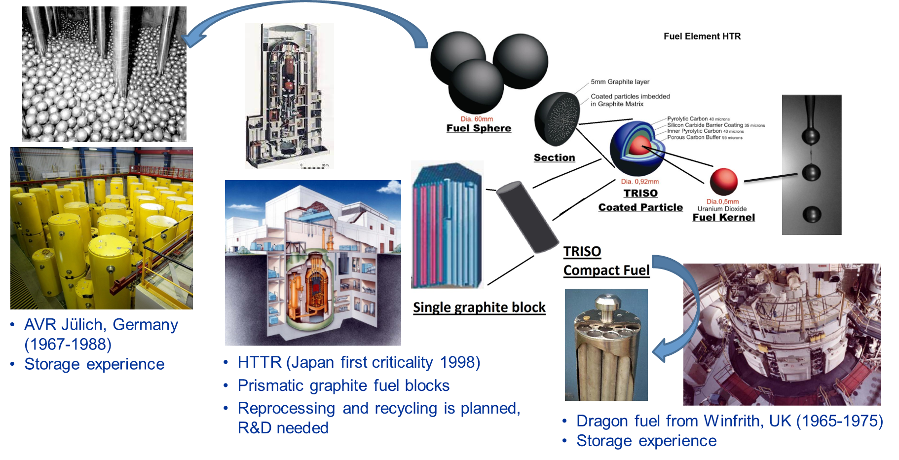
Identified Challenges for the Management of SMRs’ Spent Fuels
HTGR-type SMRs: TRISO particles in Pebble beds/Prismatic blocks
CHALLENGES
  Very limited worldwide experience in managing the back end of the fuel cycle

Slide 13
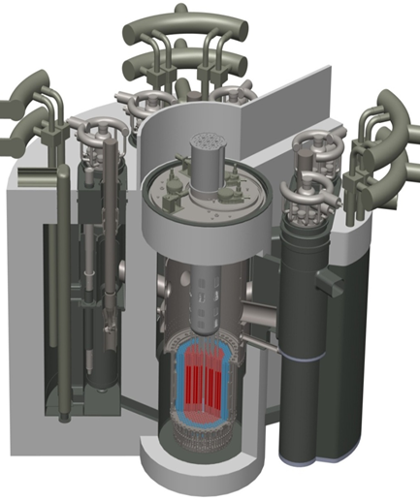
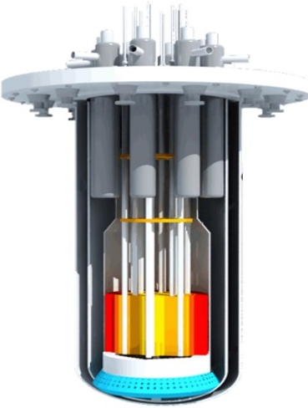
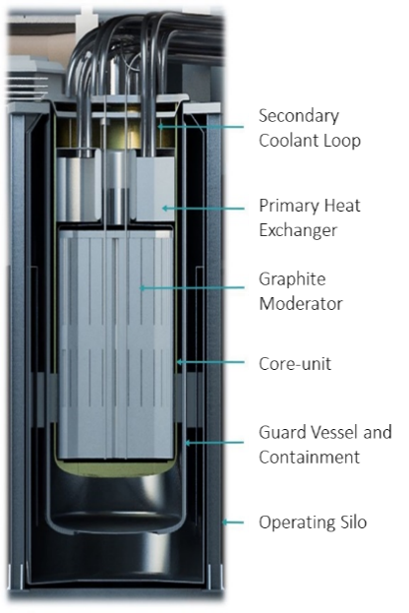
Identified Challenges for the Management of SMRs’ Spent Fuels
Liquid Metal Fast Neutron SMRs: New fuel types (Oxide, Nitride, Metallic)
CHALLENGES
New spent fuel characteristics and chemistry
Envisaged for multirecycling
Molten Salt SMRs (Th, FR): Nuclear fuel (Th, U, Pu, MA) dissolved in melted chloride/fluoride salts
CHALLENGES
Chemistry of the fuel cycle
Recycling of fissile material
Managing salt mixtures containing all fission products

Slide 14
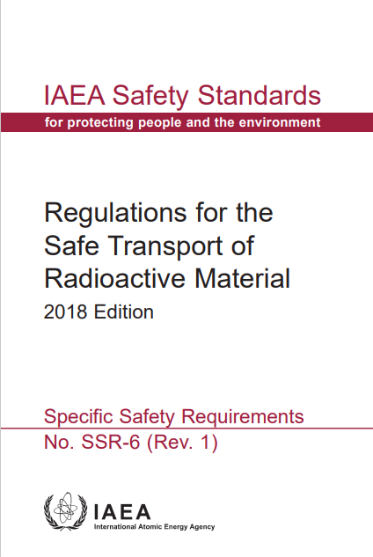
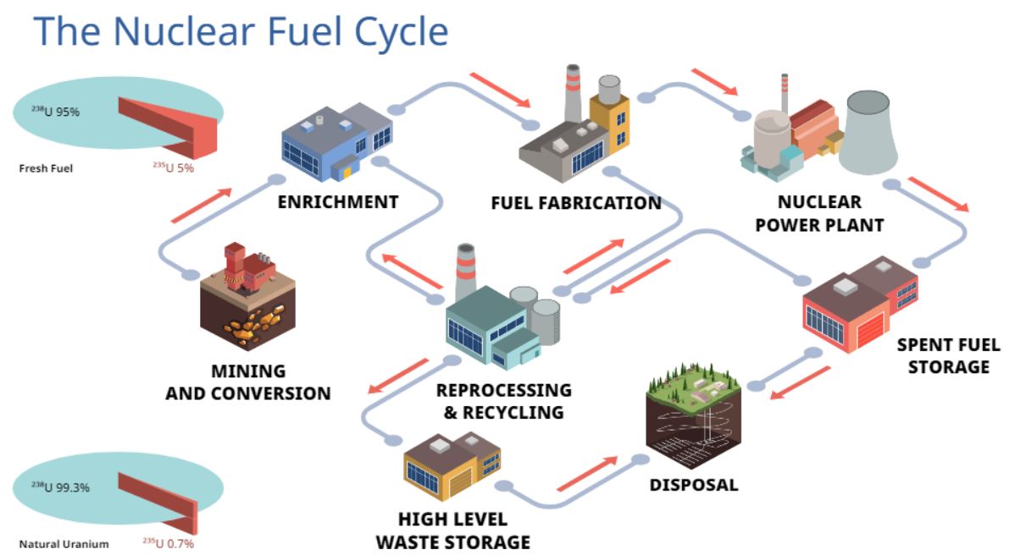
Overview of Back End of the Fuel Cycle Implications for SMRs
Storage systems are optimized for current fuels
New spent fuels will require major changes and research
Transport packages are content specific
Needed at all stages of the Fuel Cycle
Reprocessing and recycling
Reprocessing is specialized on current fuels and capacities are limited
Ageing of available Rep&Rec facilities, specially in Europe
Accelerate implementation of Multi-recycling in LWRs as transition to AMRs
Disposal
Designs under development are based on current spent fuel and HLW
New spent fuels and wastes will require additional research
Integration of existing and new fuel cycles is key for sustainability

Slide 15

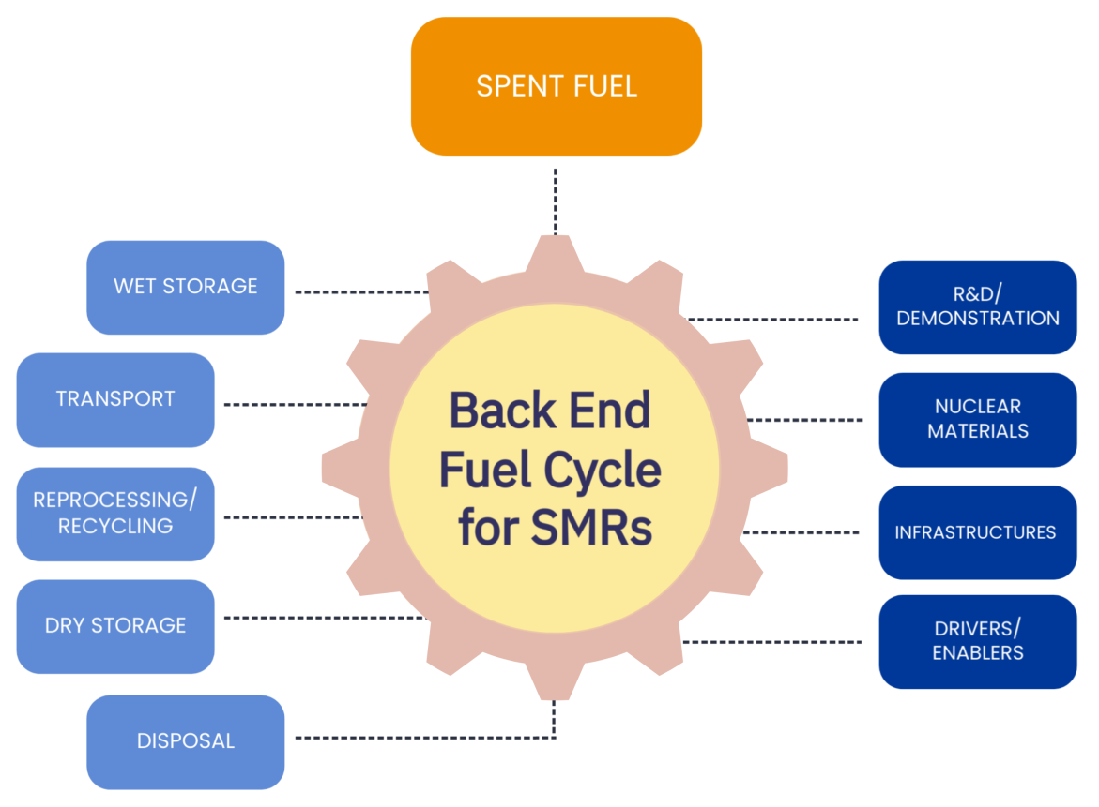
Coordinated Research Project on Challenges, Gaps and Opportunities for Managing Spent Fuel from SMRs
Understanding the implications of the management of new spent fuels is paramount to make informed decisions
MAIN OBJECTIVES:
To identify viable nuclear fuel cycle options for the different SMR technologies
To identify common technologies/similarities for various reactor types and/or significant differences
To prepare a list of generic key parameters for countries to perform their analysis incorporating their specific context
SMR-COGS, CRP T13021

Slide 16

Coordinated Research Project on Challenges, Gaps and Opportunities for Managing Spent Fuel from SMRs
MAIN OUTPUTS
Development of specific roadmaps for managing spent fuel from the different SMR technologies, identifying what can be derived, optimized or adapted from existing practices, or what needs to be fully developed
To compare various SMR systems, in terms of efforts required to develop and implement an SFM strategy
  Nuclear fuel cycle facilities
  Technology readiness level
  Nuclear materials involved
  Infrastructures (e.g., human resources, financing)
  R&D / Demonstrations
  Enablers/Synergies
STATUS of the Coordinated Research Project SMR-COGS
  14 Research Contracts from ARG, ARM, CPR, CZR, EGY, INS, LIT, MEX, POL, ROM, UKR
  17 Research Agreements from FRA, CAN, DEN, JOR, NOR, SIN, SPA, SWE, TUR, UK, USA
  from Industry, Operators, Researchers, Regulators, etc.
First Research Coordination Meeting on 11 to 15 November 2024 in Vienna

Slide 17
Up-Coming Related IAEA Activities
Technical Meeting on Operating Experience and Lessons-learned on Managing Non-standard/Exotic Legacy Power and Research Reactor Fuels, 18 – 21 February 2025, Vienna
Technical Meeting on the Management of Spent Fuel from High Temperature Gas Cooled Reactors, 7 – 11 July 2025, Vienna
Workshop on the Challenges in Managing Spent Evolutionary Advanced Technology Fuels, 10 – 14 November 2025, Vienna

Slide 18
Thank You
A.Gonzalez-Espartero@iaea.org

