Slide 2
Accelerating Microreactor Development and Deployment
Through Joint Public
Test Beds and Private Advanced Reactor
Development

Slide 3
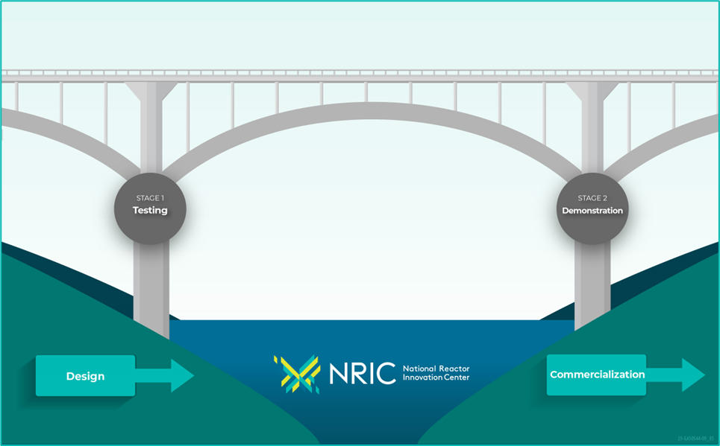
The National Reactor Innovation Center (NRIC)
NRIC Enables Nuclear
Reactor Tests and
Demonstrations
United States (U.S.) government authorized NRIC through the Nuclear Energy Innovation Capabilities Act (NEICA)
NRIC is under the U.S. Department of Energy (DOE) Office of Nuclear Energy
Located at the Idaho National Lab (INL) in the Nuclear Science & Technology division
Partner with industry to bridge the gap
between research and commercial
deployment
Leverage U.S. national lab expertise and infrastructure

Slide 4
Collaborative Approach
LANL
NRIC Is Partnering Nationally to Support Demonstrations
INL MFC, NS&T, ATR,ESH&Q, F&SS, S&S
Advanced Reactor Developers
Advanced Construction Tech Developers
International Partners & Resources
IES, NSUF, ART, ARDP
Complementary Tech Fields
Demo Sites
End Users
PNNL
ANL & ORNL
NRC
DOE NE-3/4/5/7 and ID
DOD; NASA; others
Investors
Policymakers
NNSS

Slide 5

Portfolio Built to Empower Innovators
Building Testing Foundation
  Advanced reactor test beds
  Experimental facilities
  Virtual test bed
Addressing Costs & Markets
  Advanced construction
  Digital engineering for nuclear
  Maritime applications

Slide 6
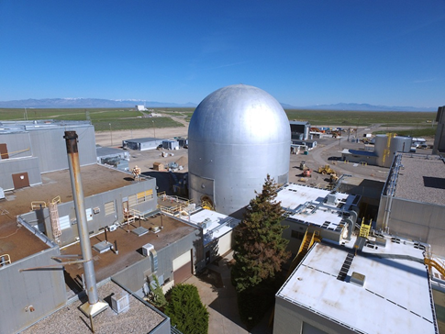
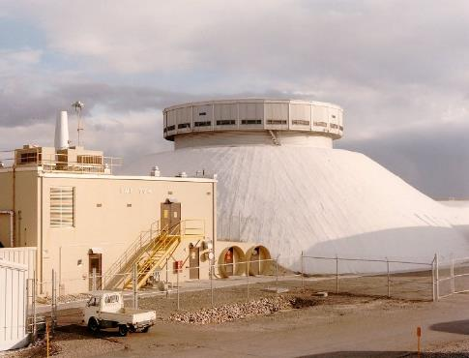
NRIC Test Bed Strategy
Leveraging INL’s Resources and Capabilities
  NRIC Demonstration of Microreactor Experiments (DOME) test bed
  NRIC Laboratory for Operations and Testing in the United States (LOTUS) test bed
Working with Other U.S. DOE Facilities
  Existing Resources
  Expertise
  Capabilities

Slide 7
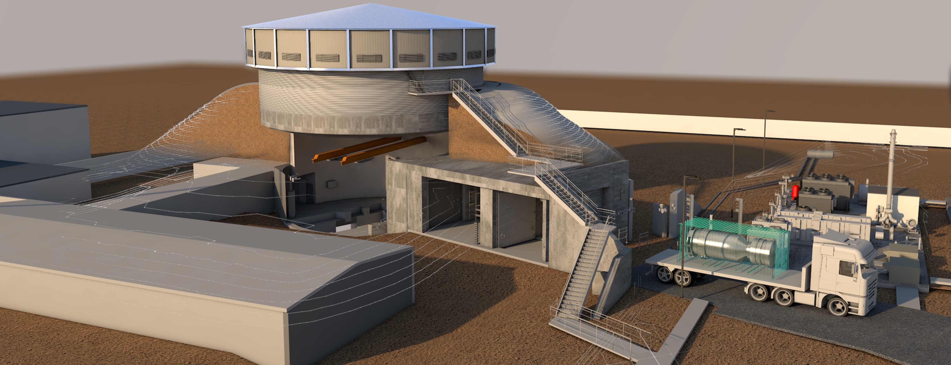
NRIC-LOTUS Test Bed
Facility Specifications
  Hazard Category 2 facility
  Designed for experiments using high security fuels
  Provides safety class confinement
  Test cell space
    ~50 ft (~15.2 m) diameter floor space
    ~17 ft (~5.2 m) to bottom of crane hook
    13 ft (~4m) x 13 ft (~4m) material transfer tunnel
  Polar Crane Capacity – 5 US ton
  Argon Cover Gas System Available
  Cell and Yard Equipment Power
    Standby Diesel Generator

Slide 8
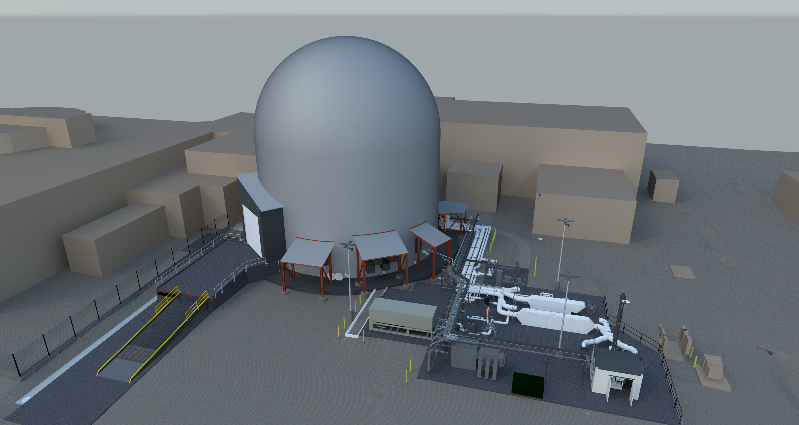
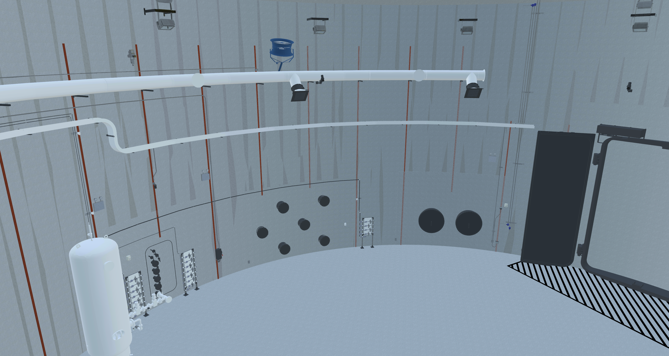
NRIC-DOME Test Bed
Facility Specifications
  Hazard category 2 facility
  Provides safety class confinement
  Large floor space for reactor experiments
    ~65-ft. (~19.8 m) diameter
    ~46-ft. (~14 m) height to crane
  Hatch opening
  ~15 ft. (~4.6 m)wide × ~17 ft. (~5.2 m) tall
  Penetrations
    Small penetrations for process
    Large penetrations for primary reactor cooling

Slide 9
Benefits of Working with NRIC
Help overcome barriers to nuclear innovation
  Financial
  Technological
  Regulatory
Provide infrastructure
  NRIC-DOME test bed
  NRIC-LOTUS test bed
Expand industry knowledge and expertise on nuclear technologies
Improve accessibility to DOE to support private industry and government agencies

Slide 10
NRIC
Questions?
Contact: Troy Burnett, P.E. – troy.burnett@inl.gov
NRIC – nric@inl.gov

