Slide 2
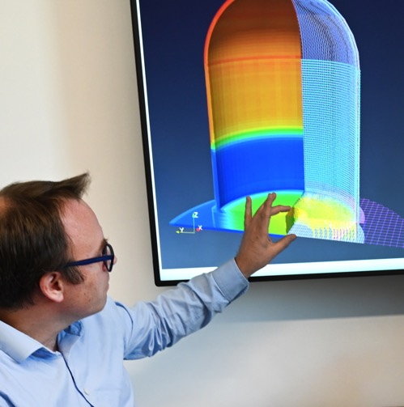
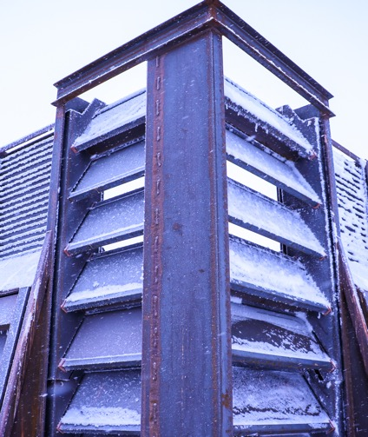
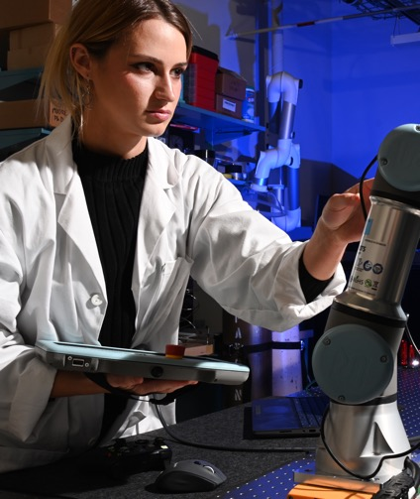
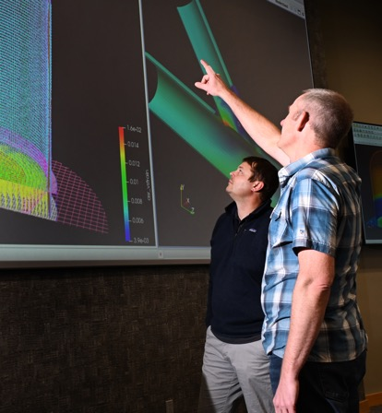
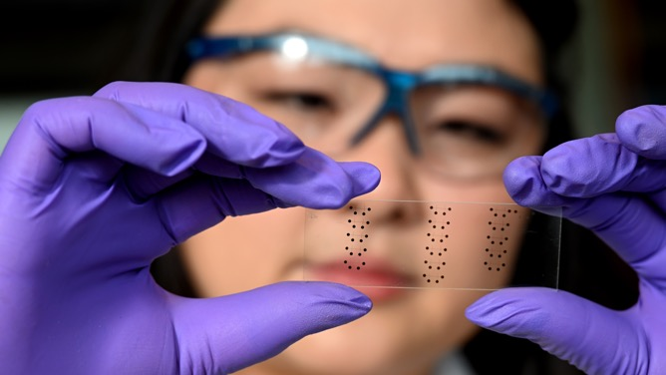
Date: 22 October 2024
Name: Palash Kumar Bhowmik
Todd Anselmi
George Griffith
Piyush Sabharwall
Youssef Ballout
Email: PalashKumar.Bhowmik@inl.gov
SMR Current Status: Development Needs and Global Perspectives
INL/CON-24-81429

Slide 3
Outline
Overview of Small modular reactors (SMRs)
  Reactor capacity
  Reactor development phases
Status of SMRs
SMRs development needs: Challenge addressed
Solution approach and conclusion.

Slide 4
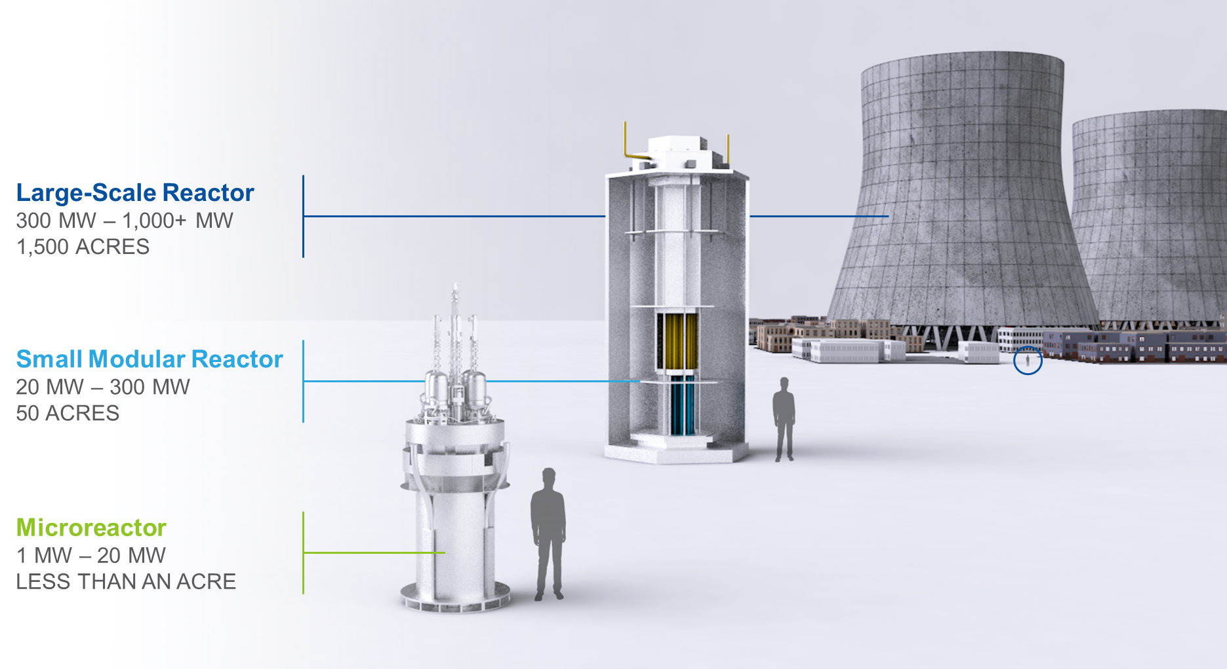
Overview of SMRs: reactor sizes
Small modular reactors (SMRs): reactor capacity up to 300 MWe defined by IAEA, have been recognized as clean, affordable, and sustainable energy sources [1].
Despite the recent surge in interest, the basic SMR concept is not a novel one. Initial plant designs in the 1950s—including the very first commercial reactors—were, in many ways, SMRs with power output ranges of 10–100 MWe [2].
SMRs Development phases: more than 80 SMRs are under design, development, demonstration, deployment, and beyond (4D+) phases worldwide.

Slide 5
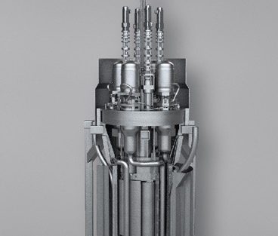
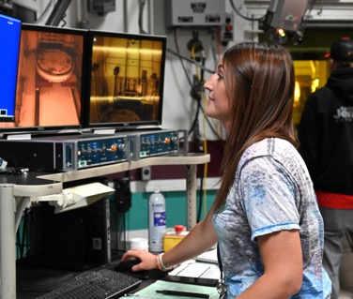
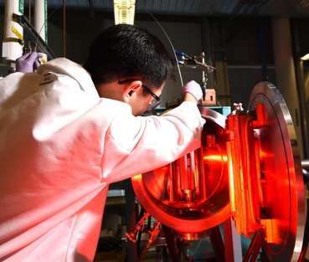
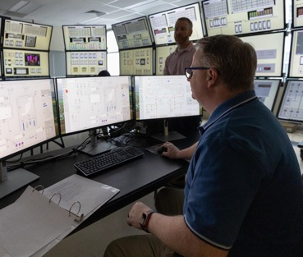
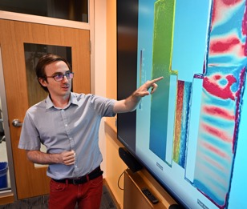
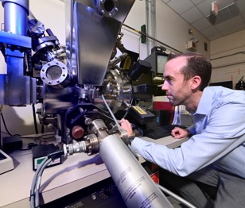
Overview of SMRs: Challenges in accelerated deployments
Major challenges identified for accelerated deployment are:
  qualifying the advanced fuel-to-reactor design;
  supporting rapid scaled/prototypic experimentations;
  maintaining local and global codes, standards, and licensing;
  supply chain issues;
  effective cradle-to-grave nuclear fuel cycle and fuel material transportation, and
  mitigating financial and environmental risks.
Sustaining the existing commercial reactor fleet and expanding deployment of nuclear energy
Regulatory
and safety
research
Advanced
modeling and simulation
Fusion
Energy
Advanced
reactor technologies
Fuel
cycle and separations
Nuclear
fuels and materials
Notes:
22-50705-R0

Slide 6
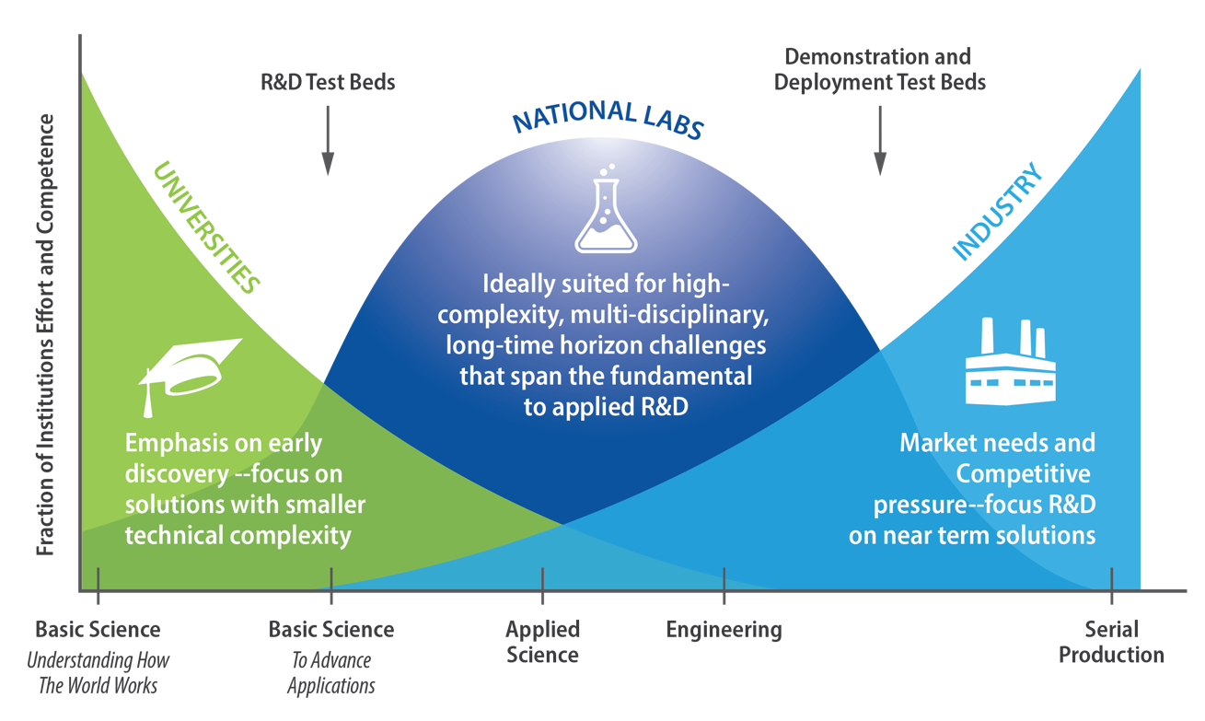
Overview of SMRs: Solution approaches
Solution approach: A synergistic approach among industry, academia, government.
Licensing Focus: SMRs 4D+ phase should maintain global codes, standards, customer expectation and regulatory requirements.
Safety Integration: SMRs should incorporate defense-in-depth safety strategies, including safety barriers, margins, and fail-safe design goals.
Risk Management: A risk-informed decision-making approach and best estimate plus uncertainty analysis are essential to ensure safety for people, facilities, and the environment.
Notes:
22-50705-R0

Slide 7
SMRs Status: worldwide
Types: SMR designs vary in terms of target application, reactor type (e.g., fuel type, coolant type, power conversion type), safety system (e.g., active, passive, hybrid), fuel cycle, and plant layout.
  Design types: Water-cooled (land or marine-based), high-temperature gas-cooled, fast neutron spectrum, Molten-salt, and micro-sized
Final construction stage and initial operation: Only two SMRs
  the Russian-Federation (RF)-developed floating power SMR, KLT4S, which began commercial operation in May 2020;
  a high-temperature gas-cooled SMR developed by China that recently began commercial operation [2].
Delayed construction status: CAREM an integral pressurized-water reactor (i-PWR)-type SMR developed by Argentina, which was scheduled to begin its civil construction in 2024, but since has been delayed due to several challenges [2][3].
Notes:
22-50705-R0

Slide 8
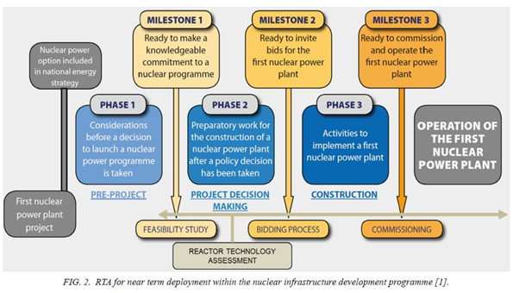
SMRs Status: worldwide (cont’d)
IAEA nuclear power program and reactor technology assessment and deployment phases and milestones [4], which is equally applicable for SMRs and advanced reactors.
Large-capacity reactors entail the following unavoidable challenges, which make SMRs more competitive, as listed below:
  Construction delays leading to increasing costs.
  Lengthy and challenging regulatory approvals:
  Supply chain challenges
Notes:
22-50705-R0

Slide 9
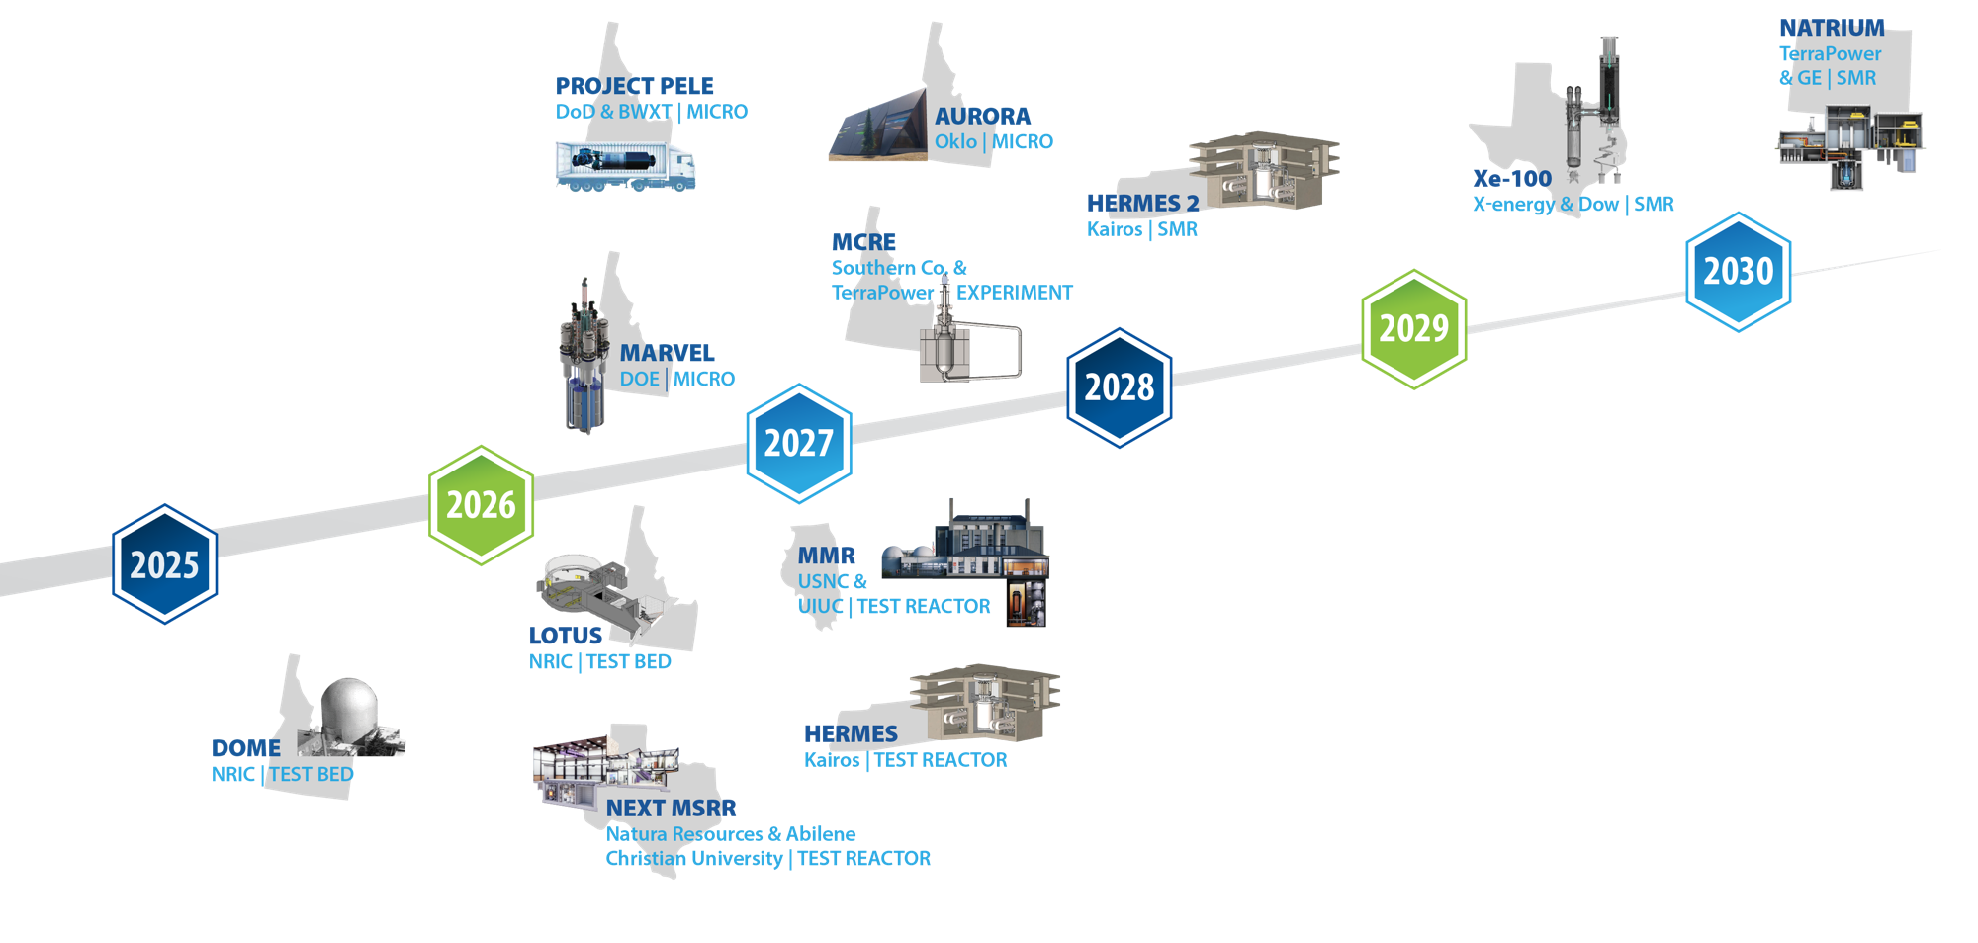
SMRs and Advanced Reactor Demonstration Status: in the U.S.
Notes:
22-50705-R0

Slide 10
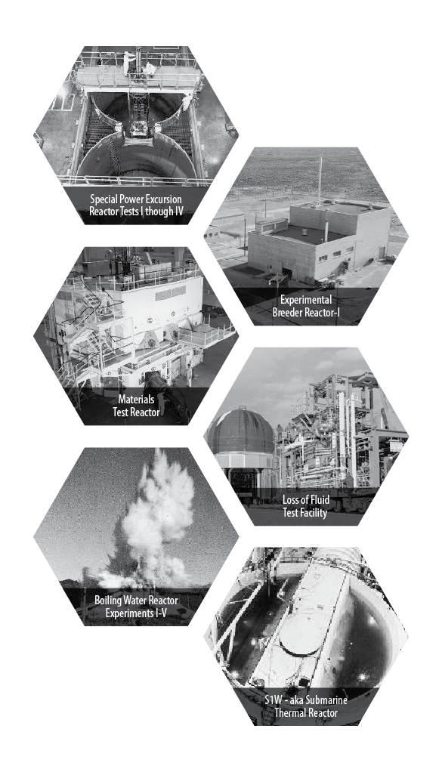
SMR Status: in the U.S. (cont’d)
Our Heritage: The National Reactor Testing Station drove nuclear innovation in the U.S. and around the world
1st
Nuclear power plant
U.S. city to be powered by nuclear energy
Submarine reactor tested; training of nearly 40,000 reactor operators until mid-1990s
Mobile nuclear power plant for the army
Demonstration of self-sustaining fuel cycle
Basis for LWR reactor safety
Aircraft and aerospace reactor testing
Materials testing reactors

Slide 11
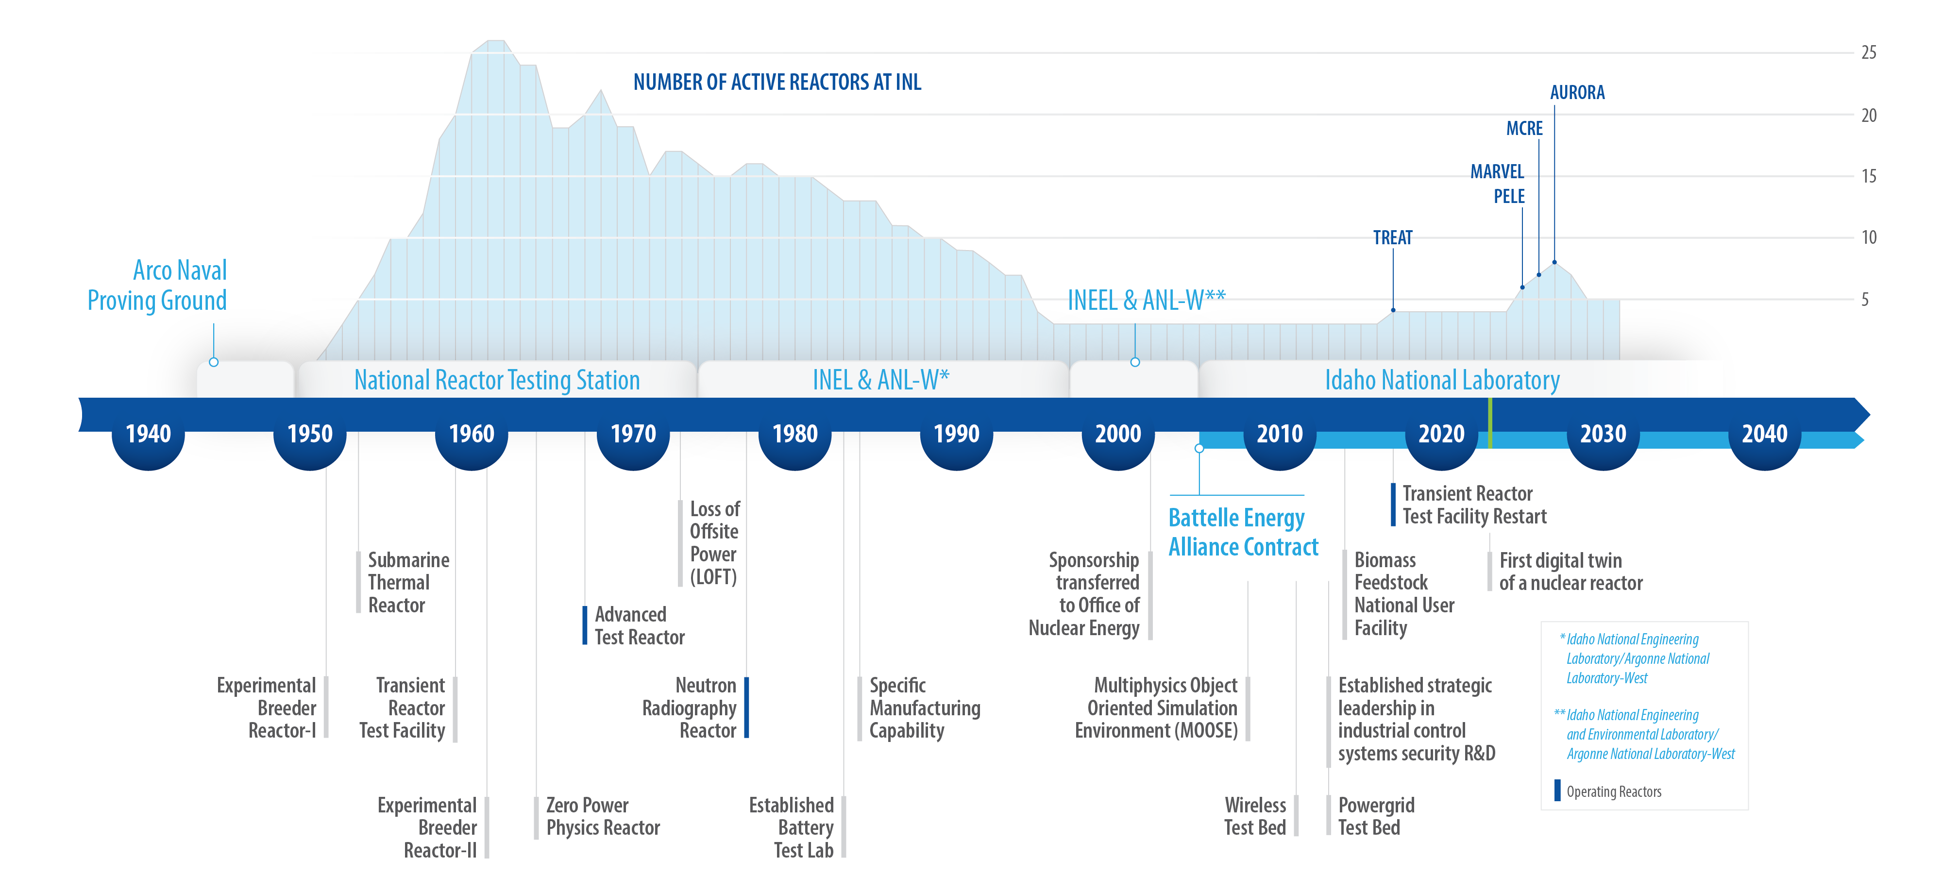
SMR Status: in the U.S. (cont’d)
Legacy history of reactor testing at INL!
Notes:
23-50477-R10_INL_History_Timeline*

Slide 12
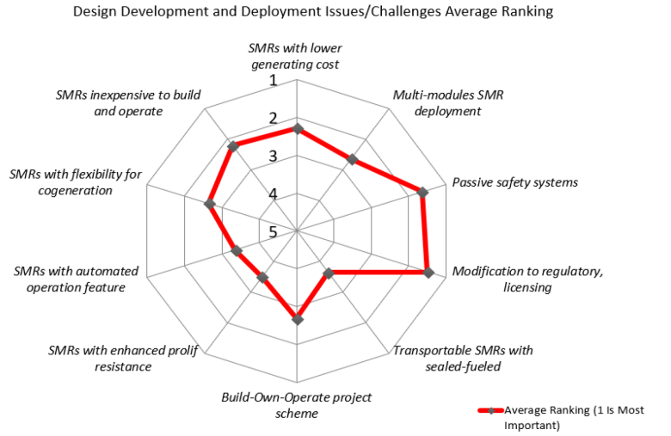
SMRs Development Needs
The general SMR challenges are related to new technology, complex engineering tasks, reliability issues, economic viability, licensing, and regulatory issues [5].
Subki [6] used expert surveys to categorize and rank the major challenges for SMR deployment. The priorities that are indicated include: (a) necessary regulatory and licensing changes, (b) economics, (c) instruments and control, and (d) proliferation resistance.
Notes:
22-50705-R0

Slide 13
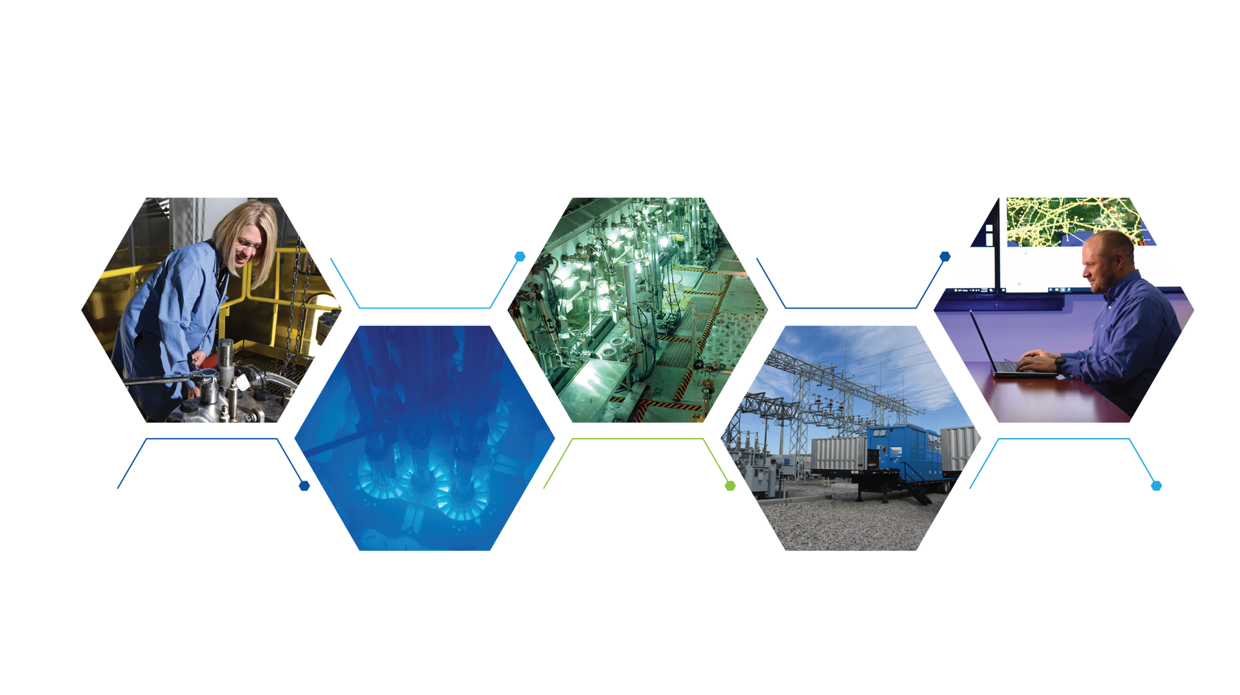

SMRs Development Needs: Creating a secure, resilient, clean energy future
Energy & Environment
Science & Technology
Advanced
Test Reactor Complex
Nuclear Science
& Technology
Materials and
Fuels Complex
National & Homeland
Security Science
& Technology

Slide 14
SMRs Development Needs (cont’d)
Qualifying the advanced fuel-to-reactor design: For a new nuclear fuel material, the time required from fuel material identification to passing the qualification process is estimated to be 20 years in the U.S. [7].
Thus, many SMR conceptual designs consider matured fuel materials, with final-state R&D being conducted to commercialize them. Examples of such cases are tri-structural isotropic (TRISO) particle fuel, high-assay low-enriched uranium (HALEU) fuel, and accident-tolerant fuel (ATF) concepts.
Supporting rapid scaled/prototypic experimentations: Reactor system design and analysis requires appropriate use of M&S tools, and scaled-facility test data supports the Evaluation Model and Development Assessment Process (EMDAP) specified by the NRC Regulatory Guide (RG) 1.203 [8].
Maintaining local and global codes and standards, and meeting regulations
Resolving supply chain issues
Cradle-to-grave nuclear fuel cycle, including transportation
Mitigating financial, environmental, and other related risks
Notes:
22-50705-R0

Slide 15
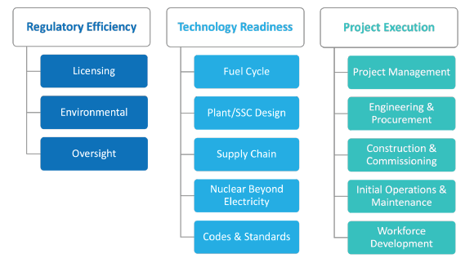
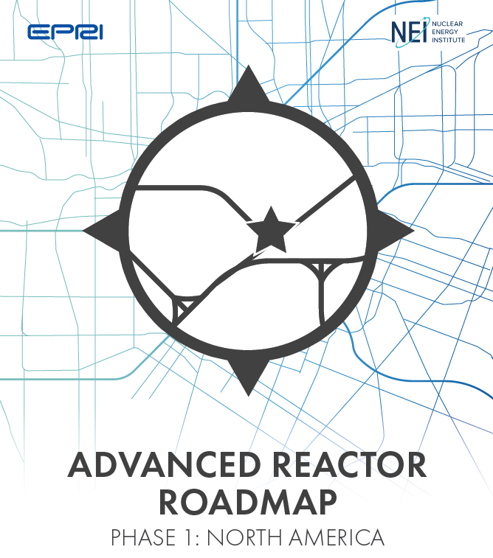

SMRs Development Needs: Advanced Reactors Codes and Standards Collaborative (ARCSC)
The ARCSC was established to ensure coordination and collaboration among standards design organizations (SDOs) in the USA and Canada to support reactor designers, regulators, and other stakeholders.
The ARCSC was established to support the Advanced Reactor Roadmap established by the Nuclear Energy Institute (NEI) and Electric Power Research Institute (EPRI).n input from AR designers and other AR industry stakeholders, SDOs have identified codes and standards that are a priority for revision or initial development
ARCSC and its constituent SDOs and stakeholders interface with the Roadmap through the Codes & Standards element.
Source: https://arcsc.nei.org/Home
Notes:
22-50705-R0

Slide 16


SMRs Development Needs: Priority Codes and Standards
The standards that the industry identified for attention spans a broad set of technical subjects including (not limited to):
Performance and integrity of materials used in high temperature environments
Fire protection for advanced reactor facilities
Qualification and condition monitoring of electrical equipment
Categorization of structures, systems and components used for seismic design n input from AR designers and other AR industry stakeholders, SDOs have identified codes and standards that are a priority for revision or initial development
Although the ARCSC focus is on codes and standards issued by organizations in the USA and Canada, there is continual engagement with international efforts to preclude duplication of efforts.
International participants (WNA, IAEA, SDO Convergence Board)
Source: https://arcsc.nei.org/Home
Notes:
22-50705-R0

Slide 17
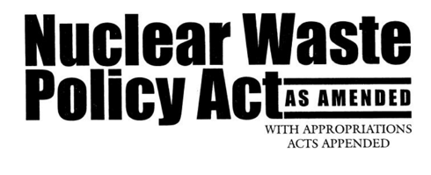
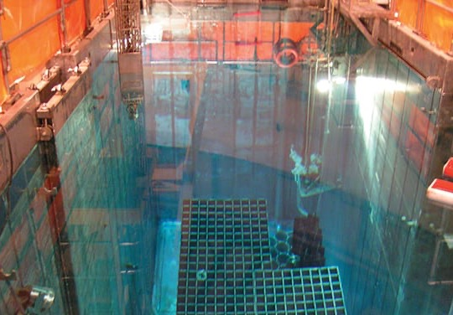
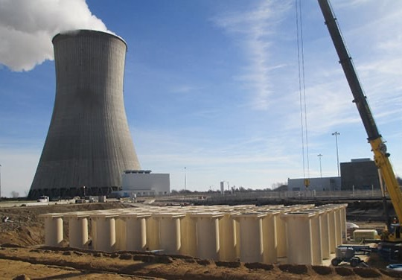
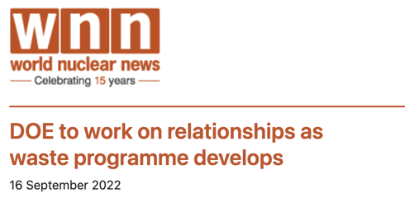
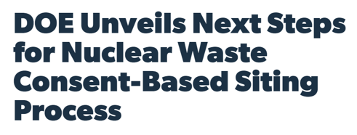
SMRs Development Needs: Disposition of nuclear waste is a policy and social issue, not a technical challenge
Safe, secure interim WET storage exists
Safe, secure long-term DRY storage exists
We need a national, consent-based dialogue
to identify a permanent geological repository
Notes:
https://world-nuclear-news.org/Articles/DOE-to-work-on-relationships-as-waste-programme-de
https://www.powermag.com/doe-unveils-next-steps-for-nuclear-waste-consent-based-siting-process/

Slide 18
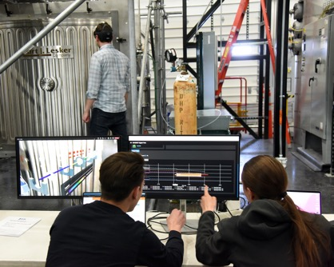
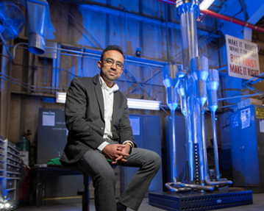
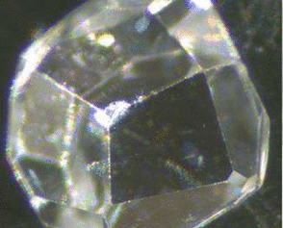
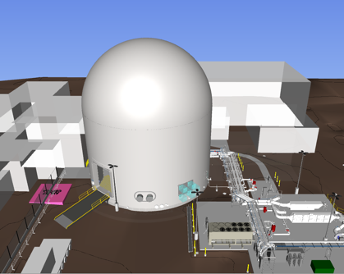
SMRs Development Needs:
Enabling the future of nuclear energy through innovation
Achieving battery-like functionality for
nuclear systems
Advanced
Reactors
Advancing technology through fundamental science
Digital
Engineering
Notes:
Images:
Digital Engineering: DOME-Exterior of the DOME (EBR-II) with its new utility systems in the bottom right and new entrance door on the left side of the structure
Advanced reactors: MARVEL
Advancing tech through fundamental science: High-quality, well faceted single crystal ThO2 funded under TETI. Image from Physical Reviews publication focusing on thermal transport in nuclear fuel single crystals (ThO2 is fuel candidate material). https://pubs.acs.org/doi/full/10.1021/acs.chemrev.1c00262#
Achieving battery-like functionality for nuclear systems.
Fission battery initiative demo using digital twin of MAGNET to predict controls actions. (project with MAGNET will demonstrate autonomous and reliable operation of experiments/test articles through Digital twin technology, with dynamic risk assessment capability, and establish a sufficient set of sensors to measure nuclear system parameters)
Enabling U.S. Technological Leadership in Global Energy Markets:
Supporting all Advanced Reactor Demonstration Program Projects (ARDP)
Digital engineering center of excellence established (DICE)
Fission Battery Initiative
Nuclear Materials Discovery and Qualification Initiative (NMDQi) – integrated into a new DOE NE-5 program called Advanced Materials and Manufacturing Technologies (AMMT).
Fission Batteries: to drive technology developments for next generation nuclear reactors enabling distributed use of nuclear energy. Attributes: economic, standardized, installed, unattended and reliable
Revolutionizing Space Exploration: Partnership w/ LANL and ORNL radioisotope power systems. INL heavily engaged in space nuclear propulsion reactor tech. and working with NASA on development of Fission Surface Power.
Advanced Reactors:
MARVEL: funded by DOE-NE and partnering with LANL and ANL and commercial businesses. Will provide crucial understanding of fundamental features, operation and behavior of microreactors. Connect MARVEL to net-zero microgrid. First operation target early 2024.
Pele: DoD microreactor program to power military bases and other DoD infrastructure. Collaboration between DoD, NRC, DOE, and NASA. INL announced as siting location for prototype. FY 22 will focus on design and fuel considerations.
TRISO: In final qualifications for TRISO coated particle fuel and advanced graphite for advanced gas reactors.
NRIC: DOME and LOTUS. And working with INL and University to advance digital design for nuclear reactor systems.
Utah Associated Municipal Power Systems (UAMPS)- deploying NuScale SMR VOYGR to provide electricity to site and broader region
Advancing technology through fundamental science: two DOE-BES supported Energy Frontiers Research Centers (EFRCs)
DOE-BES support. INL leads TETI (partner with ORNL and universities), to develop atom-to-mesoscale understanding of phonon and electron transport in advanced nuclear fuels.
INL partner on MSEE (led by BNL). Provides predictive understanding of bulk and interfacial chemistry of molten salts.
Digital engineering: principles are predicted to save up to 25% of costs in complex vertical construction and are already realizing multiple years in reduced schedules at the Department of Defense.
At INL, digital engineering is centered around 5 key areas:
Transformation from document-centric design to model-based design,
Integration of data across the lifecycle in a digital thread,
Development of operational digital twins,
Establishment of next generation cloud, edge, and HPC computing,
And finally, workforce transformation to a digital-first environment
To realize this vision the laboratory has partnered with several universities:
North Carolina State University
Virginia Commonwealth University
Naval Postgraduate School
Agreements to deploy these technologies to industry are currently in development with:
TerraPower
General Electric Hitachi
and many ARDP award winners through NRIC
NRIC works closely with the INL-led Gateway for Accelerated Innovation in Nuclear (GAIN) to build on the success of GAIN’s industry engagement through regularly available funding awards to industry.

Slide 19
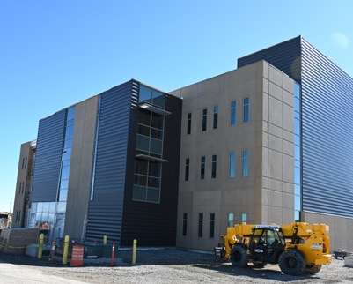
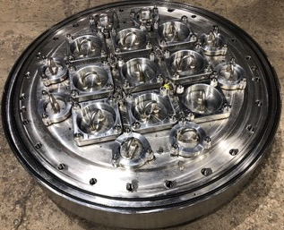
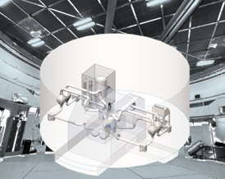
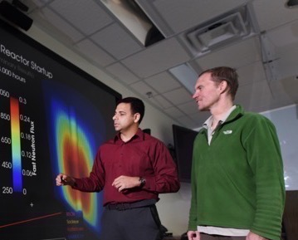
SMRs Development Needs: Expanding and deploying national nuclear energy strategic infrastructure
Advanced Post Irradiation Examination Capabilities
ATR retrofit to expand irradiation capabilities
Establishing Testbeds for reactor demonstrations
High performance computing and advanced modeling and simulation capabilities
Notes:
Images:
Advanced PIE capabilities: SPL
Retrofit ATR: Top head closure plate to facilitate I-Loop(s) and other experiments in the outer reflector of ATR
MOOSE
Lotus ZPPR Laboratory for operating and testing in LOTUS test bed
INL’s nuclear energy infrastructure is a critical national asset serving key national security, energy, and scientific functions. INL maintains and expands capabilities to meet shifting needs of the advanced reactor and national security communities and provides modern business and outreach approaches to streamline access so that strategic assets can be deployed in a timely, cost-effective, and safe manner.
Expanding and Deploying National Nuclear Energy Strategic Infrastructures (from Lab Plan)
Establishing Testbeds for reactor demonstrations (DOME, LOTUS)
Expanding irradiation capabilities - ATR I-Loop installation underway
Sample Prep Lab construction underway
Advanced PIE capabilities: IMCL and SPL both designed to enable high-throughput testing and analysis. SPL (operational target FY 25) dedicated to study non-alpha core materials.
ATR I-loop: enable prototypic and instrumented testing of advanced LWR fuels under variety of conditions.
MOOSE: INL-developed modeling and simulation tool to improve design, analysis, and validation of new tech. approaches and experiments to accelerate development and qualification of new nuclear technologies.
ATR: In response to a 2017 joint NE and Naval Reactors directive to explore options for the extension of ATR operations beyond 2040, INL and the Naval Nuclear Laboratory (NNL) collaborated on and submitted a business case and recommendation to replace ATR in July 2020. NE/NR responded this past December stating that “DOE-NE and NR are proceeding with the development of a Critical Decision – 0 (CD-0) Mission Need package to maintain a thermal irradiation testing capability in parallel with developing an associated acquisition strategy, engagement strategy, and memorandum of agreement.” ATR Plant Health Program investments and risk management strategies continue to sustain current reactor operations.
TREAT: Transient Water Irradiation System (TWIST) in design phase and will be INL’s future LWR fuel safety testing device
VTR- When completed, the INL-led Versatile Test Reactor (VTR) will provide flagship, next-generation irradiation capabilities. VTR will work in combination with an expansion of transient testing at INL’s (TREAT) and thermal irradiations in ATR. An earlier adopter of digital engineering, the VTR, has sustained milestone performance across a geographically dispersed team through the pandemic due to the team's digital engineering strategy.
STAR (funded by DOE-FES): ATR complex houses essential PIE capabilities and INL’s Safety and Tritium Applied Research (STAR) Facility. The fusion-plasma environment is harsh in terms of material temperatures (>1,000°C), surface heating (>10 MW/m2), surface erosion (mm/y), and intense high-energy (14 MeV) neutron-irradiation damage. STAR is uniquely equipped to handle tritium and radioactive materials, as well as other chemically toxic substances, including beryllium, molten salts, lithium, and lead. INL works closely with the DOE Office of Fusion Energy Science to ensure that the STAR Facility is aligned with program objectives.”
Strengthen and leverage NRIC: As a national program led by INL, NRIC facilitates industry access to INL’s existing nuclear facilities, and the unique nuclear infrastructure assets of the other DOE national laboratories. NRIC targets expansion of national strategic infrastructures to support advanced reactor design and development. NRIC tailors its support to the requirements of each advanced reactor demonstration project, including those projects already underway.
Molten Chloride Reactor Experiment (MCRE) is a liquid fueled, fast spectrum, critical experiment that will operate in the LOTUS test bed. Image not to scale, approximately 6ft tall. Project Pele in DOME

Slide 20
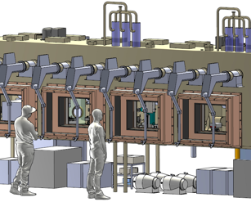
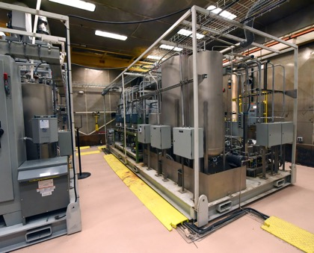
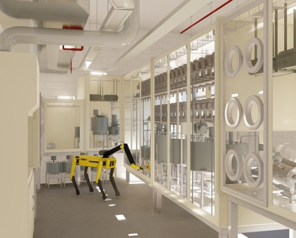
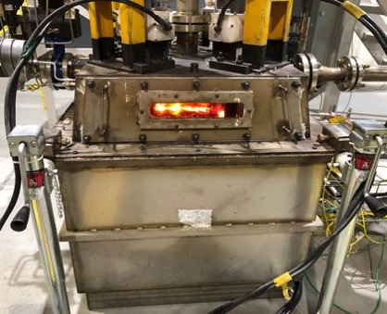
SMRs Development Needs: Leading advanced reactor fuel cycle development through RD&D test beds
Molten Salt Thermophysical
Examination Capability (MSTEC)
Moran –
uranium-based spent fuel test bed
Beartooth –
special nuclear material test bed
Veolia's GeoMelt Engineering Scale Melt Unit
Notes:
Images
MSTEC
Beartooth-Remote IAEA Inspections by Mobile Robotics & Digitally Enhanced Mixed Reality Methods using the SPOT robot in Beartooth
Geomelt- Veolia's GeoMelt Engineering Scale Melt Unit. The picture shows the in-process molten surface of the top of the melt through the viewing window. The vitrification process using GeoMelt removes the reactivity of the sodium components and incorporates everything into a glass form for safe and compliant disposal. BEA has partnered with Veolia for application of their technology to reactive (sodium) materials and wastes for the successful treatment and disposal of thousands of pounds of sodium and the elimination of several liabilities.
Stewarding RD&D test bed facilities is critical for INL to engage and train the next generation of fuel cycle, nonproliferation, and waste management experts.
All new fuel cycle test beds are designed with the ability to demonstrate innovative safeguards and security concepts applicable to advanced reactors and their fuel cycles in support of national security objectives.
Developing RD&D Test Beds
Advanced test beds allow INL to lead advanced reactor development (including SMRs, microreactors, liquid-fuel reactors, and TRISO fuel development)
Test Beds
Beartooth (completed 2023) will expand nonproliferation research capabilities allowing researchers to process HALEU, plutonium, thorium, uranium-233 and their minor actinides and fission products. Complemented with digital twin research, undperinned by AI, machine learning and deep learning.
MSTEC developed through NRIC to support industry developers. Will provide users with characterization equipment, infrastructure and technical staff with data needed to design, demonstrate, license, and operate molten salt reactors.
Modern Waste Management Capabilities: INL developing embedded waste management test bed capabilities at MFC to address challenges with legacy and newly generated waste streams.
Geomelt
Pyrolysis
Drum Assay

Slide 21
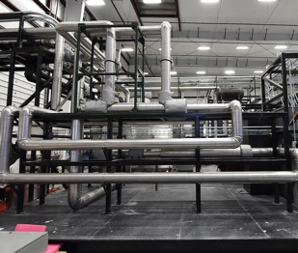
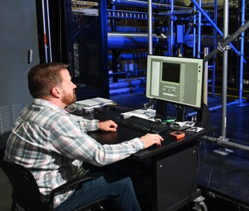
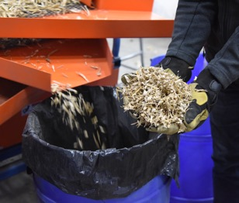
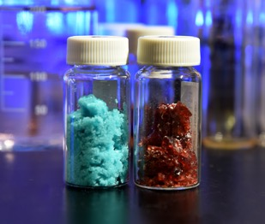
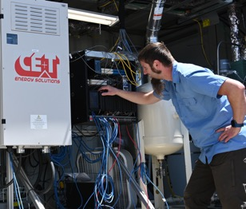
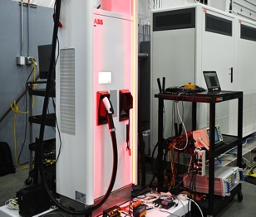
SMRs Development Needs: Discovering new technologies for sustainable clean energy integration for electricity, transportation, and industry
Critical materials recovery
Secure vehicle charging
Nuclear H₂
High-efficiency
thermal
energy use
Integrated energy systems solutions
Sustainable fuels through waste recycling

Slide 22














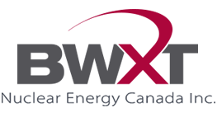
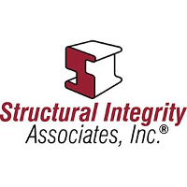



SMRs Development Needs: Impact of Advanced modeling and simulation tools
MOOSE
BISON
Blackbear
An Example modeling and simulation tools is MOOSE developed by INL
  Citations for Multiphysics Object Oriented Simulation Environment (MOOSE): 1,240
  2020 MOOSE paper is the most cited paper in Elsevier Software-X
  INL papers using MOOSE: ~200
  Citations of INL papers using MOOSE: ~3,000
  5,000+ unique visitors a month to the
  MOOSE website
Falcon
Griffin
Grizzly
Magpie
Marmot
Mastodon
RELAP-7
Sockeye
Pronghorn
Nuclear Entities Using INL MOOSE-Based Applications:
Notes:
2021 Special Issue of Nuclear Technology on the MOOSE Multiphysics Computational Framework: has thousands of views
Dr. Derek Gaston’s groundbreaking Multiphysics Object-Oriented Simulation Environment (MOOSE) application was a revelation to all of us working in nuclear energy research and development and enabled us to more quickly and efficiently resolve issues related to performance and capabilities.
MOOSE is a game changer. It is the foundation of INL’s international reputation in modeling and simulation as well as DOE-NE’s Advanced Modeling and Simulation program.
The Nuclear Regulatory Commission (NRC) adopted a combination of existing NRC and MOOSE-based codes for the licensing of advanced reactors.
Dr. Gaston’s groundbreaking work has accelerated research outcomes for hundreds of scientists and promises to play an important role in the development and deployment of advanced nuclear technologies, such as microreactors and small modular reactors.

Slide 23
Conclusion and Final Remarks
The development of advanced SMRs is currently ongoing. These new reactors are being designed by prioritizing customer needs with an accelerated innovation in design, development, demonstration, deployment, and beyond (4D+) by minimizing engineering, regulatory, and economical challenges.
The following characteristics were highlighted:
  SMRs are not a new concept; however, SMRs adopt an optimized economic scaled design for rapid deployment. Several SMR designs are in the process of obtaining design approvals.
  Addressing SMR engineering and regulatory challenges will support broader nuclear innovations, including Generation IV designs. While financial hurdles are common, SMR vendors must adhere to cost and schedule commitments for customers and regulators.
  New nuclear reactor technology providers need to understand the potential challenges and regulatory compliances to appropriately utilize their resources. Customers of these reactor technologies need to understand and evaluate the reactor design feature to select the appropriate SMR technology, associated TRL, and required regulatory approvals to make a well-informed decision.
Notes:
22-50705-R0

Slide 24
Acknowledgements and References
Acknowledgements: The authors would like to thank the United States (U.S.) Department of Energy (DOE) Advanced Reactor Demonstration Project (ARDP) program office, the National Reactor Innovation Center (NRIC), and the Reactor System Design and Analysis Division at Idaho National Laboratory for their encouragement, assistance and overall support. Authored by Battelle Energy Alliance, LLC, under DOE Contract No. DE-AC07- 05ID14517.
References:
INTERNATIONAL ATOMIC ENERGY AGENCY (IAEA), “Technology Roadmap for Small Modular Reactor Deployment,” IAEA Nuclear Energy Series No. NR-T-1.18, IAEA, Vienna, Austria (2021).
The Advanced Reactor Information System (ARIS) database. IAEA. Available: https://aris.iaea.org/TechnicalData/.
Schlegel, J. P., and P. K. Bhowmik. “Chapter 14 – Small modular reactors.” in Wang, J., S. Talabi, and S. Bilbaoy Leon (Eds.), Nuclear Power Reactor Designs, Academic Press, San Diego, CA, USA. 283–308. (2024). https://doi.org/10.1016/B978-0-323-99880-2.00014-X.
INTERNATIONAL ATOMIC ENERGY AGENCY (IAEA), “Nuclear Reactor Technology Assessment for Near Term Deployment,” IAEA Nuclear Energy Series No. NP-T-1.10, IAEA, Vienna, Austria (2013).
HIDAYATULLAH, H., S. SUSYADI, and M. H. SUBKI, “Design and technology development for small modular reactors–Safety expectations, prospects, and impediments of their deployment,” Prog. Nuclear Energy, 79, 127-135 (2015). https://doi.org/10.1016/j.pnucene.2014.11.010.
SUBKI, M. H., “Advances in development and deployment of small modular reactor design and technology,” In Proceedings of the ANNuR-IAEA-USNRC Workshop on SMRs Safety and Licensing, 12–15 January 2016.
FAIBISH, R. “Accelerated Fuel Qualification White Paper,” Accelerated Fuel Qualification Working Group White Paper Task Force. (2021).
U.S. Nuclear Regulatory Commission (NRC), Transient and Accident Analysis Methods, Regulatory Guide 1.203, December 2005. NRC, Washington, D.C., USA. (2005).
Notes:
22-50705-R0

Slide 25

