Slide 1
IAEA International Conference on small modular reactors and their applications
October 21-25, 2024
CANDU Owners Group: Excellence Through Collaboration for an Evolving Nuclear Landscape
Sonia Iqbal
October 24, 2024

Slide 2
Presentation Outline
Introduction to CANDU Owners Group (COG)
Early Industry Collaboration to Support SMR Development and Deployment
Canadian Nuclear Landscape
COG SMR Program
Looking Ahead

Slide 3
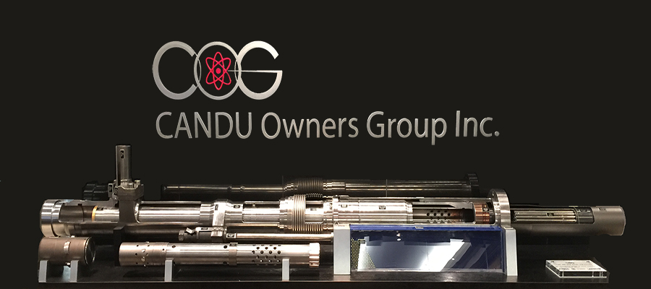
Introduction to CANDU Owners Group

Slide 4
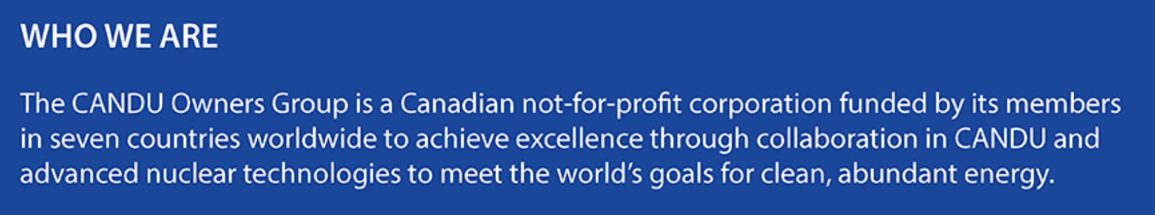







CANDU Owners Group (COG)
Information Exchange
Research &
Development
Nuclear Safety & Environmental Affairs
Learning & Development
Joint Projects
& Services
Notes:
Through COG's various lines of business, COG facilitates research, joint projects, information exchange and industry alignment on industry standards, regulations and the most recent trends and areas of interest of our members and participants.
Joint Projects and Services (JP) develops solutions to problems and issues shared by two or more COG members through shared resources and provides a wide range of services including quality assurance auditing.
Research and Development (R&D) is a mechanism for COG members to share the risks, costs and the rewards of R&D projects in six program areas including five core areas related to more immediate industry opportunities and challenges, as well as in Strategic Research and Development (SRD) focussed on longer-term issues.
Information Exchange (IE), including Learning & Development (L&D), leverages experience across the industry and among CANDU utilities to share experience and best practices through shared operating experience, through the work of industry peer teams and several other collaboration mechanisms. As well, through the IE line of business, COG provides a series of professional development and training workshops and programs to strengthen today's nuclear leaders and to prepare the people who will be the leaders of tomorrow.
Nuclear Safety and Environmental Affairs (NSEA) facilitates industry alignment on industry standards and regulations, both in Canada and internationally. As well, NSEA facilitates industry progress in the areas of nuclear safety and environmental management. It facilitates collaboration amongst members, participants and partner organizations to explore and develop common positions and activities in new areas of COG member interest, including small modular reactor development and decommissioning and radioactive waste management. Through forums, peer teams and participant groups, NSEA is helping the industry as it evolves to meet new opportunities and changing expectations.

Slide 5
COG Members
Canadian Members
International Members
Bruce Power
Canadian Nuclear Laboratories
New Brunswick Power
Ontario Power Generation
Saskatchewan Research Council
SaskPower
CNNO, China
NPCIL, India
SNN, Romania
KHNP, Korea
NASA, Argentina

Slide 6

Early Industry Collaboration to Support SMR Development and Deployment

Slide 7

Canadian Roadmap for SMRs
Roadmap published November 2018
Success will rely on strategic partnerships – across the sector and internationally
Concrete set of recommendations across four thematic pillars to guide future actions needed by “Team Canada”
  Demonstration and Deployment
  Policy, Legislation and Regulation
  Capacity, Engagement, and Public Confidence
  International Partnerships and Markets

Slide 8
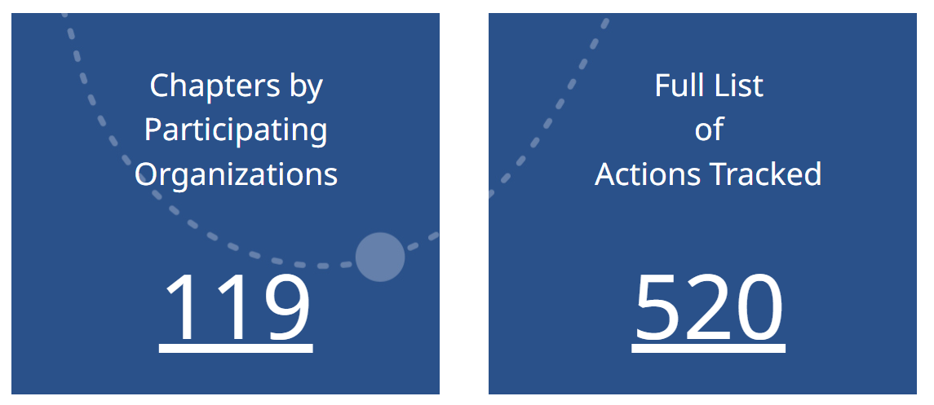
Canada’s SMR Action Plan
SMR Action Plan responds to all 53 recommendations in Canada’s SMR Roadmap and includes additional voluntary actions
Actions are guided by thematic pillars from the roadmap
Introduction of pan-Canadian “three stream strategy”
Progress Update published October 2022
Notes:
Moving forward, the SMR Action Plan will be critical because it is Canada’s plan for the development, demonstration, and deployment of SMRs to reduce emissions, decarbonize heavy industry, and spur economic development.
It is encouraging to see the level of work and collaboration that has been taking place in the nuclear domain in the past few years. However, we recognize that more is needed to fully capitalize on Canada’s SMR opportunity. The SMR Action Plan Leadership Table will continue to meet biannually and work with the full spectrum of Canada’s nuclear energy sector to develop an SMR supply chain and sector that will benefit Canadians economically, environmentally, and socially.
The Leadership Table represents an arrayof cross-jurisdictional and multidisciplinary leaders in Canada’s nuclear energy sector
The mandate of the Leadership Table is to provide a forum composed of the federal government, interested provincial and territorial governments, Indigenous representatives, industry (nuclear and high-emitting sectors), electric utilities, and non-governmental organizations to review progress and discuss strategic priorities as they relate to the development and deployment of SMRs. The Leadership Table will provide advice and guidance as required to ensure progress is made towards advancing the development and deployment of SMRs in Canada

Slide 9
Canada’s Three Stream Strategy
Stream 1
On-grid SMRs in the short term to provide a clean and innovative energy option
Stream 2
On-grid advanced reactor designs to reduce nuclear by-products
Stream 3
Micro SMRs for heat and electricity generation and remote applications
The three streams are being developed in parallel with equal priority
Notes:
Stream 2 - On-grid advanced reactor designs to reduce nuclear by-products
Stream 3 - Micro SMRs to displace diesel generation and bring affordable, clean energy to remote areas for mining and in northern remote communities for heat and electricity generation.

Slide 10

Canadian Nuclear Landscape

Slide 11
Canada’s Climate Change Goals
~ 24GWe New Nuclear
Large NPPs
SMRs and Advanced Reactors
Various technologies under consideration
Stream 1: On-grid SMRs
Stream 2: On-grid Advanced Reactors
Stream 3: Micro SMRs
Notes:
Declaration to triple nuclear energy!
As identified in the Pan-Canadian SMR Roadmap, SMRs cover a wide range of power levels, designs, technological readiness levels and end user applications. In Canada, that can range from traditional on-grid generation to co-generation, heavy industry, mining, and remote community applications.
To meet this broad-based Canadian need, the four Utilities (SaskPower, OPG, Bruce Power and NB Power) have been working collectively and investing over the last two years to develop three streams of SMR projects. The three streams of projects will reduce carbon emissions and create growth opportunities for communities connected to the grid (Stream 1), will support advancement in nuclear technology and innovative methods to reduce nuclear by-products (Stream 2), and will bring affordable, clean energy to remote communities and mines (Stream 3). These three streams are being developed in parallel with equal priority.

Slide 12
Canada’s Three Stream Strategy: Vision to Reality
Licensee | Technology | Location | Status
Stream 1: On-grid SMR deployment
Ontario Power Generation | GE-Hitachi BWRX-300 | Darlington, Ontario | October 2022: Application for Licence to Construct submitted to CNSC Construction to be completed as early as end of 2028
SaskPower | GE-Hitachi BWRX-300 | Two potential sites in Estevan, Saskatchewan | Final site selection in 2025 Decision on whether to build an SMR will be made in 2029 Potential deployment in mid-2030s
Stream 2: On-grid advanced reactor development
New Brunswick Power | ARC-100 | Point Lepreau, New Brunswick | June 2023: License to prepare site submitted Targeted to be fully operational by early 2030’s
New Brunswick Power | Stable Salt Reactor -Wasteburner (SSR-W) | Point Lepreau, New Brunswick | Expected to be in operation by early 2030s
Stream 3: Micro-SMR deployment to for heat and electricity generation and remote applications
Global First Power | USNC MMR | Chalk River, Ontario | Environmental and licensing assessments are ongoing
Saskatchewan Research Council (SRC) Nuclear | eVinci micro-reactor | Saskatchewan | Expected to be operational by 2029 (subject to licensing and regulatory requirements)
Notes:
Real first projects (not MOUs) are critical to making SMRs a practical tool to combat climate change.
OPG Announcement re: GEH – December 2021. Only site in Canada that has a LPS for new nuclear.
Stream 1 - OPG and SaskPower undertook comprehensive Stream 1 technology selections.
Selection of the same technology by OPG and SaskPower helps enable a pan-Canadian, fleet-based approach to SMR deployment.

Slide 13

COG SMR Program

Slide 14
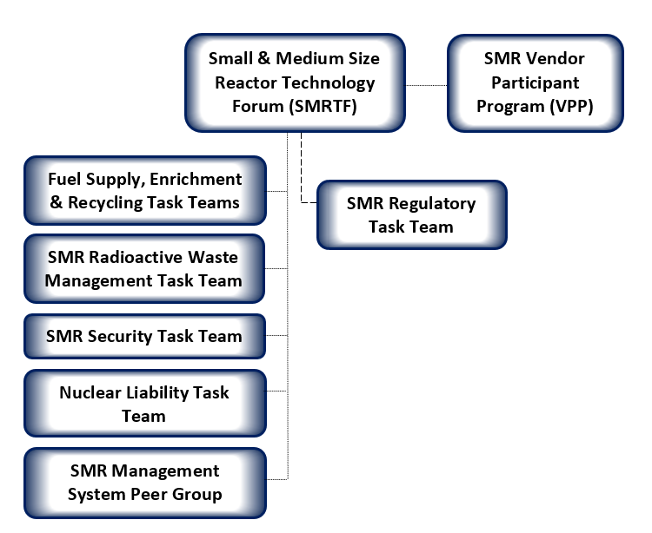
COG SMR Forums
Notes:
COG members, and the nuclear industry as a whole, are pursuing the future prospect of advanced technologies and small modular reactor (SMR) deployment in Canada and worldwide.
In response to this, COG established a set of SMR activities consisting of:
The SMR Technology Forum (SMRTF) and related SMR Task Teams;
The COG SMR Vendor Participant Program (SMR VPP); and
The CEO SMR Forum.
These groups were established to drive a collaborative effort to accelerate the development and implementation of SMRs – for both flexible on-grid application and to provide energy self-sufficiency in remote areas. An integrated and collaborative approach brings advantages by de-risking plans for all partners.
VPP: X-energy, USNC, Westinghouse, ARC Clean Technology, GEH, Terrestrial Energy, NuScale, Moltex Energy

Slide 15
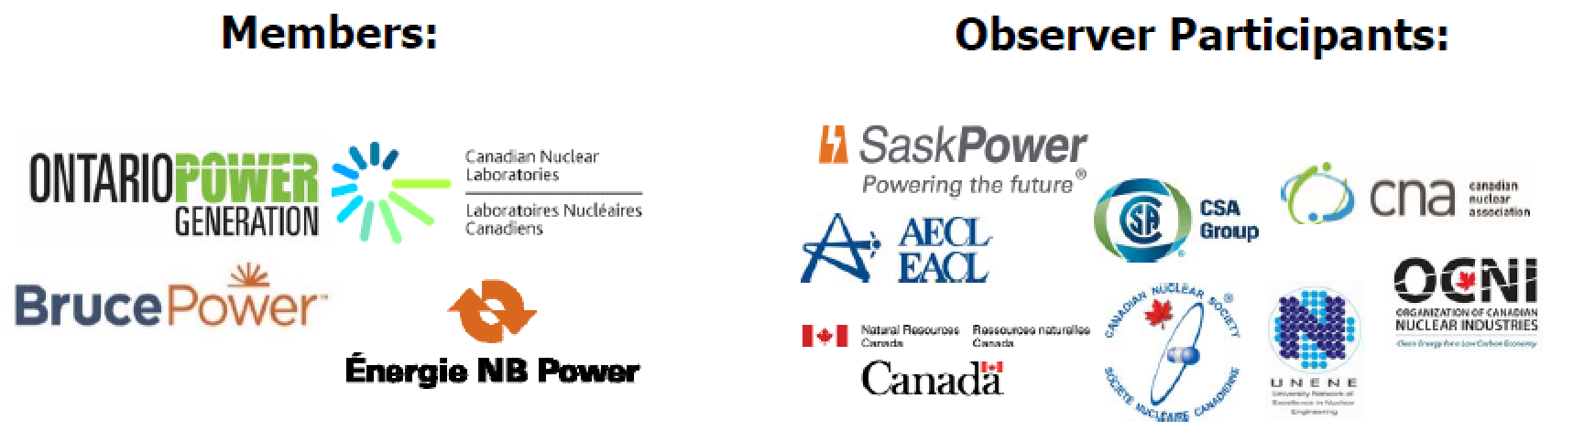
















Small & Medium Sized Reactor Technology Forum (SMRTF) Members
SMR Vendor Participant Program (VPP) Members

Slide 16
Other SMR Initiatives
  Regulatory Priorities Briefing Book
  Recommendations for CSA Standards improvements
  SMR Training & Certification Industry Group
  Workforce and talent development
  Participation in Canadian and international initiatives
    Canada/US Execute Task Force on SMR Regulation
    CSA Task Forces for Small Reactors and Harmonization
    IAEA Technical Working Group on SMRs (TWG-SMR)
    IAEA Harmonization & Standardization Initiative (NHSI) Industry Track Working Groups
    NEI/EPRI Advanced Reactors Codes and Standards Collaborative (ARCSC)
Notes:
Interim joint report on Classification and Assignment of Engineering Design Rules to Structures, Systems and Components (June 2023)
Final report on Tristructural Isotropic (TRISO) Fuel Qualification (June 2023)
X-energy’s reactor pressure vessel construction code assessment white paper (August 2021)
Technology-inclusive, risk-informed reviews for advanced reactors (August 2021)
GE Hitachi’s Containment Evaluation Method (April 2022)
Terrestrial Energy’s Methodology for Developing a PIEs List for the Integral Molten Salt Reactor (May 2022)
Joint Report on GEH BWRX-300 Steel-Plate Composite (SC) Containment Vessel (SCCV) and Reactor Building Structural Design White Paper (June 2023)Joint Report on GEH BWRX-300 Safety Strategy White Paper (July 2023)

Slide 17

Looking Ahead

Slide 18
Looking Ahead
Canadian nuclear landscape is evolving to include SMRs
Expect industry will continue to evolve with projected widespread introduction of non-electric nuclear applications, new licensees and non-traditional operator/licensing models
COG will continue to support its members with their future aspirations and to accommodate broader industry collaboration
  Technology-specific research and development and joint projects to solve common challenges in compliance with the Canadian regulatory framework
  De-risk plans for all partners and provide support to new entrants
22 new reactors were deployed in Canada between 1971 and 1992
  Leverage the COG collaboration model and Team Canada approach
  “We can do it again, and we can do it better”

Slide 19


Thank you

