Slide 2
DOE MARVEL Microreactor - Status
IAEA SMR Conference
John Jackson
National Technical Director
DOE-NE Microreactor Program
LRS # INL/CON-24-80711

Slide 3
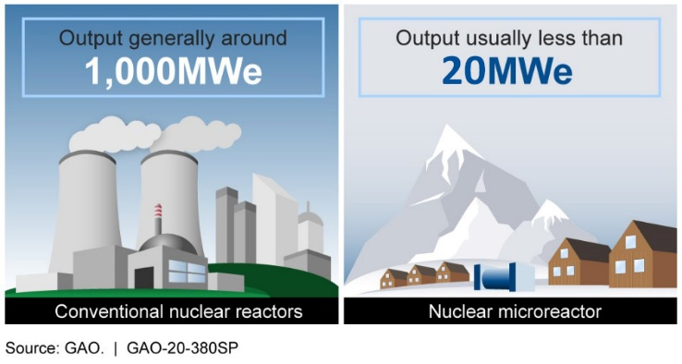
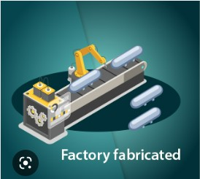


What are Microreactors?
Much smaller and simpler than traditional nuclear power reactors.
Technologies evolving from advances in materials, space reactor technologies, advanced nuclear fuels, and modeling & simulation.
Minimum site preparation
Flexible operation
Enhanced safety
Refueling (every 2-10 years)
Operational lifetime: 5 – 20 years

Slide 4
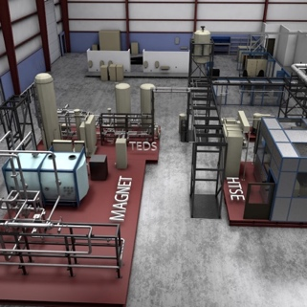
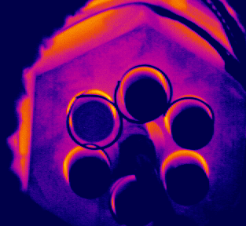
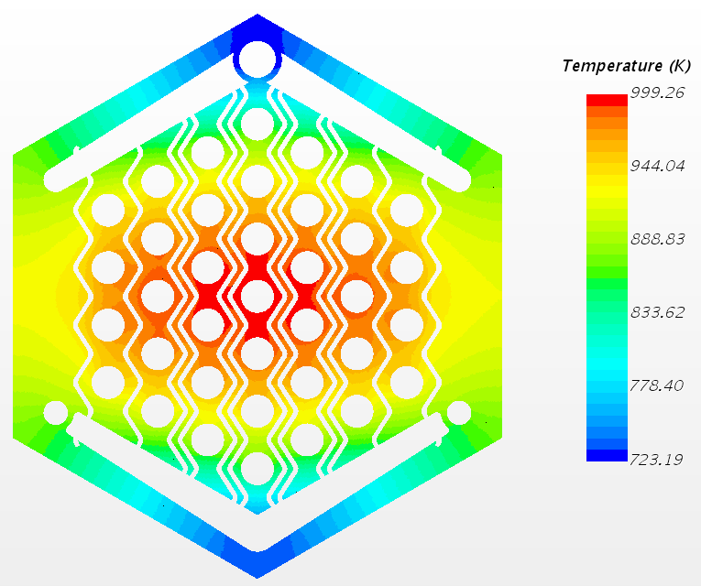
DOE Microreactor Program
Program Vision
Through cross-cutting research and development and technology demonstration support, the Microreactor Program will enable broad deployment of microreactor technology by:
Achieving technological breakthroughs for key features of microreactors
Identifying and addressing technology solutions to improve the economic viability and licensing readiness of microreactors.
Enabling successful demonstrations of multiple domestic commercial microreactors.
Program Objectives
Address critical cross-cutting R&D needs that require unique laboratory/university capability or expertise
Develop R&D infrastructure to support design, demonstration, regulatory issue resolution, and M&S code validation
Develop advanced technologies that enable improvements in microreactor viability
Microreactor Application
  Integrated Nuclear Testing
  Applied R&D
Demonstration Support Capabilities
  Non-nuclear Testing
  Test-beds for developers/regulators
Technology Readiness Level
Technology Maturation
  Matures fundamental microreactor enabling technologies and capabilities
System Integration & Analyses
  Identification of technology and regulatory gaps for Microreactors

Slide 5
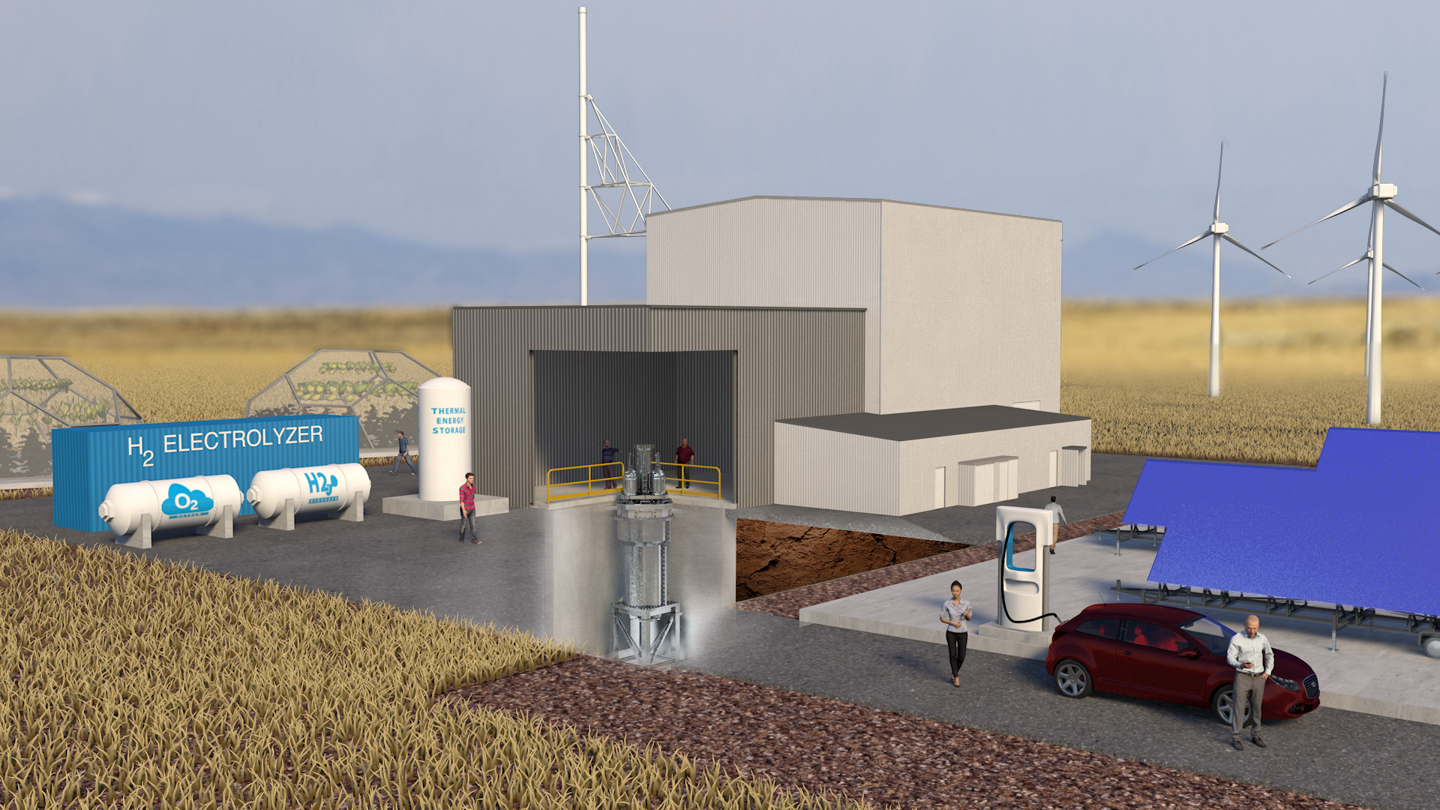
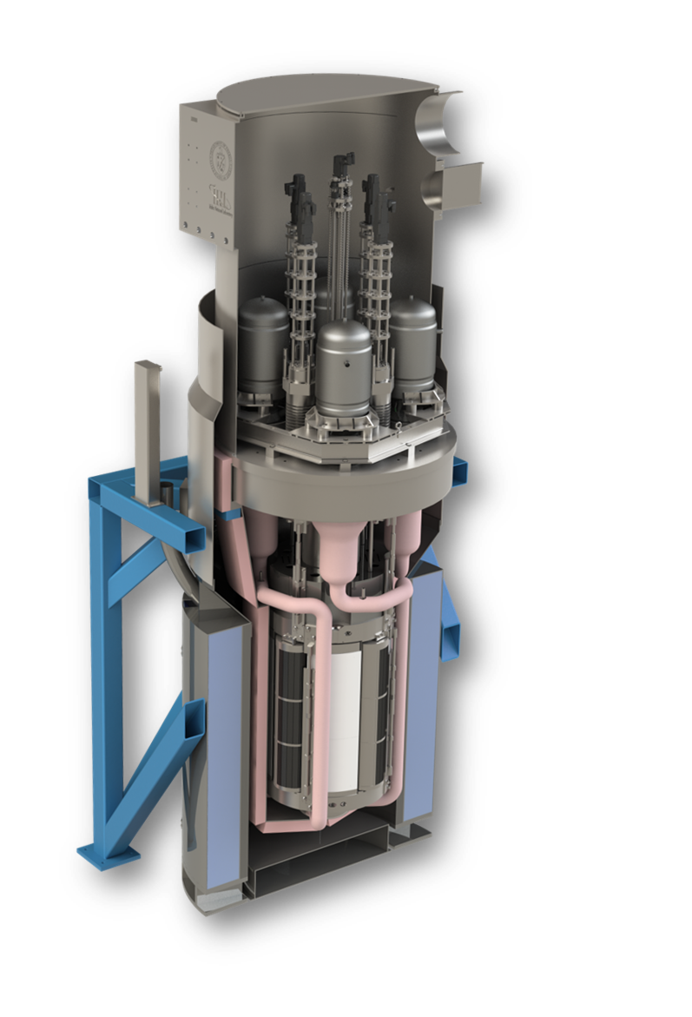
MARVEL can Enable a New Class of Nuclear Reactors
(Microreactor Applications Research, Validation & EvaLuation)
Project Goals:
Development of a small-scale microreactor that provides a platform to test unique operational aspects and applications of microreactors
Primary Objectives:
Operational microreactor
Produce combined heat and power (CHP) to a functional microgrid
Share lessons learned with commercial developers
Train future operators
U.S. DOE Sponsor Program:
Create momentum,
Champion rapid technology maturation to de-risk industry
Collaborate and engage microreactor end-user companies
85 kW-thermal
~ 20 kW-electric
~ 10 feet tall
< 8 tons
2 operators
Self-regulating

Slide 6
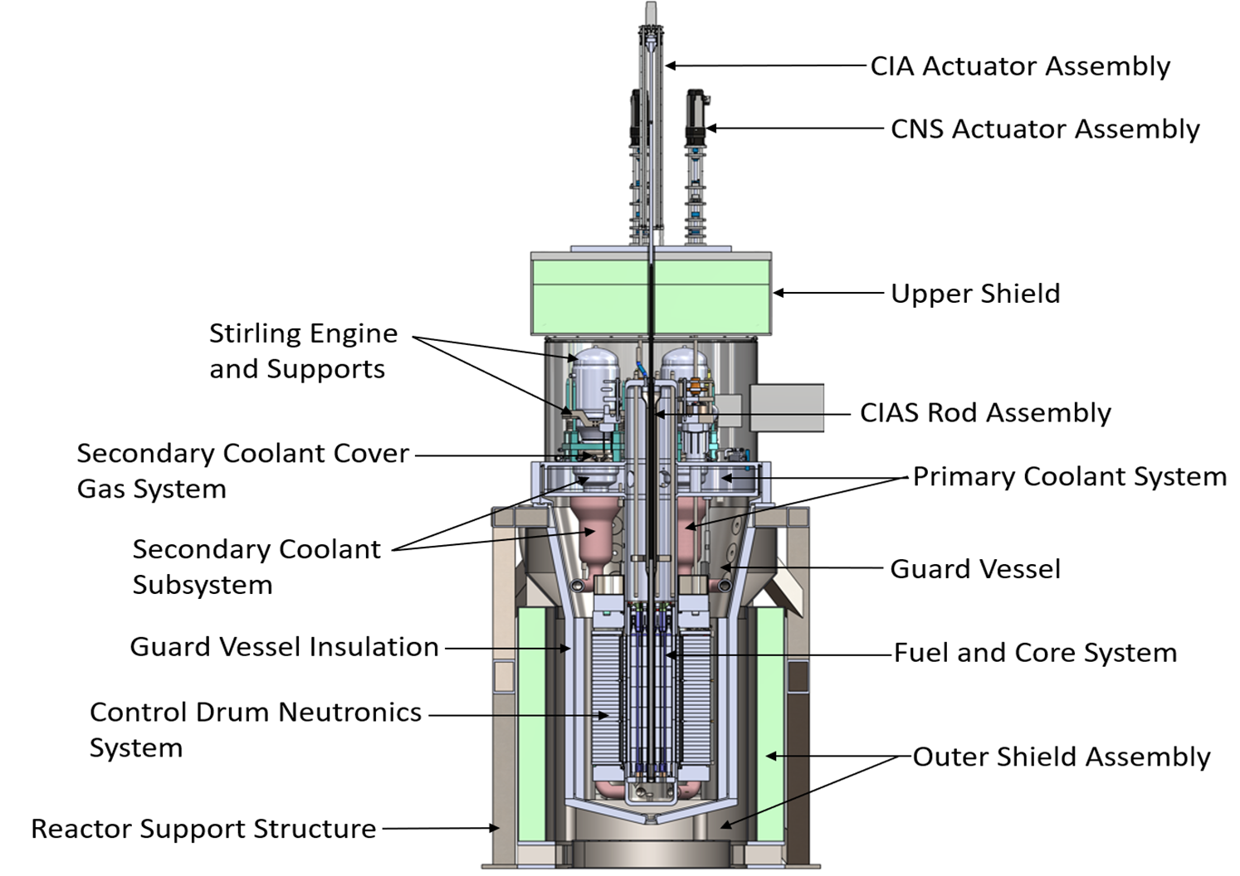


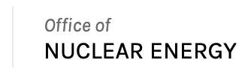


MARVEL Reactor Design
A key design feature of MARVEL is the ability to remove and replace the Power Conversion System
DOE Idaho Operations Office
Project Goal:
Build a Test Microreactor
Key Design Features
Reactor Type | Liquid Metal Thermal Reactor
Thermal Power | 85 kW-th
Electrical Power | ~20 kW-e
Coolant Drive | Natural Circulation
System Life | 2 years
Fuel | TRIGA Fuel
Weight | 7.5 metric ton
height | <15 feet

Slide 7




Key Modeling Simulation Tools Used in MARVEL Project
Updated geometry for shielding calculations
3D Neutronic Model
3D Thermal-structural response; stress classification lines
Structural Mechanics Models
Reactivity Coefficients, Neutronic Parameters, Power Distribution
1D Nodal Transient T
1D/3D System TH Model
Fuel Pin Model
Coolant Temperatures Power
Startup Model
Form Factors for Pressure Drops, Subchannel Flow Distribution
Solid Works
3D Components CFD Models
SAR
Updated geometry for procurement drawing and specs
Procurement Specs

Slide 8
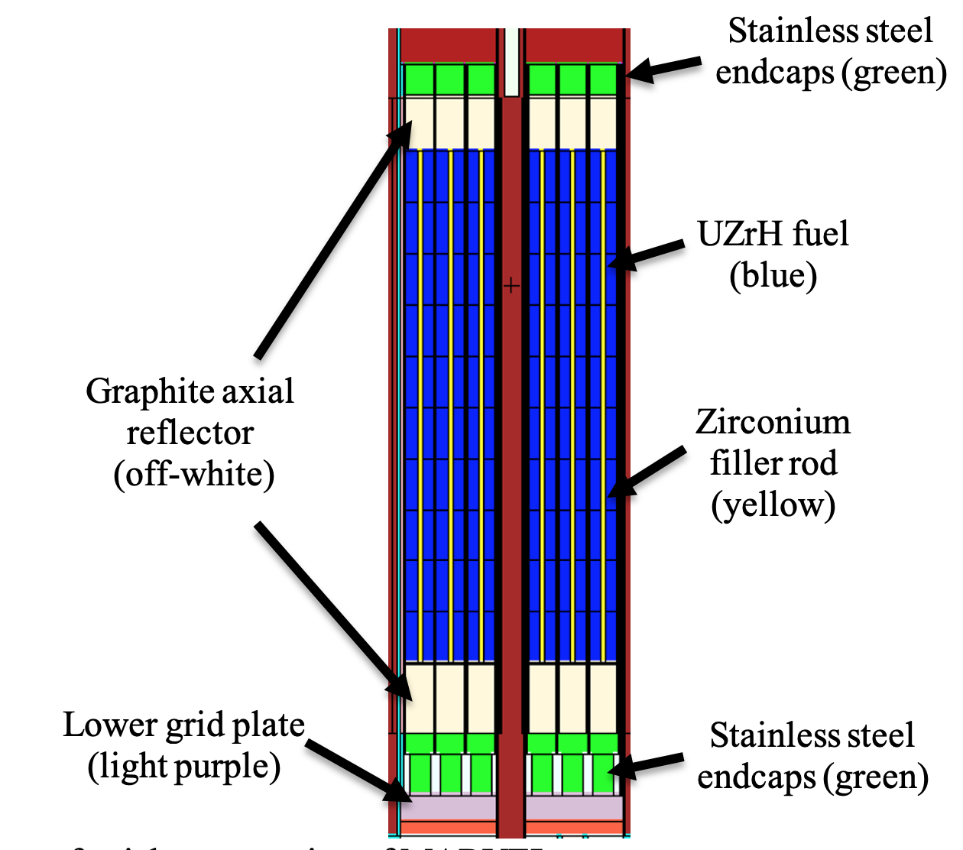
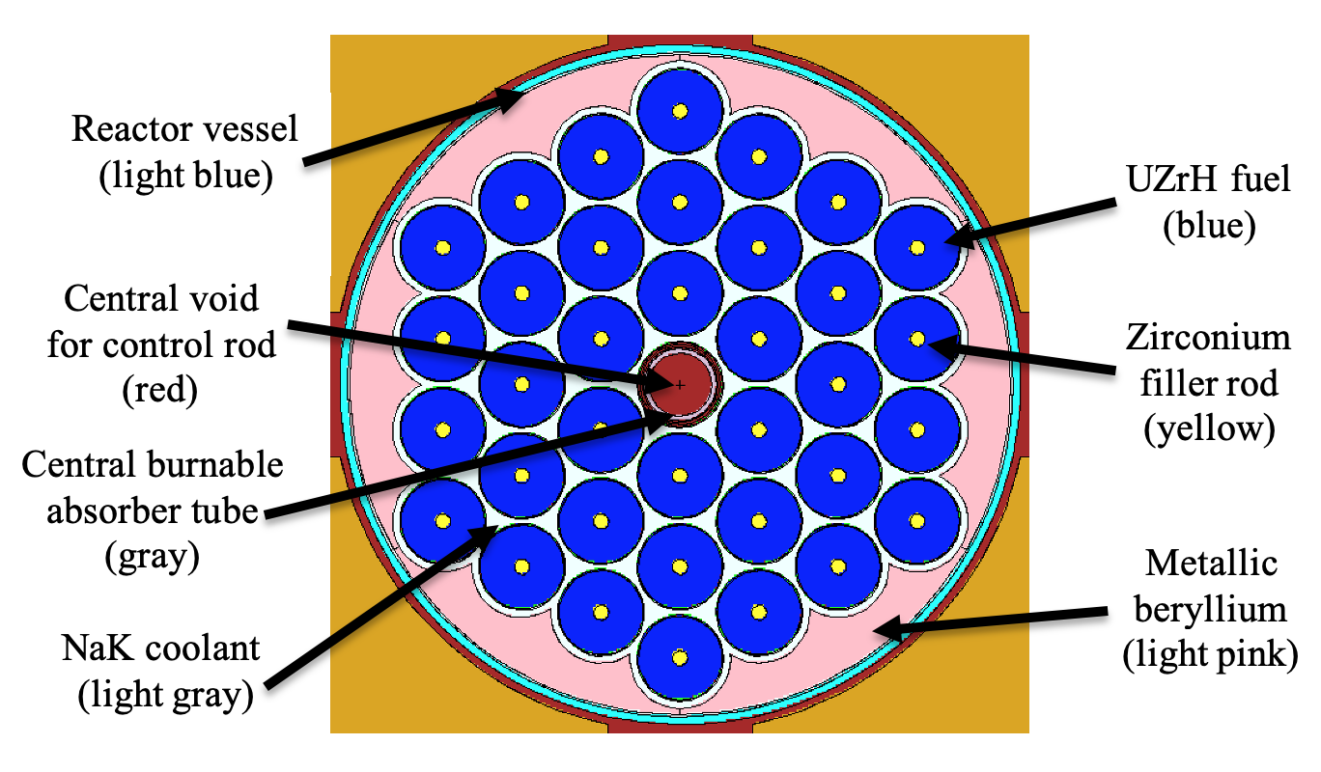
MARVEL Core

Slide 9
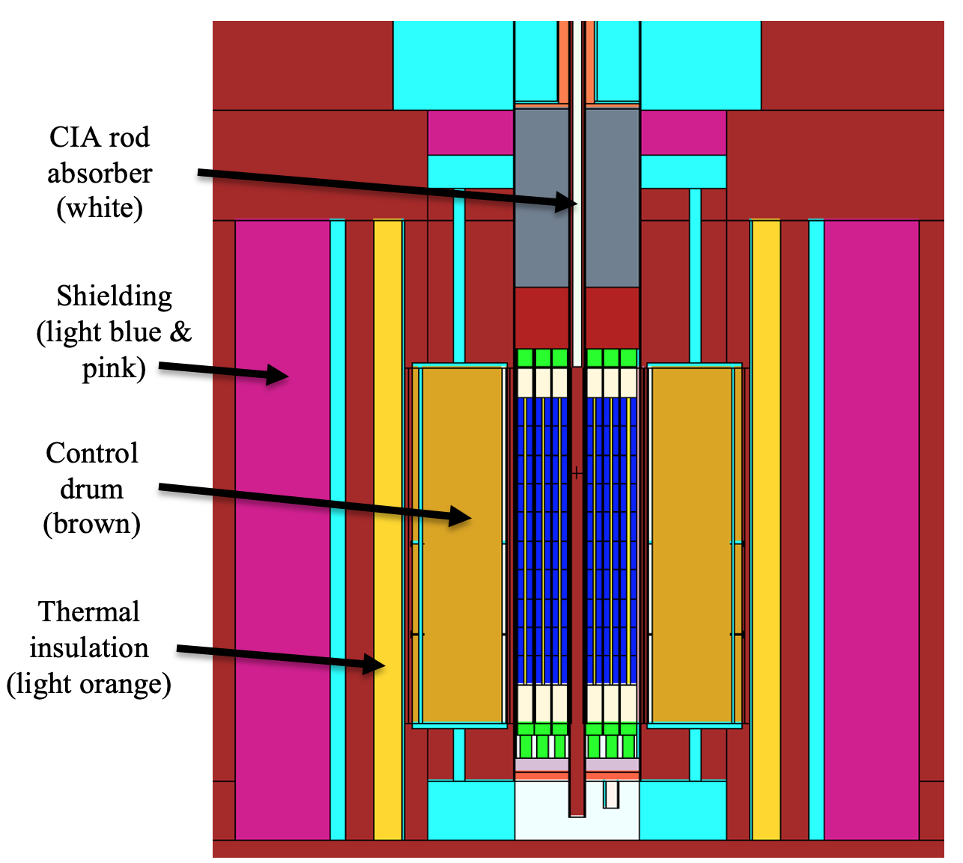
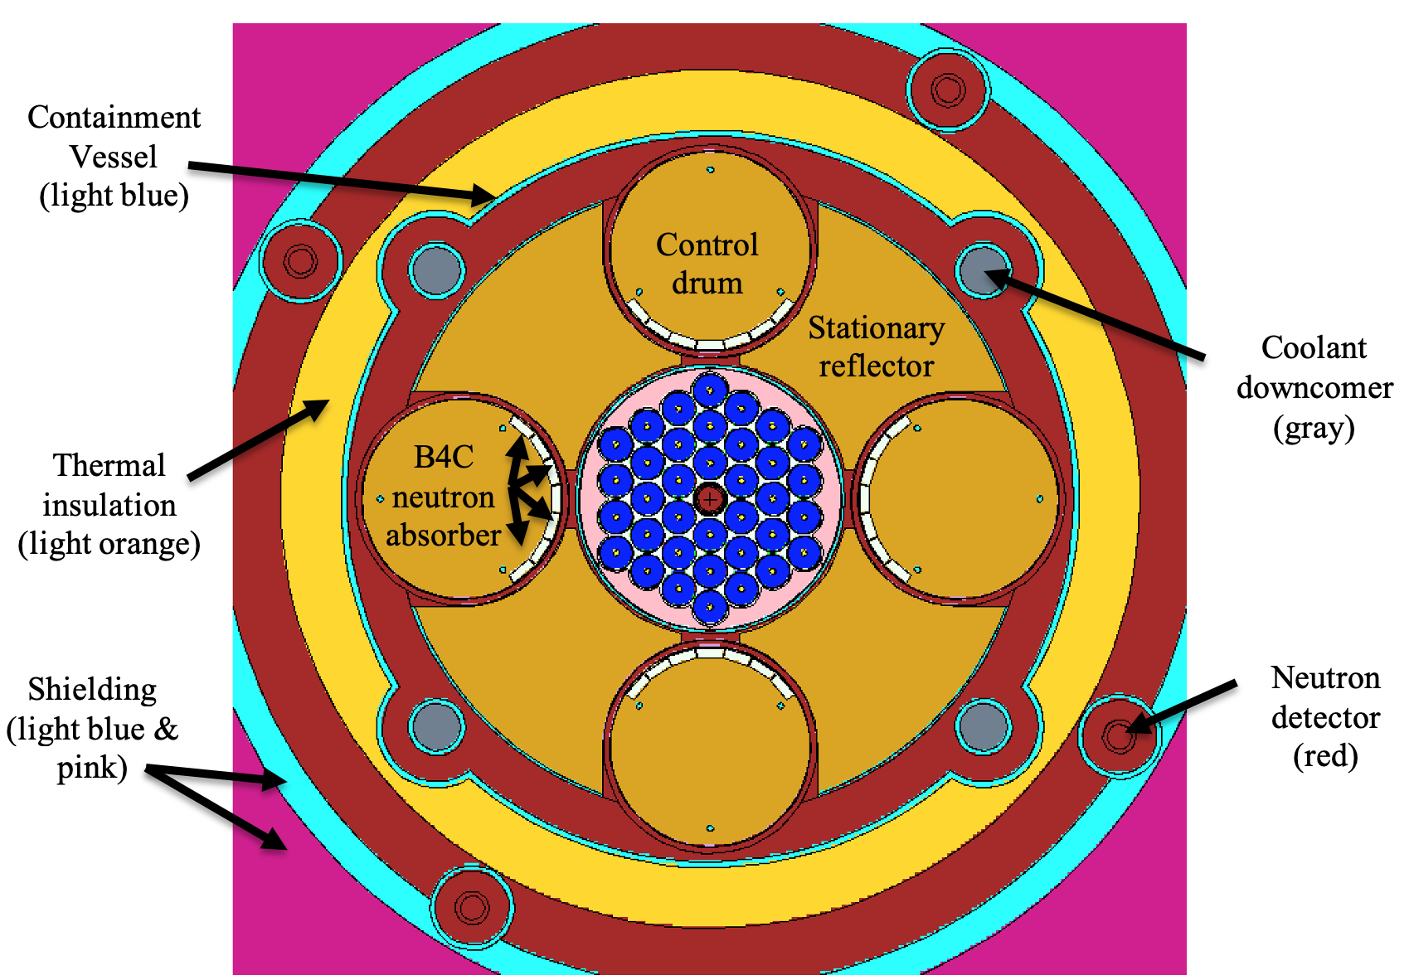
MARVEL NCNP Model

Slide 10
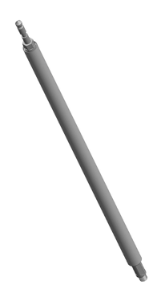
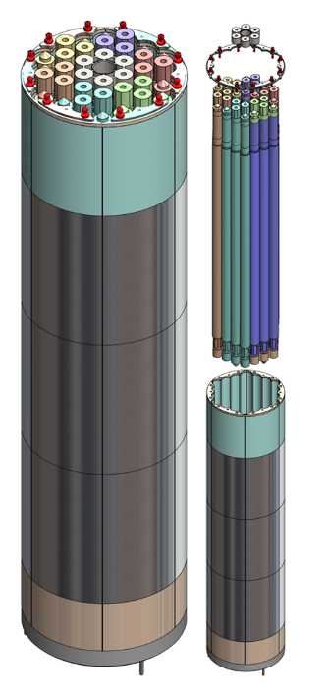
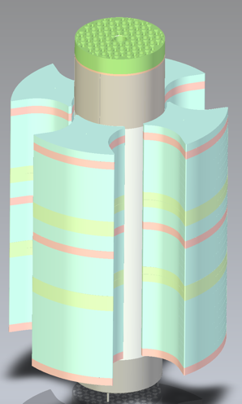
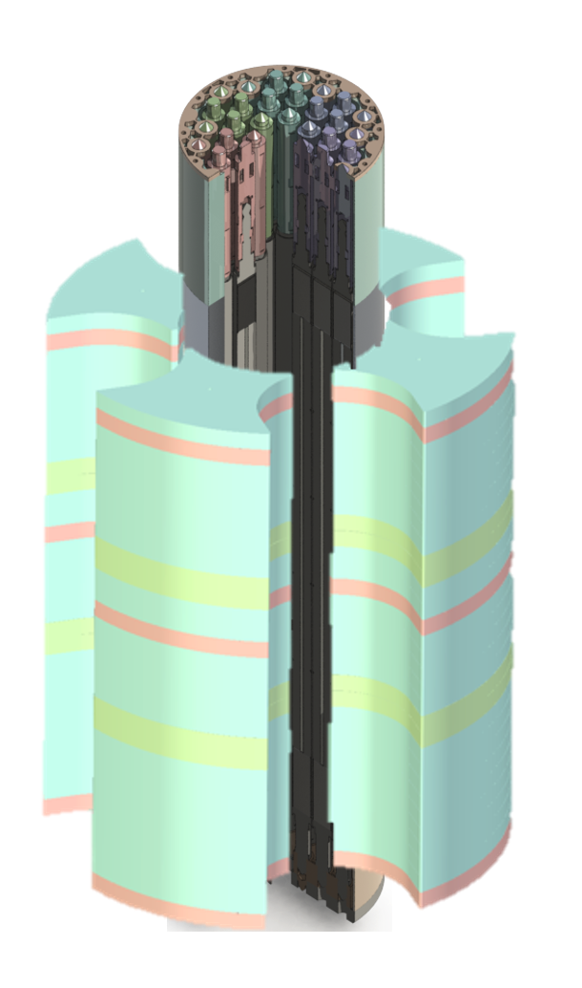
Overview of Fuel and Core System (FCS)
Includes Fuel Subsystem (FS)
Core Support Structures Subsystem (CSS)
Stationary Core Reflectors Subsystem (SCR)
Fuel subsystem
Core support structures
Stationary core reflectors

Slide 11
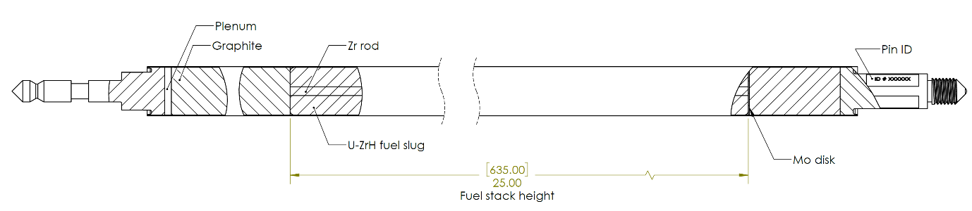
MARVEL Fuel Element Design
304 SS Cladding and End-Caps
Graphite Neutron Reflector
Mo Diffusion Barrier Disc
Graphite Neutron Reflector
(5x) Annular U-ZrH_{1.6} fuel meat (30 wt% uranium, 19.75% enrichment) with central Zr rod
U-ZrHx contains both the fuel (uranium) and neutron moderator (hydrogen) in one, reducing the size requirement of the reactor core to achieve the desired neutron energy spectrum

Slide 12
MARVEL Scoping Analysis: Fuel Safety Margin
Peak fuel meat temp of 730 °C during the postulated “LOFA + LOCA” accident scenario
The primary failure mechanism for MARVEL fuel is internal gas overpressurization (same as TRIGA)
This is a function of fuel meat temp driven by hydrogen dissociation (same as TRIGA)
Under the most conservative assumptions:
  A peak fuel meat temp of 916 °C precludes fuel element damage
  A peak fuel meat temp of 950 °C precludes fuel element rupture
Rounding down for conservatism, we set the fuel element limit as a peak fuel meat temp of 900 °C
We have a peak fuel meat temp margin of ~ 170 °C before challenging the integrity of the fuel element

Slide 13
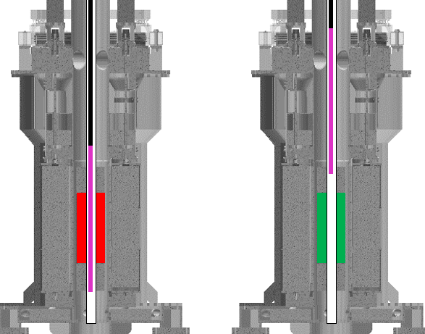
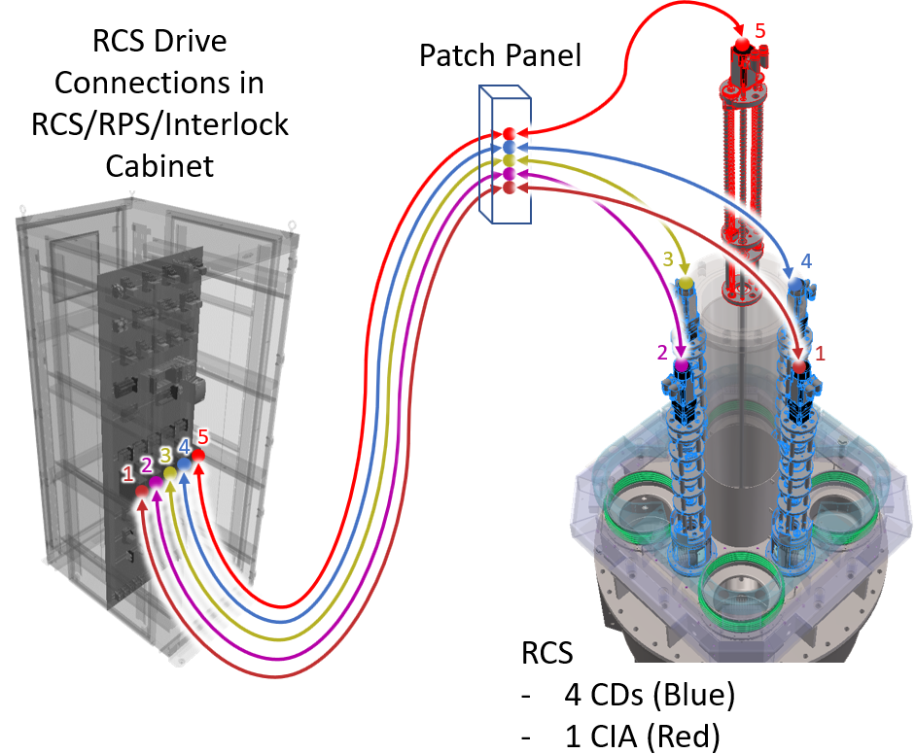
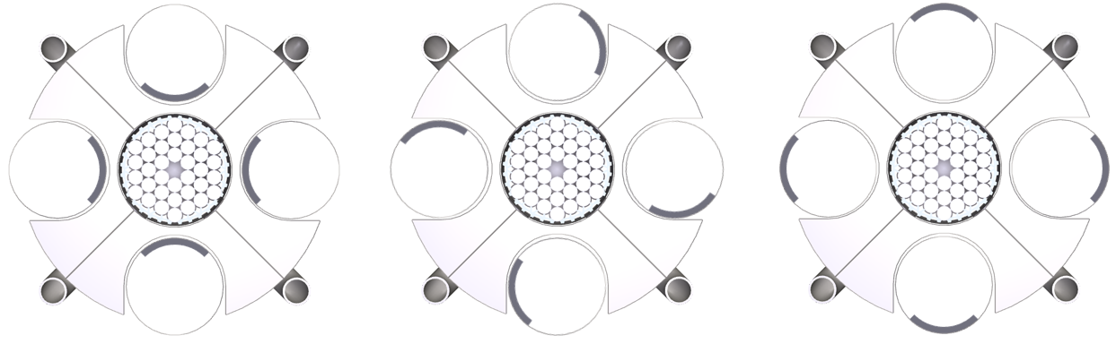

Reactivity Control Overview
Four drums, one absorber, and associated drivers in control cabinet used to control reactor reactivity
CIA In
Criticality Enabled
Full-in: Shutdown
Partial Out: Initial Criticality
Full Out: Maximum Reactivity*
*Will be set below full out
(180 degree) using a tuned hard stop

Slide 14
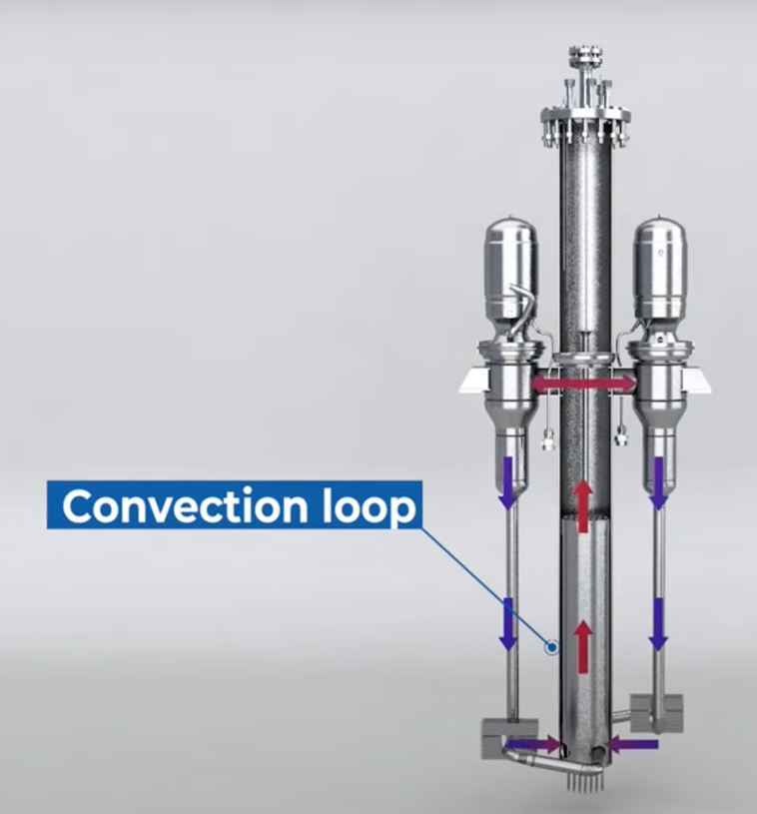
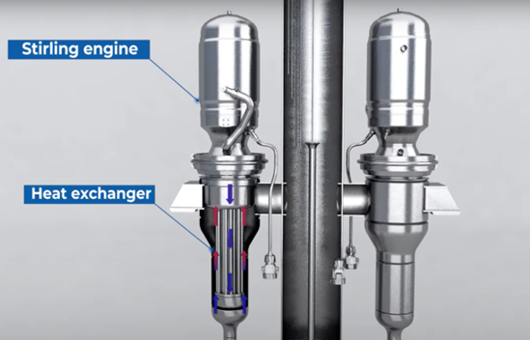
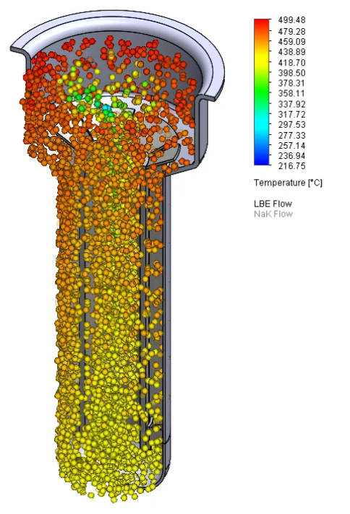
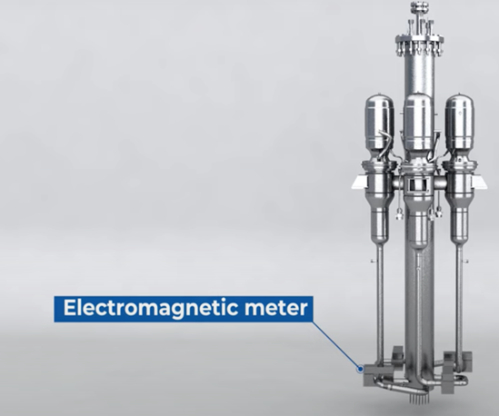
MARVEL Natural Circulation Model Validation
(Primary Coolant Apparatus Test – PCAT)

Slide 15
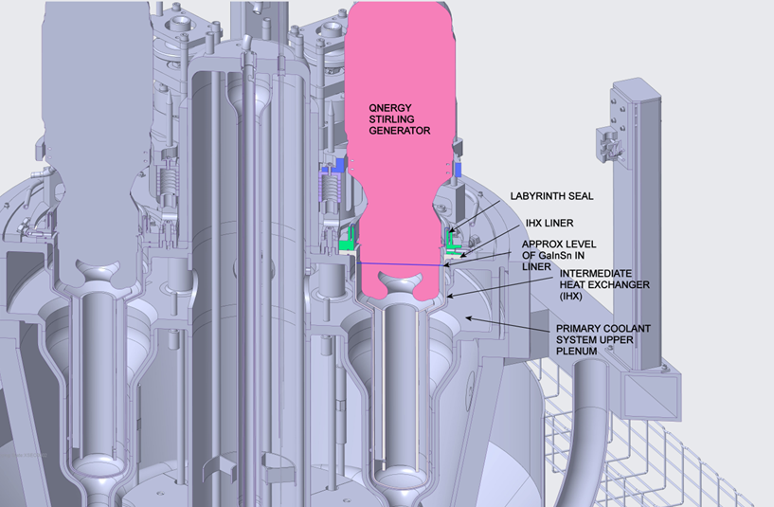
Mounting of Stirling Generators at Reactor Upper Plenum – Technical Risk Reduction
Stirlings mounted into eGa-In-Sn bath in Intermediate Heat Exchanger (IHX)
IHX liner required to protect IHX from corrosive effect of
eGa-In-Sn. Liner and generator both require routine replacement
Generators mounted on springs to allow free movement, expected ~1/16 inch amplitude at ~60 Hz. May be more during startup, shutdown and some transients

Slide 16
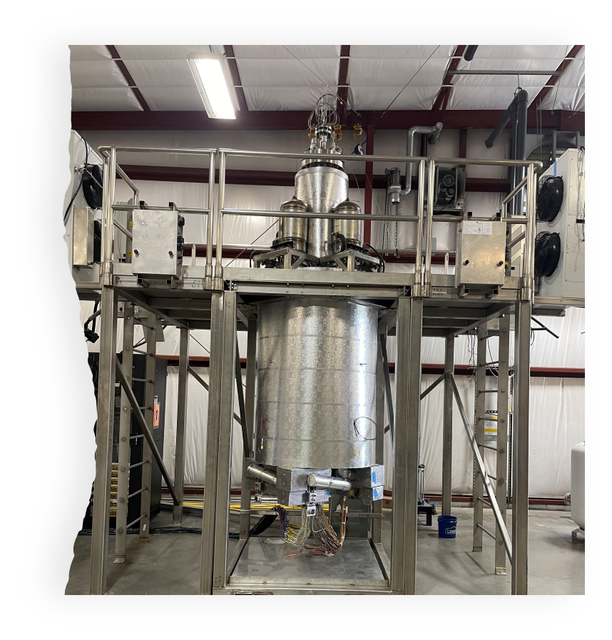
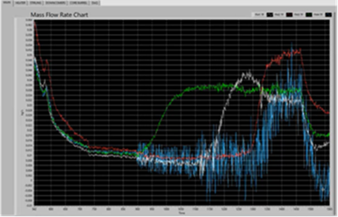
MARVEL Thermal Hydraulic Prototype - PCAT
Thermophysical twin of MARVEL
Full-scale, electrically heated
Data used to validate models, per NQA-1
Initial startup on September 19, 2023, with demonstration of natural circulation and power generation
Paused testing due to Stirling engine coolant concern
Three of the four Stirling engines failed due to freezing of intermediate coolant during pause
Resume testing with engineering controls in place
NaK flow measurements through 4 loops

Slide 17
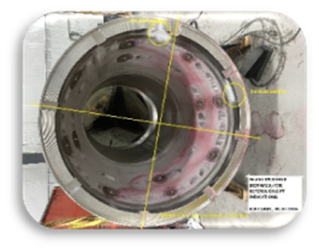
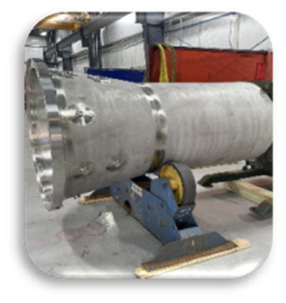
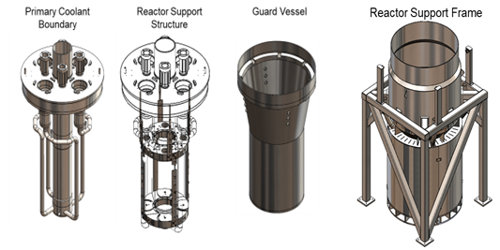
FY 24 Progress – MARVEL Fabrication
Transferred all structural material and closed-out original fabricator contract.
Guard Vessel
Issued contract and staged all materials at vendor
Fabrication ~75% completed; on track for 09/13 completion
Weld Distortions- The items identified have all been resolved through the NCR process; strategies have discussed with the supplier to prevent re-occurrence.
Primary Coolant System (PCS)
Critical path; will be released as a limited funded contract
Bid is due back on August 26th with award shortly after, and shipment of structural material following.
Reactor Support Frame (RFS)
RFP planned for FY25 Q1 release

Slide 18
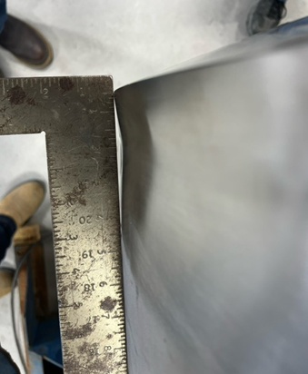
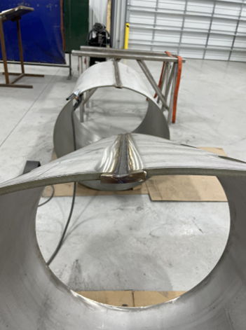
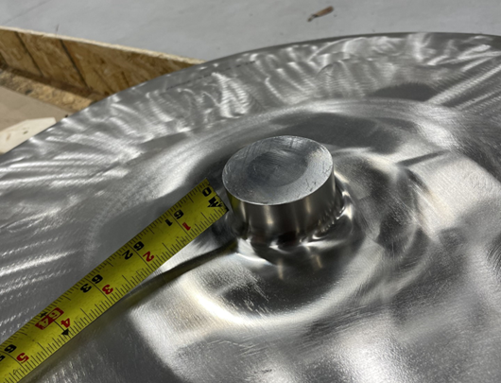
Problems Encountered During Fabrication
Weld Distortion Issues
Throughout the project, the supplier has experienced weld distortion on several components. This can be attributed to excessive heat input and the absence of stiffeners, heat sinks or chill blocks.
The items identified have all been resolved through the NCR process.
Mitigation strategies have discussed with the supplier to prevent re-occurrence.

Slide 19
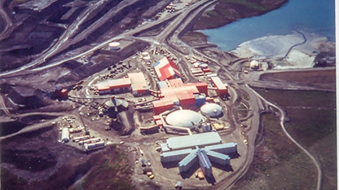
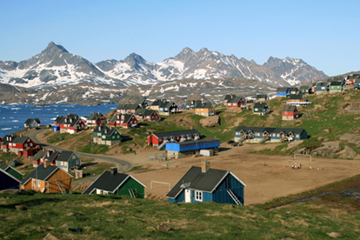
MARVEL Value Statement for Public / End Users
Nuclear Energy is new to microreactor entry market
Operation complexity
Fear of colocation
Training needs
Reliability
Customers reluctant to adopt microreactor technology unless they “see one” first (not willing to be the first in their backyard)
Having no real test reactor is a barrier to market entry
End users deem it necessary to “interact” with a microreactor prior to providing customer requirements
End users unsure of technology potential prior to interaction
MARVEL will be the first microreactor to achieve criticality to power end user applications

Slide 20






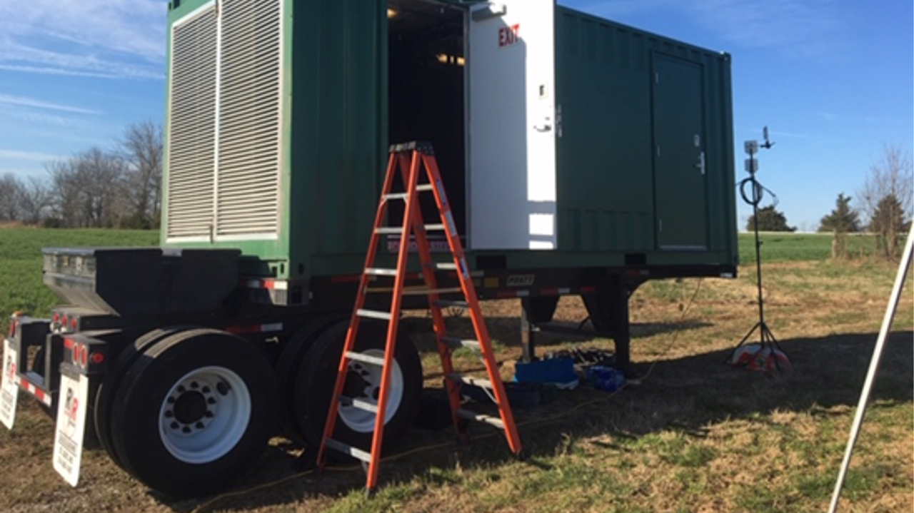


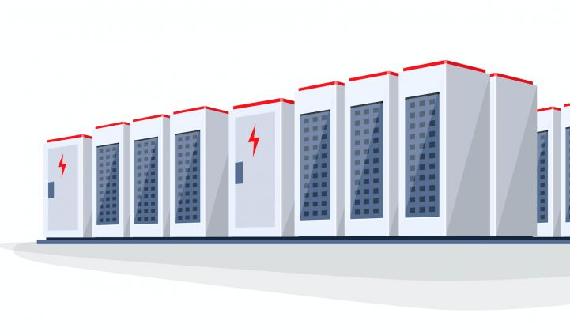

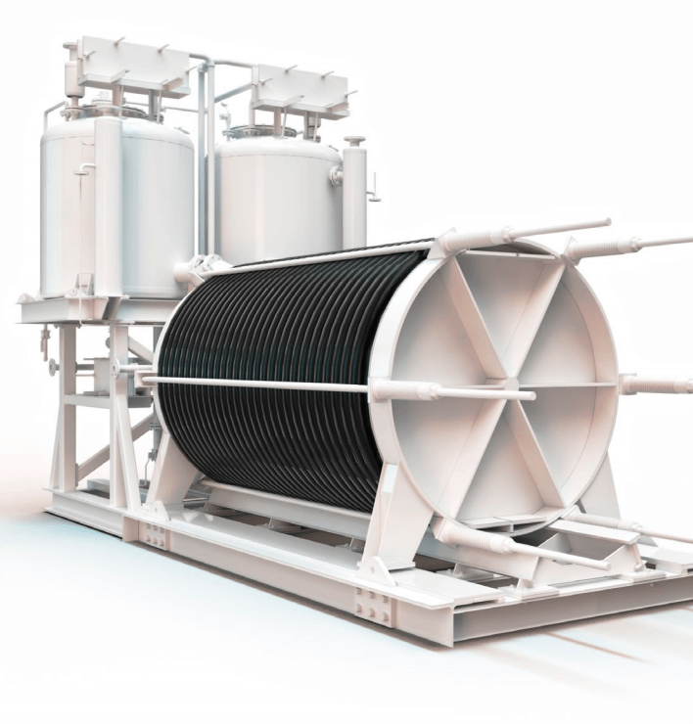

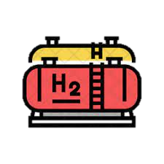
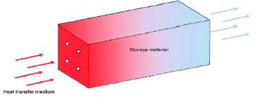
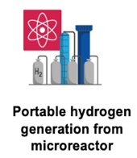
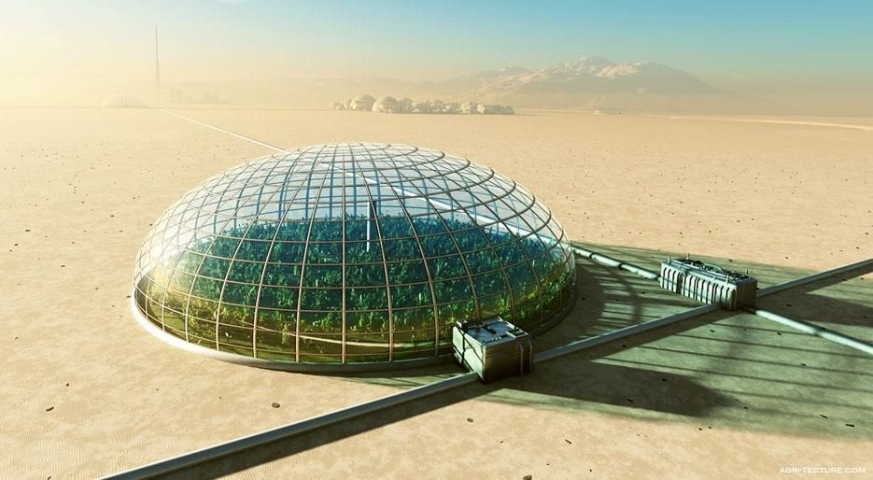
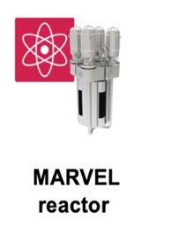

Conceptual MARVEL Utilization Model
Assets by INL $$
Assets by Public $$
Public-Private $$
Private Incubator $$
Private $$
Renewables
Hydrogen
Electricity Users
TRL
H2 Electrolyzer
Solar
Wind
Battery
Containerized Supercomputer
Microreactor Developers
R&D by Private $$
Microreactor-Microgrid
Heat Users
Electricity
H2 Storage
Microgrid Inverter
DOE MRP
R&D by Private $$
Thermal Storage
High Grade
Heat
HGHES
H2 Generation from Heat
NEUP
R&D by Private $$
Low Grade
Heat
Bio dome
Generation
Consumption
Assets by Public $$

Slide 21
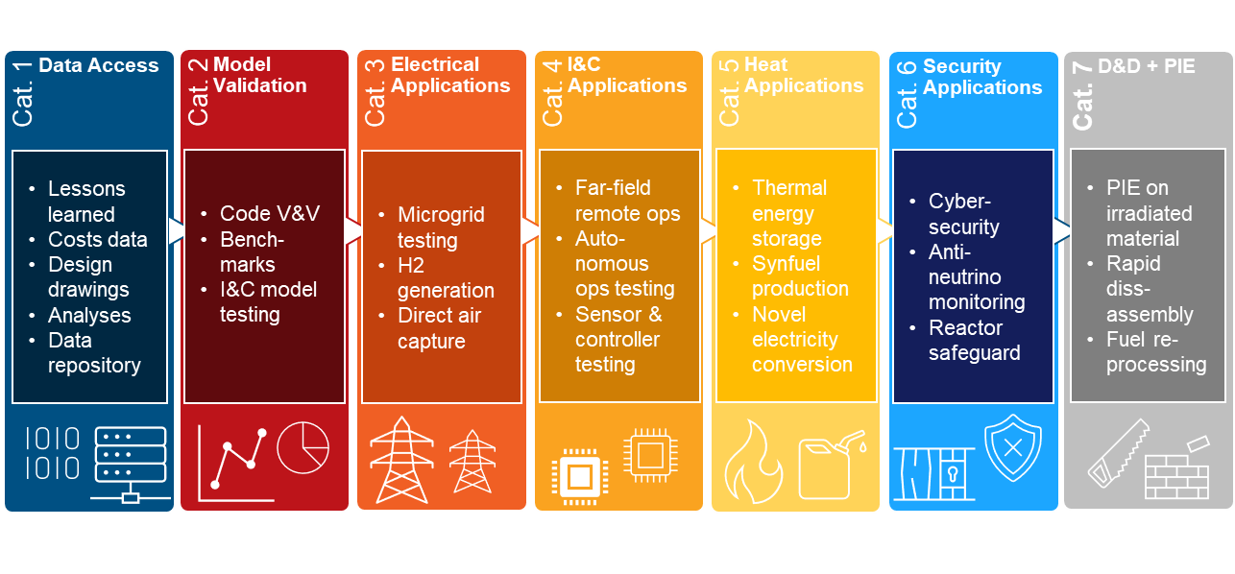
MARVEL Utilization Plan
Report:
A. Abou-Jaoude, M. W. Patterson, “MARVEL Utilization Plan”,
Idaho National Laboratory, INL/RPT-24-78261, June 2024, https://www.osti.gov/biblio/2371533
Conceptual MARVEL Applications:
And many more possibilities!

Slide 22
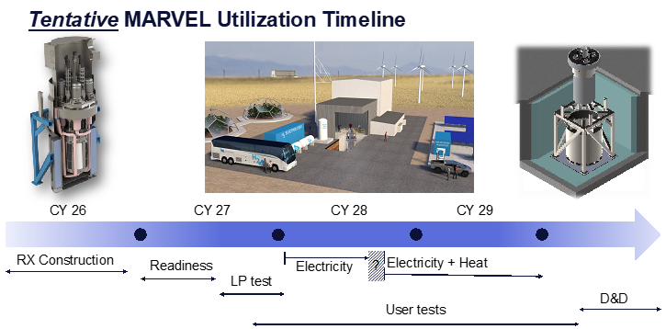
How to Engage? Some Suggestions...
Fill out the pre-engagement questionnaire
Timeline | Engagement
When do you need to perform these tests?
~CY27 Q3: Startup Testing & Benchmarks
~CY28 Q1: Microgrid Applications
~CY28 Q3: I&C and HMI
~CY28 Q4 & Beyond: Heat Applications
DOE Programs | Funding
DOE Programs
IES: combined nuclear heat & electricity demo
OE/NetZero: nuclear microgrid demo
ASI: new sensors & controls demo
NEAMS: software V&V
LDRD: new technology R&D
ARSS: safeguards and security
FECM: direct carbon air capture with nuclear
Funding Mechanisms
Subcontract: CRADA, SPP
GAIN vouchers (apply in 2026!)
Others (iFOA? Sponsored FEED study?)
University Proposals
NEUPs on harvesting/processing data?
IRPs on hardware testing?
Submit in >2025 CINR call!

Slide 23
Thank You

