Slide 1
153-120000-001-000

Slide 2
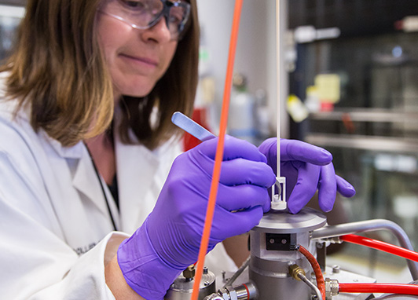
Heat Distribution Results from Experiments Using an Array of Five Sodium Heat Pipes
Pablo Diaz Gomez Maqueo
2024 OCTOBER 23

Slide 3
SECTION 1
Introduction

Slide 4
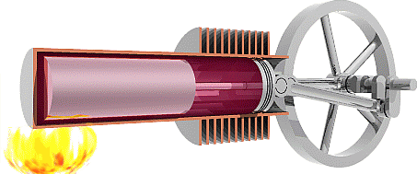
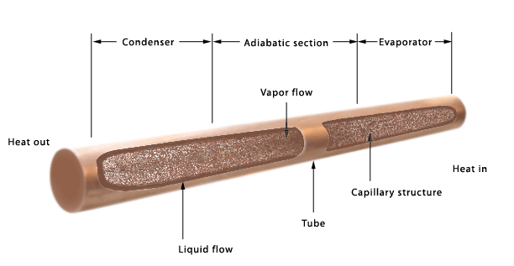
Introduction
Heat pipes are a passive heat transport device:
Simplified design
No moving parts*
Self-regulating
Generator Device
(e.g. Stirling Engine)
https://en.wikipedia.org/wiki/File:Beta_stirling_animation.gif
Water heat pipes are widely used in industry for low temperature applications (less than 300 °C)¹.
Heat Pipe
Alkali metal heat pipes such as sodium or potassium are adequate for higher temperatures (above 500 °C)¹ and provide a high heat transport capability.
[1] Peterson, G. (1994). An introduction to heat pipe modeling, testing and applications, John Wiley and Sons.
Reactor Core
Zohuri, B., & Zohuri, B. (2019). Basic Principles of Heat Pipes and History. Heat Pipe Applications in Fission Driven Nuclear Power Plants, 161-202.

Slide 5
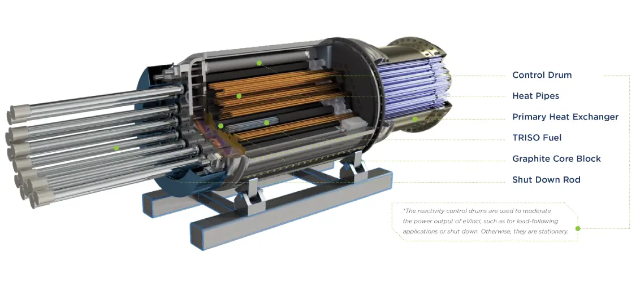
Introduction
Example of a heat pipe reactor: Westinghouse eVinci Model
Heat pipe reactor concepts in the Canadian Nuclear Landscape:
Westinghouse – eVinci
Dunedin – Canadian Nuclear battery
AECL Nuclear Battery (1980s)
Other example concepts in the US²:
Micro Nuclear, LLC – Micro Scale Nuclear Battery
NuScale Power – NuScale Microreactor
Oklo – Aurora
https://westinghousenuclear.com/energy-systems/evinci-microreactor
[2] Black, G., Shropshire, D., Araújo, K., & van Heek, A. (2022). Prospects for Nuclear Microreactors: A Review of the Technology, Economics, and Regulatory Considerations. Nuclear Technology, 209(sup1), S1–S20

Slide 6
SECTION 2
Methodology

Slide 7
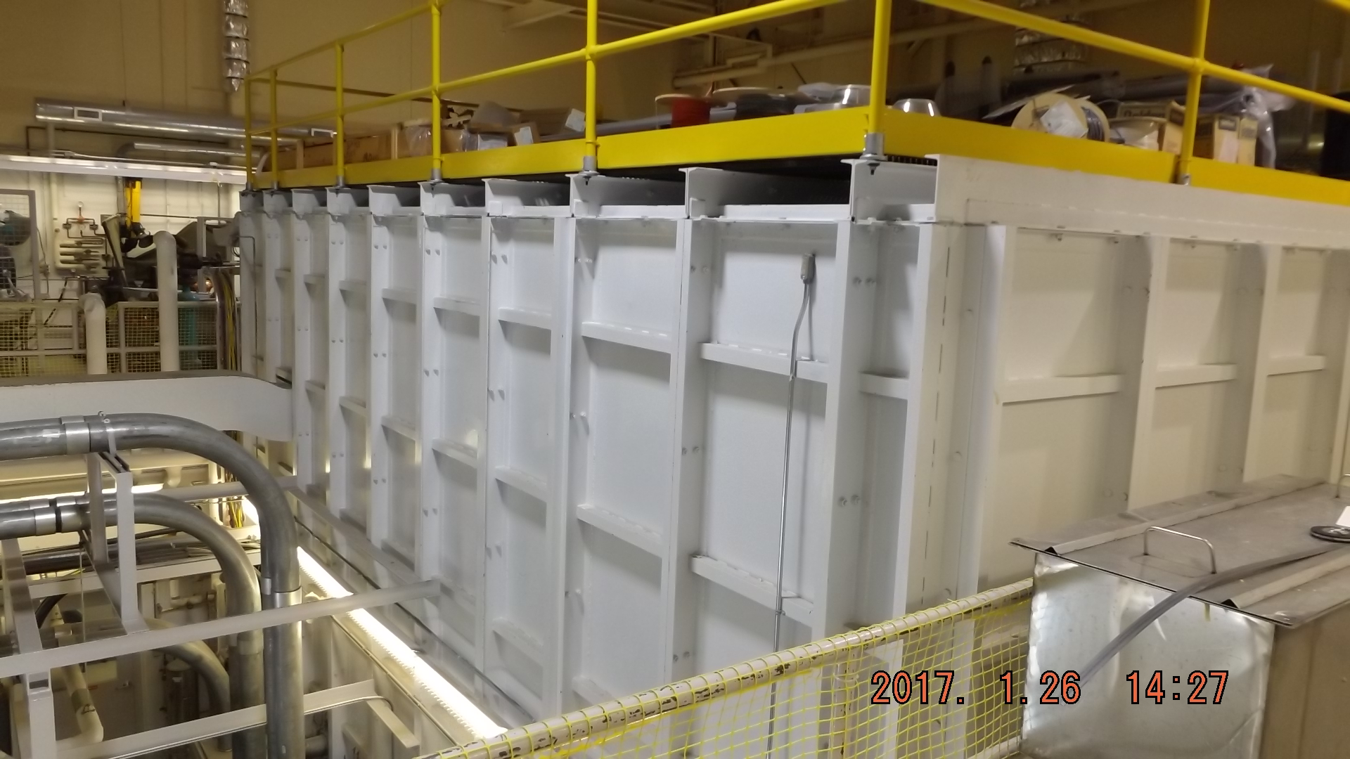
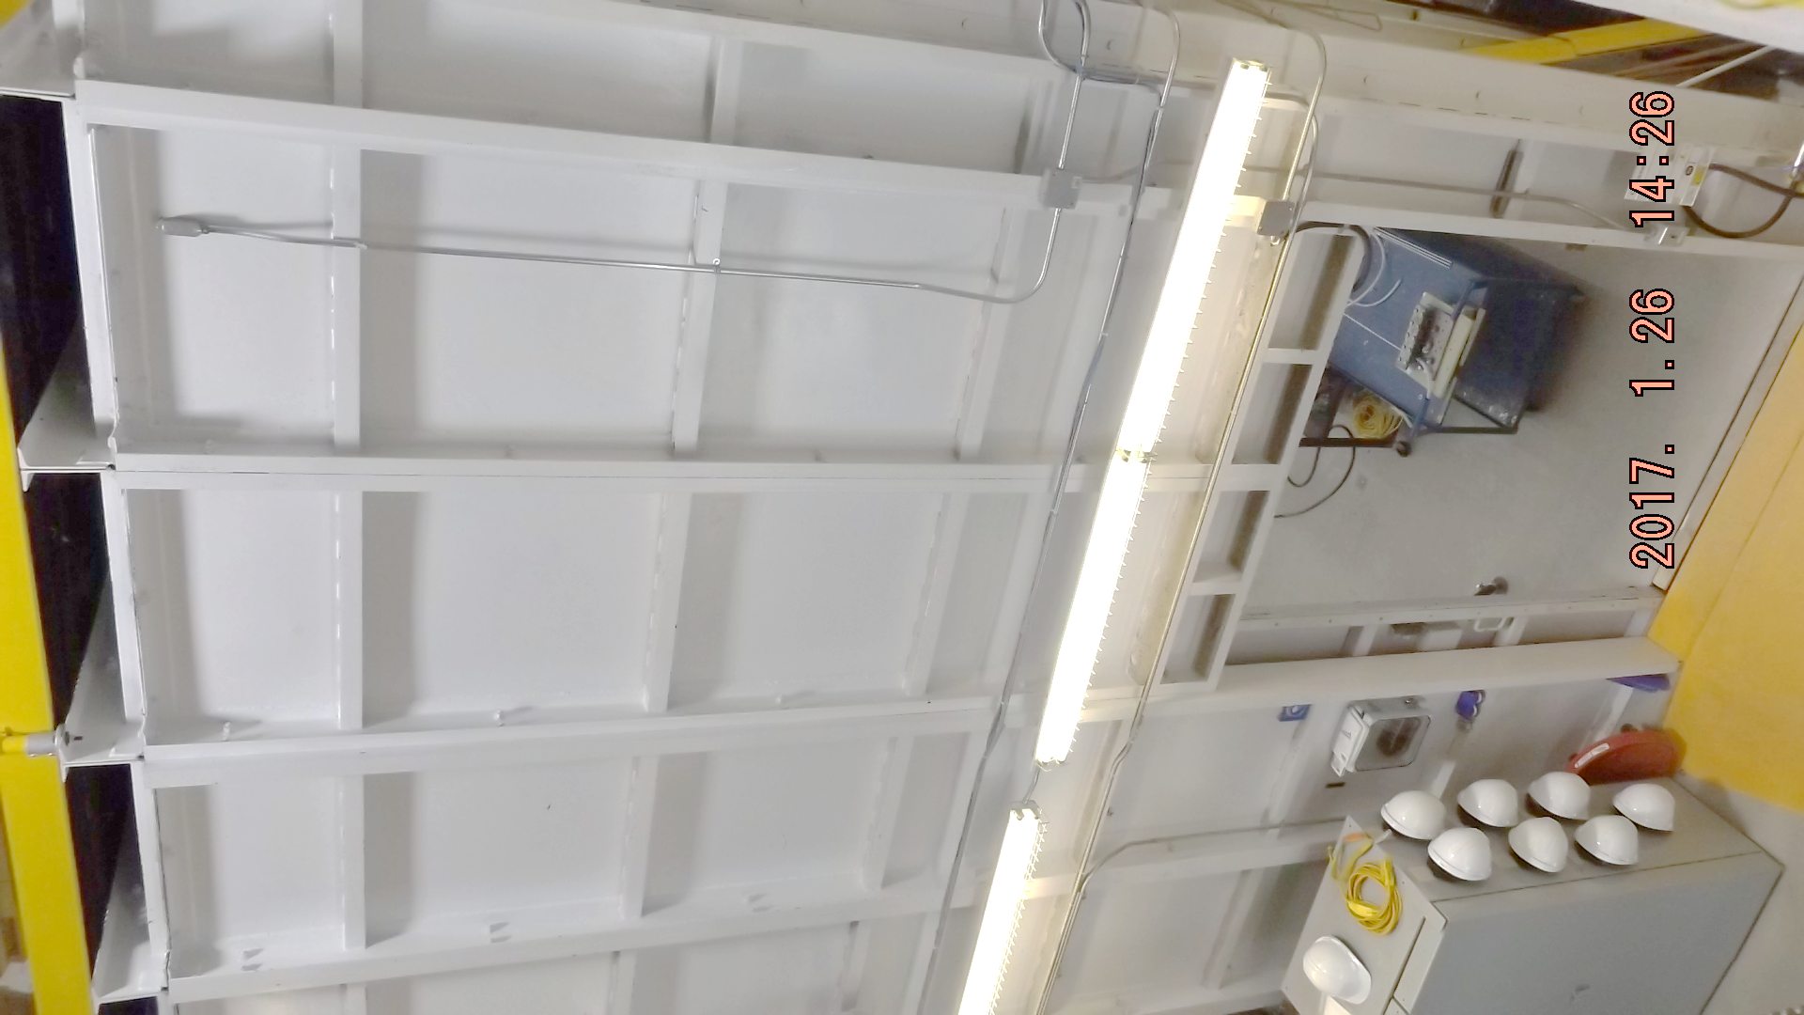
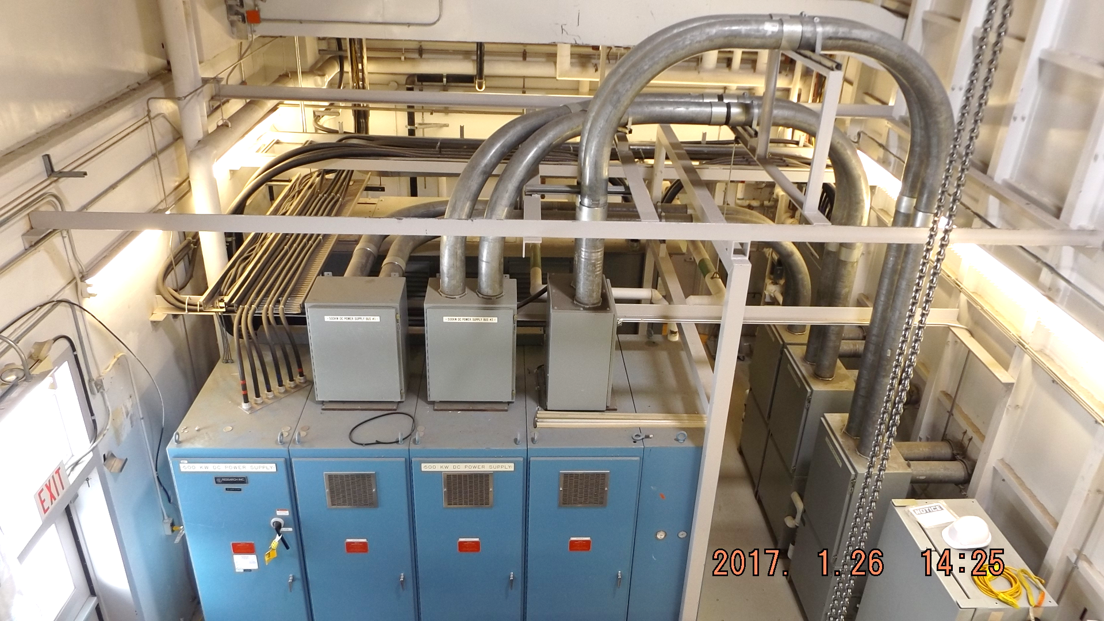
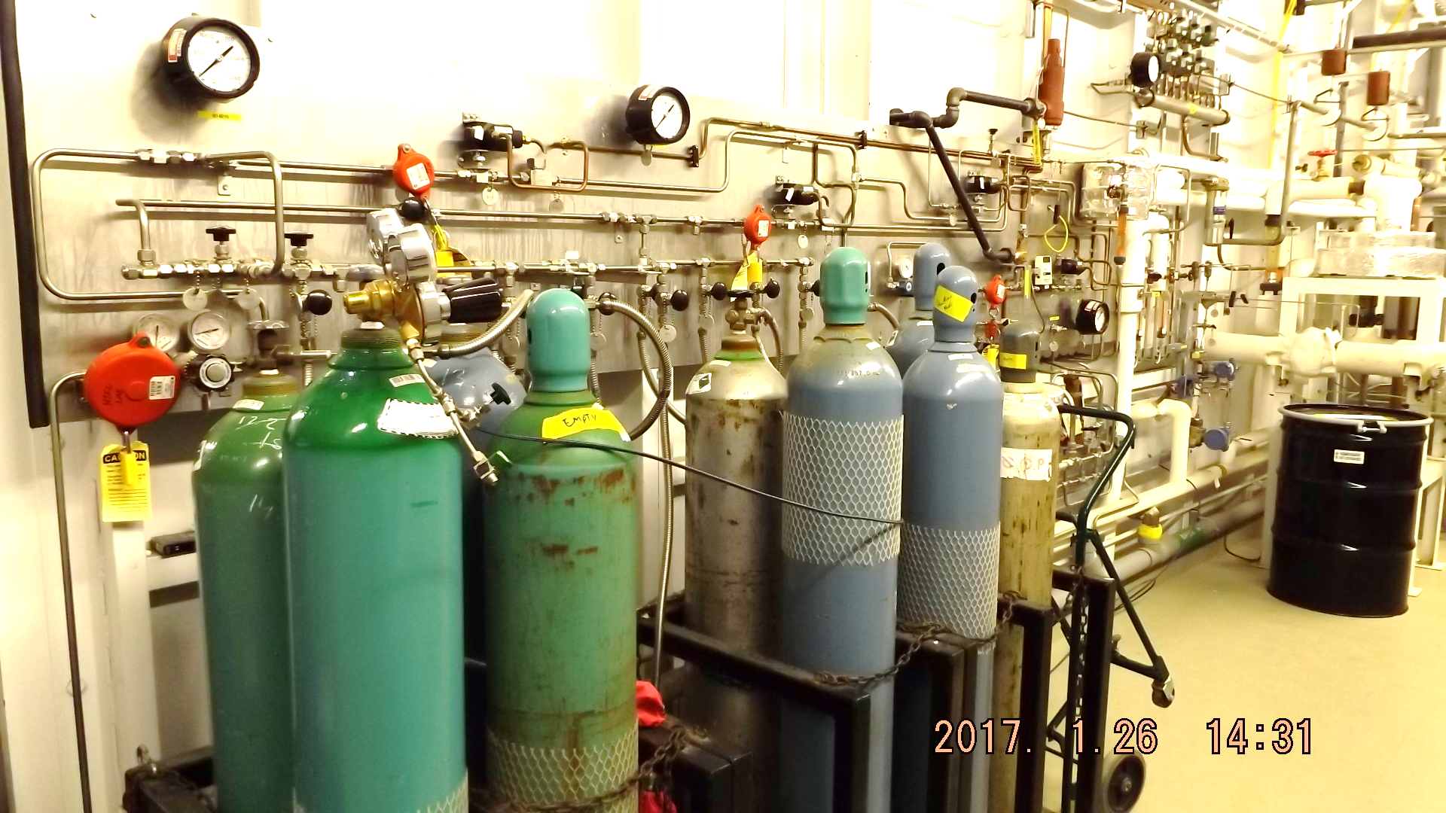
HTFC Laboratory Systems
Containment Cell
20’ high, 30’ x 20’ wide
EMI protection, Bonded
Fire rated
Ventilation
Containment Cell
Power Supplies
500 kW DC
50 kW AC
10 kW Induction
Multiple AC outlets (600 – 120V)
High Pressure Gas
Argon, Helium,
Carbon-dioxide, Nitrogen
Argon-oxygen, hydrogen
Up to 20 MPa

Slide 8
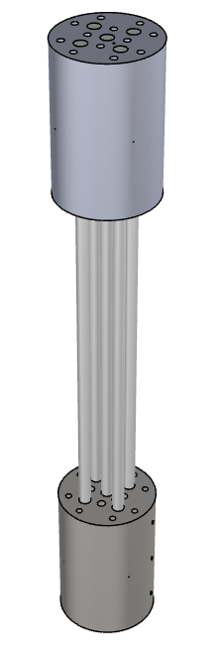
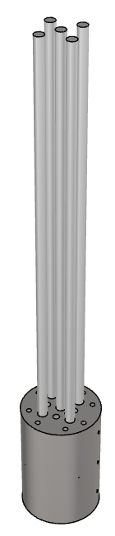
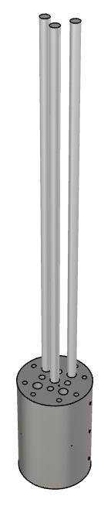
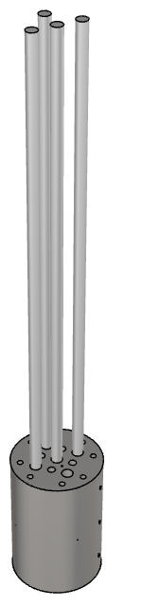
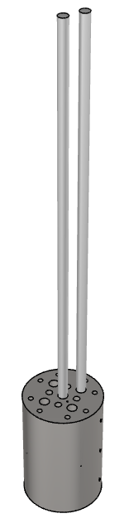
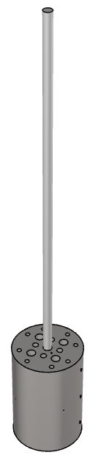
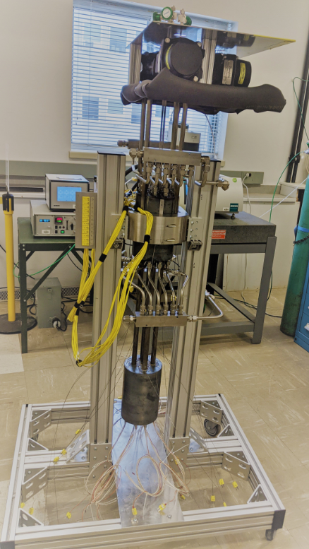
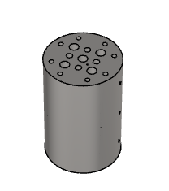
Experiment description
Heat pipe experiment setup
36 in (91 cm) tall sodium heat pipe
Five 2 kW heat pipes
Effect of transient change in power
Three heat pipes can be disabled
Cooling block
Heat pipe experiment design
The heat pipe experimental rig is designed to be technologically and vendor agnostic and to be able to produce data that is useful for benchmarking simulation codes and independent assessments
Heat pipes
(5x)
Heating block

Slide 9
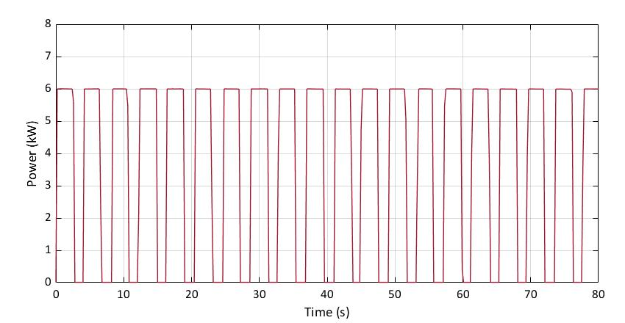
Heating and cooling blocks
Heating and cooling block details
Example of applied power (at 60%)
Heating Block Top View
Cooling Block Top View
On|Off
7.62 cm
(3 in)
1 Cycle (3.6 kW average)
Cooling
Channels
3
3
Small Heaters
(0.50 kW)
2
5
4
2
5
4
Heat Pipes
1
Large Heaters
(1.50 kW)
1
Heat Pipes
Measurements:
Voltage
Current (shunt resistors)
Measurements:
Flow rate
Pressure
Temperature
Heat Transfer
Through Heat Pipes
Power is controlled with solid state relays using on/off cycles
Each on/off cycle is 4 seconds long
Reported power is the average delivered power per cycle

Slide 10
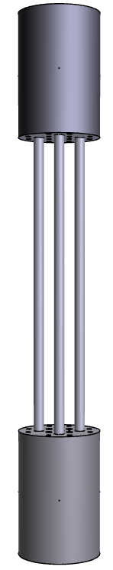
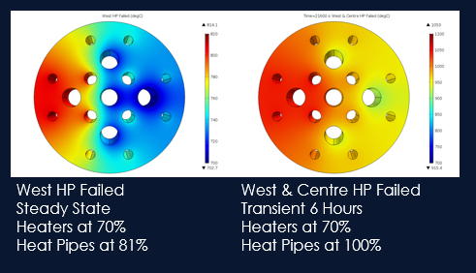








Thermocouples and heat pipe actuation
15.24 cm
(6 in)
Heating and cooling block details
22.86 cm
(9 in)
11.43 cm
(4.5 in)
Heating Block Top View
Cooling Block Top View
Top
$$T_{3}$$
$$T_{25}$$
3
3
22.86 cm
(9 in)
1.27 cm
(0.5 in)
$$T_{2}$$
2
5
4
$$T_{4}$$
$$T_{24}$$
2
5
4
$$T_{26}$$
1
1
Mid-Point
$$T_{1}$$
$$T_{23}$$
22.86 cm
(9 in)
Heat pipes with valves capable of being disabled:
Heat Pipe #1
Heat Pipe #4
Heat Pipe #5
Pre-test simulations:
Base
11.43 cm
(4.5 in)
15.24 cm
(6.0 in)
1.27 cm
(0.5 in)
11.43 cm
(4.5 in)
3.81 cm
(1.5 in)
1.91 cm
(0.75 in)

Slide 11
SECTION 3
Results

Slide 12
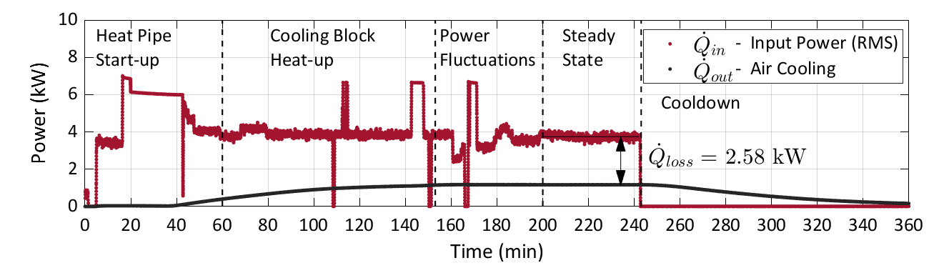
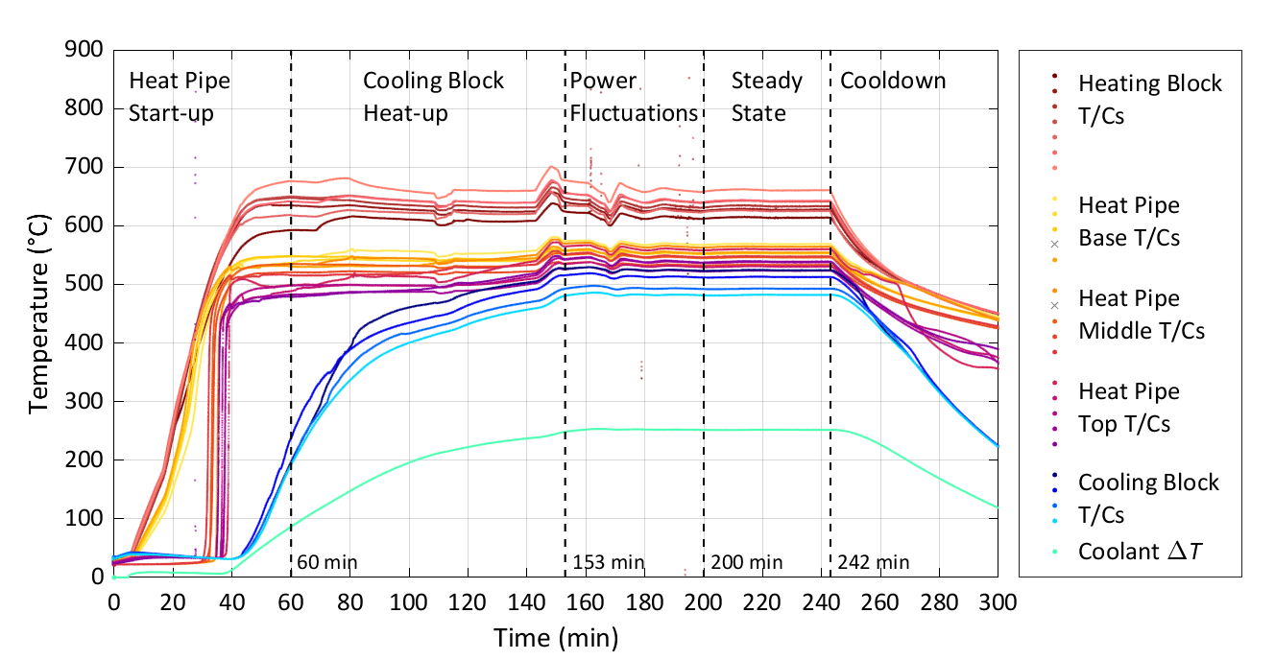
Baseline Commissioning Experiments
~470 °C

Slide 13
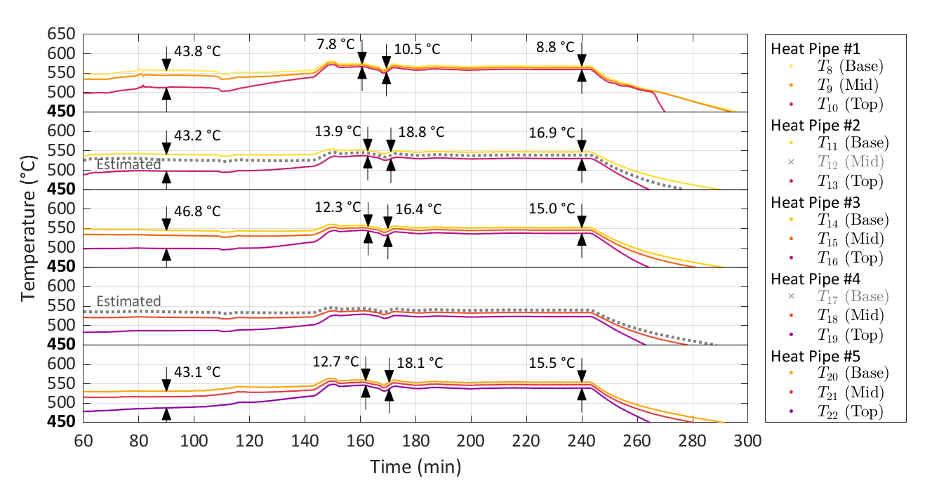
Baseline Commissioning Experiments
T_{diff} @ 90 min
Minimum T_{diff}
Maximum T_{diff}
T_{diff} @ 240 min
Cooling block reached temperature

Slide 14
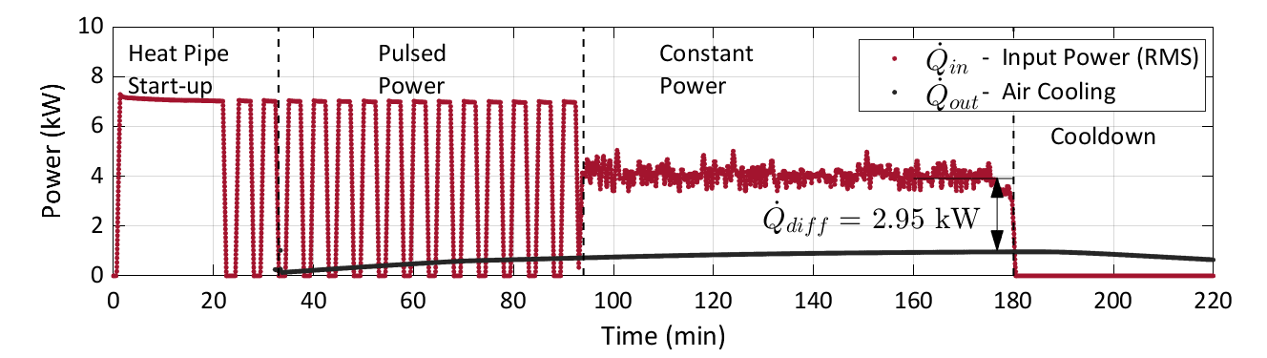
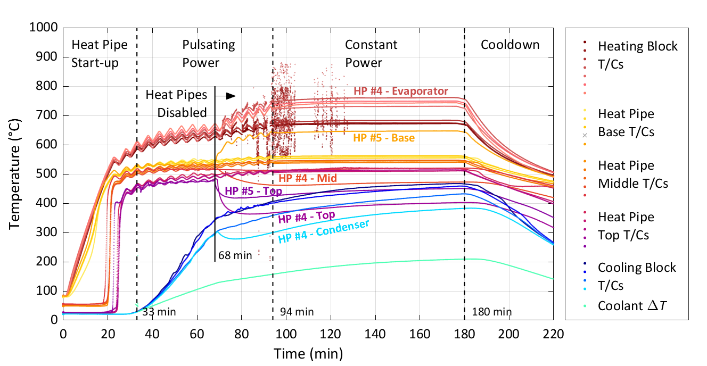
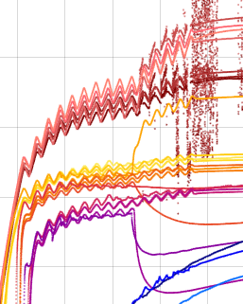
Pulsed Power and Disabling of Heat Pipes
Heating Block Top View
3
2
5
4
5 min
1
5 min
Observations:
Pulsation period of 5 minutes corresponds to power input
Higher amplitude at heating block
Pulsations observed at cooling block

Slide 15
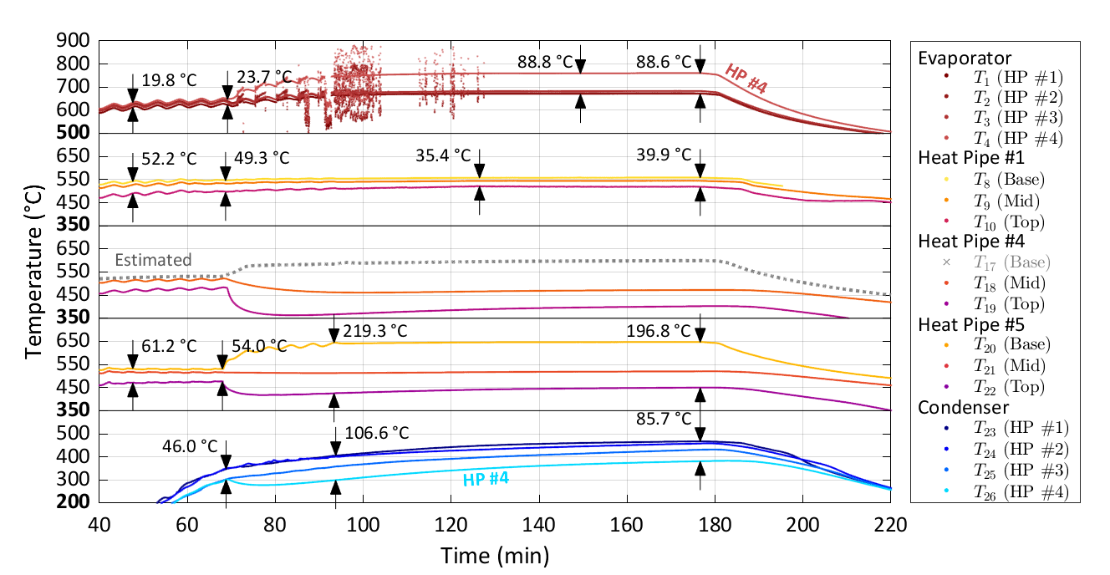
Pulsed Power and Disabling of Heat Pipes
T_{diff} @ 48 min
T_{diff} @ 68 min
Minimum T_{diff}
T_{diff} @ 240 min
Observations:
Cooling block did not reach temperature
Failed heat pipes show a drop in temperature at mid-point and at the top near the cooling block
Failed heat pipes show an increase in base temperature
Temperature difference is observed at the cooling block

Slide 16
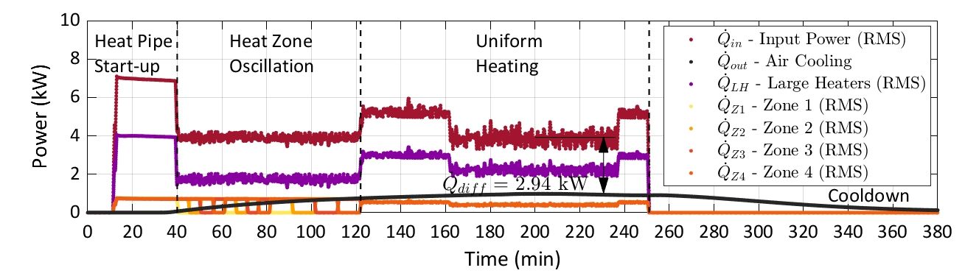
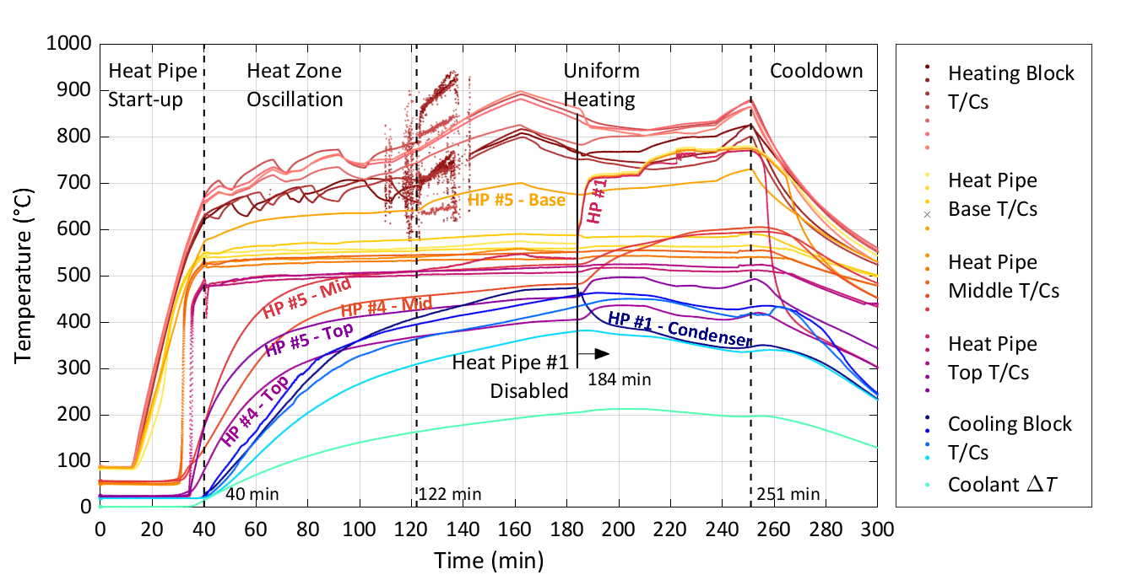
Transient Non-uniform Heating
Heating Block Top View
Zone 3
Power remains
constant
3
Zone 2
2
5
4
Zone 4
1
Observations:
Zone 1
Oscillations are only observed at heating block
Heat pipe temperature in the adiabatic section remain constant
Previously failed heat pipes could not be recovered

Slide 17
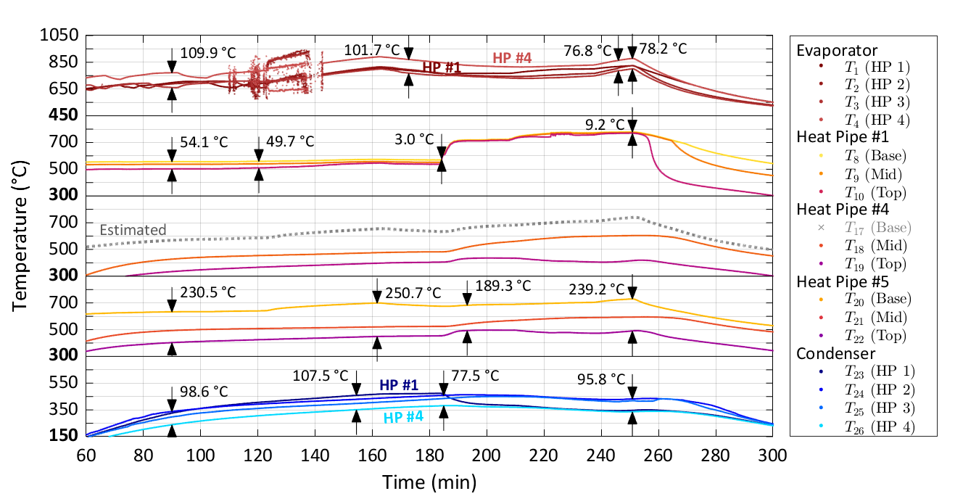
Transient Non-uniform Heating
T_{diff} @ 90 min
Minimum T_{diff}
T_{diff} @ 250 min
Observations:
Cooling block did not reach temperature
Failed heat pipes 4 and 5 show similar temperature distributions as in pulsed power test
Heat pipe 1 has a sudden increase in temperature along the adiabatic section.
Heat pipe 1 has a drop in temperature at cooling block

Slide 18
SECTION 4
Summary

Slide 19
Summary
Key points:
On the first experiment, measurements demonstrated the expected functionality of the sodium heat array.
For the second experiment, power pulses produced associated heat pipe temperature fluctuations. Once back to constant power, the temperature fluctuations stopped, showing no pulsing instability for this experiment at the conditions tested.
After disabling two heat pipes, the temperature at the base increased while the temperature at the top decreased.
For the third experiment, temperature on the heating block varied as power oscillated through the four zones. However, this oscillation was not seen on the adiabatic section (base, mid, and top), or the cooling block.
After disabling heat pipe #1 during the third experiment, it kept operating as if enabled but with an effectively reduced condenser length.

Slide 20
This work was supported by Atomic Energy of Canada Limited’s Federal Nuclear Science & Technology Work Plan.
Questions?

