Slide 1

Overview of Modified Design Features of SMART-C
October 23, 2024
Min Young Park
Korea Atomic Energy Research Institute

Slide 2
01
Introduction
02
Overview of SMART
03
Key Design Features of SMART-C
04
Summary

Slide 3
01
Introduction

Slide 4
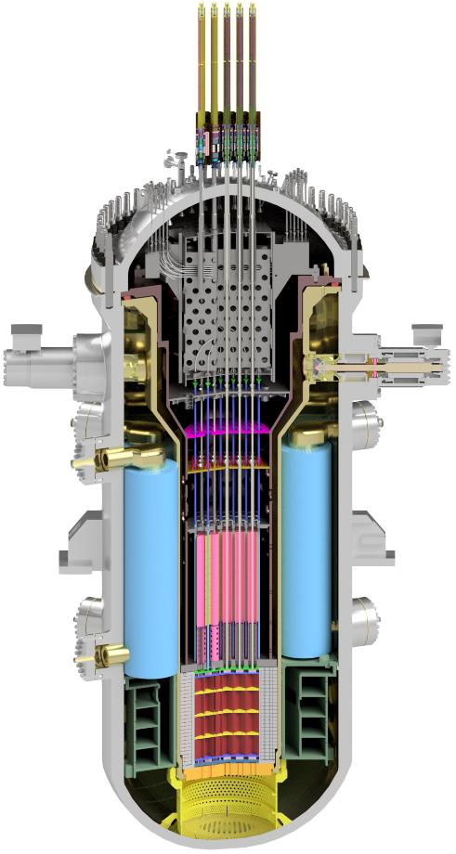
01
SMART
Introduction
NAME
SMART
System-integrated Modular Advanced ReacTor
TYPE
Advanced Integral PWR
THERMAL POWER
365 MW

Slide 5
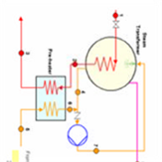
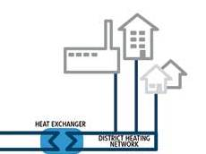
01
Cogeneration
Introduction
PURPOSE
Electricity Generation
and Desalination or District Heating
Electricity
100 MWe
Steam
Transformer
Hot Water
Heat supply
Desalination Plant
Steam
Sea
Water
Fresh
Water
40,000 t/day

Slide 6
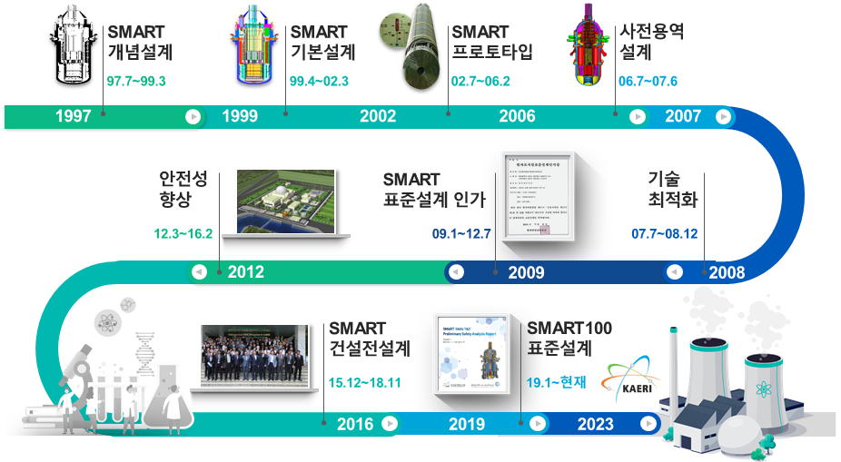

01
Development chronicle
Introduction
Conceptual design
of SMART
Basic design
of SMART
SMART Prototype
SMART Preliminary feasibility study
97.7~99.3
99.4~02.3
02.7~06.2
06.7~07.6
Integral Reactor
World First
SDA
Safety enhancement
SMART Standard Design Approval
Technology Optimization
12.3~16.2
09.1~12.7
07.7~08.12
SMART
SMART Pre-project Engineering
Standard design of SMART100
PPE Project
15.12~18.11
19.1~24.09

Slide 7
02
Overview of SMART

Slide 8
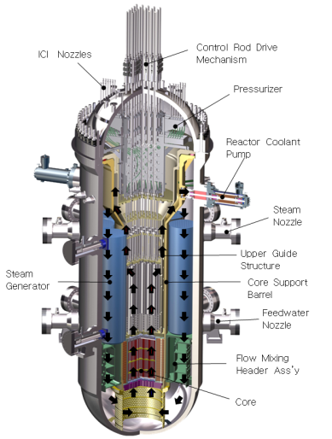
02
Overview of SMART (1/2)
CORE
ICI Nozzle
CRDM
57 fuel assembly
Cylindrical low enriched uranium oxide pellets
Pressurizer
RCP
Reactor Coolant Pump
4 canned motor pump
Horizontally mounted
Steam Nozzle
UGS
Steam Generator
SG
CSB
8 cassettes
Once-through type with helically coiled tubes
Feedwater Nozzle
FMHA
Pressurizer
Core
Maintain the coolant in a saturated state
Wet thermal insulator is installed

Slide 9
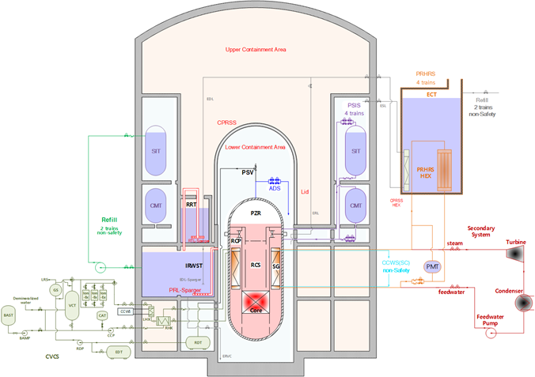
02
Overview of SMART (2/2)
CORE
Passive Residual Heat Removal System
Passive Safety Injection System
Containment Pressure and Radioactivity Suppression System
FEATURE
To maintain a reactor in the safe condition for 72 hours without any operator action at the postulated design basis accidents.
All safety systems can operate not depending on electrical power from emergency diesel generator for 72 hours.
Safety-grade batteries provide necessary DC power for valve initiation and post accident monitoring.
CPRSS
PRHRS
PSIS

Slide 10

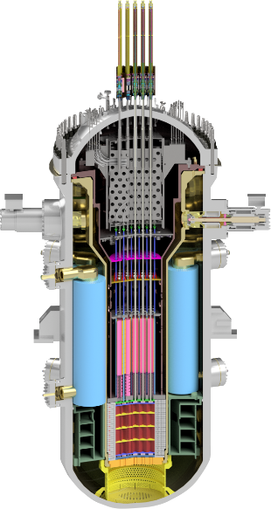
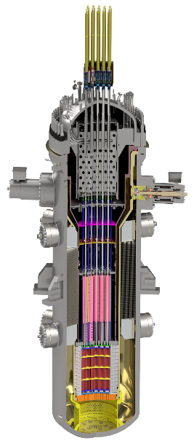
02
Overview of SMART-C
SMART100
SMART-C
365 MWt
110 MWe
PWR
Integral
About 6 m
30 months
Cassette type helically coiled SG
Passive (4 SIT trains)
Battery
DC power + natural circulation
72 hour
< 1.0X10⁻⁷/RY
Arch-shaped rectangular
Thermal power
Electric output
Reactor type
Reactor configuration
Reactor size (diameter)
Refueling cycle
SG type
Safety system
Emergency power
Driving force
Operator action
365 MWt
110 MWe
PWR
Integral
About 4.6 m
30 months
Block type helically coiled SG
Passive (2 SIT trains)
Battery
DC power + natural circulation
72 hour
< 1.0X10⁻⁷/RY
Reduced arch-shaped rectangular
SMART100
SMART-C
Core Damage frequency
Containment building

Slide 11
03
Key Design Features of SMART-C

Slide 12
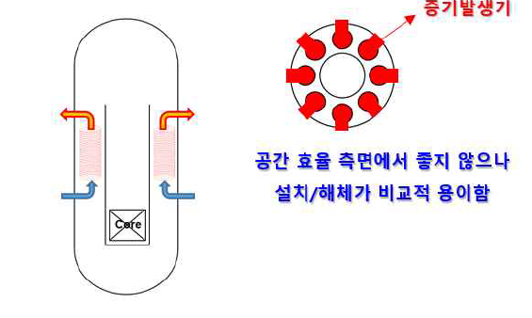
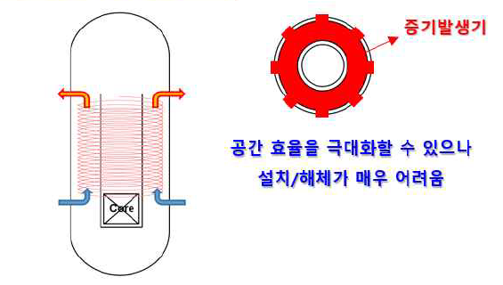
03
Steam Generator
Key Design Features of SMART-C
  Volume and weight reduction of reactor vessel by 45%
    For portability and cost-effectiveness
    Achieved through modification in steam generator design
      8 cassette type SGs to block type SG
    Reactor vessel diameter has decreased from 6 m to 4.55 m
Steam generator
Steam generator
Bad space efficiency
Relatively easy to install and dismantle
Maximize space efficiency
Difficult to install and dismantle
SMART100
SMART-C

Slide 13
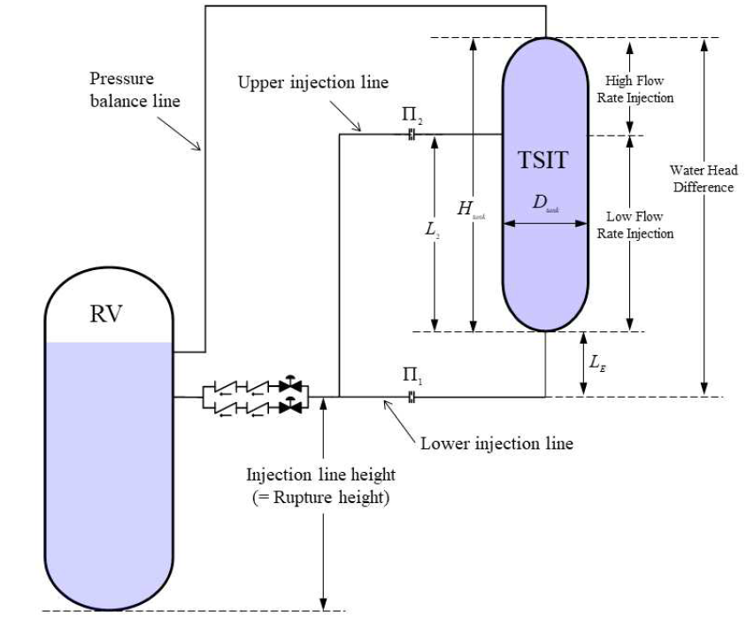
03
Safety Injection
Key Design Features of SMART-C
  Simplification of passive safety system
    Reduction in number of trains from 4 to 2
    Implementation of the two-stage SIT
      CMT and SIT merged into a single tank (TSIT)
    High/low flow injection achieved by implementing
    independent injection line with different
    orifices (with different flow resistances)
Conceptual design of two-stage SIT

Slide 14
04
Summary

Slide 15
01
PRESENTATION TITLE
Summary
  KAERI developed an integral type PWR, SMART
    SMART and SMART100 has gained standard design approval in 2012 and 2024, respectively.
  One of the most promising SMRs
    High degree of development completeness (SDA)
    Safe and innovative SMR
    Wide range of applications, including the potential for cogeneration
  Variation of SMART has been proposed, SMART-C
    Enhanced portability and economic viability
      Through SG and safety system modification
  Further studies (detail design) will be conducted on SMART-C and the feasibility in various industrial fields will be evaluated

Slide 16
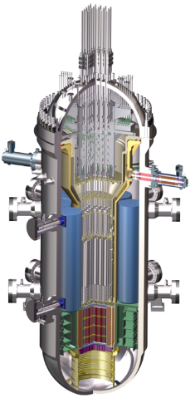

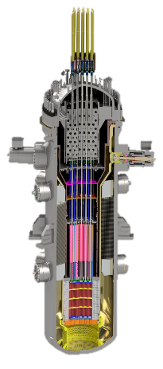
THANK YOU
SMART
100MWe
SMART100
110MWe
SMART-C
110MWe
25 m
20 m
15 m
10 m
5 m
0 m
SMART
SMART100
SMART-C

Slide 17
