Slide 2

PRELIMINARY ANALYSIS OF INITIAL CRITICALITY FOR PELUIT-40 USING HTGR CODE PACKAGE (HCP)
Nuri Trianti, Nina Widiawati, Fitria Miftasani, Topan Setiadipura,
Cici Wulandari, Dwi Irwanto, Zaki Su’ud
Research Center for Nuclear Reactor Technology,
Nuclear Energy Research Organization,
National Research and Innovation Agency

Slide 3
OUTLINES
Introduction
Reactor Design
Calculation Methods
Results and Discussion
Validation of the Simulation
Pebble Height Determination for Initial Criticality of PeLUIt-40
Calculation Analysis for B1 Case with Determined Pebble Height
Calculation Analysis with the Variation of Temperature Levels (B2 Case)
Conclusion

Slide 4
INTRODUCTION
PeLUIt-40 is a 40 MWth HTGR-type reactor designed for cogeneration, generating both electricity and heat.
Cogeneration system integrates the reactor with a steam generator, focus on passive safety, ensuring high levels of operational safety.
Simulations using HTR Code Package (HCP)
B1 Case: Initial criticality simulation (k-eff = 1.0) under helium and air atmosphere at 20°C.
B2 Case: Temperature coefficient simulations with core temperature variations (20°C, 120°C, 250°C) to study k-eff under different conditions.

Slide 5
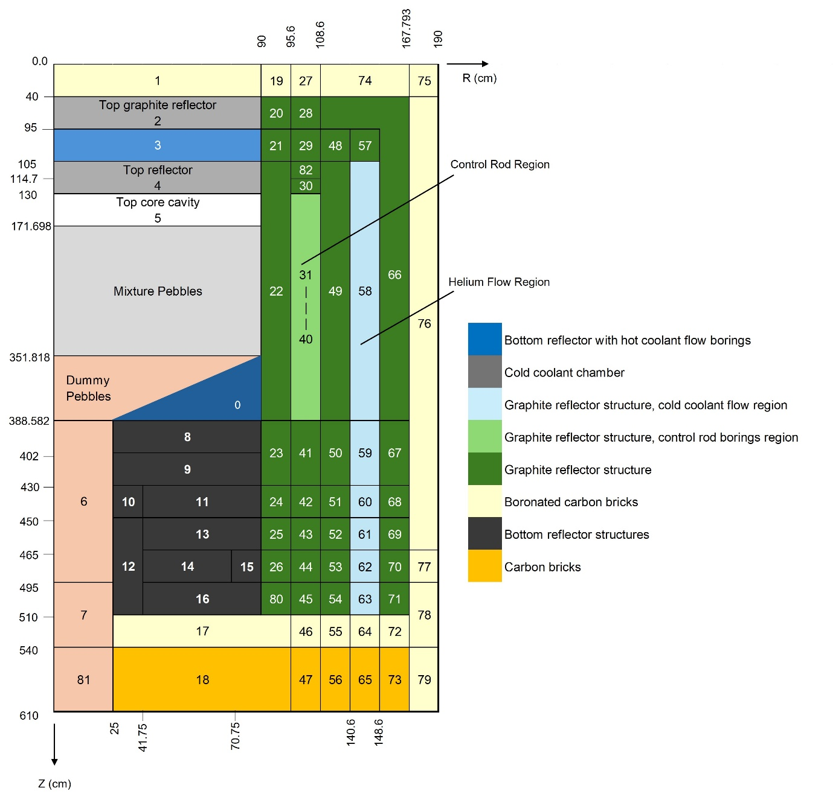
REACTOR DESIGN
PARAMETER | VALUE
Thermal output (MWt) | 40
Average core height (cm) | 197
Reactor core diameter (cm) | 180
Top reflector thickness (cm) | 100
Side reflector thickness (cm) | 100
Bottom reflector thickness (cm) | 100
Void thickness (cm) | 40
Initial uranium loading (g/pebble) | 5
Uranium enrichment (%) | 17%
Diameter of pebble balls (cm) | 6
Fuel kernel density (g/cm³) | 10.4
Fuel kernel diameter (µm) | 500
Refueling scheme | OTTO
Graphite reflector density (g/cm³) | 1.75
TRISO layers | buffer/I-PyC/SiC/O-PyC
Thickness (µm) | 90/40/35/40
Density (g/cm³) | 1.05/1.9/3.18/1.9

Slide 6
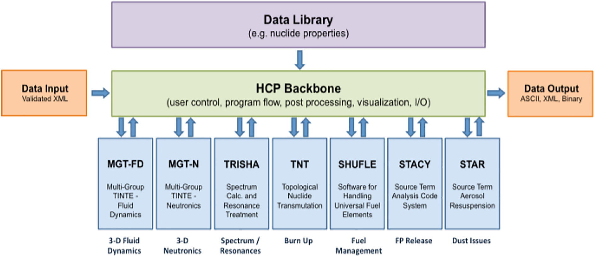
CALCULATION METHODS
HTR Code Package (HCP): A comprehensive system designed for simulating HTGRs, focusing on design, safety, and operation.
Key Modules:
  TRISHA: Neutron spectrum calculations for power distribution.
  Fluid Dynamics: Simulates coolant gas flow and heat transfer.
  SHUFLE: Fuel management, simulating fuel movement in the core.
  STAR: Dust production and transport for environmental impact.
  STACY: Fission product release, key for safety.
  TNT: Burn-up calculations for fuel depletion.
Architecture of the HTR Code Package (HCP)
Simulation in PeLUIt-40:
Utilized TRISHA, TNT, and SHUFLE modules to simulate initial criticality
and assess reactor performance.

Slide 7
CALCULATION METHODS
The Scenario Involved in the Calculation
B1 Case | Original | Deviated
Density of dummy pebbles | 1.73 g/cm³ | 1.84 g/cm³
Boron equivalent of impurities in dummy pebble | 1.3 ppm | 0.125 ppm
Core atmosphere at initial criticality | Helium | Air
PeLUIt-40 Validation: Power variation from 10 MW to 40 MW, with k-eff compared across different loading heights.
Performed using 40 MW power for k-eff calculation.
Core Changes:
- Graphite pebbles used instead of defined dummy pebbles (higher density: 1.84 g/cm³ vs. 1.73 g/cm³).
- Impurities in boron content lower than defined (0.125 ppm vs. 1.3 ppm).
- First criticality calculated in ambient air rather than helium.
Temperature Coefficient Simulation (B2 Cases): k-eff calculated under helium and air atmospheres at 20°C, 120°C, and 250°C without control rods.

Slide 8
Validation of the Simulation
K-eff in Power Variations for Original and Deviated B1 Case
Objective: Validate PeLUIt-40 input against HTR-10 with power levels ranging from 10 MW to 40 MW.
k-eff (Original Case): Approximately 1.014 across power levels, indicating stable reactor behavior.
k-eff (Deviated Case): Higher at 1.024, showing additional reactivity due to operational deviations.
Impact of Coolant: k-eff is lower when air is used as a coolant compared to helium, due to higher neutron absorption in air.
Boron Concentration: Higher boron concentration in the original case reduces k-eff for helium due to increased neutron capture by boron.
Power increase leads to slight k-eff decreases in both conditions, indicating predictable reactor behavior under varying power levels.
Power (MW) | k-eff
 | Original | Deviated
10 | 1.01438534137 | 1.02426113628
20 | 1.01438534120 | 1.02426113724
30 | 1.01438534111 | 1.02426113749
40 | 1.01438534083 | 1.02426113761

Slide 9
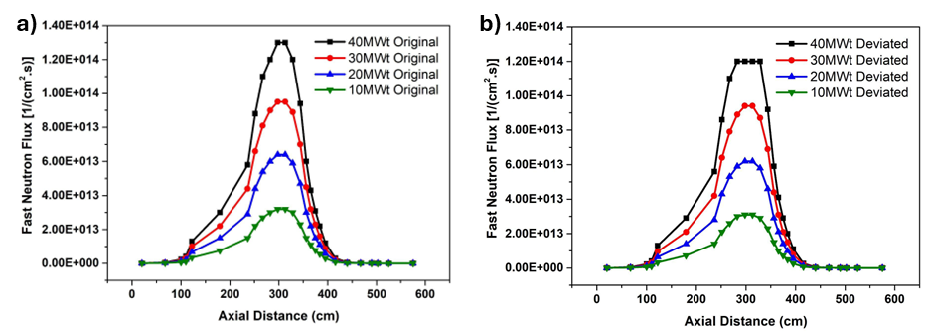
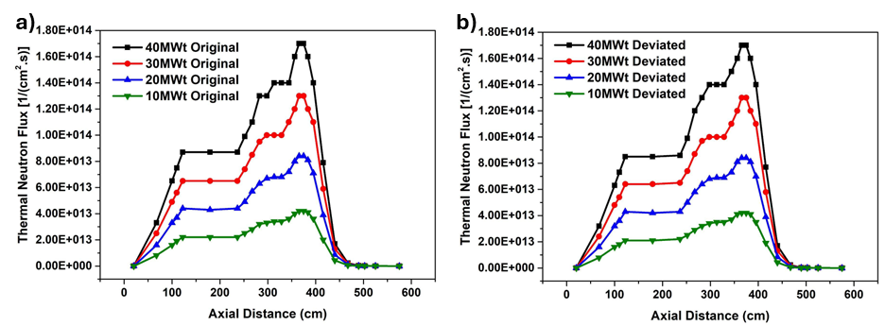
Validation of the Simulation
Fast Neutron Flux: Deviated cases show lower axial fast neutron flux compared to original cases at all power levels.
Thermal Neutron Flux: No significant difference between original and deviated scenarios in the axial thermal neutron flux profiles.
The deviations primarily impact the fast neutron flux, while the thermal neutron flux remains consistent across scenarios, indicating stable thermal neutron behavior under both conditions.
Axial fast neutron flux profile (a) original and (b) deviated scheme
Axial thermal neutron flux profile (a) original and (b) deviated scheme

Slide 10
Pebble Height Determination for Initial Criticality of PeLUIt-40
Pebble Height Variations for Peluit-40 for Initial Criticality
Pebble Height (cm) | Number of fuel balls | Number of graphite moderator balls | k-eff
90 | 7047 | 5316 | 0.907602
100 | 7830 | 5907 | 0.946276
110 | 8613 | 6498 | 0.980246
115 | 9005 | 6793 | 0.995747
117 | 9162 | 6911 | 1.001694
120 | 9396 | 7089 | 1.010363
123 | 9631 | 7266 | 1.014385
130 | 10179 | 7679 | 1.034291
140 | 10963 | 8270 | 1.060151
150 | 11746 | 8861 | 1.083375
160 | 12529 | 9451 | 1.10434
170 | 13312 | 10042 | 1.123369
180 | 14095 | 10633 | 1.140748
Calculate k-eff for different core loading heights in PeLUIt-40 at 40 MW, under helium atmosphere and 20°C, without control rods.
Key Results:
  k-eff increases with core loading height but not in a linear fashion.
  Achieving k-eff = 1 is possible with a loading height of 117 cm, requiring 9162 pebble fuel balls and 6911 graphite moderator balls.

Slide 11
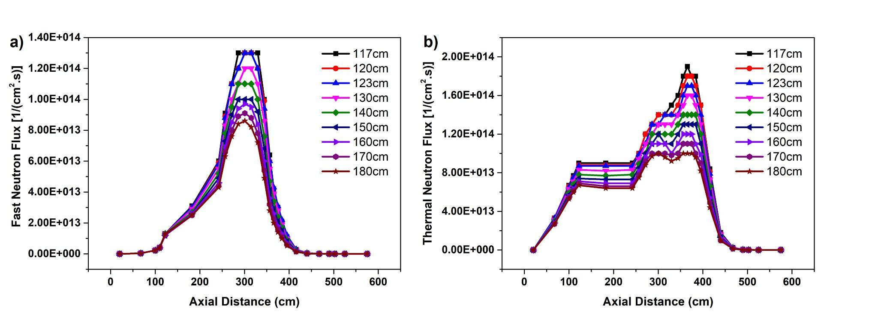
Pebble Height Determination for Initial Criticality of PeLUIt-40
Factors Affecting Flux:
Increased distance between core and reactor vessel reduces neutron moderation and absorption.
Neutron flux is highest near the core center and decreases with distance due to factors like neutron leakage and reduced moderation efficiency.
Importance:
Neutron flux distribution is essential for optimizing reactor design, burnup profiles, and fuel composition.
Proper analysis ensures better power distribution and helps identify potential operational issues.
Axial (a) fast and (b) thermal neutron flux profile with the variation of pebble heights.
Neutron Flux Decrease: Both fast and thermal neutron fluxes decrease as core loading height increases.
Impact: Neutron flux influences reactor power distribution and overall performance, particularly in pebble-bed reactors.

Slide 12
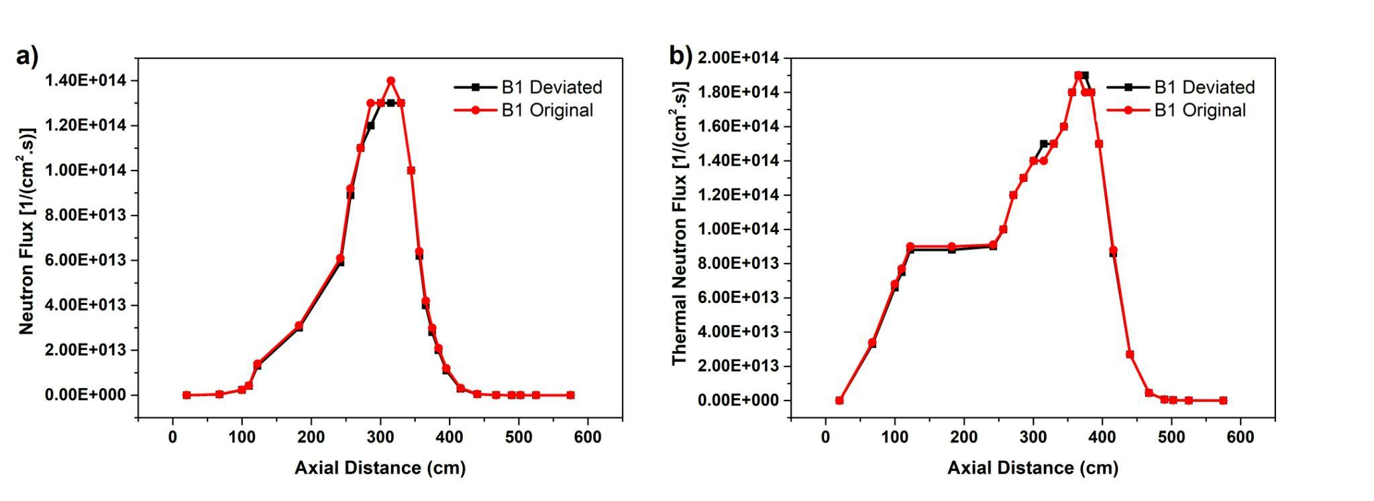
Calculation Analysis for B1 Case with Determined Pebble Height
K-eff Values and Maximum Fast and Thermal Neutron Flux af Benchmark Problem B1 with Original wnd Deviated Scenarios
Scenario | k-eff | Max. Fast Neutron Flux [1/(cm².s)] | Max. Thermal Neutron Flux [1/(cm².s)]
B1 Original | 1.001693983 | 1.4E+14 | 1.9E+14
B1 Deviated | 1.011804662 | 1.3E+14 | 1.9E+14
Axial (a) fast and (b) thermal neutron flux profile for benchmark problem B1 with the variation of scenarios (original and devated).
First criticality with pebble height of 117 cm under helium and air atmosphere at 20°C without control rods.
Increased slightly from 1.0017 (original) to 1.0118 (deviated), indicating marginally higher reactivity in the deviated scenario.
Fast Neutron Flux: Decreased from 1.4E+14 [1/(cm²·s)] to 1.3E+14 [1/(cm²·s)] in the deviated scenario, showing reduced fast neutron intensity.
Thermal Neutron Flux: Remained constant at 1.9E+14 [1/(cm²·s)] in both scenarios, indicating no impact on thermal neutrons.
Deviations primarily affect fast neutron population, while the thermal neutron population remains stable along the reactor's axial length.

Slide 13
Calculation Analysis with the Variation of Temperature Levels (B2 Case)
  k-eff Increases: Deviated scenarios show slightly higher k-eff values across all temperatures.
  Neutron Flux:
    Fast Neutron Flux: Minor decrease in deviated scenarios at all temperatures.
    Thermal Neutron Flux: Slight increase in deviated scenarios, indicating a shift in neutron population dynamics.
Deviated scenarios exhibit marginally higher reactivity and shifts in neutron behavior, with an increase in thermal neutron flux and a slight decrease in fast neutron flux across varying temperatures.
K-eff Values and Maximum Fast and Thermal Neutron Flux af Benchmark Problem B2 with Original and Deviated Scenarios
Scenario | Temperature (ºC) | k-eff | Max. Fast Neutron Flux [1/(cm².s)] | Max. Thermal Neutron Flux [1/(cm².s)]
B21 Original | 20 | 1.148216985 | 8.50E+13 | 9.90E+13
B21 Deviated |  | 1.156694957 | 8.30E+13 | 1.00E+14
B22 Original | 120 | 1.133615587 | 8.60E+13 | 9.80E+13
B22 Deviated |  | 1.141703808 | 8.40E+13 | 1.00E+14
B23 Original | 250 | 1.116852855 | 8.70E+13 | 9.30E+13
B23 Deviated |  | 1.124676976 | 8.60E+13 | 9.50E+13

Slide 14
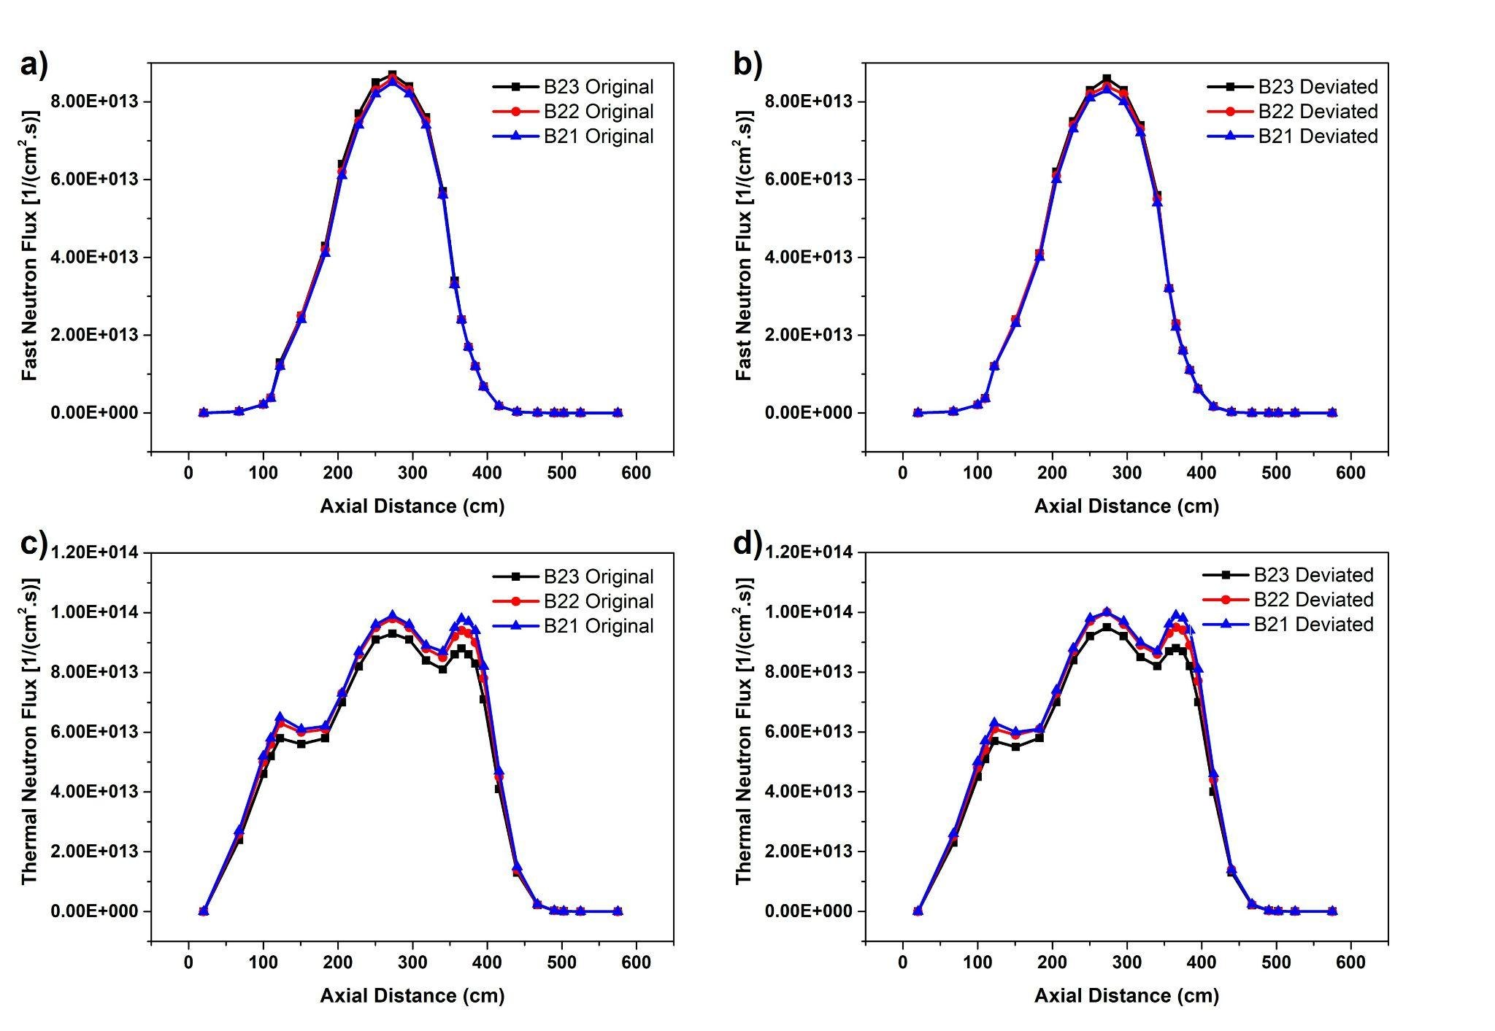
Calculation Analysis with the Variation of Temperature Levels (B2 Case)
Boron impurities in the coolant affect k-eff and neutron flux values, particularly in the thermal neutron spectrum.
Fast Neutron Flux (Fig. 7a):
  No significant change in fast neutron flux between original and deviated scenarios.
Thermal Neutron Flux (Fig. 7b):
  Lower thermal neutron flux in the original scenario due to higher boron concentration, as boron acts as a thermal neutron absorber.
  The increase in boron concentration reduces thermal neutron flux, though not in a directly proportional manner.
Boron impurities have a more pronounced effect on thermal neutron flux due to its strong absorption of thermal neutrons, leading to reduced flux in the original scenario with higher boron levels.
Axial (a, b) fast and (c, d) thermal neutron flux profile for benchmark problem B2 with the variatio of scenarios: (a,c) original and (b,d) deviated.

Slide 15
CONCLUSIONS
The analysis of initial criticality for PeLUIt-40 utilizing the HTGR Code Package (HCP) has provided valuable insights into the reactor's behavior under various conditions.
Through simulations and calculations, critical loading heights and effective multiplication factors (k-eff) were determined, as crucial parameters in assessing the reactor's performance and safety.
Initial criticality calculations for PeLUIt-40 were obtained with a pebble bed height of 117 cm, achieving the k-eff value of 1.001693983 under helium atmospheres at a core temperature of 20°C, without the insertion of control rods.
In the deviated case, the k-eff value is slightly higher than the original case, even though the neutron capture with air cooling is greater than helium, but the presence of boron impurities in the coolant has a significant influence on the calculation results. This is caused by the cross-section of boron absorption which is quite high.

Slide 16
THANK YOU

