Slide 1
HEXANA : a sodium advanced modular reactor for sustainable industrial decarbonization
P. Gauthé, J.B. Droin, H. Polge, P. Andreucci, S. Nizou

Slide 2
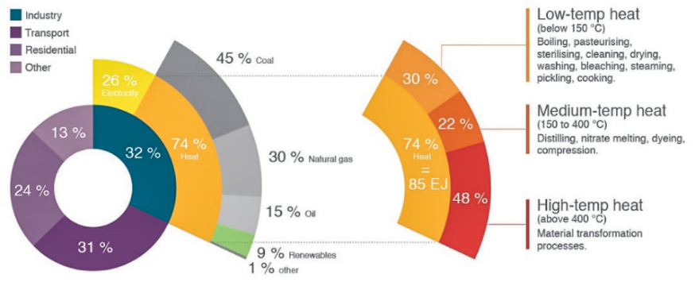
No climate solution without industry decarbonization
43%
of global CO2 emissions come from industry
90%
of industrial energy is driven by fossil fuels
3/4
of required energy is heat
50%
of the needed heat is >400°C

Slide 3
Why does the Gen-IV Sodium Fast Reactor technology is a good candidate among other Gen-III SMR ?
Delivery of high T° heat to the industries, in complement to electricity…
  Direct process heat delivery on a wide temperature range (70-500°C)
  Can be completed by electrical heating and/or H2 if needed, with a very good efficiency
  Also enables heat storage for flexibility and decoupling issues
… and because it’s a sustainable solution
  Good for climate and ecology (spent fuel as a ressource, less waste, less water)
  Good for countries (energy independence)
  Good for industries (stable OPEX, long term guaranteed prices)
  Good for the nuclear industry (makes nuclear sustainable)

Slide 4
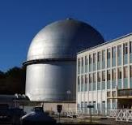
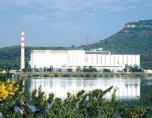
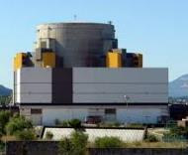
Why does the Gen-IV Sodium Fast Reactor technology is a good candidate among other Gen-IV systems ?
For its maturity and credibility!
Core proven technology
  >400 years of global operational feedback
  50 years of R&D in France, Operation of Phenix and SuperPhenix
Fuel & Materials
  Qualified, manufacturable, and recyclable MOX fuel
  Reactor structure materials identified and qualified
Ecosystem
  Well-known and mature industrial ecosystem (Framatome, CEA, EDF, ORANO…)
  Strong expertise related to the ASTRID project
1967
RAPSODIE
Proof of concept
40 MWth
SFR feasibility
1973
PHENIX
Prototype
250 Mwe
MOX fuel, material and components qualification
1986
SUPERPHENIX
Industrial FOAK
1200 Mwe
Industrial feasibility of large SFR

Slide 5







HEXANA : An innovative architecture for modular and flexible energy production
Modular
Flexible
Integrated
2 nuclear modules of 400MW thermal power
Heat storage module
Industrial clusters
Tailor-made power levels
90°C to 500°C
90 °C
300 °C
500 °C
On-site production
Integrated into industrial clusters
Flexible power generation
Large industrial applications
Hydrogen, steel, ammonia, e-fuels, etc.
Heat
Constant power
Variable power provided by heat storage

Slide 6
BOP Architecture
480°C
180 bar
345 MWe
530°C
510°C
HOT TANK
510°C
0.05 bar
SODIUM SECONDARY LOOPS
SODIUM-SALT HEAT EXCHANGER
STORAGE SALT LOOP
STEAM GENERATOR
WATER-STEAM LOOP
CONDENSOR
800 MW
455 MW
COLD TANK
300°C
435°C
300°C
238°C

Slide 7
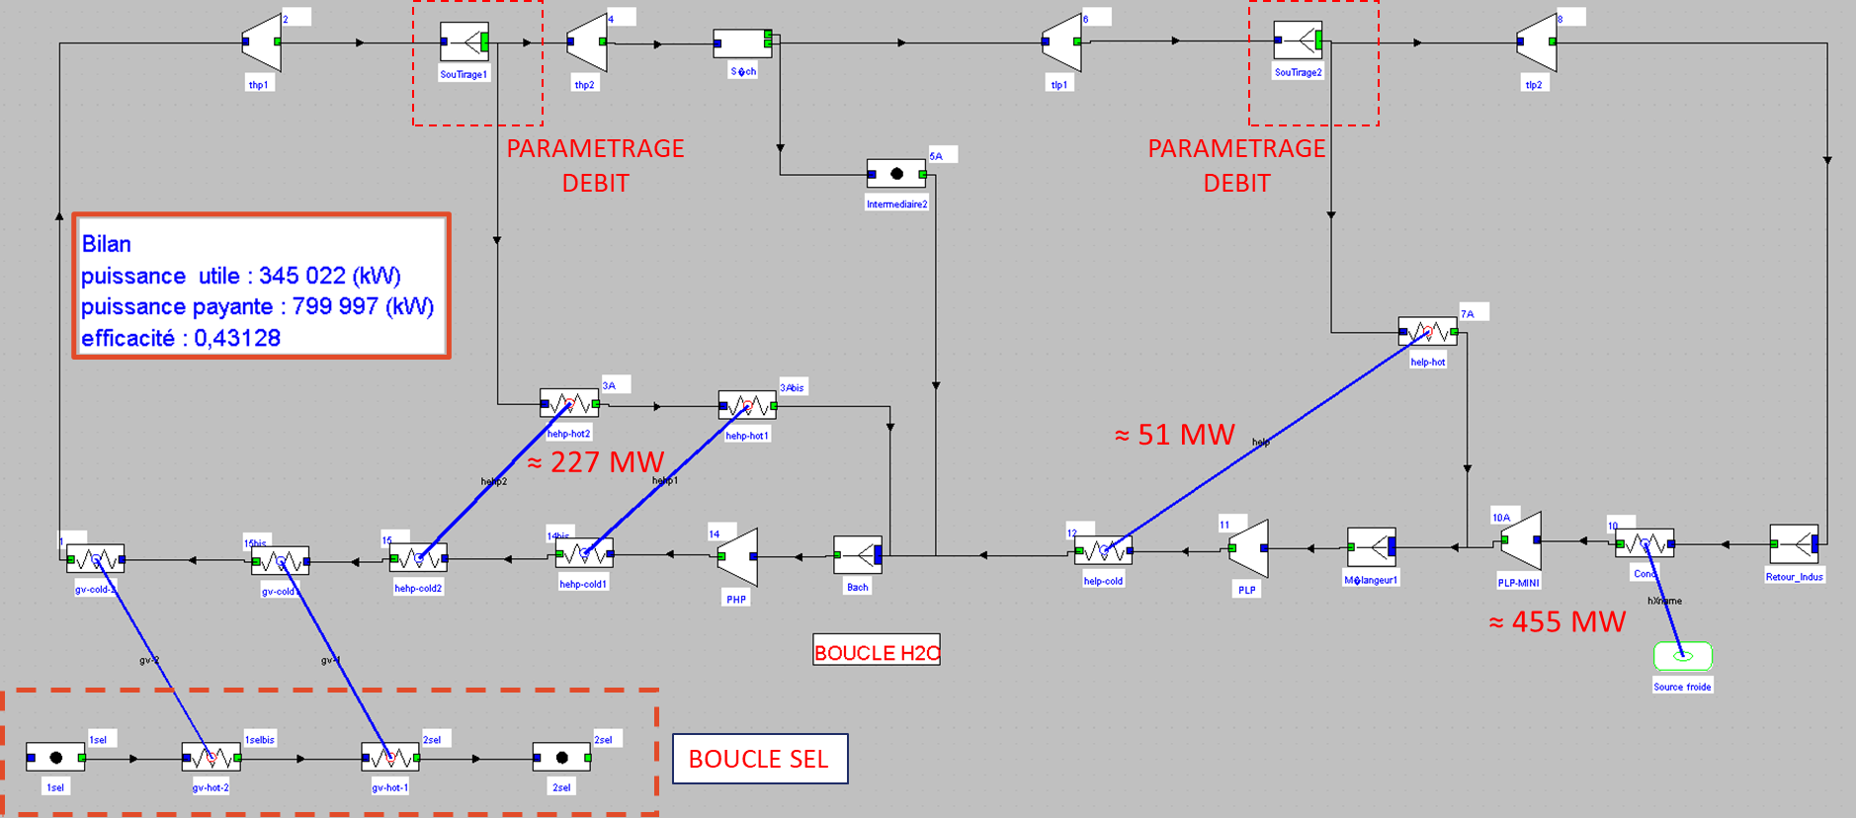
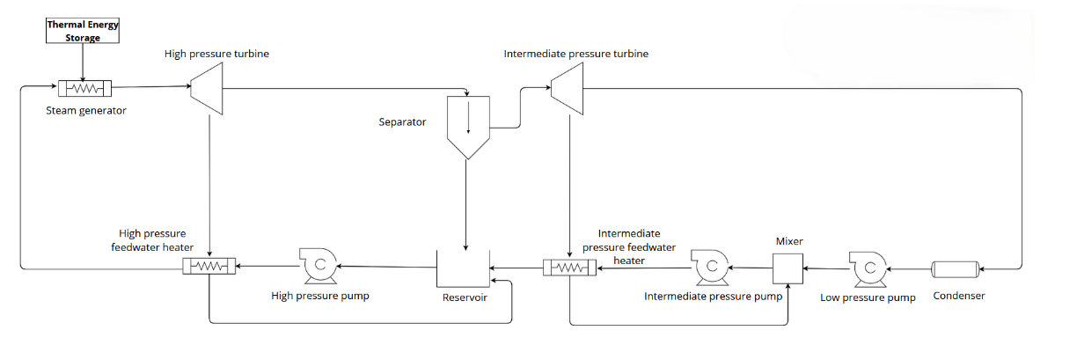
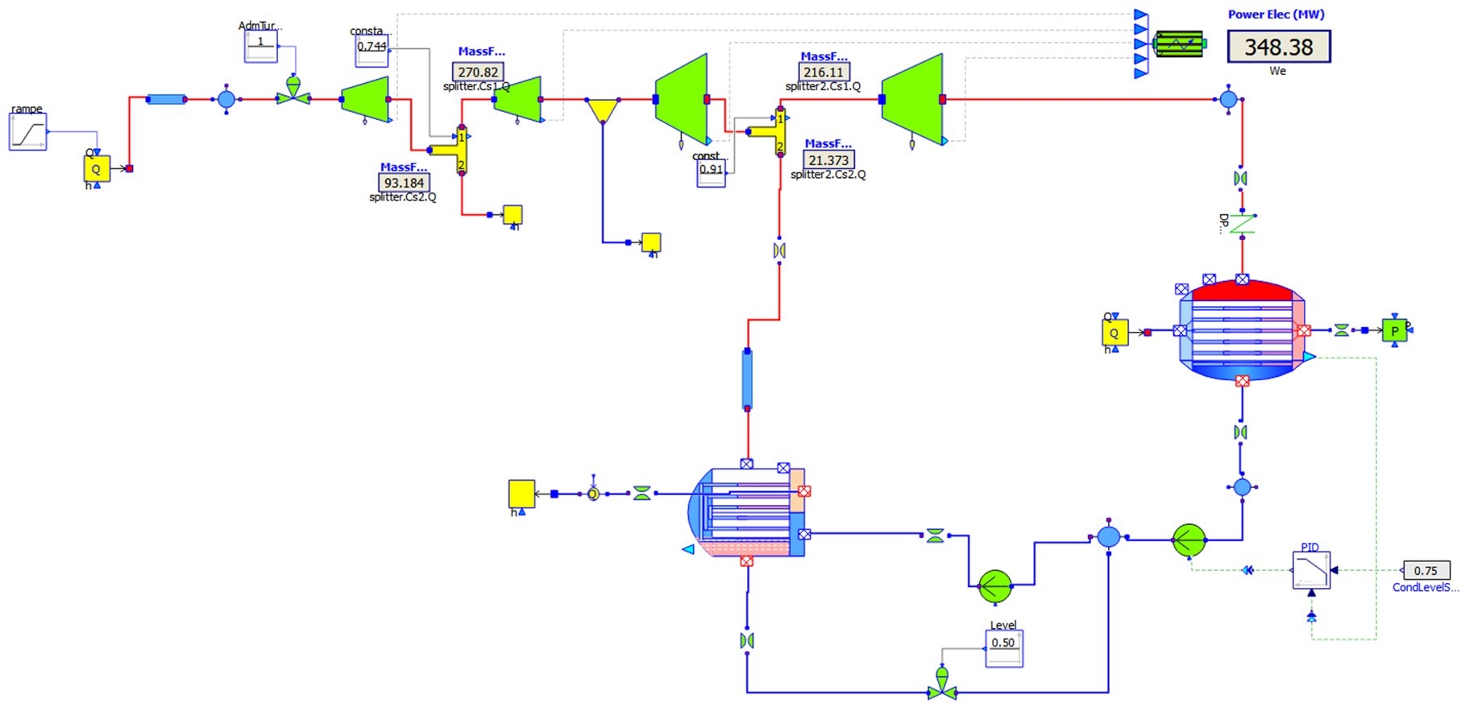
Use cases modelisation
OBJECTIVE : optimize the direct heat supply
Thermoptim simulation for steady-state
Rankine PCS design
Modelica simulation for dynamic transients

Slide 8
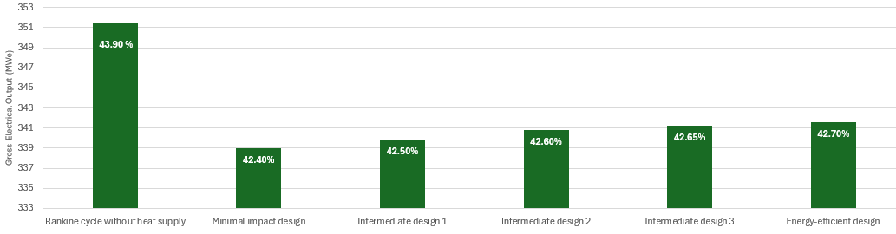
Theoretical case : small direct heat demand
30 MWth of heat demand with two temperatures
Optimisation of Rankine PCS design
Conclusion : in this case, it’s better to take the heat directly from the storage system without modification of a standard PCS system

Slide 9
Interest of the HEXANA storage system
Industrial needs
Profitability
Flexibility of energy supply
Decoupling between the nuclear site and industrial site
Enhanced siting possibilities
Sell energy when it’s expensive, store when it’s cheap
Public subsidies for capacity and grid security
CAPEX reduction (no pressure)
Safety
Maturity
Decoupling between industrial risks and the reactor
Elimination of interaction between sodium and water or any pressurized fluid
Concept assessed by HEXANA team since 2017
GW scale industrial thermal storage already operating worldwide
Different backups or innovative tracks

Slide 10
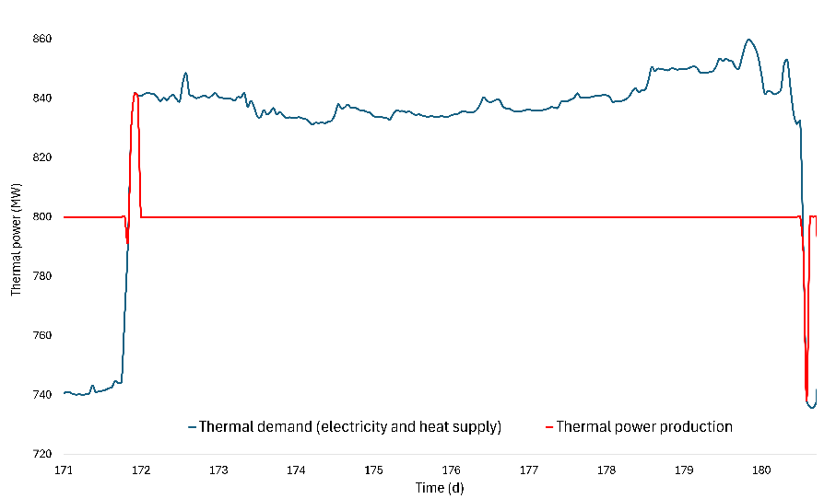
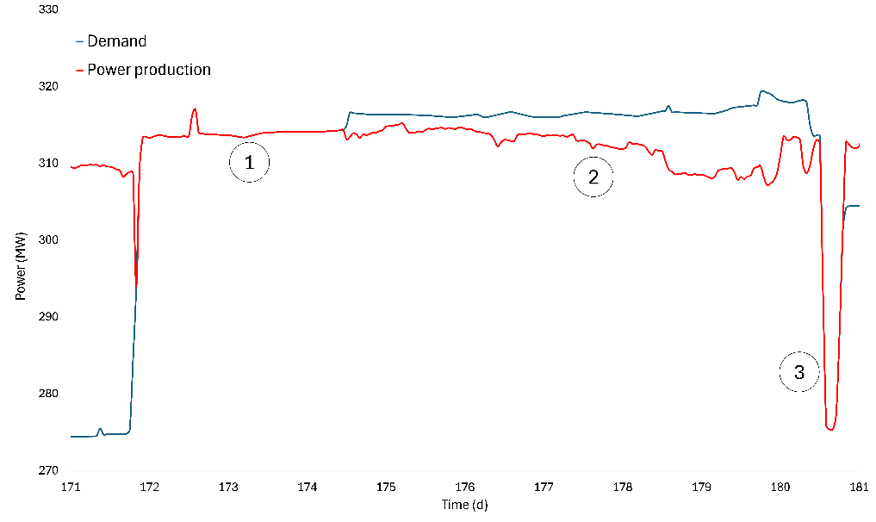
Heat storage design and strategy
Buffer approach : delay the import or export of power to ro from the grid
Load following approach : follow the demand in electricity of the industrial and minimize the import and export link to and from the grid
In each use case, the goal is to design the right size of the thermal storgae to meet the demand without overinvesting

Slide 11
Conclusion : Why is HEXANA a relevant solution to decarbonize industrial hubs?
Compatible with industrial needs
  Relevant size & power (modular concept)
  Continuous energy delivery thanks to module twinning
  Multi-energetic and integrated production (for ex: desalination + H2 + preheating + elec -> steel)
Enable to meet climate targets
  Higher energetic efficiency than Gen-III reactors thanks to the high temperature
  Less need for water
  Ultra low carbon energy (<3 geqCO2/kWh)
  Can replace gas a back-up systems
  Reliable, predictible and guaranteed energy prices on several decades
  Independant from any fuel importations and from the Uranium market evolutions (fast reactor)
  → Geopolitically resilient technology
  Base-load nuclear operation + high flexibility thanks to storage = optimized plant capacity factor
  → increased revenue + increased lifetime
Ease the integration of renewables onsite
  Absorption of intermittency thanks to heat storage
  Possibility to store extra energy in the storage during renewables overproduction periods
  → HEXANA can play the role of an industrial hub energy stabilizer (without significant grid reinforcement measures)

