Slide 1


Thorizon’s cartridge core molten salt reactor
LAUREAT
IAEA SMR conference 21-25 October 2024, Vienna
    INDICO ID 237
Sander de Groot, Thorizon CTO and co-founder
Selected by:

Slide 2
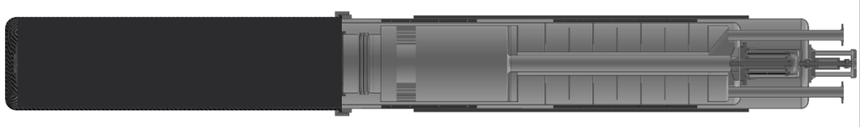
Thorizon’s solutions for molten salt reactor design challenges
Innovative cartridge based-core
Thorizon solved the two main issues in molten salt reactor realization due to its innovative cartridge-based core
  Thorizon’s concept: combining molten salt cartridges into a set creates a critical reactor core
  The problem:
  The solution
  In a molten salt reactor, the salt acts as both the coolant and the fuel
  Cartridges contain all primary system components: salt, pump, heat exchanger
  When the pump is active, the molten salt is circulated
  Only when cartridges are together and salt is circulated, fission energy is generated through neutron interaction between the cartridges
1
Material
Integrity
  Impossible to find and license reactor materials
  for a lifetime of >60 years due to effects of corrosion, heat, and irradiation
  Salt is contained in cartridges that are replaced every 5 to 10 years.
  Containment materials are already qualified for nuclear use.
  1
2
Fuel
Management
  Large volume of salt is needed for operations and salt is difficult to transport and handle after use.
  Fuel volume is compartmented and contained in modular cartridges all the time.
  Cartridges allow for transport and handling of fuel.
Patented by Thorizon, positively reviewed and recognized by industry experts as very promising
Source: : IAEA Status of molten salt reactor technology, team analysis
Notes:
Sander

Slide 3

Illustration of the concept
What Thorizon does
  Cartridge contains all primary systems: salt, pump, heat exchanger
  When the pump is active, salt is pumped upwards through the cartridge

Slide 4

Illustration of the concept
What Thorizon does
  Only when cartridges together are active, there is a critical configuration at top of the reactor

Slide 5

Illustration of the concept
What Thorizon does
  Only when cartridges together are active, there is a critical configuration at top of the reactor
  Heat is extracted through the heat exchanger on the lower part of the cartridge

Slide 6

Illustration of the concept
What Thorizon does
  When the pumps stop, the salt drops to the bottom of the cartridges
  The fission reaction stops, the reactor is not critical anymore

Slide 7



Thorizon was founded as spin-off from NRG and raised sufficient financing to scale the company
History of Thorizon
2018
August 2022
2023
2024
Thorizon was spun off from NRG, the national nuclear research institute of the Netherlands, where molten salt technology was developed for years
Thorizon raises €12,5mln to develop its technology, starts hiring engineers and opens an office in Amsterdam
Thorizon expands to France to work closely together with the French nuclear industry. Initially starting in Lille, Thorizon quickly realizes Lyon hosts most nuclear talent.
Thorizon receives a
€ 10mln grant for its consortium in France 2030.
Notes:
Note: they need proof we have over 24 months of financing – this is on the next page, I think this is still nice to give some color.
Laure

Slide 8

Thorizon was founded as spin-off from NRG and raised sufficient financing to scale the company
Latest news
2024
October 2024, the Thorizon One project was selected by the European SMR Alliance
After successful pre-screening, Preliminary safety review with ASN (French) and ANVS (Dutch) regulators
Notes:
Note: they need proof we have over 24 months of financing – this is on the next page, I think this is still nice to give some color.
Laure

Slide 9
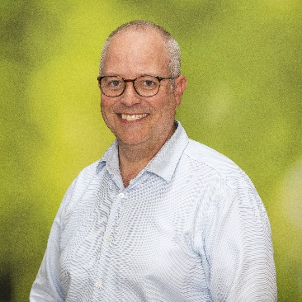







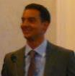

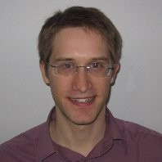
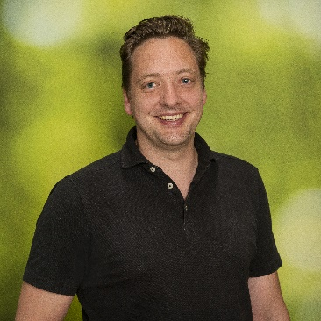

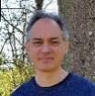









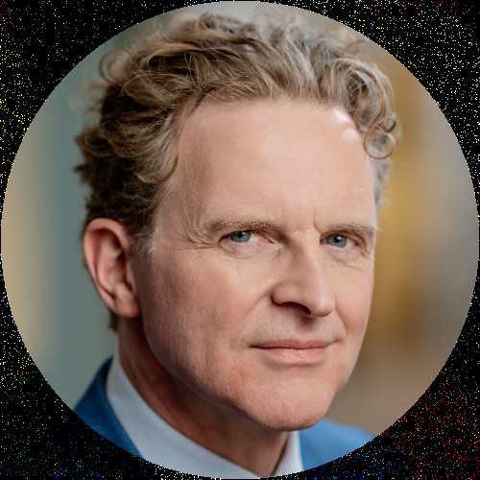
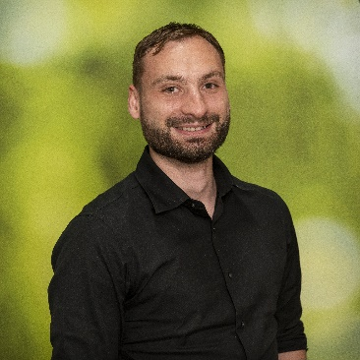



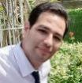



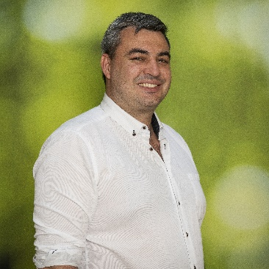
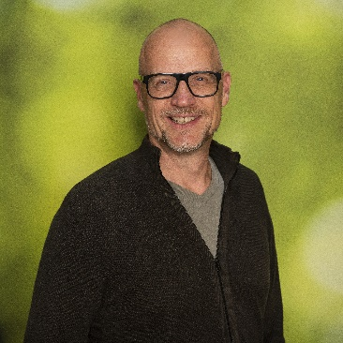

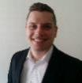
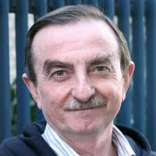
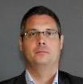
We are rapidly building a high-performing team across Amsterdam and Lyon, combining strong industry and scale-up experience
Experienced and scalable
  Our management team
20 team members
in Amsterdam
Netherlands
  Sander de Groot CTO & Co-founder
  25yr nuclear research and development
  Kiki Lauwers CEO
  15yr tech scale-up and management
  Laure Claquin
  COO & director France
  15yr large nuclear projects & management
~30% women
>10 nationalities
19 team
members
in Lyon
France
  Alexander van der Touw
  CFO
  25yr finance and funding experience
  Margriet Hooghiemstra Chief of Staff
  10yr strategy, M&A and business building
  Our growing team of experts
  Safety
  Neutronics
  Thermal Hydraulics
  Mechanical Engineering
  Systems Engineering & Prototyping
  Chemistry
  Program

Slide 10
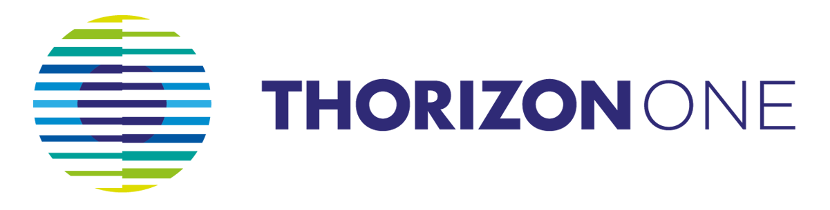
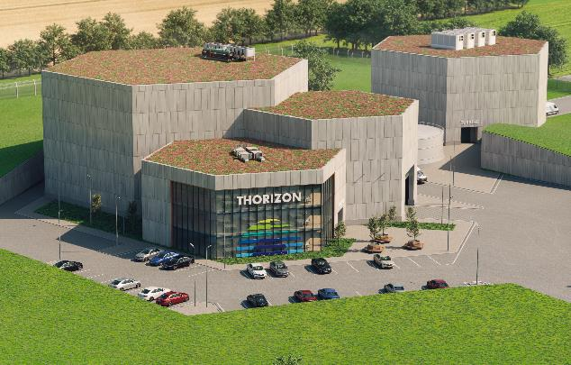
The Thorizon One proposition
The Thorizon One reactor
Thorizon One facility includes a 250MWth reactor island and a salt storage system
The facility integrates a highly flexible, turnkey, full-service asset with attractive economics into the existing value chain
Highly flexible asset
  50-300 MWe flexible power, 100 MWe baseload
  Multiple units can be combined per site
  600 MWh intra-day storage to enable load following
  550°C heat for industrial processes and hydrogen generation
Full-Service turnkey delivery
  Project management from pre-feasibility to commissioning
  Scalable reactor design adapted to project and site requirements
  Local licensing support
  Fuel and cartridge lifecycle management
Attractive economics
  LCOE of € 60 per MWh
  Industrialized cartridge production in series offsite
  Basic reactor building, no pressure dome, no primary system
  Off-the-shelf balance of plant based on proven technology
Target to first operation in 2032

Slide 11




These cartridges have many advantages
Double confinement
Advantages of the modular cartridge system
Additional safety
Without active pumping, the core becomes subcritical
Closed system with two containment barriers
Control rod systems not in salt
Rapid time to market
Using existing technology, materials and components
Demonstrator with one or more cartridges
core section
Gas-salt plenum
Additional flexibility
Different fuels in different parts of the core
Reactor spectrum adjustable
Continuous improvement and innovation with each coreload
Series production
Cost reduction of plant building on site
Series production of primary circuit off-site
Transportability connects to facilities for (repetitive) reprocessing
Heat exchanger
Pump
Connection to secondary salt system

Slide 12
These cartridges have many advantages
Double confinement
Advantages of the modular cartridge system
Additional safety
Without active pumping, the core becomes subcritical
Closed system with two containment barriers
Control rod systems not in salt
Rapid time to market
Using existing technology, materials and components
Demonstrator with one or more cartridges
core section
Gas-salt plenum
Additional flexibility
Different fuels in different parts of the core
Reactor spectrum adjustable
Continuous improvement and innovation with each coreload
Series production
Cost reduction of plant building on site
Series production of primary circuit off-site
Transportability connects to facilities for (repetitive) reprocessing
Heat exchanger
Pump
Thorizon executes an internal and external development and prototyping program, combining supply chain with demonstration

Slide 13
These cartridges have many advantages
Advantages of the modular cartridge system
Additional safety
In combination with generic molten salt technology benefits:
  Large fuel flexibility, many reactor design options, and robust inherent safety features
  Largely non-nuclear fuel qualification route, as molten salt fuel behaviour is chemistry dominated
  Less hazardous and more convenient fuel (re)manufacture following reprocessing and easy QA/QC -> fuel cycle closure
Rapid time to market
With the benefits of a cartridge core approach
  Material challenges resolved by timely replacement
  Handling and transportation facilitated by cartridge containment, with proliferation concerns avoided
  Compartimented salt volumes, with forced and guided flow circulation, limiting interdisciplinary coupling complexity
  Demonstration by single cartridge prototyping, and cost reduction by off-site series production of the primary circuit
Additional flexibility
Series production
A real opportunity to achieve competitive nuclear circularity
  Better use of nuclear material resources
  Minimize and even reduce existing longlived nuclear waste

Slide 14
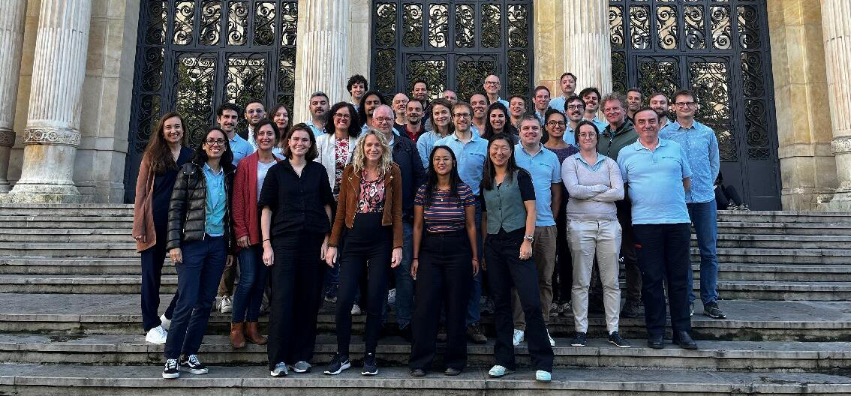
Thank you for your attention
Join our mission

Slide 15

LAUREAT
We contribute to a clean planet by developing a
reliable nuclear reactor that makes more efficient use
of fuel and minimizes waste.
In the future, we foresee several clean energy technologies that function in synergy. This mix will provide affordable and accessible energy for all, fulfilling a basic human necessity.
Contact details
info@thorizon.com
www.thorizon.com
Selected by:

