Slide 2


Making the Complex Simple
The application of parametric design tools
in the realisation of Rolls-Royce SMR.
Andy Crabb
Rolls-Royce SMR / AtkinsRéalis

Slide 3
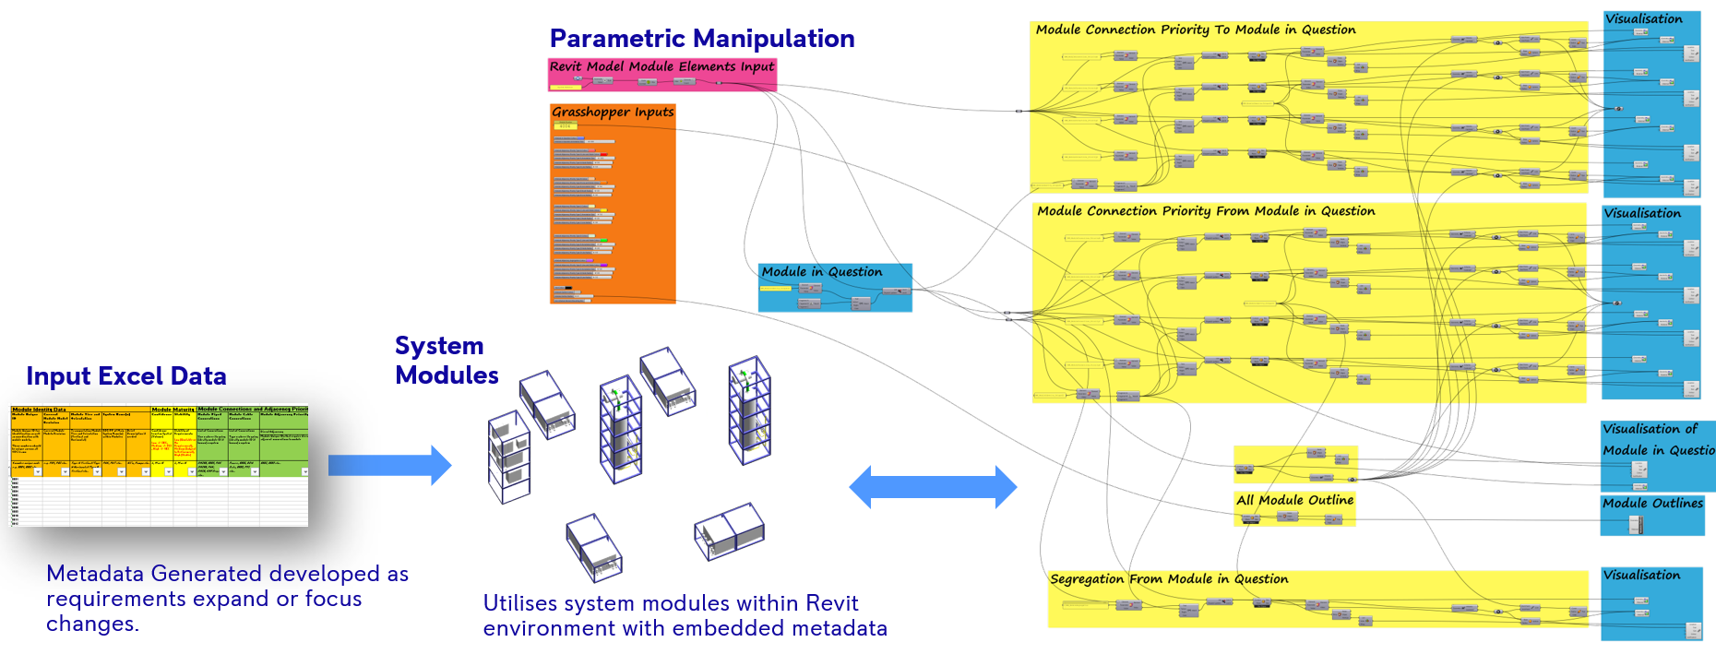
Making the Complex Simple
Introduction
Parametric thinking embodies a new method of applying a vast set of variables in a way that can be simply manipulated by the human mind. A subject is explored to isolate the key design aspirations to allow a computer storyboard to be developed to encompass the various design attributes tied to a computer logic that can visually manipulate the variables in real time.
FIG. 1. Example of the algorithm.

Slide 4
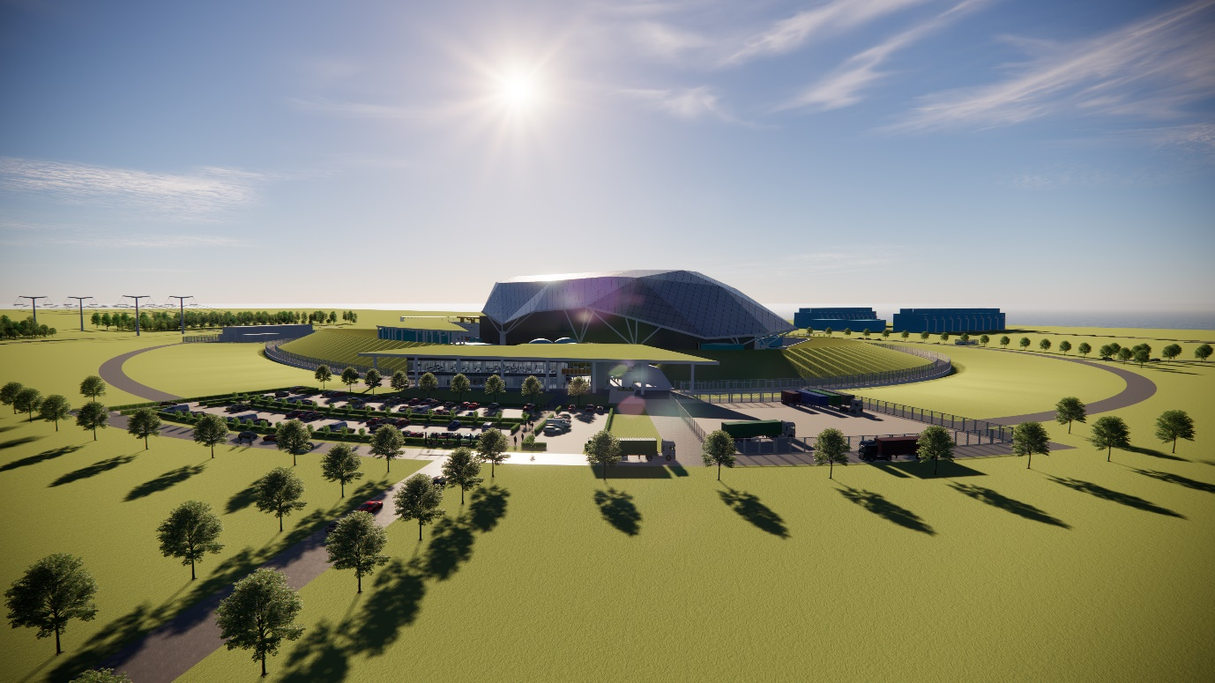
Making the Complex Simple
Introduction
The application of parametric thinking has enabled Rolls-Royce SMR to design its Small Modular Reactor (SMR) to encompass modularity throughout its evolution from the first principles of its bold architectural vision through to the detail of how the smallest elements are put together.
Parametric modelling has given the power of great design thinking back to the designers to be able to deal with immense complexity in a coherent and coordinated way. This innovative toolset enables true three-dimensional design modelling to happen in real time, while taking onboard an unintelligible number of variables. This innovative way of thinking has opened fresh new areas of computational design that can adapt to many environments ranging from shell roof structures, earthworks, functional optimisation, modular construction to cost and schedule control.
Parametric thinking has been fundamental to the production of an efficient new design for energy production for our future energy security in the form of Rolls-Royce SMR.
FIG. 2. Rolls-Royce SMR vision.

Slide 5
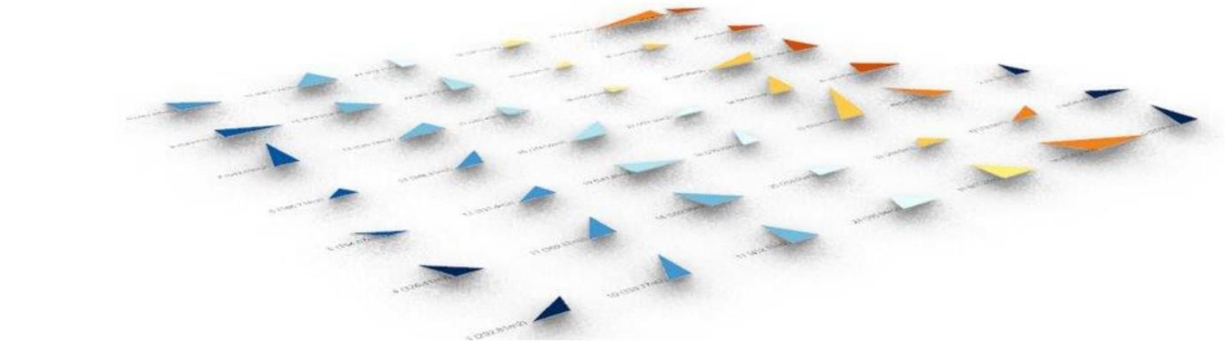
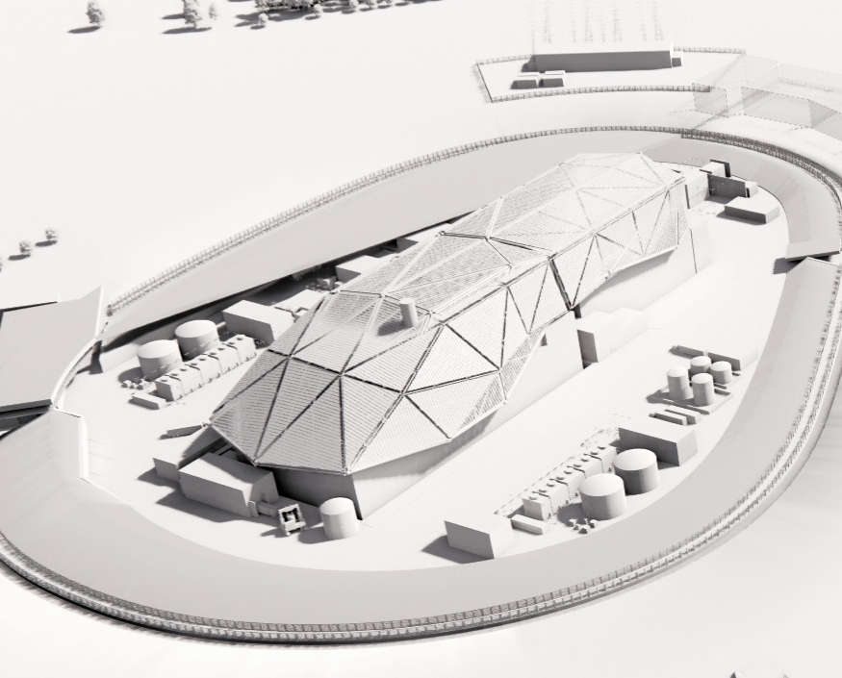

Making the Complex Simple
Shell Roof
The shell roof responds to the functional technical forms that sit below it (Reactor and Turbine Building) acting as a unifying element, merging two vital and typically distinct elements into one visually dynamic form.
When developing the design for the shell roof there were several design and functional objectives, all of which were used as direct and indirect parameters that were built into the algorithm used to develop the shell roof design proposition.
When developing the algorithm, the architectural team used the design and performance objectives as key parameters to drive the design output of the shell roof. One of the first design iterations was to optimise the number of panels or facets required to panellise the shell roof. Using parameters such as the longest length of steel that can be achieved to cover such distances, the required number of panels was optimised.
FIG. 4. Shell roof kit of parts.
FIG. 3. Isometric view of Shell Roof over RI and TI.
FIG. 5. Panel optimisation.

Slide 6
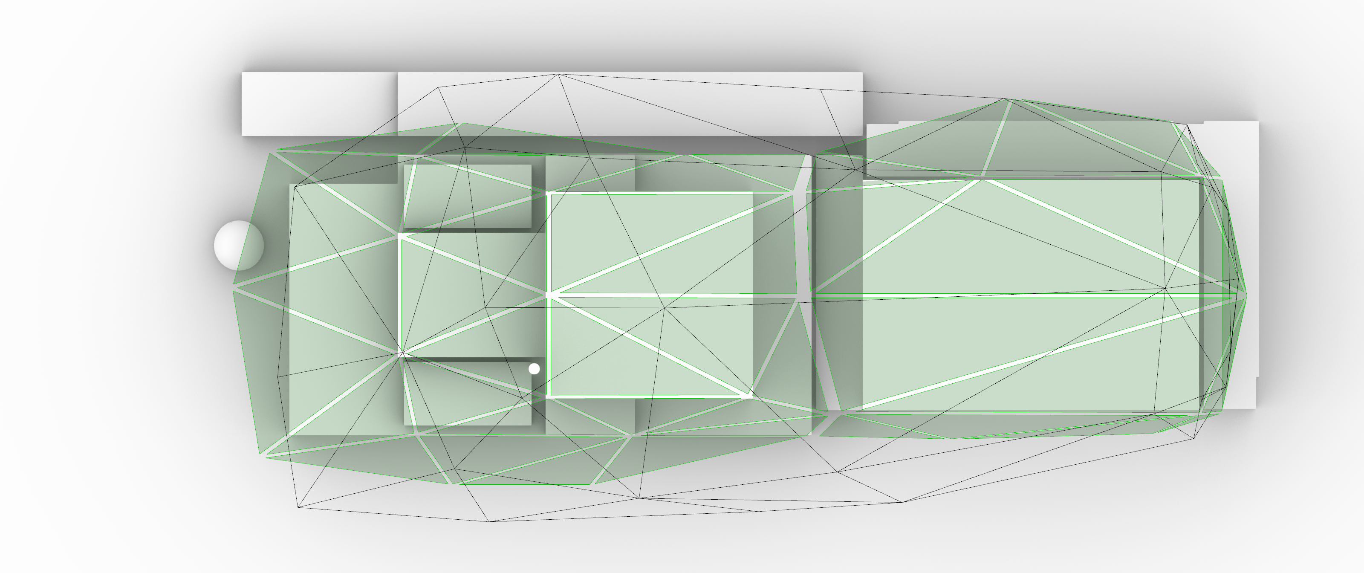
Making the Complex Simple
Shell Roof
Minimising the number of panels enabled optimisation of the size of the panels. This process achieved a significantly narrower form, which can be seen in the illustration. The grey line highlights the form and panel separation of the previous shell roof, where the green region emphasises the optimised shell roof. As a result of this algorithmic process, the overall surface area of the shell roof was reduced by 14.6%.
An additional realised benefit of the application of an algorithmic process has meant that the shell roof fits more comfortably within the site factory, which will aid the construction process. This process has also reduced oversailing elements by bringing the shell tighter to the building beneath, as illustrated.
By utilising such tools, the design team has been able to realise the reduction in number of facets, as well as overall surface area which will help reduce the overall cost to RR SMR.
TABLE 1. Optimisation of Shell Roof Surface Area
Optimisation | Before | After | Percentage change
Roof Surface Area | 23,755m2 | 20,295m2 | 14.6%
FIG. 6. Reduced shell roof footprint.

Slide 7
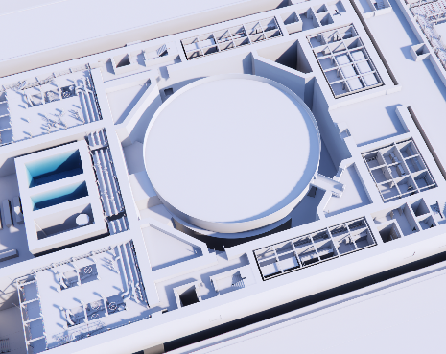
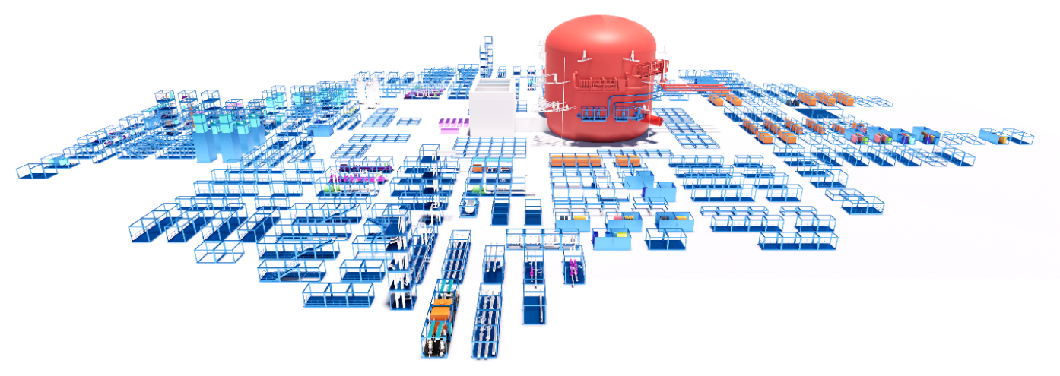
Making the Complex Simple
Modular Disposition
The objective was to understand and manipulate, and eventually set out the volumetric design and high-level connectivity for the modularisation of the main functional systems with the Reactor Island Layout.
To enable optimisation for the disposition of the modularisation of RR SMR a series of metadata criteria were identified that governed the setting out of the functional systems. These were identified within each module and fed into from the various teams that were formulating the evolving designs. A series of metadata was embodied into each system and module to identify significant linkages, significant separations, placement criteria and proximities/importance, heights above other elements, access criteria, seismology and radiological criteria.
FIG. 7. Extract from general arrangement drawings.
FIG. 8. Modular kit of parts.

Slide 8
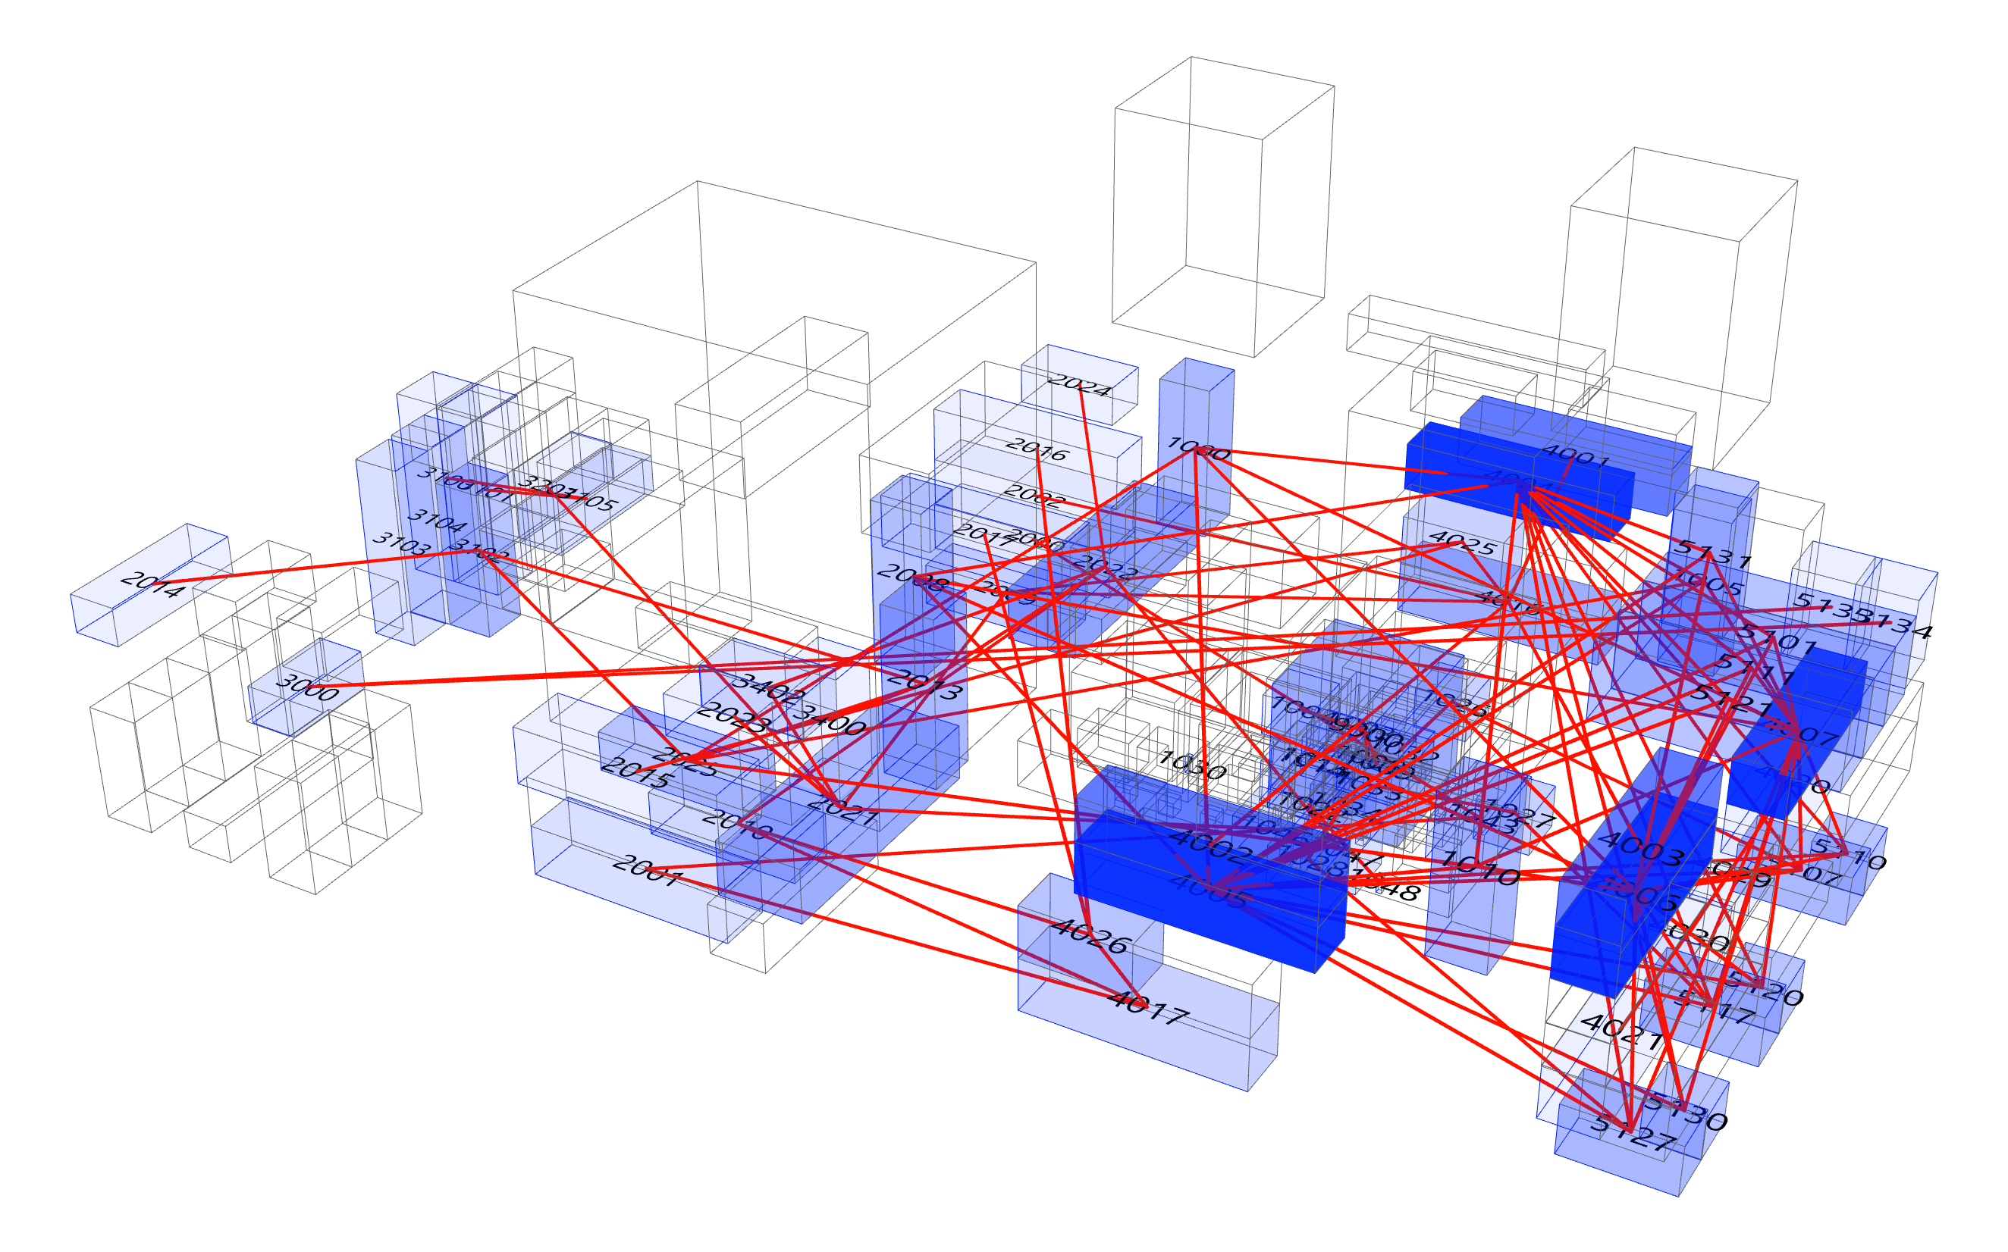
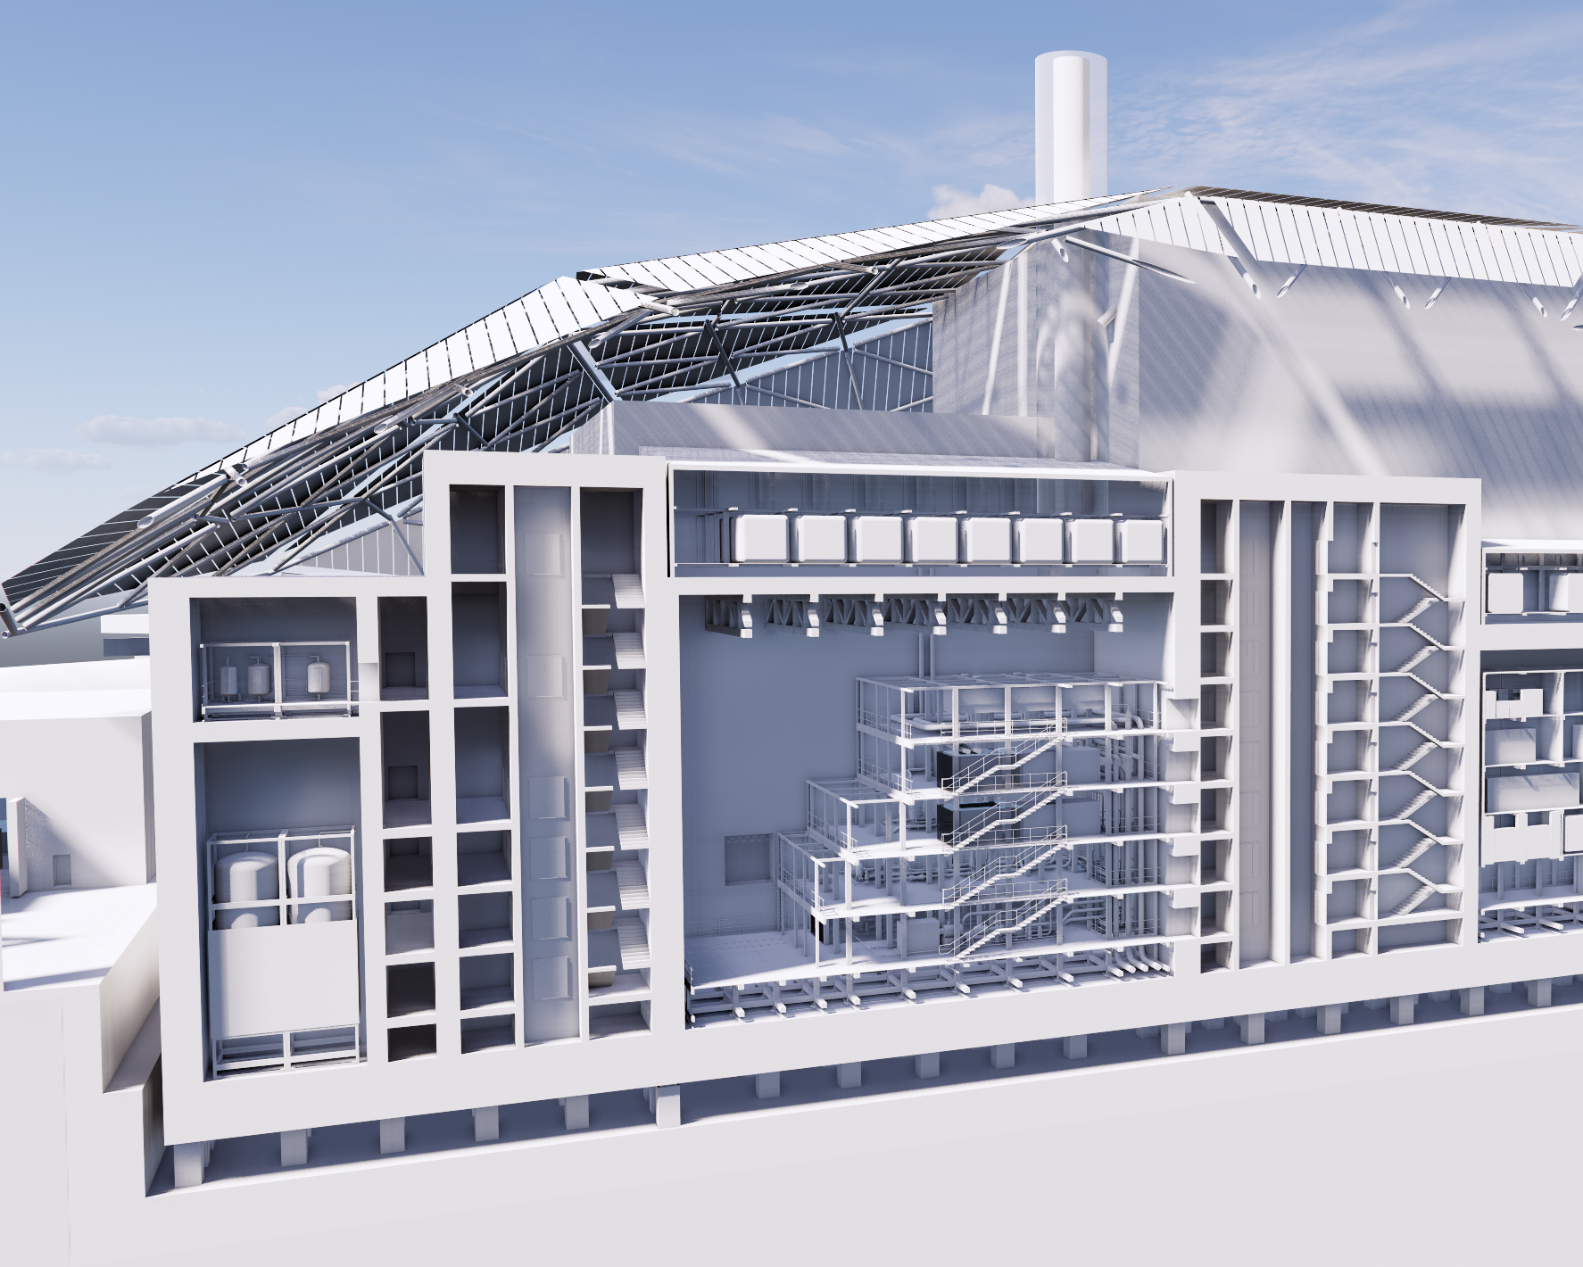
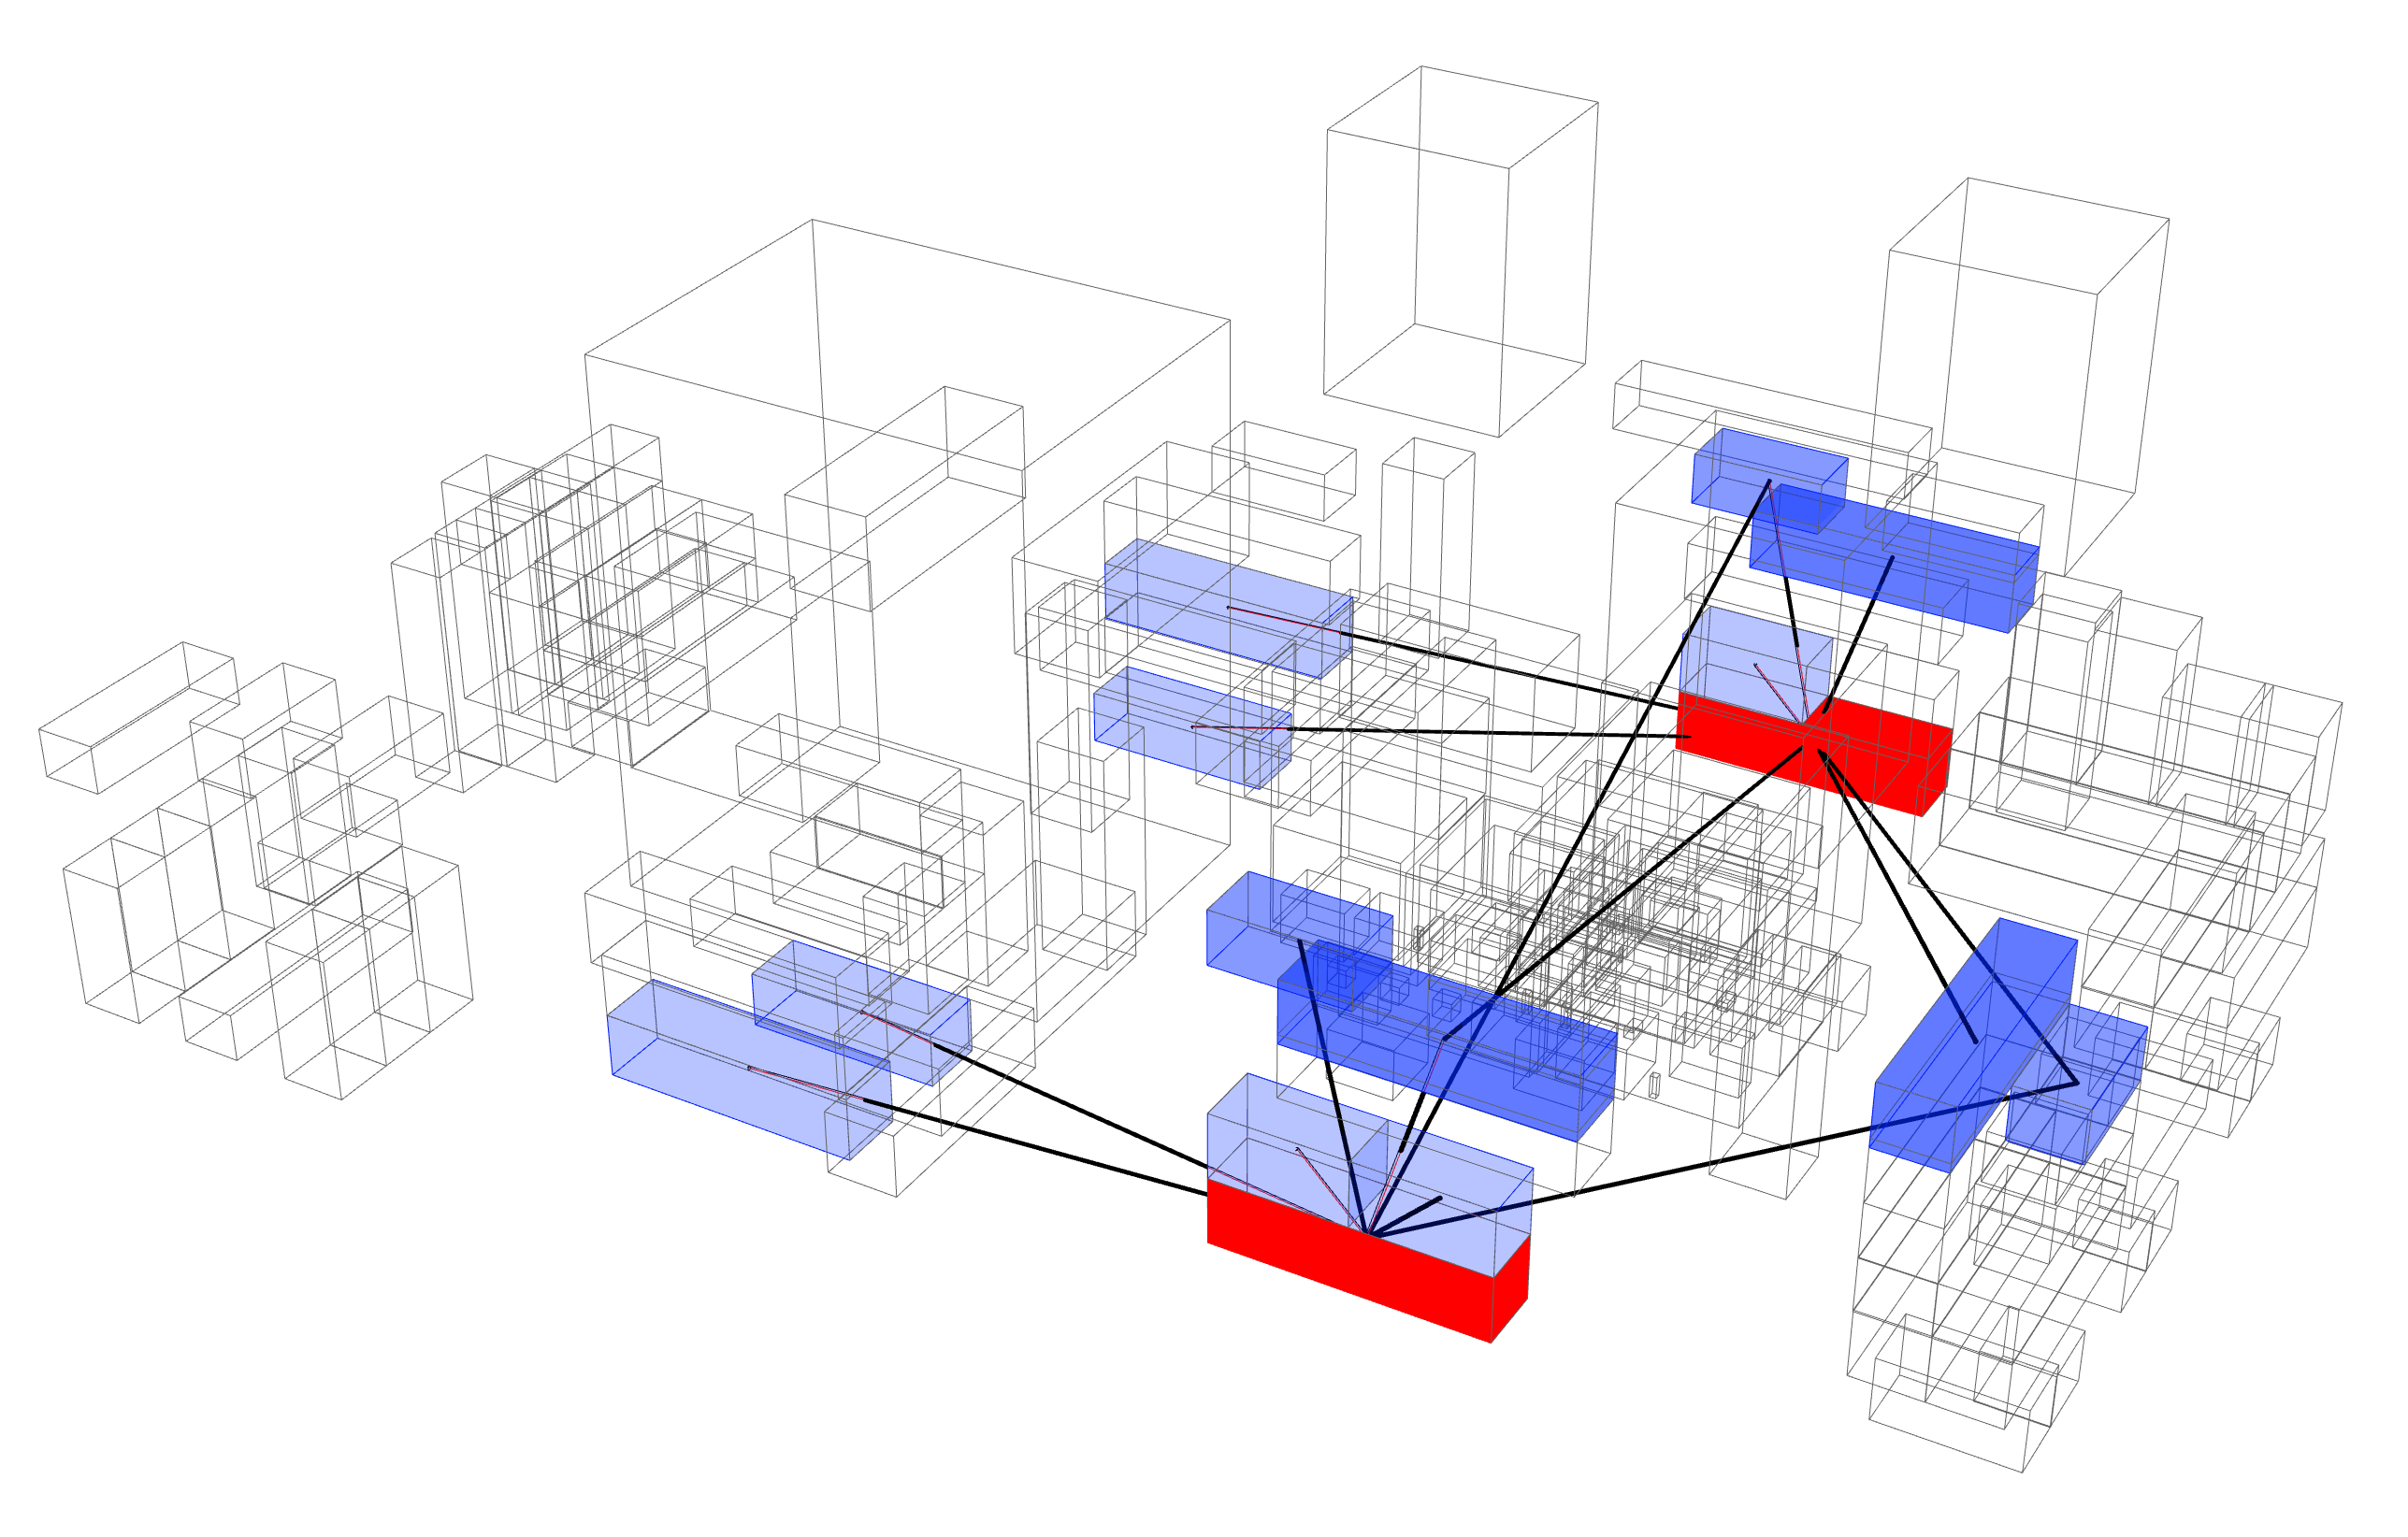
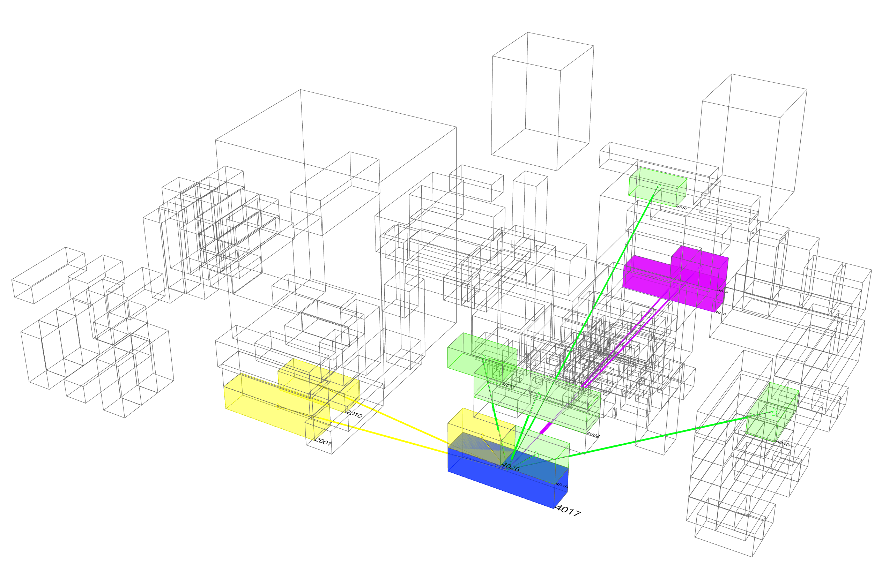
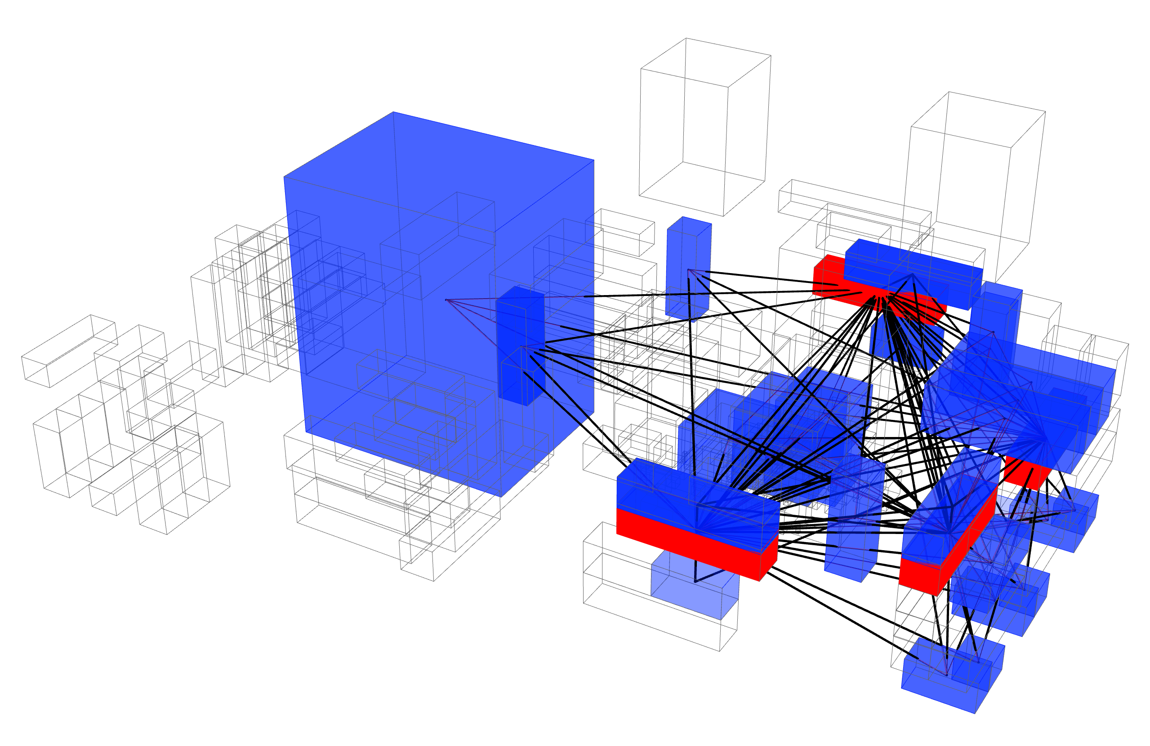
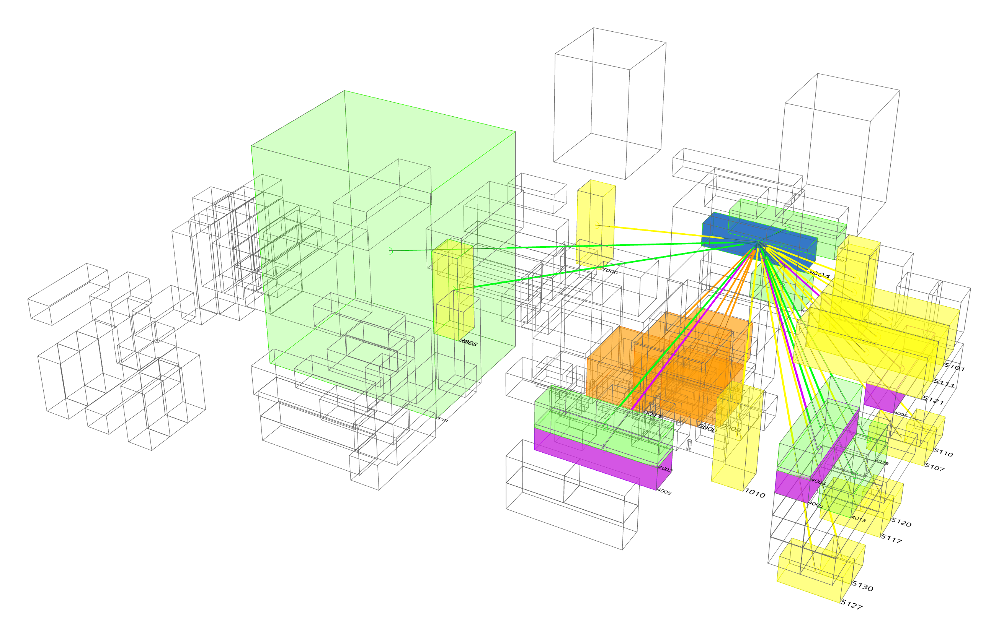
Making the Complex Simple
Modular Disposition
Metadata can be viewed in real time with changes to the layout and implications on adjacencies/linkages instantly updated and easily disseminated, understood, discussed and agreed.
Tangibility afforded by parametric modelling helps accelerate conjoined design consideration across many challenges to evolve a design that balances a vast number of diverse inputs.
Volumetric disposition of systems via module layout can be studied from many perspectives to facilitate the most optimised layout that balances inputs from various, and frequently opposing, systems and requirements.
FIG. 9. Section illustrating location of modules within RI.
FIG. 10. Dynamic nodal diagram.
System Nodal Diagram (BKA)
Division 2 Switchboard Module Nodal Diagram
System Nodal Diagram (JQA)
Division 1 DPS Module Diagram

Slide 9
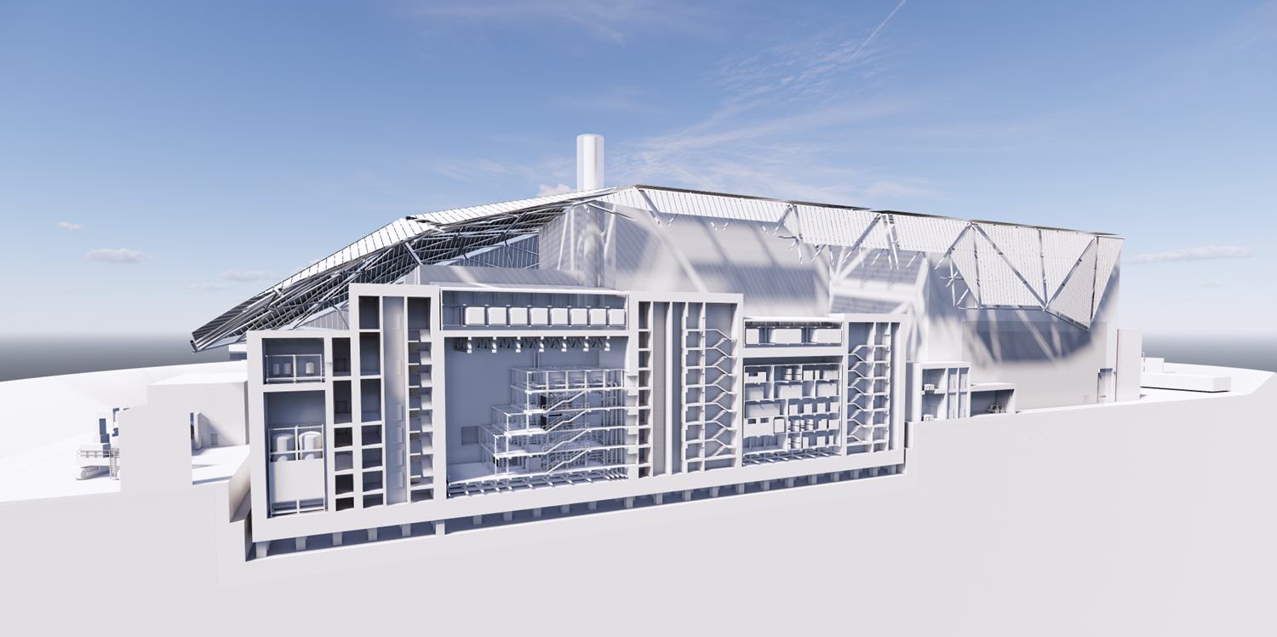
Making the Complex Simple
Conclusion
Parametric modelling has been applied to various areas across RR SMR. Reactor Island Modules, Shell Roof and the enclosing Berm earthworks have each benefitted from early adoption and integration of parametric thinking into the design process.
AtkinsRéalis have utilised the parametric expertise from their Research & Innovation team to develop the design with greater levels of accuracy and control, enabling effective optimisation and a generic design that is more responsive and adaptive to the ever-evolving requirements and constraints of the site.
-
Parametric thinking has enabled the simplification of a complex challenge in the evolution of an efficient and innovative new vision of energy production in the form of RR SMR.
Shell Roof
Berm
Reactor Island Modules
FIG. 11. Sectional perspective of RR SMR illustrating interior of RI, Shell Roof and Berm.

