Slide 1
Vincent NKONG-NJOCK

Slide 2
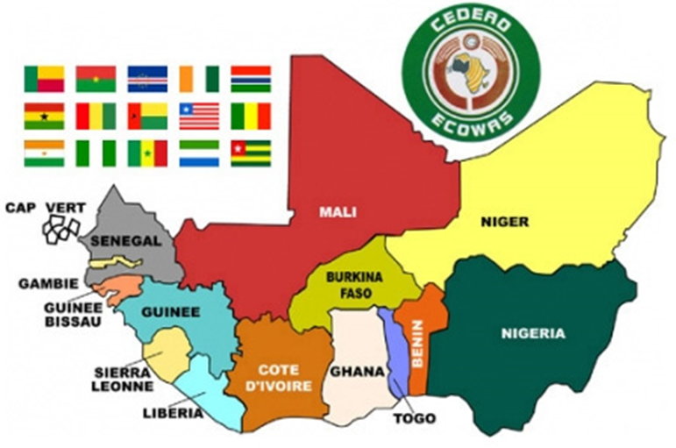

OPPORTUNITIES & CHALLENGES FOR INTRUDUCING SMRs IN AFRICA
Vincent Nkong-Njock
iLEMEL

Slide 3
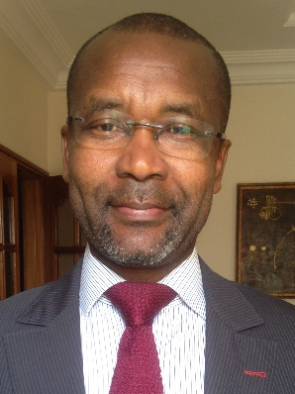
INTRODUCTION
Vincent NKONG-NJOCK
CEO of iLEMEL Energy & President iLEMEL Engineering
Special Advisor to the
        Permanent Secretary to Energy (SPE) and
        Minister of Energy and Petroleum (MPE), Senegal
Experience
With more than 30 years’ experience in developing infrastructures, markets and raising funds in the energy and nuclear fields.
Former Head, Division of Simulation and Training, French Atomic Energy Commission (CEA)
Former Programme Management Officer, IAEA TC Department
Former Group Lead, Nuclear Power Infrastructure, IAEA NE Department.
Former Co-Director, Massachusetts Institute of Technology - International Nuclear Leadership Education (MIT – INLEP) Programme
Adjunct Lecturer in Nuclear Engineering, Cheikh Anta Diop University (UCAD), Dakar, Senegal, and KEPCO International Nuclear Graduated School (KINGS), Ulsan, South Korea
Education
PhD Nuclear Engineering at National Polytechnic Institute (INP) Grenoble, France

Slide 4
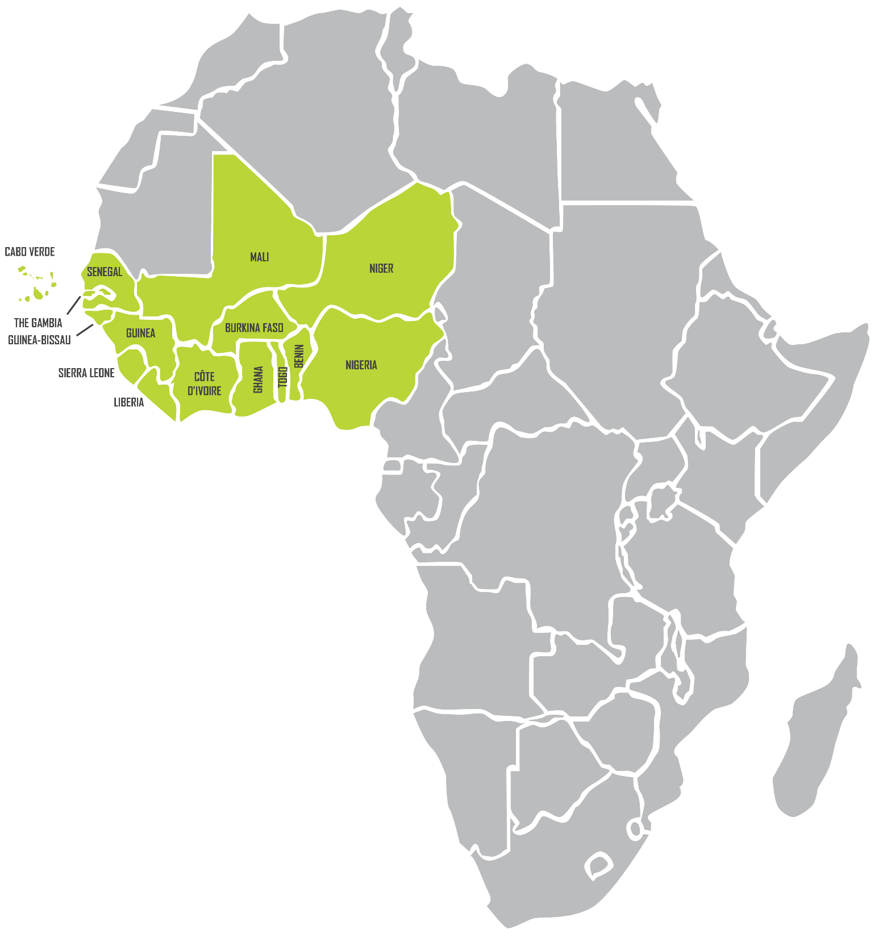
THE ECOWAS REGION
  15 countries with a land area of 5 million m²
  Climate from semi-arid to humid tropical
  Population of over 300 million people
  60% of population live in rural areas
  11 of the 15 countries are LDCS and HIPIC
  Almost 176 million people have no access to electricity (52%)

Slide 5
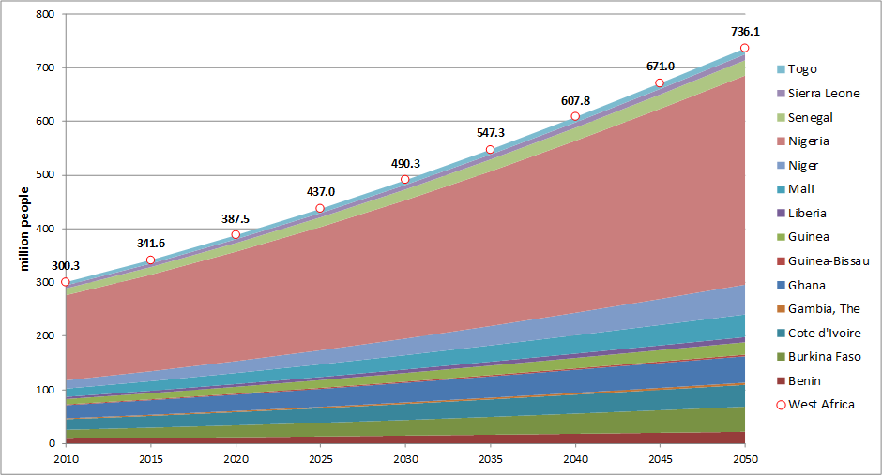
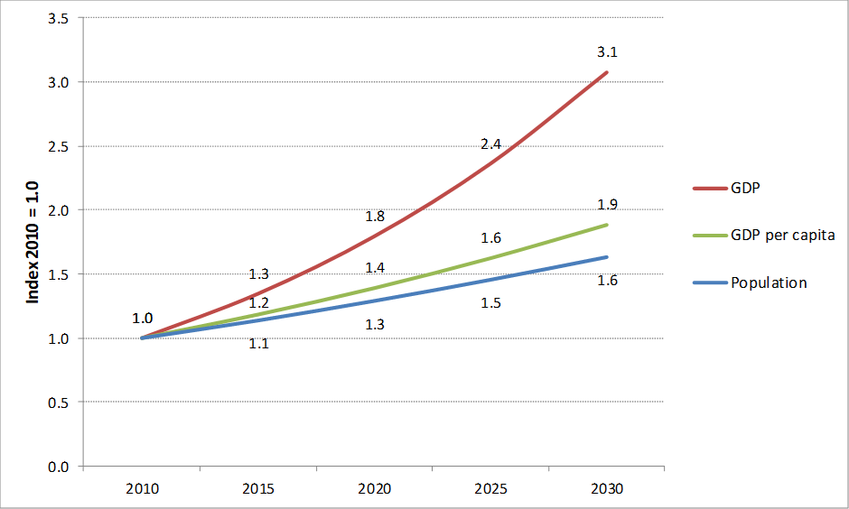
DEMOGRAPHY & ECONOMY
Population, GDP per capita and GDP trends in the Western Africa until 2030
Expected* population 490,9 million peoples
Expected * GDP 870 US$
*In 2030

Slide 6
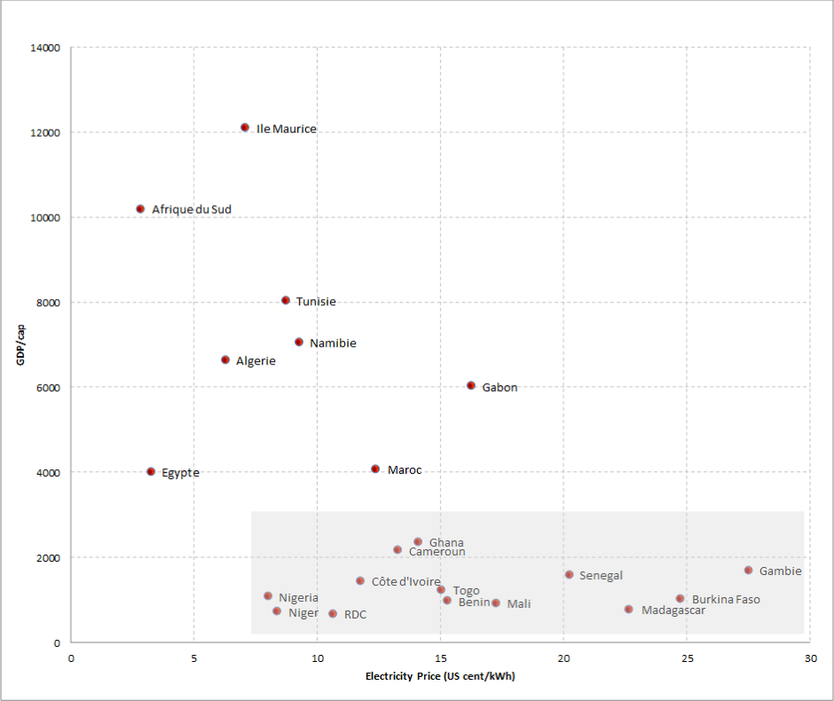
LOW GDP PER CAPITA / HIGH ELECTRICITY PRICE

Slide 7
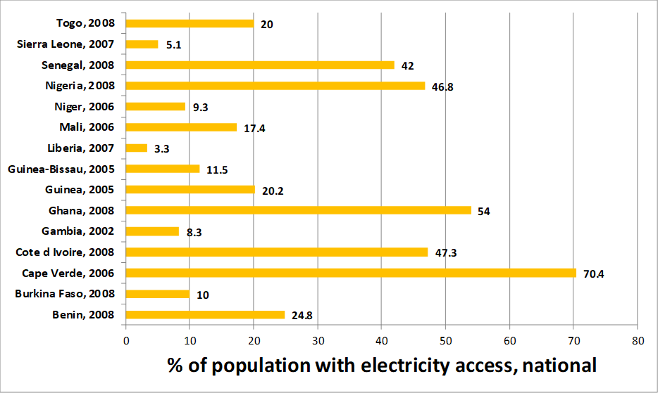
STATUS OF ENERGY SERVICES
ELECTRICITY ACCESS
UNDERDEVELOPPED ELECTRICITY SECTOR
Low electricity access;
High electricity supply cost;
Shortage of supply relative to demand; and
Difficult financial situation for most of the national utility operators.

Slide 8
ELECTRICITY PRICE

Slide 9
PROJECTED INCREASE GDP

Slide 10
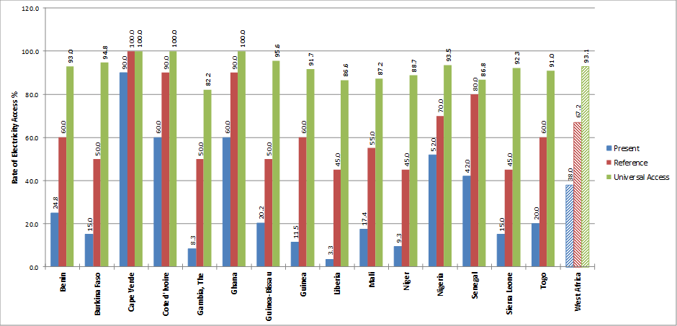
INCREASING ELECTRICITY ACCESS

Slide 11
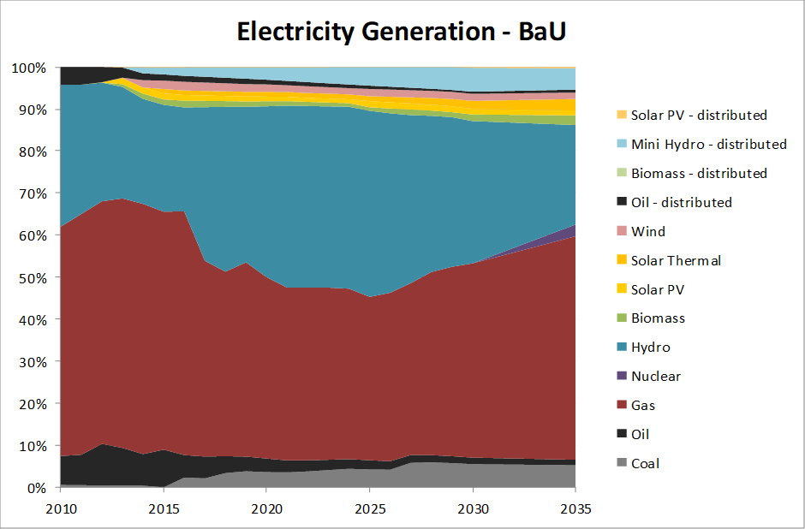




SCENARII ENERGY PLANNING
Installed capacity, MW, scenario Cooperation | 2010 | 2020 | 2030 | 2035
Coal | 38 | 382 | 1.284 | 1.999
Oil | 1.465 | 2.401 | 1.937 | 1.280
Gas | 4.978 | 19.897 | 27.115 | 32.028
Nuclear | 0 | 0 | 0 | 1.229
Hydro | 3430 | 10.979 | 20.682 | 22.150
Biomass | 0 | 268 | 806 | 1.889
Solar PV | 0 | 370 | 1.519 | 1.950
Solar Thermal | 0 | 503 | 1.431 | 2.116
Wind | 0 | 706 | 1.491 | 2.192
Oil Distributed | 4.323 | 3.505 | 3.124 | 4.761
Biomass Distributed | 0 | 0 | 0 | 0
Mini Hydro Distributed | 0 | 856 | 36.70 | 4.604
Solar PV Distributed | 0 | 0 | 53 | 194
Total Generation Capacity | 14.233 | 39.865 | 63.113 | 76.391
Peak Load Centralized System | 8.870 | 17.271 | 40.375 | 60.197
Interconnection Capacity | 3.838 | 14.444 | 17.873 | 21.629
Installed capacity, MW, scenario SE4ALL | 2010 | 2020 | 2030 | 2035
Coal | 38 | 447 | 1.737 | 4.823
Oil | 1.465 | 2.407 | 1.947 | 2.569
Gas | 4.978 | 20.507 | 30.780 | 37.373
Nuclear | 0 | 0 | 229 | 2.000
Hydro | 3.430 | 11.454 | 22.221 | 22.464
Biomass | 0 | 293 | 1.073 | 2.293
Solar PV | 0 | 584 | 2.666 | 5.115
Solar Thermal | 0 | 1.016 | 4.039 | 7.540
Wind | 0 | 799 | 2.103 | 3.472
Oil Distributed | 4.326 | 3.839 | 4.399 | 8.007
Biomass Distributed | 0 | 0 | 0 | 0
Mini Hydro Distributed | 0 | 944 | 4.130 | 5.041
Solar PV Distributed | 0 | 19 | 350 | 1.738
Total Generation Capacity | 14.237 | 42.309 | 75.674 | 102.437
Peak Load Centralized System | 8.869 | 19.096 | 48.314 | 78.129
Interconnection Capacity | 3.838 | 14.824 | 20.828 | 22.178

Slide 12
MAIN CONSIDERATIONS FOR SMRs
Introduction of the first SMR
Nuclear Energy Policy
Domestic Industry Participation
Proliferation resistance & physical protection
Public acceptance
Economic Competitive
ness
Safety
Radwaste Management
Viable financing scheme
Affordable
(Capital cost, generating cost)
Security of Supply
TECHNOLOGY

Slide 13
SMR’ PRODUCT REQUIREMENTS
KEY REQUIREMENTS IN SMR DESCRIPTIONS:
Lower upfront capital cost
    Capital cost confidence
Readily available supply chain
    Off-the-shelf components
    Fewer large components
Shorter construction schedule
    Factory constructed transportable modules
Simpler to operate and maintain
    Long cycles / short outages
Full accompaniment of the Supplier / Need of an Integrator
    FOAK / Short term operation and experience

Slide 14
OPPORTUNITIES FOR SMRs in WEST AFRICA
INTEGRATION INTO THE GRID
COST & FINANCE
BUT AN INTEGRATOR IS NECESSARY
YOU MUST OWN THE SAFETY CASE & LICENSING BASIS AND BE ABLE TO OPERATE & MAINTAIN UNITS WITH EXCELLENCE (QUANTIFIED)
ALWAYS NEED OF PLENTY OF TRAINING INCLUDING OJT AND OVERSEAS EMBEDS TOO

Slide 15
CONSTRAINTS & BARRIERS
Policy and Institutional Issues:
  Absence of political targets for renewable energy in general and solar/wind in particular, in many countries;
  Non-existent or weak nuclear policy measures for level playing field in many countries;
  Weak national agencies with unclear responsibility for nuclear in many countries.
Financial/Economics:
  High upfront costs of nuclear compared with smaller scale conventional systems even where competitive;
  Lack of large scale projects at regional level to take advantage of higher solar or wind resource endowments and economies of scale;
  Lack of innovative financing mechanisms.
Capacity Building & Technology Transfer
  Inadequate skilled technical manpower in many countries.
  Limited or no local manufacturing due to small national markets.
  Limited R&D with little or no linkages to entrepreneurial/ manufacturing sector.

Slide 16
ACCESS TO TECHNOLOGY : SELECTION
DO YOU WANT FIRST-OF-A-KIND
01
DO YOU WANT Nth OF A KIND
02
DO YOU WANT MAINSTREAM
03
GO TALK TO OTHER CUSTOMERS TOO
04
ENGAGE YOUR KNOWN PARTNERS
05
DO YOU WANT FIRST-OF-A-KIND
01
DO YOU WANT Nth OF A KIND
02
DO YOU WANT MAINSTREAM
03
GO TALK TO OTHER CUSTOMERS TOO
04
ENGAGE YOUR KNOWN PARTNERS
05

Slide 17
IMPORTANTS COMMON REQUIREMENTS
POLICY SPECIFIC
TECHNOLOGY SPECIFIC
DESIGN SPECIFIC
STAKEHOLDER INVOLVMENT

Slide 18
IMPORTANCE OF COMMON REQUIREMENTS
REQUIREMENTS & GENERAL DESIRES
RISKS MINIMIZATION
ACCESS TO TECHNOLOGY
IMPROVEMENT OF NATIONAL CAPABILITIES
STAKEHOLDER INVOLVMENT

Slide 19
 | REQUIREMENTS AND CHALLENGES
Technological Issues | Competent Staff and OJT availability Licensability (delays due to design innovation & FOAK) Non-LWR technologies (worsen the challenges) Impact of innovative design Fuel cycle to proliferation resistance Operability Spent fuel management and waste handling policies Transport and Safety
Non-Technological Issues | Economic competitiveness (impact of economies of scale) Regulation for fuel or NPP leasing First of a kind cost estimates / O&M additional needs Availability of design for newcomers in a short term Infrastructure requirements Post Fukushima action items on Institutional Issues and Public Acceptance Siting

Slide 20


FINANCING CONSIDERATIONS
World & Regional Development Banks (WB, African Development Bank, Infrastructure Development Bank, etc. ) are not financing new NPPs
New (Private) structures needed
Capital payback cost sensitive to interest rates that is very HIGH
Interest rates reflect credit/sovereign rating / Currency issue
Most West African Countries are BB+ or less
The Banking System is still very weak

Slide 21
INFRASTRUCTURE AND SERVICES IN WEST-AFRICA
Some Infrastructure and Service needs:
Emergency planning
Quality assurance
Regulatory reporting
Plant security
Health physics
Plant staffing
Supervisors / Senior Operators / Operators / Technicians
Engineering / Procurement / Administrative Support
Radwaste processing and disposal
Additional Infrastructures and services needed to be developed

Slide 22
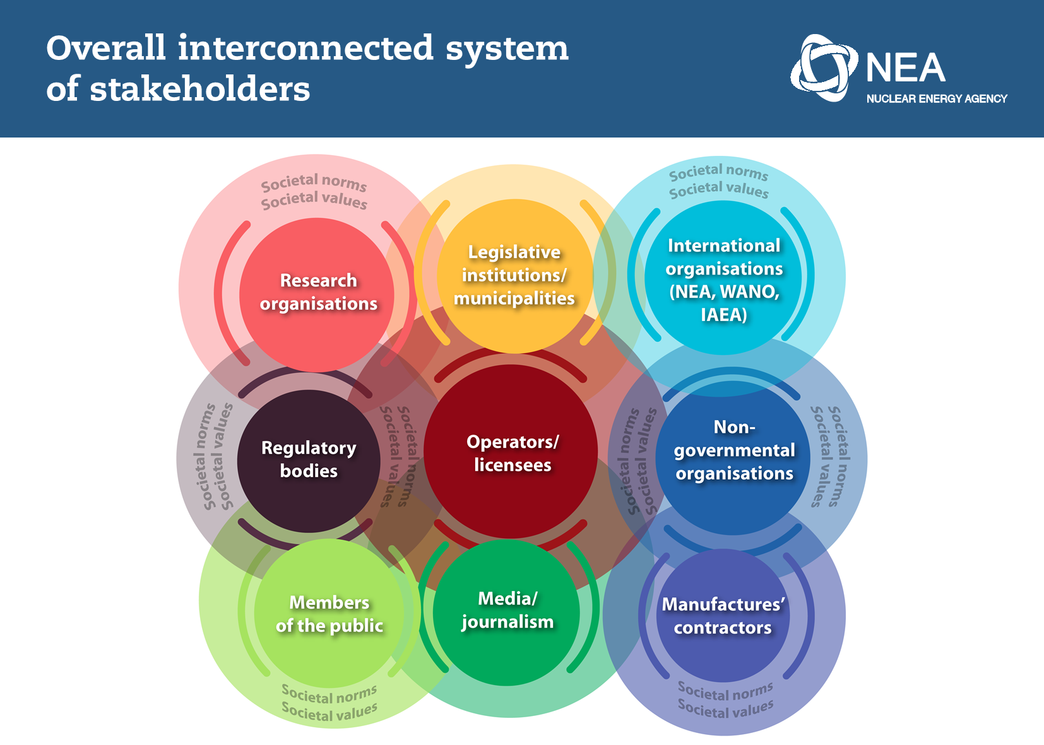
LACK COMPETENT STAKEHOLDERS OF NUCLEAR POWER PROGRAMME
Engineering organizations
Manufacturing enterprises
Civil construction companies
Technical support organizations
Operation and maintenance companies
General services utilities/companies

Slide 23


International Presence l Experience with ENERGY & NUCLEAR
Tailored Solutions for Complex Projects
THANK YOU
23
Vincent NKONG-NJOCK CEO of iLEMEL Energy,
V.Nkong-Njock@ilemel.com

