Slide 2
Considerations on the Accelerated Deployment of SMRs
Ms Milana OZERINA

Slide 3
Contents
Introduction
Deployment timeline for SMRs
Early engagement with key stakeholders
Role of the IAEA
New collaboration model for embarking countries
Conclusion

Slide 4
Introduction
As countries strive for cleaner and more resilient energy systems, SMRs have emerged as a transformative force in the nuclear energy landscape, offering potential solutions for various energy challenges.
The accelerated deployment of SMRs requires collaborative efforts between governments, vendors, operators, and regulatory bodies to ensure smooth and efficient implementation.
As global interest in SMRs grows, the IAEA revised its guidance Milestones Approach in 2023, incorporating specific considerations for SMR deployment. This ensures that the infrastructure development process is aligned with the needs of SMR technologies.
Given the potential for SMRs to be deployed faster than large NPPs, there is a need to review a deployment timeline.
SMRs offer economic advantages by being more cost-effective in certain scenarios. To maximize their potential, regulatory streamlining is necessary to fast-track their deployment.

Slide 5
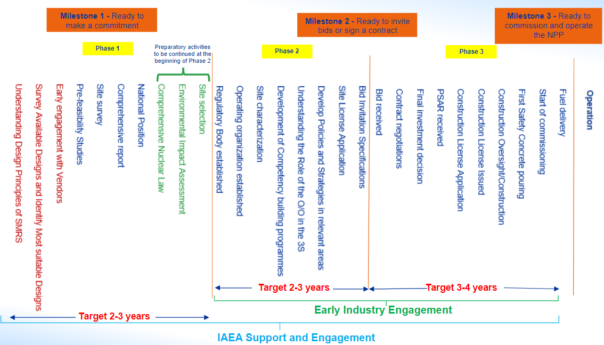
Deployment timeline for SMRs 1/3

Slide 6
Deployment timeline for SMRs 2/3
More preparatory activities in Phase 1 which will require more efforts and financial recourses but should not increase the targeted time.
Site selection, environmental impact assessment and comprehensive nuclear law preparations should be started late in Phase 1 and continued in the beginning of Phase 2. This proactive approach aims to streamline the regulatory and licensing processes in Phase 2.

Slide 7
Deployment timeline for SMRs 3/3
Early establishment of working groups within the NEPIO which will later be transformed into Operating Organization and Regulatory Body is highly desirable to fit within the targeted timeline.
Shortening Phase 2 can lead to a reduction in pre-construction costs, including regulatory, legal, and engineering expenses.
Moreover, potential risks and uncertainties associated with market conditions, regulatory environments, and technological advancements can be mitigated.

Slide 8
Early engagement with key stakeholders
Governments
Vendors
Owners/Operators
Regulatory Bodies
Early government investment ensures smoother SMR project completion.
+
Creates jobs
Supports local industries and economic growth
Drives innovation and local expertise
Strengthens global leadership in nuclear technology
Address energy needs faster and reduce financial risks
Enhances energy security and price stability
Early engagement helps vendors expand market presence and secure long-term contracts => Strong market presence leads to more orders, creating a self-sustaining growth cycle.
Close collaboration with NEPIO helps vendors align with legal and regulatory requirements.
Vendors can establish training centers to promote SMR technology and provide technical expertise.
Establishing communication with vendors ensures smoother project execution.
Early information gathering enhances bidding negotiations.
Early involvement accelerates the licensing process for site applications.
Regulatory streamlining is key to shortening deployment timelines.
Regulatory frameworks should be tailored to each country's specific needs.
Embarking countries must establish a robust regulatory framework in Phases 1 and 2.

Slide 9
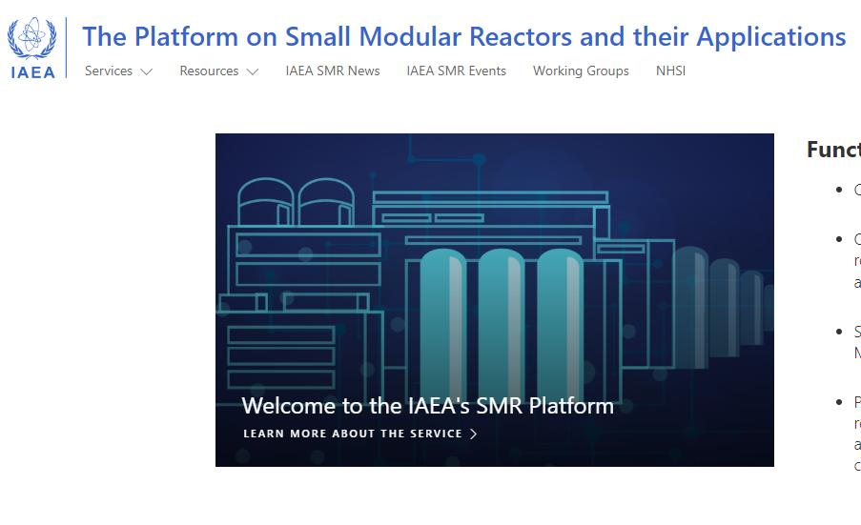
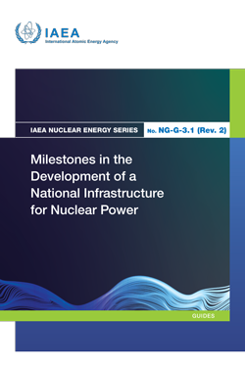
Role of the IAEA
The IAEA serves as a pivotal hub for fostering global collaboration in nuclear energy, providing guidance and trainings for the Member States.
The IAEA SMR Platform can spearhead collaborative initiatives among countries facing similar SMR deployment needs. By fostering resource-sharing and enabling a collective approach to regulatory challenges, the platform becomes a nexus for countries to leverage shared experiences and expertise.
The IAEA can establish a robust monitoring and evaluation mechanism to assess the progress of SMR deployment worldwide. Regular assessments will not only help identify challenges but also track improvements, allowing for adaptive strategies to be implemented swiftly.
The IAEA can establish an online learning platform offering courses related to SMRs.

Slide 10



New collaboration model for embarking countries
IAEA
With shared SMR infrastructure, countries can better withstand disruptions in energy supply and mitigate the impacts of geopolitical tensions or natural disasters.
Countries can pool their resources and expertise, leveraging each other's strengths in design, engineering, and operation.
Jointly investing in SMR projects allows countries to share the financial burden associated with nuclear technology development and deployment.
Vendor
Country A
Country C
Country B
Country D
Figure 2. New cooperation model for embarking countries
Steps:
Sign the joint MoU between country A and country B.
Establish a joint task force or working group.
Work towards aligning regulatory frameworks between the two countries.
Collaborate on a joint technology assessment.
Facilitate joint discussions with potential vendors.
Collaborate on capacity-building initiatives.
Explore opportunities for resource sharing, such as joint funding mechanisms.
Establish a dispute resolution mechanism within the collaboration framework.

Slide 11
Conclusion
Accelerated SMR deployment requires collaboration among regulatory bodies, governments, and industry stakeholders.
Phase 1 activities and shorter Phase 2 offer economic incentives for vendors and operators.
The main incentives for the early involvement of the Government are job creation and attraction of investment.
IAEA plays a key role in harmonizing global efforts, knowledge sharing, and monitoring SMR progress.
A new collaboration model and updated timelines highlight the importance of synchronized global efforts.

Slide 12
Thank you!

