Slide 1
FEASIBILITY STUDY FOR DEPLOYMENT OF FUTURE SMRs IN SLOVAKIA
Stanislav Pecko, PhD.
Mr. Joshua Best
Sr. Manager for SMR Development Project
Manager – Nuclear Power Group

Slide 2
Project Overview
Motivation
Need
Opportunity
IAEA Feasibility Study
  Phase 1: Screening
  Phase 2: Assessment
Lessons Learned
Conclusions

Slide 3
Motivation
Decarbonisation Necessity
EU binding target for Climate neutrality by 2050
Decarbonisation priorities for Slovakia:
Eliminate all domestic lignite and coal power generation
(Vojany & Nováky) - DONE
Industry decarbonisation:
  Largest GHG emissions in Slovakia
  Most from steel production
  USSK the largest industrial emitter – decarbonisation plan via electrification of blast furnaces
Heating decarbonisation
  Most of heating is from fossil sources (gas, coal)
  Decarbonisation via electrification (heat pumps)
Mobility decarbonisation
  Support for EVs, etc.
Structure of electricity production in 2023
(Slovakia, total production 29 961 GWh)
This document contains confidential or proprietary information. It shall not be reproduced, discussed, reviewed, or released, in whole or in part, to any party other than the intended recipient(s) and their agents with a need to know such information unless Sargent & Lundy, L.L.C. has provided written permission otherwise. ©Sargent & Lundy, L.L.C. 2024

Slide 4
Motivation
SMRs are fully inline with Slovak grid needs
5 challenges
3 consequences
1 solution
1. Expected electricity production shortage
2. Insufficient increase in non-fossil production
3. Significant increase in electricity demand
2,6 TWh yearly generation gap in SK grid in 2030
17 TWh in 2050
SMRs
SK grid needs stable sources
4. Increasing share of intermittent renewables
TWh
SK grid needs small-medium stable sources without additional requirements for new back-up energy sources
5. New large sources larger than 500 MW will challenge single outage
contingency (N-1)
Yearly electricity consumption in Slovakia Yearly electricity production in Slovakia
Potential yearly SMR production in Slovakia
This document contains confidential or proprietary information. It shall not be reproduced, discussed, reviewed, or released, in whole or in part, to any party other than the intended recipient(s) and their agents with a need to know such information unless Sargent & Lundy, L.L.C. has provided written permission otherwise. ©Sargent & Lundy, L.L.C. 2024

Slide 5
Need
Study to evaluate:
1
2
3
4
5
SMR technology assessment
Project economy
Project management
Site assessment
Licensing
Assessment of the suitability of selected locations for the placement of nuclear installation and quantitative assessment of this suitability (ranking reflecting the suitability for deployment of SMR).
Selected SMR technologies and suppliers will be assessed based on current information in terms of technological maturity, safety, licensing status and readiness for deployment.
Created an overview of local legislation and regulatory needs for the deployment of SMR in Slovakia, taking into account the specifics of SMR.
Obtained information from suppliers and expert insight on cost estimation, expected performance, construction duration, supply chain, fuel cycle costs, operation and maintenance, decommissioning, human capital, etc.
Overview of possible mechanisms for the project financing, procurement and deployment schedule of SMR in Slovakia.
Analysis of project management options, list of main risks and proposal of strategies for their mitigation.
This document contains confidential or proprietary information. It shall not be reproduced, discussed, reviewed, or released, in whole or in part, to any party other than the intended recipient(s) and their agents with a need to know such information unless Sargent & Lundy, L.L.C. has provided written permission otherwise. ©Sargent & Lundy, L.L.C. 2024
Notes:
See answer to question 11. in the application for details.

Slide 6
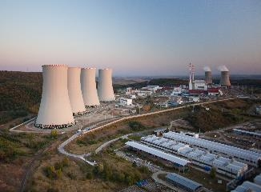
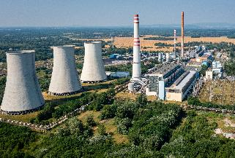
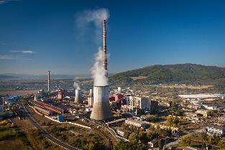




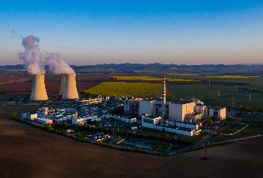
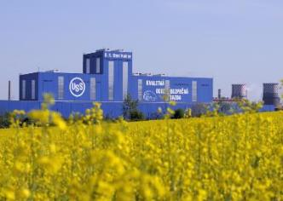
Proposed Sites
Mochovce
Nuclear Power Plant
Vojany
Black Coal Power Plant
Nováky
Lignite Coal Power Plant
Jaslovské Bohunice
Nuclear Power Plant
U.S. Steel Košice
Largest Steel Production Plant
Notes:
Potential locations for SMR placement:
Power plant Novaky (ENO)
Location: Slovak Republic, Trenčín Region / Prievidza District / Nováky
Locality owner: Slovenské elektrárne, a.s.
Current fuel: lignite
Installed electrical output: 266 MW
ENO is located in the central part of Slovakia. The site is connected to railway and road infrastructure, electricity distribution (110, 22 and 6 kV). Existing infrastructure - industrial and drinking water, sewage network, compressed air and IT networks, possibility of connection to a high-pressure gas pipeline near the site. Total area of power the plant is 280ha (80 ha main area, 200 ha of sludge pots). There is no direct 400kV connection in ENO (nearest is ca 5 km away).
The first electricity from ENO was supplied to the grid in 1953. Developments in the sector and the change in environmental requirements for electricity generation caused that the decision was taken to close the plant by the end of 2023.
ENO have been operating in the General economic interest since 2005 (surcharge for electricity produced from domestic lignite). This has negative impact on consumer prices in the form of system operating tariff. Besides electricity production, ENO supplies heat to the region (municipalities of Prievidza, Novaky, Zemianske Kostoľany) and it is a key source for ensuring security of supply in the locality in terms of electricity grid. New transformer station Bystričany was built.
In terms of emission factor, ENOs are one of the most polluting and least efficient power plants in the region in terms of CO2t/MWh.
Emissions factor CO2
for electricity supplied
2021 - 1,548
2022 - 1,577
tCO2/MWh net
Power plant Vojany (EVO)
Location: Slovak Republic / Košice region / Michalovce District / Vojany
Locality owner: Slovenské elektrárne, a.s.
Fuel: black coal, biomass, solid recovered fuel
Installed electrical output: 220 MW
EVO is located in eastern part of Slovakia. The first electricity from EVO was supplied to the grid in 1966. Currently, in addition to the continued production of electricity and heat, SE are preparing the transformation of the site. Solid secondary fuel and biomass is a potential replacement of coal. In the vicinity of the area there is a sludge bed and stabilizer landfill on which SE intends to build a PV power plants. The total area of the power plant is approximately 258 ha, of which the power plant itself is 115 ha and sludge and stabilizer pods 143 ha. The site is connected to railway (both wide and normal gauge) and road infrastructure, electricity distribution (400, 220, 110, 22 and 6 kV). There is existing infrastructure - industrial and drinking water, sewage network, compressed air and IT network, high-pressure gas pipeline.
Table 3: Emission factor EVO
Emissions factor CO2
for electricity supplied
2021 - 0,800
2022 - 1,012
tCO2/MWh net
Power plant Bohunice (EBO)
Location: Slovak Republic / Trnava region / Trnava District / Jaslovské Bohunice
Locality owner: Slovenské elektrárne, a.s.
Fuel: nuclear
Number of reactor units: 2 PWR (Pressurized Water Reactor)
Reactor type: VVER 440/V 213
Installed electrical output: 2 x 505 MW
Coolant: demineralized water
Bohunice V2 Nuclear Power Plant is located in Western Slovakia near Trnava. Electricity is generated in two units with VVER 440/V-213 pressurised water reactors, which were commissioned in 1984 and 1985 respectively. The V2 power plant changed to combined generation of electricity and heat after building up the centralised heat supply system from Bohunice NPP to Trnava in 1987. Detour from the Trnava heat supply line also heats Leopoldov, Hlohovec and Jaslovské Bohunice. Since 2000 a modernisation programme amounting to 500 mil. eur was implemented at V2 units, and was completed in 2010 by power increase up to 505 MWe (gross) per unit. Assumed operational lifespan of the EBO is at least 60 years.
Available traffic connections: road, rail.
Power plant Mochovce (EMO)
Location: Slovak Republic / Nitra region / Levice District / Mochovce
Locality owner: Slovenské elektrárne, a.s.
Fuel: nuclear
Number of reactor units: 2 PWR (Pressurized Water Reactor)
Reactor type: VVER 440/V 213
Installed electrical output: 2 x 505 MW
Coolant: demineralized water
In the south of Slovakia, between Nitra and Levice, there are four units of the Mochovce Nuclear Power Plant with pressurised water reactors of the VVER 440/V-213 type. The first unit of the power plant has been supplying electricity to the grid since the summer of 1998, the second unit since the end of 1999. The gross capacity of each unit was increased from 440 to 470 MW in 2008. In 2020 and 2021, the electrical capacity of the second and subsequently the first unit was increased by replacing and modifying secondary circuit components to 500 MW. The first and second units of Mochovce NPP supply more than 7 million MWh of electricity to the grid annually, which covers more than a quarter of electricity consumption in Slovakia. This avoids CO2 emissions of more than 7 million tonnes each year compared to a coal-fired power plant. Currently, in Mochovce Unit 3 is under commissioning process and Unit 4 is under construction with expected completion in 2025. Each of the unit represents additional 475 MW, and their operation will result in significant increase of nuclear share in energy mix. Assumed operational lifespan of the Units 3 and 4 is at least 60 years.
Available traffic connections: road, rail.
U.S. Steel Košice
Location: Slovak Republic / Košice region / Košice District / Košice
Locality owner: U.S. Steel Košice, s.r.o.
Fuel: metallurgical gases, natural gas, coal
Steam output: 286 t/h (each)
Heat output: 208 MW (each)
U. S. Steel Košice (USSK) is an integrated flat steel producer situated 15km south of the city of Košice. USSK currently operates a power plant combusting own metallurgical gases, natural gas and steam coal. The main product of the power plant is steam and electricity is a by-product. Annual consumption of steam coal amounts to ~400kt.
USSK currently purchases up to 1TWh of electricity from the grid which may increase almost threefold after intended decarbonization of the plant (final decision pending). USSK can, hence, poise as the key customer in the project. In addition, USSK can provide land for the project inside or near the existing facility, and utilities required for the SMR (e.g. electricity or water).
Currently, main sources of CO2 in USSK’s processes are:
Coke production (coal, blast furnace gas, coke oven gas)
Sinter production (coal)
Blast furnaces (coke, pulverized coal, blast furnace gas, coke oven gas, natural gas)
Hot strip mill (natural gas, blast furnace gas, coke oven gas)
Annealing in strip processing (natural gas, blast furnace gas, coke oven gas)
Power plant (currently):
3 gas fired boilers (natural gas, blast furnace gas, coke oven gas, convertor gas)
2 coal fired boilers (steam coal)
Available traffic connections: road, rail.

Slide 7

Opportunity
FIRST is designed specifically to support countries considering SMRs or other advanced reactors to meet their clean energy needs with secure and safe nuclear power.
establish a nuclear power program under the highest international standards for nuclear security, safety, and nonproliferation,
take advantage of next generation nuclear innovations and technologies in their sustainable energy plans,
meet their clean, reliable energy goals while protecting the global climate we all share; and
deepen relationships through government, industry, national laboratory, and university engagements.
This document contains confidential or proprietary information. It shall not be reproduced, discussed, reviewed, or released, in whole or in part, to any party other than the intended recipient(s) and their agents with a need to know such information unless Sargent & Lundy, L.L.C. has provided written permission otherwise. ©Sargent & Lundy, L.L.C. 2024

Slide 8
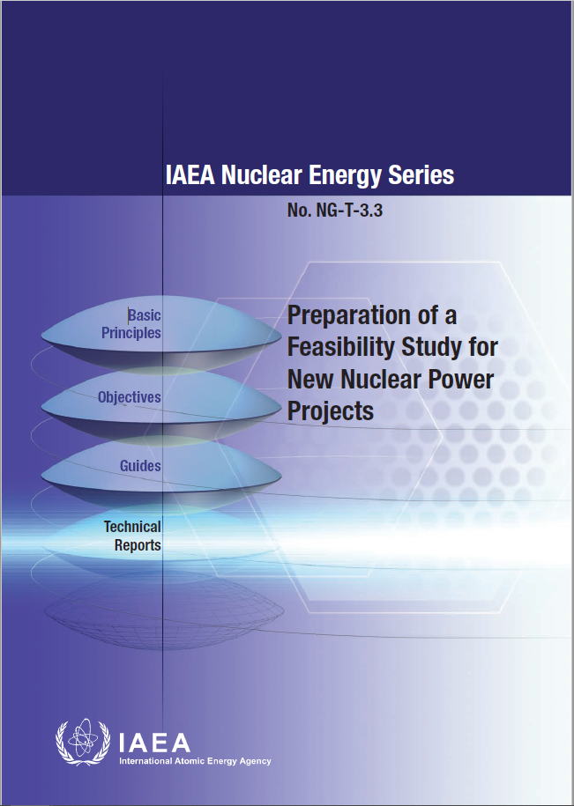
IAEA Feasibility Study
IAEA NG-T-3.3 – Preparation of a Feasibility Study for New Nuclear Power Projects
  Electrical system analysis
  Unit capacity and system integration
  Site and supporting facilities
  NPP technology and fuel cycles
  Environmental impact of the project
  Licensing and authorization
  Project implementation approach
  National participation
  Organization, human resources and training
  Economic analysis
  Funding and financing
  Stakeholder communication for transparency
  Emergency preparedness and response within the site
  Cogeneration
  Decommissioning
  Guidance for the bid invitation specification

Slide 9

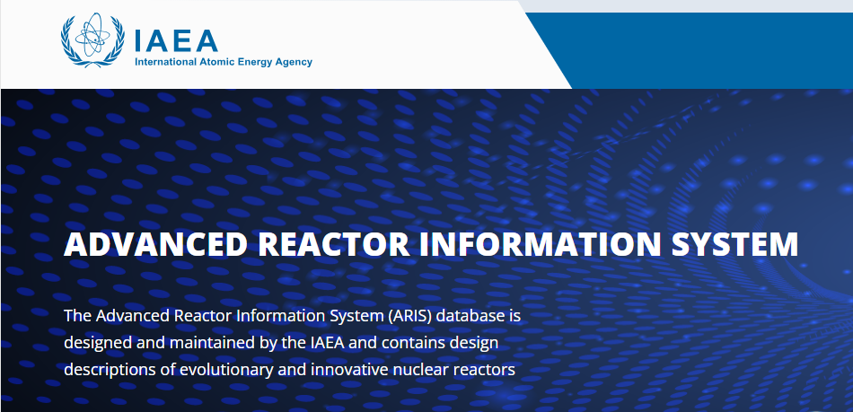
Phase 1: Screening
Sites
Technologies
SMR Screening Criteria
The technology is currently licensed in a country, is under review for a license in a country, or will be licensed for siting, construction, or operation in a country by 2028.
The technology has load-following capabilities and is suitable to perform in grids with high percentages of variable renewable energy sources.
The technology is capable of cogeneration of hydrogen, process steam, or district heat.
A standard configuration of the technology can generate a minimum of 100 MW(e) electricity.
The technology provider is interested in participating in this study.
Fatal Flaws Evaluation or “Red Flag” Study
Preliminary, high-level evaluation of site suitability
Applied to one or more specific sites
Goals:
  Eliminate clearly unsuitable sites
  Identify/determine scope of key studies and evaluations for potentially feasible sites

Slide 10
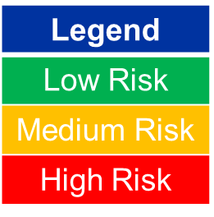
Phase 1: Screening
Technology to Site Matching
SAMPLE

Slide 11
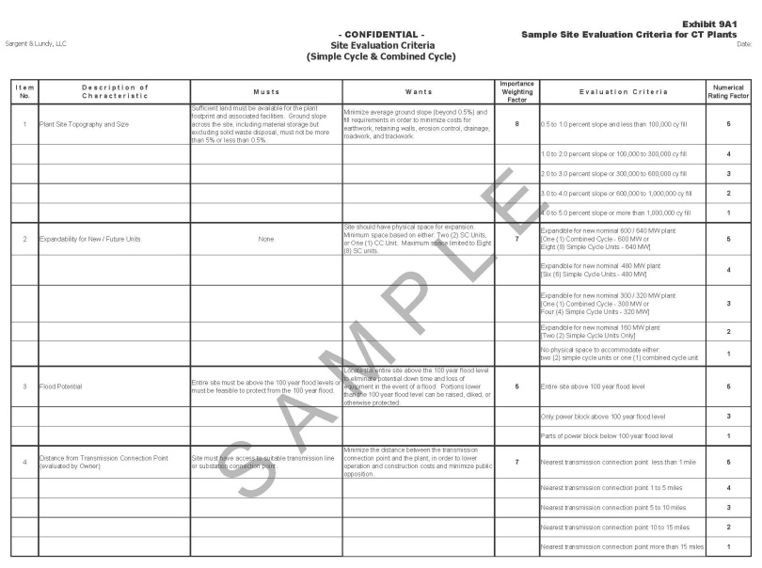
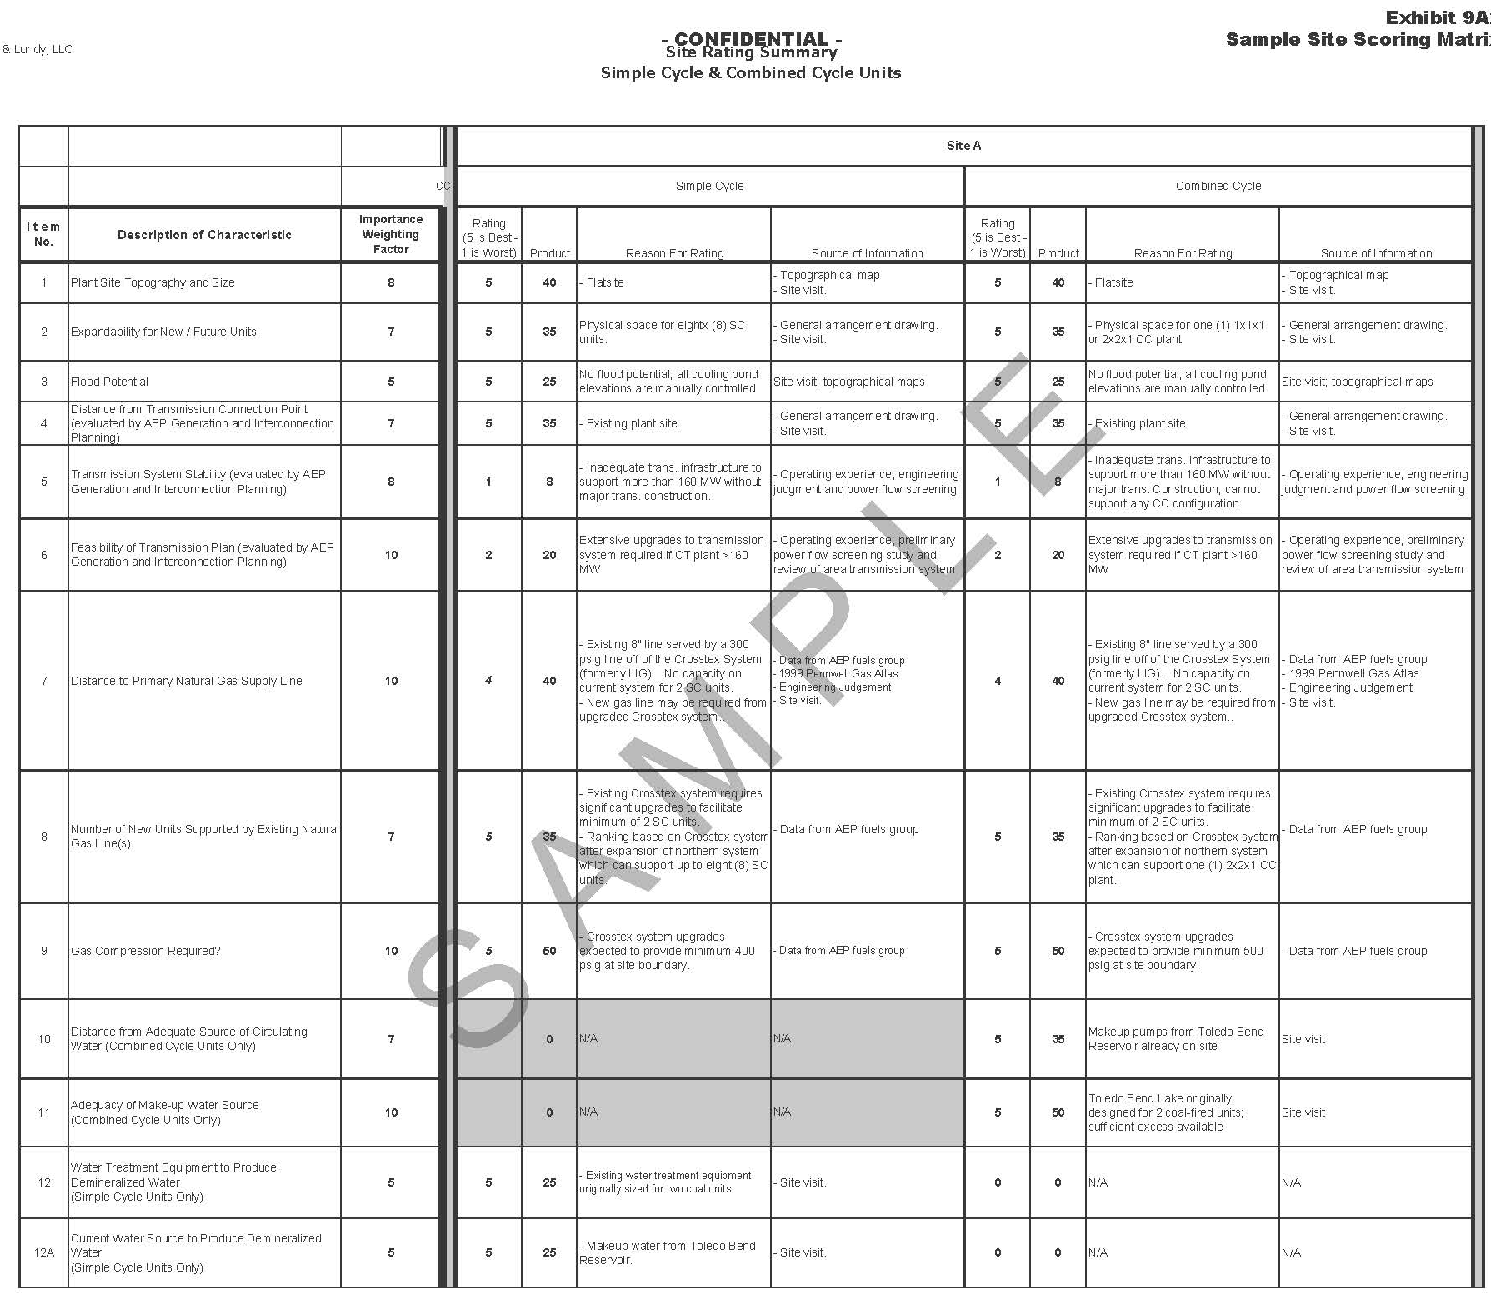
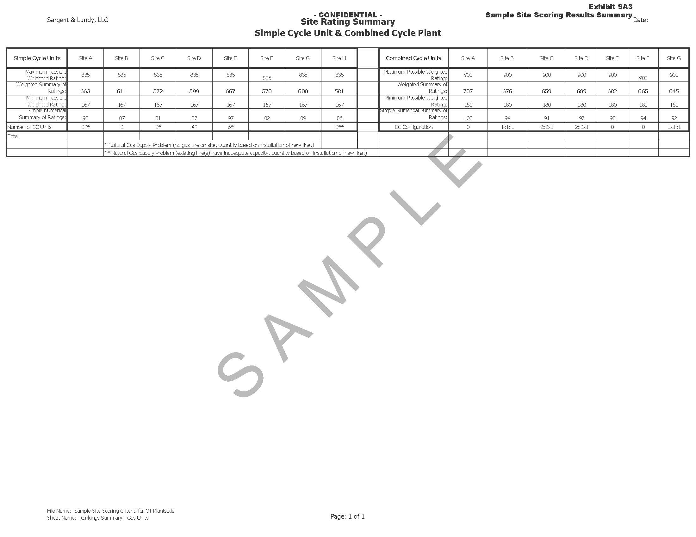
Phase 2: Assessment
Sites
Work closely with Slovak stakeholders to define parameters for site evaluation criteria
Characteristics / features to be evaluated
“Must” have requirements; critical parameters
“Wants” desired features/parameters, but not critical
Importance / Weight factor (1-10)
Develop Evaluation Criteria (1-5)
Perform site evaluations and scoring
Align results w/ S.E. and other Slovak stakeholders
Category | No. of Criteria | Raw Score |  | Maximum Score
A. Fuel, Transmission, and Transportation - Engineering | 6 | 40 |  | 200
B. Site Development - Engineering | 6 | 25 |  | 125
C. Water Supply - Engineering | 4 | 25 |  | 125
D. Performance Impacts | 1 | 10 | 100 | 50 | 500
E. Air Quality - Environmental | 4 | 30 |  | 150
F. Water Quality - Environmental | 4 | 30 |  | 150
G. Ecology - Environmental | 6 | 40 | 100 | 200 | 500
H. General Land Use | 6 | 40 |  | 200
G. Social Issues and Project Acceptance | 8 | 60 | 100 | 300 | 500
 | 45 |  | 300 |  | 1500
SAMPLE

Slide 12
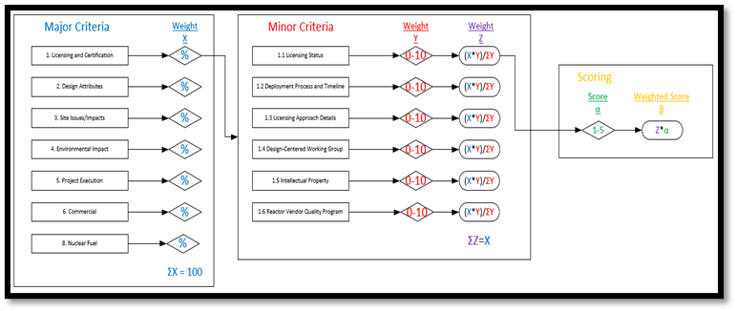
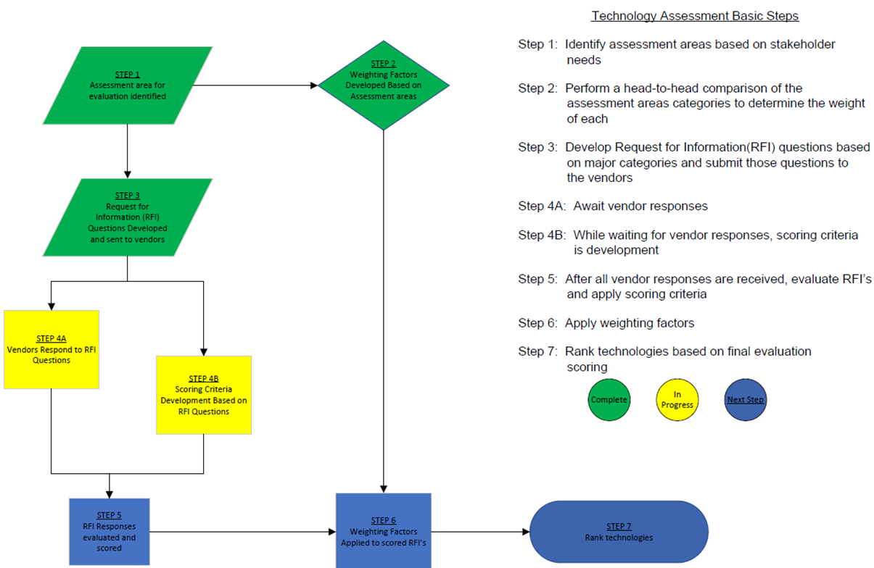
Phase 2: Assessment
Technologies

Slide 13
Lessons Learned
Start data gathering early
Site owner interviews and in-person site visits
Schedule adequate time for establishing non-disclosure agreements
Continuous stakeholder engagement – R.A.C.I. methodology

Slide 14


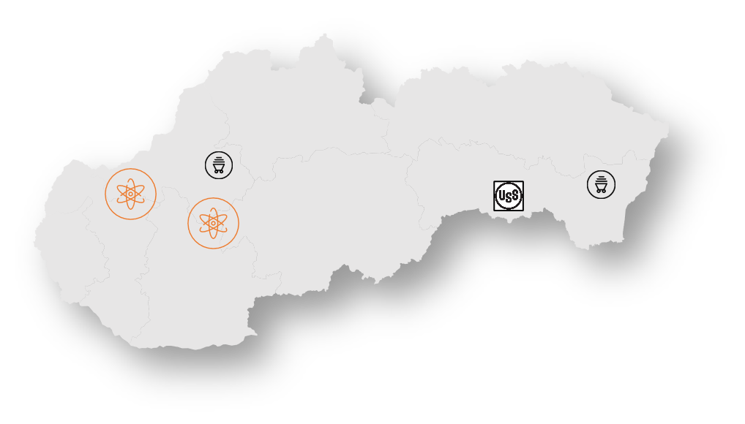
Conclusions
Guides + Expertise + Tools + Focus

Slide 15
THANK YOU
For more information, please contact:
Stanislava Pecko, PhD.
Slovenské Elektrárne
stanislav.pecko@seas.sk
+421 0910 674 678
Joshua Best, PE, PMP
Sargent & Lundy L.L.C.
joshua.h.best@sargentlundy.com
+1 312-269-3153

