Slide 2
NUCLEAR-RENEWABLE HYBRID ENERGY SYSTEMS: CONSIDERATIONS FOR FUTURE DEPLOYMENT IN GHANA
E. K. Boafo¹, E. Shitsi¹, H. A. Gabbar²
¹GAEC, GHANA
²UOIT, CANADA
IAEA-CN-327-044

Slide 3
Introduction
Climate change has impacted the infrastructure and economy of Ghana significantly (rising sea levels, increased storm surges, extreme rainfall, flooding, and drought).
NHES can address the need for grid flexibility, GHG emission reductions, and the optimal use of investments.
Before deploying NHES, several factors must be considered to make informed choices (techno-economic analysis, regulatory aspects, stakeholder engagement, policy, and governmental considerations)
Techno-economic analysis was performed using the Holistic Energy Resource Optimization Network (HERON) for capacity and dispatch optimization of NHES
2

Slide 4
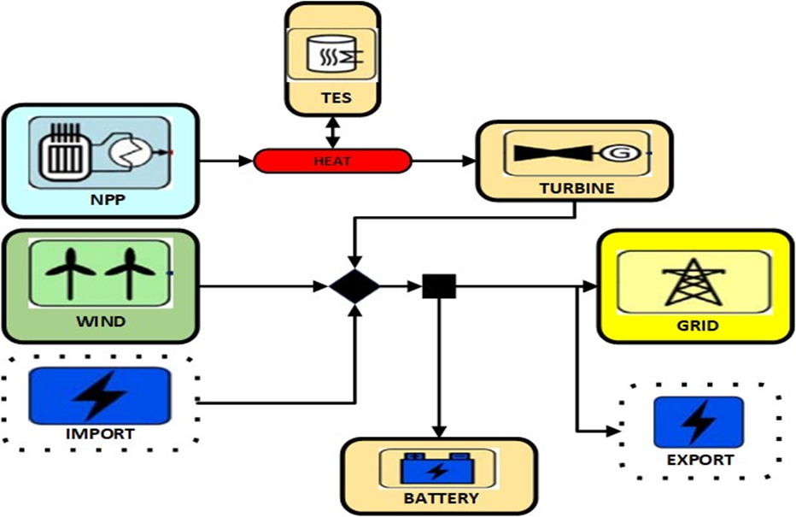
NHES Configuration
The configuration comprises an NPP, a wind farm, a turbine generator, batteries, and a thermal energy storage unit.
3

Slide 5
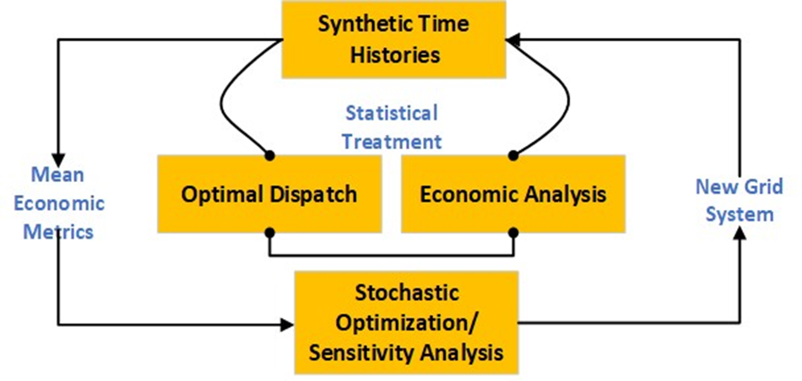
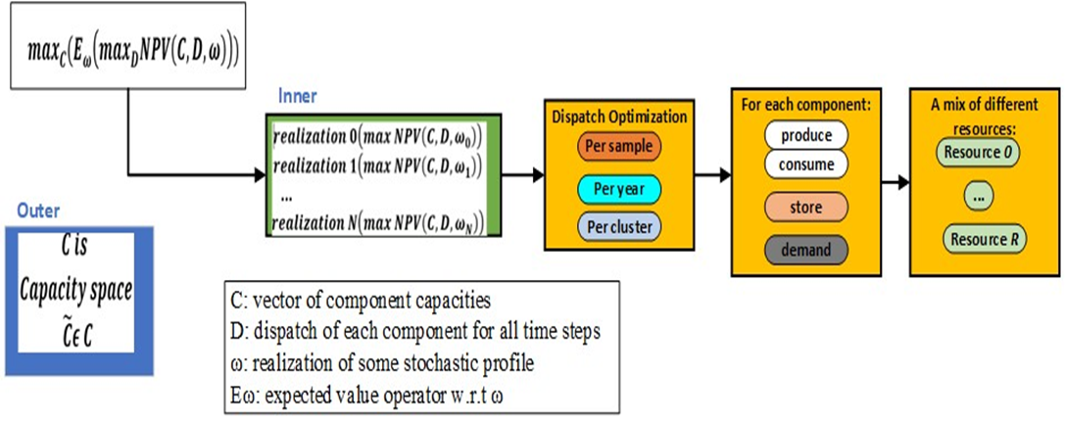
HERON Workflow
The objective is to minimize cost and maximize profits (NPV)
Two-layer optimization:
Outer Layer: component capacity, market sizes, and tuning variables in RAVEN
Inner Layer: optimizing dispatch of resources using BO
4

Slide 6
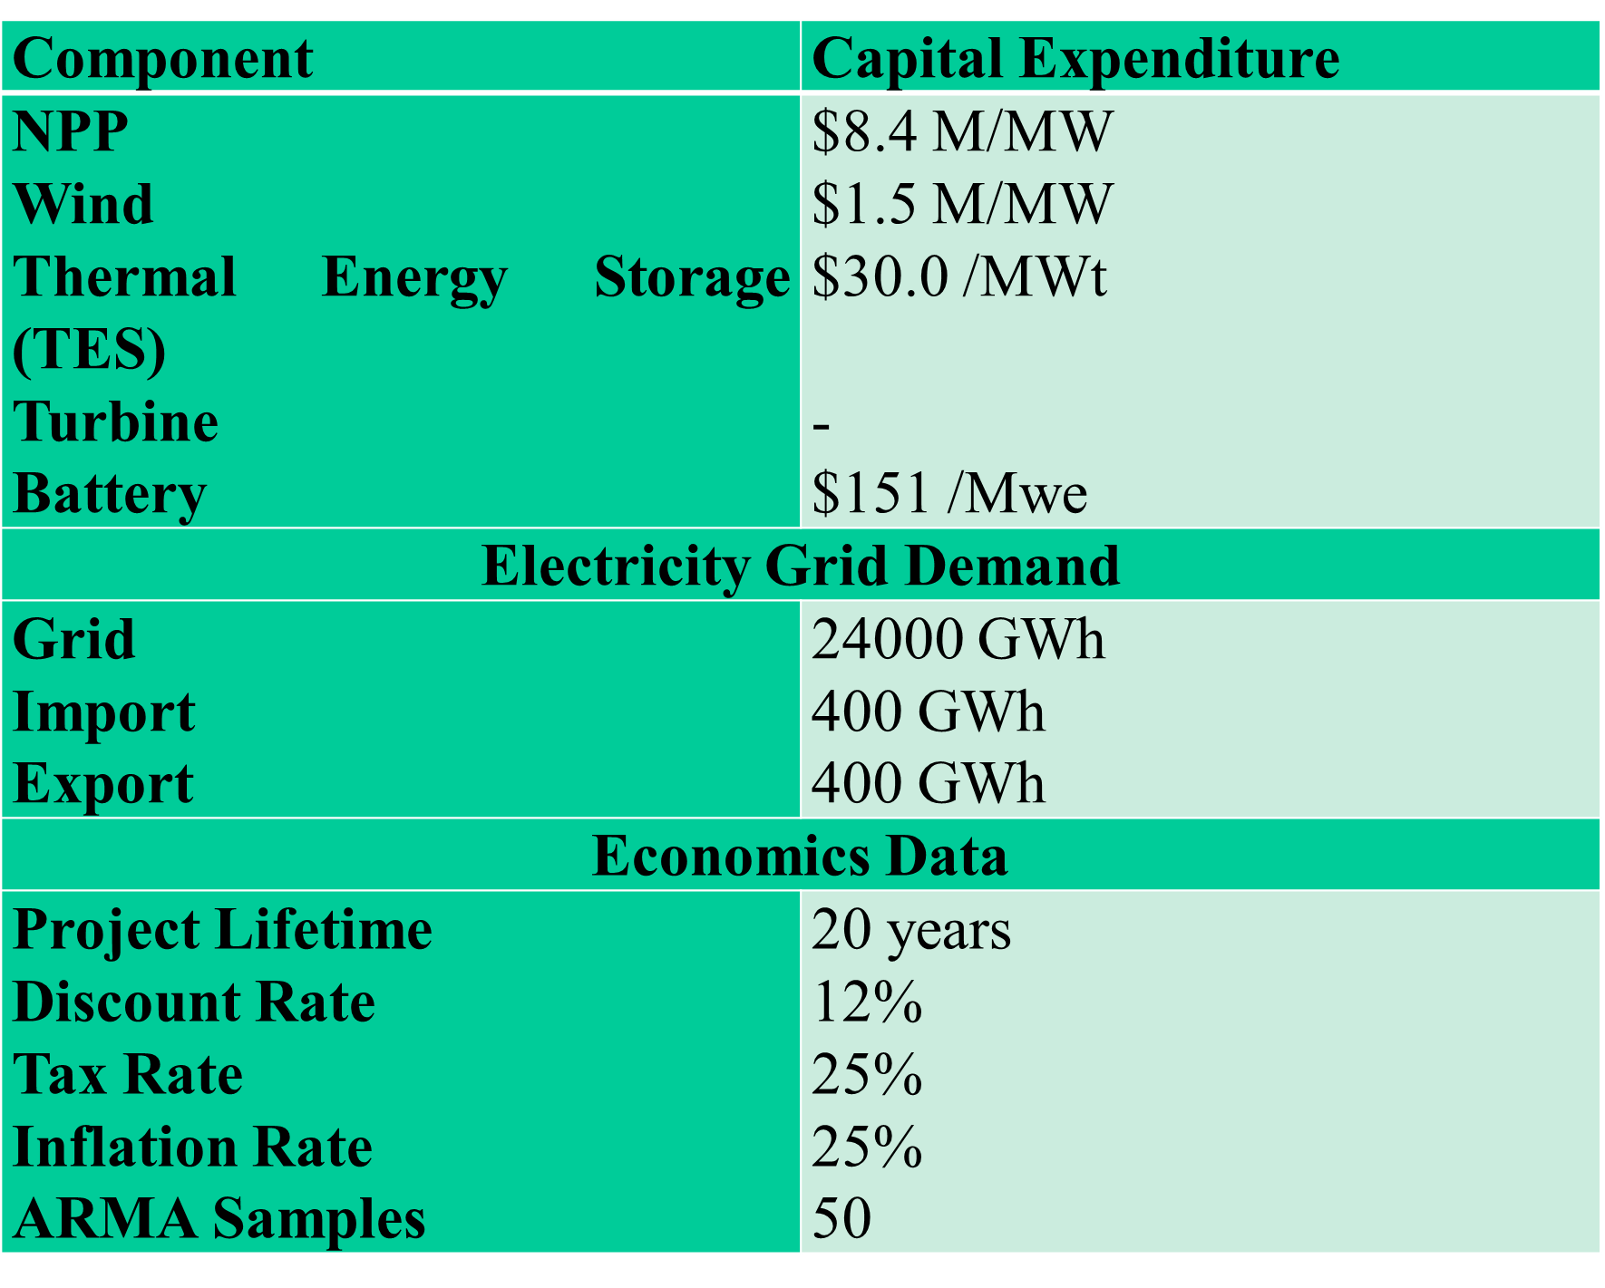
Configuration and Scenario Data
5

Slide 7
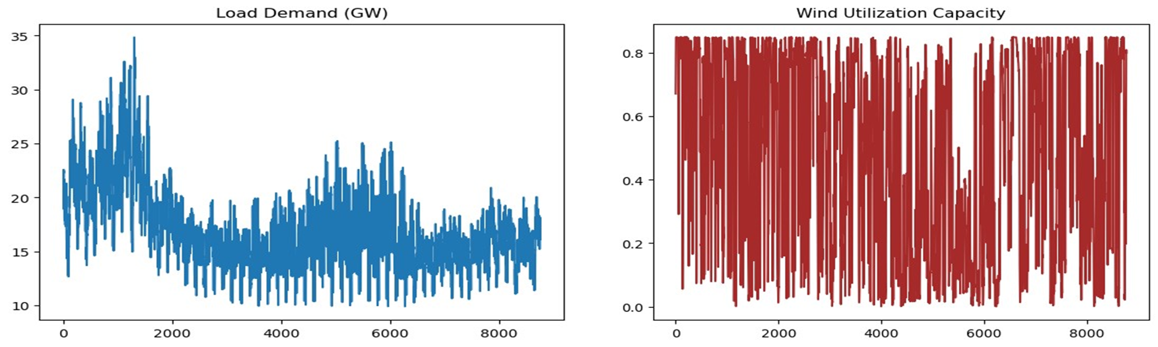
Model Simulation
Load demand profiles and wind utilization capacities throughout the year.
Synthetic time histories were used based on the ARMA algorithm in RAVEN.
The ARMA model was trained and the synthetic histories were generated using data from the New York ISO [5].
6

Slide 8
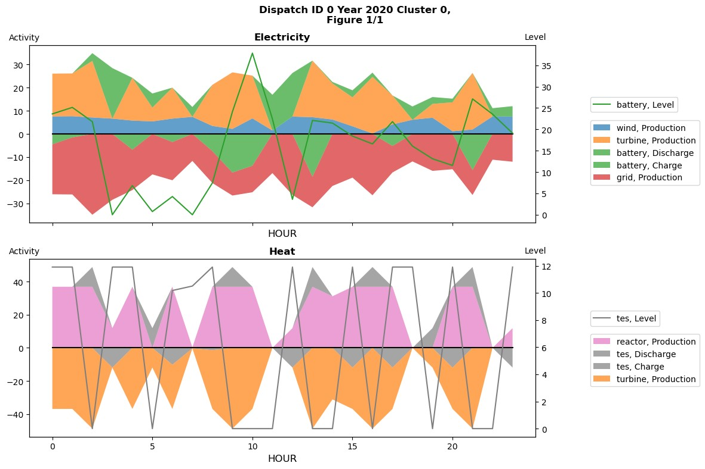
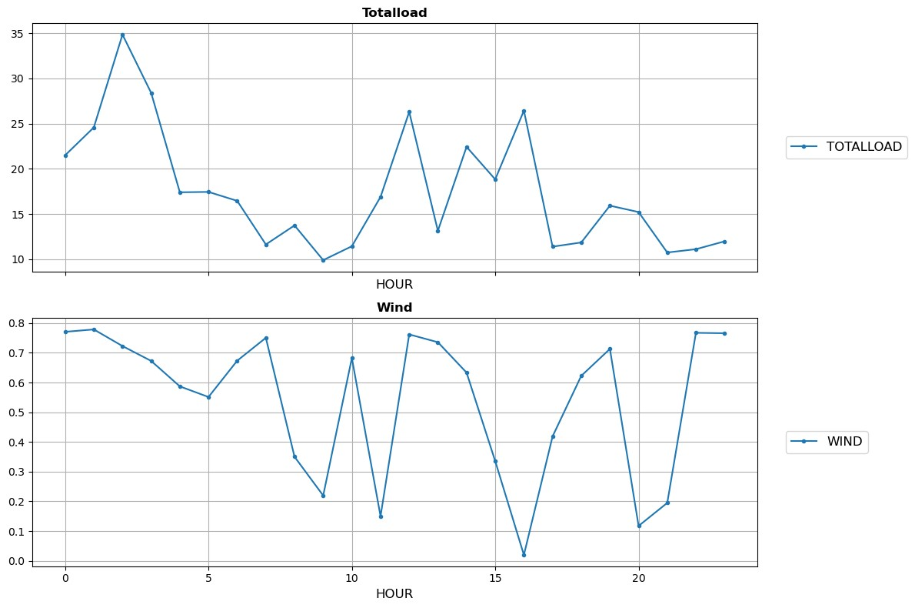
Dispatching Results
7

Slide 9
Dispatching Results
When the variable renewable energy peaks, the amount of energy demanded by the grid reduces.
The TES and battery build-up storage as the electricity clearing price is low due to high VRE production.
NHES can meet the load demand by varying the capacities of generators.
8

Slide 10
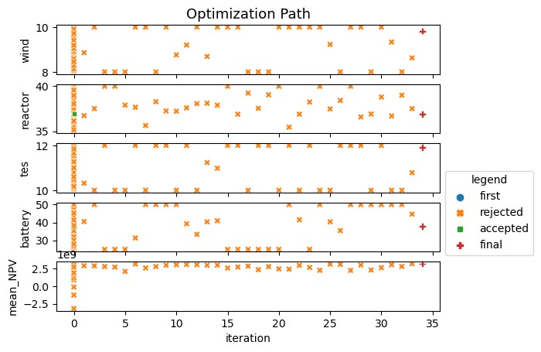
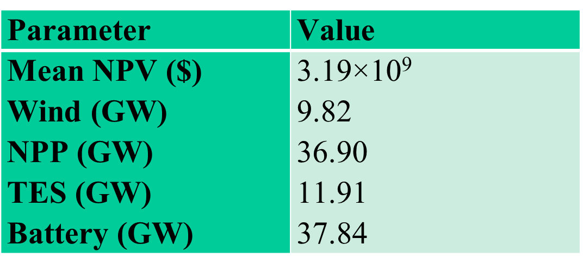
Optimization Results
The Bayesian Optimizer ran 50 initial samples
An acceptable solution was found at the 40th iteration
NPV for the optimal solution is $3.19 Billion for a project lifetime of 20 years
9

Slide 11
Other Considerations
Regulatory Aspects:
- NRA, EPA, and PURC should be engaged early
Stakeholder Engagement:
  - GAEC, NPG, GSA, and GNPPO are engaging stakeholders
Policy and Governmental Considerations:
  - Ghana’s Energy Transition Framework
  - Renewable Energy Masterplan (REMP)
  - The policies support the future deployment of NHES
10

Slide 12
Conclusions
Deploying NHES in Ghana has the potential to yield significant economic and environmental benefits.
Techno-economic analysis was successfully performed using HERON to estimate the economic viability of an NHES.
NPV required to meet the objective function was ~ $ 3.19 Billion for a project lifetime of 20 years.
Other considerations (regulatory, stakeholder engagement, and government policy) favor NHES deployment in Ghana.
11

Slide 13
References
[1] Ghana Integrated Power Sector Master Plan – 2023. Energy Commission of Ghana. Available: https://www.energycom.gov.gh/newsite/index.php/planning/ipsmp-data.
[2] Ela E, Milligan M, Kirby B. Operating reserves and variable generation, 2011. NREL/ TP-5500-51978, National Renewable Energy Laboratory, Golden, CO. [accessed 28.08.12]
[3] D. J. McDowell, P. W. Talbot, A. M. Wrobel, K. L. Frick, H. C. Bryan, C. Boyer, R. D. Boardman, J. Taber, J. K. Hansen, 2021. A Technical and Economic Assessment of LWR Flexible Operation for Generation and Demand Balancing to Optimize Plant Revenue, Idaho National Laboratory, Report INL/EXT-21-65443-Revision-1.
[4] International Atomic Energy Agency, 2022. Nuclear–renewable Hybrid Energy Systems, Nuclear Energy Series NR-T-1.24, ISSN 1995–7807.
[5] The New York ISO Annual Grid & Markets Report- Power Trends 2021,” New York ISO, 2020. [Online]. Available: https://www.nyiso.com/documents/20142/2223020/2021-Power-Trends Report.pdf/471a65f8-4f3a-59f9-4f8c-3d9f2754d7de.
12

