Slide 1
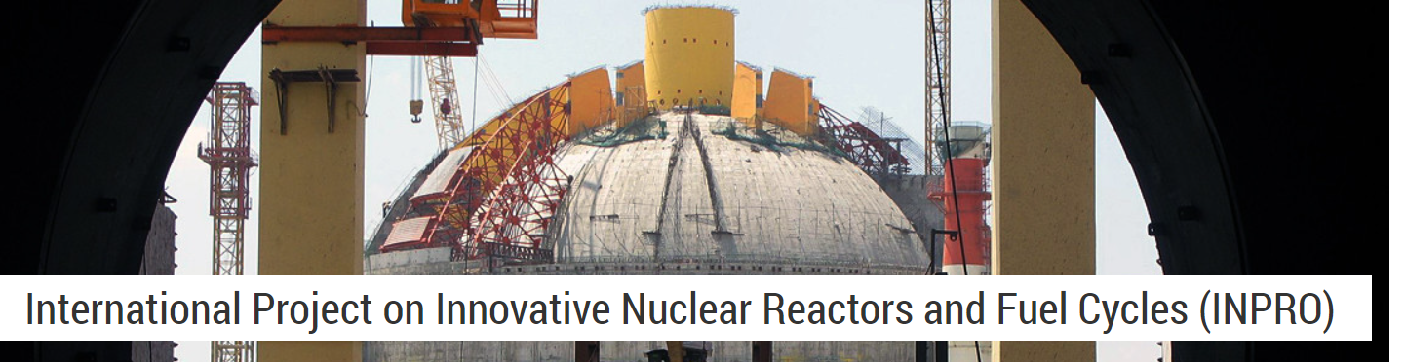
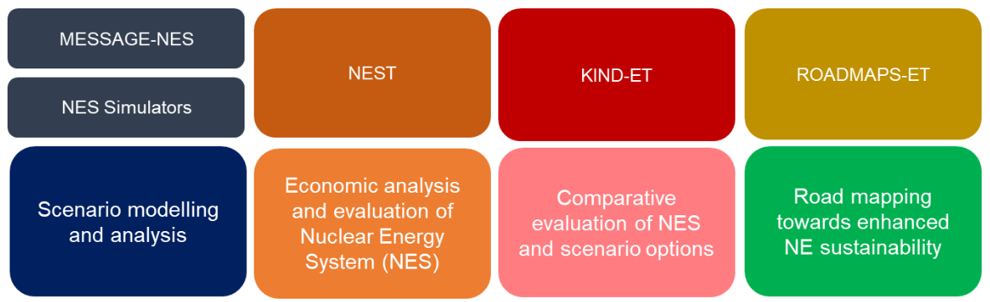
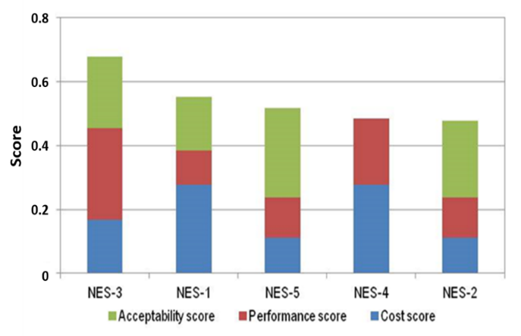
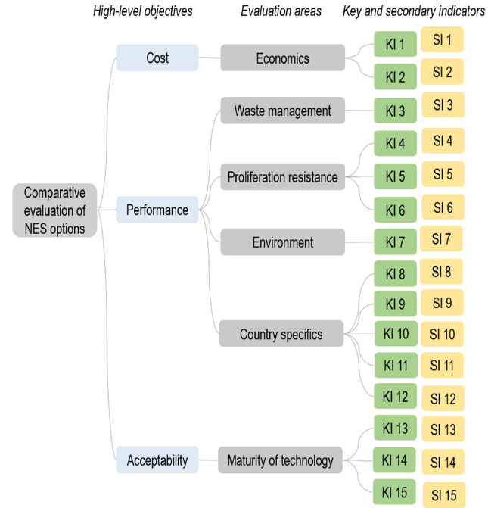
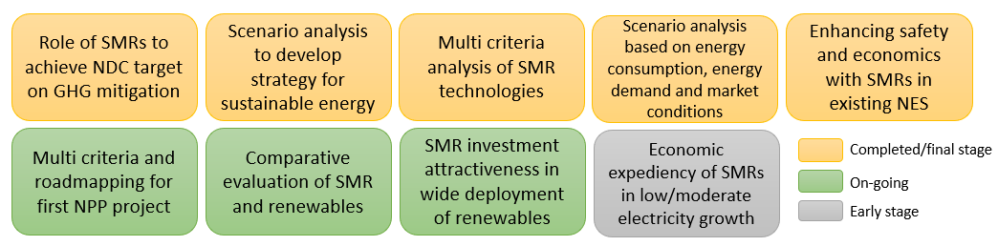
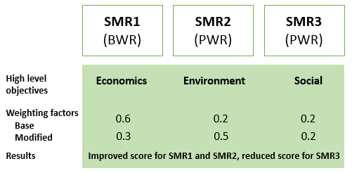
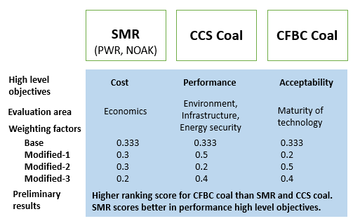


IAEA-CN-327-335
Analysis Support for Enhanced Nuclear Energy Sustainability:
An INPRO Service to Member States
J.M.C. Johari, V. Kuznetsov, G. Fesenko, A. Bychkov, S. Jeon
International Atomic Energy Agency
Email: J.M.C.Johari@iaea.org
Introduction
IAEA’s International Project on Innovative Nuclear Reactors and Fuel Cycles (INPRO) supports Member States in their long-term strategic planning for deploying sustainable nuclear energy.
Global and regional nuclear energy evolution scenarios are developed and analysed, using developed scientific-technical analysis tools.
The analysis methods and tools are now available to Member States and come in as Analysis Support for Enhanced Nuclear Energy Sustainability or ASENES service package
Abstract
The IAEA’s International Project on Innovative Nuclear Reactors and Fuel Cycles (INPRO) supports Member States in their long-term strategic planning for deploying sustainable nuclear energy. Over the past decade, INPRO developed methods and scientific-technical analysis tools to support modelling and analysis of nuclear energy systems, including global and regional scenarios. These analysis tools are available to Member States and come in a service package called the “Analysis Support for Enhanced Nuclear Energy Sustainability” (ASENES). INPRO uses ASENES analyses to develop a global vision of sustainable nuclear energy in the current century and beyond. An ongoing collaborative project called ASENES-SMR, addresses sustainable deployment scenarios for small modular reactors (SMRs). This project has 14 national and regional case studies, and the support of twelve Member States. The project identified some preliminary factors for successful deployment of SMRs: improving cost competitiveness and attractiveness for investment; introducing innovations in technology; and implementing institutional arrangements. For favourable economics, there needs to be a transition from economy of scale to the economy of mass production of reactors modules. The studies may assist Member States in the future planning and deployment of SMRs in strategically sustainable nuclear energy systems.
Elements of ASENES Service Package
Application of ASENES Service for SMR
ASENES SMR collaborative project (2020-2025)
14 national and regional case studies by Armenia, Bangladesh, Belarus, China, Indonesia, Jordan, Mexico, Pakistan, Romania, Russian Federation, Thailand, and Ukraine
Observers: Bulgaria, Chile, Ghana, Malaysia, Morocco, USA, Viet Nam
Schematic of objective tree and outputs in KIND-ET
Delivery and Application of ASENES Service
ASENES in IAEA Learning Management System (LMS) – available in English, Russian, Spanish
Instructor assisted distant training
Face-to-face training, INPRO School
Supplementary materials: demo cases, reports, publications, etc.
User needs to have:
Access to national nuclear energy data and plans
In-depth knowledge of NES development in country
Multi criteria analysis of SMRs: (a) using KIND-ET, and (b) using KIND-ET and NEST
Conclusion
Contact INPRO
INPRO developed ASENES service to assist Member States in formulating national strategies for enhancing nuclear energy sustainability.
INPRO continues to develop new methods and tools to expand scope and content
ASENES supports productive dialogue between proponents and decision-makers
As part of INPRO Advisory Service, ASENES is available upon request.
M.Gladyshev@iaea.org; J.M.C.Johari@iaea.org
IAEA LMS: https://elearning.iaea.org/m2/
IAEA NUCLEUS: https://websso.iaea.org/IM/UserRegistrationPage.aspx
IAEA LMS
IAEA NUCLEUS

