Slide 2
STATUS OF NUCLEAR POWER PROGAMME IN MONGOLIA
International Conference on Small Modular Reactors and their Applications, 21-25 October 2024, Vienna , Austria
CHADRAABAL MAVAG
Head,
Nuclear Technology Department
Nuclear Energy Commission,
Government of Mongolia

Slide 3
CONTENTS
KEY POLICIES AND LEGISLATIONS
CURRENT ENERGY-MIX AND ELECTRICITY CAPACITY
STATUS OF NUCLEAR POWER PROGRAMME
CHALLENGES AND DRIVING FORCES
SUMMARY
International Conference on Small Modular Reactors and their Applications, 21-25 October 2024, Vienna , Austria

Slide 4

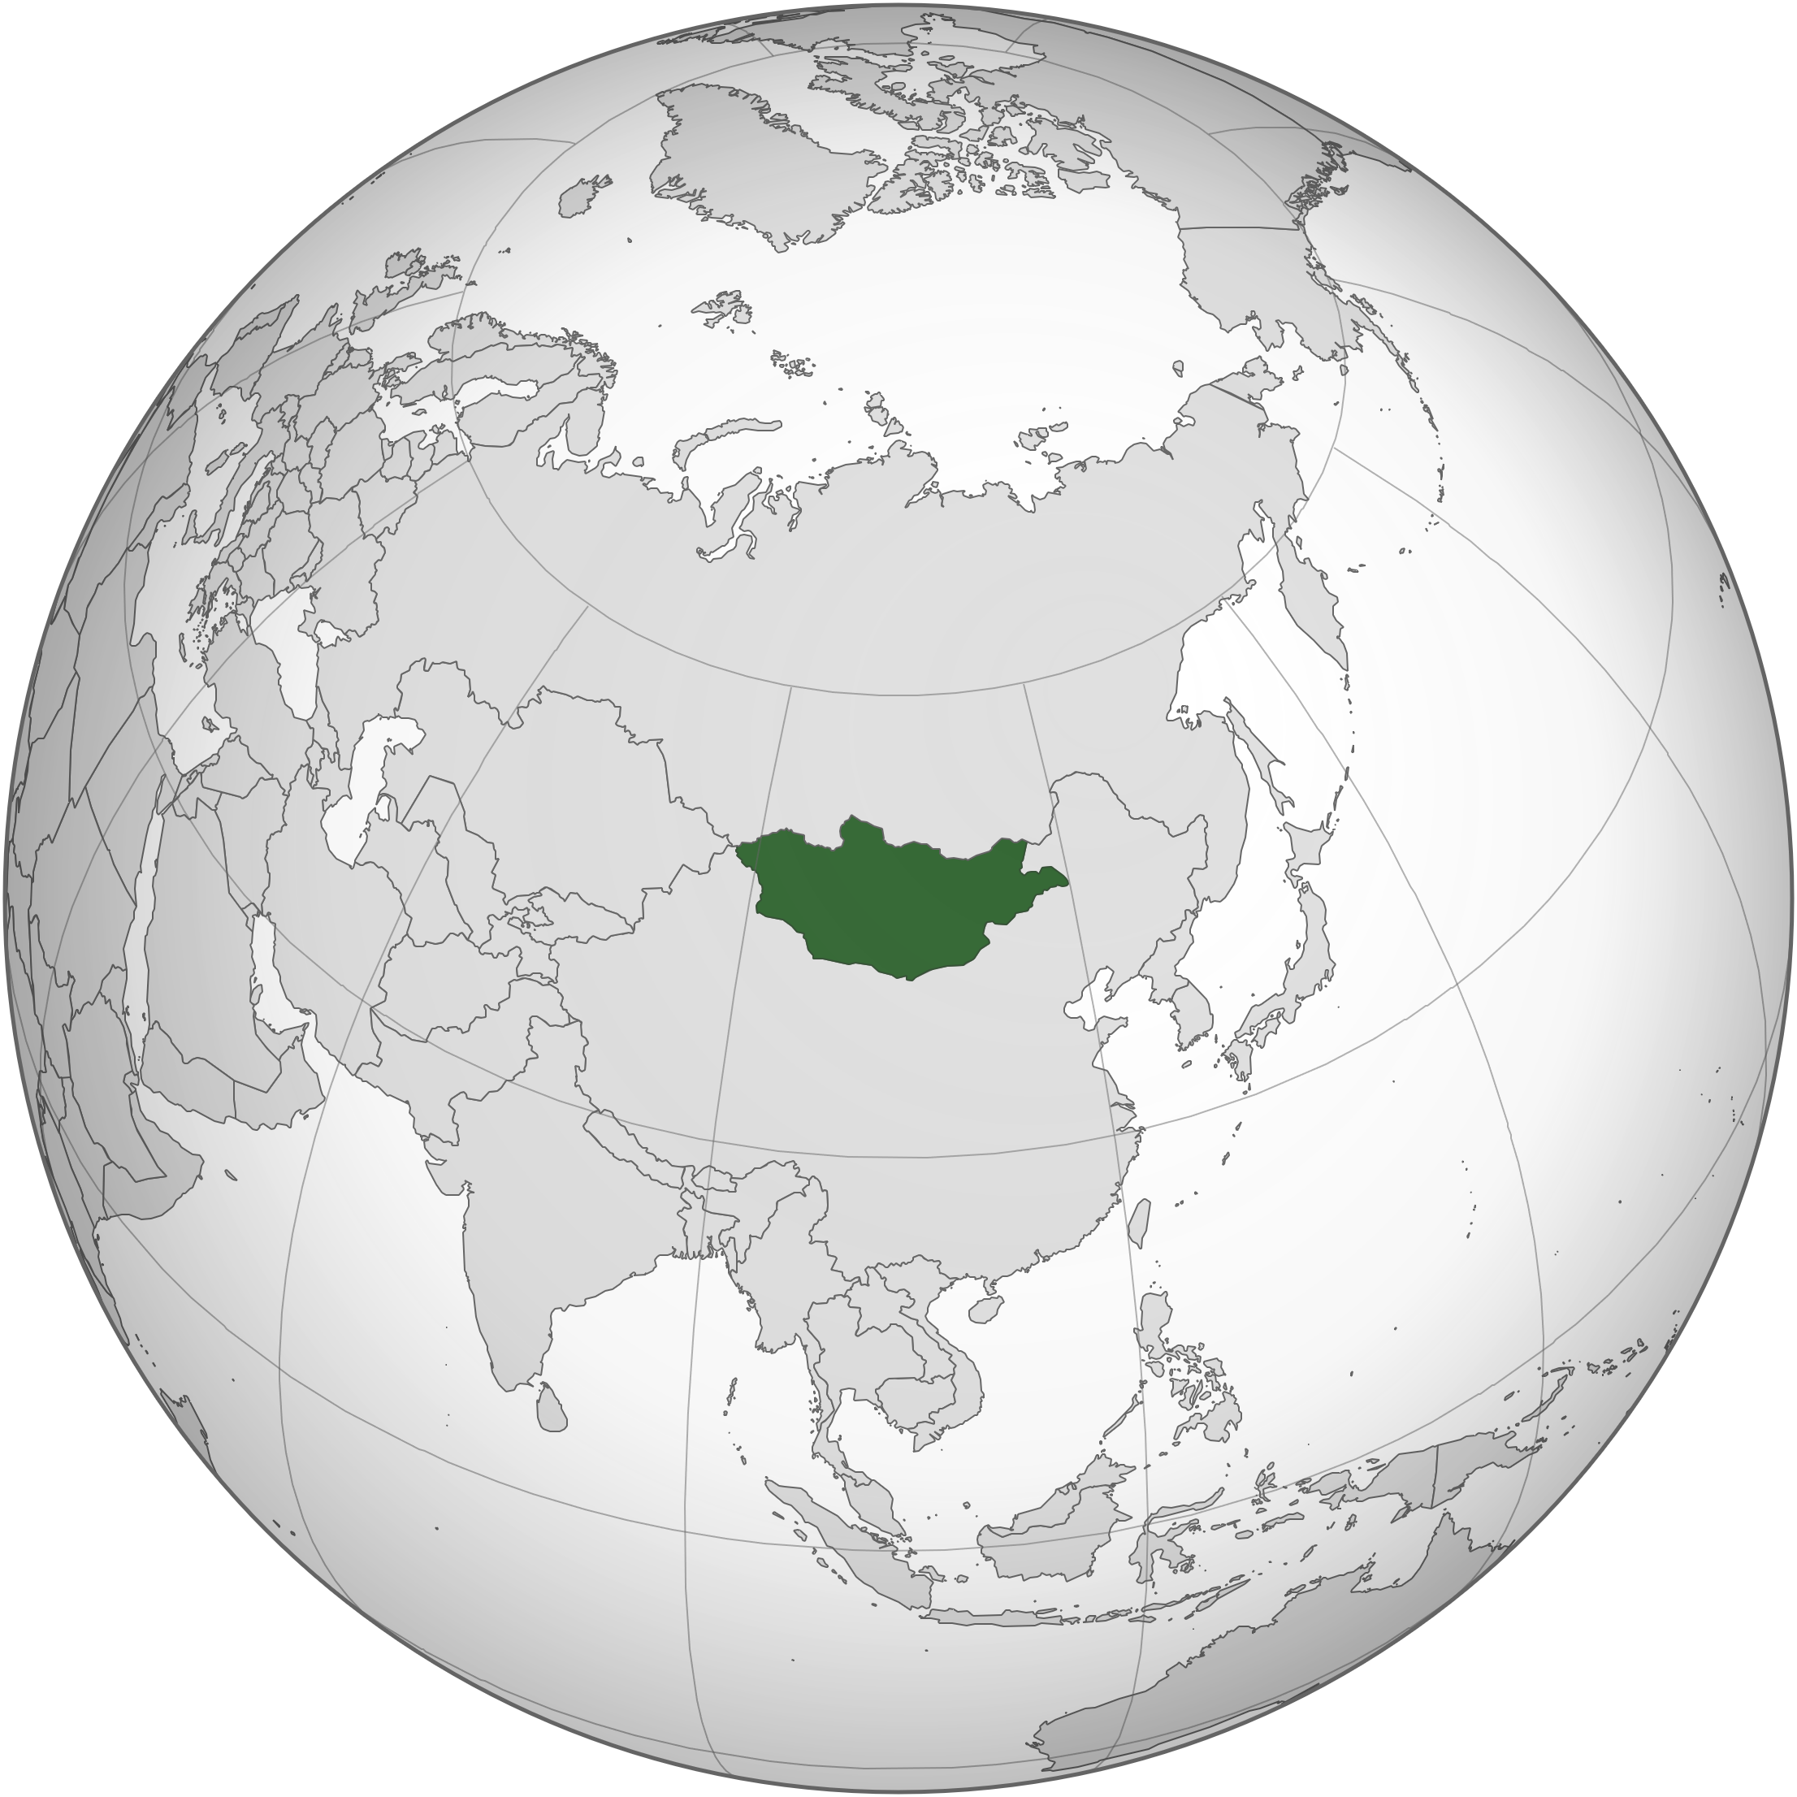
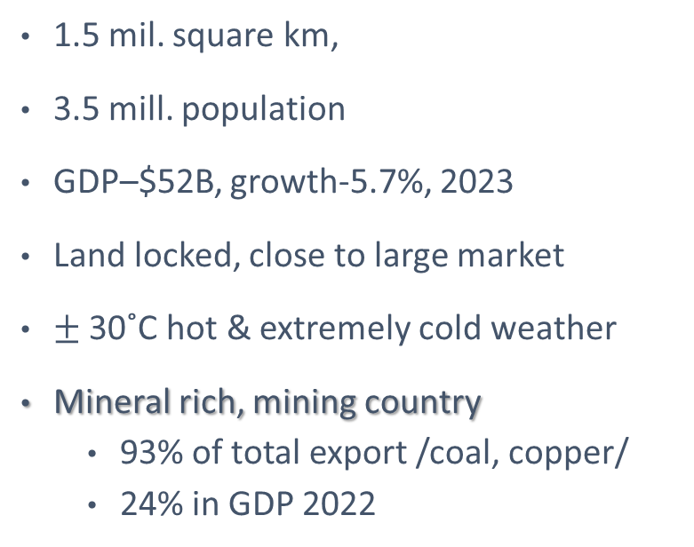
Mongolia at glance
1.5 mil. square km,
3.5 mill. population
GDP–$52B, growth-5.7%, 2023
Land locked, close to large market
$±$ 30˚C hot & extremely cold weather
Mineral rich, mining country
    93% of total export /coal, copper/
    24% in GDP 2022
Key messages for the country in the nuclear field
No Nuclear Facilitates
Party to key international accords including NPT
Newcomer for NPProgram
Proven uranium reserve (inferred)
International Conference on Small Modular Reactors and their Applications, 21-25 October 2024, Vienna , Austria

Slide 5
LEGAL FRAMEWORKS
National Security Concept of Mongolia /2010/
Mongolia’s Long-Term Development Policy “Vision-2050” /2020/
New Revival Policy /2021/
State Policy on Exploitation of Radioactive Minerals and Peaceful Uses of Nuclear Energy /2009/
Nuclear Energy Law /2009/
Government’s Action Plan for 2024-2028
International Conference on Small Modular Reactors and their Applications, 21-25 October 2024, Vienna , Austria

Slide 6
NUCLEAR POWER ACTIVITIES cont…
6
Government’s Action Plan for 2024-2028
Cross-border connection railway and cargo transshipment terminal of “Gashuunsukhait-Gantsmod”, “Hangi-Mandal”, “Shiveekhuren-Sekhee” border ports;
Tavantolgoi 450MW TPP;
Erdeneburen 90MW HPP;
Egiin River 310MW HPP;
Renewable energy and distributed sources;
Kherlen-Toono and Orkhon-Ongi water pipelines;
Ereentsav-Choibalsan-Baruun Urt-Bichigt vertical road;
An Uranium Project and NPP basic research;
Coal-chemical and coking coal-chemical factory;
Copper Processing factory
Steel plant
Petroleum Refinery factory;
Gold refining plant based on Oyu Tolgoi project;
National Satellite.
3. Economic policy
3.3. economic diversification and liberalization
3.3.3. growth and liberalization of the energy sector
3.3.3.7. Implement a policy of building nuclear power plants and conduct basic research activities
14 MEGA Projects…
International Conference on Small Modular Reactors and their Applications, 21-25 October 2024, Vienna , Austria

Slide 7
LEGISLATIONS AND INTERNATIONAL ACCORDS
Nuclear Energy Law, 2009
Law on Licensing, 2022
Law on Energy, 2001
Other Laws
LEGISLATIONS
Convention on the Physical Protection of Nuclear Material, 1986,
Convention on Early Notification of a Nuclear Accident, 1987
Convention on Assistance in the Case of a Nuclear Accident or Radiological Emergency, 1987
International Convention for the Suppression of Acts of Nuclear Terrorism, 2005
CONVENTIONS
TREATY
NPT, 1970
CSA, 1972 and SQP
AP, 2003
Treaty on the Prohibition of Nuclear Weapons, 2021
International Conference on Small Modular Reactors and their Applications, 21-25 October 2024, Vienna , Austria

Slide 8
Ownership & Regulatory license
Regulatory Framework
Key regulations:
Basic safety standards, /2016/
Regulation on Security of Radiation Sources /2015/
Basic Regulation on Radiation Protection and Safety /2016/
Regulation on Transport of Radioactive Material /2019/
Regulation on Nuclear Material Accounting System /2020/
GOVERNMENT
PRIME MINISTER
State owned “Erdenes MGL” LLC
Ministry of Industry and Mineral Resources
Ministry of Energy
State owned
“Mon-Atom” LLC
Nuclear Energy Commission
Institute of Economics for Energy
Division of Nuclear Radiation Inspection
Ministry of Environment and Tourism
Energy Regulatory Commission
International Conference on Small Modular Reactors and their Applications, 21-25 October 2024, Vienna , Austria

Slide 9
Licensing environment
NUCLEAR ENERGY LAW (2009)
Article 2. Legislation on Nuclear Energy
  2.4. Relations connected to exploitation of nuclear energy that have not been comprehensively regulated under this Law shall be regulated by the relevant articles, paragraphs and sub-paragraphs of the Law on Energy.
Article 15. License
  15. The following activities shall be carried out with the license granted by the Nuclear Energy Commission:
    15.1.1. Construct, modify, renovate and decommission nuclear facilities;
    15.1.2. Exploit nuclear facility;
    15.1.3. Possess, use and sell nuclear substance;
    15.1.4. Import, export, transport nuclear substance, managing nuclear waste;
ENERGY LAW (2001)
Article 2. Legislation on Energy
2.3. Matters related to use nuclear power shall be regulated by the Nuclear Energy Law.
International Conference on Small Modular Reactors and their Applications, 21-25 October 2024, Vienna , Austria

Slide 10
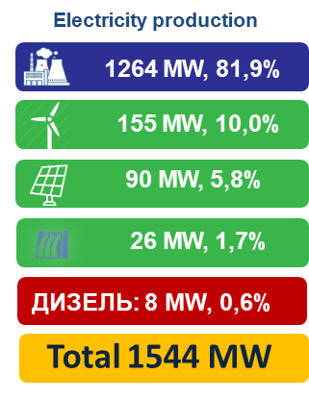
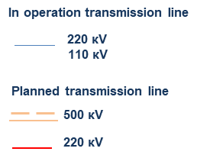
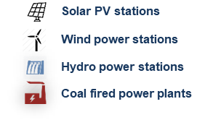
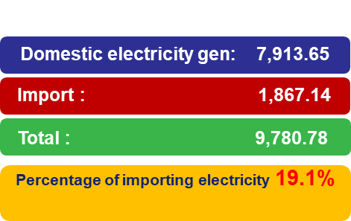
Electricity generation, 2022
Source: Ministry of Energy
Ulaangom
Bayan-Ulgii
Moron
Sukhbaatar
Erdenet
Darkhan
Bulgan
Ulaanbaatar
Choibalsan
Khovd
Uliastai
Zuunmod
Багануур
Chingiskhaan
Tsetserleg
Altai
Baruun urt
Bayankhongor
Arvaikheer
Чойр
Mandalgovi
Sainshand
Dalanzadgad
Oyutolgoi
Tavantolgoi
Cu
Yearly incremental rate of energy demand is about 6-7% depending on economic development
Expected electricity demand is going to be 3.5GWe by 2030

Slide 11


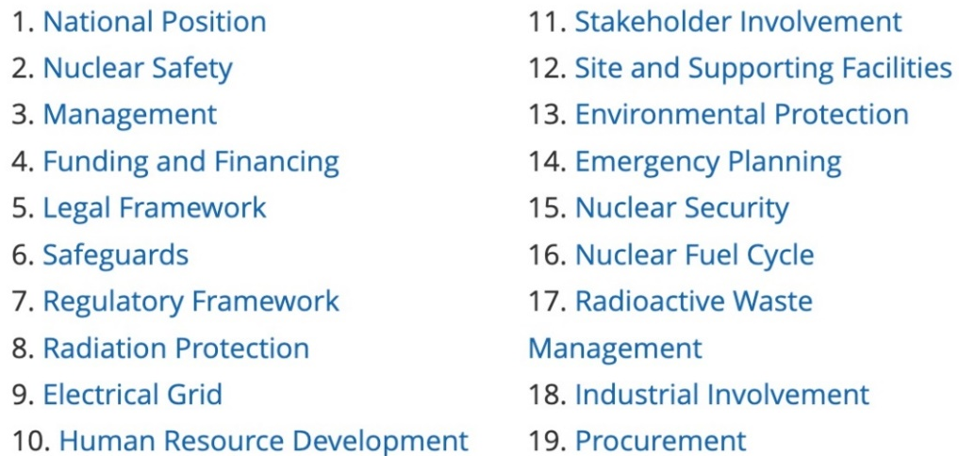
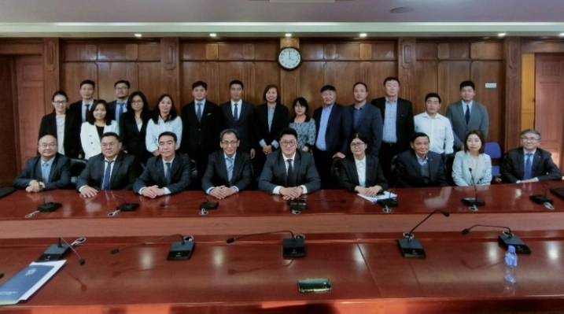
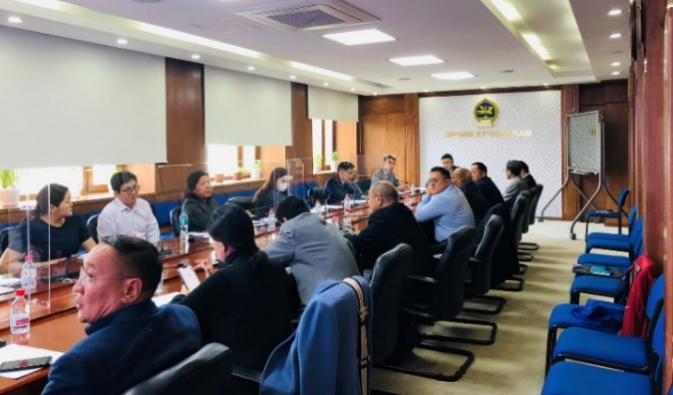
NUCLEAR POWER ACTIVITIES
11
Working Group
Exploitation of Radioactive minerals and
nuclear energy
MINISTRY OF ENERGY
MINISTRY OF MINING AND HEAVY INDUSTRY
MINISTRY OF EDUCATION AND SCIENCE
New Revival policy
MINUTES OF MONGOLIAN GOVERNMENT MEETING №16
To implement the New Revival Policy of Mongolia and to intensify the implementation of development projects, and to fulfill objectives reflected in the energy sector, a joint order, “To Study a Possibility of Use of Nuclear Power in Mongolia", was approved by the Minister of Education and Science, the Minister of Energy, and the Minister of Mining and Heavy Industry dated August 11, 2022.
Minutes of the meeting
of the Government of Mongolia, April 03, 2024.
In accordance with the IAEA's "Recommendations for the Development of Nuclear Energy Infrastructure", the head of the NEC was instructed to study 19 basic issues of nuclear power plant infrastructure and prepare and present a preliminary feasibility study.
International Conference on Small Modular Reactors and their Applications, 21-25 October 2024, Vienna , Austria

Slide 12
Development
Activities of WG
A preliminary study on economy of 300/600MWe NPP
Review activities of previous results obtained by NEA prior to 2020
Finalization of a Preliminary Report
Submission to NEC meetings
Discussion at meetings of Council of Ministry of Energy
Preparation to form a NEPIO and initiate key studies stipulated in the Phase 1
Coordinated activities with the IAEA
Development of a RoadMap for NP Program
  Consulting meeting
Implementation the national project MON2010 for 2024-2025
  National Workshops in Q3 and Q4, 2024
  HRD and EMs
  A National project proposal for 2026-2027
  Preparation of a Pre-Feasibility and a Comprehensive Report
Activities of State-owned Mon-Atom LLC
MoU with the Rosatom on cooperation in nuclear power field, 2023
  Roadmap development
  Consulting meeting
International Conference on Small Modular Reactors and their Applications, 21-25 October 2024, Vienna , Austria

Slide 13
Tentative timeline for NPProgramme
2024
Submit WGR to the Government of Mongolia
2024
Establish NEPIO
Initiate studies
2025
Pre-Feasibility studies
Comprehensive report
2026
2027
Implement national project
Establish/draft national policies
Draft Comprehensive Nuclear Law
Self-evaluation
SEED (Site Survey)
National position
INIR (Phase 1)
Notes:
Хэдэн онд ЦЭХС барих боломжтой талаар ярина

Slide 14

DRIVING FORCES and RESTRAINING FORCES in NPProgram
Driving forces:
  Worldwide initiatives for carbon-free energy sources;
  Energy security issues;
  Government commitments (inclusive in the Government’s action plan);
  International bilateral and multilateral cooperation including the IAEA, EU and the FNCA;
Restraining forces:
  Long-term Government commitment;
  Newcomers with inadequate knowledge and experience;
  Funding and financial sources;
  Proven SMR’s technology and its use;
  Public perception;
International Conference on Small Modular Reactors and their Applications, 21-25 October 2024, Vienna , Austria

Slide 15


MAJOR DEVELOPMENTS TO BE TAKEN RELATED TO NPP PROGRAMME
The Cabinet Office’s decision to develop a Prefeasibility Study by conducting nuclear power infrastructure studies in all 19 issues in June, 2024;
A Formation of NEPIO under the NEC;
Finalize a RoadMap of NPP programme;
Preparation of a Prefeasibility Study;
  Studies relevant to the 19 issues of the Phase 1;
  Learn experiences and lessons of mature countries;
Preparation of a Comprehensive Report;
The IAEA INIR mission; and
Work on the public acceptance;
International Conference on Small Modular Reactors and their Applications, 21-25 October 2024, Vienna , Austria

Slide 16
SUMMARY
The Government is taking necessary measures to put new energy sources into energy system to meet the increasing demands;
Mongolia aims to study the possibility of use of nuclear power in its energy-mix. In this regard, the IAEA’s support is vital for the country;
Due to Mongolia's sparse population, vast landmass, and low energy consumption, the use of a SMR is being considered as a potential alternative to diversify energy sources and provide stable electricity;
The public acceptance for nuclear power is essential as the country consider to embark on nuclear power program;
Intensify eco-friendly, energy-based projects through advanced technology and science, specifically nuclear energy in accordance with the leading economic directions to meet near future and long-term electricity demand;
Strengthen international cooperation, especially with the IAEA, in the nuclear energy field.
International Conference on Small Modular Reactors and their Applications, 21-25 October 2024, Vienna , Austria

Slide 17
International Conference on Small Modular Reactors and their Applications, 21-25 October 2024, Vienna , Austria
Thank you for your attention
E-mail: office@nea.gov.mn
Web: www.nea.gov.mn

