Slide 1


Argentina's view
on the SMR market
Ph.D. Germán GUIDO-LAVALLE
President of the National Atomic Energy Commission
International Conference on Small Modular Reactors and their Applications
21–25 October 2024, Vienna, Austria

Slide 2








GOVERNANCE
National Nuclear Activity Law (Law No. 24.804). CNEA is responsible for advising the Executive Branch in the definition of nuclear policy.
PRESIDENCY
MINISTRY OF ECONOMY
GENERAL SECRETARIAT
PRESIDENCY
SECRETARY OF ENERGY

Slide 3








1976
1982
1986
1989
1994
1997
2 CNEA members on the Company`s Board
SUDACIA S.A.: 64.43%
CNEA: 35.57%
CONUAR-FAE
Merging
(April, 2019).
Neuquén Province: 51%
CNEA: 49%
Secretary of Energy: 79%
CNEA: 20%
IEASA.: 1%
Secretary of Energy: 51%
CNEA: 48%
Mendoza Province: 1%
ASSOCIATED
COMPANIES

Slide 4
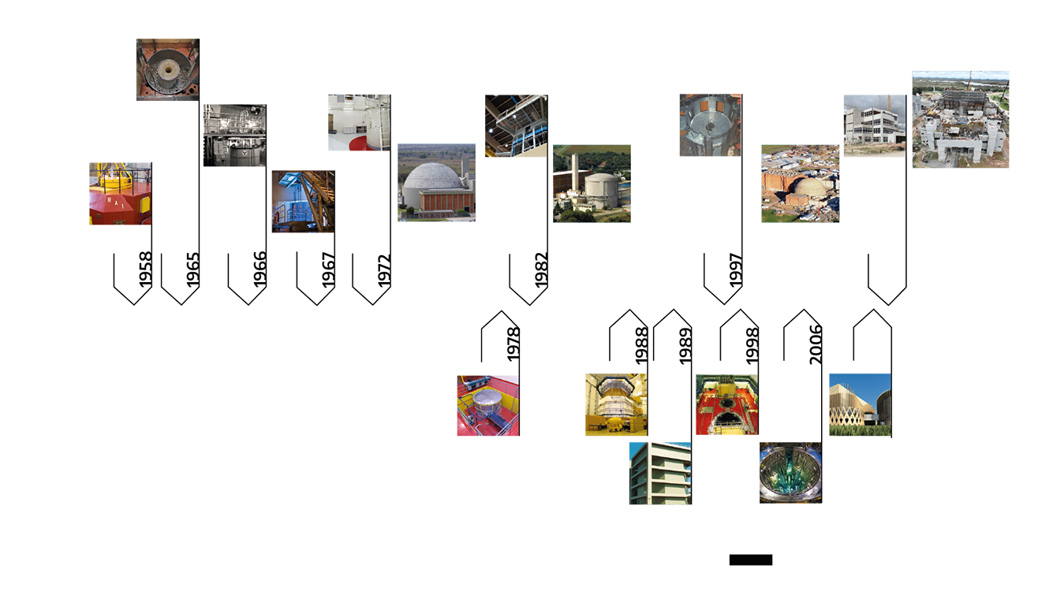
ARGENTINE EXPERIENCE IN NUCLEAR
REACTORS
NPPs
RESEARCH REACTORS

Slide 5

ENERGY SECURITY +
NET ZERO CHALLENGE
A NEW ROLE OF NUCLEAR ENERGY
IN THE GLOBAL ENERGY TRANSITION
Will SMRs be
the answer?

Slide 6
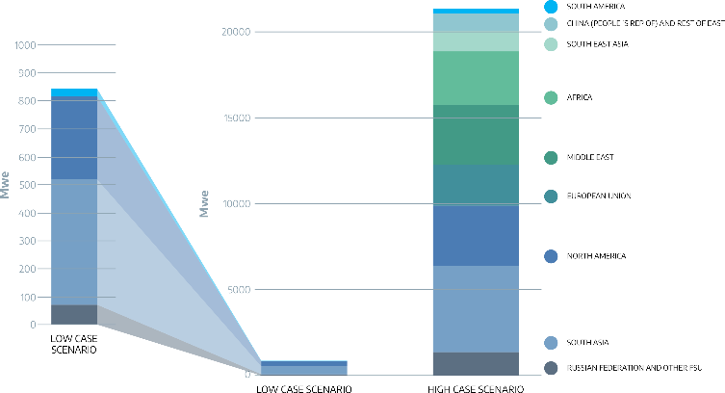
A BIG NEW MARKET FOR NUCLEAR IS EXPECTED
ESTIMATED SMR CAPACITY BY REGION IN 2035
SCENARIOS | SHELL | IEA | IAEA
TOTAL NEW MARKET | 90 Gwe | 315 GWe | 480 GWe
NEWCOMERS (20%) | 18 GWe | 72 GWe | 97 GWe
But is it for SMRs?
There are great challenges to face
NEA Report 2021

Slide 7

NO MORE MARKETING
SMR
SMALL
MODULAR
REACTOR

Slide 8
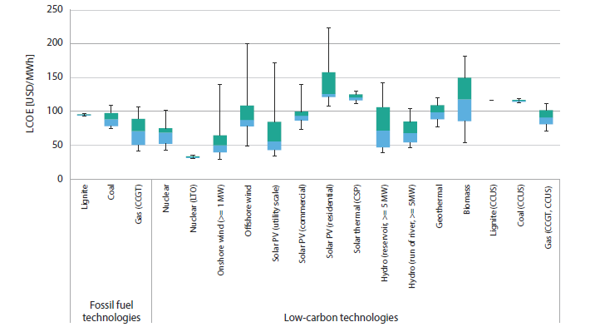
SMR COST WILL BE COMPETITIVE?
LCOE by technology
IF ONLY…
Ready and proven technologies
Fast licensing
Real Modularity for manufacturing and building (shorter times)
Note: Values at 7% discount rate. Box plots indicate maximun, median and mínimum values. The boxes indicate the central 50% of values, i.e. the second and the third quartile.
https://www.oecd-nea.org/jcms/pl_51126/low-carbon-generation-is-becoming-cost-competitive-nea-and-iea-say-in-new-report

Slide 9
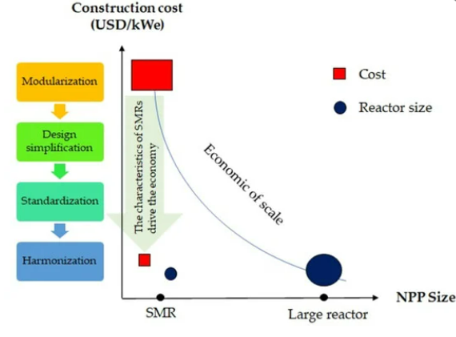
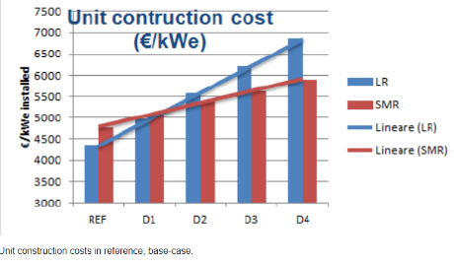
WHEN SMALL IS BETTER?
CONSTRUCTION DELAYS AD EXTRA-COSTS ON LARGE AND
SMALL NUCLEAR PROJECTS.
https://www.researchgate.net/figure/Self-Financing-process_fig2_264677283

Slide 10
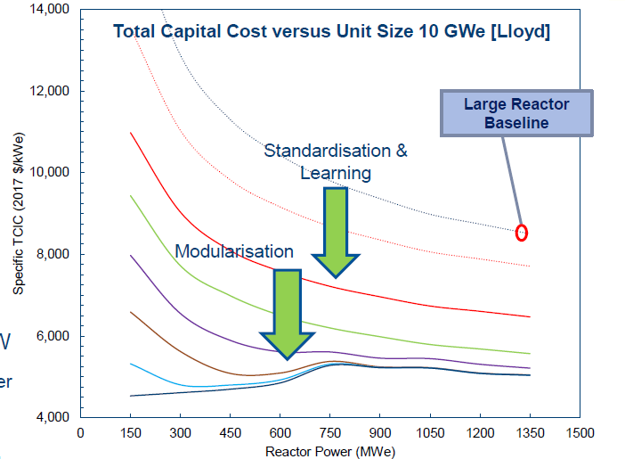
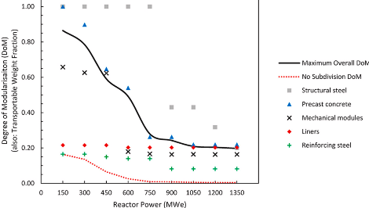
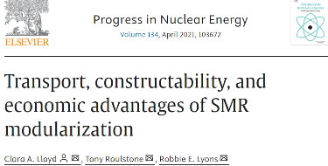
MODULARIZATION vs. SIZE

Slide 11
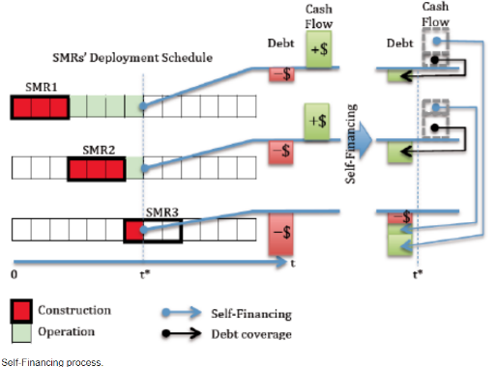
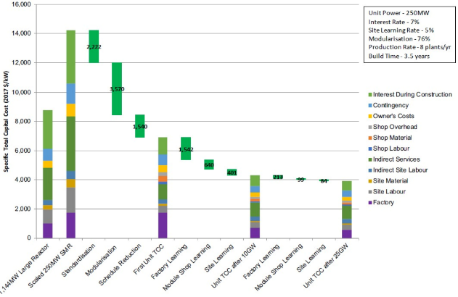
LEARNING CURVE
DECK - SMR Economics Tony Roulstone - 2024.06.25 Ingersoll y Carelli (2021)
https://www.researchgate.net/figure/Self-Financing-process_fig2_264677283

Slide 12
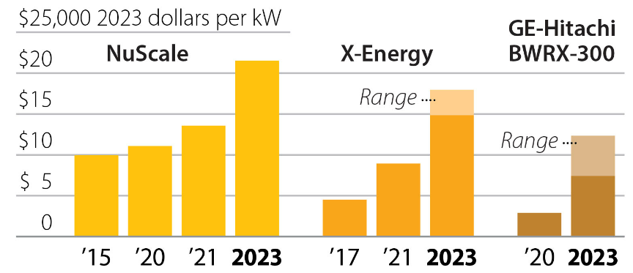
WHAT COSTS ARE WE PROMISING?
SMR Construction cost estimates keep rising
Cost projections for small modular reactors, by year
IEEFA
Source: IEEFA calculations based on public data
https://www.researchgate.net/figure/Self-Financing-process_fig2_264677283

Slide 13

What have we done
at CAREM?
What have we learned?

Slide 14



























MAIN SUPPLY CHAIN

Slide 15
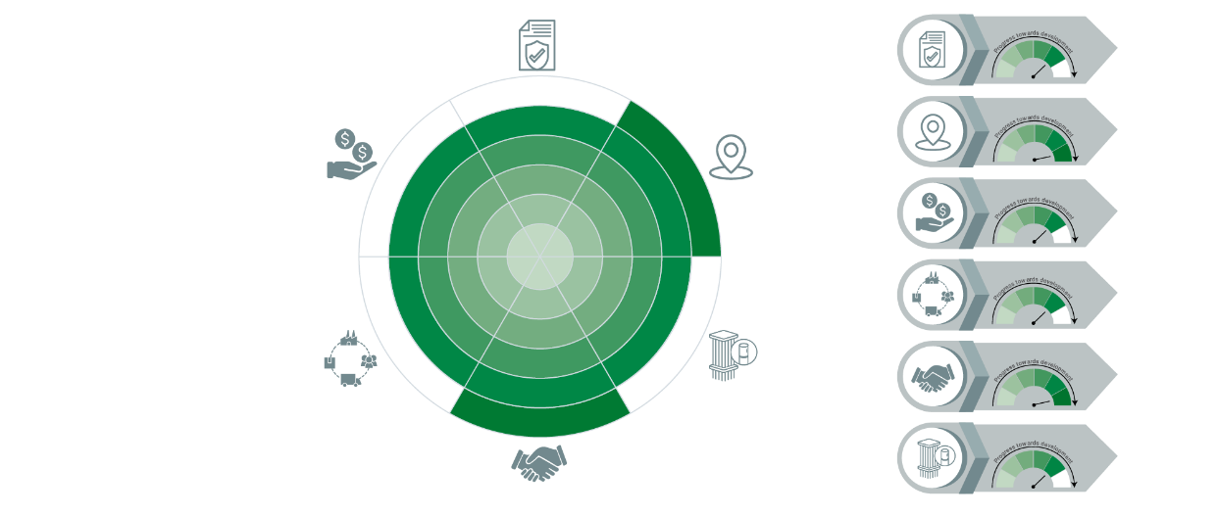
NEA SMR DASHBOARD
LICENSING
SITING
FINANCING
SUPPLY CHAIN
ENGAGEMENT
The compilation includes analysis of 56 SMR designs and the progress towards their deployment and commercialization.
FUEL
* NEA (2024), THE NEA SMALL MODULAR REACTOR DASHBOARD: Second Edition OECD Publishing, Paris

Slide 16
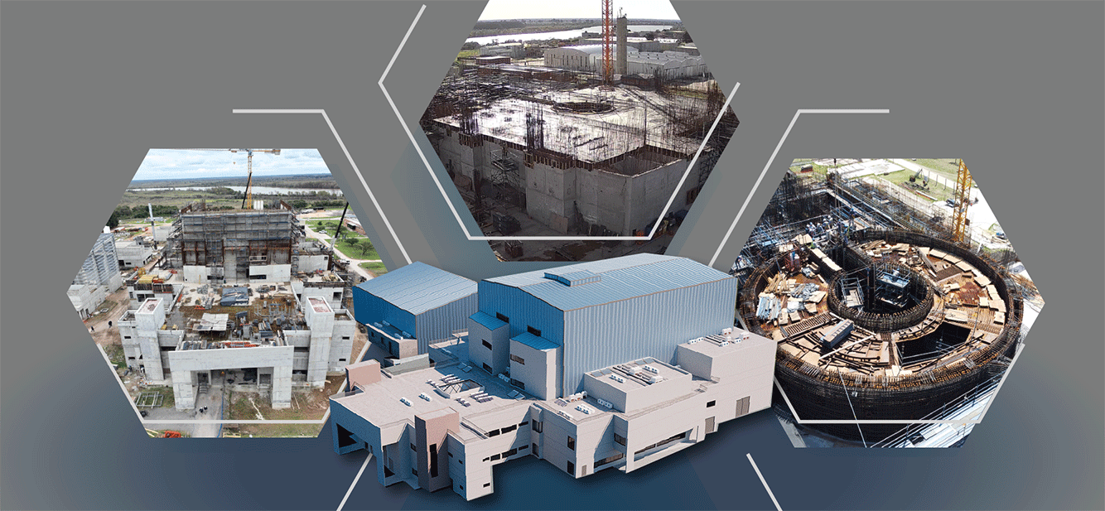
CAREM STATUS
PHYSICAL
ADVANCE
REACTOR
BUILDING
CONTAINMENT AND CONTAINMENT LINER

Slide 17
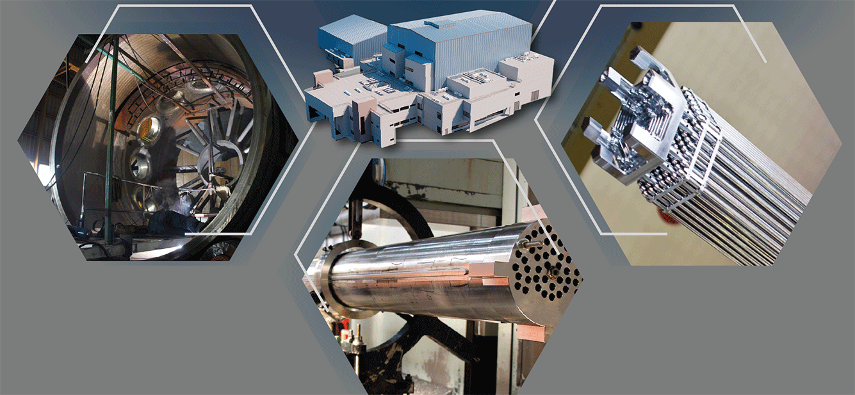
CAREM STATUS
REACTOR
PRESSURE VESSEL
FUEL
ASSEMBLIES
STEAM
GENERATOR

Slide 18



