Slide 2
The Development Status of Innovative SMR and Future Plan
S. HEO, S.G. LIM and H.G. KIM
Innovative SMR Development Agency,
Republic of KOREA

Slide 3
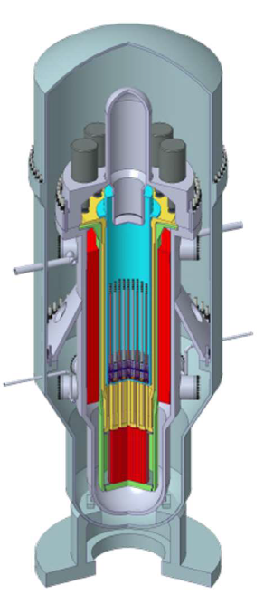
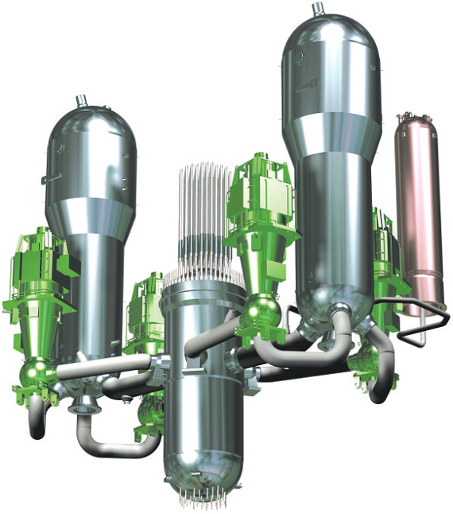
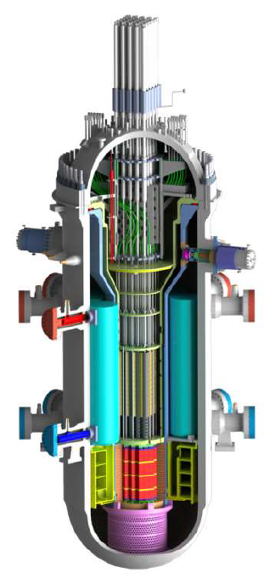
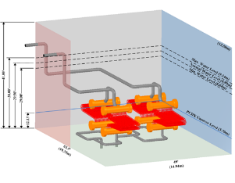
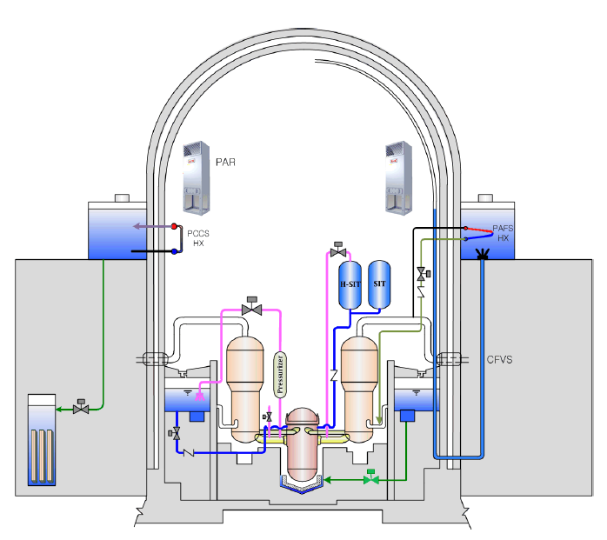
Introduction of i-SMR Development
Proven Tech. of Large Commercial PWR
SMART(100MWe)
i-SMR(170MWe)
APR1400 & APR+(1500MWe)
Passive systems
iPOWER(1250MW, Passive PWR)
World’s first standard design Approval SMR (2012)
More Safe
More Economical
More Flexible

Slide 4
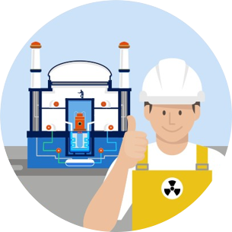
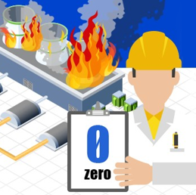
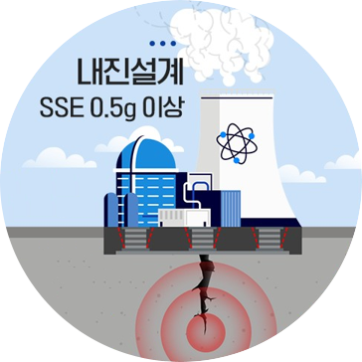
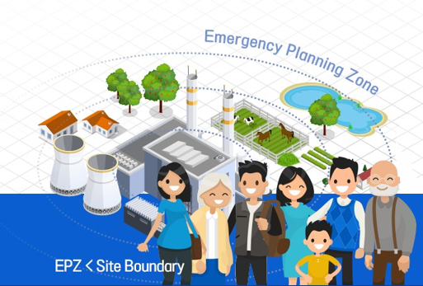

Development Goals - Safety
Safety
Elimination of LOCA by integrated reactor
Passive safety system with natural circulation
Safety system without safety-class DC power
Reduced the likelihood of failure
CDF
< 1.0e-9 / RY
Seismic Design 0.5g
Underground reactor
Seismic design of major equipment
EPZ
< site boundary
Reduction of radioactive leakage
Small reactor
Low accident probability
Steel containment

Slide 5
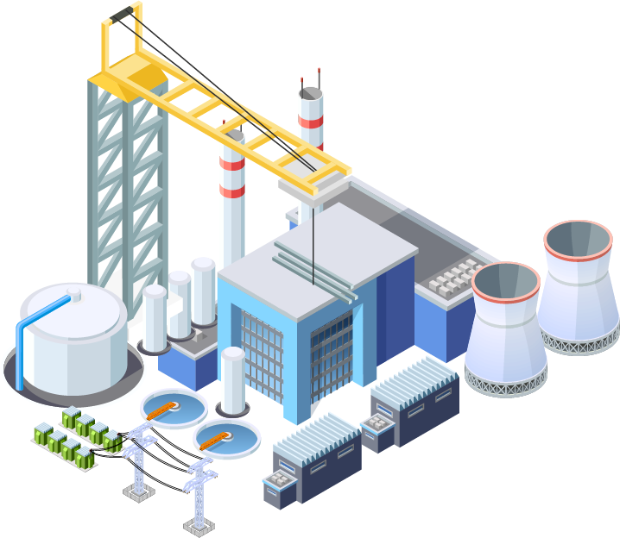


Development Goals - Economics
Reduction in construction volume
Design simplification of system
Multiple modules in a single reactor building
Construction unit price
< $3,500/kWe
Modularization and factory manufacturing
Design optimization for inland transportation
Reduced construction time and cost
Power generation unit price
< $65/MWh
Significant reduction in operators
3 operators in one integrated MCR for multiple modules
Autonomous/Automatic operation and operate support system
Digital twin and predictive preventive maintenance

Slide 6
Top-Tier Requirements
Integrated PWR
Power : 170 MWe
Design Life : 80 years
Seismic design : 0.5g
General
CDF : 1.0 × 10⁻⁹ /M·Y
EPZ : Within site boundary
Grace time : over 72 hrs
Fully passive safety system without AC/DC power
Safety
Overnight cost : $3,500 /kWe
LCOE : LCOE $65 /MWh
Construction time ≤ 24 month (First module)
Modularization and factory manufacturing
- component design optimization
considering inland transportation
Economic
Boron free operation
Flexible utilization
Refueling cycle ≥ 24 months
Flexibility

Slide 7
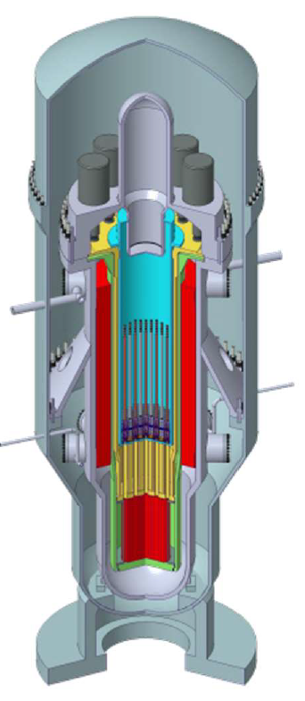
i-SMR Design Features (1/2)
Steel CV
Integrated module reactor
PZR
RCP
Elimination of pipe break
IV-CEDM
Minimization of rad-waste by boron free operation
UGS
Elimination of CEA ejection by In-vessel CEDM
CSB
Enhanced thermal margin
Helical Coil
Once-through SG
Optimization of economics by module manufacture & RCP
RV
Schematic diagram of RV and CV

Slide 8
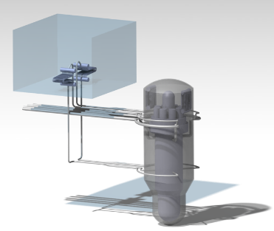

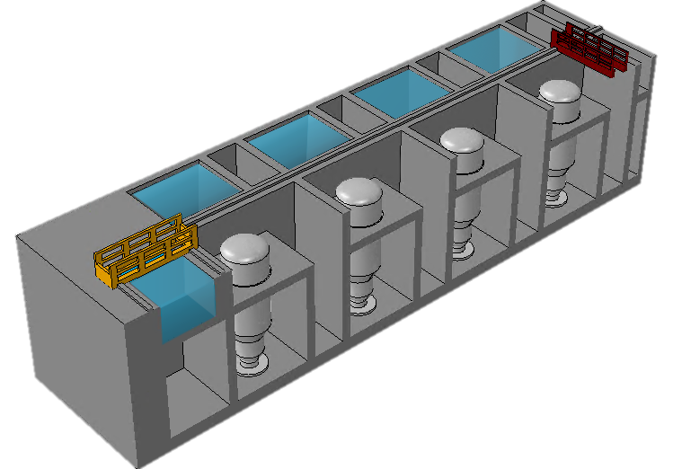
i-SMR Design Features (2/2)
Emergency Cooling Tank
Full passive safety system with dry containment vessel
PAFS
Practical elimination of severe accident
PCCS
Independent module arrangement
PECCS
Flexible utilization
(Load following operation or hydrogen or heat)

Slide 9
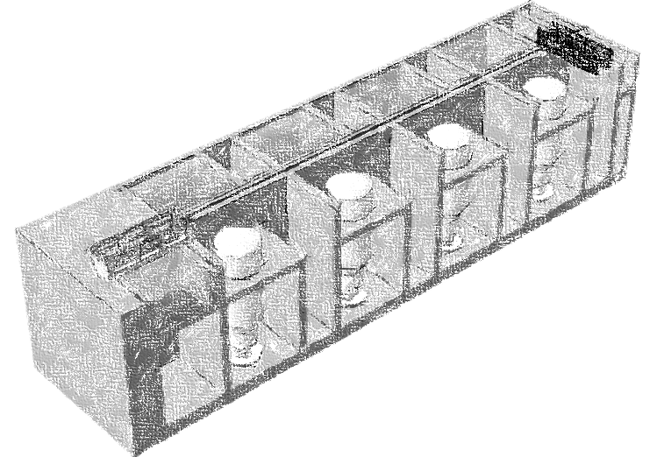
Regulatory Challenges for Standard Design Approval
• Regulation by principles
• 3 Crews Operation
• EPZ Elimination
• Communication with Developer
and Regulator
• Effectiveness of Pre-review
Pre-
Review
Innovative
Design
Plant
Module
Design
• Flexible Utilization
• Separate review for Reactor
module / Plant / Site
Site
Module

Slide 10




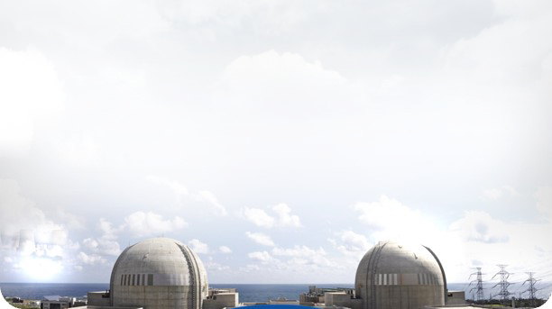









Organization for SMR development & commercialization
KHNP
Utility
Public
Sector
Private
Sector
KEPCO E&C
A/E + NSSS
DESIGN
DOOSAN
EQUIPMENT
SUPPLY
i-SMR
Development
Agency
Robust Supply Chain
KNF
CORE DESIGN,
NUCLEAR FUEL
Construction Co.
CONSTRUCTION
More than 500 nuclear plant parts suppliers
KAERI
Nuclear R&D
All key nuclear organizations in Korea are actively participating in i-SMR development.

Slide 11
Milestone of i-SMR Development
2023
2024
2025
2026
2027
2028
2029
2030
2031
2032
2033
2034
Standard
Design
Nuclear Design
Final Safety Analysis
Design Spec.
Licensing
Separate Effect Test Integral Effect Test
Pre-design Review
Deployment
SSAR
Standard design Approval
Business model setup
Site preparation
Construction Permit
First Module Installation
Government funding and Pre-design review start in 2023.
Standard Design Approval by 2028 and Construction permit by 2030
Commercial operation of first module by 2034

Slide 12
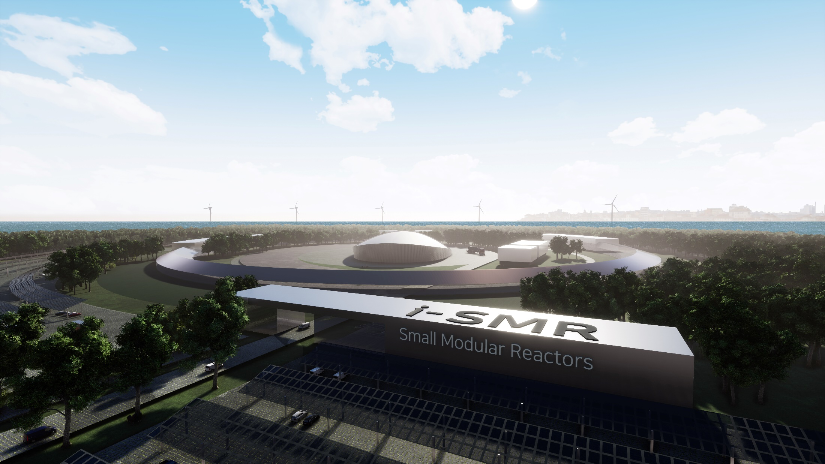
THINK SAFETY
Thank you

