Slide 1


2024.10
DYNAMIC ANALYSIS OF STEAM DUMP SYSTEM OF SMR
Ye Zhu
Nuclear Power Institute of China

Slide 2
CONTENT
01
02
03
04
05
工作概INTRODUCTION
述
SYSTEM DESCRIPTION
仿真SIMULATION MODEL
分析能力
DYNAMIC ANASYSIS
CONCLUSION

Slide 3
01
INTRODUCTION
Steam Dump System of NPP
Provide a artificial load for the reactor
Ensure the safety of the reactor
Surplus steam bypasses the turbine and directly enters the condenser
The steam dump system is considered to be the most important system in nuclear power plant as it is closely related to reactor safety. Hainan Changjiang small module reactors (SMR) applied once-through steam generator and integrated reactor vessel. The once-through steam generator secondary side water inventory is relatively limited and steam pressure is directly affected by the feedwater pressure. Thus the design and characteristic of the SMR steam dump steam differ notably from the tradition nuclear power plant.

Slide 4
02
SYSTEM DESCRIPTION
Process system
Process Description
The steam dump system consists of 4 sets of steam dump pipelines.
Each group consists of one steam bypass valve with a capacity of 21.25% of rated steam flow.
Each main steam pipe connects to 2 sets of steam dump pipelines.
The outlet steam from the four sets of bypass valves is discharged to the condenser.

Slide 5
02
Instrument&Control system
SYSTEM DESCRIPTION
Control Mode
Power difference regulation mode
Power difference quick-open mode
Steam pressure regulation mode
Steam pressure high quick-opening mode

Slide 6
02
SYSTEM DESCRIPTION
Instrument&Control system
Power difference regulation mode
When the difference between the turbine load and the reactor is less than 40%. The difference is processed by a function generator to produce a steam dump flow demand signal. The steam dump flow demand output signal is linear related to the power difference to maintain the load balance.
Power difference quick-open mode
When the difference between the turbine load and the reactor is greater than 40%, the power differential quick-open dump process is triggered. The 4 groups of bypass valves open according to the low to high quick-open set point. When the quick-open signal disappears, each bypass valve returns to the power difference regulation mode. This mode is effective under any operating condition.
Power difference control channel: Implements the steam dump process according to the power difference between the reactor and turbine. The load difference control channel is further divided to 2 modes.

Slide 7
02
SYSTEM DESCRIPTION
Instrument&Control system
Steam pressure regulation mode
Active during normal start-up and turbine runup. When the steam pressure is higher than the set value, the steam pressure measurement signal is compared with the steam pressure set point, and the resulting deviation signal is sent to the proportional-integral controller to regulate the steam bypass valves.
Steam pressure high quick-opening mode
A rapid increase in steam pressure above the bypass valve quick-open setpoint triggers quick-opening signal. The four sets of bypass valves open in sequence according to the low to high quick-open set point. When the quick-open signal disappears, the bypass valves switch back to regulation mode.
Steam pressure control channel:
Implements the dump controls based on the deviation between the measurement steam pressure and the set point.

Slide 8
02
SYSTEM DESCRIPTION
OTHER RELATED SYSTEMS
Feedwater system
Mainly consists of 3 feedwater pumps and a feedwater control valve set. The control logic of feedwater system is to maintain a fixed steam pressure.
Reactor coolant system
Mainly consists of 4 reactor coolant pumps (RCP), 16 casing steam generators which located inside the reactor pressure vessel (RPV), a pressurizer and related instrument devices. The reactor coolant flows into 16 once through steam generators, transfers heat to the secondary side feedwater.
Reactor power control system
4 "R" control rods to regulate the reactor core power. The position of control rods is affected by two sets of control logic: the reactor coolant average temperature channel and reactor power-turbine load difference channel. The purpose is to maintain the balance of reactor power and-turbine load, and keep the average temperature of reactor coolant is at the set point.
The steam dump process is a joint operation and the steam dump system is closely coupled with other primary and secondary side systems.
The related systems are described in this chatper.

Slide 9
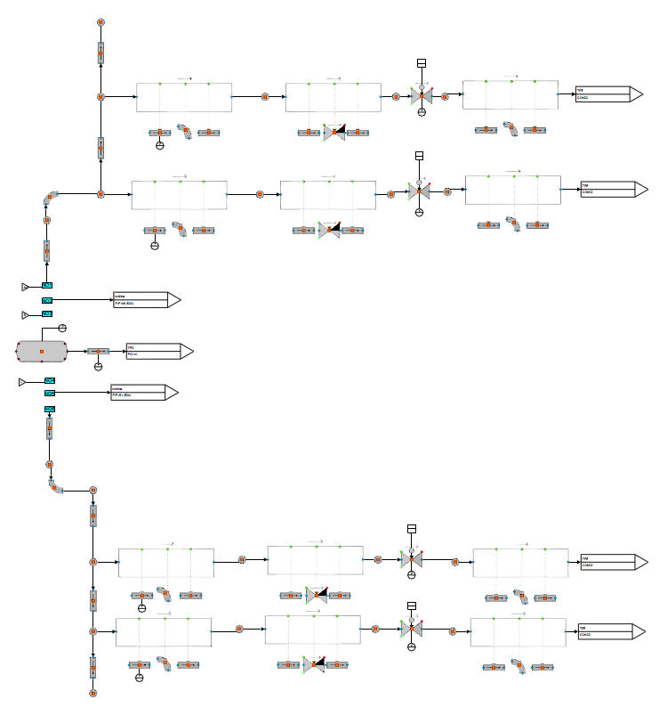
03
SIMULATION MODEL
Process component
The 4 steam bypass valves are built by CONTROL_VALVE component;
The connecting pipes are built by PIPE component;
The steam main pipe is built by TANK_HORI component.
All equipment parameters, pipe length and elevation are built according to realistic design.

Slide 10
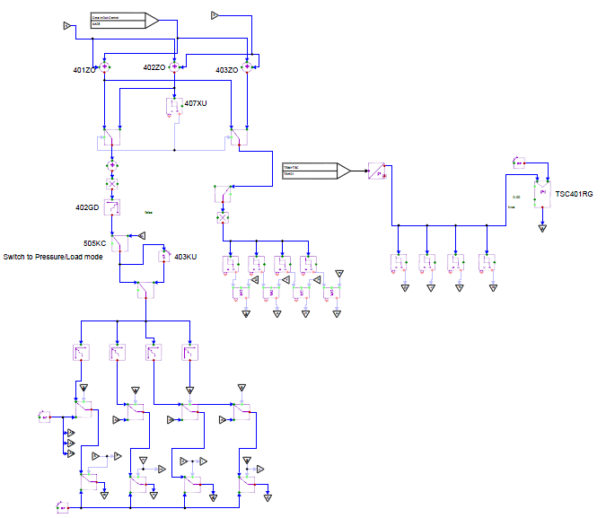
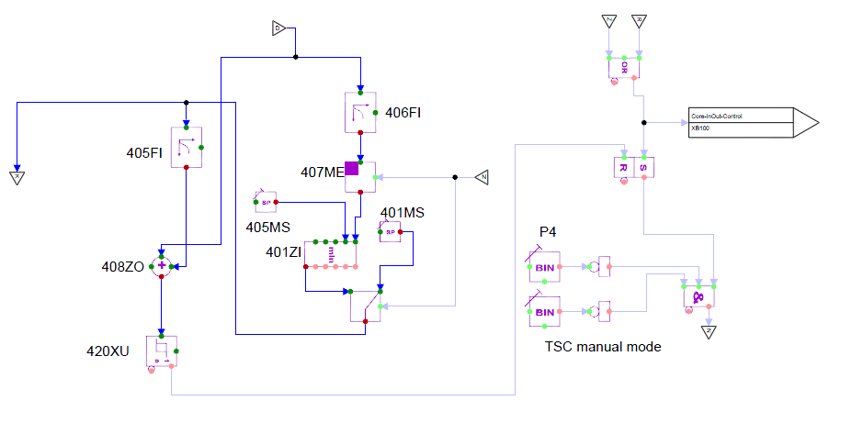
03
SIMULATION MODEL
Control Logic model
Apros automation components are used to build the steam dump control logic.

Slide 11
04
DYNAMIC ANALYSIS
The harshest and worst condition is turbine load rejection condition at full power, which can be further divided into two cases.
Turbine reject to plant power load:
Turbine load reduces to ~8%, resulting turbine shaft speed remarkably increased. Thus the turbine inlet valves close in 0.3s due to the turbine over-speed protection signal. The 4 steam bypass valves open in sequence according to reactor power-turbine load difference. After the turbine shaft speed reduced to normal range, the turbine inlet valves adjust to a small opening position to provide plant electric power. In this mode, the final reactor power is set to 40%.
Turbine trip:
Turbine inlet valves close at ~0.2s. The 4 steam bypass valves open in sequence according to reactor power-turbine load difference. The final reactor power is set to 40%.

Slide 12
04
Turbine reject to plant power load
DYNAMIC ANALYSIS
The sudden closure of turbine inlet valves resulted dramatically decreasing of steam/feedwater flowrate as well as dramatically increasing of steam pressure. All 4 steam bypass valves opened in sequence to provide an artificial load. At 144s, the turbine inlet valve reopened to a small opening to provide plant electric load. The peak value of steam pressure reaches ~5.5MPa but it is still lower than main steam safety valves opening set point (5.7 and 6.1MPa). After about 150s, the whole system reached a new steady state.

Slide 13
04
Turbine trip
DYNAMIC ANALYSIS
The process is similar to turbine reject to plant power load condition. The difference is the turbine load is set to 0 once the turbine trip signal is detected resulting almost simultaneously opening of all 4 steam bypass valves. Besides, the turbine inlet valve do not reopen. Finally after about 150s, the whole system reached a new steady state.

Slide 14
05
CONCLUSION
Based on the APROS simulation software, a dynamic simulation model of SMR steam dump and other related system is presented including the steam generator and reactor core. Simulation shows the following results:
The steam dump system generally performed its function, provide an artificial load on the secondary side.
The jointly operation of the steam dump system, reactor power control system and feedwater system can enable the plant to implement turbine load rejection and turbine trip operations successfully and safely without initiating the reactor trip or steam safety valves open.
During the steam dump process, oscillation can be observed on the 3rd steam bypass valve position.
Further analysis and optimization can be done to reduce or avoid frequently open/close of valve.

Slide 15
2024.10
Ye Zhu
Nuclear Power Institute of China
Chengdu, Sichuan, China
Thanks for your attention!

