Slide 2
On some safety aspects in Small Modular Reactors

Slide 3
On some safety aspects in Small Modular Reactors –GOAL
NPP were under complex process evolution with various stages - SMR is one of them
Important insights possible from their evaluation with multiple criteria in three groups / facets
    FACET I = Adequacy to evolving safety principles
    FACET II = Capability to meet safety goals objectives
    FACET III = NPP and the evolving new technologies

Slide 4
On some safety aspects in Small Modular Reactors -METHOD (1)
FACET I = SET OF CRITERIA RELATED TO SAFETY IN A DIRECT OR INDIRECT MANNER - CONSIDERING THE IMPACT ON THE WHOLE FUEL CYCLE (FRONT END, OPERATION AND BACK END):
Criteria defined in expert opinion approach and related to the evaluation of safety level considering:
  Credibility of uncertainties (CRU)
  Credibility of the level of conservatism(CRC)
  Evaluation of the adequacy of the type of method acceptable (deterministic -best estimate or not, probabilistic, combined) used in safety evaluations, performed by based on past similar experience (DPC)
  Impact of capability to manage change control during the design and safety evaluation phases (CHC)
Criteria defined in expert opinion approach by comparison with existing reference levels and related to the evaluation of safety level considering:
  Level of conservatism (LEC)
  Safety margin acceptability (SM)
  Defence in depth Acceptance criteria for levels and in general (DiDA)
  Defence in depth - Independence of levels(DiDI) and Cliff Edge Effects (CEE) confirmed by specialized methods as for instance probabilistic Risk Assessment (PRA)
Criteria defined in expert opinion approach by comparison on nuclear projects with indirect impact on the plant safety, as for instance:
  Impact of generation / technology phase and human factors (CGEN)
  Impact of site selection predefined criteria (CSIT)
  Emergency Plan and mitigating actions (CEP)
Criteria defined in expert opinion approach for the elements of the fuel cycle with impact on operational safety (type of fuel used of the existing features of reprocessing or storage or any other synergy with other fuel cycles:
  Front end fuel cycle (FEFC)
  Back-end fuel cycle (BEFC)

Slide 5
On some safety aspects in Small Modular Reactors –METHOD(2)
          FACET II = CAPABILITY TO MEET SAFETY GOALS OBJECTIVES

Slide 6
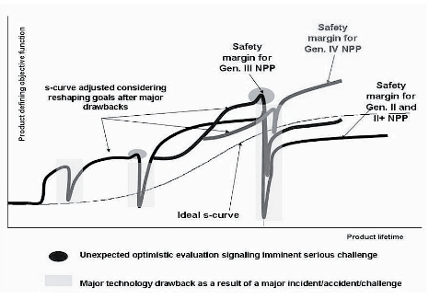
On some safety aspects in Small Modular Reactors –METHOD(3)
    FACET III = NPP AND THE EVOLVING NEW TECHNOLOGIES

Slide 7
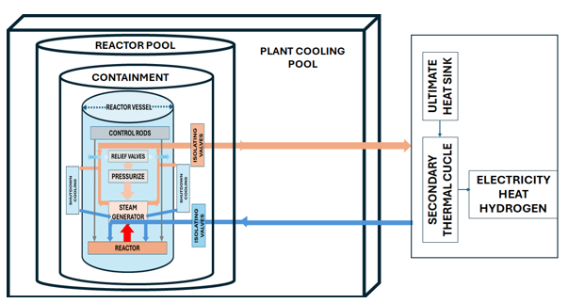
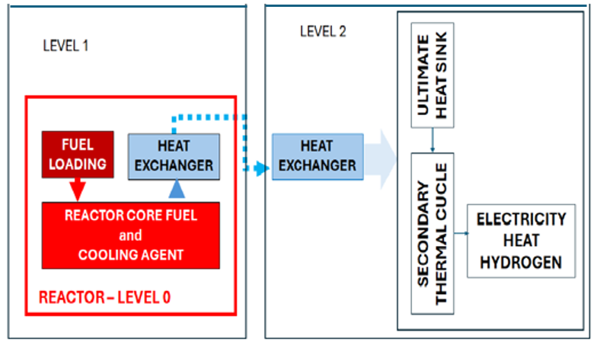
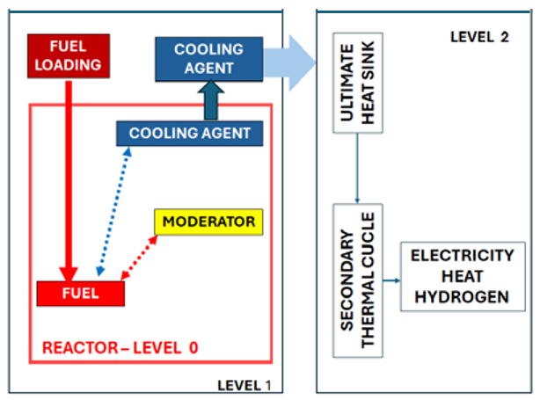
On some safety aspects in Small Modular Reactors –METHOD(4)
SAMPLE CASES CONSIDERED
Hypothetical SMR case as evaluated in previous projects for three phases: Research and development, FOAK and NOAK
    A=Water cooled (W) B=Gas cooled (G) C=Molten salt (M)
    Source: D.SERBANESCU, An Exegetic Comparison for Various Types of Small Modular Reactors, NUCLEAR 2024 Proceedings of nuclear 2024 the 50th international conference of sustainable development through nuclear research and education Part 1 nuclear energy, ISSN 2066-2955, Mioveni, Romania

Slide 8
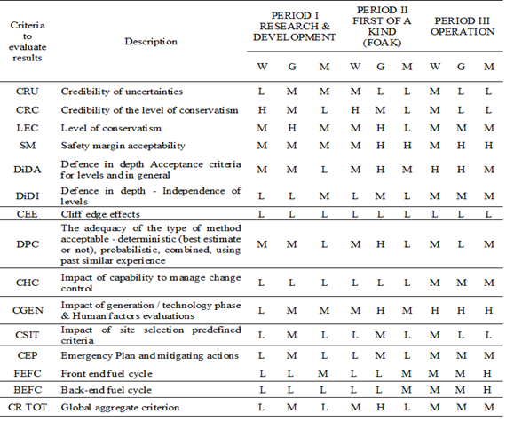
On some safety aspects in Small Modular Reactors –RESULTS(1)

Slide 9
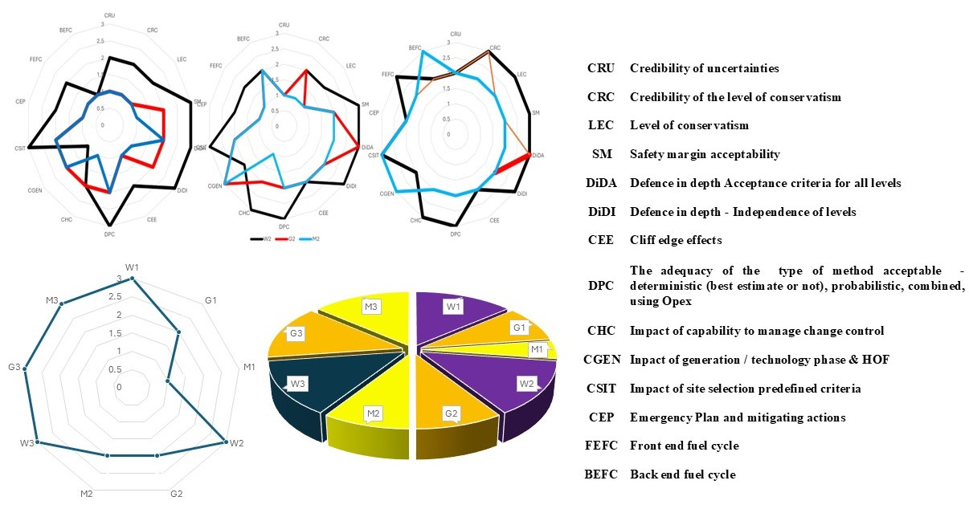
On some safety aspects in Small Modular Reactors –results(2)
PERIODS I=R&D II=FOAK III=NOAK
I
III
II
I
III
II

Slide 10
On some safety aspects in Small Modular Reactors-conclusions (1)
The evaluations performed were conducted for in depth calculations for all the cases from the perspective of Emergency Planning (EP) and detailed presentations of similarities and differences are presented.
Even if the types are very different for evaluations of EP there are similarities given by the considered source term, the scenario of major accident and the mitigating barriers.
Therefore, from EP perspective common aspects are identified like expected source term in case of severe accident, plant release barriers and site characteristics.
However, for other aspects considering the SMRs as thermodynamic machines being one of its dominant features, further detailed evaluations are under development in the project.

Slide 11
On some safety aspects in Small Modular Reactors-conclusions (2)
The development and implementation most probably will take place in phases: from research to FOAK and then commercial operation (NOAK).
As the technical challenges are highly similar
  The exchange of information and a coordinated manner for developing new plants will become essential for the success, mainly in the context of high importance allocated now to the proprietary, competition and patent aspects.
  The dominant technical challenges from safety perspective are similar.

