Slide 1
Collaboration – the key to standardized SMR deployment
Ronan Tanguy
Programme lead – Safety & Licensing
IAEA International Conference on Small Modular Reactors and their applications
22 October 2024

Slide 2

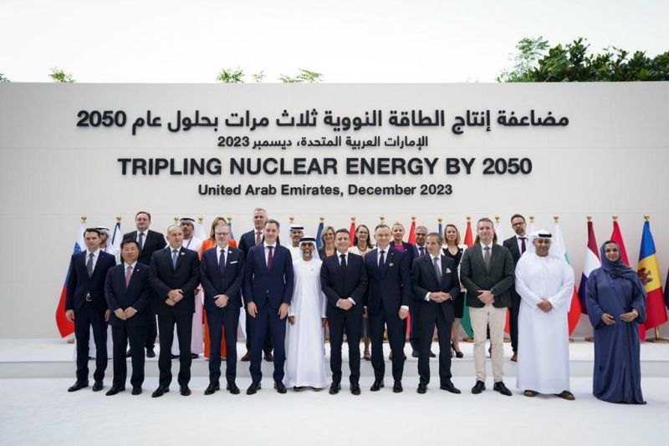
Influencing Policy - Net Zero Nuclear
The Net Zero Nuclear initiative is a long-term project engaging with climate change events.
Focuses on the goal of recognition for nuclear as a green source of energy & advocating for a tripling of nuclear capacity
25 countries declared their support for tripling global nuclear capacity by 2050.
Government pledge
120 companies determine that nuclear energy capacity should at least triple by 2050, from current levels, to help achieve global goals for decarbonization, clean energy supply and enhanced energy resiliency and security.
Industry Pledge
https://netzeronuclear.org/

Slide 3


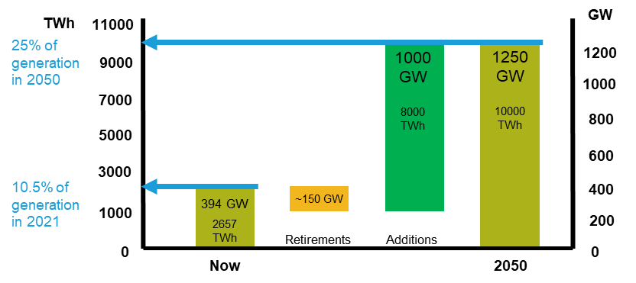

Net-zero needs a lot of new nuclear
Net Zero Nuclear -tripling of nuclear capacity by 2050 – 413GWe x 3 ~1200GWe
IPCC 1.5°C median scenario calls for ~1200GWe nuclear capacity by 2050
Translates as 1000GWe new nuclear by 2050
Today we build less than 10 GWe per year!!
40 GWe per year for 25 years
20 x 1000 MWe
+ 70 x 300 MWe SMRs per year
Source: WNA Harmony Programme 2021
3
Notes:
So what do we mean in terms of more and faster, well
In order to achieve the net Zero targets set out by countries, the World Nuclear Association Harmony Program believes that nuclear capacity needs to rise to around 25% of total generating capacity by 2050. This is also inline with the median IPCC scenario which calls for around a total of 1200GW of nuclear generation installed by 2050.
So that means over the next 25years we need to build around 60 or more new nuclear power plants each year every year – for reference we are currently building around 10 a year.

Slide 4
Much work needed to deploy nuclear power with speed and at scale
  Policies and markets that recognize and value the attributes of all low carbon energy sources
  Markets that ensure stability, reliability and affordability of energy
  Markets that have embedded signals incentivizing long-term planning and investment
  Science-based technology-agnostic criteria for ESG and Climate Financing
  Inclusion of nuclear in lending policies of international development banks, multilateral banks and other international financial institutions
  Innovative financing frameworks that optimize the social value of investments
Technology neutral Policies & Markets
Affordable Financing
  Provide mandate and resources for regulators to streamline and collaborate
  Optimized licensing processes that allow regulators to collaborate and accept each others’ methodologies & analyses
  Increased convergence in Codes & Standards
Streamlined Licensing
Global Markets
  Rebuilding of capabilities and acceleration of learning curves for nuclear projects
  Establishment of a global market with its associated global supply chain
  Moving from projects towards products

Slide 5


The SMR promise
A standardized, reactor design that can be manufactured in a central facility and deployed worldwide

Slide 6


The current landscape
Differences in nuclear regulations between countries mean that designs must be modified before they can be exported / imported
Multiple different supply chains are required

Slide 7
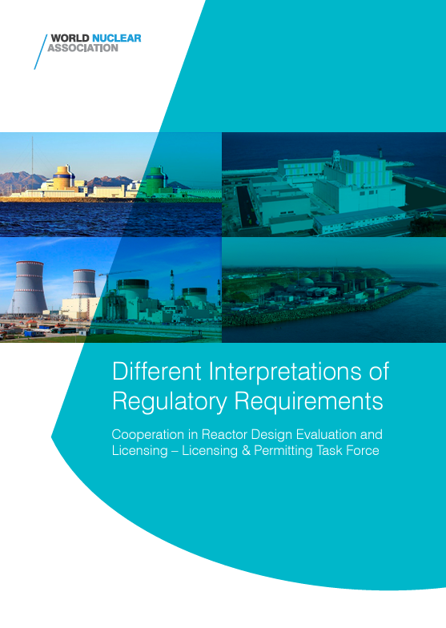
On the regulatory side
All countries have same fundamental nuclear safety standards.
    Incorporation of into specific national regulatory standards and guidance continues to result in differences
These differences in design solutions are often the result of
  How national regulators identify fault scenarios and acceptance criteria
  Differences in acceptance criteria amongst national regulators can be difficult to discern as they are not always part of the written requirements
  The method of demonstrating a safety case can vary widely among national regulators
This variability creates risks that present major challenges for new build projects and SMR deployment.
Regulators working together on a single design helps to identify best practice

Slide 8
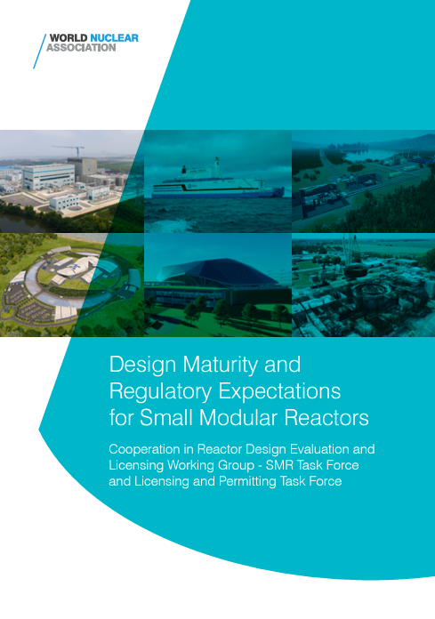
On the industry side
Multitude of SMR designs at different stages of design and technological readiness
  Major R&D and the demonstration of a clear programme of future technical development must be completed before engaging with or completing pre-licensing activities
Early and consistent regulatory engagement is key
  Build trust with the regulators, understand design maturity
Lessons learnt from engagement with regulators should be shared
  Allowing gap analyses to be undertaken and undertaking mitigating activities prior to regulatory engagement abroad
New technologies and new processes pose FOAK risks to licensing activities and designers.

Slide 9
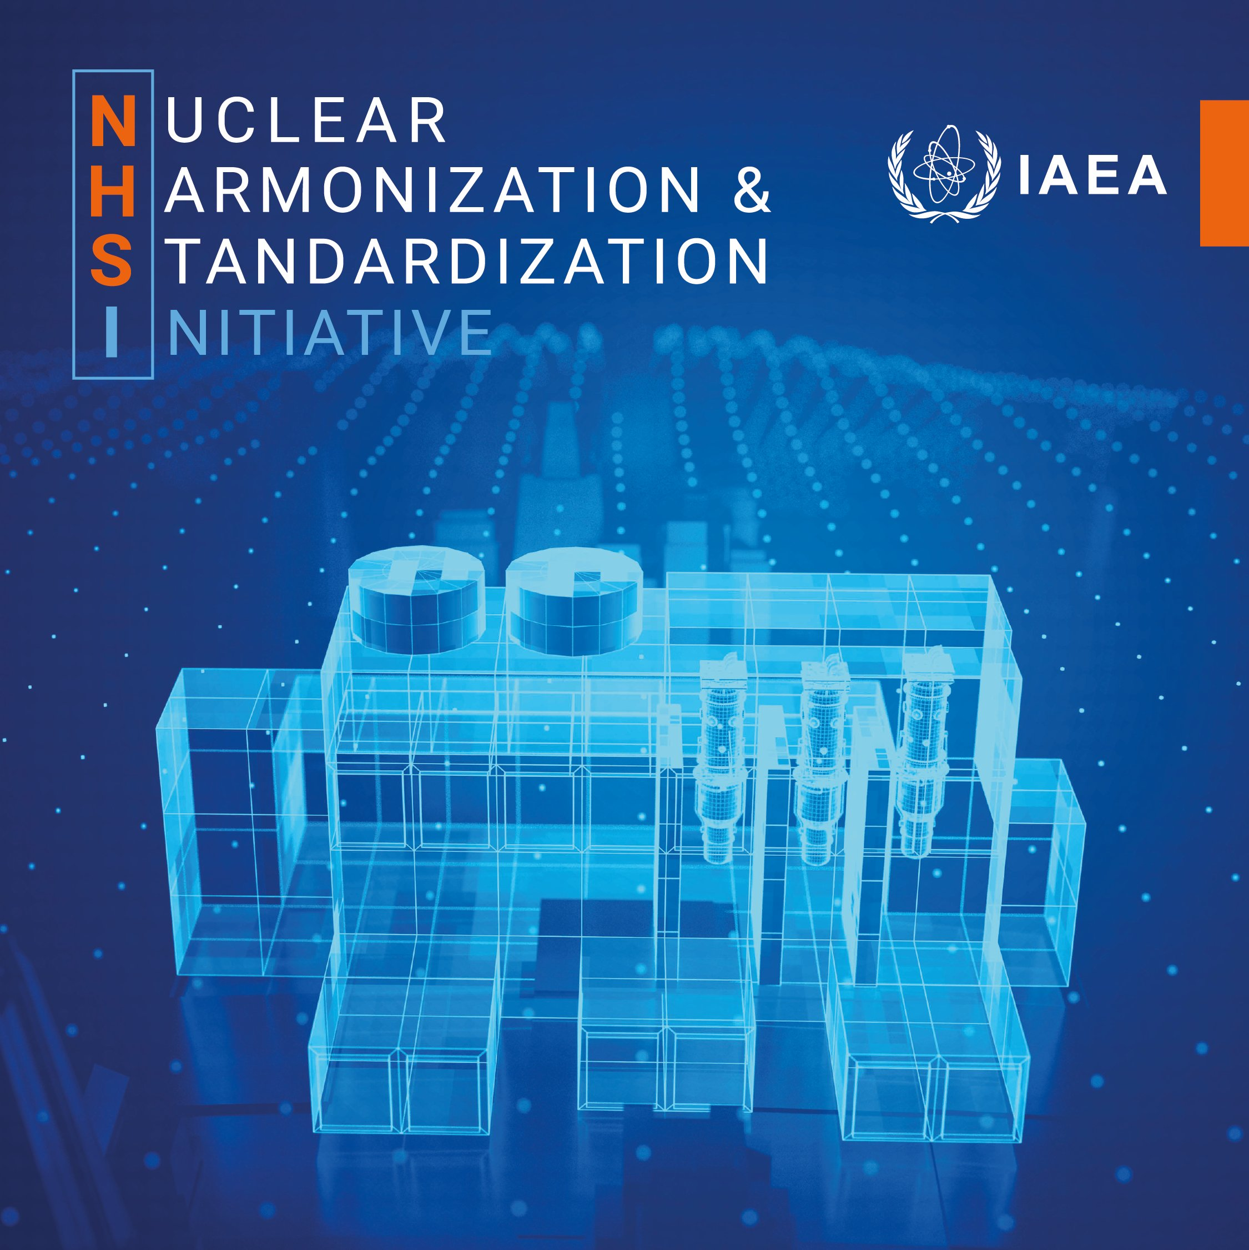
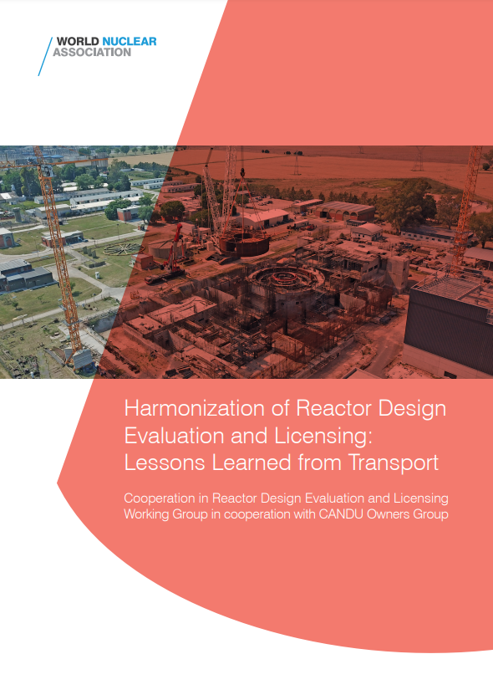
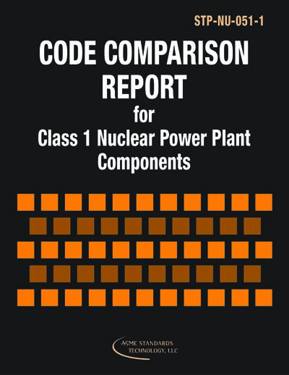
Enabled by industry initiatives
Opportunities to align industry practices will support accelerated deployment goals
World Nuclear Association working groups are engaged in many such activities
Jointly managing IAEA NHSI Industry Track Topic 2 on Codes & Standards for SMRs and supporting activities of 3 Regulatory Track Working Groups
Standard Developing Organizations Convergence Board aiming to converge where possible and limit divergence
Supply chain activities such as developing common procurement specifications and use of commercially available items

Slide 10
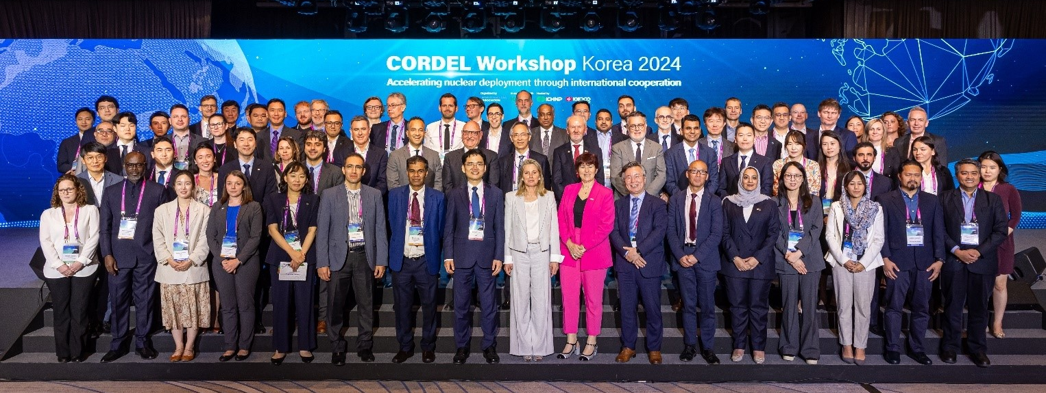
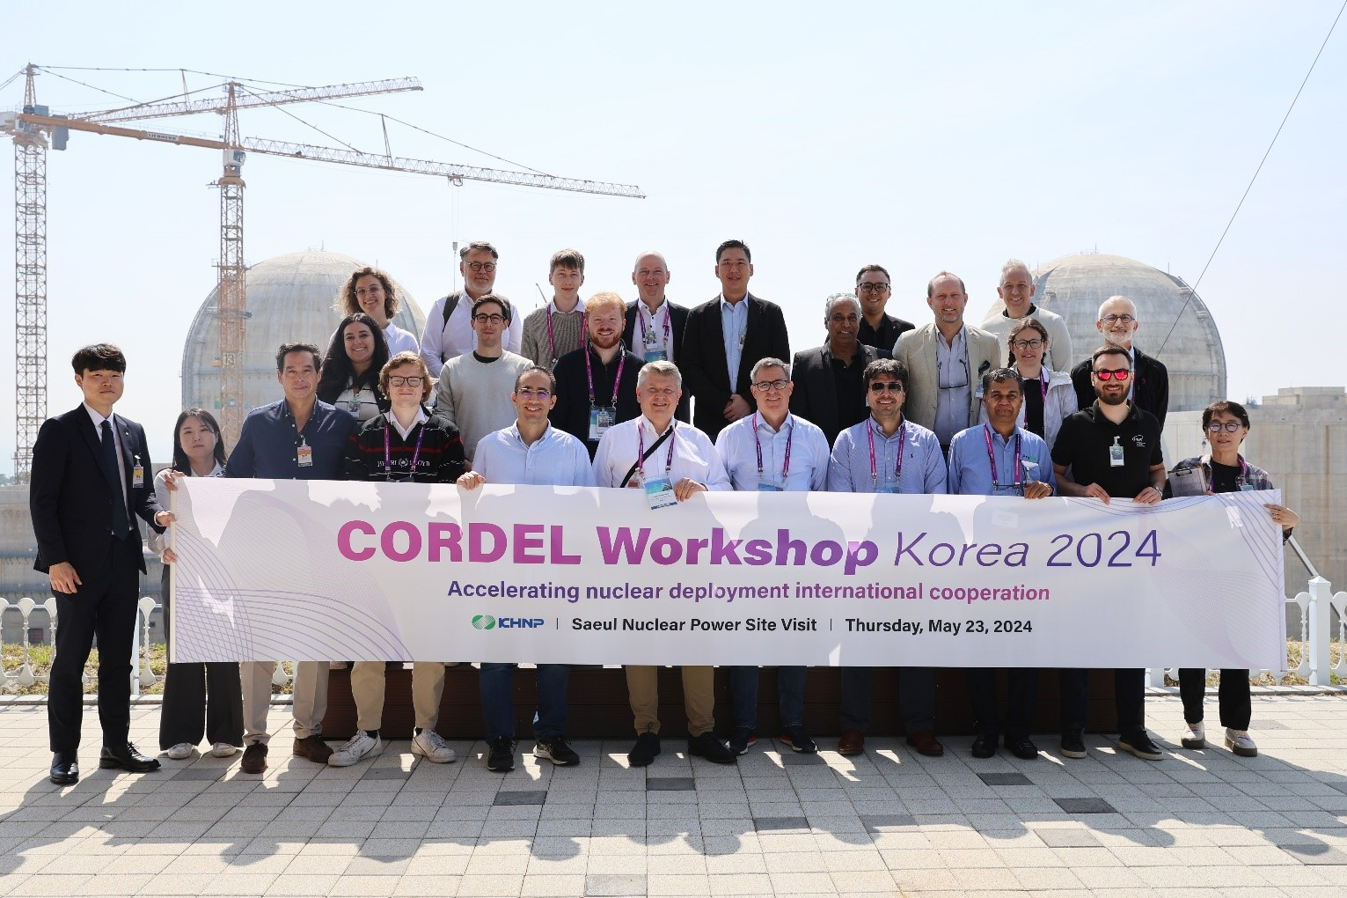
CORDEL Workshop Korea 2024
Held in Busan from 21-23 May 2024
In association with KNA and hosted by KHNP and KEPCO E&C
205 participants from 33 countries
Recognition of progress over past years on regulatory side
Industry needs greater collaboration
Need for a “new normal”
Must take advantage of current attention from policymakers
Reduce costs and deployment times for emerging countries

Slide 11
Collaborating as a sector
Deployment of fleets of standardized reactor designs is imperative for the success of SMRs.
Benefits through the entire lifecycle of nuclear plants
Requires a change in mindset and culture toward increased collaboration by all parties
We do not need to harmonize all regulatory requirements (or codes and standards), rather we need to find streamlined / efficient approaches to demonstrate equivalent levels of safety between national frameworks.
Build upon recent collaborative success stories such as the UAE’s experience with its successful Barakah project, and the cooperation between regulators to review BWRX-300 and NUWARD
Realistic about our expectations - these collaborative review efforts will likely identify differences in national regulatory approaches and requirements.
Review of suitably mature reactor designs can address differences
Need for the international organizations to better coordinate and integrate their activities to promote efficiency and progress.
Urgent requirement for government policy to provide the mandate and resources to enable regulators to continue to and enhance engagement in the international collaborative activities
The sector as a whole must work together to recruit and develop the workforce it needs to support the tripling of nuclear power.
Notes:
Now as I am sure you are all aware that volume of nuclear power plants will require a significant amount of more regulatory reviews
This raises question about whether we have sufficient regulatory capacity and expertise to support these requirements, and thus why we are very supportive of the IAEA Nuclear harmonization and standardization initiative, to look at how resource can be used more effectively

Slide 12
ronan.tanguy@world-nuclear.org

