Slide 2
THE VALUE OF EARLY ENGAGEMENT
BETWEEN STAKEHOLDERS TO ENSURE
SUCCESSFUL DEPLOYMENT OF SMRS
IN THE GLOBAL SOUTH
An African perspective
Ingrid KIRSTEN and Anthony STOTT
Vienna Center for Disarmament and Non-Proliferation (VCDNP)

Slide 3
Presentation Outline
Background – How did we get here?
Early engagement – challenge / risk
Mitigation
Workshop in South Africa / Meeting in NY
Value of early engagement

Slide 4
Limited Engagement ₁
Limited engagement to date between developers and potential end-users of SMR technologies in Global South
Risk / Challenge
Designs finalized with little consideration of deployment in Global South countries
Deployment in Global South more difficult, in particular from safeguards and nuclear security perspective
Higher costs to End-User (due to “back-fits”)
Global South countries retain the view that nuclear power is not an option / not accessible to them

Slide 5
Limited Engagement ₂
Limited engagement with international financial institutions, ODA funders and philanthropies on peaceful uses
Risk / Challenge
Sustainable development and climate action funders continue to “ignore” Peaceful Uses
Lack of funding assistance to develop infrastructure for Peaceful Uses (power and non-power)
Funding for peaceful uses and the IAEA is limited and cannot keep up with country needs

Slide 6
Early Engagement ₁
Between SMR Developers and Potential End-Users in Global South
Mitigation
SMR Developers:
SMR Potential End-Users in Global South:
express their needs / international nuclear obligations
Better understand their options to include nuclear power in their energy mix
better understand the needs of Global South countries – in terms of size, safeguards, security, costs, etc.

Slide 7
Early Engagement ₂
Forums / Platforms where Global South policy and decision makers engage with financial institutions, philantropies, development assistance community
Mitigation
Nuclear science and technology (non-power, power (non-electrical, electrical)) is discussed.
Benefits and challenges of Peaceful Uses (non-power and power) for Global South countries and the contribution to sustainable development is explored
Global South countries’ policy and decision makers recognise the opportunity and way forward to benefit from Peaceful Uses (non-power and power)

Slide 8
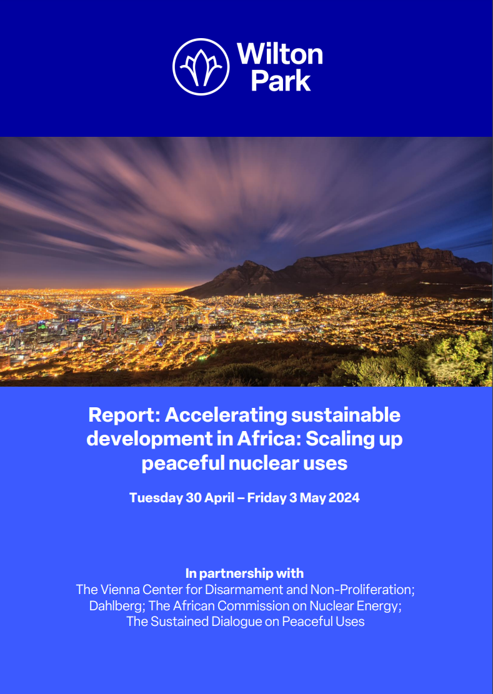
Recent Engagements
Accelerating Sustainable Development in Africa: Scaling Up Peaceful Nuclear Uses, 30 April to 3 May 2024
A three-day multi-stakeholder workshop on nuclear-development-climate change nexus
- Policymakers and Regulators from 11 African countries
- Advanced and Small (A/SMR) reactor developers
- Philantropies, Potential Investors
- International experts, including from IAEA and OECD / NEA
Plenary and Thematic Breakout discussions leading to Recommendations on:
- Regulatory and legal perspectives
- Financial perspectives
- Stakeholder involvement and perception perspectives
- Infrastructure perspectives
https://vcdnp.org/wp-content/uploads/2024/07/SAWorkshopReport2024.pdf

Slide 9
Recent Engagements
Oppenheimer Dialogue Funder Roundtable on Nuclear, Climate, and Technology Policy
26 September during Climate Week
- Launch of the Oppenheimer Dialogue Funder Roundtable Series
- Establishing a community of practice & collective impact strategy for
nuclear philanthropy.
https://vcdnp.org/wp-content/uploads/2024/07/SAWorkshopReport2024.pdf

Slide 10
Value of Early Engagement
Bold leadership by civil society
New partnerships
Towards a more secure future
Early Investment
Technology Access
Sustainable Access

Slide 11
Lessons Learned / Conclusions

Slide 12
Ingrid KIRSTEN
ikirsten@vcdnp.org; ikirsten@middlebury.edu
Anthony K STOTT
astott@vcdnp.org; akstott@middlebury.edu
Vienna Center for Disarmament and Non-Proliferation (VCDNP) Vienna, Austria https://vcdnp.org/

