Slide 2
Advanced Construction Technology Initiative (ACTI)
Program Status and Perspectives on Potential Technologies for Nuclear Energy
Luke Voss, NRIC Program Manager, 10/2/24

Slide 3
Introduction: ACTI Program Scope
Demonstrate technologies to significantly reduce the cost and schedule for construction of advanced reactors.
Demonstrate the technology by 2026/2027 to improve the economics of deploying advanced reactors.
Selected technologies will not require major R&D efforts. With prototyping and testing, the technologies will be ready for deployment at scale.

Slide 4
Benefits of Demonstration & Testing
Bridge the gap between development and commercialization
Learn by doing reduces risks associated with first commercial build
Build confidence with regulators
Develop supply chain

Slide 5
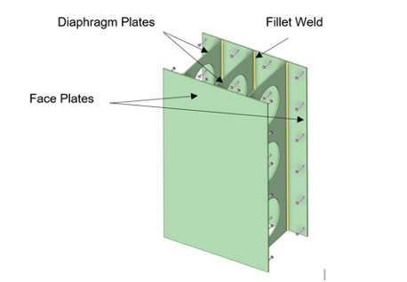
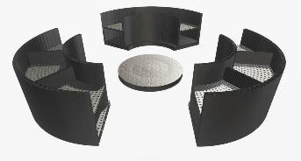
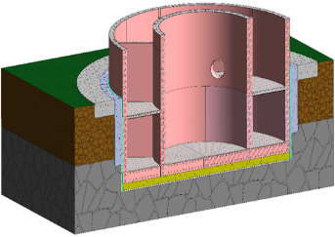
ACTI Project with GEH
Team - General Electric Hitachi
  EPRI, Black & Veatch, Purdue, UNCC, Aecon Wachs
Technologies Demonstrated:
  Steel concrete composite design for modular walling system
  Advanced monitoring and digital twin technologies
  NDE methods for steel concrete composite
Phase 1:
  Build & test steel concrete composite design
  Design a reactor building demonstration
  Develop advanced monitoring and digital twin technologies
  Demonstrate NDE methods for this technology
Potential Phase 2:
  Implement Phase 1 work to build a demonstration reactor building

Slide 6
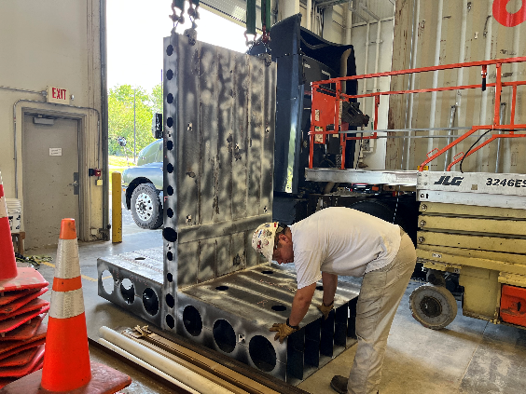
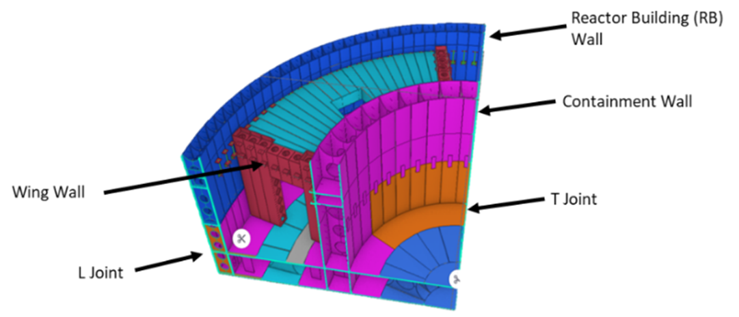
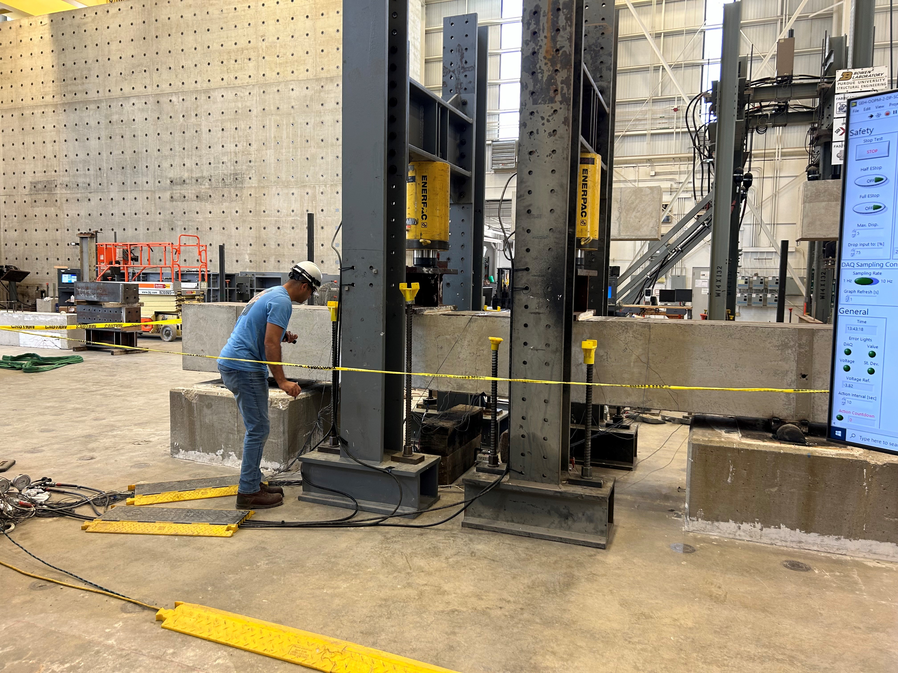
Project Accomplishments
Demonstrated concept of fabricating Diaphragm Steel Plate Composite (DPSC) assemblies in a factory setting
Successfully tested DPSC specimens at Purdue
Designed a demonstration structure using the DPSC design
Established digital twin and monitoring techniques
Demonstrated NDE methods to inspect concrete inside DPSC modules

Slide 7
Current GEH Project Schedule
Phase 1 completes January 2025
Potential Phase 2 scope may include:
  Build and test reactor building structure using DPSC design
  Disassemble and decommission demonstration structure
  If executed, will occur in 2025

Slide 8
Project Objectives & Benefits
Benefits to the nuclear industry through the following:
  Demonstrate DPSC fabrication and erection of the critical joint and section types
  Develop construction and fabrication workforce capability for DPSC modules
  Establish and improve supply chain capabilities for mass deployment to nuclear industry
  Demonstrate viability of non-destructive testing methods during construction
  Advance fit up techniques with digital twin technology to better align modules

Slide 9
Potential Advanced Construction Technology Projects
Improved implementation of the graded approach to nuclear quality assurance requirements
Digital Twins for developing and deploying advanced nuclear facilities
Construction and testing of structural elements using high temperature concrete
Diaphragm wall construction testing and demonstration
Testing of robotic and 3-D printing of reinforced concrete techniques
Deployment of pre-cast concrete in nuclear construction
Techno-economic analysis of nuclear construction

Slide 10
Topic 1: Improved Implementation of the Graded Approach to NQA requirements
Current practices for over-implementation of nuclear quality assurance (NQA) requirements pose significant challenges for deployment of advanced reactors.
  Examples: 10CFR50 Appendix B, NQA-1
Many advanced reactor designs inherently mitigate several of the safety concerns that challenge light water reactors (LWR)
Substantial cost efficiencies may be realized through improved implementation of engineering, procurement, and construction requirements defined in existing codes and standards.
There remains a need to conclusively demonstrate how this evolving regulatory paradigm can be effectively applied to the design, licensing, and construction of nuclear structures, potentially unlocking economic benefits while maintaining safety and reliability

Slide 11
Topic 2: Digital Twins for Developing and Deploying New Nuclear Facilities
Digital twins could:
  Increase design productivity by automatically transferring information between applications.
  Enable systems engineering approaches to accommodate a wider range of simulations, analyses, and verification in the early stages of design.
  Reduce errors by providing a robust digital thread of information maintained throughout the project lifecycle to ensure data are not “lost”
NRIC suggests a project to build an open-source, project-agnostic, plug-and-play digital twin backbone that could benefit the nuclear energy industry
  Develop a Technology Readiness Level (TRL) 7 open-source “digital engineering for nuclear” ecosystem
  Demonstrate use and operation of the ecosystem in the design of a nuclear facility
  Begin the NQA-1 qualification of the digital engineering ecosystem

Slide 12
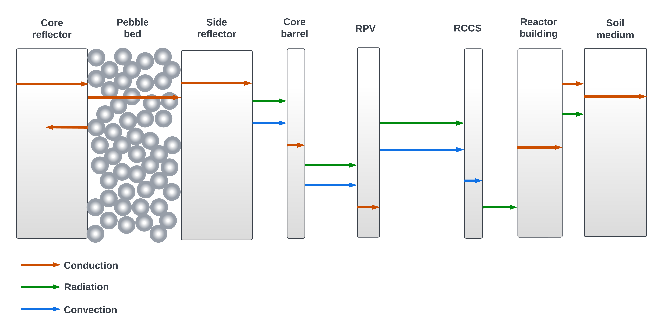
Topic 3: Construction & Testing Using High Temp Concrete
High temperature reactors could experience risk of reduced structural integrity due to a severe thermal cycle that could potentially compromise the entire reactor plant investment without necessarily posing immediate environmental or public safety risks.
Instead of advanced reactors capability to operate at higher temperatures being considered a risk, it can be considered as an asset (e.g. commercialize heat at nearby industrial facilities).
A comprehensive understanding of high-temperature environments in the nuclear energy domain is essential.
NRIC proposes a project to demonstrate and better understand the behavior of concrete structures at elevated temperatures:
  Help establish a more widely accepted high temperature concrete design procedure for advanced nuclear applications

Slide 13
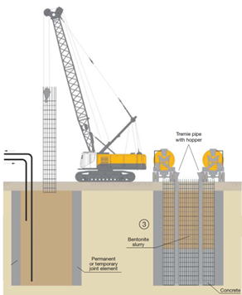
Topic 4: Diaphragm Wall Construction Testing & Demonstration
A diaphragm wall is constructed using a vertical trench that is supported by a light mud fluid until the mud is replaced by concrete.
This system can significantly reduce excavation for nuclear facilities when compared to the common practice of bathtub excavation.
The walls can create a leak tight facility with spaces used for reactor operations, fuel storage, hot cell work, or other radiological activities.
The successful transfer of this method from non-nuclear industries to nuclear requires special knowledge of design, concrete technology, joint formation, and construction suited to meet nuclear regulatory requirements.
A baseline demonstration of the technology could be utilized in conjunction with one or more reactors to provide proof of concept of the speed of construction.

Slide 14
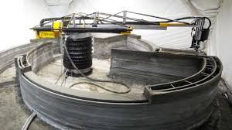
Topic 5: Testing of Robotic and 3D Printing of Reinforced Concrete Techniques
Using 3D printing technology for nuclear construction offers numerous potential benefits such as:
  Time reduction
  Cost efficiency
  Enhanced structural integrity
  Faster operational readiness
  Increased worker safety
Using this technology in a nuclear application presents unique challenges, such as the temperature ranges and seismic loads the structures must withstand.
Immediate development work is needed in concrete formulation development, existing technology assessment for printing techniques, testing standards development, regulatory engagement, and test site development.

Slide 15
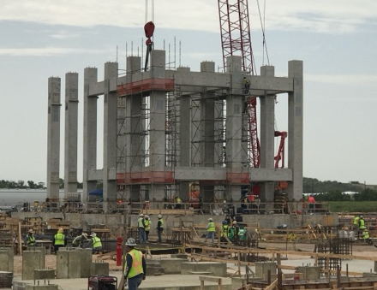
Topic 6: Deployment of Pre-Cast Concrete in Nuclear Construction
In order to meet US decarbonization goals, a mature nuclear construction supply chain is needed.
Modular precast reinforced concrete construction has been widely deployed for decades in US non-nuclear construction sectors to build mission-critical infrastructure.
A robust supply chain, including factories, infrastructure, trained labor, and proven transportation already exists for precast concrete.
Standardized modules can be quickly assembled on site by a small, trained workforce, unlike traditional cast-in-place concrete work.
A multi-pronged demonstration project of pre-cast concrete is proposed to provide a pathway to deployment, using an archetype reactor building as an example.

Slide 16
Topic 7: Techno-Economic Analysis of Nuclear Construction
In the past decade, researchers have performed techno-economic analysis of nuclear construction to diagnose the reasons behind nuclear cost and schedule overruns
Given the large gap in nuclear construction in the United States, most studies use decades old construction cost data, maybe not pertinent for today’s challenges (e.g. higher labor and material costs, new NRC regulations).
INL and partners have been developing tools that can analyze cost and schedule data from nuclear projects and perform techno-economic analysis in such a way to remove proprietary information and then compared across construction projects.
Insights and lessons learned from these techno-economic analysis of these data can:
  Provide a more objective comparison of the effectiveness of these advanced construction technologies in terms of cost and schedule
  Model the application of these technologies in real nuclear power plant construction to estimate their contribution to potential capital cost construction risk reduction
  Translate the experience from these construction projects into learning that can be applied to advanced nuclear construction
NRIC proposes a construction techno-economic analysis program that involves collecting cost and schedule data from nuclear projects, assembling the costs for each project, and performing a detailed techno-economic analysis of the costs to understand the effectiveness of each technology.

Slide 17
Summary
Nuclear construction is difficult with substantial risk of schedule and cost overruns
The current NRIC ACTI project represents only a first step in a much larger needed effort.
The myriad of potential solutions demands a comprehensive prioritization strategy and systematic approach.
NRIC envisions paving the way for a streamlined, cost-effective nuclear construction process, ultimately accelerating the clean energy transition and unlocking the future of reliable, low-carbon nuclear energy.

