Slide 2

Steel-Concrete modular construction. Economic impact on the levelized cost of electricity for large reactors or SMRs
Session 15.1 : Economic and macroeconomic analysis and impact of technology development on the cost of SMRs
Author: Alliard ; Co-authors: Niepceron, Crozet, Maupu
Tuesday, 22 October 2024,16:45-17:00

Slide 3
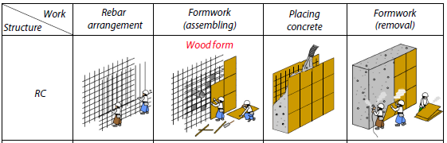
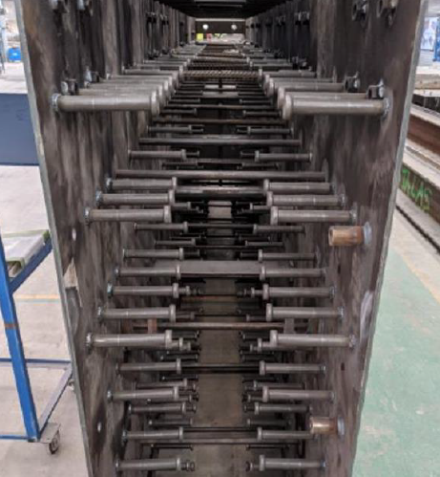
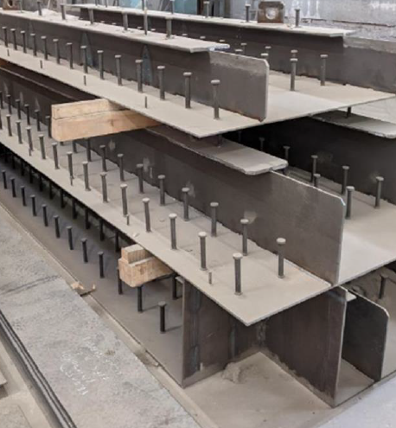
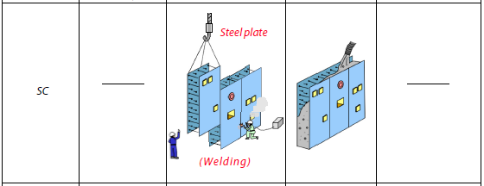
What is Steel-Concrete ?
SC Wall module SC slab module
Source : EDF Source : EDF

Slide 4
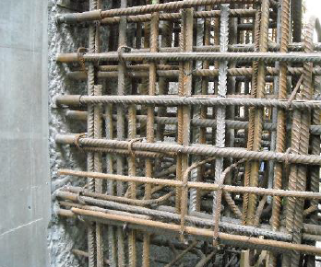
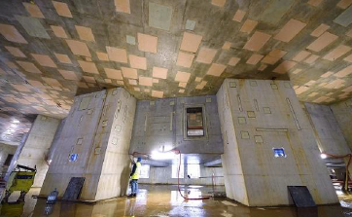
Why using Steel-Concrete ?
Advantages
No problem of steel rebars and embedded plates congestion
Faster construction = lower capitalized plant cost (INDIR, OWN, IDC)
Less on-site works. Better quality by factory prefabrication.
Flexibility to weld the systems support on plates
Less expensive in the pools
Drawbacks
Anticipated detailed design. No last minute modification.
More expensive in ordinary walls/slabs
Not yet licensed in Europe but codification is in progress and planed to be time-to-market for SMRs (see Track #3 Paper #66 by Niepceron et al.)
Source : EDF
Source : ITER ORGANIZATION website

Slide 5
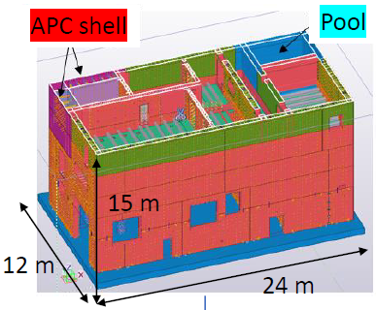
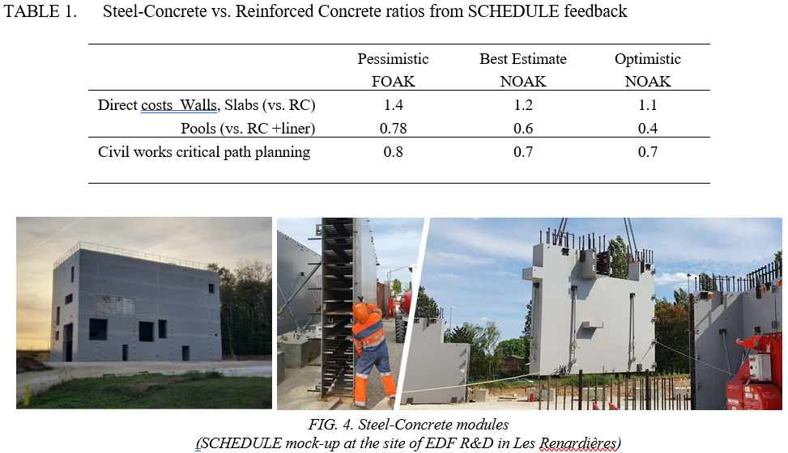
Pilot building “SCHEDULE”
Steel Concrete High Efficiency Demonstration eUropean ColLaboration
EU funded project 800732 (2018-2023)
Full-size diesel building made with SCS above reinforced concrete raft
Compared to 58 identical buildings in RC erected at French NPPs (ultimate safety upgrade program)
New phase of R&D tests by EDF next years
Modules of reasonable size, transportation by trucks and lifting by ordinary tower cranes, without pre-installed electromechanical components

Slide 6
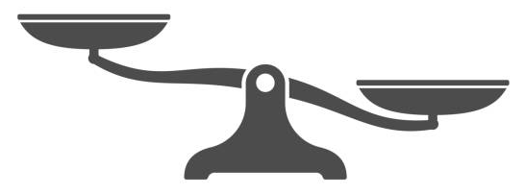
How much time and money savings ?
> Purpose : to quantify the Steel-Concrete economic effect
LCOE ($/MWh)
or
Capitalized Cost ($/kW)
Steel-Concrete increased civil cost
(DIR)
Construction acceleration
= reduced time related costs
(INDIR, OWN, IDC)
Risk-free Private return with risk premium
Investors’ return (WACC)

Slide 7
How much time and money savings ?
> Methodology
SCHEDULE learnings feed two financial models of SMR or Large Reactor to run sensitivity analyses (RC vs. SCS)
Revised lines are DIR, INDIR, OWN, IDC because of both modified civil works cost and the accelerated schedule critical path
Various simulations (reactor size, confidence level, WACC, …)
Computation of the EPCC cost (Vendor’s point of view), Capitalized cost (Owner’s point of view), and LCOE (Electricity cost)

Slide 8
How much time and money savings ?
> Time to money exchange rate
All things considered, the Steel-Concrete effect on LCOE is -0.5% per saved month
The number of saved months of construction will depend on the plant size, and the smart selection of areas on the critical path : from a few months (SMRs) to years (Large Reactors)
No fully-equipped macromodules (cf. negative feedback on AP1000 highlighted by MIT reports). Small civil works modules only.

Slide 9
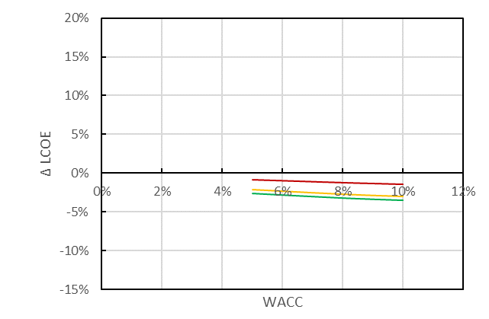
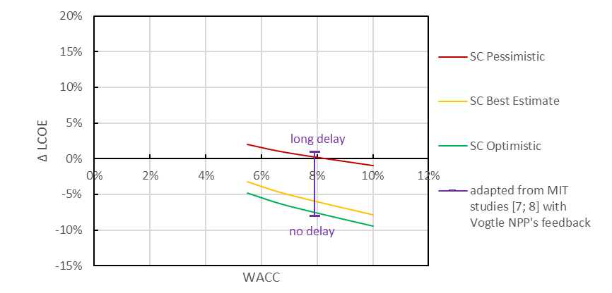
How much time and money savings ?
> Levelized Cost Of Electricity
For SMRs, the civil works relative weight in the costs breakdown and the schedule is smaller. The profitable SCS effect is thereby unfortunately moderated
Main savings come from the pools (replacement of RC + steel liner by SCS modules)
For Large Reactors, our forecasts match the MIT thesis (Champlin 2018, Steward & Shirvan 2022)

Slide 10
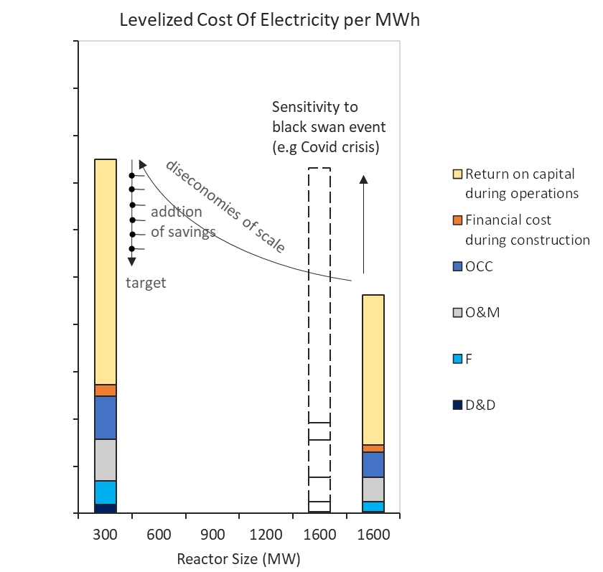
Conclusion
Smart replacement of reinforced concrete by Steel Concrete (SCS) is recommended in strategic areas, to facilitate/accelerate construction and secure the schedule reliability :
  - Pools
  - Structures on critical path of the schedule
  - Complex reinforced concrete structures
SCS enable substantial reduction of the global plant capitalized cost and the cost of electricity generation up to -8%
The higher is the cost of money, the higher savings are.
Best savings potential is for Large Reactors because of the higher relative weight of civil works in the cost and planning breakdown.
For SMRs to meet the price competitiveness challenge, according to the size and the choice of passive systems with pools, it remains an interesting optimization brick (to cumulate with other ideas).

