Slide 1
EverGREEN 2045: An Energy Mix to Decarbonize Washington State
Brittany Tarufelli, PhD
Senior Economist, PNNL

Slide 2
This research was supported by the Energy and Environment Mission Seed, under the Laboratory Directed Research and Development (LDRD) Program PNNL.
PNNL is a multi-program national laboratory operated for the U.S. Department of Energy (DOE) by Battelle Memorial Institute under Contract No. DE-AC05-76RL01830.
We thank AltaRock Energy and X-energy for providing us with cost estimate information.
Acknowledgements
The research team:
K. Harris, S. Acharya, K. Mahapatra, B. Vyakaranam, A. Campbell, P. Maloney, D. Bhatnagar, M. Weimar, and A. Zbib

Slide 3
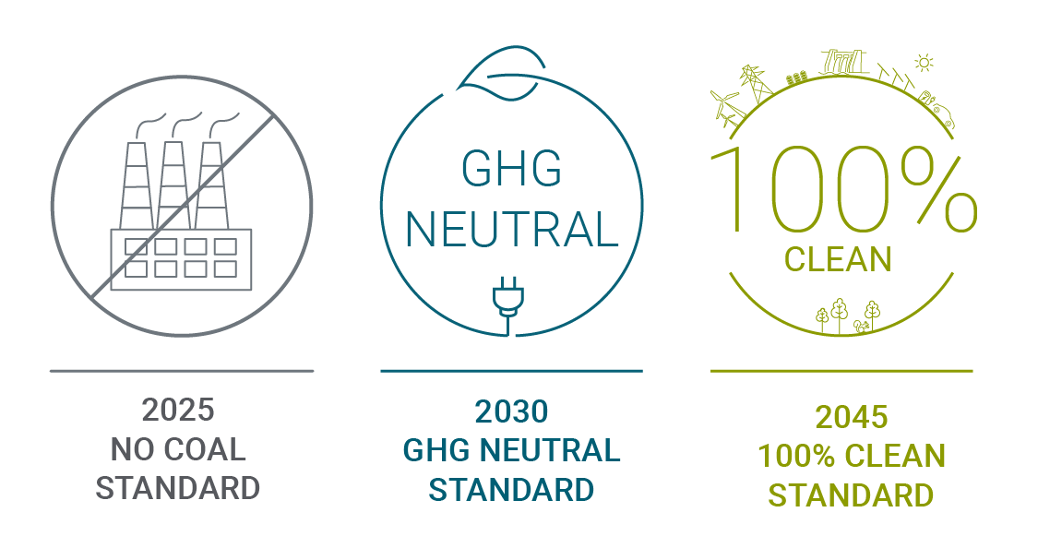
Project Motivation
The Washington Clean Energy Transformation Act:
  Transitions the state to carbon-free generation by 2045
  Eliminates coal from Washington state’s generation mix by 2025
  Imposes a $60/MWh tax on natural gas generation in 2030
  Prohibits the introduction of new conventional hydro
Implies the flexibility of generating resources will be at a premium
  Especially important with increasing amounts of wind and solar power
Need for analysis of future energy resources, including small modular reactors to understand both the costs and stability of the future electric-power system.

Slide 4
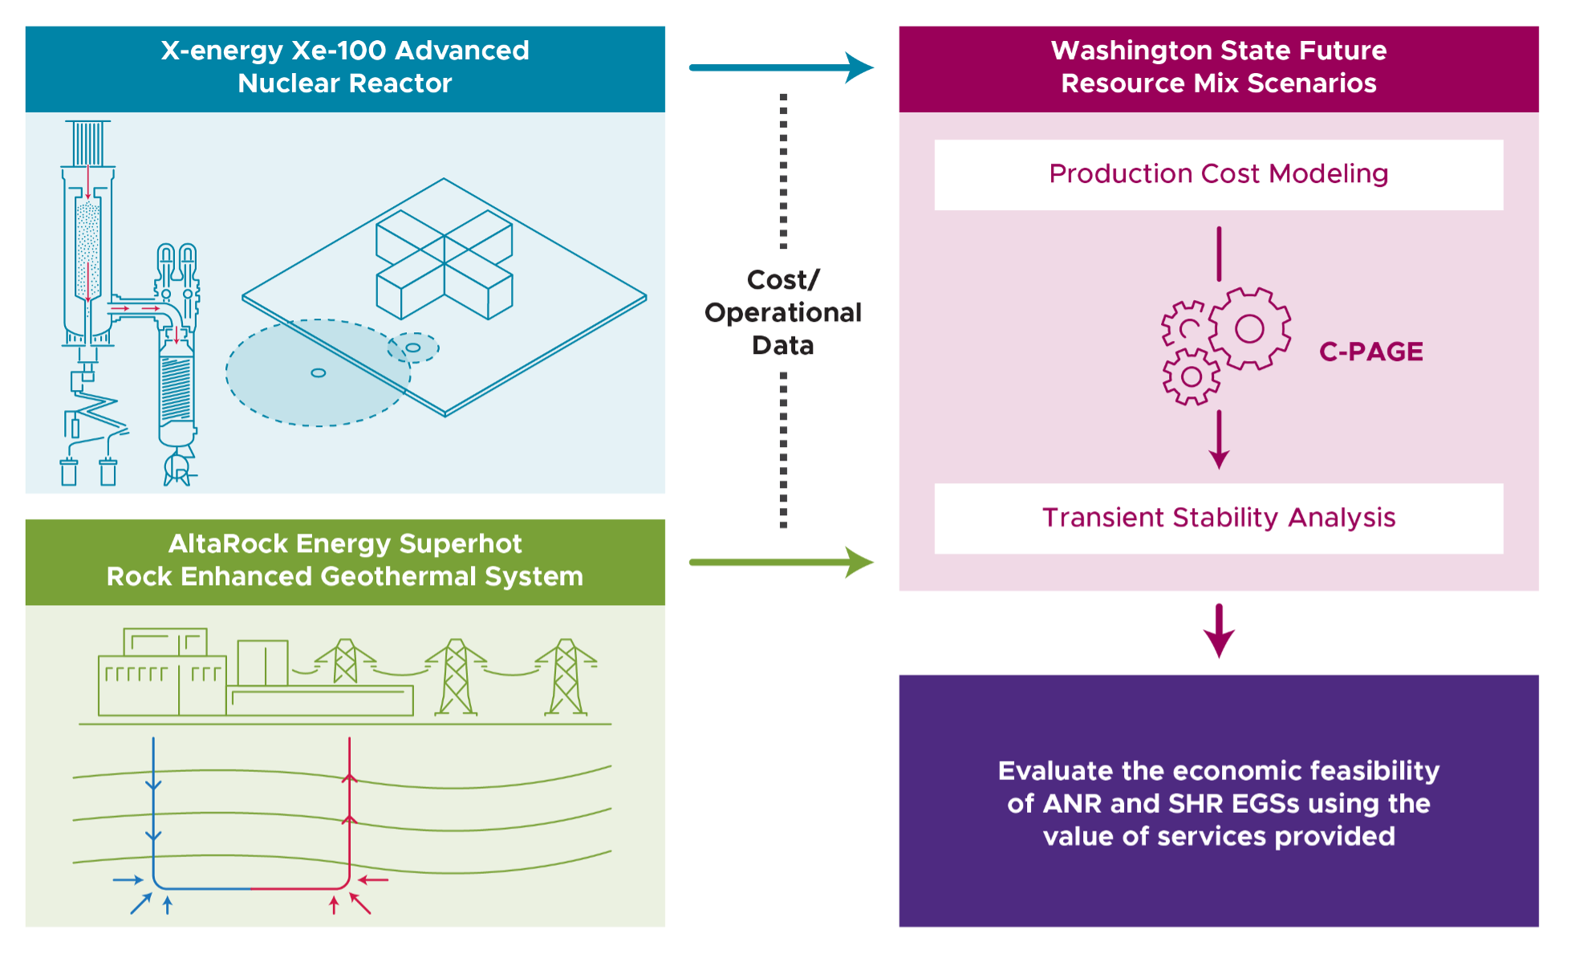
Project Approach and Modeling Framework
Estimate the costs of advanced nuclear reactors (ANR) and superhot rock (SHR) enhanced geothermal systems (EGS)
Design future resource mix scenarios with optimal resource additions for Washington State
Power systems analysis
Evaluate economic feasibility of new generation technologies

Slide 5
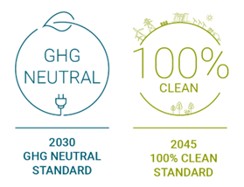
Future Resource Mix Scenarios
Designed to be compliant with Washington State’s Clean Energy Transformation Act
Base Case | 2030 GHG Neutral Case | 2045 100% Clean Energy Case
2028 WECC ADS Onshore Wind: 3,025 MW Conventional Nuclear: 1,170 MW | 2028 WECC ADS + Penalties ​$150/MWh (Coal) ​$60/MWh (NGCC) Onshore Wind: 3,025 MW Conventional Nuclear: 1,185 MW 100 MW SHR EGS 320 MW ANR | 2028 WECC ADS + 100% Clean Energy Serving WA Load Onshore Wind-6,221 MW Serving Load Conventional Nuclear-1,170 MW 1 GW SHR EGS 3 X 320 MW ANR Additional 2,880 MW ANR
SMRs added at existing sites. New wind power supply added in the Lower Snake River region, along the Columbia Gorge, and on the west side of the Cascades. New wind power supply from Montana (winter peaking) added and assumed to serve Washington load. Solar PV added along the Lower Snake region, in the Hanford site area, and the retired Centralia coal plant site area. Four-hour battery energy storage distributed with added solar generation. New, closed-loop pumped storage hydropower added on the east side of the Cascades (where surplus wind and solar exist), as well as along the Columbia Gorge and Mid-Columbia area.

Slide 6
Cost Estimates
X-energy Xe-100 SMR | AltaRock Energy SHR EGS
Generation IV high-temperature gas-cooled nuclear reactor Modular design allows 80 MW reactors to be scaled into a 4-pack 320 MW plant, cogeneration options Online refueling allowed by pebble bed design, powered by TRISO fuel (94% capacity factor) | Drilling into superhot rock provides higher temperature steam and higher efficiency Leverages economies of scale not available for current geothermal systems Novel drilling technology
Utilize G4Econs nuclear-economic model to determine LCOE
Parameters based on proprietary data, uranium market mining, conversion, and enrichment cost data, literature review, and PNNL calculations
Assumes clean electricity PTC of 1.5 cents per kW
Nth of A Kind

Slide 7
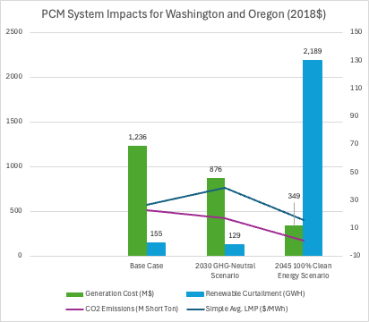
Power Systems Analysis
Production Cost Modeling
Inputs to the model include detailed cost and operational data (including those estimated for new, flexible generation technologies)
Adjusted the PCM, a linearized DC optimal power flow model, to reflect our future resource mix scenarios and evaluated results for several criteria including unserved load, production costs, carbon emissions and costs, and renewable curtailments

Slide 8
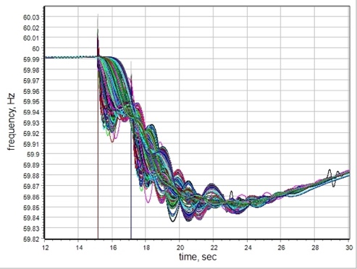
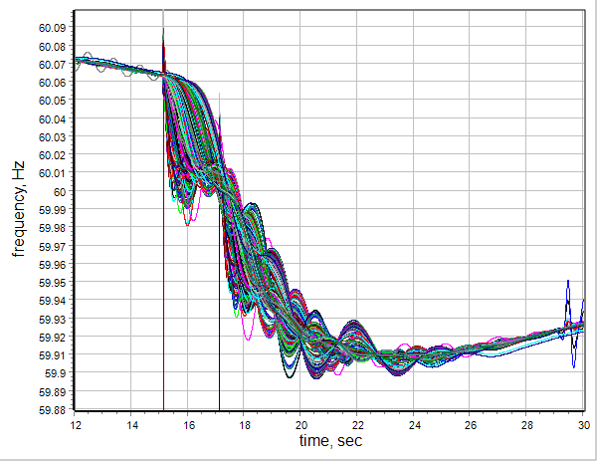
Power Systems Analysis
Transient Stability Analysis
Expose the system to a large N-2 contingency
Observe the response of the system
Compare the response of the system with and without SMRs and SHR EGSs
Compare the response of the system with and without a large addition of renewables
Inertia and frequency response characteristics improved, and voltage profile remained stable
Frequency Response: Base Case
Frequency Response: Added 1960 MW SMRs / EGS

Slide 9
Economic Feasibility
Examined economic feasibility by generator type
  Were revenues earned sufficient to cover variable O&M and fuel costs?
  Were revenues earned sufficient to cover total costs (LCOE)?
Small Modular Reactors require a capacity payment of up to $12 (unsubsidized) in 2030. Capacity payments increase from $26 (subsidized) to $38 (unsubsidized) in 2045

Slide 10
Conclusion
Our research contributes to our understanding of the economic feasibility and stability of the future resource mix
We also consider the role and economic feasibility of two future technologies that could provide valuable flexibility services to the future resource mix
More detailed analyses could incorporate:
  Transmission upgrades to better integrate renewable power
  Development of a bid-based model to analyze potential price and revenue impacts to address inherent limitations of the development of prices (based on production costs and system constraints)
Future work could also provide insight into the social and distributional impacts of the future resource mix

Slide 11

Brittany Tarufelli
Brittany.Tarufelli@pnnl.gov
Energy and Environment Directorate
Economics, Policy & Institutional Support
https://www.pnnl.gov/sustainable-energy

