Slide 2
Extended assessment of nuclear and alternative electricity generating technologies based on their impact on national GDP (Cost-to-GDP concept)
Sergey Rozhenko
Director, Power Analytics, Kept (Russia)
October, 2024

Slide 3
Small Modular Reactors costs
Cost range of SMRs
Small Modular Reactors
SMRs are defined as nuclear reactors with a maximum output of 300 Megawatt electric (MWe) for generating electricity
SMR – too expensive to be competitive?
Source: “Scalling Success. Navigating the Future of Small Modular Reactors in Competitive Global Low-Carbon Energy Markets”, NNWI, 2023.

Slide 4
Specifics of generation cost assessment
Part 1

Slide 5
LCOE and its applications
LCOE
A measure of the average net present cost of electricity generation for a generator over its lifetime
What is LCOE used for:
Comparison of electricity production costs by source
Energy planning – core of methodology of Least Cost Generation Planning
Policy advocacy and lobbing
Simple and powerful political tool
Source: Kept analysis.

Slide 6
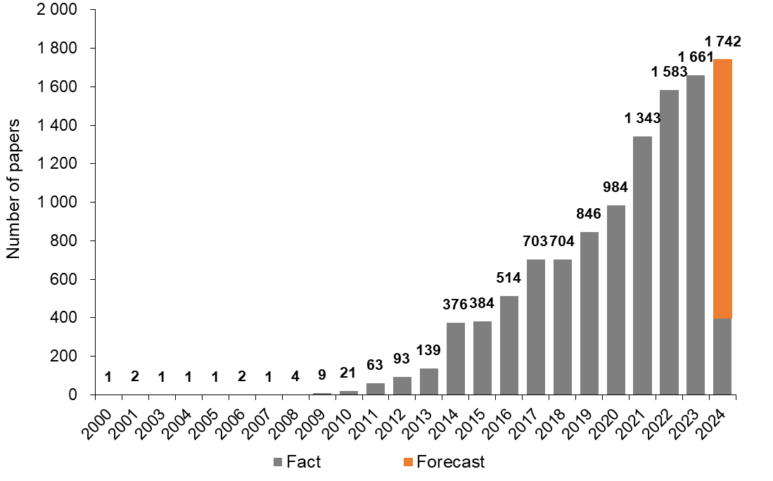
Global research statistic on LCOE
Global research count for electricity cost studies #LCOE topic
Increasing interest
>10,000 papers
>85% related to VRE
CAGR 28% over 10Y
Source: ResearchGate, Science Direct, Kept analysis.

Slide 7

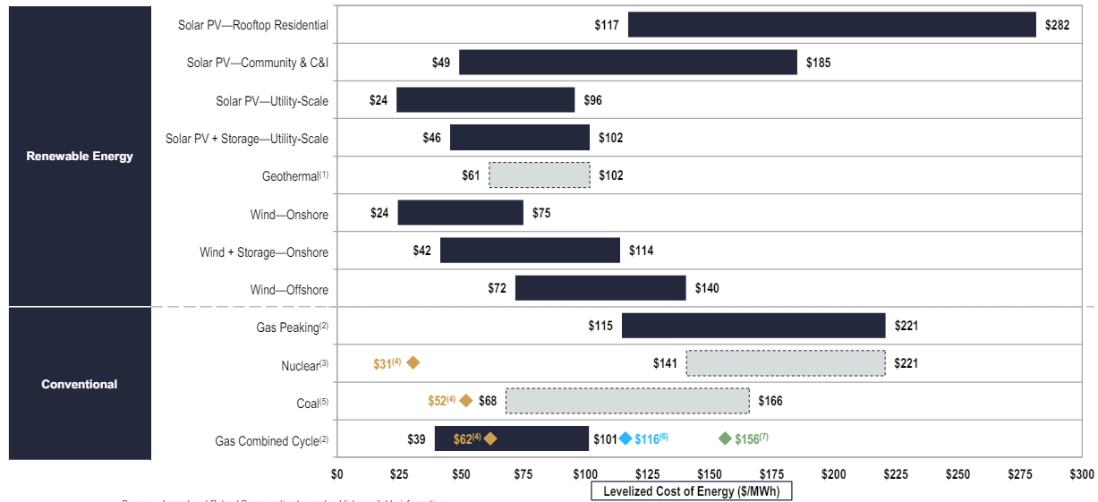
Levelized Cost of Energy Comparison
LCOE =$\frac{NPV of Total Cost over Lifetime}{NPV of Electricity Produced over Lifetime}$
Wind
24 – 140 $/MWh
Solar PV
24 – 282 $/MWh
CCGT
39 – 101 $/MWh
Geothermal
61 – 102 $/MWh
Coal
68 – 166 $/MWh
Gas Peaking
115 – 221 $/MWh
Nuclear
141 – 221 $/MWh
The most expensive
Source: Lazard (2023).

Slide 8
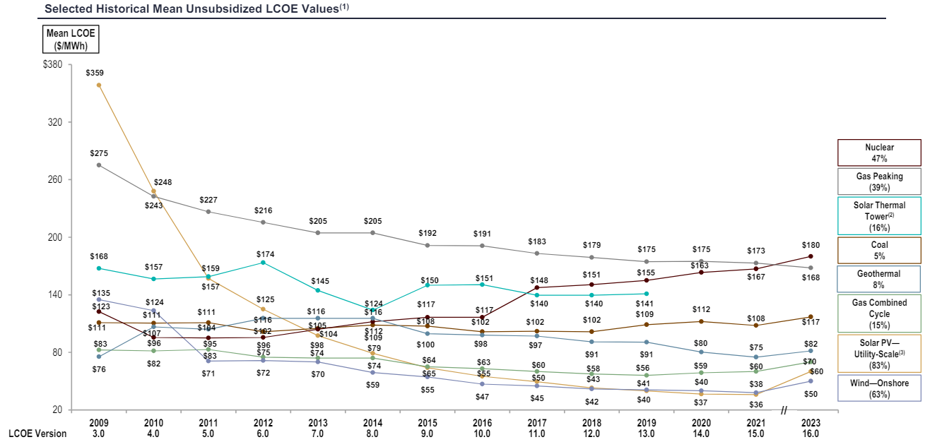
LCOE: Historical Utility-Scale Generation Comparison
The most expensive
Nuclear
180 $/MWh
The cheapest
Wind & Solar
50-60 $/MWh
Source: Lazard (2023)

Slide 9
LCOE methods extensions
Existing and proposed LCOE-based approaches
Cost adjustment
(SystemLCOE)
Energy adjustments
Existing methodologies
Value adjustment
(VaLCOE)
Base methodology of LCOE
Cost adjustment
Cost to GDP
(RealLCOE – NEW)
NEW method to discuss
Macro-economy adjustments
Value adjustment
Contribution to GDP
(WIP)
Source: Kept analysis.

Slide 10
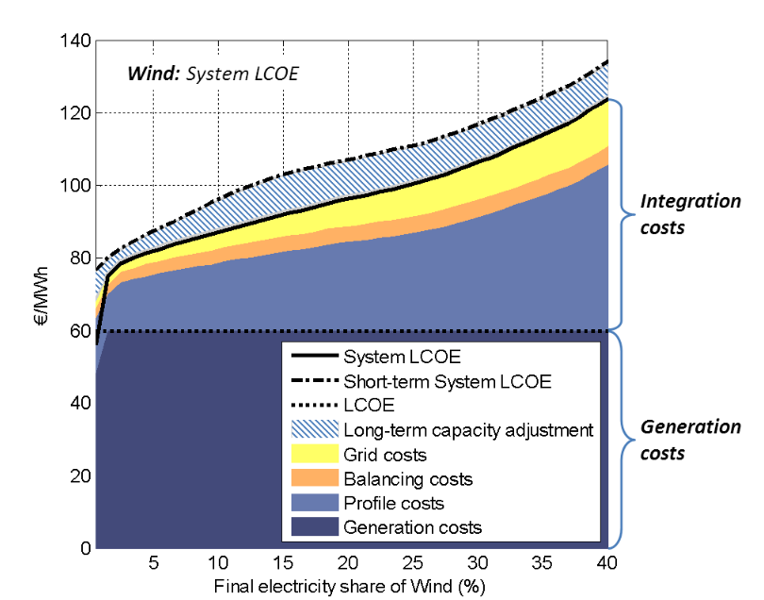
System LCOE: method to account for integration costs
System LCOE for increasing shares of wind
System LCOE
Generation costs
Integration costs
(balancing, profile, grid)
Source: UECKERDT, F., HIRTH, L., LUDERER, G., EDENHOFER, O., System LCOE: What are the Costs of Variable Renewables, Potsdam-Institute for Climate Impact Research, Germany, 2013.

Slide 11
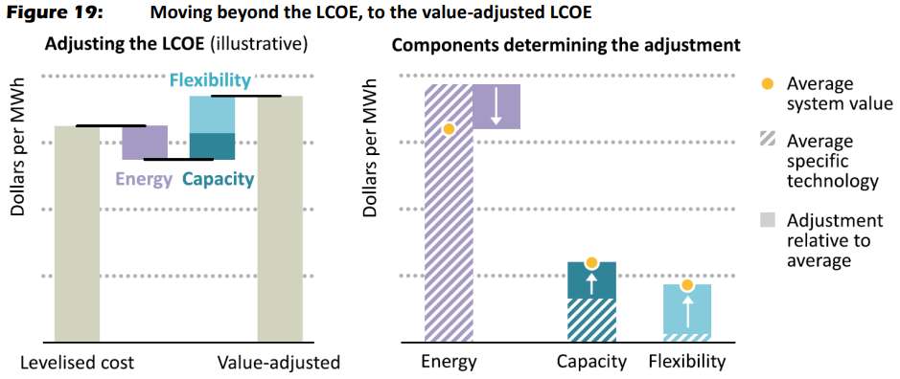
VaLCOE: method to account for value of power sources
The value-adjusted LCOE (VALCOE) approach
VaLCOE
Generation costs
Additional value
(energy, capacity, flexibility)
Source: IEA.

Slide 12

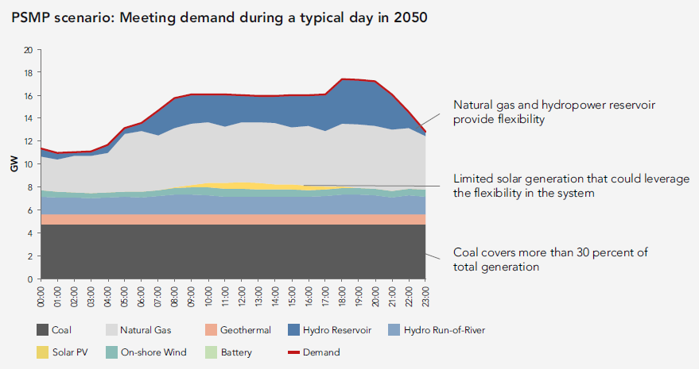
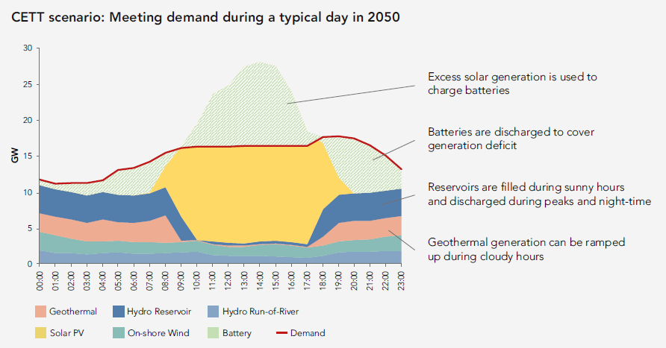
LCOE concept is core to Least cost generation planning (LCGP): Donor funded LCGP for Tanzania (example #1)
Scenario “Unaffordable fossil fuels”
Scenario
“Cheap green future”
… but often fails to deliver in practice

Slide 13
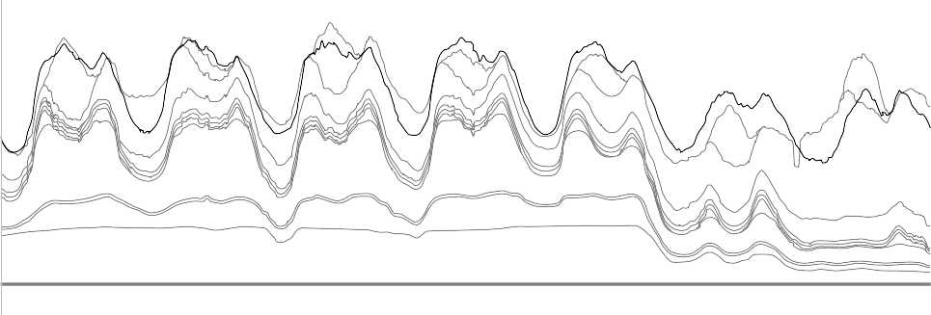
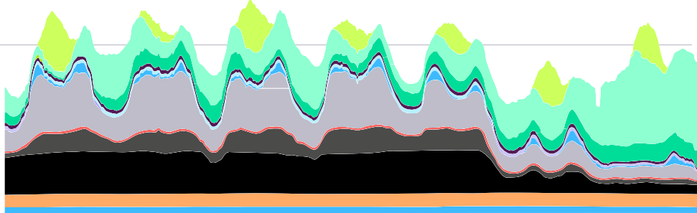
LCGP Technical issues not addressed: “Dunkelflaute”
and dispatchable generation in Germany (example #2)
Power generation by plant type in Germany, week 43, 2023
80,000
Germany invested €15 bn into coal generation in 2018-2020 due to
the need for dispatchable generation
Power (MW)
60,000
40,000
20,000
Plans for additional 10GW gas new builds released Feb 2024
0
23.10.2023
24.10.2023
25.10.2023
26.10.2023
27.10.2023
28.10.2023
29.10.2023
Date (GMT+2)
Hydro
Coal (brown/lignite)
Wind on-offshore
Other
Biomass
Coal (hard)
Solar
Load
Gas
Source: S&P Global Analytics, Energy-Charts.info, Kept analysis.

Slide 14

LCGP Cost uncertainty not addressed: Typical donor funded least cost generation plan in Africa (example #3)
Cost difference by scenario <2% (!) for 20Y+
… and too cost uncertain in long term for policy decisions

Slide 15
LCOE methods extensions – Cost-to-GDP method
Existing and proposed LCOE-based approaches
Cost adjustment
(SystemLCOE)
Energy adjustments
Existing methodologies
Value adjustment
(VaLCOE)
Base methodology of LCOE
Cost adjustment
Cost to GDP
(RealLCOE – NEW)
NEW method to discuss
Macro-economy adjustments
Value adjustment
Contribution to GDP
(WIP)
Source: Kept analysis.

Slide 16
Cost-to-GDP concept
Part 2

Slide 17
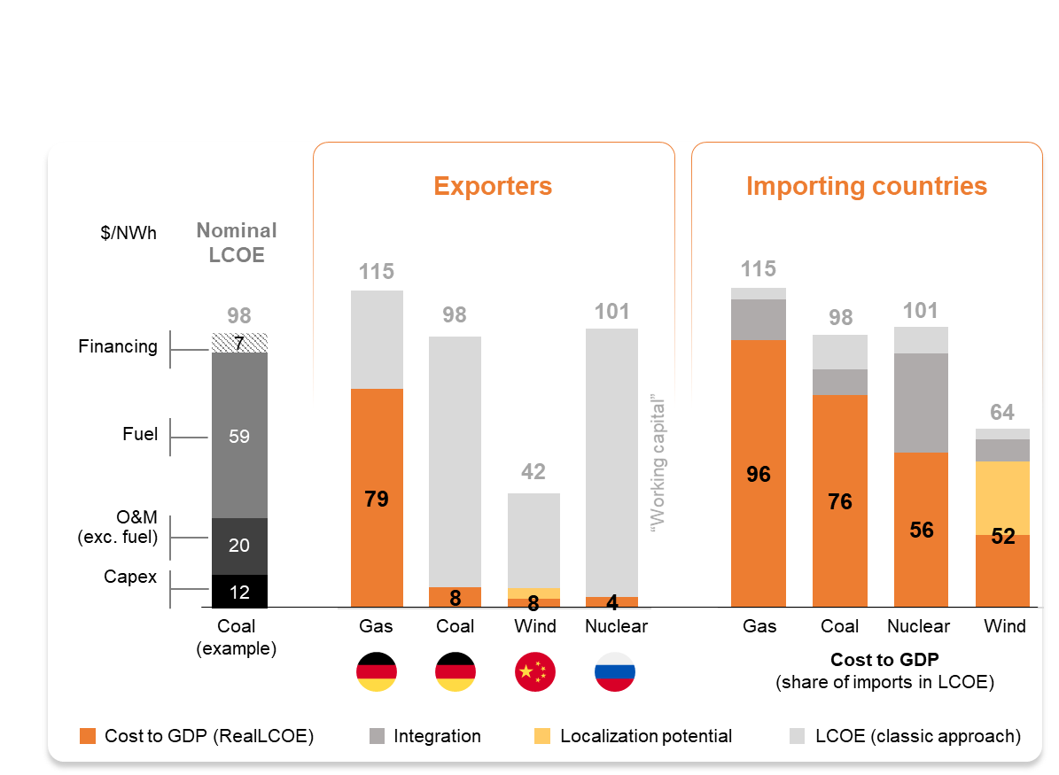
Cost to GDP (Real LCOE) based comparison of generation sources
Cost-to-GDP Concept
Real LCOE approach
Least cost generation planning
Economic and GDP planning
Least cost to GDP concept
Source: IEA, IAEA, NEA, NREL, Lazard, Kept analysis.

Slide 18
Cost to GDP – new concept of energy planning
Existing and proposed integrated energy planning concepts
Least cost generation planning
Economic and GDP planning
Least cost to GDP energy planning
SystemLCOE model
Input-output model
Cost-to-GDP model
CAPEX and OPEX to generate electricity (by generation type)
Generation by plants over their life cycle
Integration costs (SystemLCOE)
Investment in the economy
Government expenditures
End use
Net export (export-import)
Levelized cost
Deduction of the localization share (technology, fuel, personnel, services, cost of financing)
Levelized cost
Contribution to GDP
Cost to GDP (RealLCOE)
New integral electricity cost metric “RealLCOE”: cost share of imports within LCOE comprising imported fuel, equipment and services, adversely impacting GDP
Source: Kept analysis.

Slide 19


New Just: Paths to Affordable Energy Transition in Eastern and Southern Africa - Kept research
Key issues
>10,000 variables
21 countries
4 regions:
Egypt, EAR, SAR, South Africa
1
Scale of challenge
Transition paths
Role of energy sources
Climate impact
Affordability
Manageability of Transition
Similar Study on Middle East is ongoing
2
3
4
5
6

Slide 20
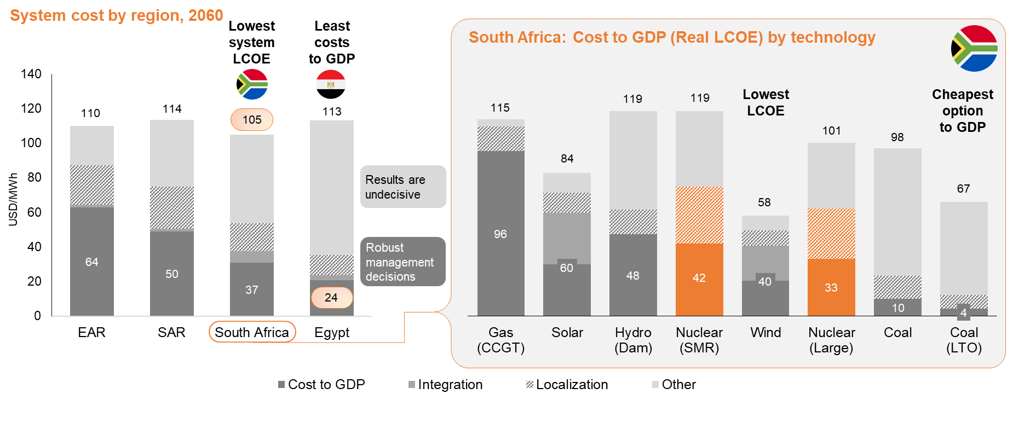
RealLCOE and system costs by technology and region
Current and future localization level by type of technology and region
1
3
4
6
7
2
8
5
Source: IEA, NEA, IRENA, NREL, Lazard, EIU Data, Kept analysis.

Slide 21
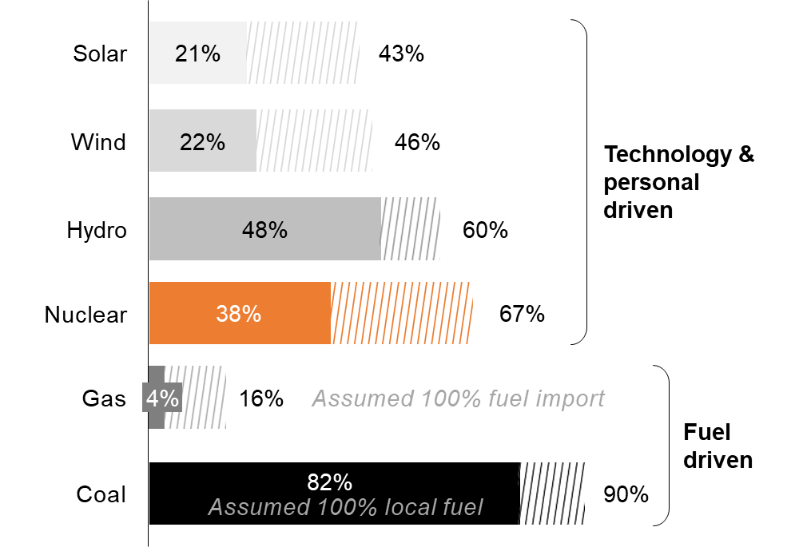

Impact of the supply chain localization on RealLCOE
Current and future localization level by type of technology and region
Local content
Solar, Wind
< 20-25 %
reference values
Nuclear & SMR
> 35-50%
with up to 70% possible
Source: Kept analysis.

Slide 22
Specifics of SMRs
Cost range of SMRs
Small Modular Reactors
SMRs are defined as nuclear reactors with a maximum output of 300 Megawatt electric (MWe) for generating electricity.
SMR (example)
119 $/MWh
Source: “Scalling Success. Navigating the Future of Small Modular Reactors in Competitive Global Low-Carbon Energy Markets”, NNWI, 2023.

Slide 23
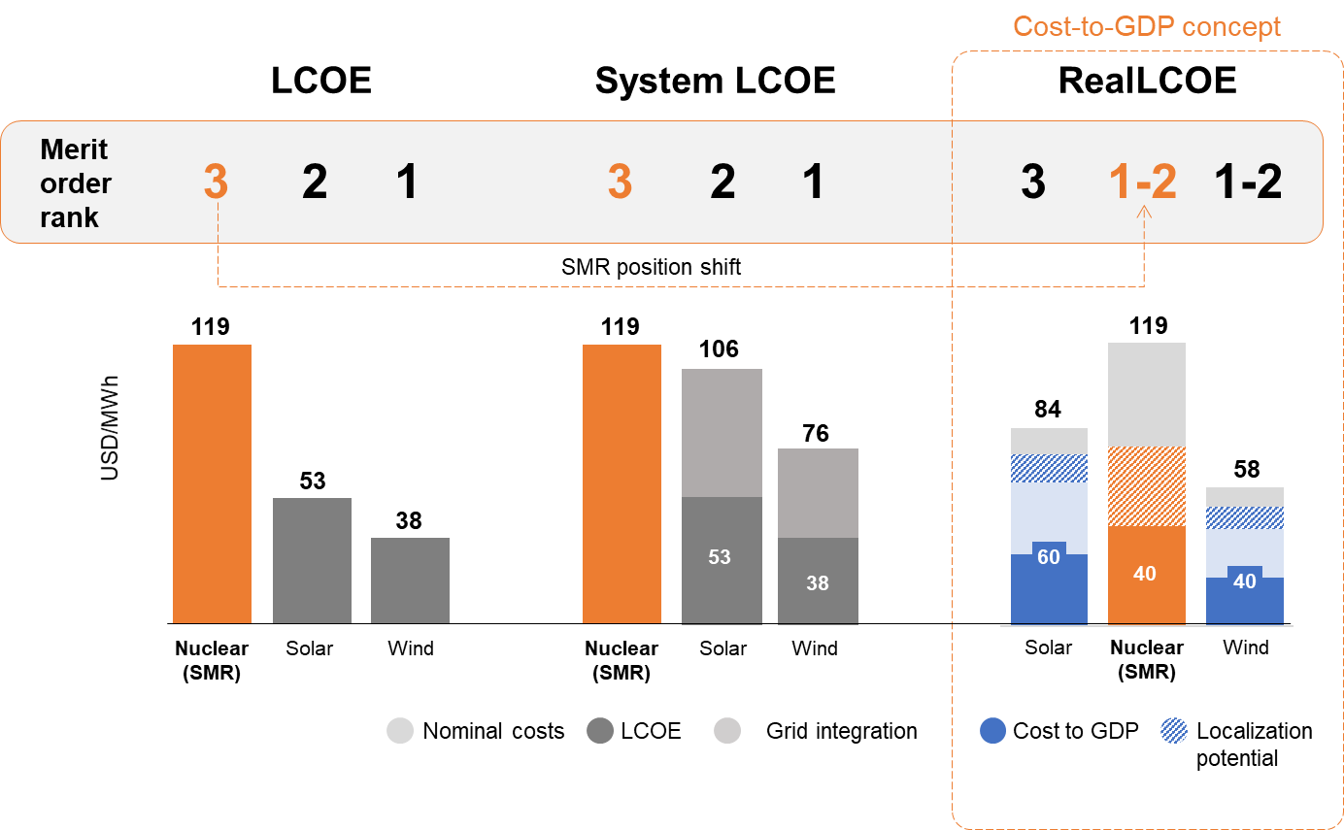
SMR vs renewables cost ranking by method
Costing Method Impact
SMR is often cost competitive vs renewables on total power system and economic costs
(cost to GDP)
Source: Kept analysis.

Slide 24
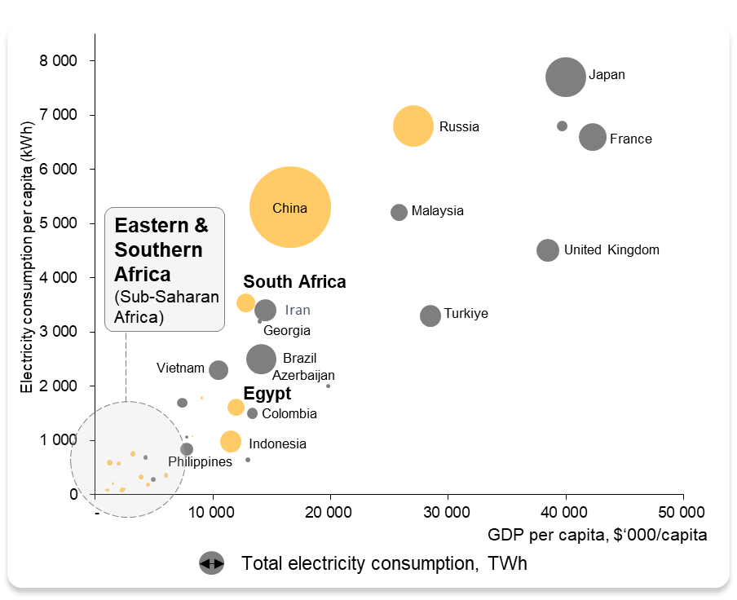
Interdependence of electricity and economy
GDP & electricity consumption by country, 2020
There are no rich countries with low electricity consumption
Electricity consumption per capita
Sub-Saharan Africa
Indonesia, India
South Africa
China
Russia
G7 (average)
USA
~200 kWh
~1,000 kWh
3,500 kWh
5,900 kWh
7,300 kWh
8,300 kWh
14,000 kWh
Source: AEP, IEA, World Bank, Kept analysis. Note: *Eastern and Southern Africa (ESA) not including South Africa and Egypt

Slide 25
Practical use for early-stage energy and economic planning
Classification of technology applicability options depending on the LCOE and RealLCOE estimates
LCOE
High
I
II
1 – Gas (CCGT)
3 – Hydro (Dam)
2 – Solar
4 – Nuclear (SMR)
6 – Nuclear (Large)
7 – Coal
5 – Wind
8 – Coal (LTO)
Opportunity for economic momentum
Worst option
South Africa case:
1
4
3
7
6
III
IV
2
8
5
Risk of resource leakage
Best option
Low
High
RealLCOE (Cost-to-GDP method)
Source: Kept analysis.

Slide 26
Summary

Slide 27
Summary
LCOE – cost assessment and policy advocacy method
Cost-to-GDP approach (RealLCOE):
Objectively takes into account the costs to the economy:
technology expenditures
integration costs
the share of local content
Provides adequate results according to
the specifics of developing countries
Easy to implement for complex systems
Easy to communicate with decision makers
Source: Kept analysis.

Slide 28

About Kept & Power Analytics
About Kept
About Power Analytics team
An audit and advisory firm working in Russia for
  Consulting engineering group in power sector
  more than 30 years
Power market
analysis
Sectoral development
plans
Leading Advisory firm in Russia since 2009
01
03
Feasibility studies
Transaction advice
02
04
  11 offices in the largest cities
of Russia and Belarus
  Our clients:
Major generating companies, financial institutions and government authorities
Employing together
www.kept.ru
  3,800 people
  Regions of expertise:
Russia
Central Asia
South Caucasus
Balkans
East & South Africa
South Asia
Middle East

Slide 29


Contacts
Sergey Rozhenko
Vadim Karle
Director,
Energy & Utilities, Power Analytics
Center of Excellence
Т: +7 495 937 44 44
M: +7 916 063 03 19
E: srozhenko@kept.ru
Manager,
Energy & Utilities, Power Analytics
Center of Excellence
Т: +7 495 937 44 77
M: +7 926 777 65 62
E: vkarle@kept.ru
The information contained herein is of a general nature and is not intended to address the circumstances of any particular individual or entity. Although we endeavor to provide accurate and timely information, there can be no guarantee that such information is accurate as of the date it is received or that it will continue to be accurate in the future. No one should act on such information without appropriate professional advice after a thorough examination of the particular situation.
Some or all of the services described herein may not be permissible for audit clients and their affiliates or related entities.
www.kept.ru

