Slide 2
Cost-Benefit Analysis of Small Modular Reactor Deployment for Electricity Generation in West Kalimantan
Suparman
National Research and Innovation Agency (BRIN)
Indonesia

Slide 3
CONTENTS
Background and Objective
Methodology
DATA
Results analysis
Concluding remarks

Slide 4
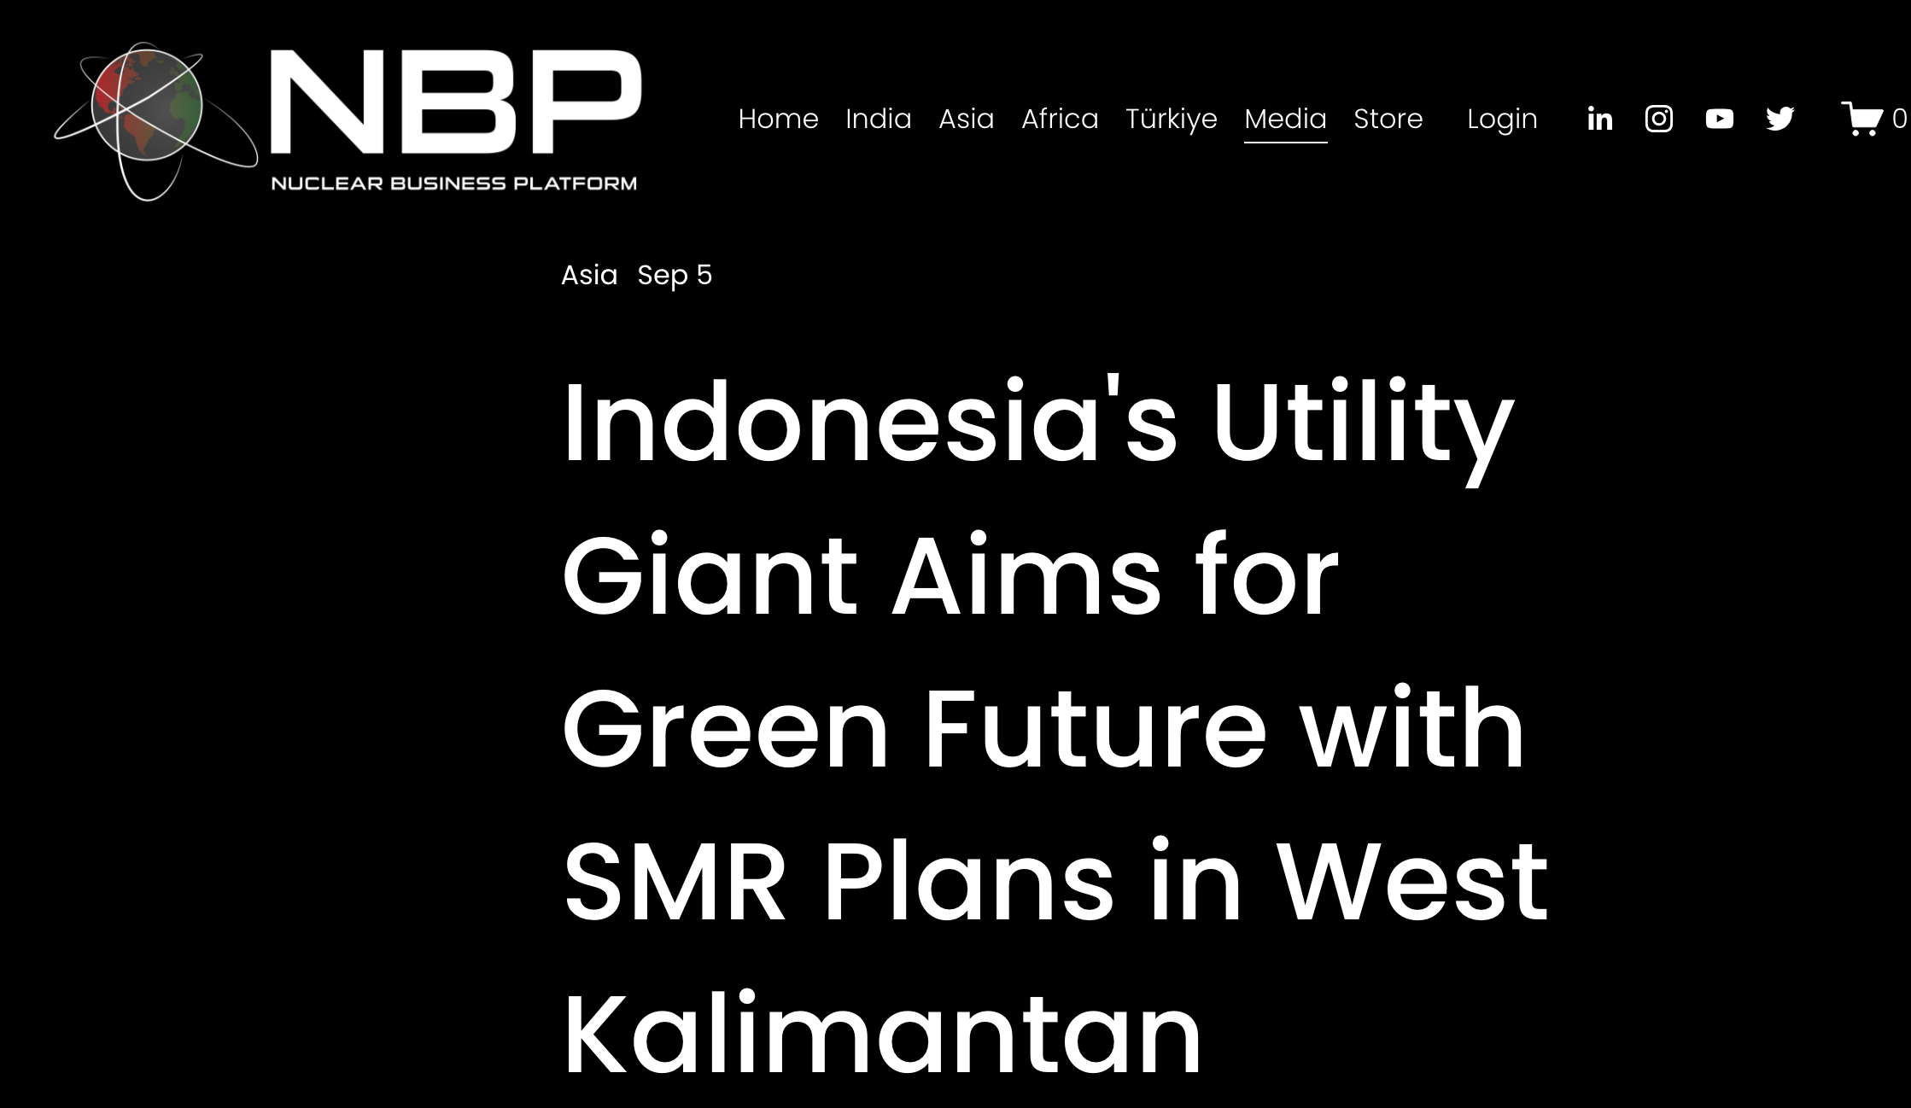
INTRODUCTION: BACKGROUND AND OBJECTIVE
Indonesia has a strong commitment to achieving Net Zero Emissions (NZE) by 2060 or sooner.
Phase-out of Coal PP and reduce the use of diesel starting in 2031
Between 2032 - 2040, the first nuclear plants start Commercial Operation Date (COD).
SMR is the option to be built in West Kalimantan
The research aims to conduct a critical analysis of the economics of Small Modular Reactor (SMR) deployment programs in West Kalimantan, Indonesia..

Slide 5
METHODOLOGY: COST BENEFIT ANALYSIS
Indicators
Project
Scenario
SMR Deployment
Economic Net Present Value
Economic Internal Rate of Return
Counterfactual
Scenario
Existing Coal Power Plant
Economic Net Present Value
Economic Internal Rate of Return
If ENPV or EIRR of SMR Project > ENPV or EIRR CPP
then SMR have more benefit or feasible

Slide 6
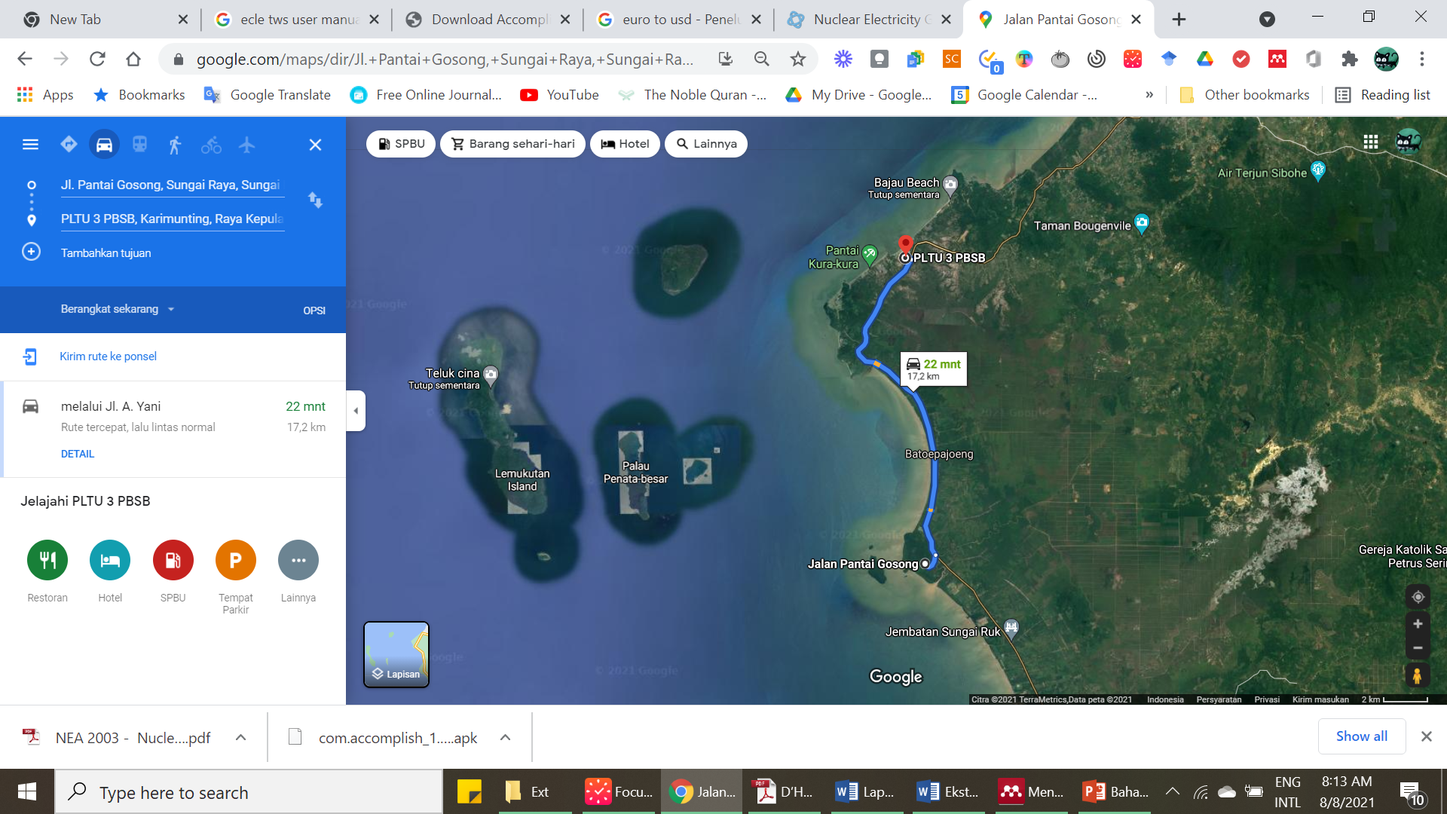
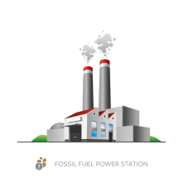
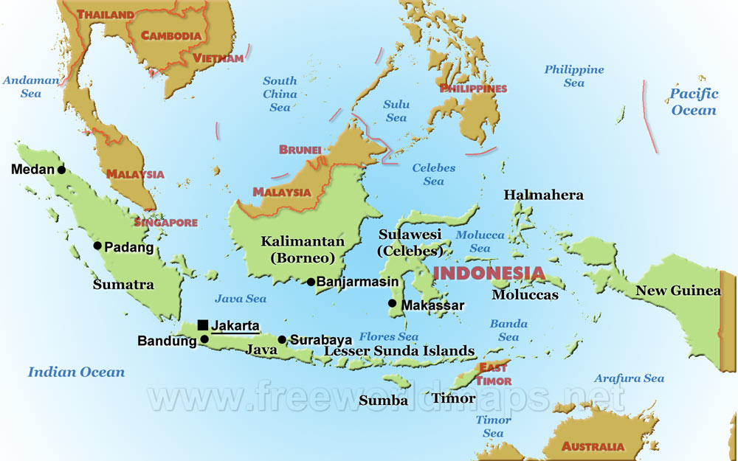
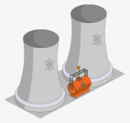
WEST KALIMANTAN SITE
Existing Coal PP
NPP candidate site

Slide 7
METHODOLOGY: QUANTIFICATION OF NPP BENEFITS
Benefits of NPP
Clean Energy
Security of supply
Quantify
- Externality cost
- CO₂ cost
Fuel cost (fuel price volatility)
Externality cost = health impact of power plant operation
(calculated using SIMPACT)
CO2 cost = carbon tax (2.5 $/ton)
Fuel price volatility = it is assumed that there is a 15% increase in fuel prices for both coal and uranium

Slide 8
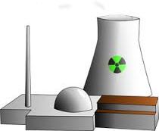
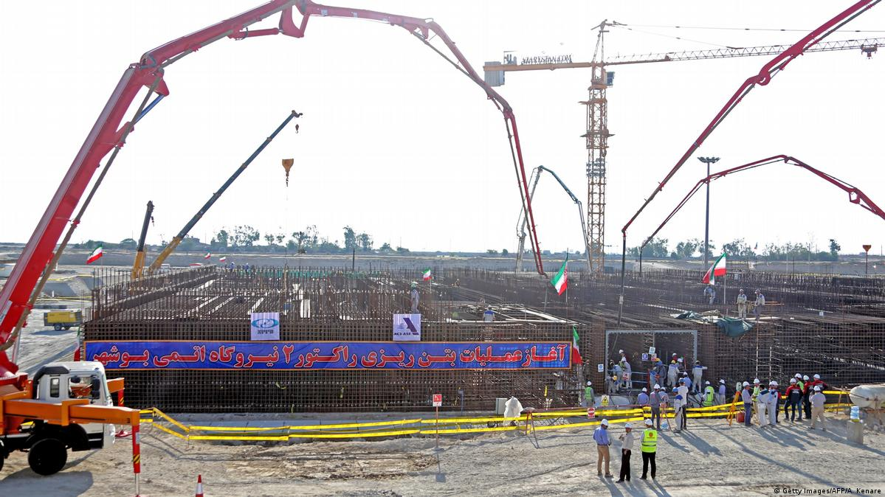
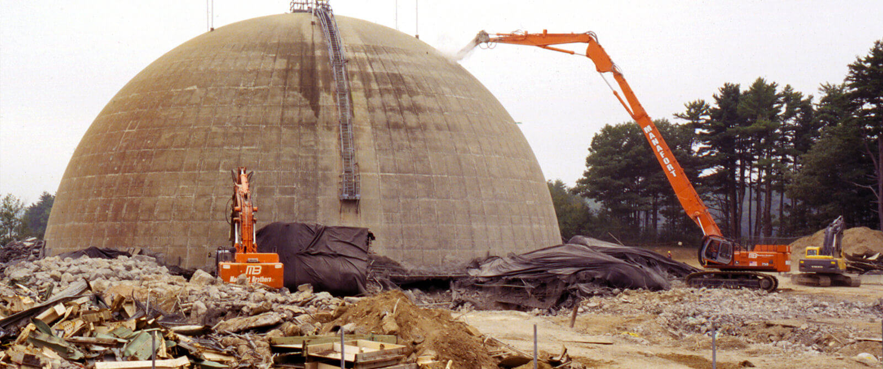
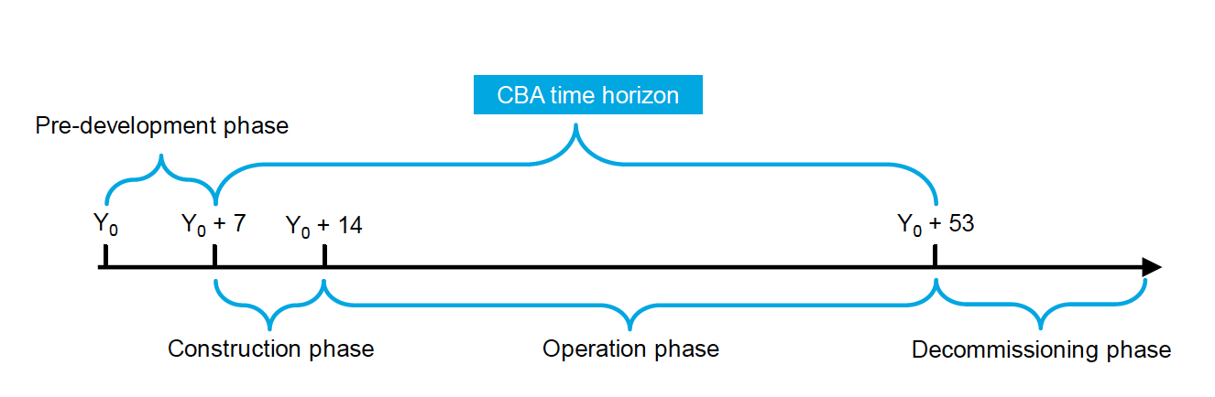
METHODOLOGY: CASH FLOW
SMR
BENEFIT = REVENUE (FROM SELLING ELECTRICITY)
Investment
Operation & Maintenance
Fuel
Decommissioning
Existing CPP
BENEFIT = REVENUE (FROM SELLING ELECTRICITY)
Investment
Operation & Maintenance
Fuel
Externality cost
Security of supply
CO2
Externality cost
Security of supply
Revenue from electricity selling
Operation and Maintenance cost
Fuel cost
Externality cost
Carbon tax
Decommissioning cost
Construction cost
SOCIAL COST

Slide 9
DATA PARAMETER
Parameter | Unit | SMR | Coal PP
Capacity | MW | 100 | 100
Life-time | Year | 60 | 30
Capacity factor | % | 90 | 80
Construction time | Year | 4 | 3
Investment cost | $/kWe | 6,217 | 1,980
Discount rate (social) | % | 7.5%
Social cost
Parameter | Unit | SMR | Coal PP
Externality cost | Cent/kWh | 8.838 × 10⁻⁶ | 0.0111 cents
CO2 | $/ton | 0 | 2.5
Security of supply | $/MWh | 0.29 | 6.41

Slide 10
OPERATION COST AND LCOE
Item | SMR | CPP
O&M cost | 12,220,200.00 | 4,621,104.00
Fuel cost | 6,208,578.15 | 29,900,800.00
Decommissioning cost | 1,384,956.00
Externality cost | 720,01 | 7,778.88
CO₂ cost | - | 1,806,312.00
Security of supply cost | 238,163.78 | 4,490,376.00
Total | 20,052,617.94 | 40,826,370.88
LCOE (cent$/kWh) | 8.94 | 8.31
The SMR’s investment is almost three times that of the CPP. However, the operational costs incurred by the SMR are much lower than those of the CPP, resulting in greater operational benefits for the SMR. Additionally, the lifetime of the SMR is longer than that of the CPP, with a lifespan of 60 years for the SMR and 30 years for the CPP. These factors indicate that while the initial investment for the SMR is higher, its operational efficiency and longer lifespan contribute to greater benefits in the long run.

Slide 11
RESULT
 | SMR | COAL PP | INCREMENTAL
ENPV (USD) | 39,008,846 | 96,001,875 | - 56,993,029
EIRR (%) | 8.04 | 11.9 | - 3.86
The investment costs for Small Modular Reactors (SMR) are approximately three times higher than those of Coal Power Plants (CPP), with SMR at $6,217/kWe compared to CPP at $1,980/kWe. This significant difference suggests that SMRs do not deliver incremental benefits over CPPs when assessed purely on cost. A sensitivity analysis is needed on investment costs and influencing parameters such as carbon tax.

Slide 12
SENSTIVITY ANALISIS: INVESTMENT COST
A decrease in investment costs, such as down to $5595/kWe (10%), can significantly improve the NPV of Small Modular Reactors (SMR), allowing it to surpass that of Coal Power Plants (CPP). This highlights the importance of investment efficiency in project evaluation.
NPV (Net Present Value) is generally preferred over IRR (Internal Rate of Return) for assessing profitability since it accounts for the time value of money. It provides a more accurate measure of a project's potential profitability, especially when comparing investments with different cash flow patterns

Slide 13
SENSTIVITY ANALISIS: CARBON TAX
A carbon tax increases the production costs for coal power plants, leading to lower Net Present Value (NPV) and Internal Rate of Return (IRR).
At a carbon tax rate of $20 per ton, the NPV and IRR of SMRs exceed those of CPPs. This implies that, under these conditions, SMRs are a more attractive option for electricity generation.

Slide 14
ANALYSIS
Both NPV (Net Present Value) and IRR (Internal Rate of Return) are important metrics used in evaluating investment projects. NPV measures the present value of future cash flows, while IRR measures the rate at which the project generates cash flows.
When choosing between projects, it is generally recommended to prioritize NPV over IRR. This is because NPV takes into account the time value of money and provides a more accurate measure of the project's profitability. A project with a high NPV indicates that it will generate a significant amount of value for the investors, while a project with a low NPV may not be worth pursuing.
NPP has a high initial investment but generates significant cash flows in the later years. It could have a high NPV but low IRR.

Slide 15
CONCLUDING REMARKS
CBA is carried out make a comprehensive study as a basis for decision making
The results show that NPP project do not provide incremental benefits from the counterfactual project (CPP) because the SMR investment cost is very high compared to the CPP
From the sensitivity analysis, the carbon tax and SMR investment costs greatly determine the feasibility of SMR
At a carbon tax value of 20 $/ton, CPP will have a negative NPV value which means it is not feasible, so SMR will be an option.
SMR will have a greater NPV than CPP's NPV at an investment cost of 5,284 USD/kWe.

Slide 16




Thank you

