Slide 2
Future Cost Projections of Small Modular Reactors: A Model-Based Analysis
Paper 57
Jonas Kristiansen Nøland, Martin Hjelmeland, and Magnus Korpås
Department of Electric Energy,
Norwegian University of Science and Technology (NTNU)
Session 15.1 – Economic and macroeconomic analysis and impact of technology development on the cost of SMRs

Slide 3




The NERES research project at NTNU
«Nuclear Energy’s role in a Renewable Energy System (NERES)»
Funding: Internally (NTNU)
Timeframe: March 2023 – Dec 2025
Homepage: https://www.ntnu.no/iel/neres
Project leader: Magnus Korpås
Postdoc
Martin Hjelmeland
Associate
Professor
Jonas Nøland
Professor
Magnus
Korpås

Slide 4
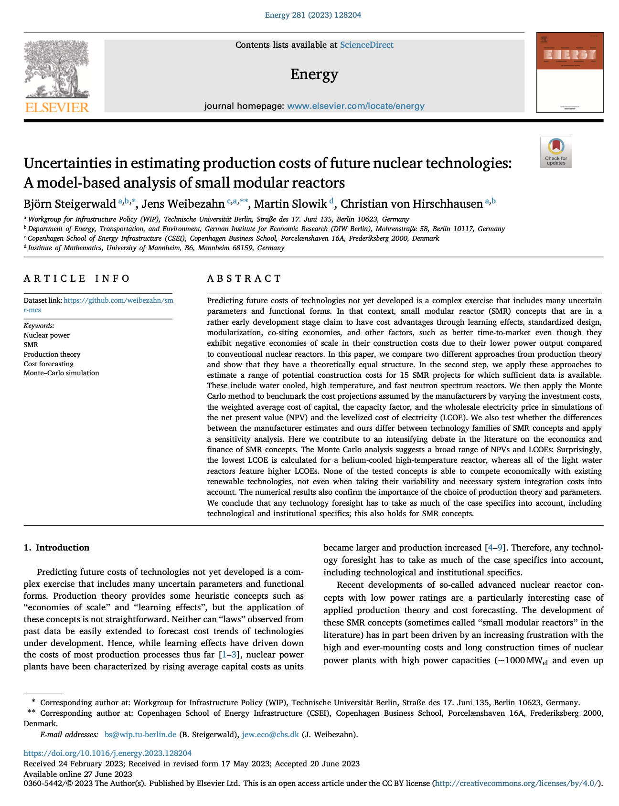
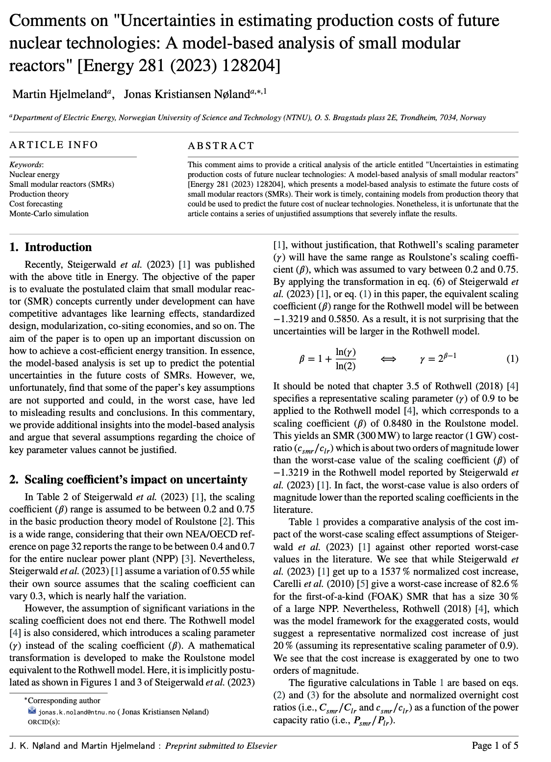
Ongoing academic debate
VS.

Slide 5

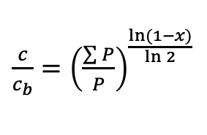
Economies of scale vs. volume
Economies of scale
Economies of volume
$\frac{c}{c_{b}}={\left(\frac{P}{P_{b}}\right)}^{k−1}$
$\frac{c}{c_{b}}={\left(\frac{\sum{P}}{P}\right)}^{\frac{\ln{(1−x)}}{\ln{2}}}$

Slide 6
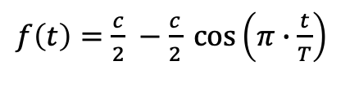
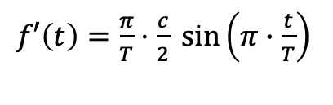
Capital spending during construction
Cumulative spending
Spending distribution
$f\left(t\right)=\frac{c}{2} −\frac{c}{2} cos\left(π∙\frac{t}{T}\right)$
$f′\left(t\right)=\frac{π}{T}⋅\frac{c}{2} \sin\left(π∙\frac{t}{T}\right)$

Slide 7
Overnight construction cost (OCC)
Small modular reactor (300 MW)
Large nuclear reactor (1000 MW)
Source: LOHSE, C. S., et al., Meta-Analysis of Advanced Nuclear Reactor Cost Estimations, INL/RPT-24-77048-Revision-0, Idaho National Laboratory (INL), Idaho Falls, Idaho 83415, US, 2024.

Slide 8
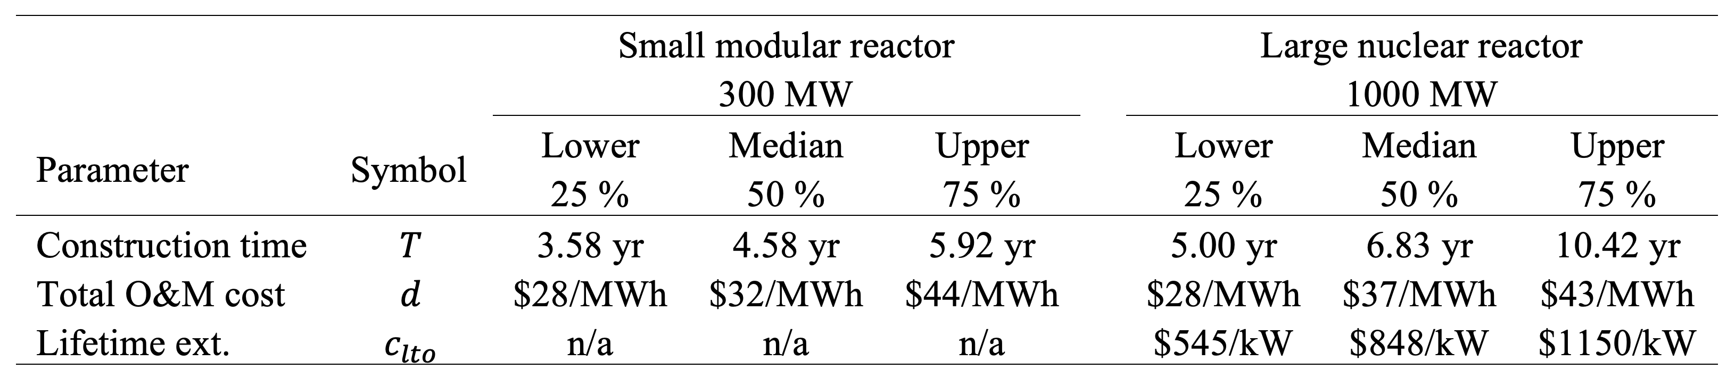
Other cost assumptions
1.) Small modular reactors are considered faster to construct.
2.) Operational costs are considered to be within the same range as large reactors.
Source: LOHSE, C. S., et al., Meta-Analysis of Advanced Nuclear Reactor Cost Estimations, INL/RPT-24-77048-Revision-0, Idaho National Laboratory (INL), Idaho Falls, Idaho 83415, US, 2024.

Slide 9
Levelized cost of electricity (LCOE)
Small modular reactor (300 MW)
Large nuclear reactor (1000 MW)
Small modular reactors are expected to be more expensive than large reactors in 2030 but cheaper in 2050.
Assuming 5 % interest rate.

Slide 10
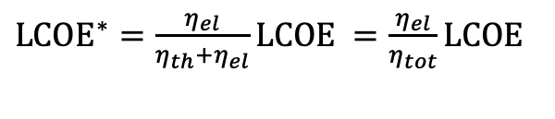
Levelized cost of energy (LCOE*)
Upper cost scenario
Median cost scenario
${LCOE}^{∗}=\frac{η_{el}}{η_{th}+η_{el}}LCOE =\frac{η_{el}}{η_{tot}}LCOE$

Slide 11
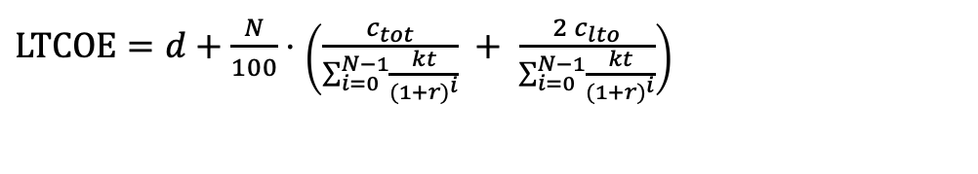
Long-term cost of electricity (LTCOE)
15-year payback time
20-year payback time
$LTCOE=d+\frac{N}{100}⋅\left(\frac{c_{tot}}{\sum_{i=0}^{N−1}{\frac{kt}{{(1+r)}^{i}}}} + \frac{2 c_{lto}}{\sum_{i=0}^{N−1}{\frac{kt}{{(1+r)}^{i}}}}\right)$

Slide 12
Concluding remarks
Large nuclear reactors benefit from economies of scale.
Small modular reactors (SMRs) benefits form economics of volume, shorter construction times, and lower risk of cost overruns.
SMRs are expected to be more expensive in 2030 but cheaper in 2050.
SMRs are expected to initially have steep learning effects for the first 10 to 20 gigawatts of cumulative capacity before the learning curve flattens out.
Utilization of heat can reduce energy costs by up to 60 %.
Considering a 100-year time horizon with short capital recovery, the long-term cost of electricity could be 40 % lower than the levelized cost of electricity.

