Slide 1
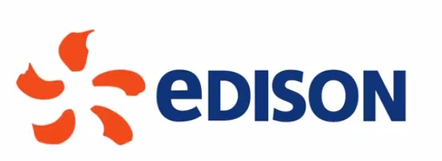
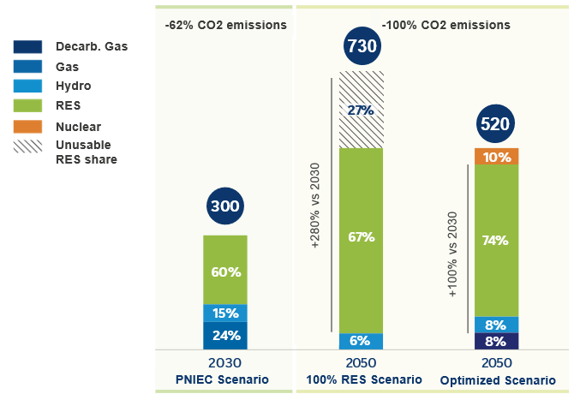
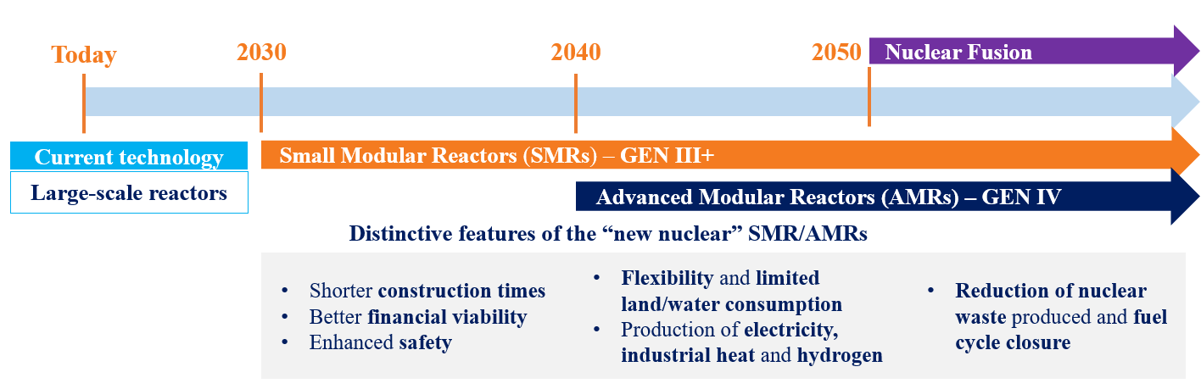
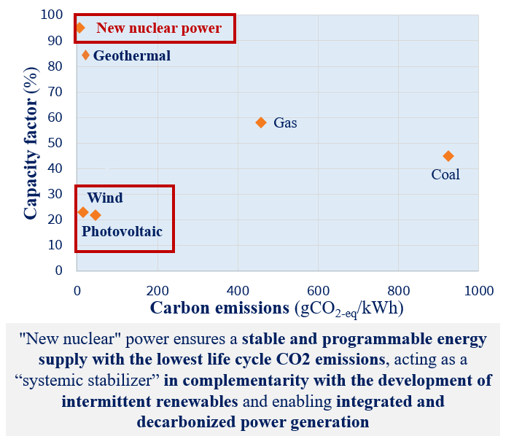
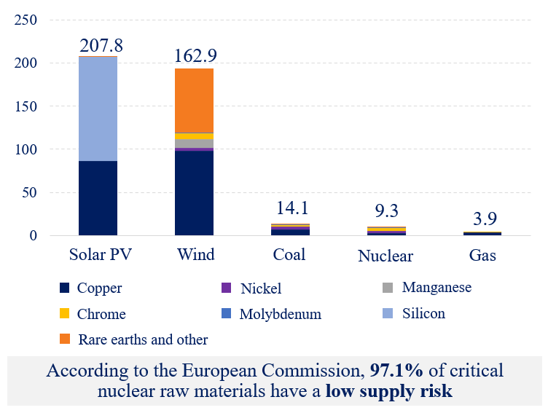
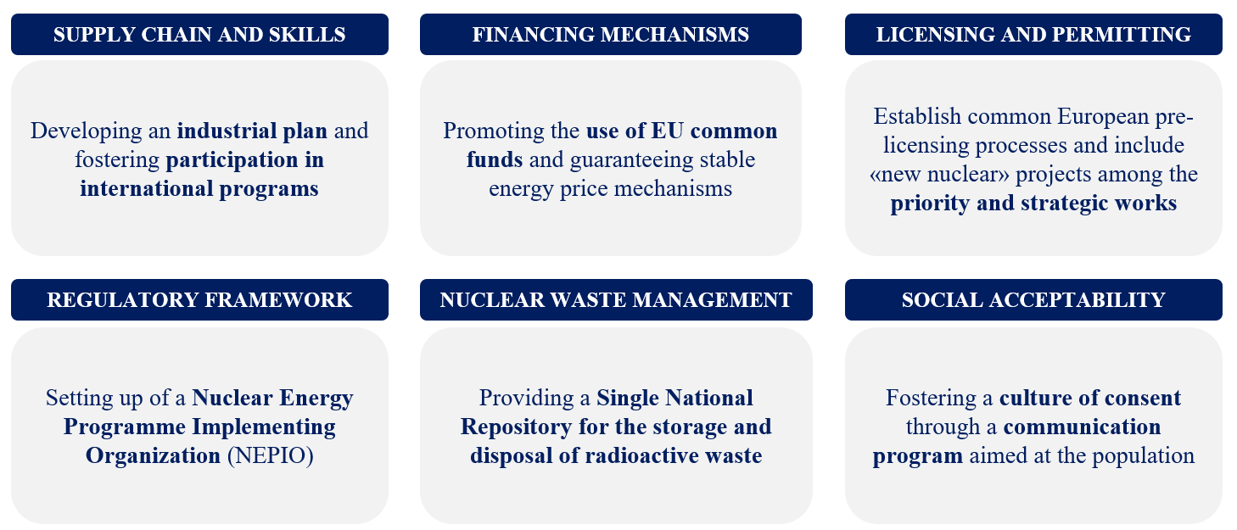
ITALIAN SCENARIO: REINTRODUCTION OF
NEW NUCLEAR AND BENEFITS FOR THE SYSTEM
IAEA-CN-327-394
Giada Caprioli, Lorenzo Mottura, Valeria Olivieri – Edison S.p.A.
contact: giada.caprioli@edison.it
ITALIAN ENERGY TRANSITION TARGETS
Italy is committed to an ambitious climate policy, aiming to reach carbon neutrality by 2050. As for climate and environmental objectives, there are requirements for economic viability and for the security of supply in Italy, thus minimizing system costs and at the same time ensuring the safety and adequacy of the national electricity grid.
How to achieve this objective? This study compares two system layouts: 100% RES Scenario (totally sourced by renewable technologies) and an Optimized Scenario, with a complementary mix of different technologies to optimize the required investments for the Italian system.
The simulation of the scenarios starts from the common 2030, taking as reference the Italian mix described by PNIEC published in June 2023. Edison has simulated such scenarios through a proprietary model with modelling of the European grid, simulation of hourly dispatching and of major commodities evolution, estimation of demand and technologies evolution.
NEW NUCLEAR IN THE ITALIAN ENERGY MIX
Evolution of Italian electricity demand, TWh
“New nuclear power”, which includes Small Modular Reactors (SMR) and Advanced Modular Reactors (AMR), features a simplified modular design (100-450 MW) and cogeneration capability, supplying decarbonized electricity and heat generation for decarbonization of industrial districts. This technological evolution enables the reintroduction of nuclear in Italy.
Pipeline of 15-20 SMR/AMR plants
from 2035 to 2050
6-7 GW
nuclear capacity to 2050
~10% coverage of electric demand to 2050
In a conservative hypothesis of reaching a nuclear production share of ~10% at 2050 and considering building the first SMR by 2035 and about one plant per year between 2035 and 2050, we would get a pipeline of 15-20 plants of small size (SMR and AMR) in operation by 2050. The pipeline takes advantage of the complementarity between SMRs and AMRs in possible uses, time availability and waste management.
The presence of nuclear power allows the optimization of the mix and an efficient production-demand balance, with a drastically lower curtailment.
BENEFITS OF NUCLEAR TO THE ITALIAN SYSTEM
Environmental benefits
European energy independence
Economic benefits
Critical raw materials by type of energy source, kg/GWh
40+ B€
Added value increase
400+ B€
Total net savings, optimized scenario vs 100% RES scenario
40+ k
Additional employees
“New nuclear” can increase the competitiveness of the country system, enabling a significant economic and employment impact
NEXT STEPS TO FOSTER NEW NUCLEAR DEVELOPMENT IN ITALY
The renaissance of interest for new nuclear power in Italy has been shown by some recent events:
Italy joined the European Industrial Alliance on SMRs, with high participation of Italian companies (second in number after French ones)
Italian Ministry of the Environment and Energy Security (MASE) launched the National Platform for Sustainable Nuclear Power to reintroduce nuclear energy into the electric mix
Nuclear development scenarios included in the National Energy and Climate Plan (NECP) delivered to the European Commission in July 2024
It is necessary to work on the 19 infrastructures of IAEA Milestones Approach to promote the development of nuclear power in Italy.

