Slide 2


ENABLING FACTORS FOR SMR UPTAKE IN BOLIVIAN FUTURE POWER SYSTEM
C. MARIANI, N. STEVANATO, S. LORENZI, M.E. RICOTTI
Politecnico di Milano
H. JIMÈNEZ RIVERA, M. HERBAS
Agencia Boliviana de Energia Nuclear

Slide 3

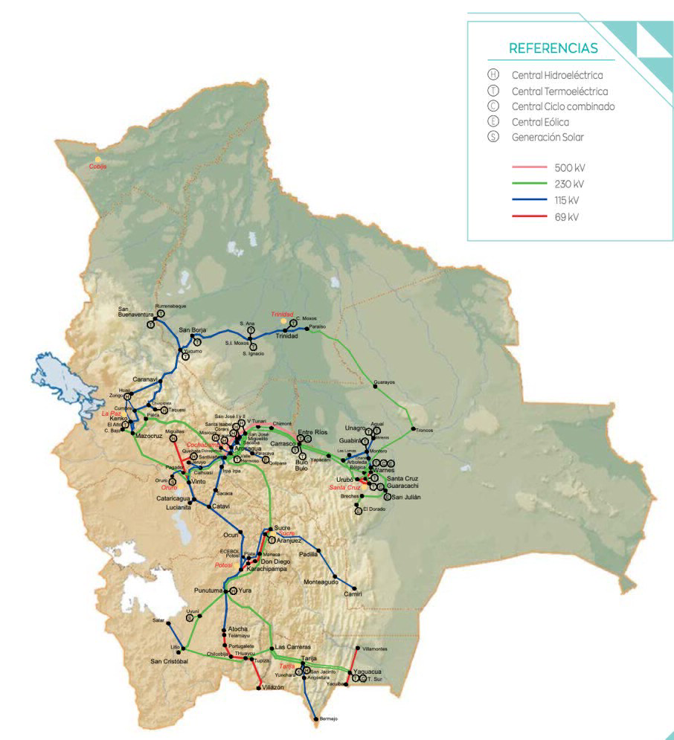
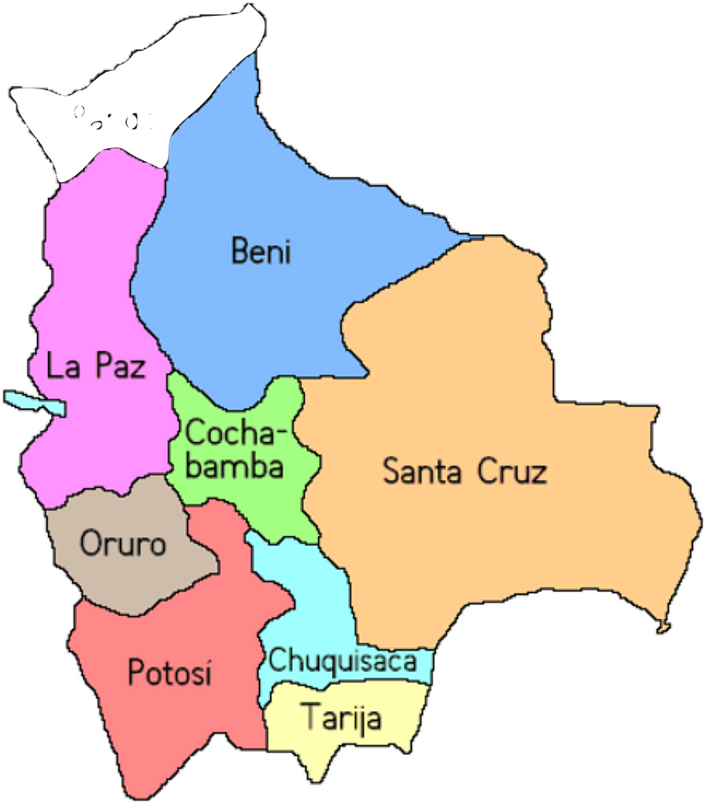
SMR in Bolivia: energy scenarios
Analyse the feasibility of introducing SMR in the Bolivian energy mix in 2035, evaluating if nuclear power turns out to be economically competitive compared to other energy sources/technologies
Energy scenarios
SMR technology & economics
Energy system modelling
Bolivian regions
Bolivian grid (Sistema Interconectado Nacional)

Slide 4



SMR in Bolivia: the tool
Inputs
Calliope
Outputs
Energy System Optimisation Model
free and open-source tool
easy-to-build energy system models
scales ranging from urban districts to entire continents
Locations
Load Demands
Existing Technologies
Transmission lines
Techno-economic parameters
Constraint parameters
Capacity Factors
Carrier Produced
Costs
Capacity Installed

Slide 5
SMR in Bolivia: the method
Focus:
Optimizing the hourly dispatch of the energy system in a short time horizon in the operation mode
or
Optimizing the new required capacities for a snapshot of the future in a planning mode.
Two modes of optimization:
  Operation: optimizes the dispatch of the existing system at the moment being, to fulfil the given load
  Planning: optimizes the installation of new plants, combining with already existing ones, to fulfil a given load

Slide 6
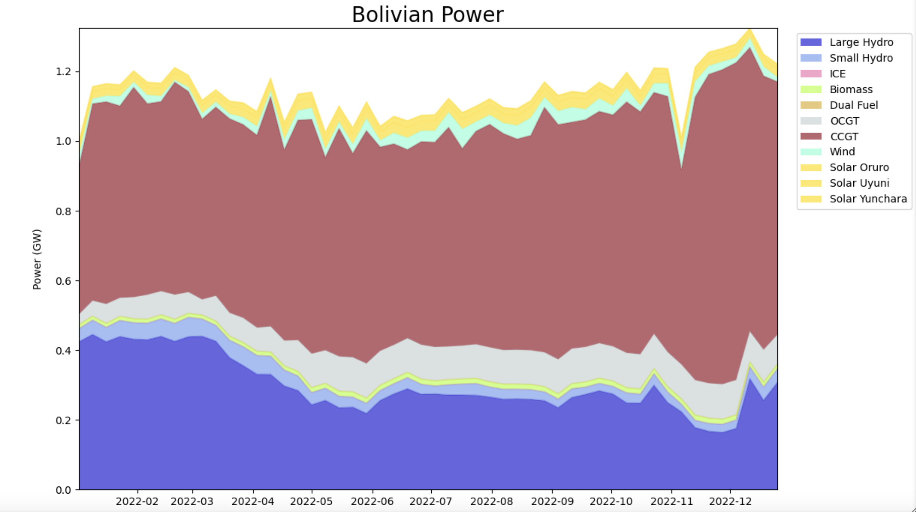
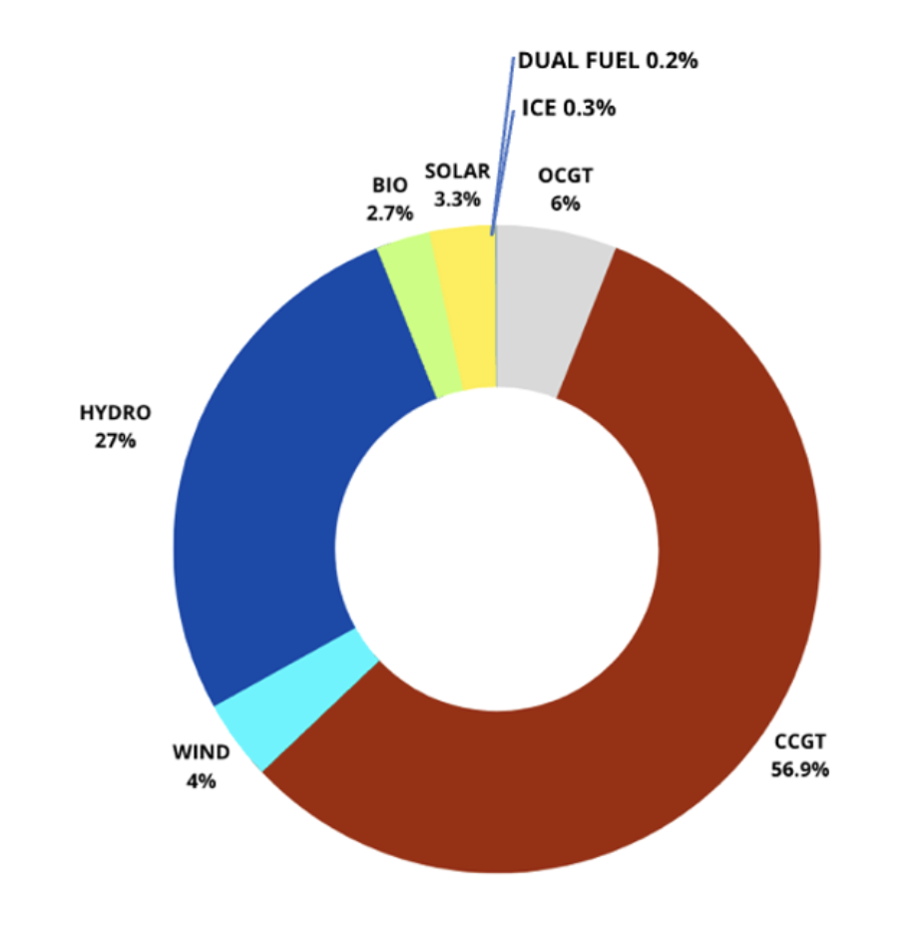
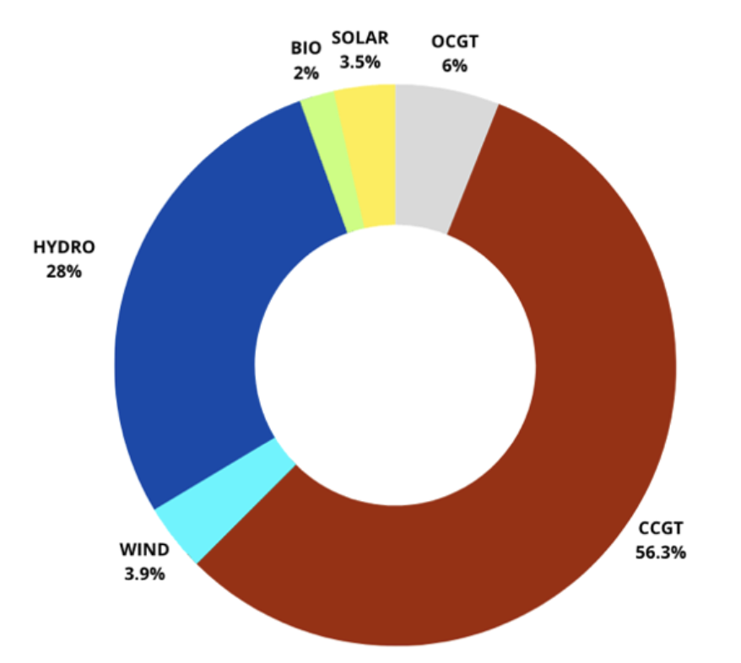
SMR in Bolivia: the “validation” (2022)
OPERATION mode (given Load demand, given Installed power)
2022 – Real scenario
[Comité Nacional de Despacho de Carga]
2022 – Calliope
optimization
Installed power (2022)

Slide 7
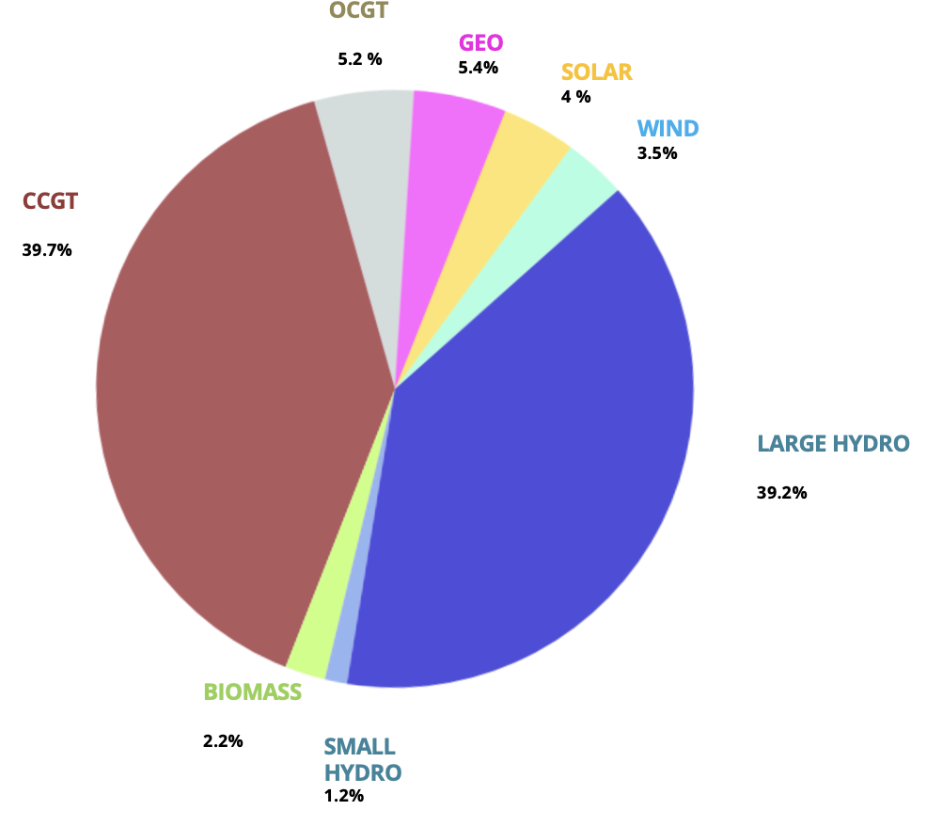
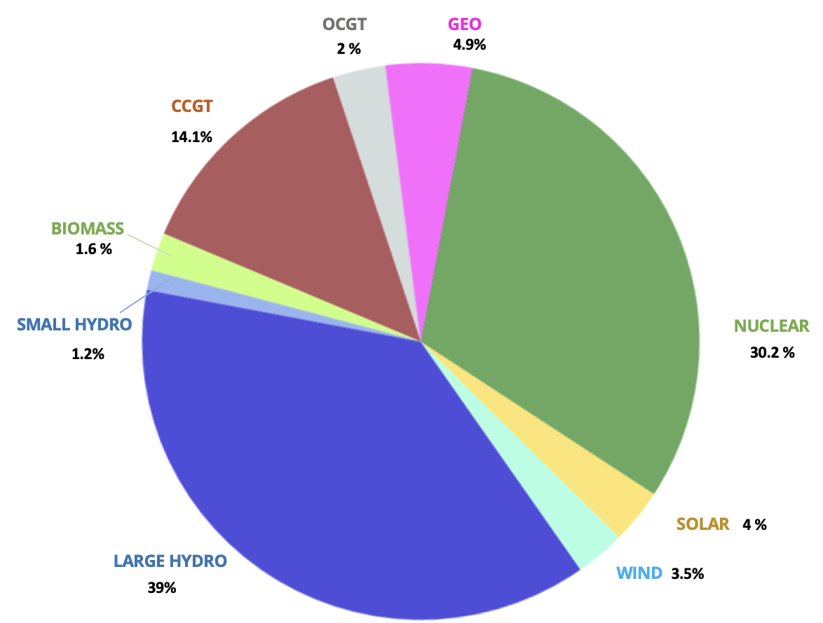
SMR in Bolivia: scenario#1 (2035)
PLANNING mode (forecasted Load demand +4%/y, constraints on new Installed power according to Bolivian Energy Plan, potential build of SMRs)
SMR
Parameter | Value
Overall Efficiency Lifetime Min Cap Factor Max Installable Units Unit Capacity Spec Investment Cost Discount rate Fix O&M Var O&M Cost of Fuel | 0.32 60 y 0.2 3 340 MWe 6000 $/kW 5% 95 $/kW y 0.003 $/kWh 0.001 $/kWh_{th}
2035 – No Nuclear
2035 – scenario#1 with free Nuclear
2 SMRs (680 MWe) in the optimised scenario

Slide 8
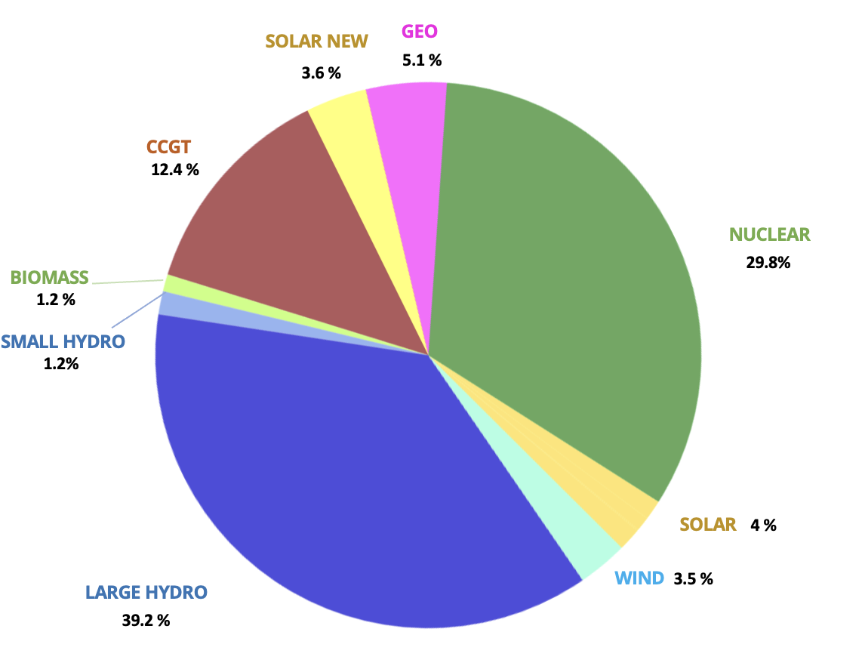
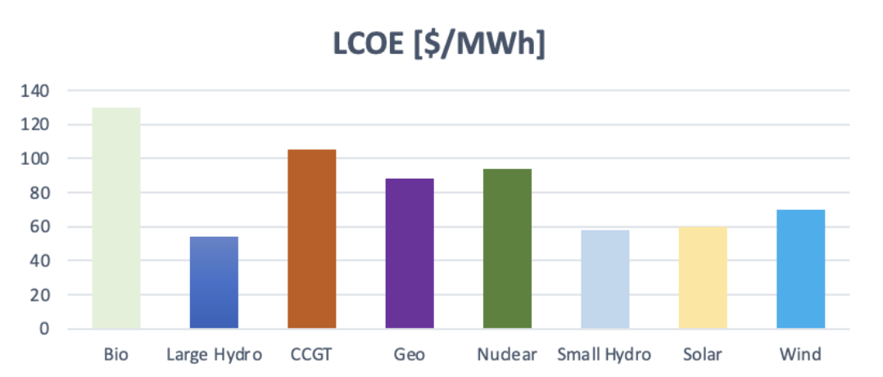
SMR in Bolivia: scenario#2 (2035)
PLANNING mode (forecasted Load demand +4%/y, no constraints on new Installed power Renewables + SMRs)
2035 – SECOND SCENARIO | 2035 – FIRST SCENARIO
 | TWh produced | MW installed | Capacity Factor
CCGT | 2 | 1651.3 | 0.19
BIO | 0.19 | 120 | 0.21
SMALL HYDRO | 0.17 | 77.26 | 0.52
LARGE HYDRO | 6.6 | 3400 | 0.50
WIND | 0.5 | 266 | 0.21
SOLAR | 0.6 | 265 | 0.26
NUCLEAR | 4.8 | 680 | 0.80
GEO | 0.8 | 105 | 0.87
NEW SOLAR | 0.5 | 240 | 0.25
2035 – No Nuclear
2035 – scenario#2 with free Nuclear + Renewables
2 SMRs (680 MWe) in the optimised scenario

Slide 9
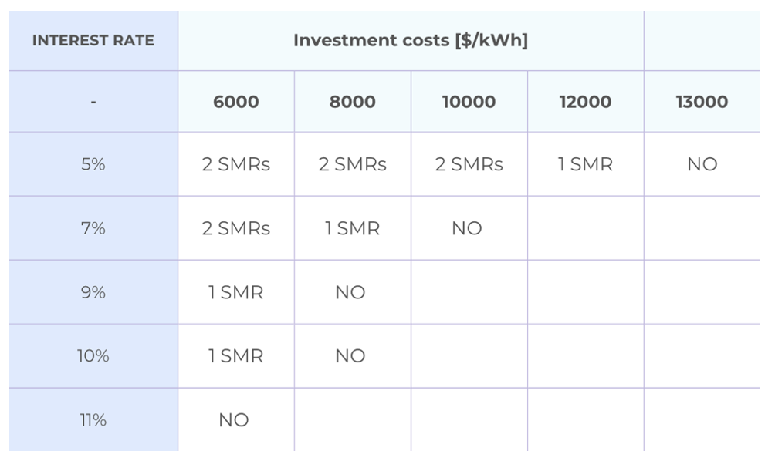
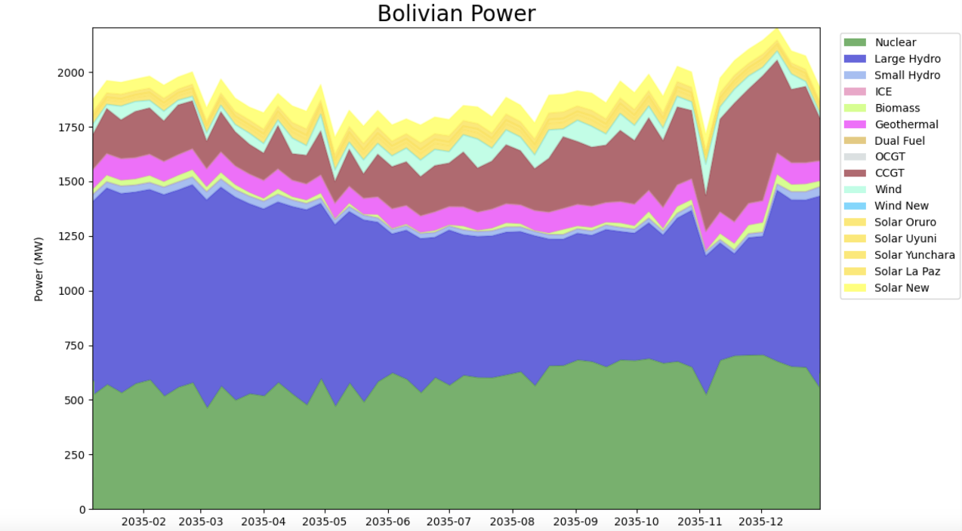
SMR in Bolivia: sensitivity analysis
SENSITIVITY ANALYSIS
Multiple runs by varying interest rate and investment costs to see when nuclear power is cut out of the energy mix
SMRs as a competitive base-load energy source
Interest on cogeneration mode (Lithium extraction, Salar de Uyuni)

