Slide 1
Simulation of flexible SMR operation with a thermal energy storage system
G. Masotti, S. Lorenzi, M. Ricotti (Politecnico di Milano, Italy)
N. Alpy, H. D. Nguyen, D. Haubensack (CEA – IRESNE, France)
G. Simonini (EDF, France)
IAEA’s International Conference on Small Modular Reactors and their Applications, Vienna, 25/10/2024

Slide 2
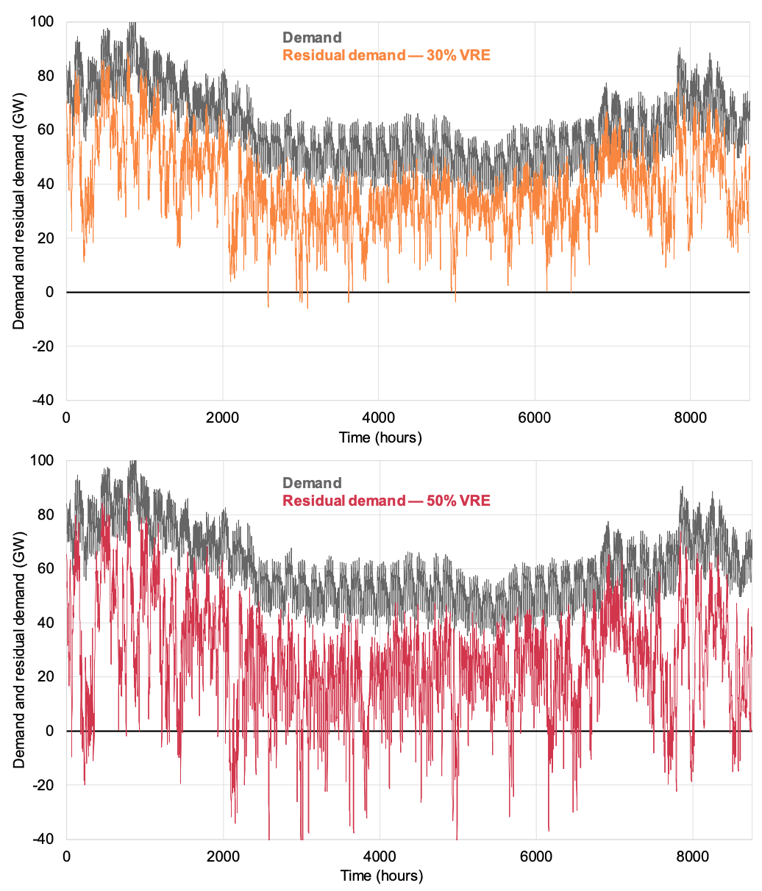
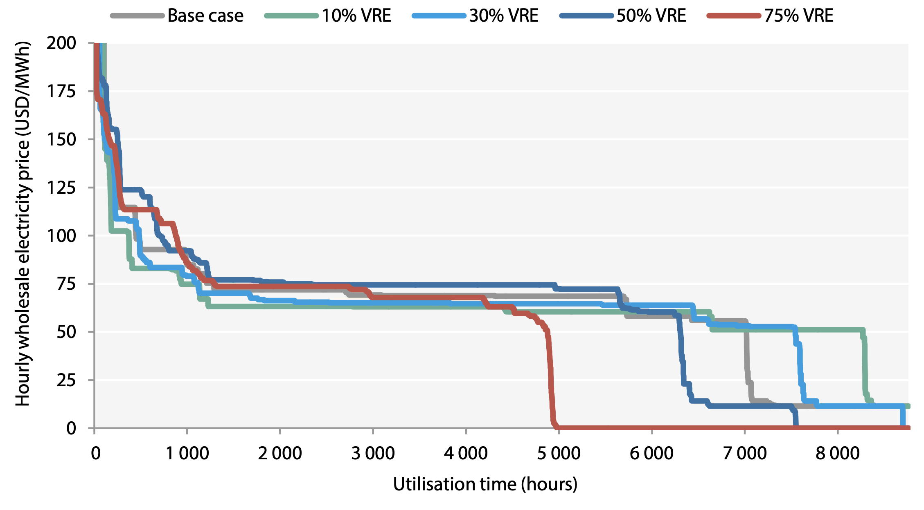
The increasing need for flexible operation
The power sector increasingly requires dispatchable generators to handle variable loads at highly fluctuating prices.
Flexible SMR operation
Technical and economic advantages of keeping reactor at rated conditions
Load following by cogeneration
Thermal Energy Storage integration
Impact of growing VRE penetration on residual demand [1] and electricity prices [2].

Slide 3
Integrated energy system analysis
Energy system architecture definition
Layout and operation optimisation
Dynamic
simulator
Safety
assessments
Definition of technical constraints, economic viability, safety guidelines, policy recommendations…
Main focus of this work

Slide 4
SMR – TES integration
E-SMR reactor
Conceptual design
PWR-type
Rated power: 540 MW_{th}
Thermal energy storage
Two-tanks, sensible heat storage system
Therminol as sensible fluid
Balance of plant
Steam cycle with representative components
Nominal electrical power output: 170 MW_{e}

Slide 5
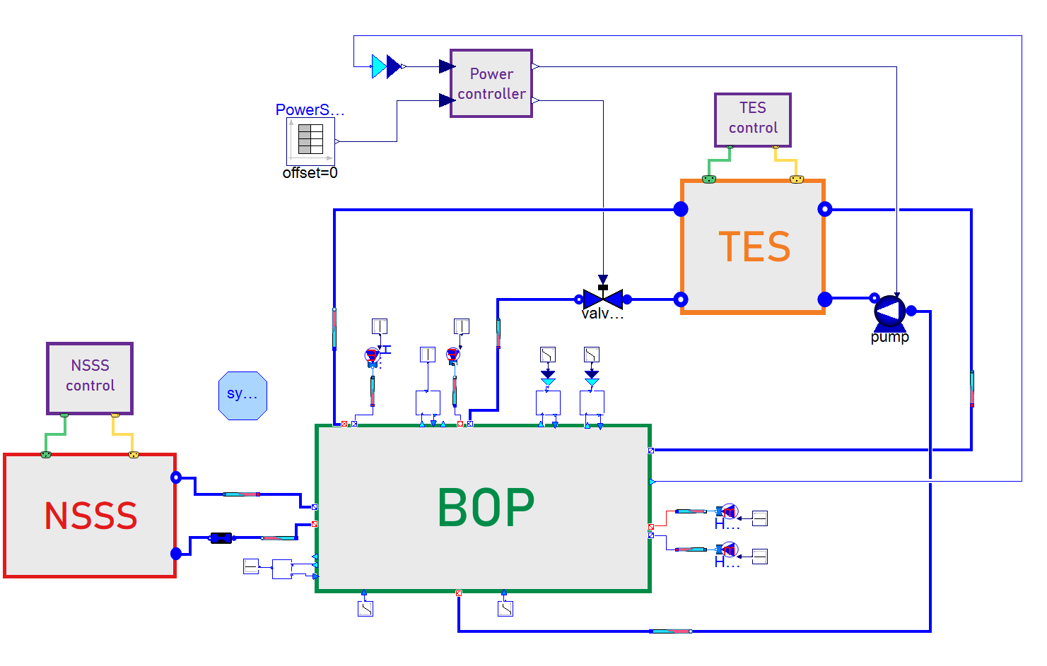
Dynamic simulator and operational strategy
TES operated to perform electrical peaking
TES
charging
TES
discharing
P_{dem} < P_{nom}
P_{dem} > P_{nom}
Main steam extraction
Condensate return in feedwater tank
Process water extraction from feedwater tank
Steam reinjection in low-pressure turbine
Models and simulator available in the open source TANDEM Modelica library [3].

Slide 6
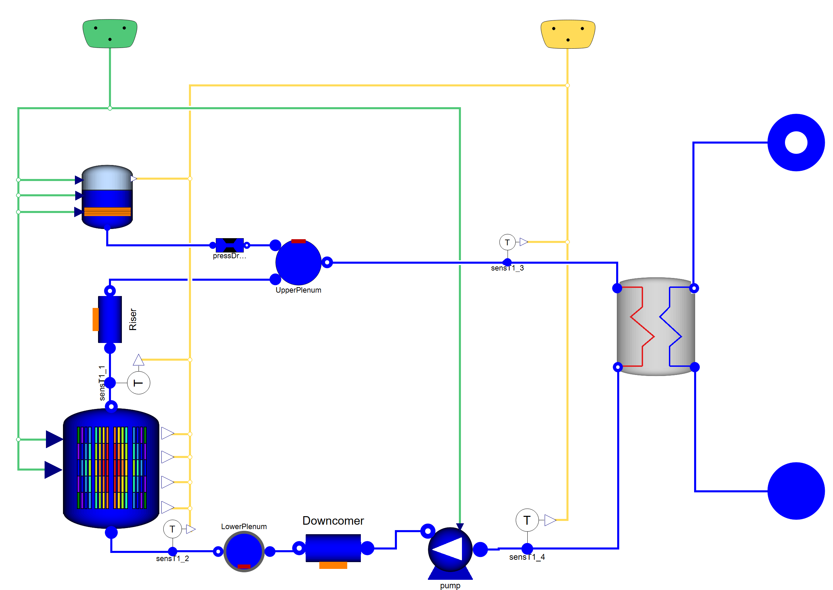
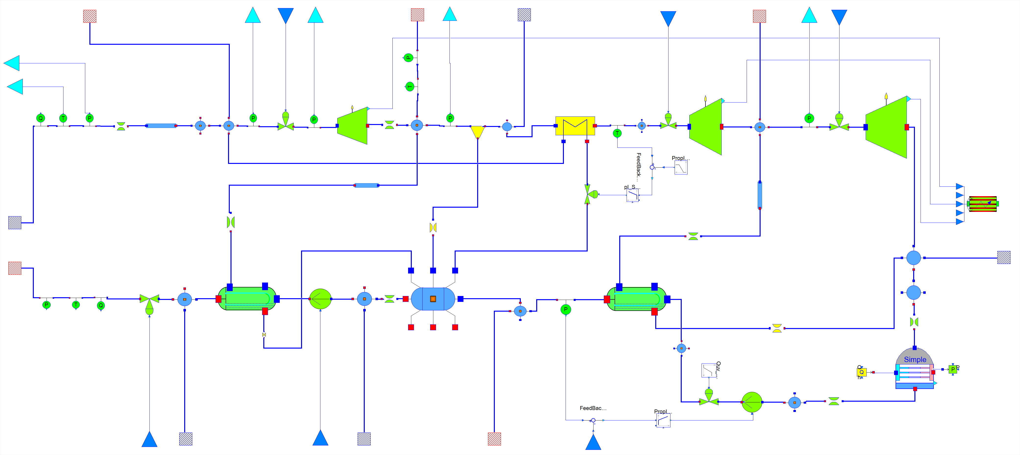
Dynamic simulator – Nuclear Power Plant
E-SMR model
BOP model
ThermoPower library components
Point kinetics model for the neutronics
Finite volume discretization approach for the thermal-hydraulics
ThermoSysPro library components
Quasi-static modelling approach
Several extraction and return points to facilitate integration with cogeneration systems

Slide 7
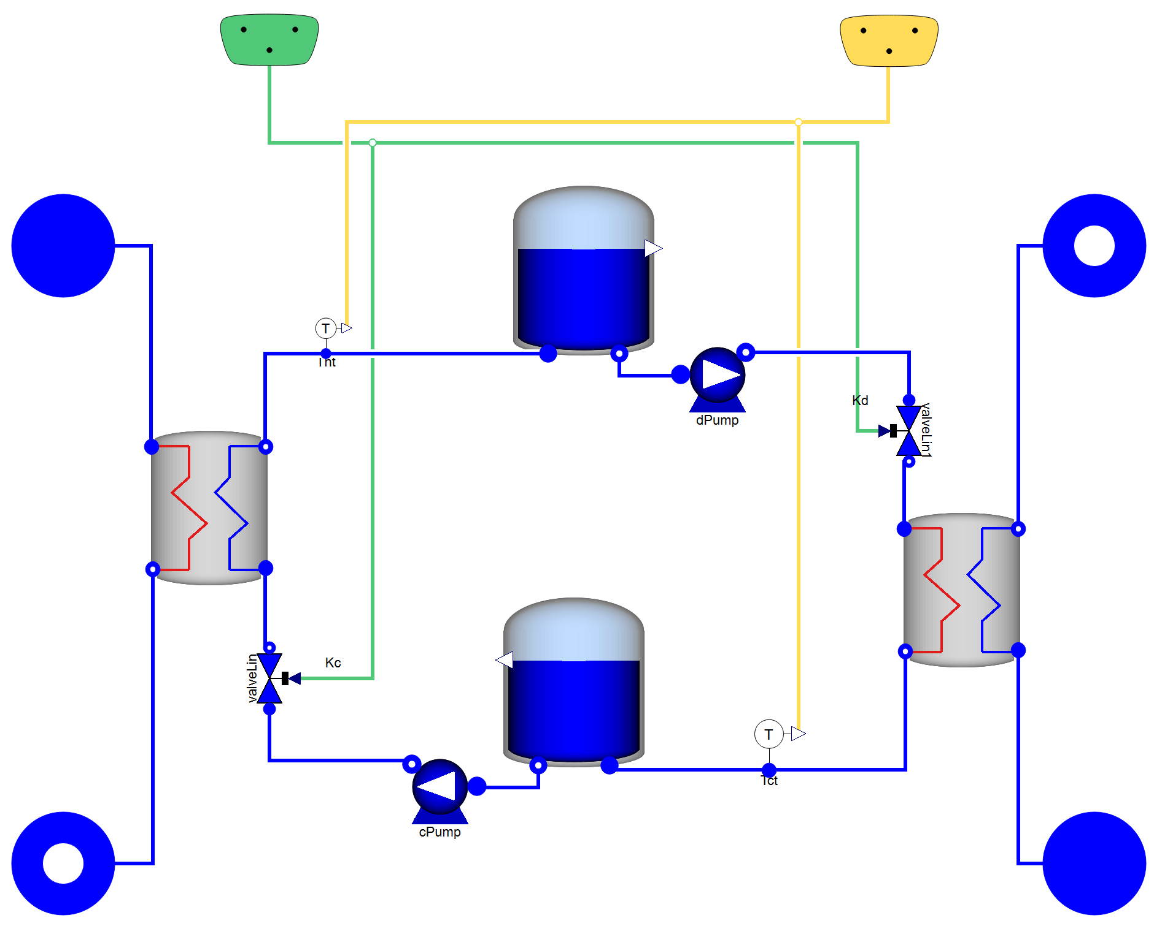
Dynamic simulator – Thermal Energy Storage
ThermoPower library components
Two-tank configuration: sensible medium flows from cold to hot tank during charging process, vice versa during discharging
Charging and discharging flows controlled through valves to meet temperature requirements
Quasi-static heat exchanger models
TES model
TES operating parameters | Value
Nominal charging/discharging power | 80 MW_{th}
Maximal peaking power | 20 MW_{e}
Storage capacity | 1.92 GWh

Slide 8
Case studies
Qualitative costrunction of load demand, following electricity market dynamics.

Slide 9
Transient analysis – Weekend

Slide 10
Transient analysis – Working day

Slide 11
Conclusions
Main outcomes:
MODELICA language proved to be well-suited for the dynamic modelling of such complex energy systems
Proposed architecture proved to be able to meet variable load demands with minimal perturbations on the nuclear island
Flexible operation can enhance the economic competitiveness with respect to baseload operation:
  Working day: 5% revenues increase
  Weekend: 23% revenues increase
Future activites will be devoted to improve the models and optimise the architecture and its operational strategy to maximise the profitability of the integrated energy system

Slide 12
Thank you for your attention!

Slide 13
References
[1] IAEA (2020), Climate Change and Nuclear Power 2020, IAEA Non-serial Publications.
[2] NEA (2024), NEA System Cost Analysis for Integrated Low-Carbon Electricity Systems: A Guide for Stakeholders and Policymakers, OECD Publishing, Paris.
[3] TANDEM Modelica Library (2024), available at: https://gitlab.pam-retd.fr/tandem/tandem

