Slide 2
GLOBAL COAL PLANT POTENTIAL FOR
COAL-TO-SMR TRANSITION:
FOCUSING ON I-SMR AS A REPRESENTATION OF THE TECHNOLOGY
Korea Energy Economics Institute
Jaejeong Shin and Sunjin Kim
Apr 23, 2024

Slide 3
Potential of SMR in Repurposing Coal Plants for a Carbon-Free Future
SMR’s Potential for Global Energy Transition Goal :
  The objective of carbon neutrality by 2050 drives the shift to carbon-free energy sources.
  SMRs have potential in replacing fossil fuels by repurposing retired coal plants, which is called Coal-to-SMR (C2S).
Lack of Comprehensive Studies : No study has quantified the number of global coal plants suitable for C2S.
Study Focus : Estimating the size of retiring coal plants suitable for C2S in 53 countries screened by SMR siting criteria
Significance of the Study : Providing insights into the feasibility of global C2S transitions

Slide 4
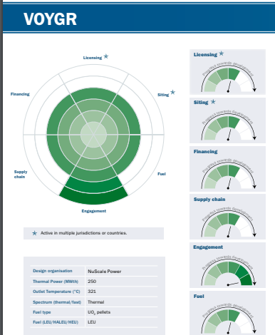
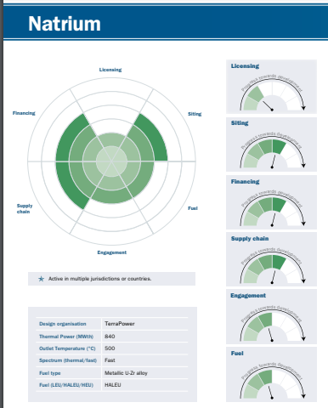
Status of Securing Coal Plants by Major SMR Vendors
No. | Name | Manufacturer | Country | Siting Score | Secured Site
1 | KLT-40S | Rosatom | Russia | 6 | Power and heat supply in polar regions
2 | HTR-PM | INET6 | China | 6 | Nuclear power plant site
3 | BWRX-300 | GE-Hitachi / Hitachi-GE | United States | 4 | Nuclear power plant site
4 | Natrium | TerraPower | United States | 4 | Coal-fired power plant site
5 | ARC-100 | ARC Clean Technology | Canada | 4 | Nuclear power plant site / Supply of heat and power to industrial complexes near ports
6 | VOYGR | NuScale Power | United States | 4 | Coal-fired power plant site
7 | XE-100 | X-energy | United States | 3 | Nuclear power plant site / Coal-fired power plant site
Source:
NEA. 2023. The NEA Small Modular Reactor Dashboard Volume 1.
NEA. 2023. The NEA Small Modular Reactor Dashboard Volume 2.

Slide 5
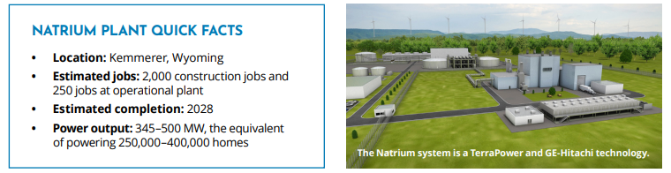
Progress of TerraPower's Demonstration Project
October 2020: Secured $80 million in investment through the U.S. Department of Energy's Advanced Reactor Demonstration Program.
November 2021: Announced plans to build one Natrium reactor at the site of PacifiCorp's coal-fired power plant in Kemmerer, Wyoming.
December 2022: Due to difficulties in securing non-Russian high-assay low-enriched uranium (HALEU), the initial operation date was delayed from 2028 to 2030.
May 2023: PacifiCorp announced plans to secure two additional Natrium reactors in Utah by 2033.
April 2024: Application for construction permit to be submitted to the U.S. Nuclear Regulatory Commission (NRC).
June 2024: Begin construction on the non-nuclear portions in Kemmerer.

Slide 6
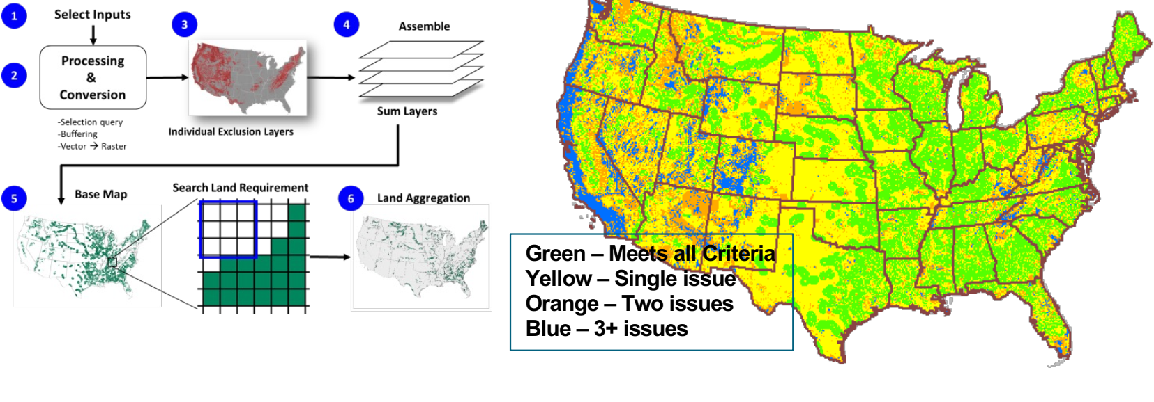
Analysis on the Feasibility of Replacing Retired Coal-Fired Power Plants: DOE (2022)
DOE (2022) "Investigating Benefits and Challenges of Converting Retiring Coal Plants into Nuclear Plants"
Many U.S. coal-fired power plants at risk of early closure (due to the U.S. Environmental Protection Agency's "Good Neighbor" Plan and carbon neutrality efforts).
Active discussion on efficiently utilizing facilities of retired coal plants via Coal-to-Nuclear
  Similarity in the siting criteria for coal and nuclear power plants
  Compatibility in the auxiliary facilities such as steam turbines, cooling systems, and other infrastructure.
Conclusion : Of the approximately 370 retired or operating coal power plant sites in the U.S., about 80% (263 GW in capacity) can be replaced with SMRs.
Source: DOE. 2022. Investigating Benefits and Challenges of Converting Retiring Coal Plants into Nuclear Plants.

Slide 7
Data for Coal Plants
Data Source : Global Coal Plant Tracker (GCPT) published in January 2023
  GCPT provides details on unit capacity, commissioning and closure years, and geolocation.
  Approximately 13,800 coal-fired power units across 107 countries.
2031-50:
807 GW
2021-30:
514 GW
Source: Written by the author based on Global Energy Monitor (2023).

Slide 8
Pre-processing GCPT Data
Data Pre-processing :
  Only "operating" or "retired" units are considered, excluding units "under construction" or "permitted."
  Closure Year: Defined as the year the last unit at the plant site was closed.
  Plants with a capacity below 680 MW (four modules of i-SMR)are excluded.
  If retiring or retired year is missing, a 30-year life span is assumed.
  This study focuses on retirements between 2021 and 2050 in that sites closed for over a decade by 2030 are considered already repurposed.
  Coal plants in Germany and South Korea are excluded due to the nuclear phase-out policy.
Final Dataset : 1,143 coal-fired power plants (899 GW capacity) across 53 countries included in this study.

Slide 9
Applying Four Siting Criteria for Coal to SMR
Siting Criteria | Screening Criteria (Unsuitable) | Data Source
Population Density | Presence of a permanent population with more than 193 people/km² within a 6.4 km radius of the site | WorldPop (2020)
Active Fault Line | Presence of an active fault line longer than 304.8 meters within an 8 km radius of the site | Global Earthquake Model Foundation (2020)
Floodplain | Presence of a 100-year floodplain within the site | Joint Research Centre (2016)
Safe Shutdown Earthquake | Presence of an area with a peak ground acceleration (PGA) of 0.5 g or higher within the site | Global Earthquake Model Foundation (2023)
EPRI (2022) outlines 42 siting criteria grouped into Health and Safety, Ecological, Socioeconomic, and Engineering/Cost-Related categories.
This study:
  Selected four key criteria;
  Assumed all criteria must be met for an SMR site to be considered suitable;
  Used GeoPandas in Python for spatial analysis.
Source: Written by the author with reference to EPRI (2022)

Slide 10
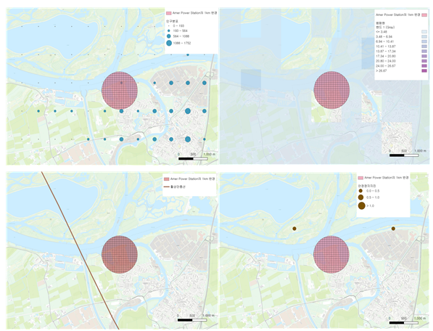
Example: GIS of Four Siting Criteria
Population
Floodplain
Safe
Shutdown
Earthquake
Fault Line
Source: Written by the author based on Global Earthquake Model Foundation (2020), Global Earthquake Model Foundation (2023), Global Energy Monitor (2023), Joint Research Centre (2016), WorldPop (2020)

Slide 11
Country Groups Based on the Policy-based Potential to Deploy SMRs
Country Group | Country
NPP Operating Countries (24 countries) | South Africa, Netherlands, Taiwan, Russia, Romania, Mexico, United States, Bangladesh, Bulgaria, Brazil, Spain, Slovenia, United Arab Emirates, United Kingdom, Ukraine, India, Japan, China, Czech Republic, Canada, Turkey, Pakistan, France, Hungary
Countries with SMR Plan (5 countries) | Sri Lanka, Indonesia, Thailand, Poland, Philippines
Unclassified Countries (24 countries) | Greece, New Zealand, Denmark, Dominican Republic, Laos, Malaysia, Morocco, Moldova, Mongolia, Vietnam, Bosnia and Herzegovina, Serbia, Ireland, Uzbekistan, Israel, Italy, Zimbabwe, Chile, Kazakhstan, Cambodia, Kosovo, Kyrgyzstan, Portugal, Australia
Source: Written by the author

Slide 12
Screened Retired Coal Capacity in the 53 Countries
(Unit: GW)
Periods | 2021-30 | 2031-40 | 2041-50 | Total
Global coal capacity of the preprocessed GCPT | 326.0 | 134.7 | 438.3 | 899.0
Screened coal capacity By the site-screening criteria | 70.4 | 27.8 | 10.0 | 108.3
Source: Written by the author based on Global Earthquake Model Foundation (2020), Global Earthquake Model Foundation (2023), Global Energy Monitor (2023), Joint Research Centre (2016), WorldPop (2020)

Slide 13
Screened Coal Capacity of the NPP Operating Countries (1/2)
Country | Coal Capacity (a) | Screened Capacity (b) | (b)/(a)
Brazil | 1.7 | 0.0 | 0.0%
Bulgaria | 2.5 | 0.0 | 0.0%
Canada | 6.4 | 5.6 | 88.3%
China | 377.7 | 2.5 | 0.7%
Czech Republic | 4.4 | 0.0 | 0.0%
France | 4.7 | 0.0 | 0.0%
Hungary | 0.9 | 0.0 | 0.0%
India | 37.8 | 0.0 | 0.0%
Japan | 25.5 | 0.0 | 0.0%
Mexico | 5.4 | 0.0 | 0.0%
Netherlands | 6.1 | 0.0 | 0.0%
Country | Coal Capacity (a) | Screened Capacity (b) | (b)/(a)
(Unit: GW)
Romania | 4.9 | 0.0 | 0.0%
Russia | 15.6 | 11.1 | 71.0%
Slovenia | 1.4 | 0.0 | 0.0%
South Africa | 33.8 | 0.0 | 0.0%
Spain | 3.5 | 0.0 | 0.0%
Taiwan | 13.1 | 0.0 | 0.0%
Türkiye | 5.0 | 0.0 | 0.0%
Ukraine | 22.6 | 2.5 | 11.0%
United Arab Emirates | 1.2 | 0.0 | 0.0%
United Kingdom | 8.6 | 0.0 | 0.0%
United States | 210.0 | 62.4 | 29.7%
Source: Written by the author based on Global Earthquake Model Foundation (2020), Global Earthquake Model Foundation (2023), Global Energy Monitor (2023), Joint Research Centre (2016), WorldPop (2020)

Slide 14
Screened Coal Capacity of the NPP Operating Countries (2/2)
 | Capacity Excluded by Each Siting Criterion
Country | Population (c) | (c)/(a) | Floodplain (d) | (d)/(a) | Fault Line (e) | (e)/(a) | Safe Shutdown Earthquake (f) | (f)/(a)
Brazil | 1.7 | 100.0% | 0.0 | 0.0% | 0.0 | 0.0% | 0.0 | 0.0%
Bulgaria | 0.0 | 0.0% | 0.0 | 0.0% | 2.5 | 100.0% | 0.0 | 0.0%
Canada | 0.0 | 0.0% | 0.7 | 11.7% | 0.0 | 0.0% | 0.0 | 0.0%
China | 375.2 | 99.3% | 88.8 | 23.5% | 69.5 | 18.4% | 0.0 | 0.0%
Czech Republic | 4.4 | 100.0% | 1.0 | 21.9% | 0.0 | 0.0% | 0.0 | 0.0%
France | 4.7 | 100.0% | 1.3 | 26.9% | 0.9 | 18.1% | 0.0 | 0.0%
Hungary | 0.9 | 100.0% | 0.0 | 0.0% | 0.0 | 0.0% | 0.0 | 0.0%
India | 37.8 | 100.0% | 4.6 | 12.2% | 1.3 | 3.3% | 0.0 | 0.0%
Japan | 25.5 | 100.0% | 0.0 | 0.0% | 23.5 | 92.2% | 10.1 | 39.6%
Mexico | 5.4 | 100.0% | 2.8 | 51.7% | 0.0 | 0.0% | 2.8 | 51.7%
Netherlands | 6.1 | 100.0% | 1.4 | 22.3% | 1.4 | 22.3% | 0.0 | 0.0%
 | Capacity Excluded by Each Siting Criterion
Country | Population (c) | (c)/(a) | Floodplain (d) | (d)/(a) | Fault Line (e) | (e)/(a) | Safe Shutdown Earthquake (f) | (f)/(a)
(Unit: GW)
Romania | 4.9 | 100.0% | 1.3 | 26.1% | 0.0 | 0.0% | 0.0 | 0.0%
Russia | 4.5 | 29.0% | 1.1 | 7.1% | 1.2 | 7.8% | 0.0 | 0.0%
Slovenia | 1.4 | 100.0% | 0.0 | 0.0% | 1.4 | 100.0% | 0.0 | 0.0%
South Africa | 33.8 | 100.0% | 0.0 | 0.0% | 0.0 | 0.0% | 0.0 | 0.0%
Spain | 3.5 | 100.0% | 0.0 | 0.0% | 1.2 | 32.7% | 0.0 | 0.0%
Taiwan | 13.1 | 100.0% | 0.0 | 0.0% | 13.1 | 100.0% | 8.9 | 68.0%
Türkiye | 5.0 | 100.0% | 0.0 | 0.0% | 5.0 | 100.0% | 0.0 | 0.0%
Ukraine | 20.1 | 89.0% | 4.1 | 18.1% | 0.0 | 0.0% | 0.0 | 0.0%
United Arab Emirates | 1.2 | 100.0% | 0.0 | 0.0% | 0.0 | 0.0% | 0.0 | 0.0%
United Kingdom | 8.6 | 100.0% | 0.0 | 0.0% | 0.0 | 0.0% | 0.0 | 0.0%
United States | 127.6 | 60.7% | 82.0 | 39.0% | 3.4 | 1.6% | 1.3 | 0.6%
Source: Written by the author based on Global Earthquake Model Foundation (2020), Global Earthquake Model Foundation (2023), Global Energy Monitor (2023), Joint Research Centre (2016), WorldPop (2020)

Slide 15
Screened Coal Capacity of the Countries with SMR Plan
(Unit: GW)
 |  |  |  | Capacity Excluded by Each Siting Criterion
Country | Coal Capacity (a) | Screened Capacity (b) | (b)/(a) | Population (c) | (c)/(a) | Floodplain (d) | (d)/(a) | Fault Line (e) | (e)/(a) | Safe Shutdwon Earthquake (f) | (f)/(a)
Indonesia | 4.4 | 0.0 | 0.0% | 4.4 | 100.0% | 0.0 | 0.0% | 1.1 | 23.9% | 0.0 | 0.0%
Philippines | 1.3 | 0.0 | 0.0% | 1.3 | 100.0% | 0.0 | 0.0% | 1.3 | 100.0% | 1.3 | 100.0%
Poland | 23.1 | 5.4 | 23.4% | 17.7 | 76.6% | 1.9 | 8.2% | 0.0 | 0.0% | 0.0 | 0.0%
Thailand | 1.4 | 0.0 | 0.0% | 1.4 | 100.0% | 0.0 | 0.0% | 0.0 | 0.0% | 0.0 | 0.0%
Source: Written by the author based on Global Earthquake Model Foundation (2020), Global Earthquake Model Foundation (2023), Global Energy Monitor (2023), Joint Research Centre (2016), WorldPop (2020)

Slide 16
Screened Coal Capacity of the Unclassified Countries
(Unit: GW)
 |  |  |  | Capacity Excluded by Each Siting Criterion
Country | Coal Capacity (a) | Screened Capacity (b) | (b)/(a) | Population (c) | (c)/(a) | Floodplain (d) | (d)/(a) | Fault Line (e) | (e)/(a) | Safe Shutdwon Earthquake (f) | (f)/(a)
Australia | 23.9 | 7.7 | 32.2% | 12.0 | 50.3% | 0.0 | 0.0% | 14.8 | 61.8% | 0.0 | 0.0%
Bosnia and Herzegovina | 0.7 | 0.0 | 0.0% | 0.7 | 100.0% | 0.0 | 0.0% | 0.7 | 100.0% | 0.0 | 0.0%
Chile | 2.4 | 0.0 | 0.0% | 2.4 | 100.0% | 0.0 | 0.0% | 0.7 | 30.1% | 2.4 | 100.0%
Denmark | 1.5 | 0.0 | 0.0% | 1.5 | 100.0% | 0.0 | 0.0% | 0.0 | 0.0% | 0.0 | 0.0%
Greece | 3.7 | 0.0 | 0.0% | 3.7 | 100.0% | 0.0 | 0.0% | 3.7 | 100.0% | 0.0 | 0.0%
Ireland | 0.9 | 0.9 | 100.0% | 0.0 | 0.0% | 0.0 | 0.0% | 0.0 | 0.0% | 0.0 | 0.0%
Israel | 4.9 | 0.0 | 0.0% | 4.9 | 100.0% | 0.0 | 0.0% | 0.0 | 0.0% | 0.0 | 0.0%
Italy | 6.9 | 2.6 | 38.4% | 4.2 | 61.6% | 0.0 | 0.0% | 1.0 | 14.2% | 0.0 | 0.0%
Kazakhstan | 7.5 | 7.5 | 100.0% | 0.0 | 0.0% | 0.0 | 0.0% | 0.0 | 0.0% | 0.0 | 0.0%
Kosovo | 1.5 | 0.0 | 0.0% | 0.0 | 0.0% | 0.0 | 0.0% | 1.5 | 100.0% | 0.0 | 0.0%
Malaysia | 3.0 | 0.0 | 0.0% | 3.0 | 100.0% | 0.0 | 0.0% | 0.0 | 0.0% | 0.0 | 0.0%
Moldova | 1.6 | 0.0 | 0.0% | 1.6 | 100.0% | 0.0 | 0.0% | 0.0 | 0.0% | 0.0 | 0.0%
New Zealand | 1.0 | 0.0 | 0.0% | 1.0 | 100.0% | 1.0 | 100.0% | 1.0 | 100.0% | 0.0 | 0.0%
Portugal | 2.0 | 0.0 | 0.0% | 2.0 | 100.0% | 0.0 | 0.0% | 0.7 | 34.5% | 0.0 | 0.0%
Serbia | 4.0 | 0.0 | 0.0% | 4.0 | 100.0% | 4.0 | 100.0% | 3.0 | 75.0% | 0.0 | 0.0%
Uzbekistan | 2.1 | 0.0 | 0.0% | 2.1 | 100.0% | 0.0 | 0.0% | 2.1 | 100.0% | 0.0 | 0.0%
Vietnam | 1.0 | 0.0 | 0.0% | 1.0 | 100.0% | 0.0 | 0.0% | 0.0 | 0.0% | 0.0 | 0.0%
Zimbabwe | 0.9 | 0.0 | 0.0% | 0.9 | 100.0% | 0.0 | 0.0% | 0.0 | 0.0% | 0.0 | 0.0%
Source: Written by the author based on Global Earthquake Model Foundation (2020), Global Earthquake Model Foundation (2023), Global Energy Monitor (2023), Joint Research Centre (2016), WorldPop (2020)

Slide 17
Key Scenarios in IEA’s World Energy Outlook
Stated Policies Scenario (STEPS):
  This scenario reflects the energy policies and measures that governments have already implemented or announced. It shows the likely trajectory of the global energy system based on current policy frameworks without assuming further advancements.
Announced Pledges Scenario (APS):
  APS assumes that all climate commitments and net-zero pledges announced by governments will be fully implemented. This includes both short-term and long-term goals, such as those outlined in Nationally Determined Contributions (NDCs).
Net Zero Emissions by 2050 Scenario (NZE):
  NZE represents the most ambitious pathway, aiming to limit global temperature rise to 1.5°C. It requires a radical transformation of energy systems, with rapid declines in fossil fuel consumption and a massive increase in renewable energy, efficiency improvements, and new technologies. Under this scenario, global CO2 emissions reach net zero by 2050.

Slide 18
Comparison with IEA’s Required Nuclear Capacity
Country | Required nuclear capacity between scenarios (GW) |  | Screened coal plant capacity (GW) [c] | Comparison with APS-STEP [a] / [c] | Comparison with NZE-STEP [b] / [c]
 | APS-STEP [a] | NZE-STEP [b]
World | 190.3 | 228.1 | 108.3 | 175.8% | 210.7%
North America | 11.8 | 12.3 | 68.0 | 17.3% | 18.1%
United States | 13.8 | 13.8 | 62.4 | 22.1% | 22.1%
Central and South America | 5.1 | 6.2 | 0.0 | - | -
Brazil | 2.5 | 2.5 | 0.0 | - | -
Europe | 6.4 | 8.0 | 11.4 | 55.9% | 69.9%
European Union | 4.7 | 4.7 | 0.0 | - | -
Africa | 3.6 | 6.2 | 0.0 | - | -
Central Asia | 6.3 | 13.8 | 0.0 | - | -
Eurasia | 8.9 | 29.4 | 18.6 | 47.9% | 158.2%
Russia | 8.0 | 27.1 | 11.1 | 72.2% | 244.7%
Asia-Pacific | 148.2 | 152.2 | 10.2 | 1450.8% | 1490.0%
China | 121.7 | 110.6 | 2.5 | 4829.4% | 4388.9%
India | 26.1 | 27.7 | 0.0 | - | -
Japan | 9.1 | 9.1 | 0.0 | - | -
Southeast Asia | 3.4 | 5.6 | 0.0 | - | -
Source: Written by the author based on Global Earthquake Model Foundation (2020), Global Earthquake Model Foundation (2023), Global Energy Monitor (2023), Joint Research Centre (2016), WorldPop (2020), and IEA (2021)

Slide 19
Conclusion
This study assesses the potential of C2S in 53 countries based on the site-screening analysis.
Out of 899 GW of coal plants retiring between 2021 and 2050 in 53 countries, 108 GW could be suitable for SMR siting.
The population criterion matters: if SMR’s safety is improved enough to meet population-related regulations, more coal plants could be converted.
Comparison with IEA’s Nuclear Capacity Requirements:
  The United States has 62.4 GW of coal plants available for SMR siting, sufficient to meet its nuclear capacity needs for carbon neutrality.
  In contrast, China has only 2.5 GW of coal plants suitable for SMR siting, which is below its nuclear capacity requirements.

Slide 20
Reference
[1] DOE. 2022. “Investigating benefits and challenges of converting retiring coal plants into nuclear plants”. Idaho National Laboratory.
[2] EPRI. 2022. “Advanced Nuclear Technology: Site Selection and Evaluation Criteria for New Nuclear Energy Generation Facilities (Siting Guide): 2022 Revision”.
[3] Global Earthquake Model Foundation. (2020). Global Active Faluts Database. https://www.globalquakemodel.org/product/active-faults-database.
[4] Global Earthquake Model Foundation. (2023). Global Seismic Hazard Map. https://www.globalquakemodel.org/product/global-seismic-hazard-map.
[5] Global Energy Monitor. (2023). Global Coal Plant Tracker January Edition. https://globalenergymonitor.org/projects/global-coal-plant-tracker/download-data/.
[6] IEA. 2021. “World Energy Outlook 2021”.
[7] Joint Research Centre. (2016). Flood hazard map of the World: 100-year return period. https://data.jrc.ec.europa.eu/dataset/jrc-floods-floodmapgl_rp100y-tif.
[8] NEA. 2023. “The NEA Small Modular Reactor Dashboard Volume 1.”
[9] NEA. 2023. “The NEA Small Modular Reactor Dashboard Volume 2.”
[10] WorldPop. (2020). Population Counts: Unconstrained Individual Countries (1 km Resolution). www.worldpop.org.

