Slide 1

Incorporating Small Modular Reactors with Solar and Wind for Ghana's Sustainable Energy Transition Beyond Conventional Nuclear Power Ambition Post-COP28
Mark Amoah Nyasapoh,
Nuclear Power Institute, Ghana Atomic Energy Commission
Co-authors: Samuel Gyamfi1, Seth. K. Debrah, Hossam A. Gabbar, N. S. Agyemang Derkyi, Archibold Buah-Kwofie, Joshua Gbinu, Felix Ohene-Fobih Ameyaw.
Date: 21 – 25 October 2024
Venue: International Conference on Small Modular Reactors and their
Applications, IAEA, Vienna – Austria.

Slide 2

  Country Overview
  Electricity Consumption & power system of Ghana
  GHG emission and Net-Zero pledges/targets
  Methodology
  Case-study analysis and results
  Research Limitations and directions & ongoing works
  Conclusions
Outline

Slide 3
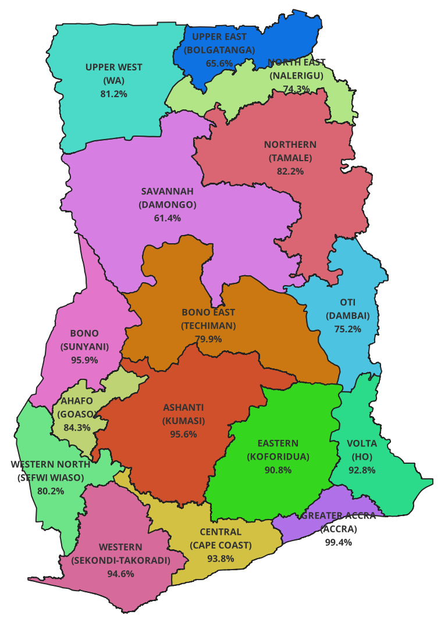
Overview
Land area: 238,533 sq km
Demographic data in 2023
  Population: 31.34 million
  Electricity Coverage: 89 %
Macro-economic data in 2023
  Total GDP (current prices) :US$ 77.57 billion
  GDP/cap (current prices) : US$ 2,500.
  Total Electricity Consumed/capita : kWh/capita 559

Slide 4
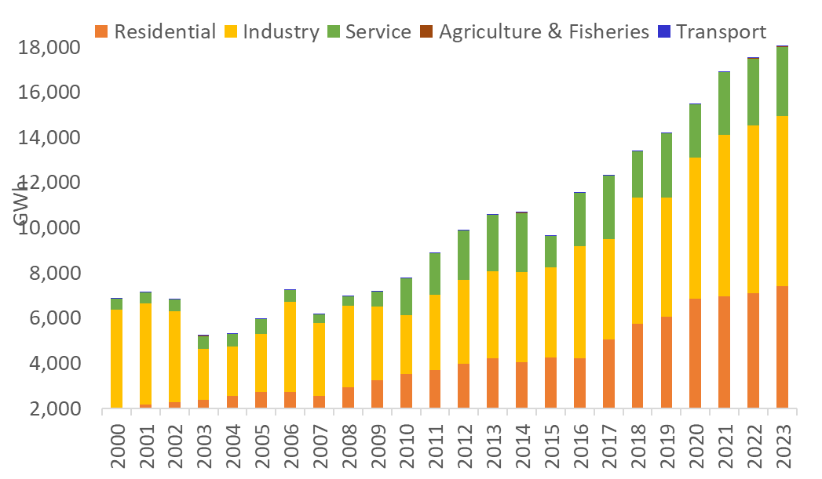
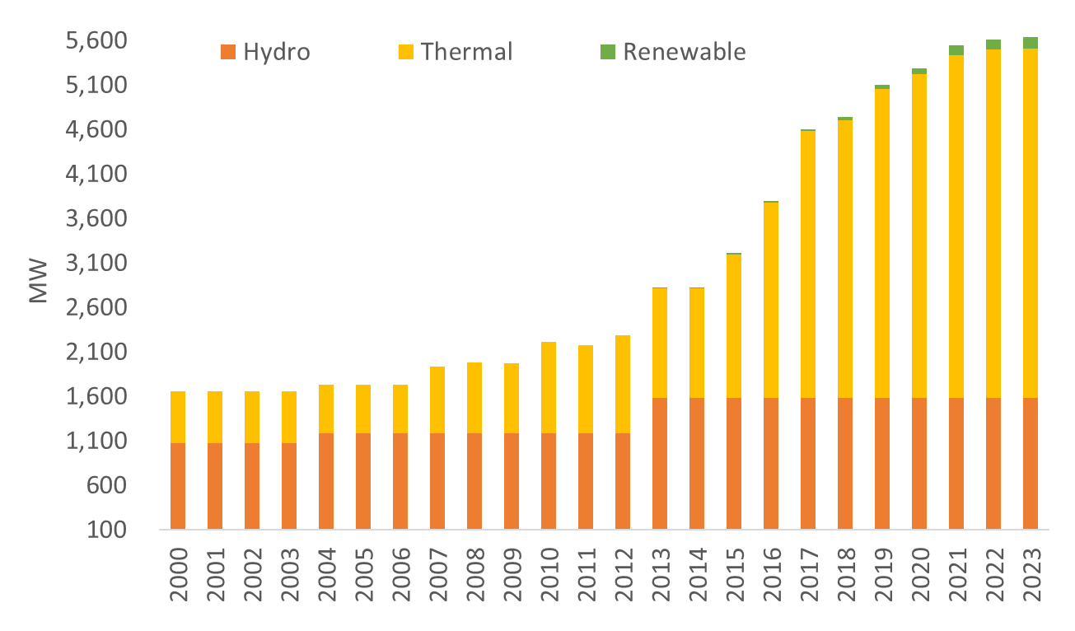
Electricity Consumption & power system of Ghana
Source: 2024 National Energy Statistics and Balances
https://www.energycom.gov.gh/newsite/index.php/planning/energy-statistics
Source: 2024 National Energy Statistics and Balances
https://www.energycom.gov.gh/newsite/index.php/planning/energy-statistics
The power system of Ghana as of 2023
Total Capacity: 5,639
  Thermal: 3,923 (69.6%)
  Hydro: 1,584 (28.1%)
  Other REs: 132 (2.3%)
Increased consumption from 6,889 GWh in 2000 to 18,046 GWh in 2023.

Slide 5
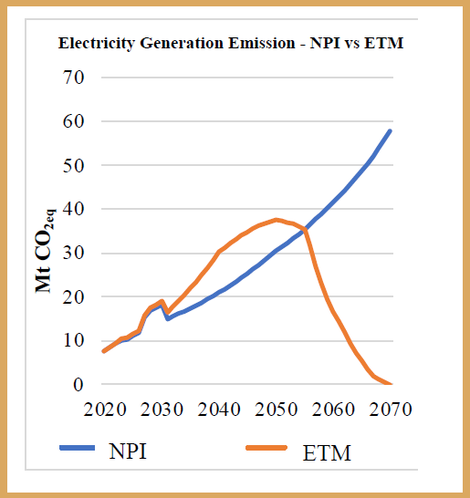
Ghana’s electricity GHG emission and Net-Zero pledges/targets
Current emiisions:7.5 MtCO2-eq in 2020
Energy Transition targets next five decades:
  Net-Zero Targets -2030
  Net-Zero Targets -2040
  Net-Zero Targets -2050
  Net-Zero Targets -2070
As a result:
7.5 MtCO2-eq in 2020, peak in mid-2050s and decrease to zero (0) MtCO2-eq by 2070
Electricity generation: 18,592 GWh in 2020 to 344,272 GWh in 2070.
Source: National Energy Transition Framework (2022)
https://www.energymin.gov.gh/

Slide 6
Ghana’s Energy Transition Targets
Source: Ghana’s National Energy Transition Framework (2022-2070)

Slide 7

Nuclear power inclusion in Ghana’s energy mix
On 28th July 2022, The President of the Republic of Ghana incorporated nuclear power inclusion in the generation mix.
  Consonance with the global collective commitment to power sustainability and availability and the peaceful exploitation of nuclear energy for the benefit of our citizens, to enhance rapid industrialization, and to propel economic growth.
The choice, therefore, is not between renewables and nuclear power;
  Rather, it is between, affordable, sustainable, severe climate change and decarbonised energy systems towards net-zero transitions.
President Akufo-Addo Approves Inclusion Of Nuclear In Energy Mix
Source: Office of the President, Republic of Ghana https://www.presidency.gov.gh/index.php/briefing-room/news-style-2/2269-president-akufo-addo-approves-inclusion-of-nuclear-in-energy-mix

Slide 8
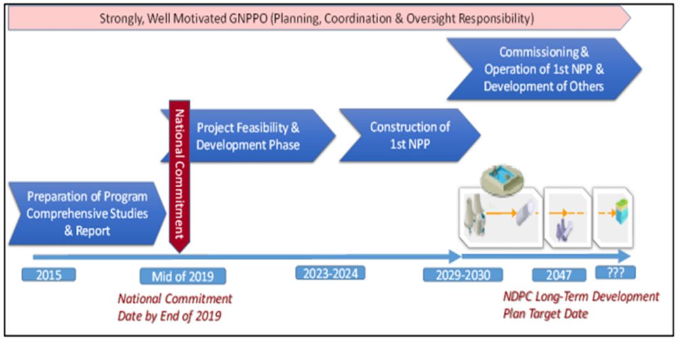
Proposed roadmap for first nuclear plant construction

Slide 9
Modeling General Assumptions
Modeling period 2018 – 2040
Demand: Business As Usual (BaU) by Energy Commission, Ghana
All-inclusive technology scenario relative to BaU
Existing Power Plants
  Operational characteristics and constraints
Cost and Performance of New Generation Options
Fuel Supply and Price: Natural gas imports and infrastructure, Gas price and volume sensitivities, Coal, Oil, Nuclear
12% Discount Rate.
20% reserve margin has been modeled into the electricity system

Slide 10
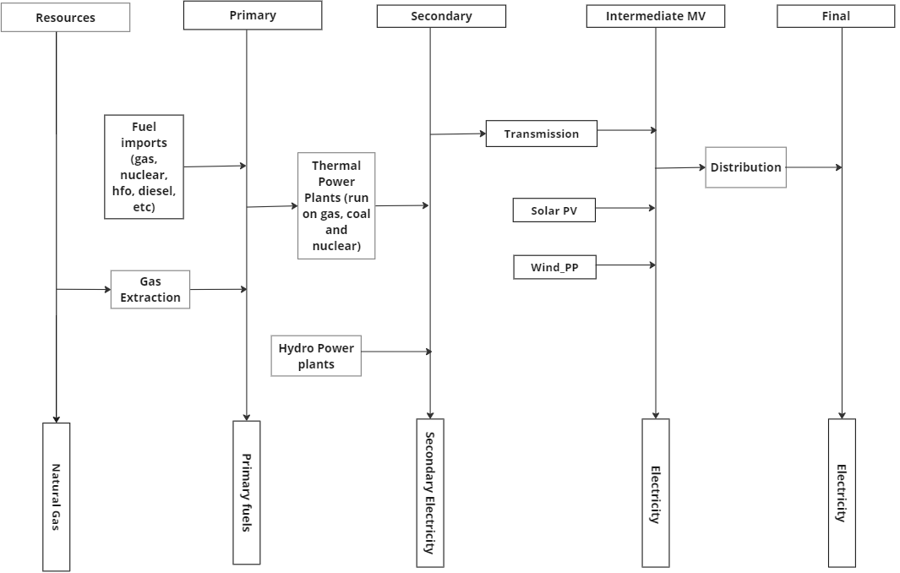
Reference Energy System – Focus on Electricity

Slide 11
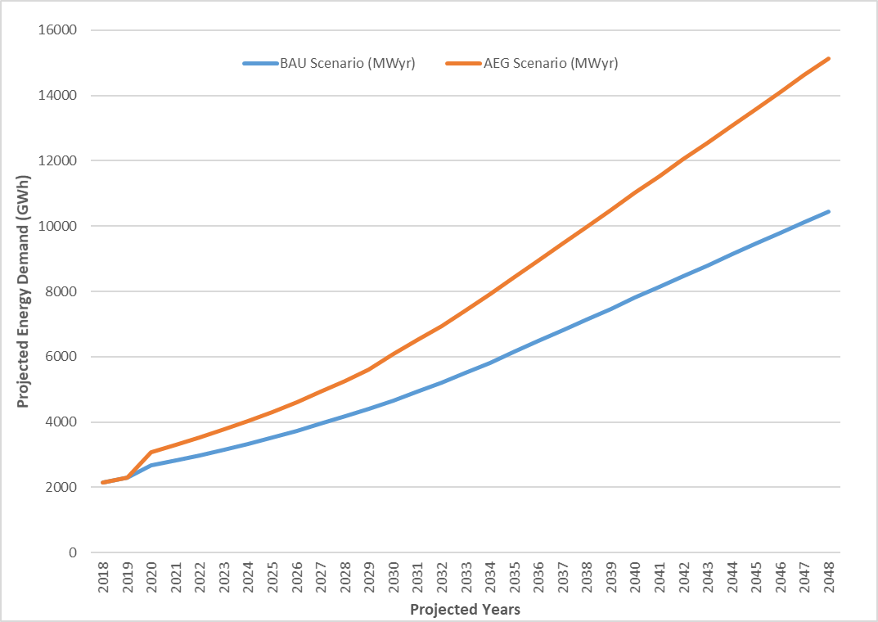
Energy Demand Projections
  Energy Commission Demand projections

Slide 12
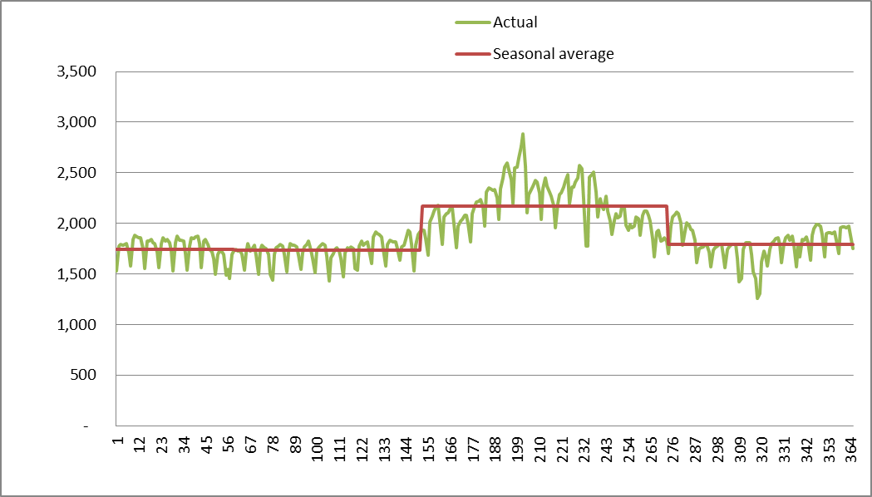
Load curve adopted for modelling
  Load curve data provided by Energy Commission

Slide 13
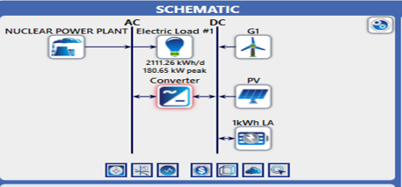
Integrated System Configuration and Simulation using HOMER software
Hybrid Optimization of Multiple Energy Resources (HOMER) Pro software was used for system design, simulation, and analysis of economic parameters.
  Off-grid stand-alone N-R HES.

Slide 14
  Case-study analysis and results

Slide 15
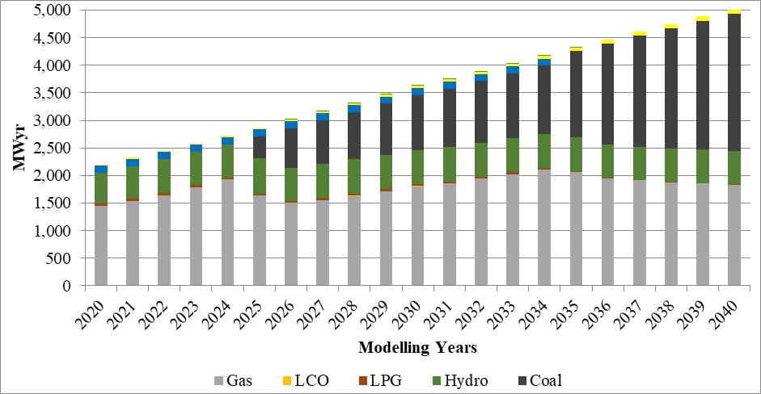
Reference scenario generation capacity (MWyr)
The reference scenario excludes heavy fuel oil (HFO), biomass, and nuclear power, focusing instead on solar, wind, and hydro. Solar capacity saw a substantial increase from 22.0 MWyr in 2020 to 102.7 MWyr in 2040.
Wind capacity remained stable at 128.9 MWyr from 2020 to 2034. Hydro power experienced a modest increase from 558.0 MWyr in 2020 to 613.7 MWyr in 2040. Gas generation, the predominant energy source, rose from 1,442.9 MWyr in 2020 to 1,834.6 MWyr in 2040.
Notably, coal power, which started at 391.1 MWyr in 2025, surged to 2,480.8 MWyr by 2040, overtaking gas as the dominant source by 2037.

Slide 16
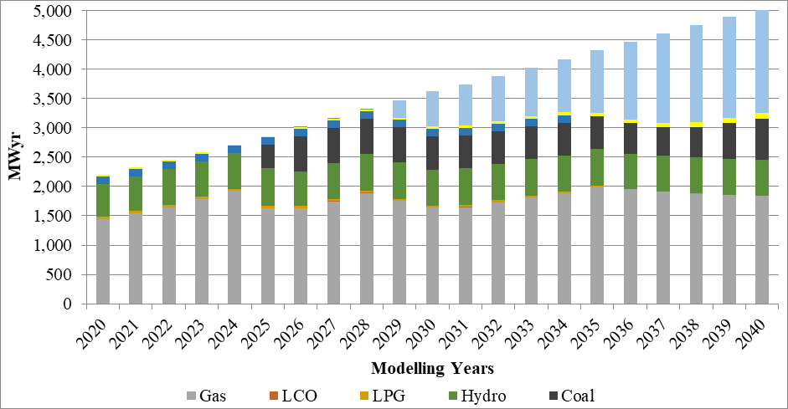
All-inclusive technology scenario (MWyr)
In the all-inclusive technology scenario, total generation capacity expanded from 2,197.5 MWyr in 2020 to 5,034.6 MWyr in 2040, incorporating nuclear energy alongside other technologies
Nuclear power commenced in 2029 with 296.1 MWyr, rising to 1,782.9 MWyr by 2040, gradually displacing coal.

Slide 17
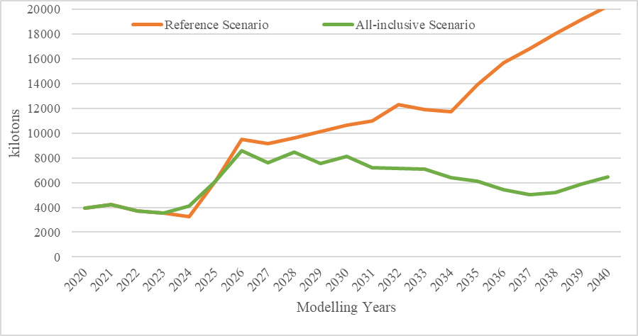
Carbon Dioxide (CO2) Emissions of Scenarios (kilotons)
With the inclusion of nuclear power in the generation mix, CO2 emissions began to decrease from 2025, reducing from 9,489.1 kilotons to 8,554.72 kilotons in 2026.
By the end of the study period in 2040, emissions were 20,264.8 kilotons for the reference scenario and 6,490.63 kilotons for the all-inclusive scenario.
These findings align with previous studies for Ghana [23], [24] and further support the nation's energy policy ambitions to integrate nuclear energy, curtail emissions, and ensure a sustainable energy future [14], [26], [29].

Slide 18
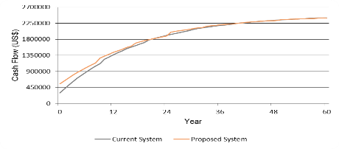
Cumulative cash flow over project life (US$)
The lifeline scenario does not offer a cost-effective energy source, whereas a hybrid energy system (HES) connected to the grid is optimal.
The off-grid hybrid energy analysis is depicted in Fig. 5. For the off-grid N-R HES site analysed, the proposed system has a net present cost (NPC) of $2,392,143, incorporating 137 kW of PV and 129 kWh of battery capacity.
The expected operating cost is $112,200.80 per year, compared to $128,162 per year for the current system. The payback period is 11.4 years with an internal rate of return (IRR) of 6.44%.
The cost of energy (COE) for the project is $0.1888.

Slide 19
Research Limitations and Future Directions
While this study offers insightful information about the proportional and economic integration or feasibility of SMRs with solar and wind energy in Ghana, there exist some limitations.
Future studies should concentrate on:
  technical, socio-political aspects, legal frameworks, and public acceptance to guarantee the effective implementation of integrated energy solutions.

Slide 20
Some Basic Modelling Assumptions for ongoing works
Modeling period 2020–2050 within the transition framework (2022–2070)
Demand: energy transition by Ministry of Energy, Ghana
10% discount rate
Existing and firmly planned capacity
  Unit types, cost, operational characteristics and constraints
Cost and performance of new generation options
  Unit types, cost, operational characteristics and constraints
Renewable energy resources and renewable energy penetration assumptions
Sensitivities
Fuel supply and price
  Natural gas volume and infrastructure
  Price and volume sensitivities
  Conventional fuels (liquid fuels, coal, nuclear)
18% reserve margin

Slide 21
Summary of findings
Employing net-zero transition strategies, such as the transition framework and related NDCs on Ghana’s energy mix influences the future energy outlook.
Ghana's shift to a sustainable energy source has potential when SMRs are combined with solar and wind energy, hence, a great deal from this, including increased economic growth, environmental sustainability, and energy security.
Technological trade-offs lead to coal, gas and liquid fuels losing their share to more environmentally friendly technologies such as nuclear and renewables.
A comprehensive strategy that takes into account socio-political, legal, and technical factors would be needed for effective implementation of such energy sources
Therefore, all stakeholders need to give integrated clean energy infrastructure investments top priority to expedite energy transformation beyond COP28.

Slide 22
Acknowledgement
Planning and Economic Studies Section (PESS) of IAEA
Nuclear Power Institute – GAEC
The Energy Commission of Ghana
Ministry of Energy, Ghana
Regional Centre for Excellence in Energy and Environmental Sustainability of the University of Energy and Natural Resources, Sunyani-Ghana.
IAEA Coordinated Research Project (CRP): Technical Evaluation and Optimization of Nuclear-Renewable Hybrid Energy Systems (I32012).

Slide 23
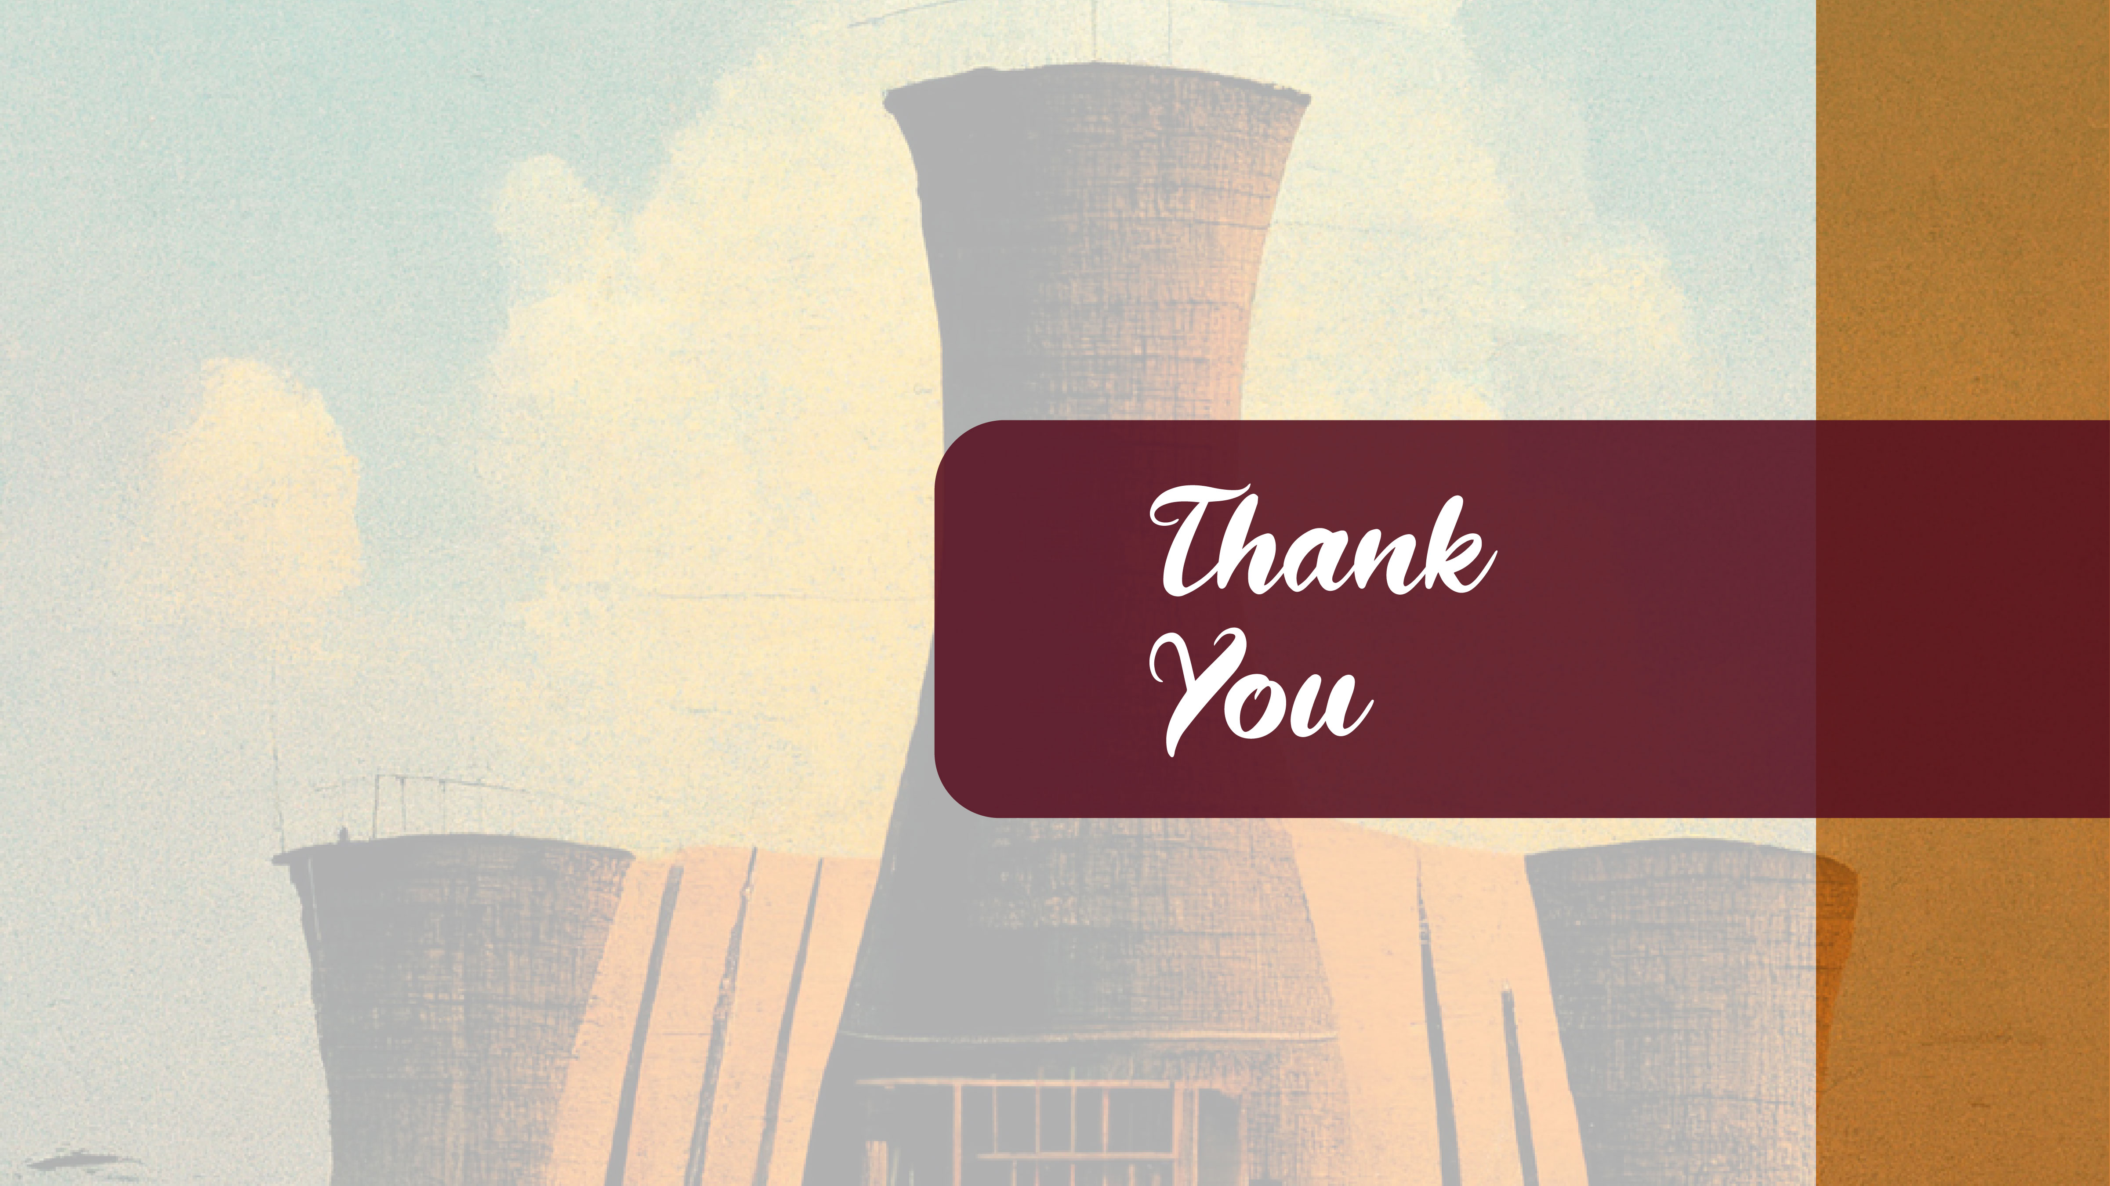
E-mail : mark.nyasapoh@gaec.gov.gh
Website : http://npi.gaec.gov.gh

