Slide 1


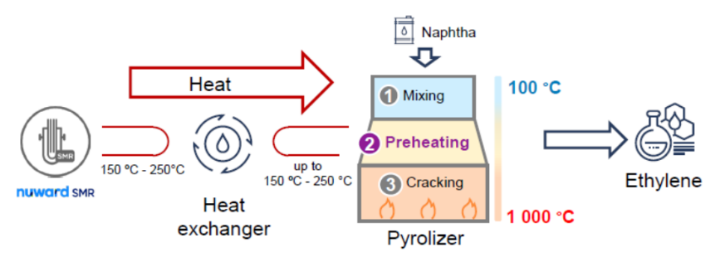
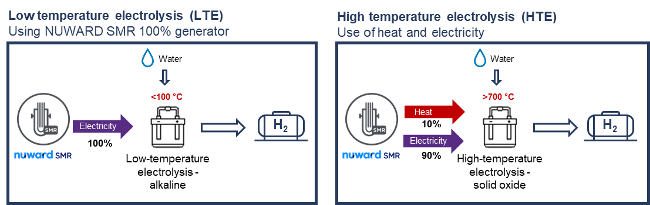
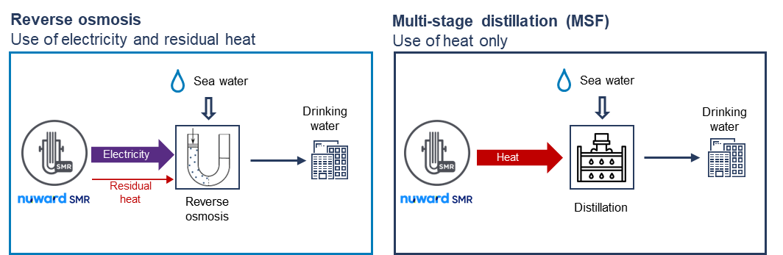
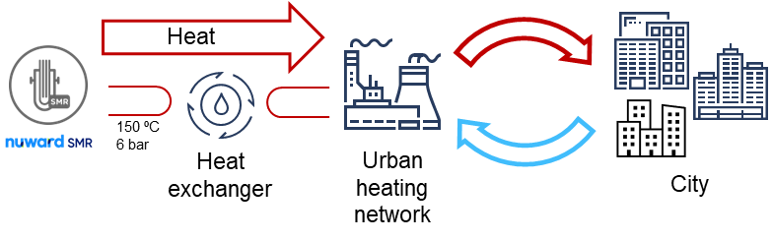
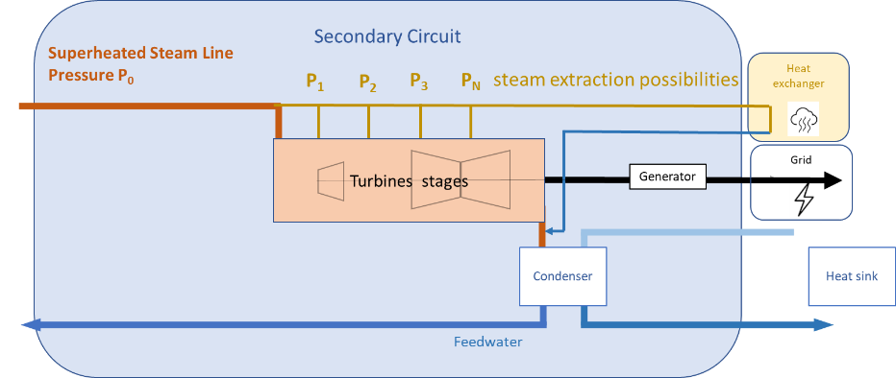

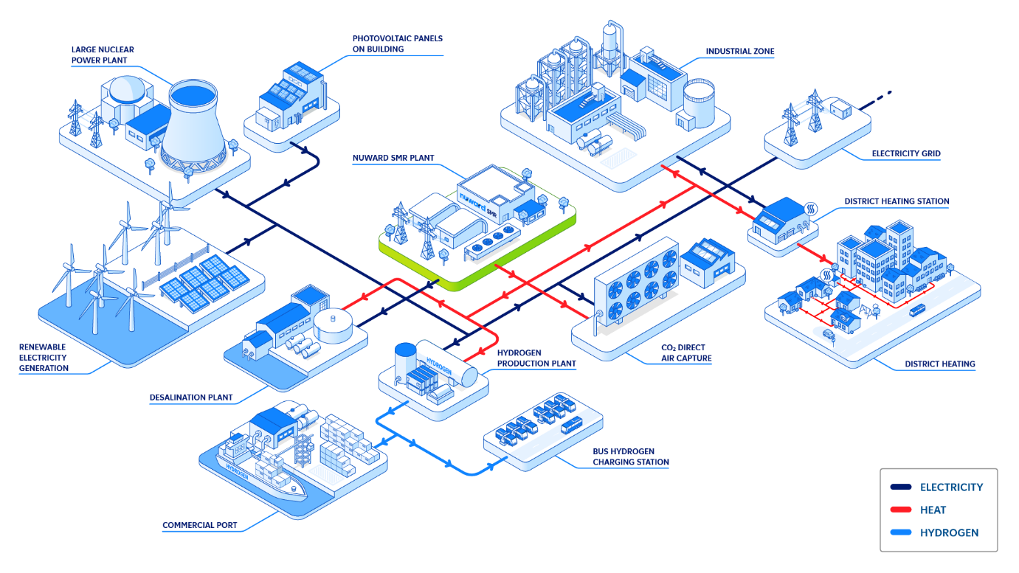
IAEA-CN-327-243
NUWARD SMR COGENERATION SERVICES
C. TERRIER - NUWARD, cedric.terrier@nuward.com
A. MENGES, JF. DHEDIN - EDF
Introduction
NUWARD is developing a Small Modular Pressurized Water Reactor as a solution to achieve transition to a Net Zero economy. NUWARD SMR is being designed and optimized to produce low carbon electricity, offering an alternative to fossil-fired power plants. It also includes a Combined Heat and Power (CHP) feature to deliver thermal power complementary to electrical power. The pressure/temperature characteristics of NUWARD SMR are suitable for supplying a range of industrial applications studied in [1]. Depending on the specific industrial application, the steam extraction location can be adapted to find a compromise between electricity production and the required steam characteristics. Integrating the CHP options also requires design specific analyses.
Processes that can be addressed by NUWARD
Coupling opportunities are analyzed in [1] based on physical feasibility, quantities of heat consumed and sustainability of the needs.
INDUSTRIAL HEAT
HYDROGEN PRODUCTION
Applications not limited to temperature needs below 250°C
Pre-heating needs are important and NUWARD SMR is a competitive solution
Thermal-electric means can complement pre-heating to go beyond 250°C
→ Both electrical and heat needs can be met by CHP service
Low temperature electrolysis → 100% electrical usage
High temperature electrolysis : electricity and heat needs
  Developed to produce hydrogen with a greater efficiency
  Process operates at 700°C, which can be reached by coupling electricity and heat at 150°C (exothermic reaction)
  500 to 600 ktCO2/year avoided by electrolysis with a NUWARD SMR vs steam reforming of natural gas [1]
~200ktCO2
avoided per year [1]
(pre-heating stage)
DISTRICT HEATING
DESALINATION
Temperatures are compatible with NUWARD SMR supply
Main challenge : seasonal variation of heat consumption
Both heat and electrical supply is thus an asset to adapt to variations in consumption needs.
Drinking water for around 180 000 inhabitants
DIRECT AIR CAPTURE
~150 000 inhabitants
Technology under development
Energy needs : electricity and heat at medium temperature (around 90°C)
Integration in the design
New systems to be added to interface NUWARD SMR secondary circuit with the customer process :
  Design of steam line extraction : several extractions required to cover a range of application as wide as possible and limit mechanical impact on turbine components
  Heat exchanger at the interface between NUWARD SMR and the customer process
Process interactions have to be studied with several purposes :
  Safety analysis
  As a supplier to industrial activities, risks associated to this industrial environment have to be taken into account in the plant design (eg H2 explosion risk for H2 production application)
  Plant operability analysis
  The kinetics and operation impact of heat process on the plant have to be studied. These kinetics and impacts are to be taken into account into the design of system regulations and, if necessary, as initial conditions for safety transients.
Simplified scheme of secondary circuit and energy usages (electricity, heat)
Conclusion
The Small Modular Reactor NUWARD SMR is developed to address a variety of low carbon energy needs. It includes a Combined Heat and Power (CHP) feature that can deliver thermal power and electrical power.
The heat service is ensured by steam extractions on the secondary circuit and a heat exchanger that interfaces this secondary circuit to the customer process. Heat provided by NUWARD SMR can cover a wide range of applications (industrial heat, district heating, desalination, hydrogen production, direct air capture).
The development of this feature is fully integrated into the design activities of the whole plant. These developments and analyses ensure a seamless integration and operation of CHP systems, as a service provided by NUWARD SMR.
[1] NUWARD SMR’s opportunities and socio-economic & environmental features – COMPASS LEXECON - https://www.nuward.com/en/opportunity-study

