Slide 2
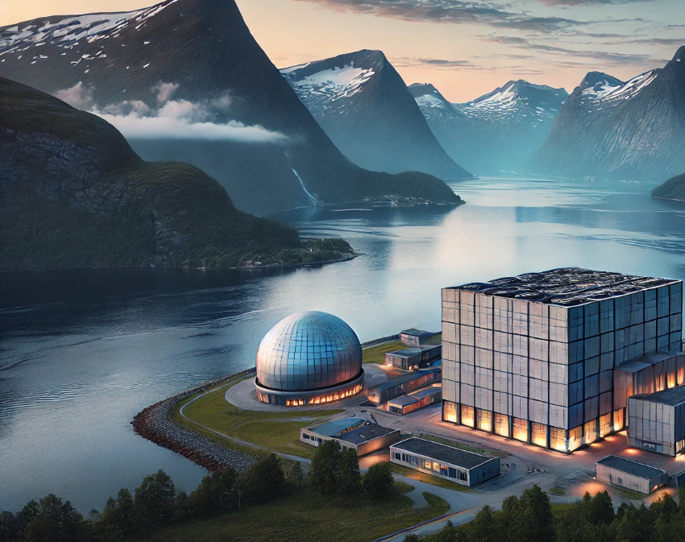
The Green Transition: Harnessing Synergies Between Oil & Gas and Nuclear in Norway
Leveraging expertise, resources and skills from the oil and gas sector to establish nuclear energy in Norway, decarbonizing the industry while paving the way for sustainable growth across other sectors.

Slide 3
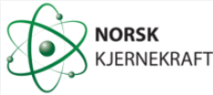


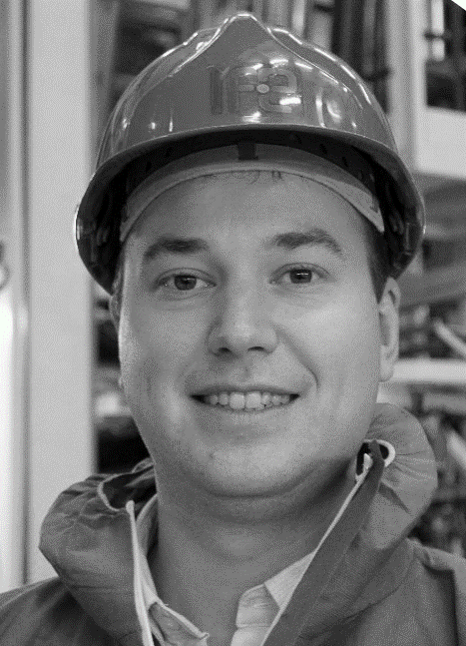
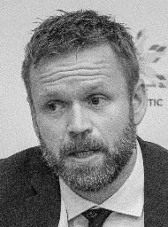

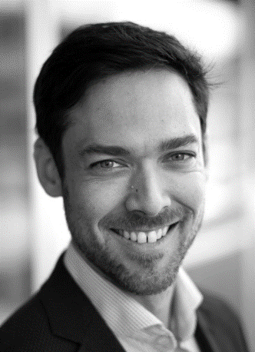

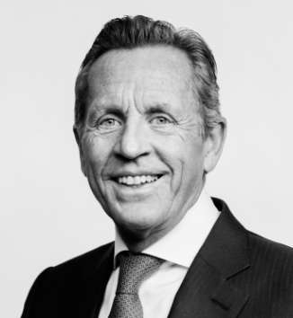
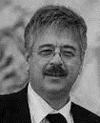






Norsk Kjernekraft – The Team
Established in 2022 after considering all long-term energy options for Norway
- A synergetic blend of Nuclear and OIL and Gas expertese
The team
Investors and co-founders
Trond Mohn
Lars Moldestad
Dr.Sc. SUNNIVA ROSE
CCO
M.sc. STEFFEN SÆLE CTO
M.sc. HÅVARD KRISTIANSEN
COO
Dr.sc ØYVIND AAS-HANSEN
CSO
Dipl.-Ing. NATALIA AMOSOVA
Strategic advisor
Dr.sc. JOHN KICKHOFEL
Strategic advisor
The board
Arne Blystad
Jakob Hatteland
Espen Nordhus
Paul Chr. Rieber (Chairman)
JONNY HESTHAMMER
Chairman and CEO
CHRISTIAN TVEIT
SUSANNE M. SPERREVIK
ÅSE STRØMME

Slide 4
Fundamental Provisions
The following factors support the green transition success in Norway
Norwegian nuclear history means that legislation and regulatory infrastructure for NPPs is already established
Favourable natural conditions in Norway ensures numerous suitable SMR-sites
Huge need to decarbonize the Oil and Gas Industry
Finally, high capital availability, growing need for new clean energy and generous tax exemptions available

Slide 5
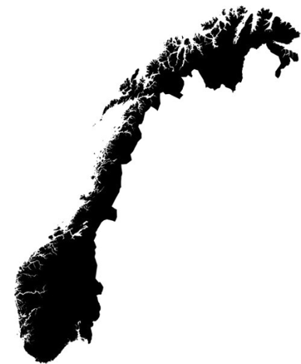



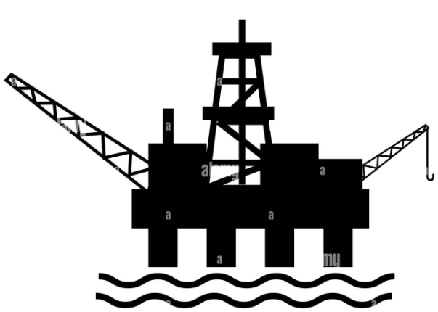




First Sites to Fit Industrie’s Needs
Norsk Kjernekraft has selected nine strategic sites for further development
Deployment is organized through SPVs, owned by NK, host municipalities and strategic partners
Sites are strategically located to support O&G, data centres and many other industries
Ofoten kjernekraft AS
Vardø
kjernekraft AS
Mo
kjernekraft AS
Trondheimsleia kjernekraft AS
Mongstad kjernekraft AS
Kollsnes kjernekraft AS
Halden kjernekraft AS
Dalane kjernekraft AS
Lister
kjernekraft AS

Slide 6
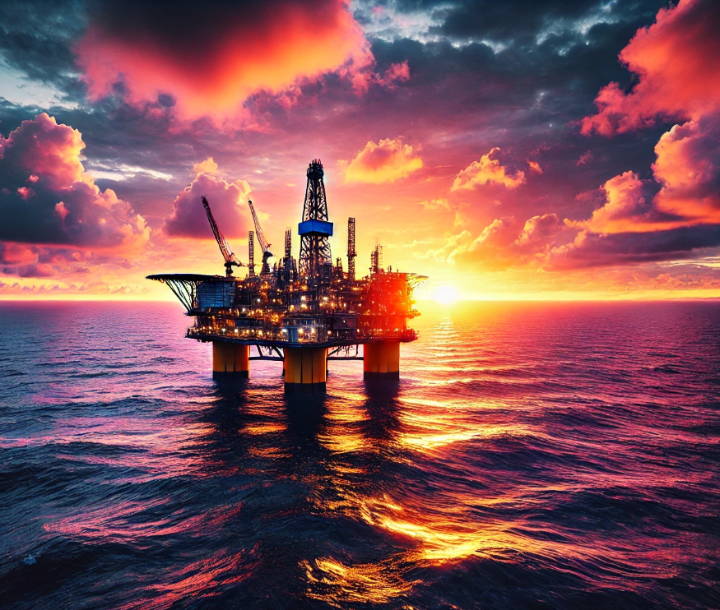
Norway: the ultimate synergy market – the foundation for success

Slide 7

Norwegian Oil and Gas still a necessity
Significance for Europe and the world:
O&G exports equivalent to 2510 TWh (2022)
Significance for Norway:
Annual export value ~ 120 billion $ (2023)
Significance for the climate:
Norway delivers already by far the cleanest O&G

Slide 8
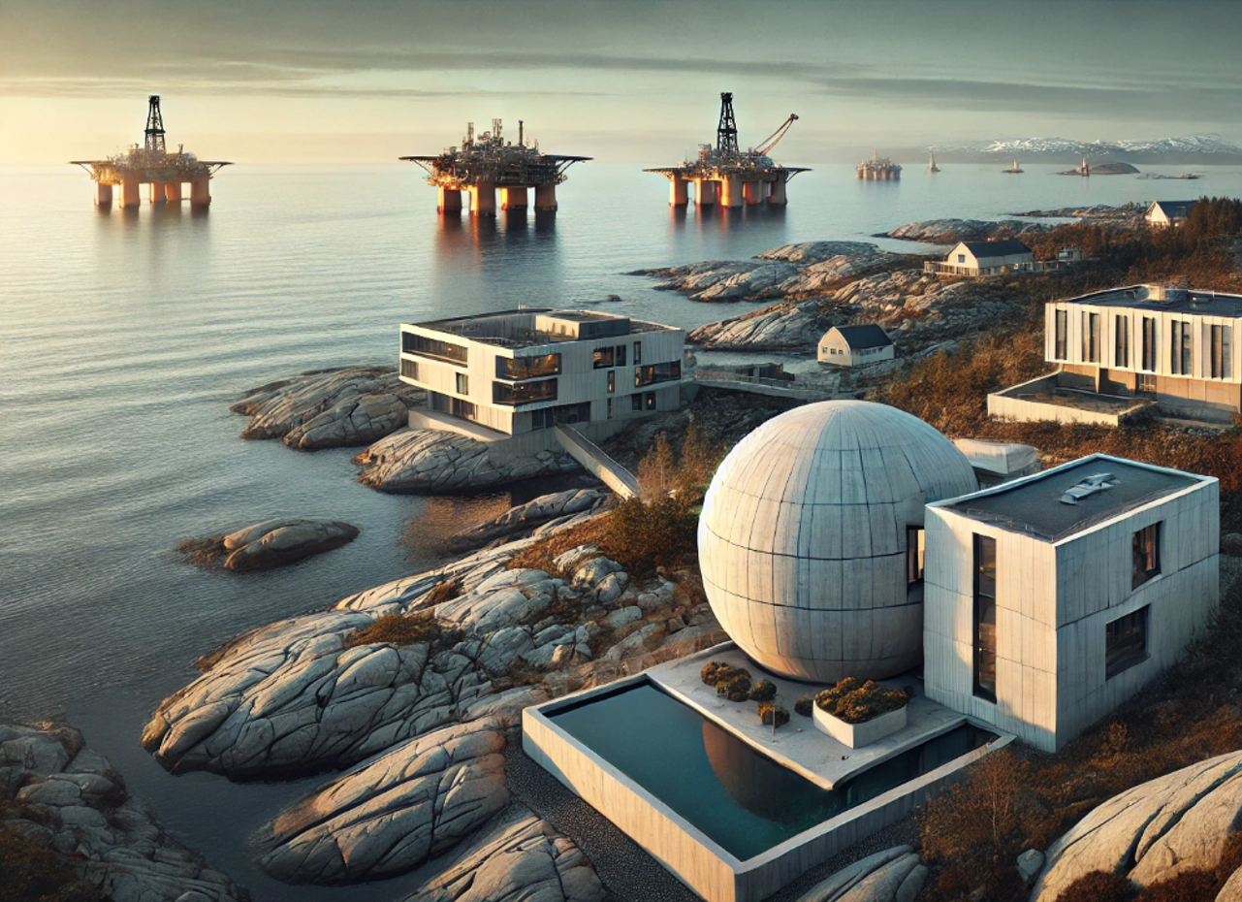
SMR Deployment in Norway- Financial Considerations
Enormous market:
Only 13 % of 68 TWh is electrified
Price to beat without nuclear:
carbon tax levels after 2030 is alone expected to yield ~ 100 €/MWh.
Total offshore electricity price likely above 200 €/MWh
Generous tax exemptions:
Investments in O&G infrastructure supported through 78 % tax deductions
Capital availability:
~ 15-20 B € invested yearly in the O&G sector only
Only 1 %
of annual investments needed to
fully electrify with SMRs

Slide 9

Synergies between O&G and Nuclear
Human Capital and skills transfer
Shared Expertise in Large-Scale Energy Projects
Supply Chain Integration
O&G distribution infrastructure can be used for H2
Stakeholder and regulator engagement experience
Capital investment opportunities
Strategic energy partnerships
By looking to Norway,
the nuclear renaissance may be secured

Slide 10
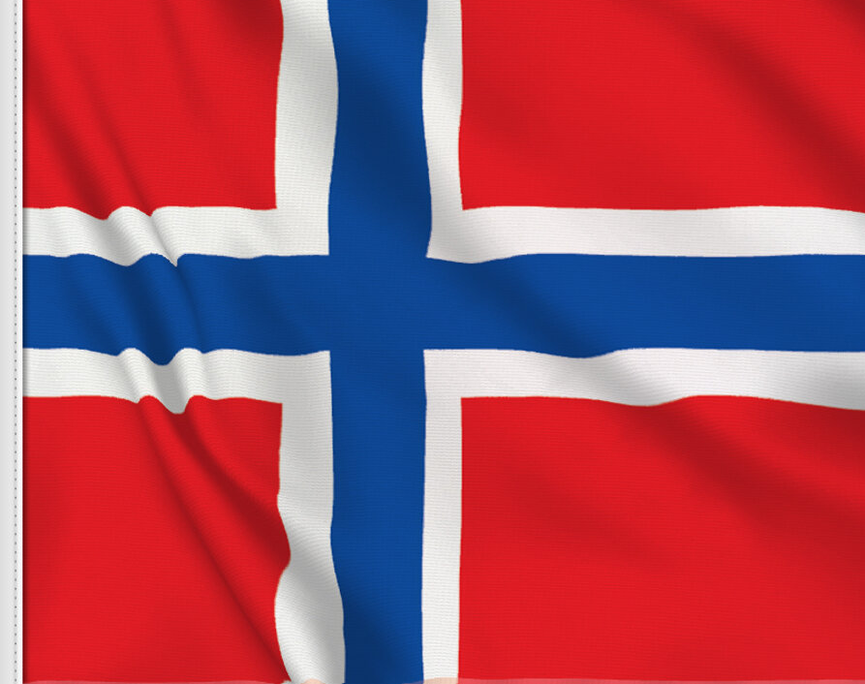
Thank you for your attention
Takk for oppmerksomheten

